Slide 1
Chapter 12
The Age of Religious Wars

Slide 2
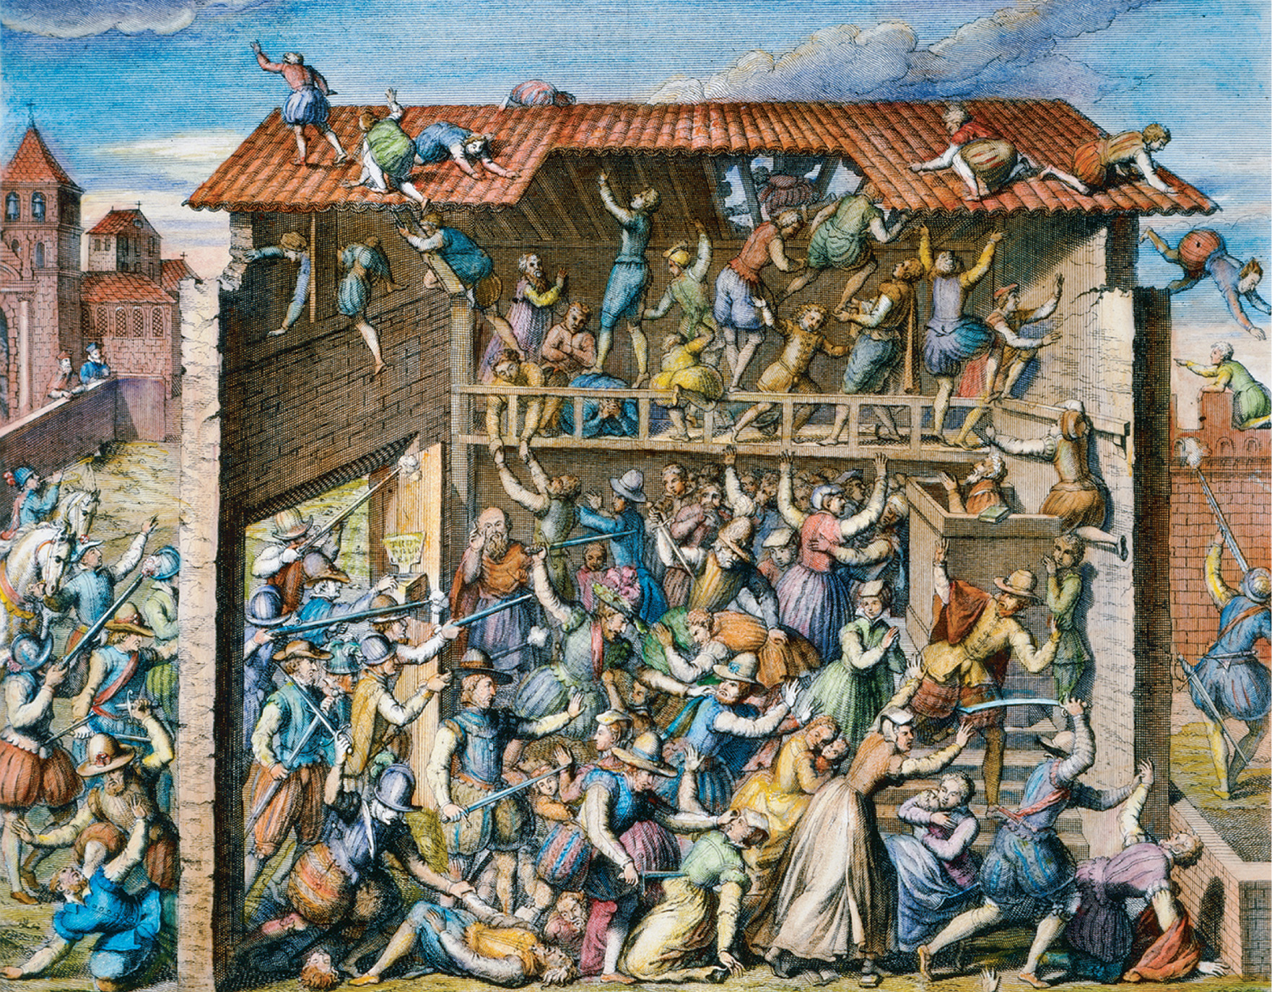
The massacre of worshipping Protestants at Vassy, France (March 1, 1562), which began the French wars of religion. An engraving by an unidentified seventeenth-century artist. The Granger Collection
Notes:
The massacre of worshipping Protestants at Vassy, France (March 1, 1562), which began the French wars of religion. An engraving by an unidentified seventeenth-century artist.
The Granger Collection

Slide 3
Counter-Reformation
Reform movement in the Catholic Church in response to the Reformation of the Protestant Church
Catholics devoted to one head and one law – such as in an absolute monarchy
Enjoyed the baroque art style, which presented life in grandiose three-dimensional displays

Slide 4
Baroque and Plain Church: Architectural Reflections of Belief Contrast between an eighteenth-century Catholic baroque church in Ottobeuren, Bavaria and a seventeenth-century Calvinist plain church in the Palatinate. The Catholic church pops with sculptures, paintings, and ornamentation, while the Calvinist church has been stripped of every possible decoration. Vanni/Art Resource, NY
Notes:
Baroque and Plain Church: Architectural Reflections of Belief Contrast between an eighteenth-century Catholic baroque church in Ottobeuren, Bavaria and a seventeenth-century Calvinist plain church in the Palatinate. The Catholic church pops with sculptures, paintings, and ornamentation, while the Calvinist church has been stripped of every possible decoration.
Vanni/Art Resource, NY

Slide 5
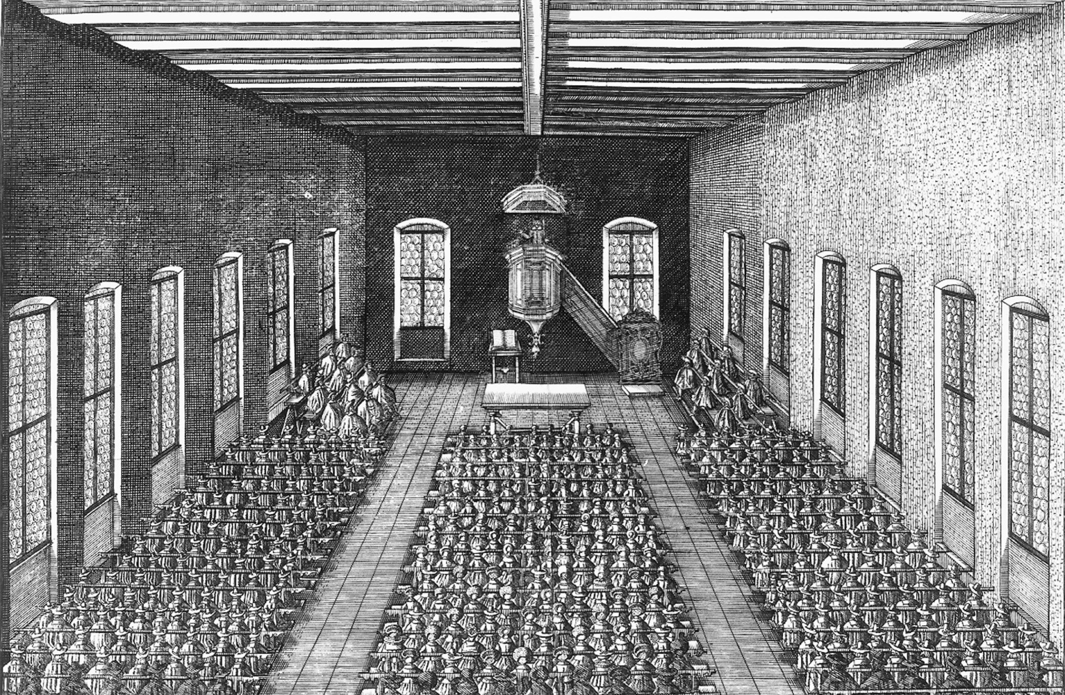
Baroque and Plain Church: Architectural Reflections of Belief Contrast between an eighteenth-century Catholic baroque church in Ottobeuren, Bavaria and a seventeenth-century Calvinist plain church in the Palatinate. The Catholic church pops with sculptures, paintings, and ornamentation, while the Calvinist church has been stripped of every possible decoration. German National Museum, Nuremberg, Germany
Notes:
Baroque and Plain Church: Architectural Reflections of Belief Contrast between an eighteenth-century Catholic baroque church in Ottobeuren, Bavaria and a seventeenth-century Calvinist plain church in the Palatinate. The Catholic church pops with sculptures, paintings, and ornamentation, while the Calvinist church has been stripped of every possible decoration. German National Museum, Nuremberg, Germany

Slide 6
Politiques
Intellectuals of the 1500’s criticized the religious strife between Catholics and Protestants
Rulers who urged tolerance and moderation and became indifferent to religion became known as politiques
Elizabeth I of England was the most successful politique

Slide 7
Protestant Repression in France
French Protestants were known as Huguenots
Emperor Charles V started the first wave of Protestant persecution in 1525
1534 – Protestants arrested and leader John Calvin sent into exile

Slide 8
Protestant Repression in France (cont.)
1540 – Edict of Fontainebleau makes Protestants subject to the Inquisition
1551 – Edict of Chateaubriand establishes more measures against the Protestants
Later the Bourbon and Montmorency-Chatillon families become sympathetic to the Huguenots

Slide 9
Appeal of Calvinism
John Calvin curries favor with powerful aristocrats like the Prince of Conde, who converted to Calvinism
The powerful combination of now political and religious (the Huguenots) dissidents made Calvinism a viable religion in Catholic France

Slide 10
The Medicis and the Guises
Catherine de Medicis unsuccessfully attempts to reconcile the differences between the Protestants and the Catholic Guises (dominant radical Catholic group of Eastern France) with religious toleration

Slide 11
The Medicis and the Guises (cont.)
The duke of Guise massacres Protestant worshippers in Champagne, causing the French wars of religion
Medicis and her young king son go under the control of the Guises

Slide 12
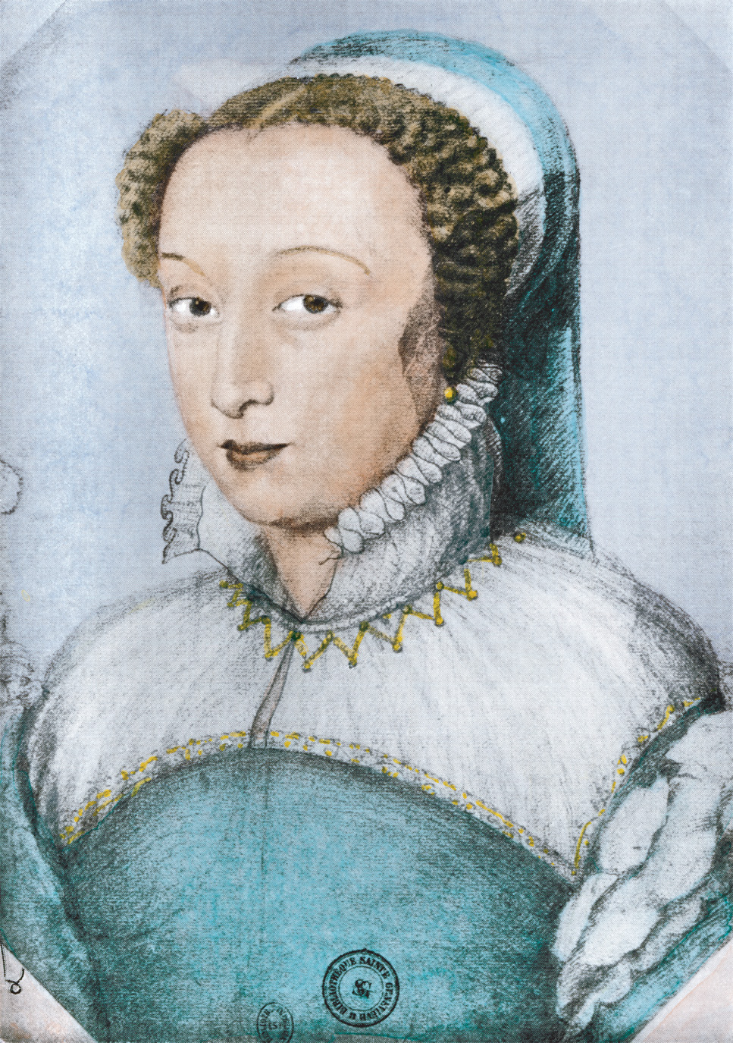
Catherine de Médicis (1519–1589) exercised power in France during the reigns of her three sons, Francis II (r. 1559–1560), Charles IX (r. 1560–1574), and Henry III (r. 1574–1589). North Wind Picture Archives/ Alamy
Notes:
Catherine de Médicis (1519–1589) exercised power in France during the reigns of her three sons, Francis II (r. 1559–1560), Charles IX (r. 1560–1574), and Henry III (r. 1574–1589).
North Wind Picture Archives/ Alamy

Slide 13
The Peace of Saint-Germain-en-Laye
Three wars of religion end with the deaths of the duke of Guise, Protestant military leader Conde, and a Huguenot victory
Peace treaty acknowledges the Protestant nobility and grants Huguenots religious freedom and the right to fortify their cities

Slide 14
The Peace of Saint-Germain-en-Laye (cont.)
Catherine, who once supported the Protestants, turns to the Guises, fearing Protestant leader Coligny would draw France into a war with Spain that could not be handled by her son

Slide 15
The Saint Bartholomew’s Day Massacre
Catherine convinces her son King Charles IX that a Huguenot coup was about to happen
Response is on August 24, 1572 – Coligny and 3,000 Huguenots are massacred in Paris; within three days, 20,000 other Protestants are also killed in France

Slide 16
The Saint Bartholomew’s Day Massacre (cont.)
Protestant cause becomes one of sheer survival
In response, Protestant writers call for an active defense of religious rights

Slide 17
Henry of Navarre
Henry III, a politique, attempts to compromise with the warring religions to save the nation (which was more important to him than religion)
Henry of Navarre leads the Protestants in turning back Henry III’s attempt to rout the Protestants at the Day of the Barricades

Slide 18
Henry of Navarre (cont.)
The two Henrys are forced into an alliance against the Guises, but Henry III is assassinated and Henry of Navarre becomes Henry IV, a Protestant, as King of France
Henry IV, basically a politique, converts to Catholicism, horrifying the Huguenots

Slide 19
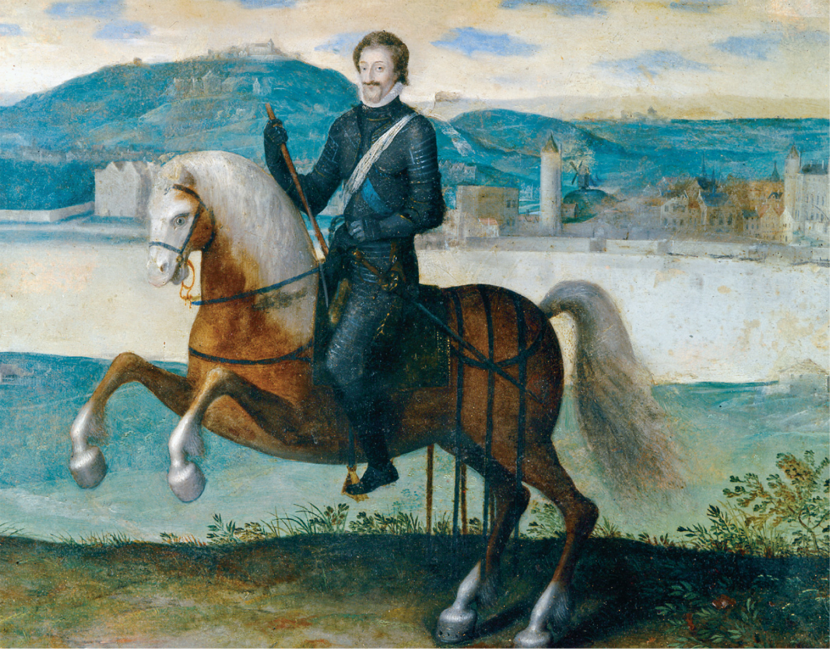
Henry IV of France (r. 1589–1610) on horseback, painted in 1594. Réunion des Musées Nationaux/Art Resource, NY
Notes:
Henry IV of France (r. 1589–1610) on horseback, painted in 1594.
Réunion des Musées Nationaux/Art Resource, NY

Slide 20
The Edict of Nantes
A formal religious settlement that gave Protestants religious freedoms within their own towns and territories
The violence stops, but hostilities remain
A Catholic fanatic assassinates Henry IV in 1610

Slide 21
Phillip II of Spain
Most powerful man in Europe until the defeat of the Spanish Armada in 1588
Was very wealthy from bullion and gold
Increased population widens economic gap between the wealthy and the peasants

Slide 22
Phillip II of Spain (cont.)
Makes the Castilian peasants the most heavily taxed people in Europe
Ran an efficient bureaucracy and military
A sea battle in the Mediterranean Sea against Turkey leads to the deaths of 30,000 Turks and Spanish control of the sea
Suppresses resistance in Portugal

Slide 23
Revolt in the Netherlands
Cardinal Greenville – leader of the council in the Netherlands who wanted to check Protestant gains through internal church reforms
William of Orange – placing political autonomy above religious creeds (eventually an avowed Calvinist), led revolt against Greenville and had him removed from office

Slide 24
Revolt in the Netherlands (cont.)
The Compromise, a solemn pledge by Philip II of Spain to Louis of Nassau (Orange’s brother) to reject the decrees of Trent and the Inquisition

Slide 25
Revolt in the Netherlands (cont.)
Revolt by the Protestants, after they were called “beggars” by Regent Margaret, is violently put down by Philip II’s Duke of Alba, who executes thousands of suspected heretics

Slide 26
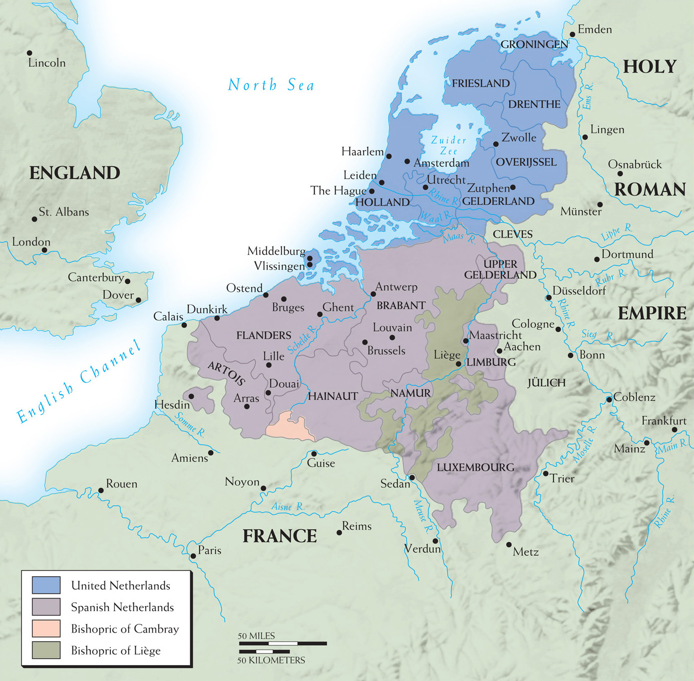
Map 12–1 THE NETHERLANDS DURING THE REFORMATION The northern and southern provinces of the Netherlands. The former, the United Provinces, were mostly Protestant in the second half of the sixteenth century; the southern Spanish Netherlands made peace with Spain and remained largely Catholic.
Copyright © 2010 Pearson Education, Inc., Upper Saddle River, NJ 07458. All rights reserved.
Notes:
Map 12–1 THE NETHERLANDS DURING THE REFORMATION The northern and southern provinces of the Netherlands. The former, the United Provinces, were mostly Protestant in the second half of the sixteenth century; the southern Spanish Netherlands made peace with Spain and remained largely Catholic.

Slide 27
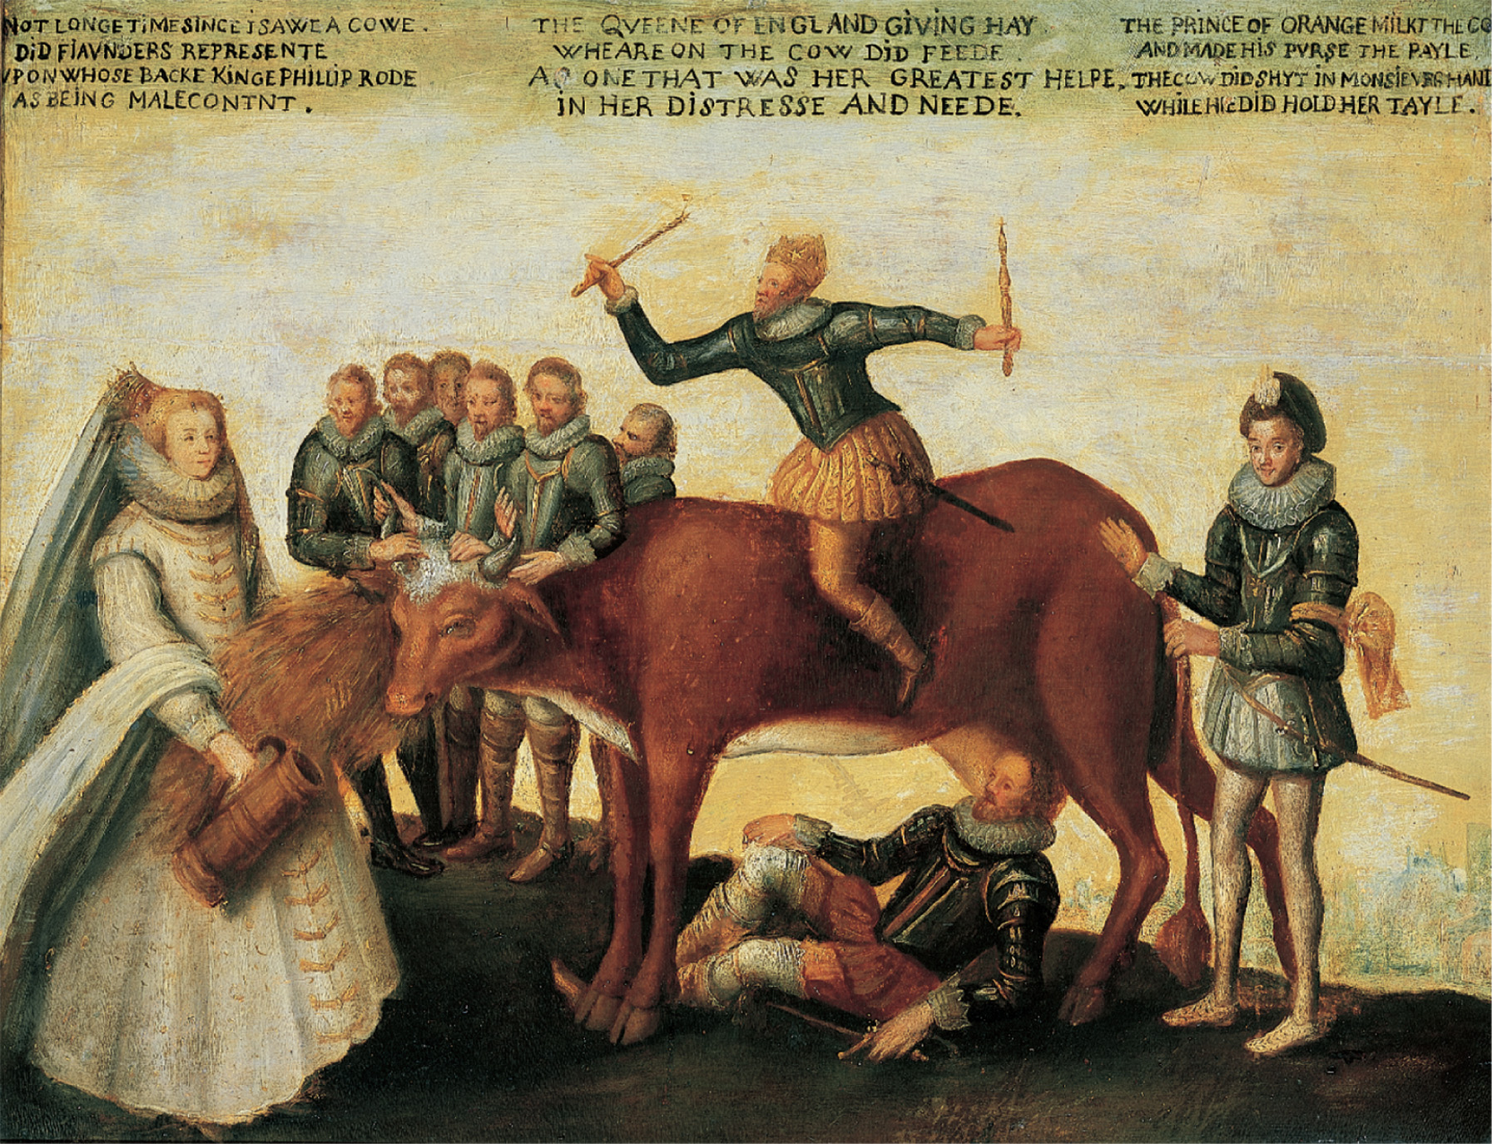
The Milch Cow, a sixteenth-century satirical painting depicting the Netherlands as a cow in whom all the great powers of Europe have an interest. Elizabeth of England is feeding her (England had long-standing commercial ties with Flanders); Philip II of Spain is attempting to ride her (Spain was trying to reassert its control over the entire area); William of Orange is trying to milk her (he was the leader of the anti-Spanish rebellion); and the king of France holds her tail (France hoped to profit from the rebellion at Spain’s expense). Rijksmuseum, Amsterdam
Notes:
The Milch Cow, a sixteenth-century satirical painting depicting the Netherlands as a cow in whom all the great powers of Europe have an interest. Elizabeth of England is feeding her (England had long-standing commercial ties with Flanders); Philip II of Spain is attempting to ride her (Spain was trying to reassert its control over the entire area); William of Orange is trying to milk her (he was the leader of the anti-Spanish rebellion); and the king of France holds her tail (France hoped to profit from the rebellion at Spain’s expense).
Rijksmuseum, Amsterdam

Slide 28
Independence for the Netherlands
William the Orange comes out of exile in Germany and leads the independence movement of the Netherlands against Spain
Orange takes over Calvinist-inclined Northern territories
Alba replaced by Don Luis de Requesens

Slide 29
Independence for the Netherlands (cont.)
Spanish Fury – Spanish mercenaries leave 7,000 people dead on November 4, 1576 – the massacre unites Protestant and Catholic Netherlands versus Spain under the Pacification of Ghent
Spain signs humiliating Perpetual Edict calling for the removal of all Spanish troops from the Netherlands

Slide 30
Independence for the Netherlands (cont.)
Southern provinces afraid of Protestant domination make peace with Spain in the Union of Arras and make one last effort to control the country
William of Orange is assassinated and replaced by his son Maurice who, with the help of England and France, finally defeat Spain

Slide 31
Independence for the Netherlands (cont.)
Spain first signs truce in 1609 and recognizes full independence of the Netherlands in 1648 with the Peace of Westphalia

Slide 32
Mary I of England
Very hostile to Protestants (executes great Protestant leaders, hundreds are burned at the stake and others flee to the Continent)
Marries into militant Catholicism by wedding Philip II of Spain

Slide 33
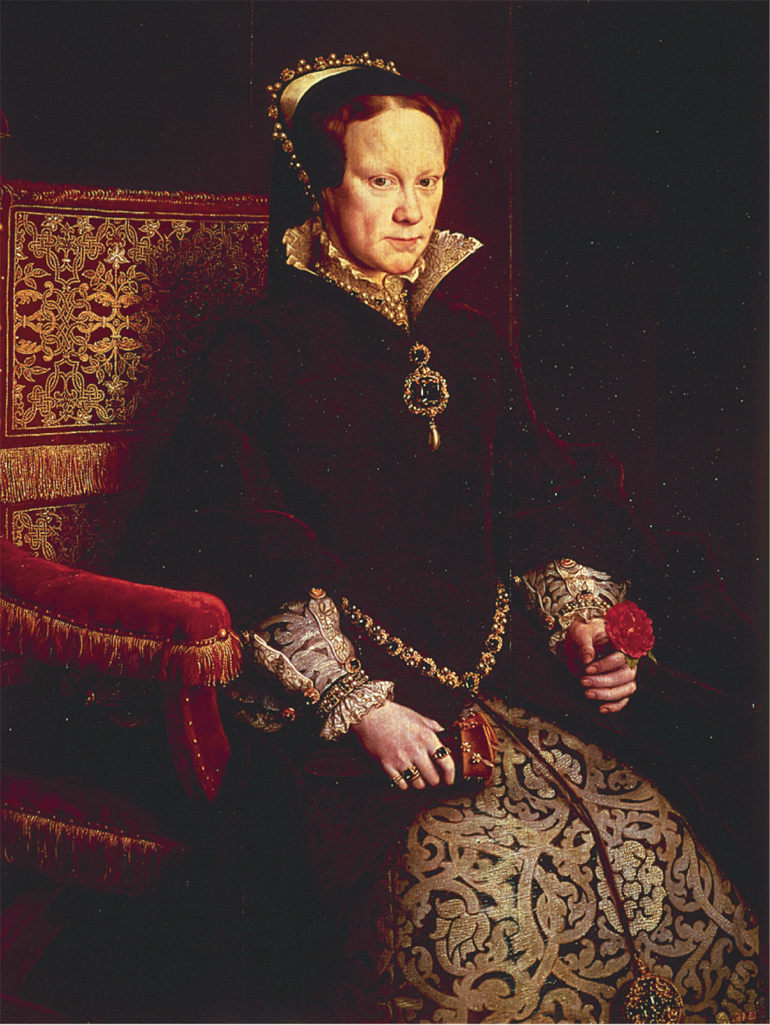
Portrait of Mary I (r. 1553–1558), Queen of England. Queen Mary I, 1554 (oil on panel) by Sir Anthonis Mor (Antonio Moro) (1517/20-76/7). Prado, Madrid, Spain/ Bridgeman Art Library
Notes:
Portrait of Mary I (r. 1553–1558), Queen of England.
Queen Mary I, 1554 (oil on panel) by Sir Anthonis Mor (Antonio Moro) (1517/20-76/7). Prado, Madrid, Spain/ Bridgeman Art Library

Slide 34
Elizabeth I of England
Settled religious differences by merging broadly defined Protestant doctrine with traditional Catholic ritual, later resulting in the Anglican Church
All anti-Protestant legislation repealed and Thirty-Nine Articles is issued in 1563, making moderate Protestantism the official religion of the Church of England

Slide 35
Elizabeth I of England (cont.)
Animosity grows between England and Spain over dominance of the seas

Slide 36
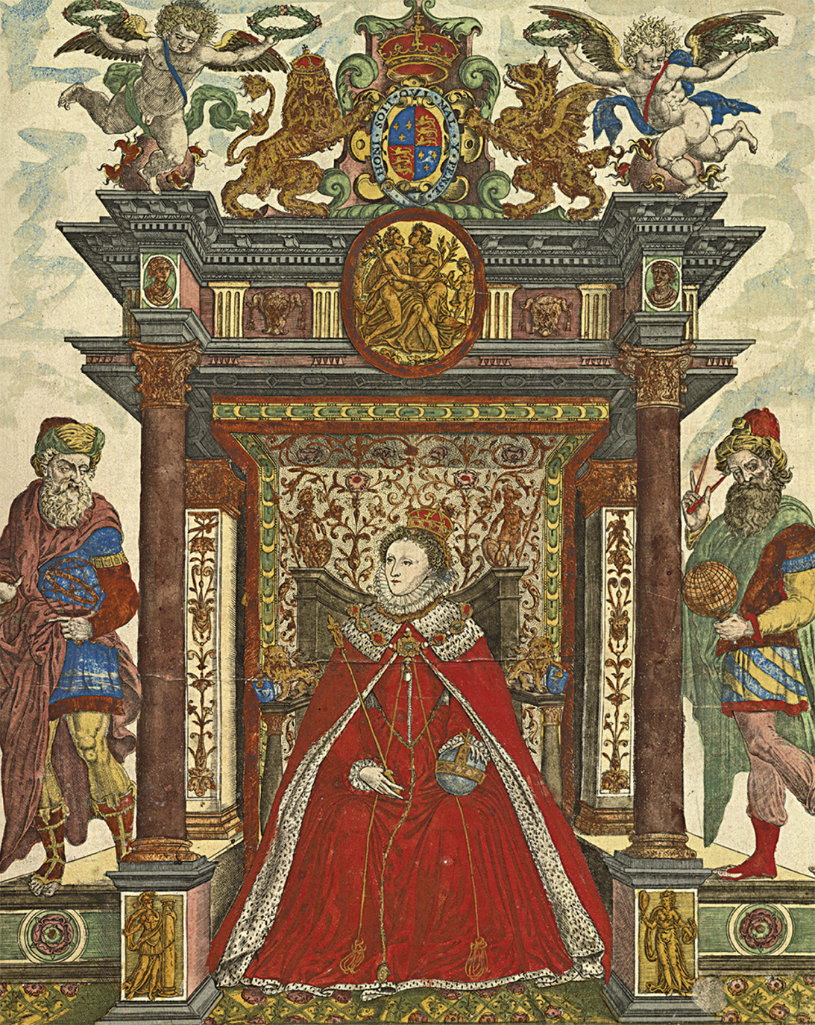
Queen Elizabeth I of England (r. 1558–1603) served as an example of religious tolerance during her reign. Despite her Protestant sympathies, she steered clear of both Catholic and Protestant extremism and, despite proven cases of Catholic treason and even attempted regicide, she executed fewer Catholics during her forty-five years on the throne than Mary Tudor had executed Protestants during her brief five-year reign. Courtesy of the Library of Congress, Rare Book and Special Collections Division
Notes:
Queen Elizabeth I of England (r. 1558–1603) served as an example of religious tolerance during her reign. Despite her Protestant sympathies, she steered clear of both Catholic and Protestant extremism and, despite proven cases of Catholic treason and even attempted regicide, she executed fewer Catholics during her forty-five years on the throne than Mary Tudor had executed Protestants during her brief five-year reign.
Courtesy of the Library of Congress, Rare Book and Special Collections Division

Slide 37
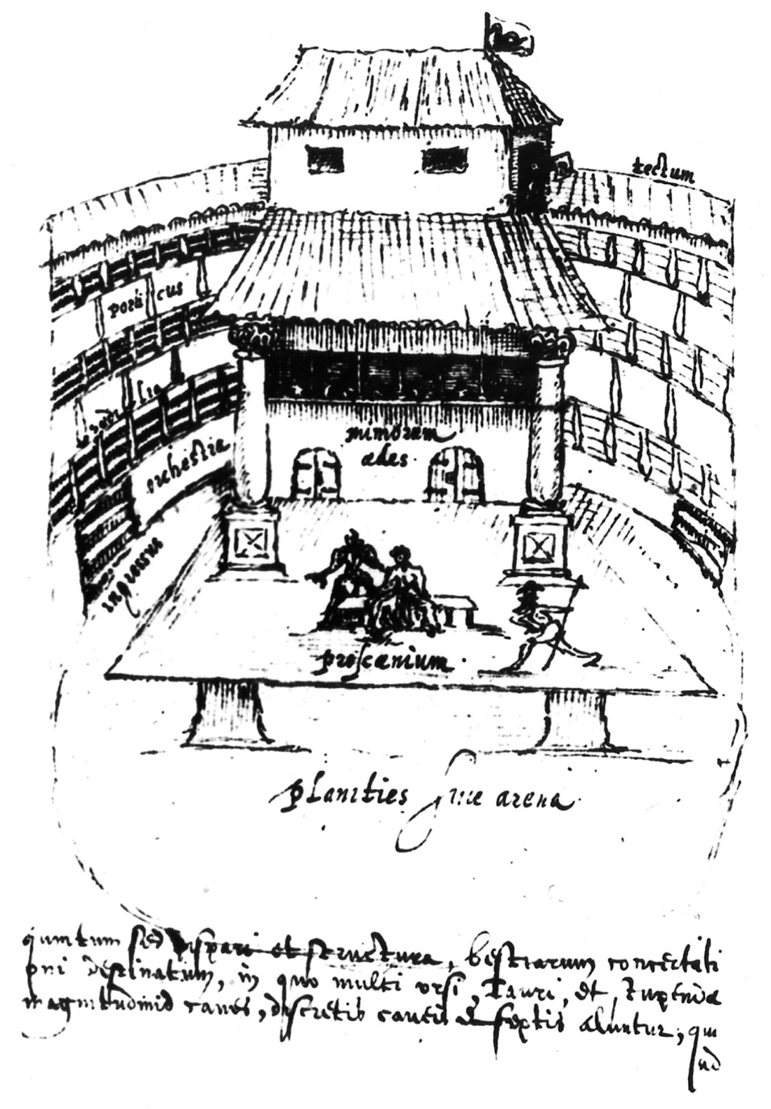
A seventeenth-century sketch of the Swan Theatre, which stood near Shakespeare’s Globe Theatre on the south bank of the Thames. The Bridgeman Art Library
Notes:
A seventeenth-century sketch of the Swan Theatre, which stood near Shakespeare’s Globe Theatre on the south bank of the Thames.
The Bridgeman Art Library

Slide 38
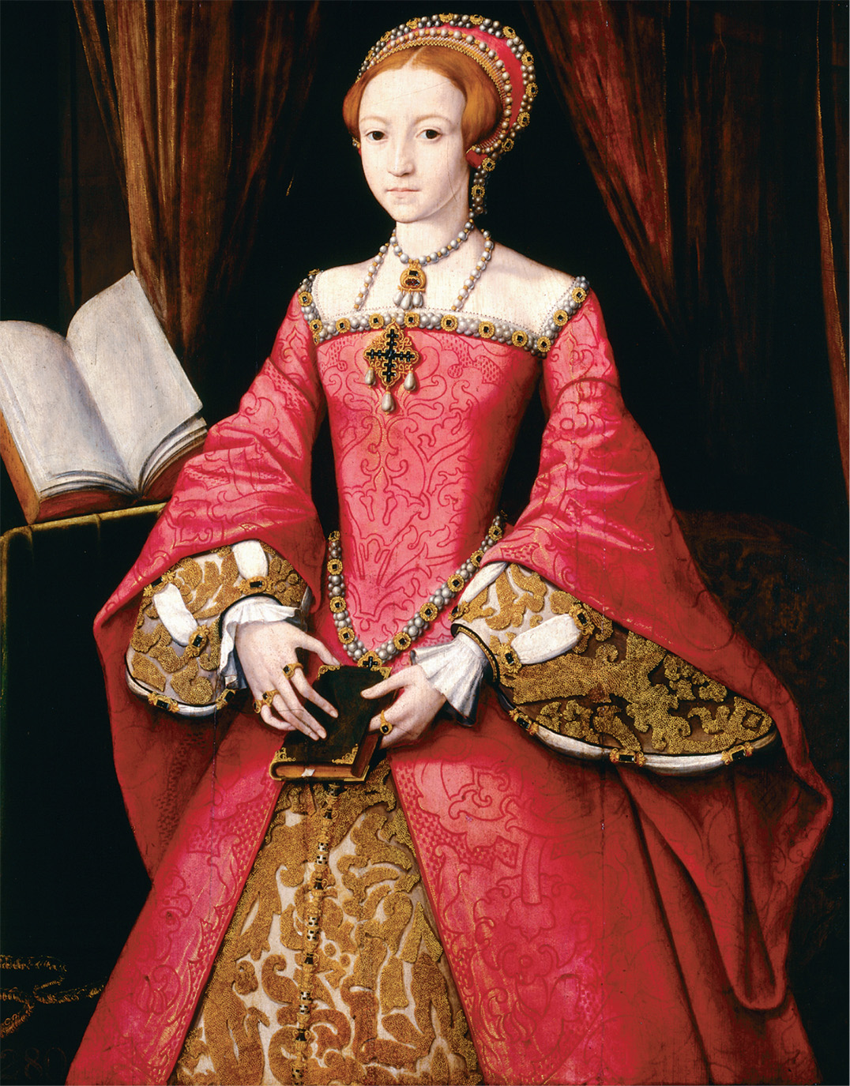
An idealized likeness of Elizabeth Tudor when she was a princess, attributed to Flemish court painter L. B. Teerling, ca. 1551. The painting shows her blazing red hair and alludes to her learning by the addition of books. UNKNOWN, formerly attributed to William Scrots. Elizabeth I, when Princess (1533–1603). Royal Collection Trust/© HM Queen Elizabeth II 2012
Notes:
An idealized likeness of Elizabeth Tudor when she was a princess, attributed to Flemish court painter L. B. Teerling, ca. 1551. The painting shows her blazing red hair and alludes to her learning by the addition of books.
UNKNOWN, formerly attributed to William Scrots. Elizabeth I, when Princess (1533–1603). Royal Collection Trust/© HM Queen Elizabeth II 2012

Slide 39
Catholic and Protestant Extremists
Radical Catholics wanted to replace Elizabeth I with Mary Stuart, Queen of Scots
Puritans – Protestants who wanted to purify the church of any “popery” had two grievances about Elizabeth:
the retention of Catholic ceremony in the Church of England
the continuation of the Episcopal system of church governance

Slide 40
Catholic and Protestant Extremists (cont.)
Presbyterians – Puritans’ creation of an alternative national church of semiautonomous congregations governed by representative presbyteries
More extreme Puritans, Congregationalists, wanted every congregation to be autonomous

Slide 41
Mary, Queen of Scots
Catholic ruler of Scotland who later is forced to abdicate the throne and flee to England and her cousin Elizabeth I
Elizabeth, who has Mary under house arrest for fear of a Catholic England uprising, uncovers two plots against her life

Slide 42
Mary, Queen of Scots (cont.)
Mary is compliant with the assassination attempts and is executed by Elizabeth
Ends all Catholic hopes of a bloodless reconciliation with Protestant England and leads to the invasion of the Spanish Armada

Slide 43
The Defeat of the Spanish Armada
Sir Francis Drake of England shells the Spanish port of Cadiz and raids Portugal, delaying the invasion of the Spanish Armada
A huge Spanish fleet of 130 ships and 25,000 sailors is crushed by the British navy (1/3 of the Armada never return to Spain)

Slide 44
The Defeat of the Spanish Armada (cont.)
Protestant resistance everywhere is given hope and Spain is never again a world power

Slide 45
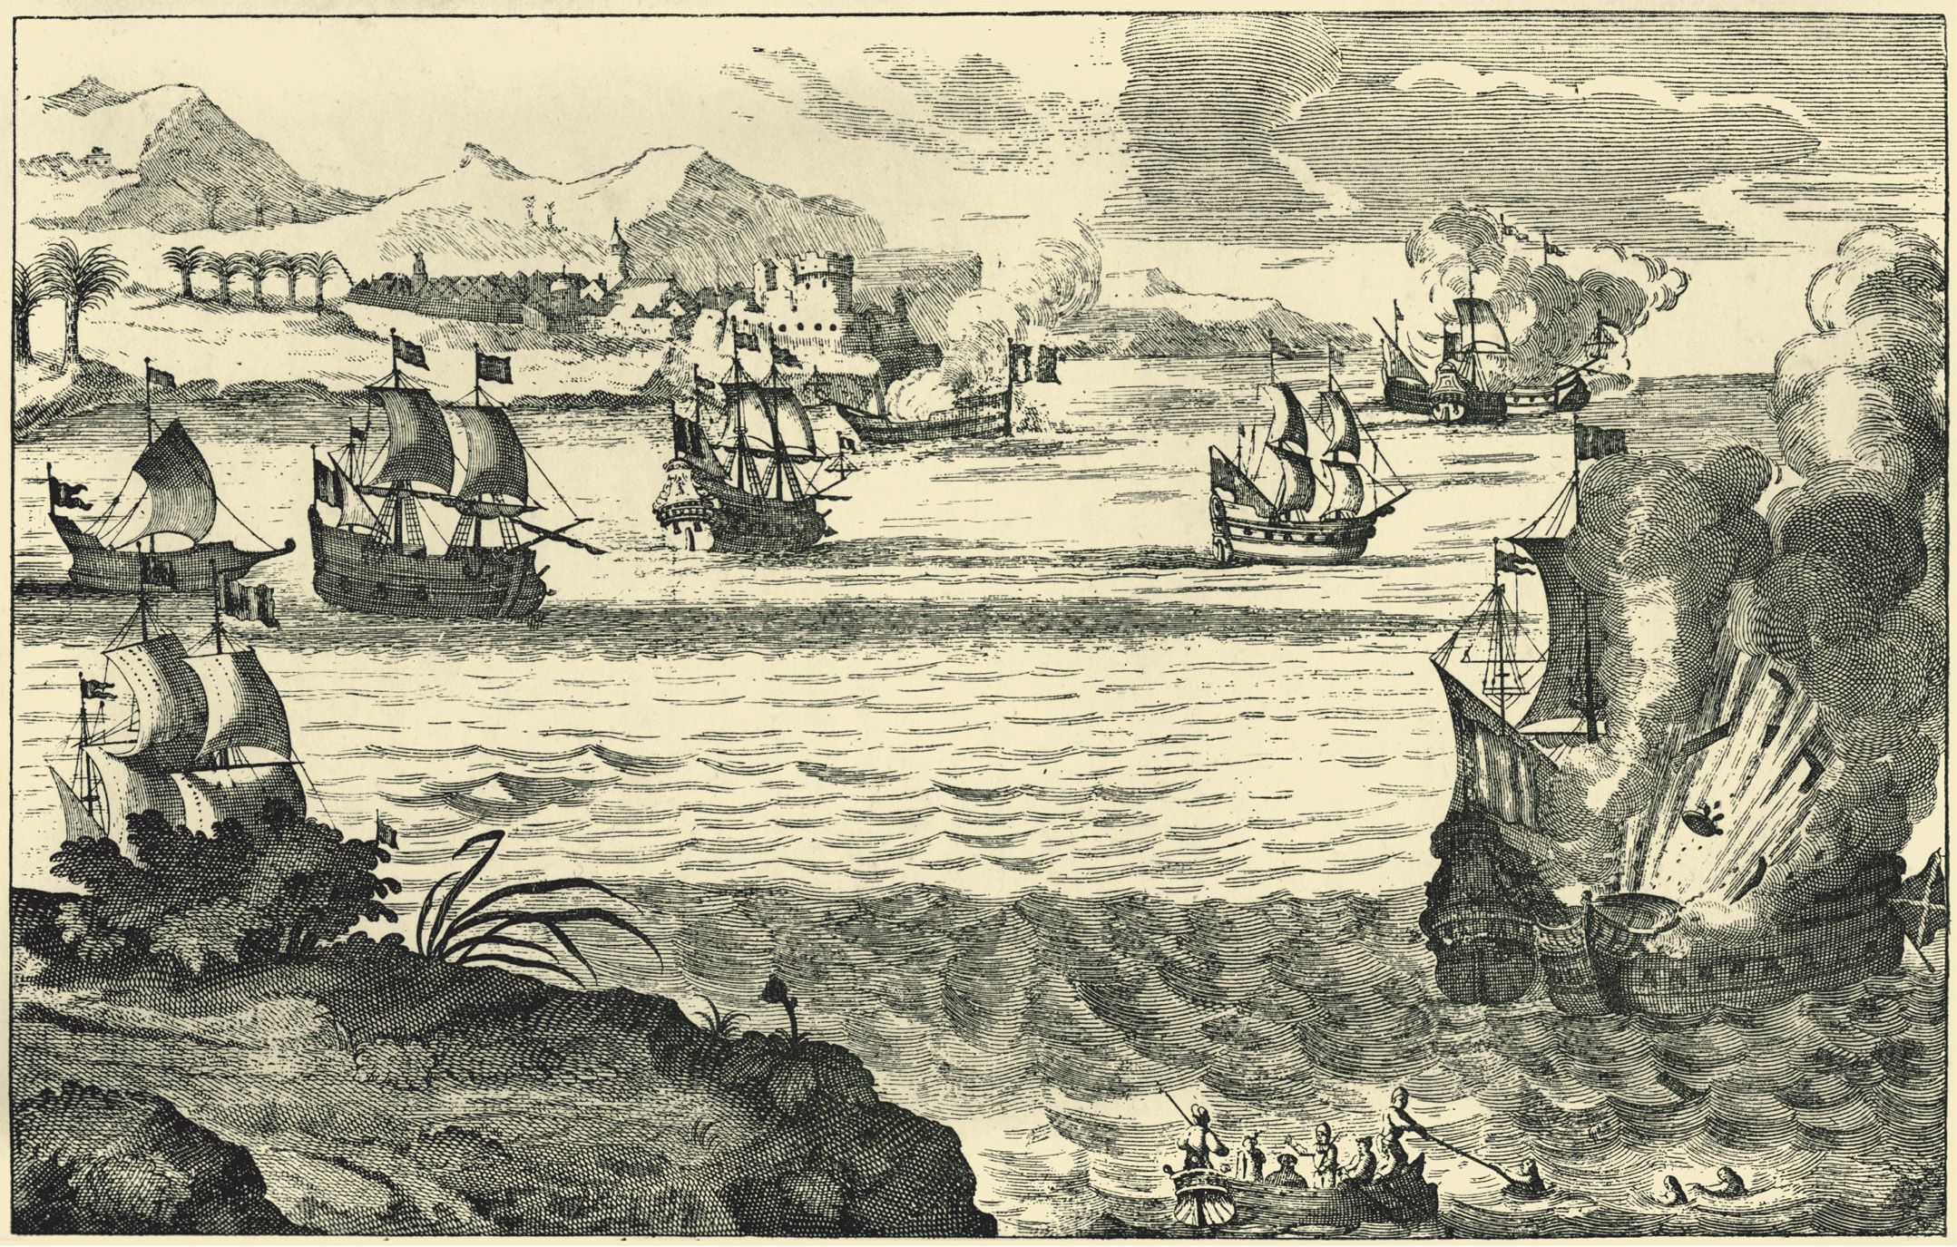
Engraving showing the destruction of the Spanish Armada by Captain Morgan. © Lebrecht Music and Arts Photo Library/Alamy
Notes:
Engraving showing the destruction of the Spanish Armada by Captain Morgan.
© Lebrecht Music and Arts Photo Library/Alamy

Slide 46
Preconditions for The Thirty Years War
Fragmented Germany – Germany was an almost ungovernable land of 360 autonomous political entities
Was Europe’s highway for trade and travel
After Council of Trent , Protestants were afraid that Catholics would attempt to recreate the Catholic Europe of pre-Reformation times

Slide 47
Preconditions for The Thirty Years War (cont.)
Religious Divisions in the Holy Roman Empire
Between the equally-numbered Catholics and Protestants
Between liberal and conservative Lutherans
Between Lutherans and Calvinists

Slide 48
Preconditions for The Thirty Years War (cont.)
Calvinism Rule of the Palatinate
Calvinism, unrecognized as a legal religion by the Peace of Augsburg, puts Frederick III in as the Elector Palatine
Lutherans felt the Palatine Calvinists threatened the Peace of Augsburg and the existence of Lutheran themselves
Maximilian I of Bavaria counters the Palatine with the Catholic League

Slide 49
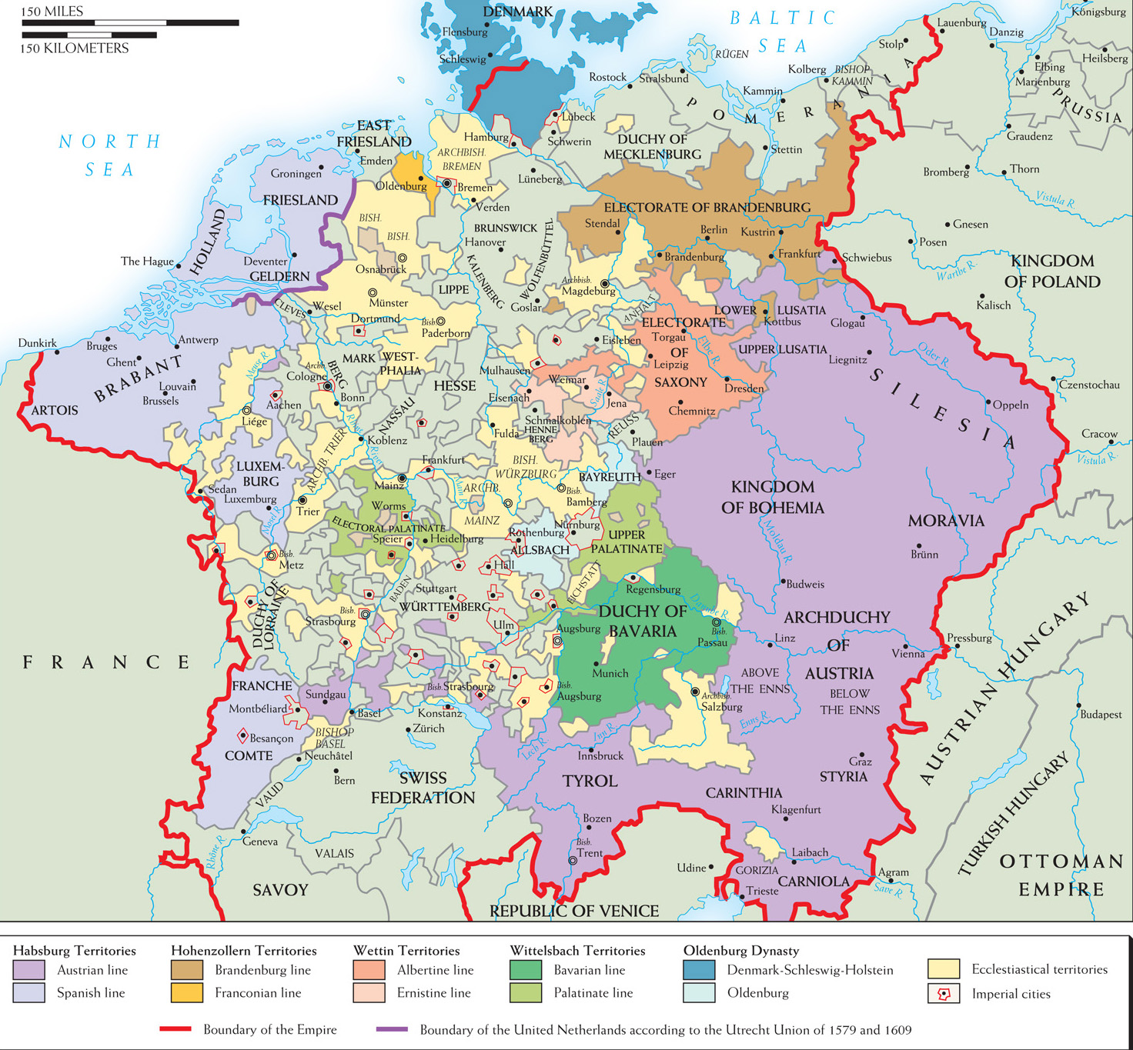
Map 12–2 Germany in 1547 Mid-sixteenth-century Germany was an almost ungovernable land of about 360 autonomous political entities. Originally “Map of Germany Showing Its Great Division/Fragmentation in the 16th Century” from Hajo Holborn, A History of Germany: The Reformation. Copyright © 1982 by Princeton University Press. Reprinted by permission of Princeton University Press.
Notes:
Map 12–2 Germany in 1547 Mid-sixteenth-century Germany was an almost ungovernable land of about 360 autonomous political entities.
Originally “Map of Germany Showing Its Great Division/Fragmentation in the 16th Century” from Hajo Holborn, A History of Germany: The Reformation. Copyright © 1982 by Princeton University Press. Reprinted by permission of Princeton University Press.

Slide 50
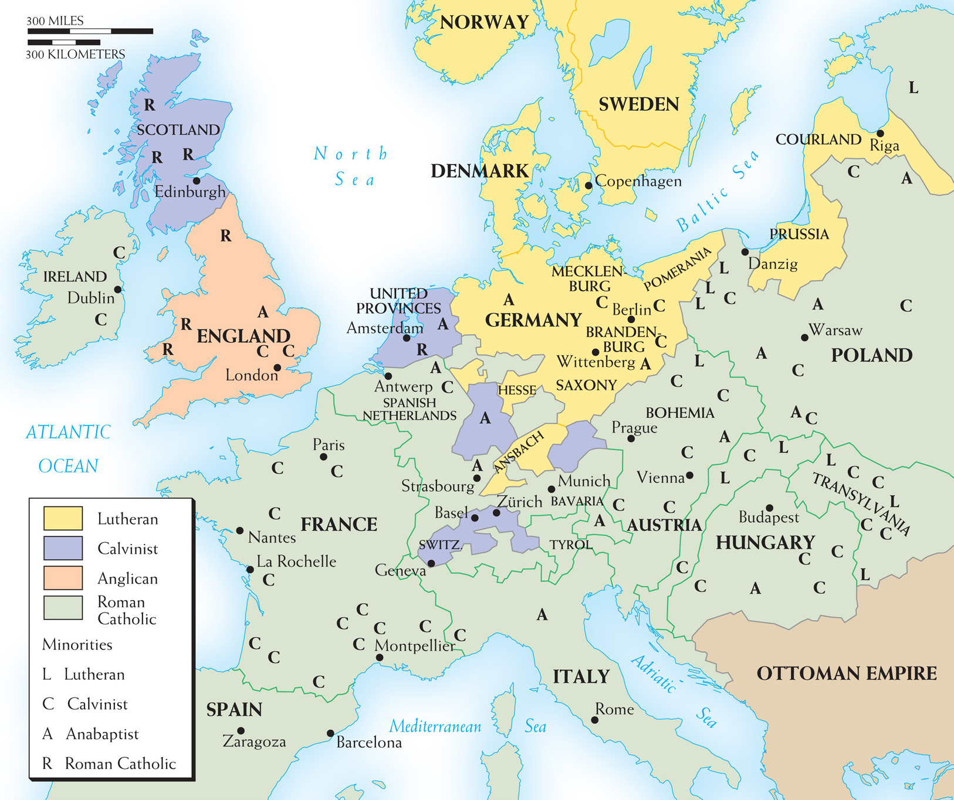
Map 12–3 RELIGIOUS DIVISIONS ABOUT 1600 By 1600, few could seriously expect Christians to return to a uniform religious allegiance. In Spain and southern Italy, Catholicism remained relatively unchallenged, but note the existence elsewhere of large religious minorities, both Catholic and Protestant.
Notes:
Map 12–3 RELIGIOUS DIVISIONS ABOUT 1600 By 1600, few could seriously expect Christians to return to a uniform religious allegiance. In Spain and southern Italy, Catholicism remained relatively unchallenged, but note the existence elsewhere of large religious minorities, both Catholic and Protestant.

Slide 51
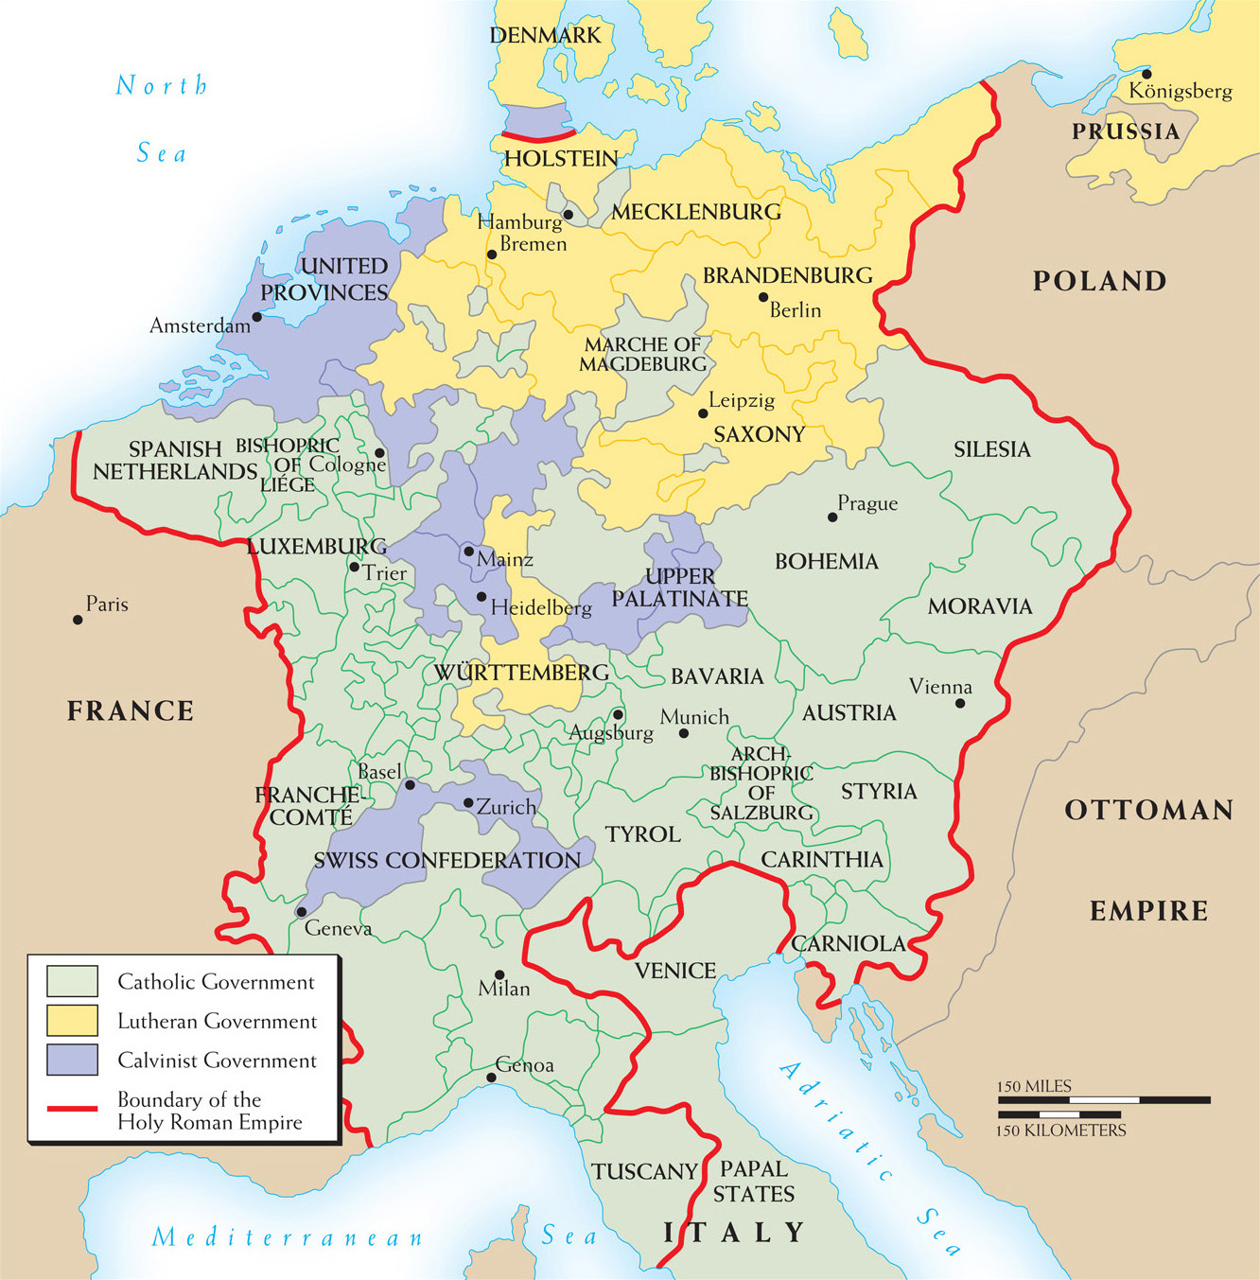
Map 12–4 THE HOLY ROMAN EMPIRE ABOUT 1618 On the eve of the Thirty Years’ War, the Holy Roman Empire was politically and religiously fragmented, as revealed by this somewhat simplified map. Lutherans dominated the north and Catholics the south; Calvinists controlled the United Provinces and the Palatinate and were important in Switzerland and Brandenburg.
Notes:
Map 12–4 THE HOLY ROMAN EMPIRE ABOUT 1618 On the eve of the Thirty Years’ War, the Holy Roman Empire was politically and religiously fragmented, as revealed by this somewhat simplified map. Lutherans dominated the north and Catholics the south; Calvinists controlled the United Provinces and the Palatinate and were important in Switzerland and Brandenburg.

Slide 52
Bohemian Period of the Thirty Years’ War
Catholics name Ferdinand II as Holy Roman Emperor, who immediately revokes religious freedom to Bohemian Protestants
Bohemians defiantly name Palatine, Frederick V, their king
Spain joins Maximilian, who defeats Frederick’s troops at the Battle of White Mountain, thereby taking over Bohemia and Palatine

Slide 53
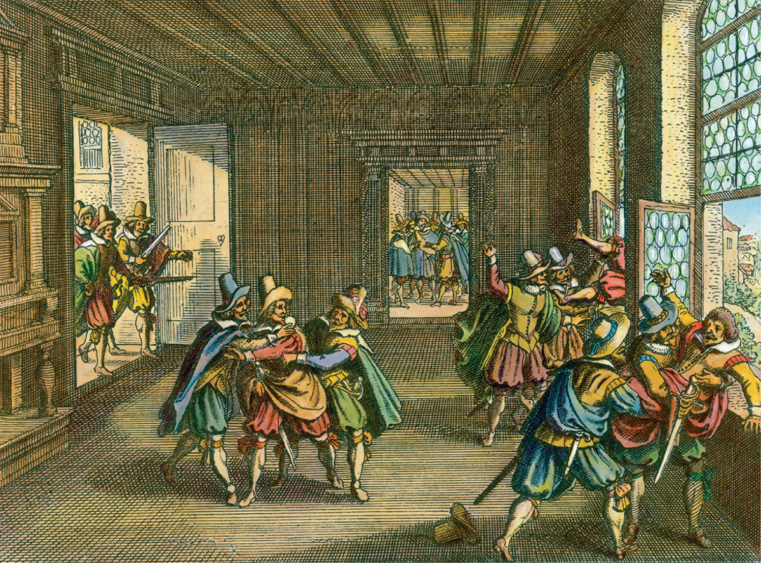
Bohemian protesters throw three of Emperor Ferdinand II’s agents out of windows at Hradschin Castle in Prague to protest his revocation of Protestant freedoms. Bildarchiv Preussischer Kulturbesitz/Art Resource, NY
Notes:
Bohemian protesters throw three of Emperor Ferdinand II’s agents out of windows at Hradschin Castle in Prague to protest his revocation of Protestant freedoms.
Bildarchiv Preussischer Kulturbesitz/Art Resource, NY

Slide 54
Danish Period of the Thirty Years’ War
Emperor Maximilian humiliates Protestant forces in Germany under Lutheran king Christian V and forces them to return to Denmark
Emperor Ferdinand gains an ally in the mercenary Protestant Albrecht of Wallenstein; breaks Protestant resistance and orders the Edict of Restitution, reasserting the Peace of Augsburg

Slide 55
Swedish Period of the Thirty Years’ War
Gustavus Adolphus II of Sweden, with help from the French and Dutch, turn the tide of the war with a smashing victory at Breitenfield
Adolphus is killed by Wallenstein’s forces at the Battle of Lutzen, but then Wallenstein is assassinated himself by Ferdinand, who was afraid of his independence

Slide 56
Swedish Period of the Thirty Years’ War (cont.)
Despite religious convictions, the assassination of Wallenstein proved it was more a war of greed and politics
Peace of Prague – German Protestant states reach a compromise with Ferdinand; the war, however, continues elsewhere

Slide 57
Fourth and Final Period: The Swedish-French Period
French, Swedish, and Spanish troops for the next thirteen years attack and loot Germany simply for the sake of warring itself
Treaty of Westphalia of 1648 ends the war, which had killed one-third of Germany’s population – the Treaty did the following:
Rescinded the Edict of Restitution and put back the Peace of Augsburg

Slide 58
Fourth and Final Period: The Swedish-French Period (cont.)
Treaty of Westphalia of 1648 ends the war, which had killed one-third of Germany’s population – the Treaty did the following:
Calvinists officially recognized
Swiss Confederacy, the Netherlands, and Bavaria become independent
Brandenburg –Prussia becomes most powerful German state

Slide 59
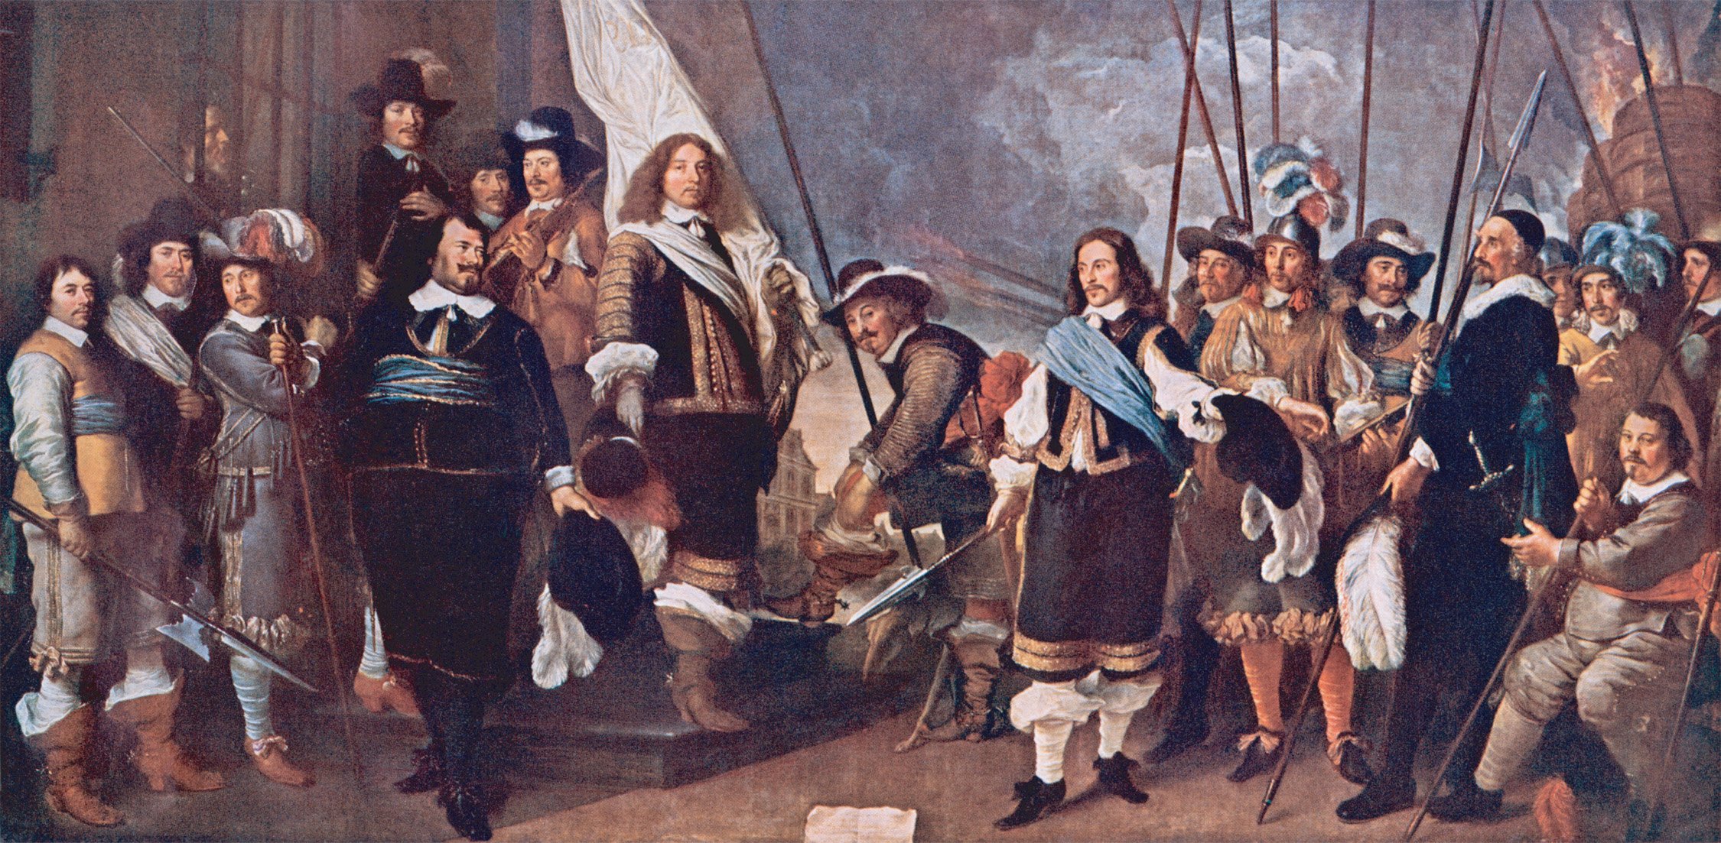
The Dutch celebrate the Treaty of Westphalia, ending the Thirty Years’ War. © North Wind Picture Archives/Alamy
Notes:
The Dutch celebrate the Treaty of Westphalia, ending the Thirty Years’ War.
© North Wind Picture Archives/Alamy

Slide 60
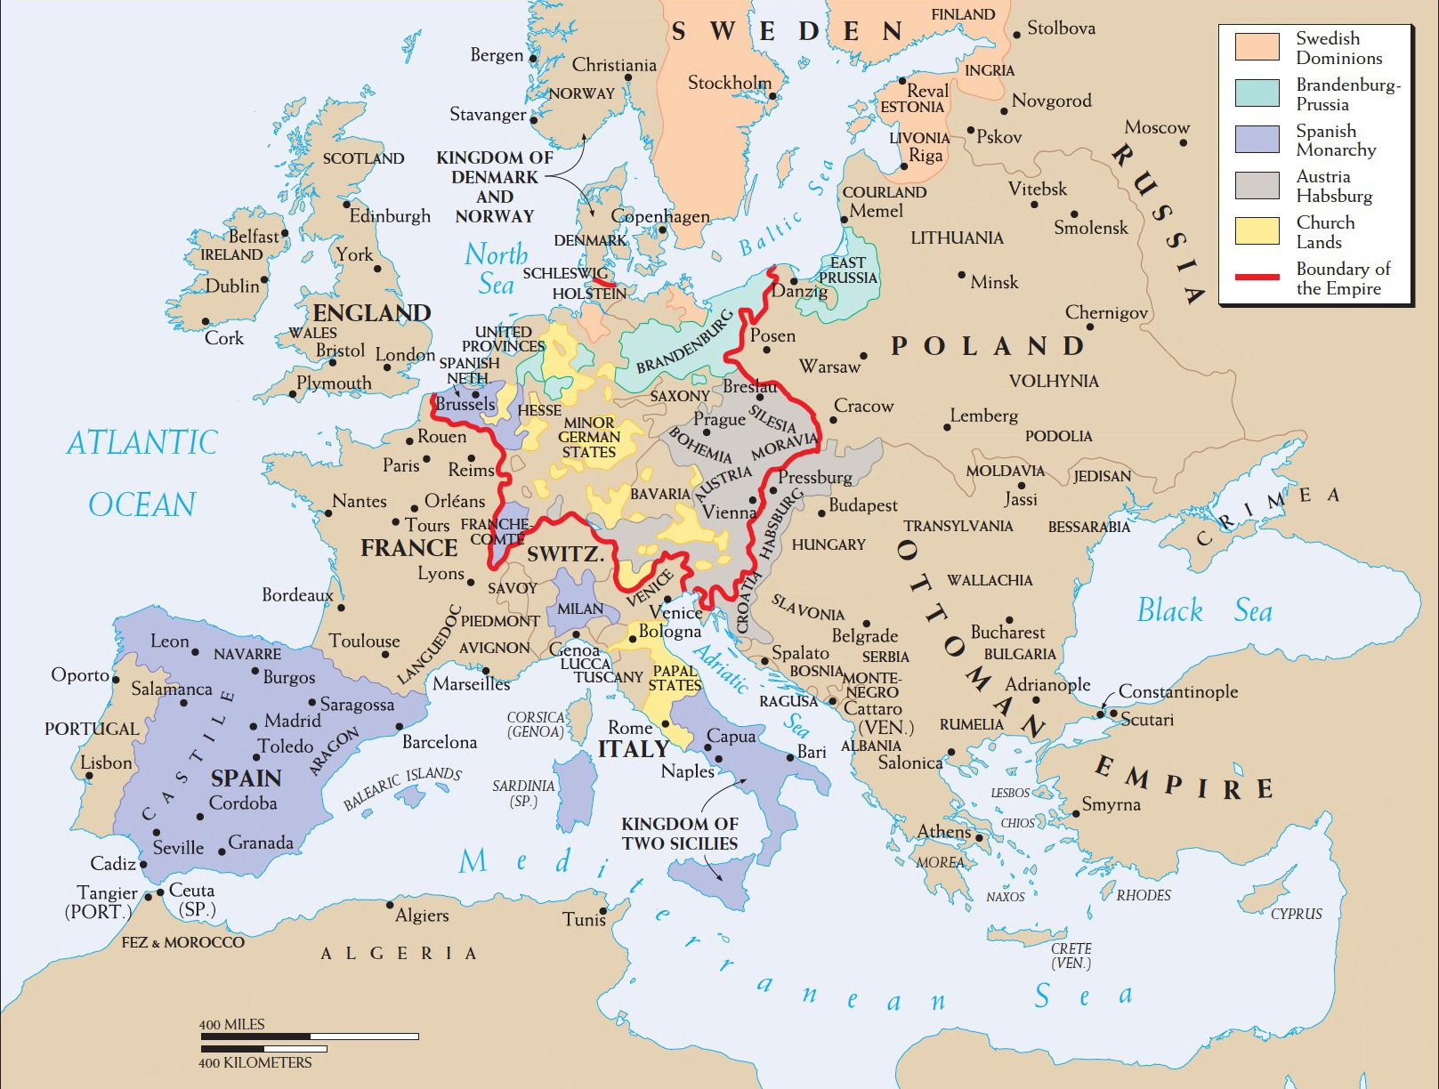
Map 12–5 EUROPE IN 1648 At the end of the Thirty Years’ War, Spain still had extensive possessions. Austria and Brandenburg-Prussia were rising powers, the independence of the United Provinces and Switzerland was recognized, and Sweden had footholds in northern Germany.
Notes:
Map 12–5 EUROPE IN 1648 At the end of the Thirty Years’ War, Spain still had extensive possessions. Austria and Brandenburg-Prussia were rising powers, the independence of the United Provinces and Switzerland was recognized, and Sweden had footholds in northern Germany.

Slide 61
Spain and France
Spain and France continue to war until 1659, when France emerges victorious
France becomes Europe’s dominant power, while Hapsburg Spain never recovers

