Slide 1
Chapter 13
European State Consolidation
in the Seventeenth and Eighteenth Centuries

Slide 2
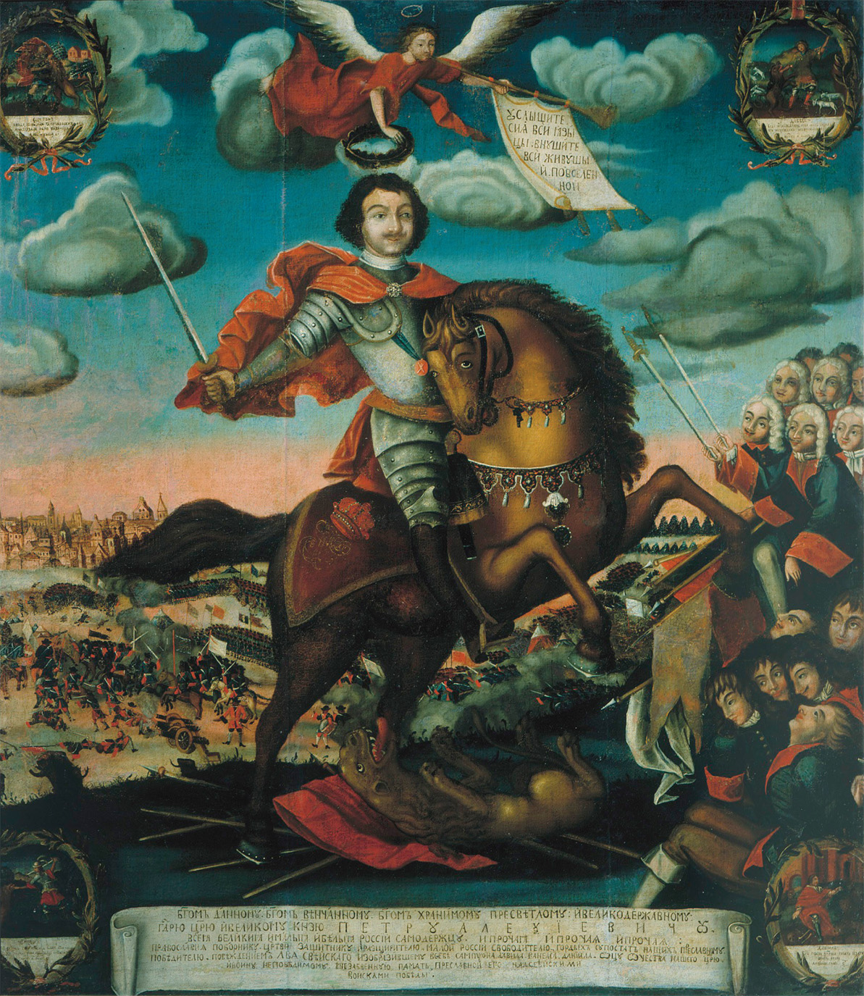
Peter the Great (r. 1682–1725), seeking to make Russia a military power after West European models reorganized the country’s political, social, and economic structures. He also radically changed the relationship of the Russian Church to the Russian state. His reign saw Russia enter fully into European power politics. The Apotheosis of Tsar Peter the Great 1672–1725 by unknown artist, 1710. bpk, Berlin/Museum of History, Moscow, Russia/ Alfredo Dagli Orti/Art Resource, NY
Notes:
Peter the Great (r. 1682–1725), seeking to make Russia a military power after West European models reorganized the country’s political, social, and economic structures. He also radically changed the relationship of the Russian Church to the Russian state. His reign saw Russia enter fully into European power politics.
The Apotheosis of Tsar Peter the Great 1672–1725 by unknown artist, 1710. bpk, Berlin/Museum of History, Moscow, Russia/ Alfredo Dagli Orti/Art Resource, NY

Slide 3
Netherlands: The Golden Age – 1600’s
As opposed to all other European nations at the time, it was a republic
Holland dominated the States General, the central government of the Netherlands, but distrusted the House of Orange
For a period of time (1688-1714) the Netherlands became a monarchy under William III of Orange

Slide 4
Netherlands: The Golden Age – 1600’s (cont.)
Dutch revert to a republic in 1714 when war with France ended
Home to great religious tolerance and a haven for Jews
The Dutch had thriving farms, fish and textile industries, plus a trade industry that reached all the way to East Asia

Slide 5
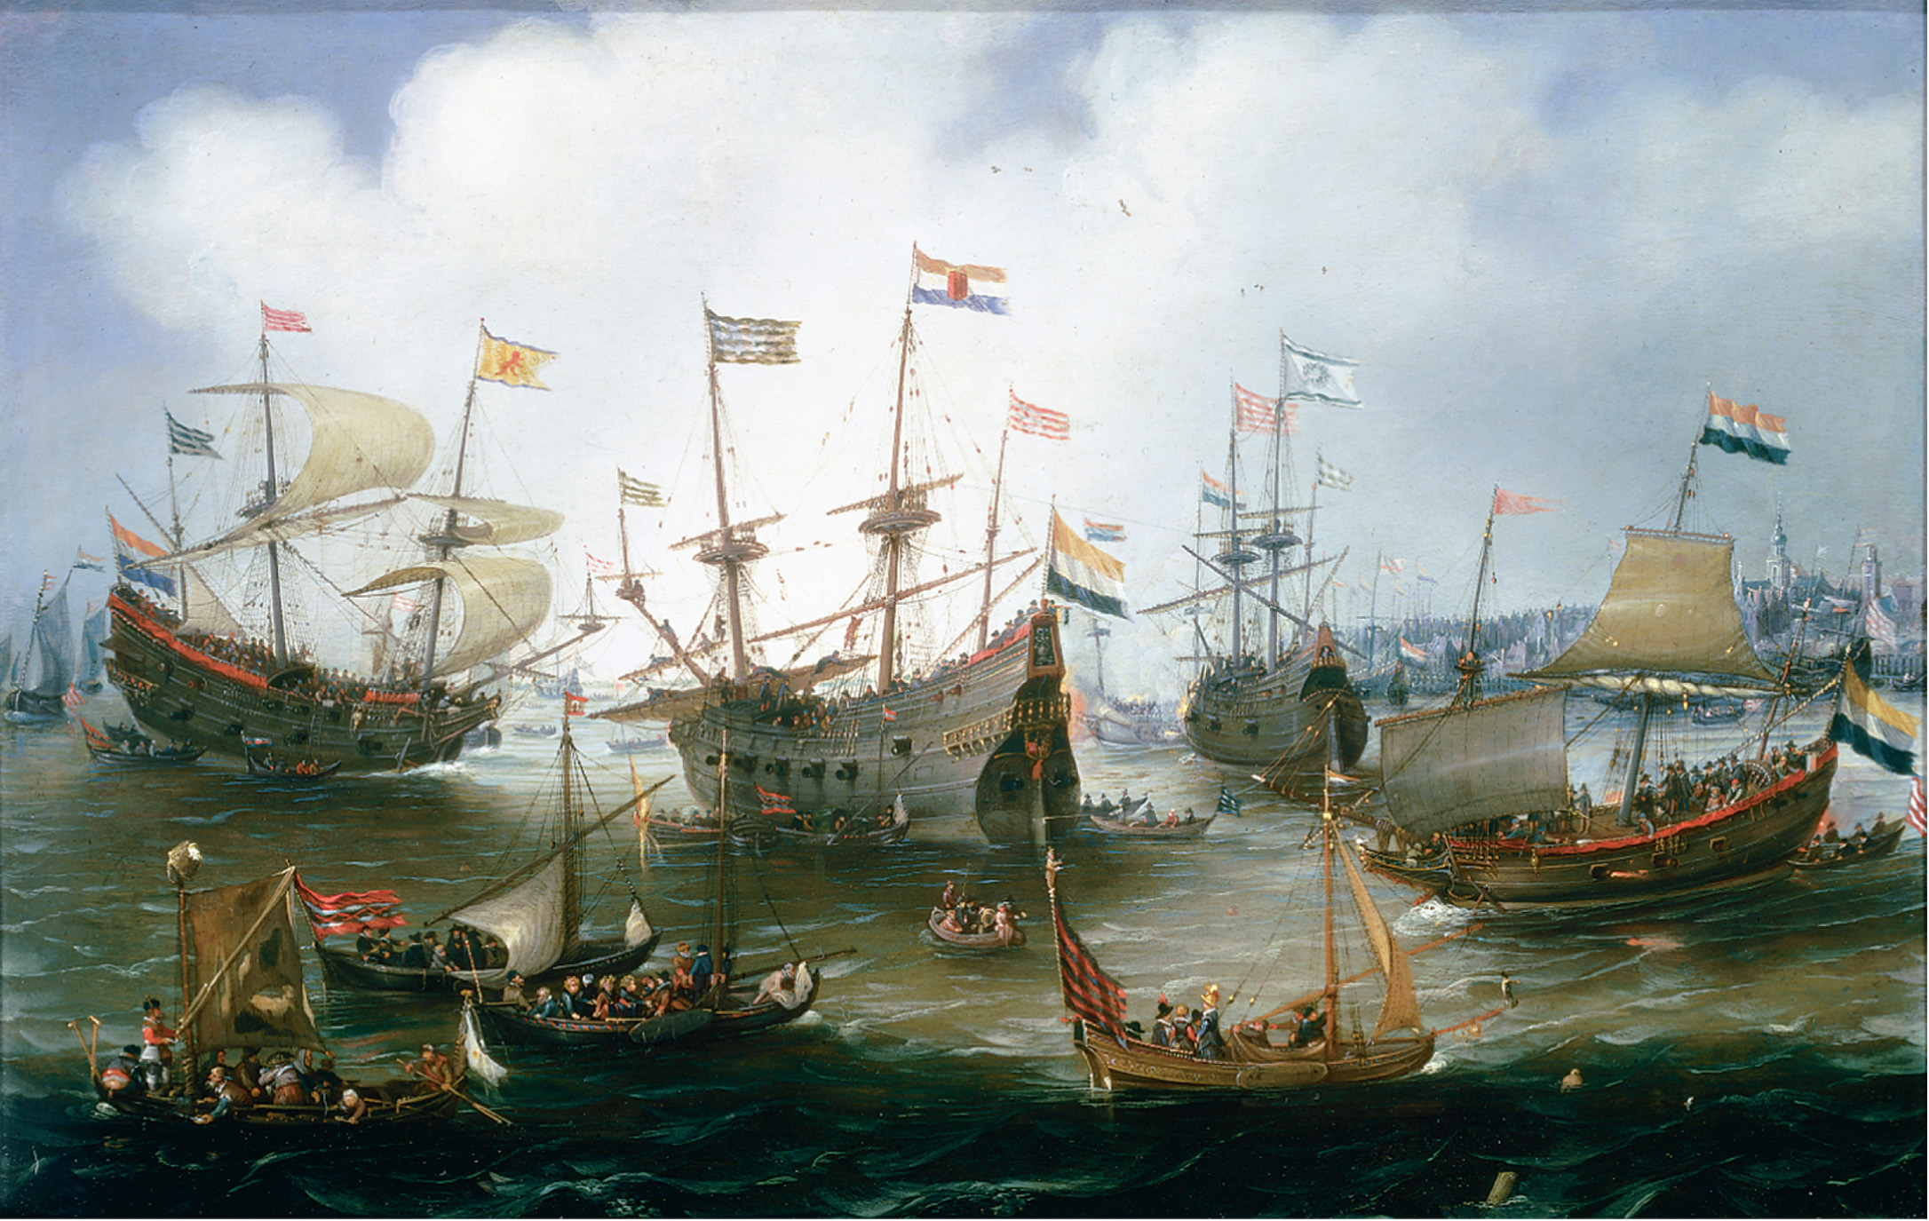
The technologically advanced fleet of the Dutch East India Company, shown here at anchor in Amsterdam, linked the Netherlands’ economy with that of southeast Asia. Andries van Eertvelt (1590–1652), The Return to Amsterdam of the Fleet of the Dutch East India Company in 1599. Oil on copper. Johnny van Haeften Gallery, London. The Bridgeman Art Library
Notes:
The technologically advanced fleet of the Dutch East India Company, shown here at anchor in Amsterdam, linked the Netherlands’ economy with that of southeast Asia.
Andries van Eertvelt (1590–1652), The Return to Amsterdam of the Fleet of the Dutch East India Company in 1599. Oil on copper. Johnny van Haeften Gallery, London. The Bridgeman Art Library

Slide 6
Economic Decline in the Netherlands
No strong stadtholder replaced William III after his death in 1702
Surpassed in naval supremacy by the British
Fishing and trade industries declined
Only financial institutions kept the Dutch from complete insignificance

Slide 7
Two Models of European Political Development in the 17th Century
England – parliamentary monarchy – a limited monarchy where the monarch is subject to the law and the consent of parliament
France – political absolutism – strong centralized monarchies, where the royal power is dominant
Neither inevitable but resulted from specific historical developments & particular political personalities

Slide 8
Two Models of European Political Development in the 17th Century
2nd half of 16th century, military concerns propelled moarchs to consider new sources of revenue
cost of warfare
other costs of gov’t
only monarchies that could build secure financial base w/out support of noble states, diets, or assemblies achieved absolute rule
France succeeded
England failed

Slide 9
Stuart England – James I
Peacefully takes throne in 1603, following childless Elizabeth I
a strong believer in the divine right of kings - power from God
Levied new custom duties known as impositions to raise money instead of securing parliamentary approved revenues
Rebuffs Puritans and maintains Anglican episcopacy, causing religious dissenters to leave England for North America

Slide 10
Stuart England – James I (cont.)
Court was center of scandal and corruption with his favorite duke (lover?) of Buckingham
sold peerages & titles to highest bidders angering nobility

Slide 11
Stuart England – James I (cont.)
Doubts about James I commitment to Protestants
Makes peace with Spain
in truth, the war had been ruinously expensive
Protestants saw this as betrayal
urged him to “purify” Church of England
Hesitant to support German Protestants in Thirty Years’ War
Convinced Presbyterian system of church gov’t would destroy royal control of church

Slide 12
Stuart England – James I (cont.)
The True Law of Free Monarchies
“kings are not only God’s lieutenants upon earth, and sit on God’s throne, but even by God himself they are called gods”
“No bishops, no king”

Slide 13
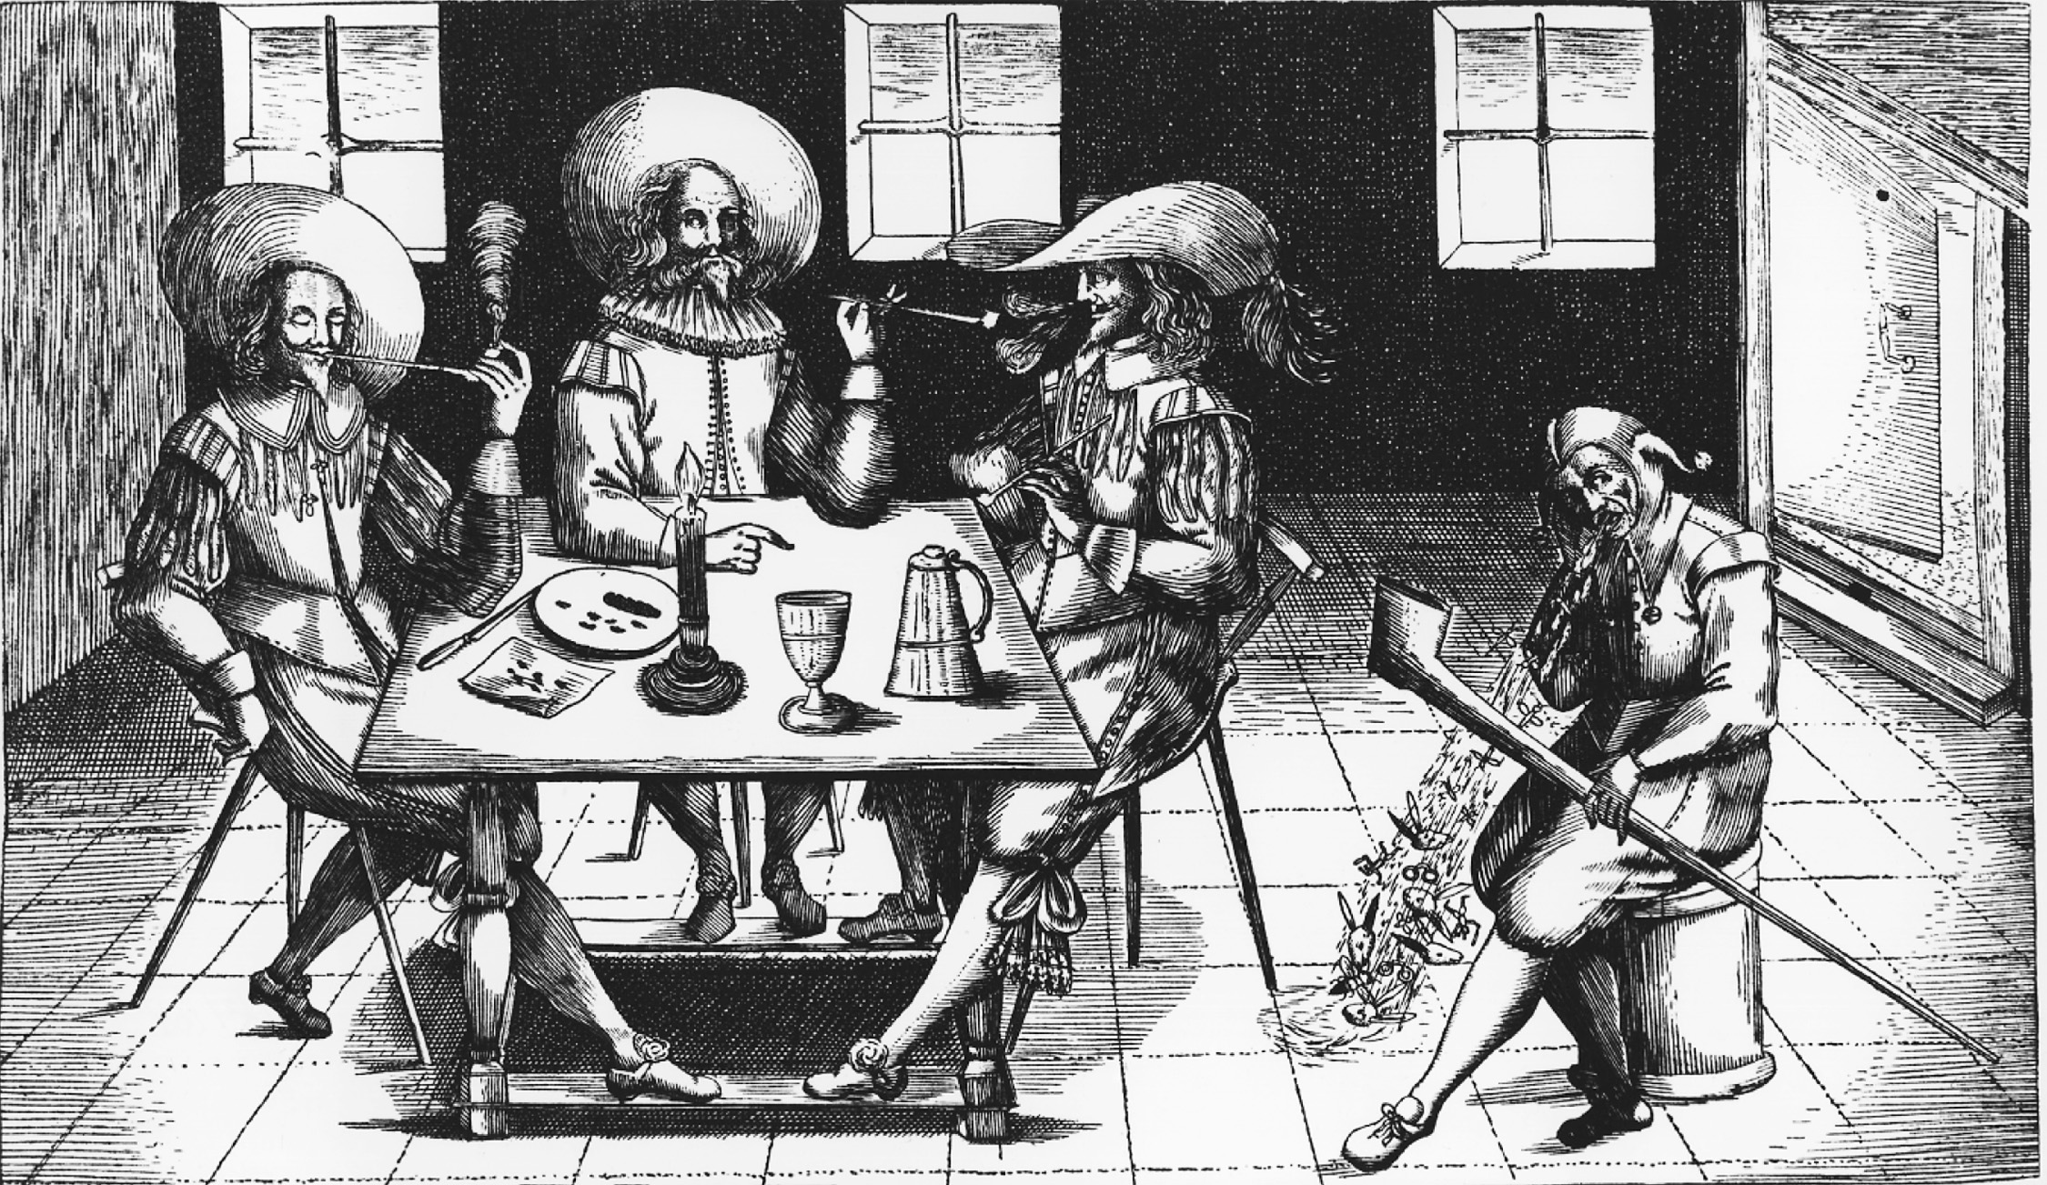
Practically from the moment of its introduction into Europe tobacco smoking was controversial. Here a court jester is portrayed as exhaling rabbits from a pipe as three pipe-smoking gentlemen look on. Christel Gerstenberg/Fine Art Value/Corbis
Notes:
Practically from the moment of its introduction into Europe tobacco smoking was controversial. Here a court jester is portrayed as exhaling rabbits from a pipe as three pipe-smoking gentlemen look on.
Christel Gerstenberg/Fine Art Value/Corbis

Slide 14
Stuart England – Charles I
Like his father:
Also a firm believer in Divine right of kings
Also in need of money
Also opposed the Puritans & supported the Anglican Church

Slide 15
Stuart England – Charles I
Parliament favored war w/ Spain but did not trust monarchy
To fund a new war with Spain, Charles levied tariffs, duties, and taxes all of which challenged local nobles & landowners
Parliament would only give Charles funds if he agreed to the Petition of Right
no forced loans or taxations w/out consent of Parliament
Charles dissolved Parliament from 1628 to 1640

Slide 16
Charles I – Years of Personal Rule
Makes peace with Spain and France to conserve limited resources
His chief advisor Thomas Wentworth institutes strict efficiency and administrative centralization to facilitate rule w/out Parliament
At same time his religious policies provoke Scottish rebellion
Archbishop William Laud tried to impose English episcopal system

Slide 17
Charles I – Years of Personal Rule
Scots rebelled & insufficient sources for war force Charles to call Parliament in 1640
Dissolved it when they refused resources until he redresses long list of grievances - Short Parliament
Scots defeat English at Battle of Newburn

Slide 18
Long Parliament and Civil War
Puritans resented Charles I over religious policies & his Roman Catholic wife
landowners & merchant classes resented his paternalistic rule & imposing financial measures
led to a semblance of unity in Parliament
House of Commons impeached & executed Strafford & Laud in 1641 & 1645

Slide 19
Long Parliament and Civil War
On other hand, Parliament is divided over religion
extreme and moderate Puritans wanted to abolish the Book of Common Prayer
conservatives wanted the Church of England to remain
divisions intensified over request to raise funds for army to suppress Scottish rebellion

Slide 20
Long Parliament and Civil War
Could not agree & King Charles invaded Parliament to arrest opponents
King & Parliament raise individual armies
Civil war ensues between the king’s supporters made up of aristocrats & nobles & loyal church officials (Cavaliers) and the parliamentary opposition made up of Puritans, townspeople, middle-class businessmen, people from Presbyterian-dominated London (Roundheads)

Slide 21
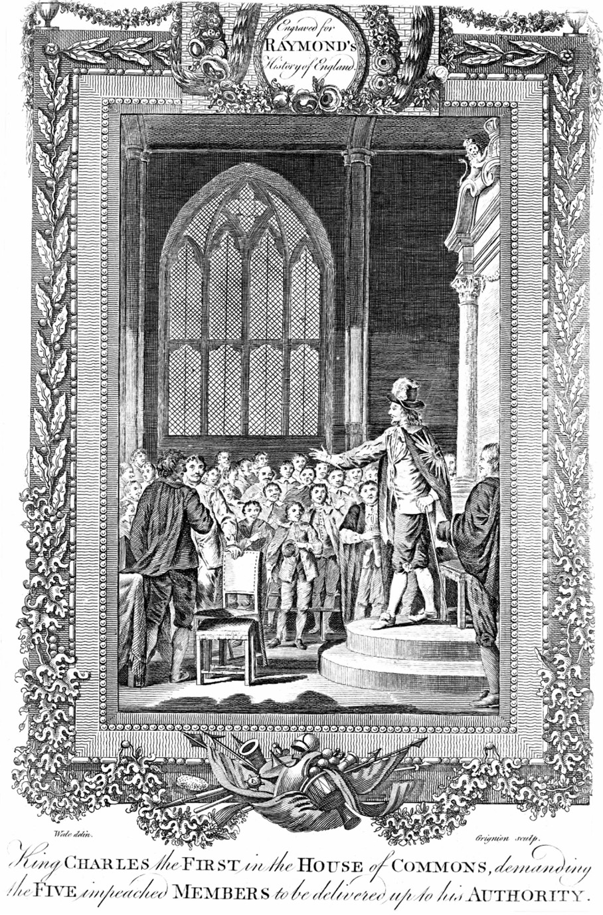
One of the key moments in the conflict between Charles I and Parliament occurred in January 1642 when Charles personally arrived at the House of Commons intent on arresting five members who had been responsible for opposing him. They had already escaped. Thereafter Charles departed London to raise his army. The event was subsequently often portrayed in English art. The present illustration is from an eighteenth-century engraving. The Granger Collection, New York
Notes:
One of the key moments in the conflict between Charles I and Parliament occurred in January 1642 when Charles personally arrived at the House of Commons intent on arresting five members who had been responsible for opposing him. They had already escaped. Thereafter Charles departed London to raise his army. The event was subsequently often portrayed in English art. The present illustration is from an eighteenth-century engraving.
The Granger Collection, New York

Slide 22
Oliver Cromwell
2 factors lead to Parliamentary victory:
alliance w/ scotland
Oliver Cromwell
Led parliamentary army in civil war
Parliament wins civil war, and in response, executes Charles I and abolishes the monarchy, the House of Lords, and the Anglican Church

Slide 23
Oliver Cromwell (cont.)
Ran basically a military dictatorship which brutally conquered Catholic countries Scotland and Ireland
Ran a one-house Parliament
Introduced Puritan prohibitions against drunkenness, theatre going, and dancing

Slide 24
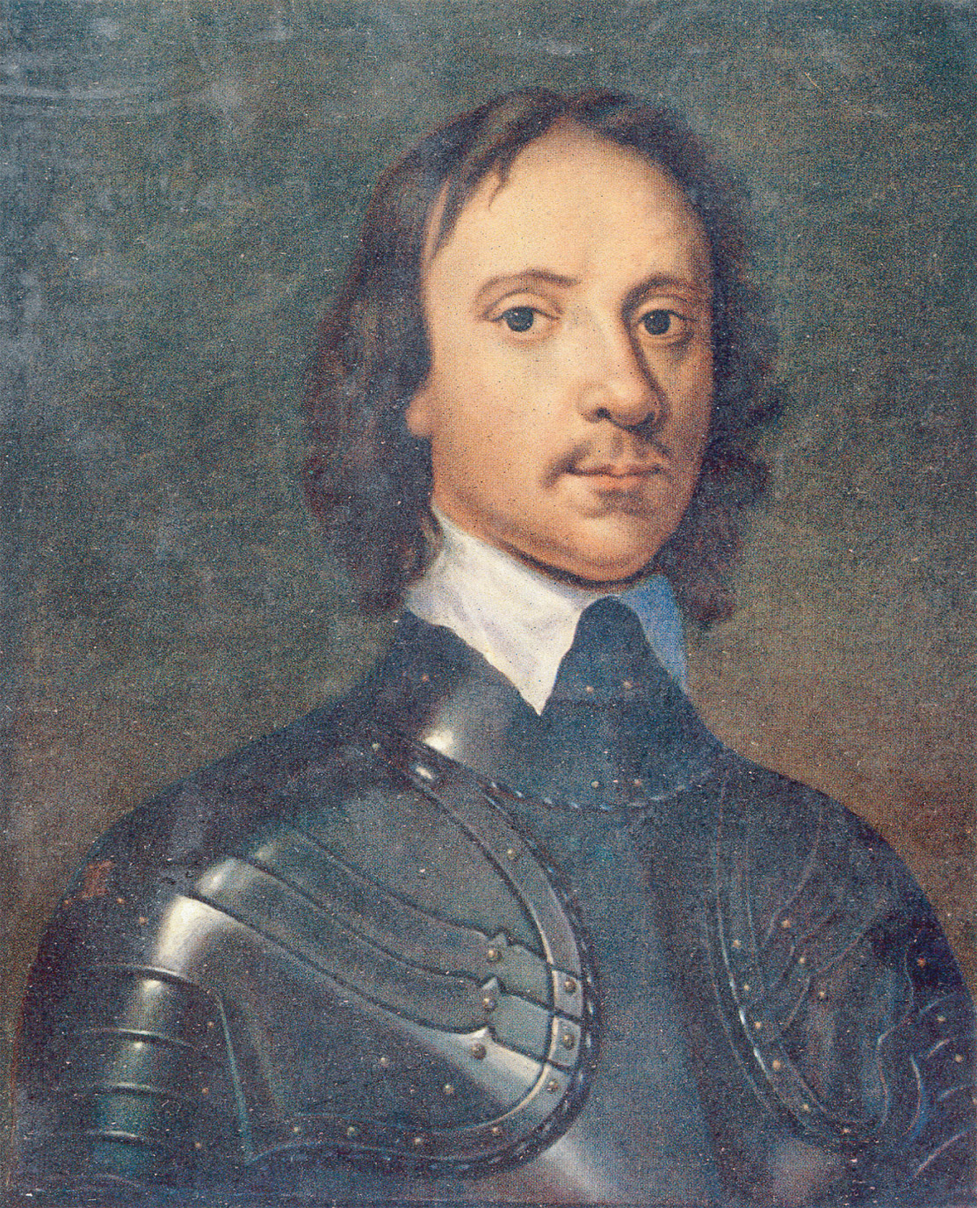
Oliver Cromwell’s New Model Army defeated the royalists in the English Civil War. After the execution of Charles I in 1649, Cromwell dominated the short-lived English republic, conquered Ireland and Scotland, and ruled as Lord Protector from 1653 until his death in 1658. Anthony Van Dyck/Beryl Peters Collection/Alamy
Notes:
Oliver Cromwell’s New Model Army defeated the royalists in the English Civil War. After the execution of Charles I in 1649, Cromwell dominated the short-lived English republic, conquered Ireland and Scotland, and ruled as Lord Protector from 1653 until his death in 1658.
Anthony Van Dyck/Beryl Peters Collection/Alamy

Slide 25
The Restoration of the Monarchy
When Cromwell dies, the people are ready to reestablish the monarchy and the Anglican Church
Charles II is named monarch and he reintroduces the status quo from before Cromwell
Restoration of the Monarchy still experienced deep divisions

Slide 26
Charles II
Charming & welcomed after Cromwell’s tyrannical reign
Secret Catholic sympathies:
Believed in religious toleration and planned to convert to Catholicism
Would but heads w/ the Clarendon Code - a series of laws excluding Catholics, Presbyterians, & Independents from religious & political life

Slide 27
Charles II
1670 - Englad & France formally allied thru Treaty of Dover against the Dutch (chief commerical competitor)
Charles II in secret pledged conversion & in return, Louis XIV would pay substantial subsidy
Attempted to unite people behind the war with Holland thru Declaration of Indulgence suspending all laws against Catholics and non-Anglican Protestants

Slide 28
Charles II (cont.)
Parliament refused to fund the war & forced Charles to rescind the act
Passed Test Act – requiring all civic and military officials to swear an oath against the doctrine of transubstantiation
aimed at James, Duke of York

Slide 29
Charles II (cont.)
Popish Plot – referred to tense time in which Titus Oates swore that king’s wife plotting to kill him to put his brother on the throne
Question of succesion:
Pits the opposition Parliament members known as Whigs (suspicious of Catholics & against James) against the Tories (monarchy loyalists & supportive of James)

Slide 30
Charles II (cont.)
Charles responds by executing Whig members for treason, converts to Catholicism on his death bed, and leaves James a Parliament filled with royal friends

Slide 31
The Glorious Revolution
James II – immediately repealed Test Act, puts Catholics in positions of power, and issues another Declaration of Indulgence permitting religious freedom
imprisoned 7 Anglican bishops
Catholic 2nd wife had a son destroying all hopes that daughter of James II would assume power
Mary was wife of William III of Orange, leader of opposition to Louis XIV

Slide 32
The Glorious Revolution
Parliament, afraid of a Catholic heir to the throne, invited William of Orange to invade England
to preserve Anglican Church & parliamentary gov’t
arrived w/ his army in November 1688

Slide 33
The Glorious Revolution
James fled to France - William and Mary (James’s eldest Protestant daughter) succeed to the throne in the bloodless Glorious Revolution
Recognized a Bill of Rights limiting power of monarchy and guaranteed civil liberties of privileged classes
Permited worship of all Protestants, but not Catholics (The Toleration Act of 1689)

Slide 34
The Glorious Revolution
Importance is that theory of divine right of kings is rejected
now a constitutional monarchy not an aristocratic oligarchy

Slide 35
The Glorious Revolution
Act of Settlement provided for the crown to go to King George I in the event that Anne (James II second daughter)died
Protestant House of Hanover in Germany assumed control of the crown - now Great Britain since England & Scotland combined in Act of Union in 1707
Closed century of strife

Slide 36
The Act of Walpole
Sir Robert Walpole dominated English politics from 1721 till 1742 based on his royal support, ability to handle the House of Commons, and control over government patronage
Promoted peace at home and abroad
Spread trade from North America to India
Built the military, especially the navy, making Britain a world power

Slide 37
The Act of Walpole
Walpole’s efforts resulted in England becoming a military power with both religious and political liberty.

Slide 38
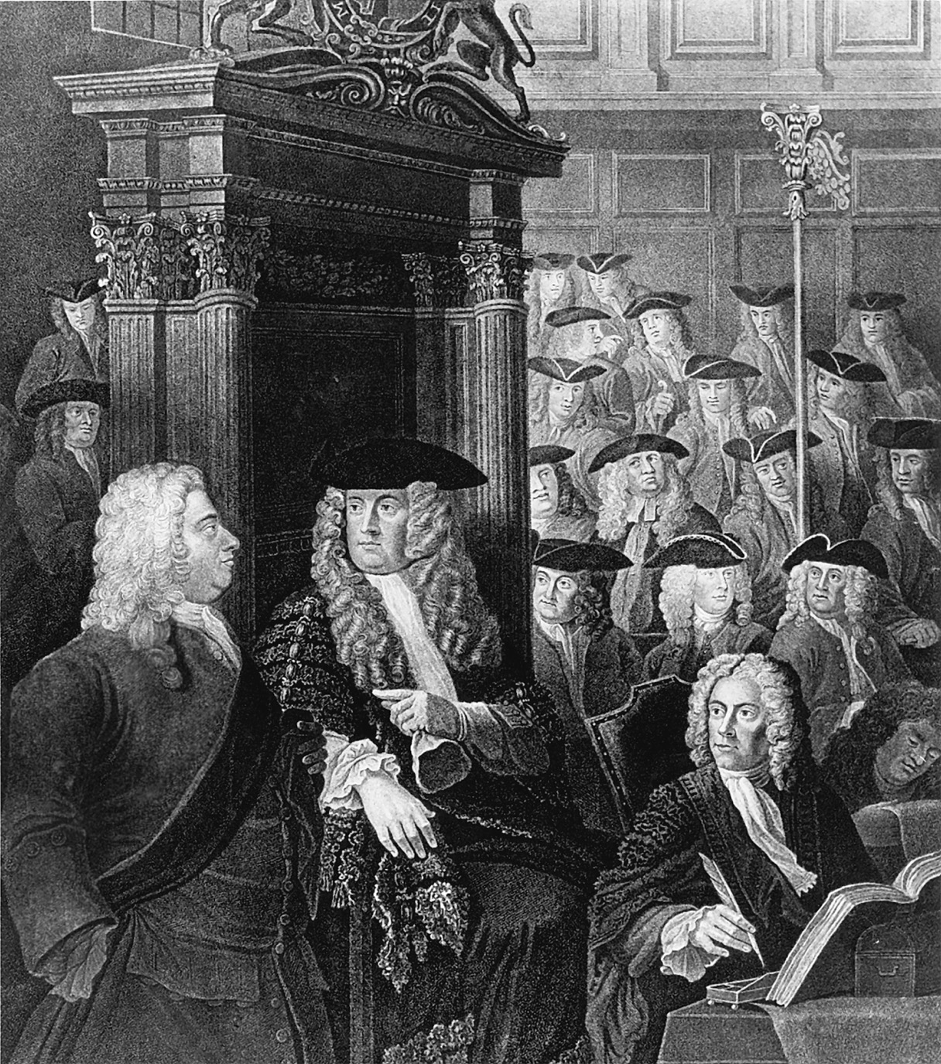
Sir Robert Walpole (1676–1745), far left, is shown talking with the Speaker of the House of Commons. Walpole, who dominated British political life from 1721 to 1742, is considered the first prime minister of Britain. Mansell/TimePix/Getty Images, Inc.
Notes:
Sir Robert Walpole (1676–1745), far left, is shown talking with the Speaker of the House of Commons. Walpole, who dominated British political life from 1721 to 1742, is considered the first prime minister of Britain.
Mansell/TimePix/Getty Images, Inc.

Slide 39
Background
Henry IV & Edict of Nantes in 1598
religious toleration of Huguenots
Henry IV - a politique
French tax system inefficient & exempted nobles, placing heavy burden on peasantry
Duke de Sully made system more efficient if not more just

Slide 40
Background
Nobles presented greatest obstacle to extension of royal power
based on inherited privileges & tradition of military service
Began selling gov’t offices conferring nobility to raise revenue
new nobles known as robe nobles became increasingly prosperous bourgeoisie

Slide 41
Louis XIII & Cardinal Richelieu
Assumed throne after assassination of his father
Cardinal Richelieu chief minister & real ruler of France
Worked to enhance royal power
Implemented intendant system to weaken nobility
curbed political power by replacing nobles w/ middle class administrators of the 32 districts
never curbed social or economic privileges of nobility

Slide 42
Years of Personal Rule under Louis XIV
Assumed throne after death of Louis XIII & Cardinal Richelieu
Cardinal Mazarin became chief minister
Nobles led series of rebellions called the Fronde to limit monarchy
Young Louis XIV fled Paris & never forgot the humiliation

Slide 43
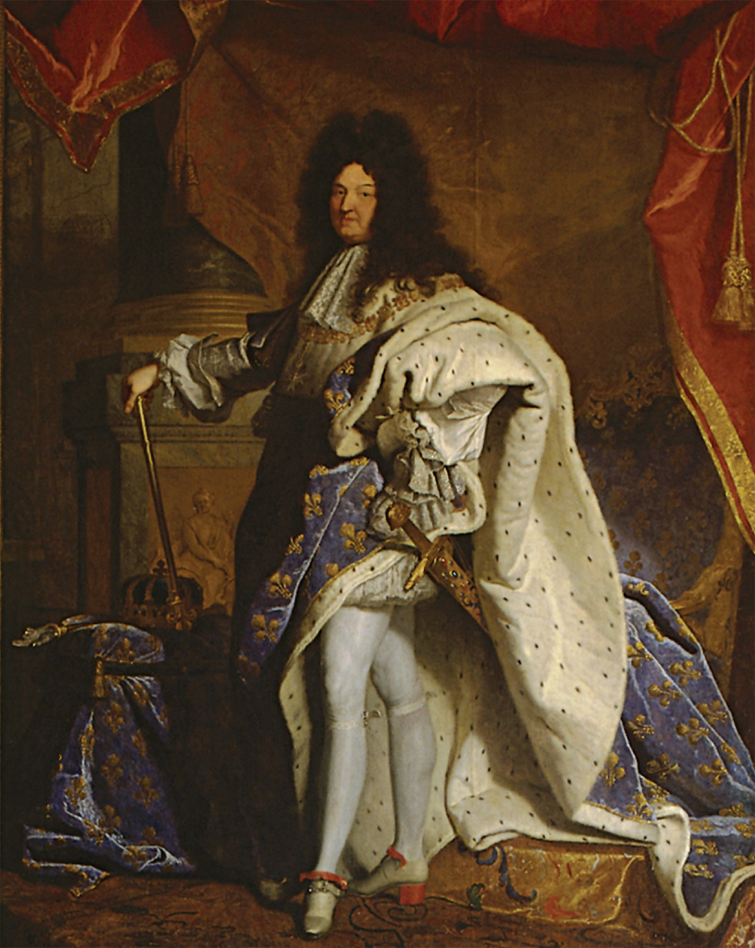
Louis XIV of France came to symbolize absolute monarchy though such government was not as absolute as the term implied. This state portrait was intended to convey the grandeur of the king and of his authority. The portrait was brought into royal council meetings when the king himself was absent. Hyacinthe Rigaud (1659–1743), Portrait of Louis XIV. Louvre, Paris, France. Dorling Kindersley Media Library/Max Alexander. © Dorling Kindersley, courtesy of l’Etablissement public du musée et du domaine national de Versailles
Notes:
Louis XIV of France came to symbolize absolute monarchy though such government was not as absolute as the term implied. This state portrait was intended to convey the grandeur of the king and of his authority. The portrait was brought into royal council meetings when the king himself was absent.
Hyacinthe Rigaud (1659–1743), Portrait of Louis XIV. Louvre, Paris, France. Dorling Kindersley Media Library/Max Alexander. © Dorling Kindersley, courtesy of l’Etablissement public du musée et du domaine national de Versailles

Slide 44
Louis XIV
Remembering the Fronde, Louis XIV determined to subtly concentrate unprecedented authority in the monarchy but assure nobles & wealthy of their standing at the local level
Huge palace that was built for Louis XIV and housed thousands of important nobles, royal officials, and servants
The Sun King liked items that were lavish and ornate

Slide 45
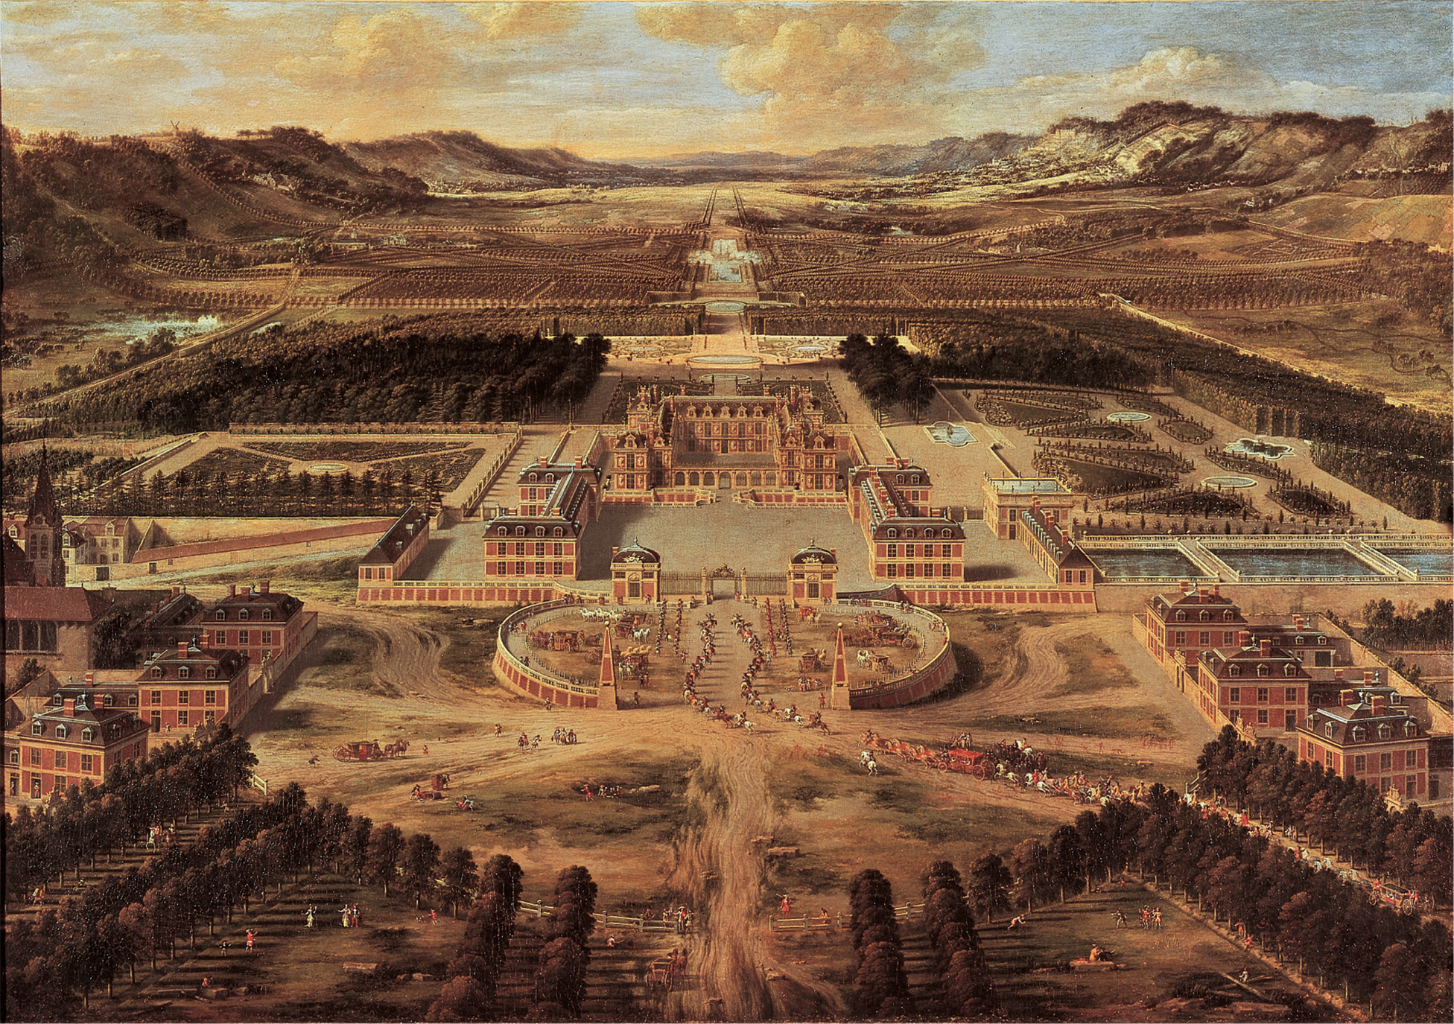
Versailles Louis XIV constructed his great palace at Versailles, as painted here in 1668 by Pierre Patel the Elder (1605–1676), to demonstrate the new centralized power he sought to embody in the French monarchy. Pierre Patel, Perspective View of Versailles. Chateaux de Versailles et de Trianon, Versailles, France. Musée du Château de Versailles/Gianni Dagli Orti/The Art Archive at Art Resource, NY
Notes:
Versailles Louis XIV constructed his great palace at Versailles, as painted here in 1668 by Pierre Patel the Elder (1605–1676), to demonstrate the new centralized power he sought to embody in the French monarchy.
Pierre Patel, Perspective View of Versailles. Chateaux de Versailles et de Trianon, Versailles, France. Musée du Château de Versailles/Gianni Dagli Orti/The Art Archive at Art Resource, NY

Slide 46
Years of Personal Rule under Louis XIV
Was an absolute monarch & ruled thru councils of foreign affairs, army, domestic admin, & econ regs
Chose ministers from families long in royal service or new to social ladder
Conferred w/ regional judicial bodies called the parlements before rulings
Consulted local opinion before enacting economic policies

Slide 47
Versailles
Description of himself as the Sun King was accurate
All aspects of political life & culture revolved around him
Understood power of art as propoganda & value of visual imagery to cultivate public image
Versailles was designed to be a visible symbol of his absolute power & greatness

Slide 48
Versailles
Embodied French cultural dominance
Art, philosophy, architecture, & fashion were the envy of the world
When the dauphin was born, he appeared in court dressed as a Roman emperor
Consumed over half of his annual revenues but paid handsomely in political revenues
Still, never threatened local social standing of the nobility, even those who avoided Versailles

Slide 49
Divine Right – Louis XIV
Devout tutor, political theorist Bishop Bossuet defended “divine right of kings”
Cited exs from Old Testament
Duty bound to reflect God’s will but not bound by dictates of mere nobles
Principal theorist of 17th century doctrine of absolutism

Slide 50
Divine Right – Louis XIV
Royal power absolute & subjects must obey sovereign power
Unlike English monarchs, did not share his power w/ parliament
“L’etat, c’est moi.”
Refused to appoint chief minister
Still, Louis was less of an absolute monarch than others, concentrating his efforts at the national level & not interfering w/ social & financial privileges of local elites

Slide 51
Colbert & Mercantilism
By late 1600s, France superior in population, administrative bureaucracy, army & nat’l unity
Jean Baptiste Colbert:
controller general of finances
implemented strict mercantilist policies
expanded manufacturing by abolishing domestic tariffs that inhibited trade
placed high tariffs on imported goods

Slide 52
Colbert & Mercantilism
Saw colonies as impt source of raw materials & market for manufactured goods
lucrative fur trade in Canada
failed to make tax system more equitable

Slide 53
Louis’s Early Wars
Strategic goals
1) wanted France to expand to its “natural” frontiers along Rhine R & Switzerland
2) wanted to make France global power by inheriting Spanish Hapsburg possessions in New World & Europe

Slide 54
Louis’s Early Wars
3) Wanted to secure France’s borders near the Netherlands, Spain, and the Hapsburg Empire
Treaties signed to end wars with the Netherlands and the Holy Roman Empire expanded France’s territory to the north and east

Slide 55
Balance of Power
Louis’s pursuits threatened other nations & pushed them to form coalitions
1) repulsed by Triple Alliance of England, Sweden & United Provinces in War of the Devolution
Treaty of Aix-la-Chapelle - gained control of certain border towns of Spanish Netherlands

Slide 56
Balance of Power
Louis invaded the Netherlands again in 1672
1) Alliance btwn William of Orange of England and HRE, Spain, Lorraine, & Brandenburg
ended w/ Treaty of Nijmwegen & France gained Franche-Comte

Slide 57
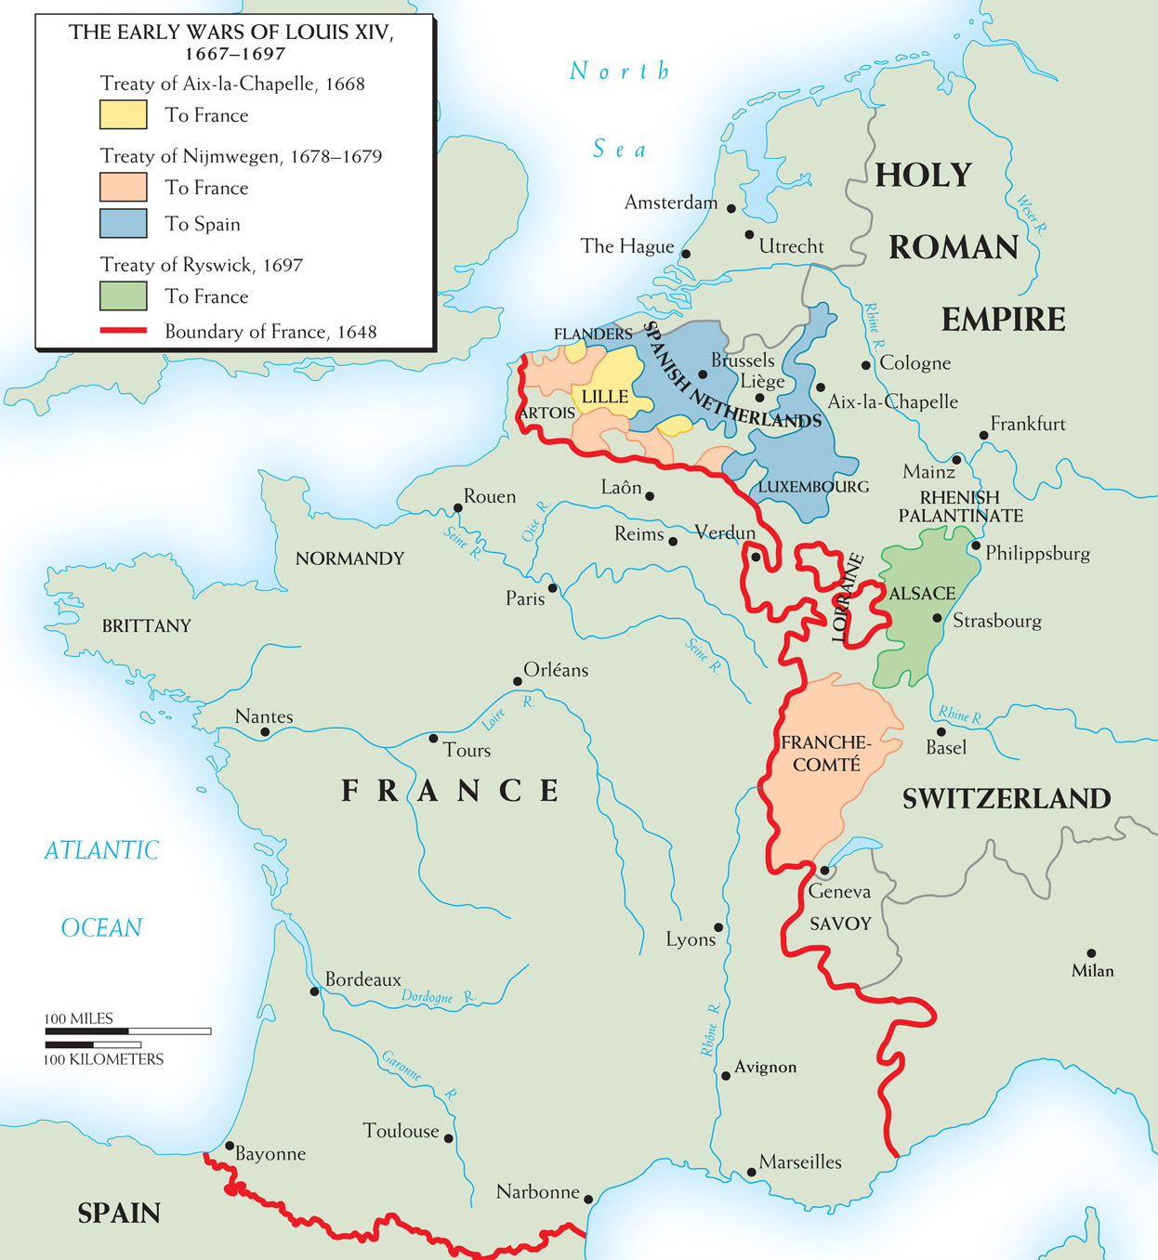
Map 13–1 THE FIRST THREE WARS OF LOUIS XIV This map shows the territorial changes resulting from Louis XIV’s first three major wars (1667–1697).
Notes:
Map 13–1 THE FIRST THREE WARS OF LOUIS XIV This map shows the territorial changes resulting from Louis XIV’s first three major wars (1667–1697).

Slide 58
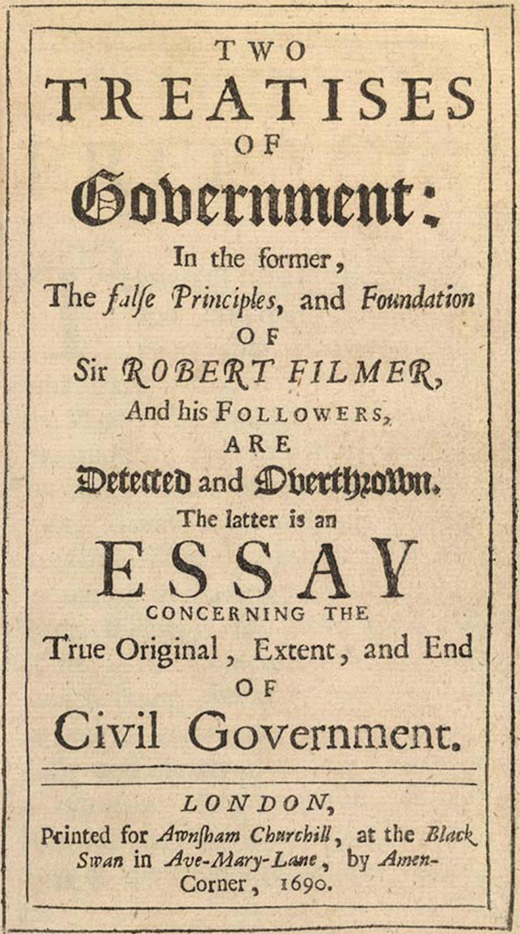
Title page from Two Treatises of Government by John Locke, London, 1690. Courtesy of the Library of Congress, Rosenwald Collection, Rare Book and Special Collections Division
Notes:
Title page from Two Treatises of Government by John Locke, London, 1690.
Courtesy of the Library of Congress, Rosenwald Collection, Rare Book and Special Collections Division

Slide 59
Louis’s Repression of Religion (cont.)
Supported by Catholic clergy & Jesuit advisors, revoked Edict of Nantes in 1685
Huguenots banned from certain professions,
churches and schools closed, ministers exiled, and Protestant children baptized
Goal of having “one king, one law, & one faith” precluded religious diversity

Slide 60
Louis’s Repression of Religion (cont.)
Long term consequence:
200,000 Huguenots fled to England, Dutch Republic, Protestant German states, & New World
Lost many skilled workers & business leaders

Slide 61
Louis’s Repression of Religion
Suppression of the Jansenists – religious order that came from the Roman Catholic Church opposed to the teachings of the Jesuits – during Louis’s reign, both he and the Popes banned Jansenism and forced its followers underground

Slide 62
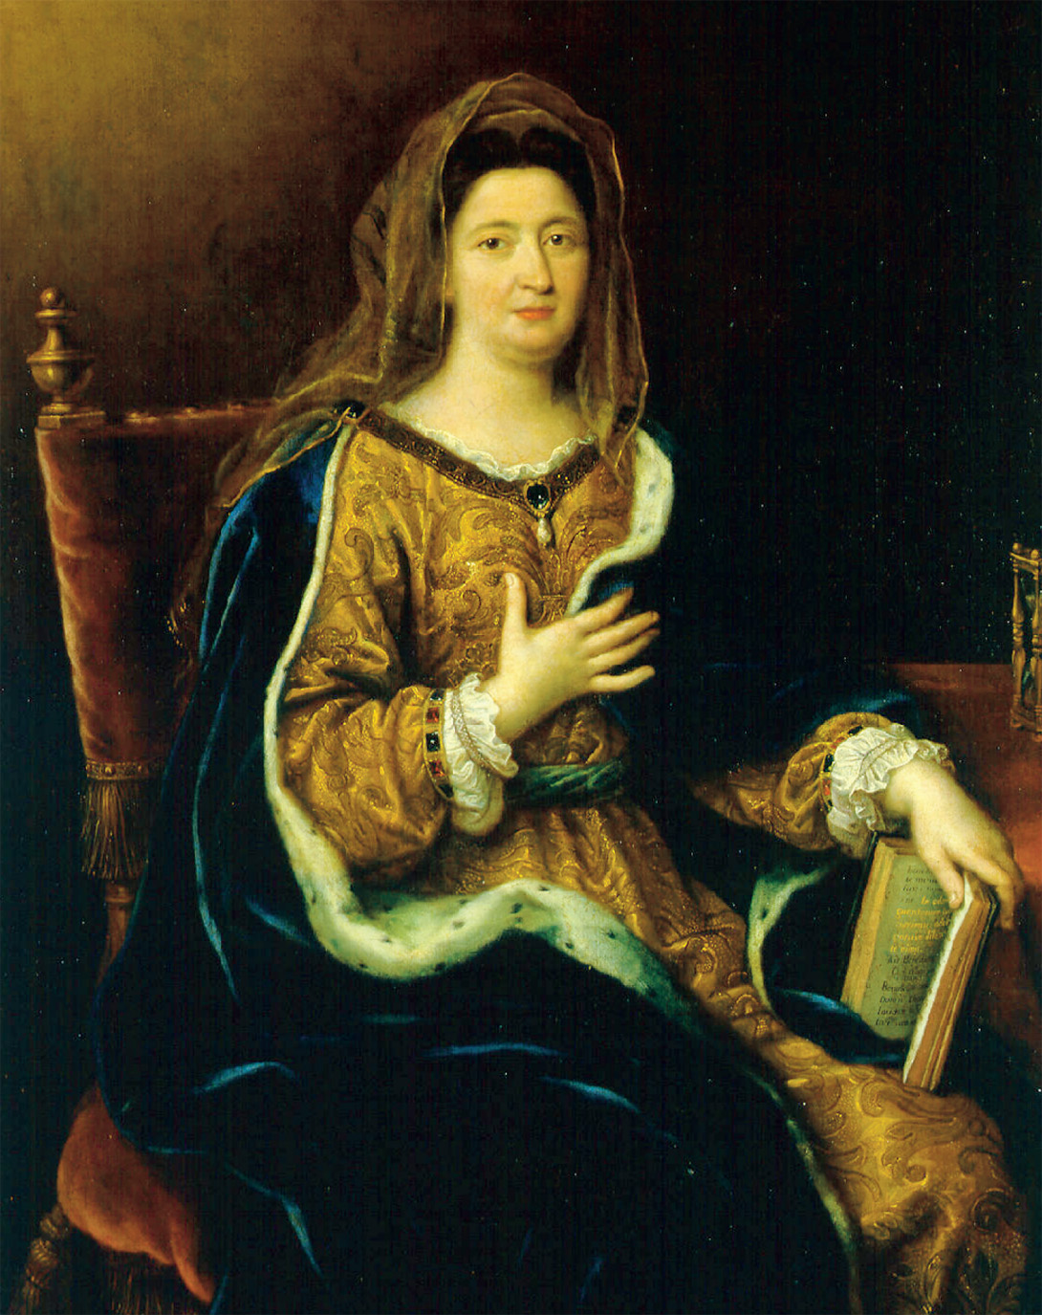
Françoise d’Aubigne, Madame de Maintenon (1635–1719), a mistress to Louis XIV, secretly married him after his first wife’s death. The deeply pious Maintenon influenced Louis’s policy to make Roman Catholicism France’s only religion. Pierre Mignard (1612–1695), Portrait of Francoise d'Aubigne, Marquise de Maintenon (1635–1719), mistress and second wife of Louis XIV, c. 1694. Oil on canvas, 128 × 97 cm. Inv.: MV 3637. Chateaux de Versailles et de Trianon, Versailles. Bridgeman- Giraudon/Art Resource, NY
Notes:
Françoise d’Aubigne, Madame de Maintenon (1635–1719), a mistress to Louis XIV, secretly married him after his first wife’s death. The deeply pious Maintenon influenced Louis’s policy to make Roman Catholicism France’s only religion. Pierre Mignard (1612–1695), Portrait of Francoise d'Aubigne, Marquise de Maintenon (1635–1719), mistress and second wife of Louis XIV, c. 1694. Oil on canvas, 128 × 97 cm. Inv.: MV 3637. Chateaux de Versailles et de Trianon, Versailles. Bridgeman- Giraudon/Art Resource, NY

Slide 63
Louis Later Wars
Nine Years’ War (1689-1697) –
Louis went to war with the League of Augsburg (England, Spain, Sweden, United Provinces, and major German states) and ended up having his expansion into Germany thwarted
also had support of Hapsburg emperor Leopold I
simultaneous w/ struggle btwn England & France for control of North America

Slide 64
Louis’s Later Wars (cont.)
War of Spanish Succession (1701-1714) – war over who would succeed Charles II (last Hapsburg king of Spain) to the throne in Spain
left entire inheritance to Louis’s grandson Philip of Anjou - becomes Philip V of Spain
Grand Alliance (England, Holland, & HRE) formed to secure Flanders as neutral barrier

Slide 65
Louis’s Later Wars (cont.)
War of Spanish Succession (1701-1714) – war over who would succeed Charles II (last Hapsburg king of Spain) to the throne in Spain
left entire inheritance to Louis’s grandson Philip of Anjou - becoems Philip V of Spain
ends in a bloody stalemate, with France able to keep their choice to the throne, Philip V, but losing Gibraltar

Slide 66
France After Louis XIV
The Duke of Orleans, regent for five-year-old Louis XV, makes John Law financial manager of the kingdom
Law organizes a monopoly on trading privileges in the French colony of Louisiana in North America – the Mississippi Bubble, as it was called, turns into a financial disaster and Law flees the country

Slide 67
France After Louis XIV (cont.)
Parlement is reinstalled and becomes the center for popular resistance to royal authority for most of the century

Slide 68
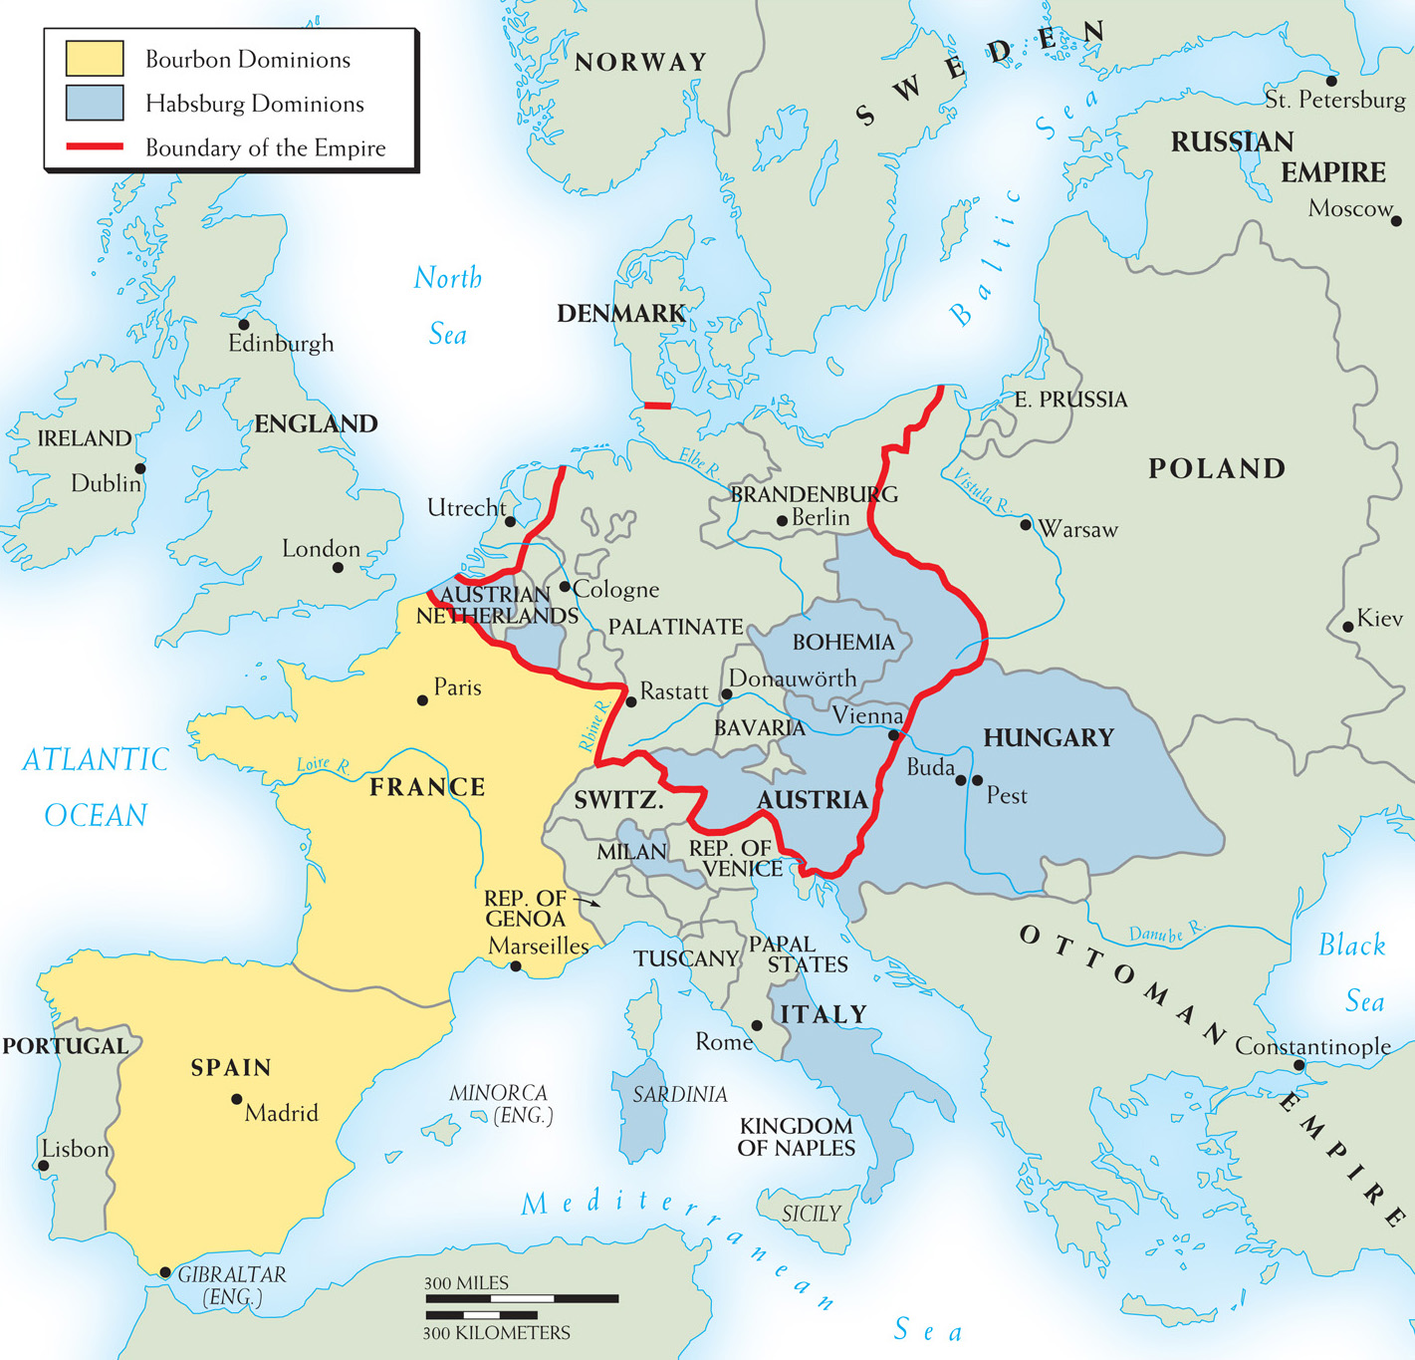
Map 13–2 EUROPE IN 1714 The War of the Spanish Succession ended a year before the death of Louis XIV. The Bourbons had secured the Spanish throne, but Spain had forfeited its possessions in Flanders and Italy.
Notes:
Map 13–2 EUROPE IN 1714 The War of the Spanish Succession ended a year before the death of Louis XIV. The Bourbons had secured the Spanish throne, but Spain had forfeited its possessions in Flanders and Italy.

Slide 69
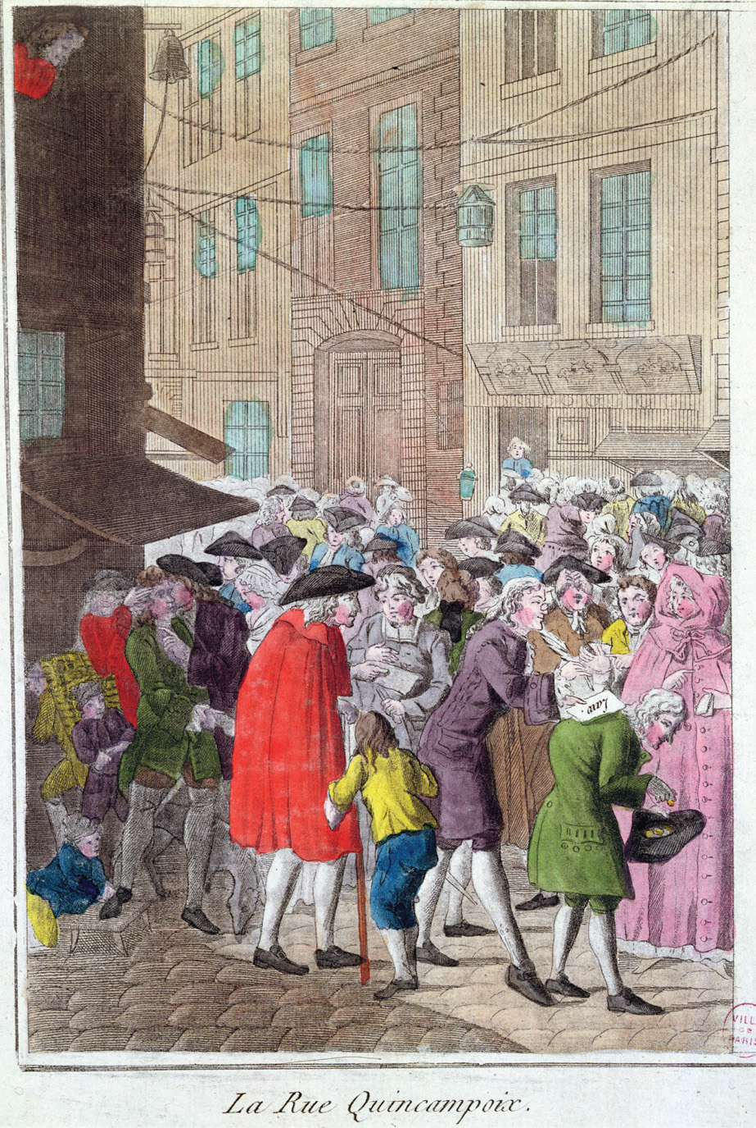
The impending collapse of John Law’s bank triggered a financial panic throughout France. Desperate investors sought to exchange their paper currency for gold and silver before the banks’ supply of precious metals was exhausted. La Rue Quincampoix, The Law Affair, c. 1797 (coloured engraving), French School (18th century). Musee de la Ville de Paris, Musee Carnavalet, Paris, France/Archives Charmet/The Bridgeman Art Library International
Notes:
The impending collapse of John Law’s bank triggered a financial panic throughout France. Desperate investors sought to exchange their paper currency for gold and silver before the banks’ supply of precious metals was exhausted.
La Rue Quincampoix, The Law Affair, c. 1797 (coloured engraving), French School (18th century). Musee de la Ville de Paris, Musee Carnavalet, Paris, France/Archives Charmet/The Bridgeman Art Library International

Slide 70
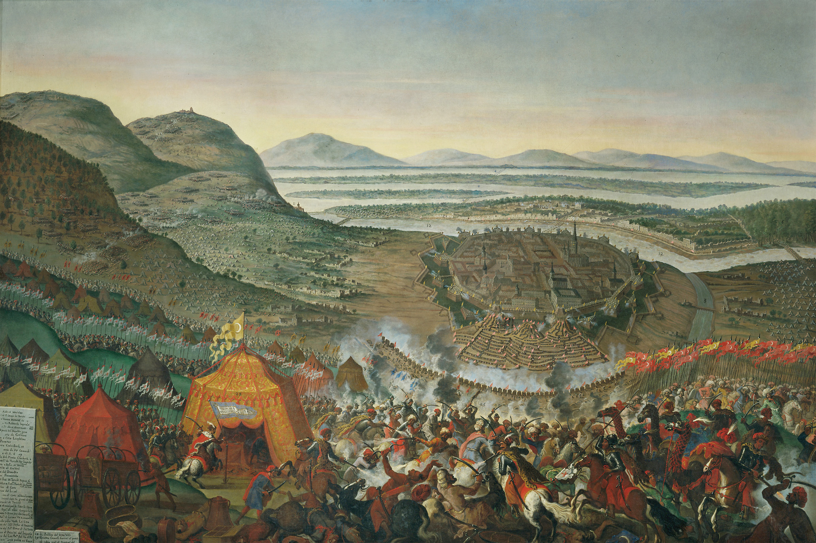
In 1683 the Ottomans laid siege to Vienna. Only the arrival of Polish forces under King John III Sobieski (r. 1674–1696) saved the Habsburg capital. Erich Lessing/Art Resource, NY
Notes:
In 1683 the Ottomans laid siege to Vienna. Only the arrival of Polish forces under King John III Sobieski (r. 1674–1696) saved the Habsburg capital.
Erich Lessing/Art Resource, NY

Slide 71
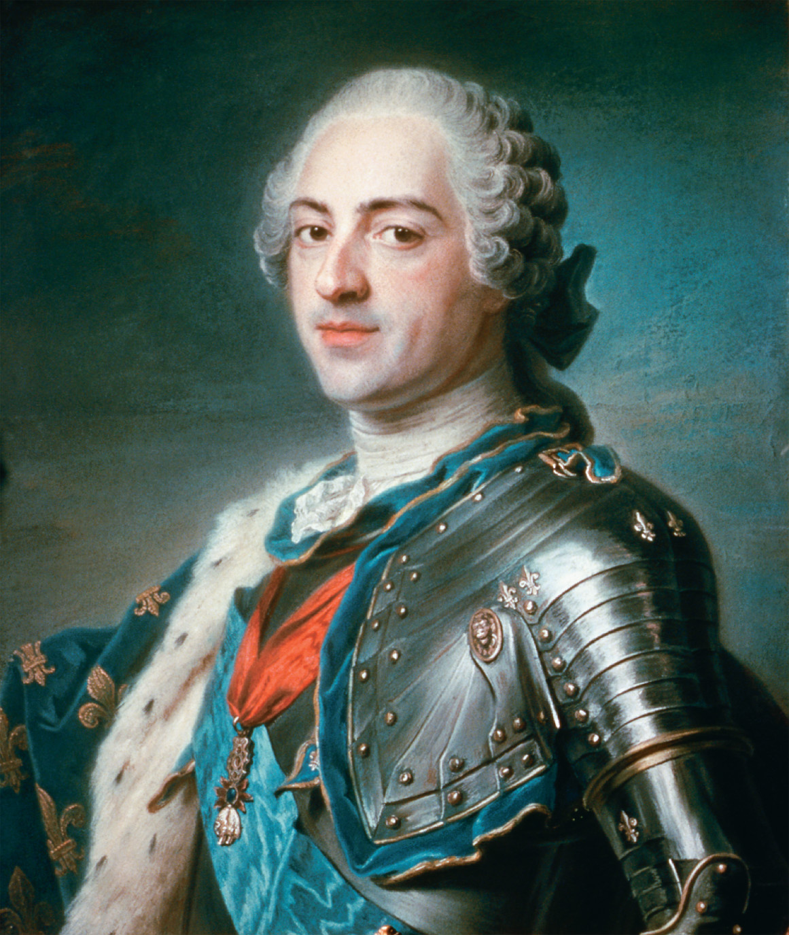
Under Louis XV (r. 1715–1774) France suffered major defeats in Europe and around the world and lost most of its North American empire. Louis himself was an ineffective ruler, and during his reign, the monarchy encountered numerous challenges from the French aristocracy. CORBIS/Bettmann
Notes:
Under Louis XV (r. 1715–1774) France suffered major defeats in Europe and around the world and lost most of its North American empire. Louis himself was an ineffective ruler, and during his reign, the monarchy encountered numerous challenges from the French aristocracy.
CORBIS/Bettmann

Slide 72
Poland with No Central Authority
Failure to maintain competitive political position
Most Polish monarchs were foreigners and tools for foreign powers
King John III Sobieski - led army to rescue Vienna from Turkish invaders
central legislative body called the Sejm or diet, but no real power as any single veto, liberum veto, could stop a Sejm
Opposition work of group of dissatisfied nobles
Poland disappears from map in 18th century as a result

Slide 73
The Hapsburg Empire and the Pragmatic Sanction
Hapsburgs one of oldest dynasties in Europe
as early as 1400s, most of Holy Roman emperors were Hapsburgs
suffered setbacks after Thirty Years’ War and ending of Hapsburg line in Spain

Slide 74
The Hapsburg Empire and the Pragmatic Sanction
Successfully reaffirmed power over Austria, Bohemia, & Hungary
Treaty of Utrecht - gave Hapsburgs control of Naples, Sardinia, & Milan in Italy & Spanish Netherlands
embraced large # of ethnic groups unified by Catholic faith & loyalty to Hapsburg dynasty

Slide 75
The Hapsburg Empire and the Pragmatic Sanction
Hapsburgs held onto the title of Holy Roman Emperor, but the title depended on help from many other German states and principalities
Their territories, some outside of Germany, were so geographically and culturally diverse that there was no real central government

Slide 76
The Hapsburg Empire and the Pragmatic Sanction (cont.)
Despite internal difficulties, the empire increases under Leopold I, Joseph I, and Charles VI
Pragmatic Sanction – Charles VI’s legal basis for a single line of inheritance within the Hapsburg dynasty, putting his daughter Maria Theresa in charge (no male heir)

Slide 77
The Hapsburg Empire and the Pragmatic Sanction (cont.)
stated all territories of Hapsburg empire were indivisible
Maria heir to the throne & inherits all Hapsburg lands but leaves her no strong army or full treasury
England & others refused to agree to Pragmatic Sanction w/out other concessions
Frederick II of Prussia invades Hapsburg Empire and puts Maria at risk in 1740

Slide 78
Hohenzollerns of Prussia
Brandenburg small state located btwn Oder & ELbe R w/ center in Berlin
ruler was one of seven princes who elected HR emperor
Hohenzollern family became hereditary rulers of Brandenburg in 1417

Slide 79
Hohenzollerns of Prussia
In early 17th century - Hohenzollerns inherited Cleves & neighboring lands on Rhine R & duchy of Prussia on Baltic coast to the northeast
Diverse & geographically separated Hohenzollern possesions had no natural boundaries, few resources, & a population of 1.5 million

Slide 80
Hohenzollerns of Prussia
Scattered & weak but Hohenzollern possessions were 2nd largest block of territory in the HRE
Only Hapsburgs could claim more land
Known as Great Elector, Frederick William forged Hohenzollern territories into a strong power
Broke local noble estates
organized royal bureaucracy
built a strong army

Slide 81
Hohenzollerns of Prussia
recognized well-equipped army would protect his territories & enable him to play a role in balance of power politics
Frederick William demanded & received loyalty of the Junkers - German landowners
In return, Junkers received full power over the serfs who labored on their estates
Junkers & officer corps became most prestigious class

Slide 82
Prussia under the Hohenzollern Family (cont.)
Frederick William’s successors
His son, William I, helps Hapsburgs in War of Spanish Succession and becomes King of Prussia
Frederick William I – most successful Prussian leader – made the strongest army in Europe the symbol of power and unity, while staying out of war
Frederick II or Great – did not have wisdom of his father and invaded Silesia, starting long Austrian-Prussian rivalry

Slide 83
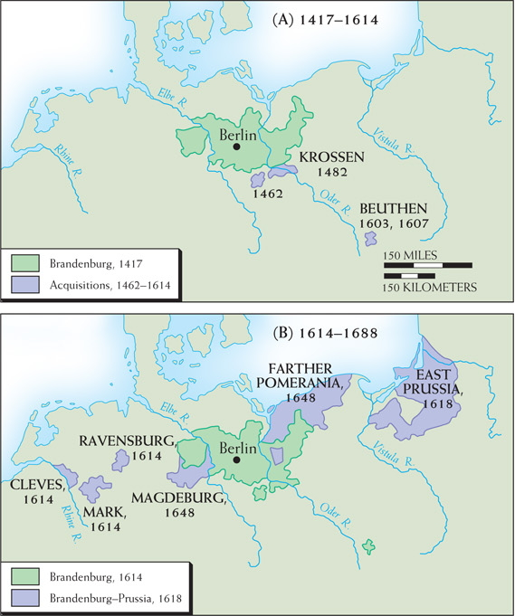
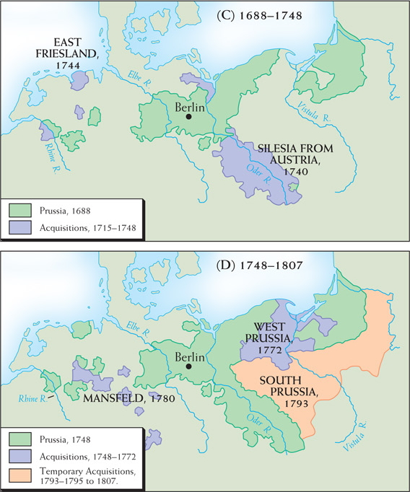
Map 13–4 EXPANSION OF BRANDEBURG-PRUSSIA In the 17th century Brandenburg-Prussia expanded mainly by acquiring dynastic titles in geographically separated lands. In the 18th century it expanded through aggression to the east, seizing Silesia in 1740 and various parts of Poland in 1772, 1793, and 1795.
Notes:
Map 13–4 EXPANSION OF BRANDEBURG-PRUSSIA In the 17th century Brandenburg-Prussia expanded mainly by acquiring dynastic titles in geographically separated lands. In the 18th century it expanded through aggression to the east, seizing Silesia in 1740 and various parts of Poland in 1772, 1793, and 1795.

Slide 84
Russia – The Romanov Dynasty
Russia geographically isolated
Sweden prevented Russia from reaching Baltic Sea while Ottoman Empire prevented Russia from reaching the Black Sea
Culturally isolated as well
scarcely affected by Renaissance, Reformation, Age of Exploration & Scientific Revolution

Slide 85
Russia – The Romanov Dynasty
Following death of Ivan the Terrible in 1584, Russia experienced weakness & chaos known as Time of Troubles
Hoping to restore orde, assembly of nobles elected young Michael Romanov to be next czar
He & his two successors, Aleksei and Theodore II, brought stability and modest bureaucratic centralization to Russia

Slide 86
Russia – Modernization
Visited Holland & England & toured shipyards, examined new military equipment, & observed western customs
recognized Russia not competitive w/ western Europe
returned to Russia determined to transform Russia into great power
1st began by expanding army & building new navy

Slide 87
Russia – Modernization
Improved Russian agriculture by introducing potato
Strengthened economy by importing skilled workers
Liberated Russian women by allowing them to be in public w/out veils

Slide 88
Peter the Great – The Boyars
Came to power at age ten and believed that the power of the tsar must be secure from the jealousy and greed of the boyars, the old nobility, and the streltsy, the guards of the Moscow garrison
publicly executed rebellious streltsy & corpses stayed on public display
repressed and humiliated the boyars by forcing nobles to shave off their traditional long beards

Slide 89
Peter the Great – Early Years (cont.)
Built a navy on the Baltic Sea and went to war with the Ottomans
Captured Azov on the Black Sea in 1696
The Great Northern War – 21 years - Peter defeats the Swedes at the Battle of Poltava
Peace of Nystad - Takes control of Estonia, Livonia, parts of Finland

Slide 90
Peter the Great – Early Years (cont.)
St. Petersburg – built a capital in honor of himself with places forcibly built by the boyars that resembled small versions of Versailles
Peter’s son, Aleksei, with Charles VI of Hapsburg, attempts a conspiracy against Peter and is sentenced to death; dies in prison under mysterious circumstances

Slide 91
Peter the Great – Later Years
Peter realized he was faced with a lot of opposition, so he brings the nobility and the Russian Orthodox Church closer to the tsar
Table of Ranks – made a person’s social position and privileges more important than lineage

Slide 92
Peter the Great – Later Years (cont.)
Abolishes the patriarch and puts in its place the Holy Synod, which consisted of several bishops headed by a layman called the procurator general
1725 – Peter dies and leaves no successor as Russia becomes unstable

Slide 93
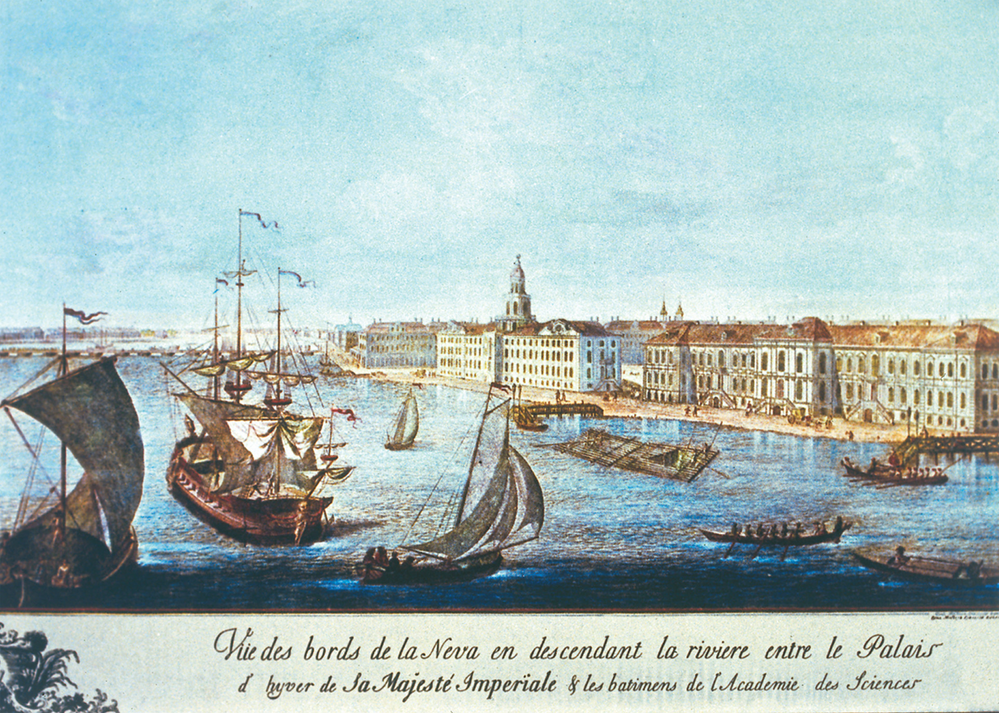
Peter the Great built St. Petersburg on the Gulf of Finland to provide Russia with better contact with western Europe. He moved Russia’s capital there from Moscow in 1712. This is an eighteenth-century view of the city. The Granger Collection
Notes:
Peter the Great built St. Petersburg on the Gulf of Finland to provide Russia with better contact with western Europe. He moved Russia’s capital there from Moscow in 1712. This is an eighteenth-century view of the city.
The Granger Collection

Slide 94
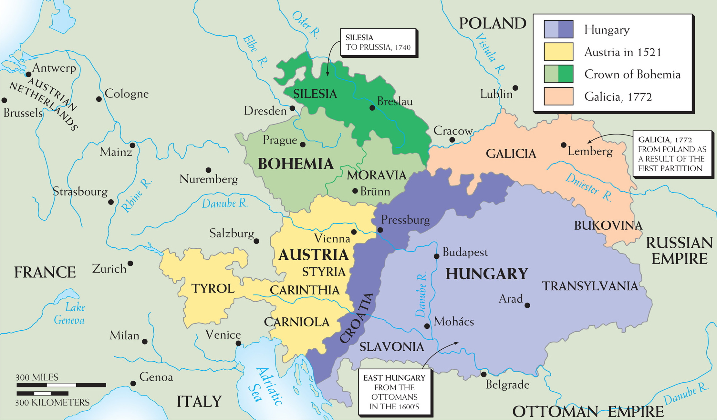
Map 13–3 THE AUSTRIAN HABSBURG EMPIRE, 1521–1772 The empire had three main units—Austria, Bohemia, and Hungary. Expansion was mainly eastward: eastern Hungary from the Ottomans (17th century) and Galicia from Poland (1772). Meantime, Silesia was lost after 1740, but the Habsburgs remained Holy Roman Emperors.
Notes:
Map 13–3 THE AUSTRIAN HABSBURG EMPIRE, 1521–1772 The empire had three main units—Austria, Bohemia, and Hungary. Expansion was mainly eastward: eastern Hungary from the Ottomans (17th century) and Galicia from Poland (1772). Meantime, Silesia was lost after 1740, but the Habsburgs remained Holy Roman Emperors.

