Slide 1
Chapter 14
New Directions in Thought and Culture
in the Sixteenth and Seventeenth Centuries

Slide 2
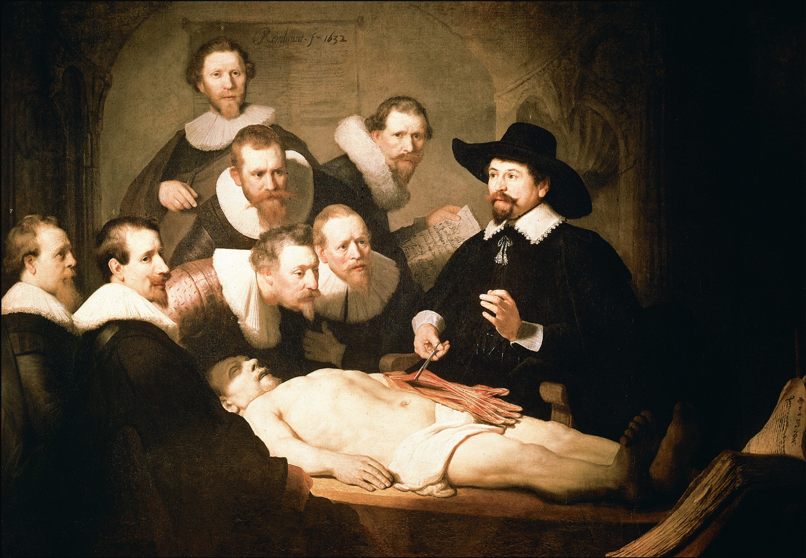
The great Dutch artist Rembrandt van Rijn (1606–1669) recorded the contemporary life of the United Provinces of the Netherlands during its golden age. The new sciences, including medicine, made much progress in the Netherlands, which was a center for publishing and instrument making and known for its religious toleration. The Anatomy Lesson of Dr. Tulp (1632) presents the dissection of a cadaver of an executed criminal by noted Dutch physician Dr. Nicolass Tulp, who stands on the right surrounded by other members of the Amsterdam guild of surgeons. Such dissections were a controversial part of new emerging medical education, with only one a year permitted in Amsterdam. The dramatic use of light and darkness is characteristic of the painting of the baroque style. Rembrandt van Rijn (1606–1669). The Anatomy Lesson of Dr. Tulp. Mauritshuis, The Hague, The Netherlands. SCALA/Art Resource, NY
Notes:
The great Dutch artist Rembrandt van Rijn (1606–1669) recorded the contemporary life of the United Provinces of the Netherlands during its golden age. The new sciences, including medicine, made much progress in the Netherlands, which was a center for publishing and instrument making and known for its religious toleration. The Anatomy Lesson of Dr. Tulp (1632) presents the dissection of a cadaver of an executed criminal by noted Dutch physician Dr. Nicolass Tulp, who stands on the right surrounded by other members of the Amsterdam guild of surgeons. Such dissections were a controversial part of new emerging medical education, with only one a year permitted in Amsterdam. The dramatic use of light and darkness is characteristic of the painting of the baroque style.
Rembrandt van Rijn (1606–1669). The Anatomy Lesson of Dr. Tulp. Mauritshuis, The Hague, The Netherlands. SCALA/Art Resource, NY

Slide 3
The Scientific Revolution
Science: called “natural philosophy”; “new science”
Scientist: term not coined until 1830s
Challenged Scholasticism, Aristotelianism

Slide 4
Nicolaus Copernicus (1473–1543)
Polish priest & astronomer
On the Revolutions of the Heavenly Spheres (1543)
Heliocentric versus geocentric view of the solar system
Challenged Ptolemaic/Aristotelian models in use since antiquity
Copernican system no more accurate than Ptolemaic but important as a new paradigm—slow to gain ground

Slide 5
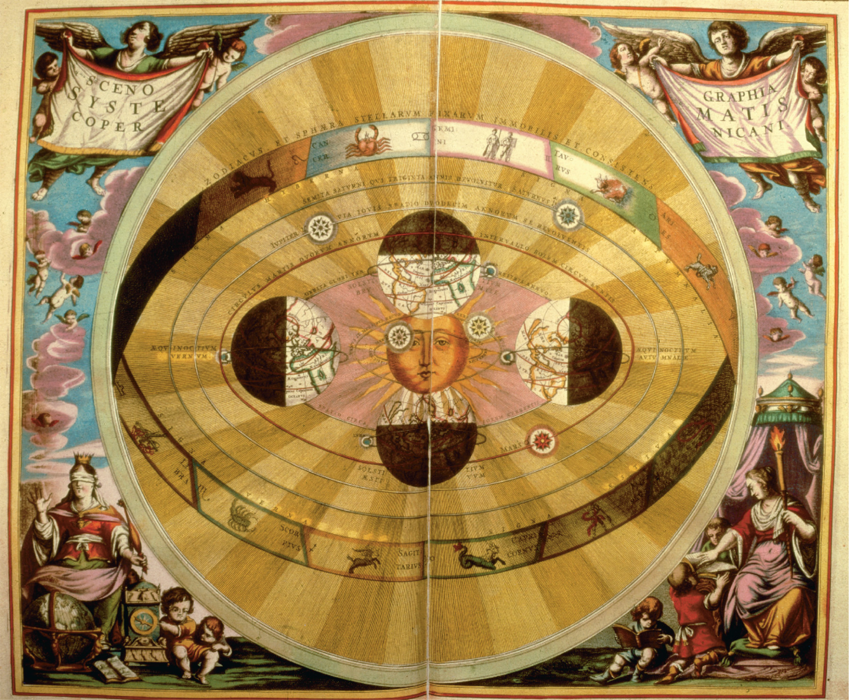
This 1543 map of the heavens based on the writings of Nicholas Copernicus shows the earth and the other planets moving about the sun. Until well into the 1600s, however, astronomers continued to debate whether the sun revolved around the earth. British Library, London, UK/British Library Board. All Rights Reserved/The Bridgeman Art Library
Notes:
This 1543 map of the heavens based on the writings of Nicholas Copernicus shows the earth and the other planets moving about the sun. Until well into the 1600s, however, astronomers continued to debate whether the sun revolved around the earth.
British Library, London, UK/British Library Board. All Rights Reserved/The Bridgeman Art Library

Slide 6
Tycho Brahe (1546–1601)
Danish astronomer
Rejected Copernican view
Recorded vast body of astronomical data drawn on by Kepler

Slide 7
Johannes Kepler (1571–1630)
German astronomer, Brahe’s assistant
Advocated Copernican view
Figured out planets move in elliptical, not circular, orbits

Slide 8
Galileo Galilei (1564–1642)
Italian mathematician & natural philosopher
Broke ground using telescope—found heavens much more complex than previously understood
Became high-profile Copernican advocate
Articulated concept of a universe governed by mathematical laws

Slide 9
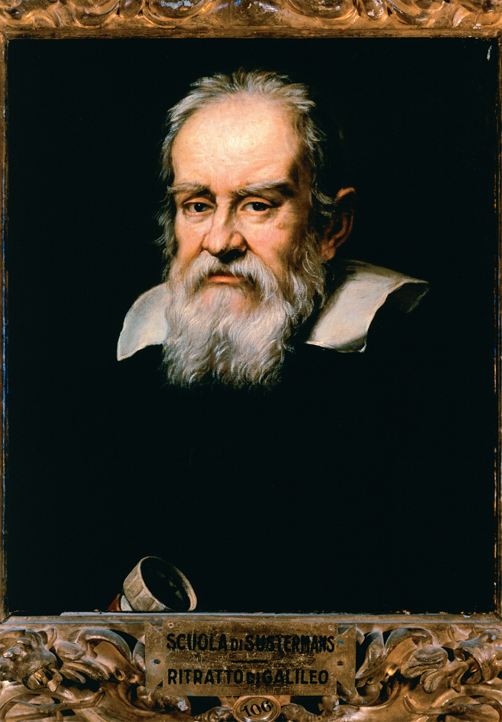
Galileo Galilei achieved a Europeanwide reputation as a mathematician, instrument maker, and astronomer. His use of the telescope revealed sights of objects in the heavens never previously viewed by human beings. His writings in defense of the Copernican system became increasingly controversial and eventually led to his condemnation by Roman Catholic authorities. Justus Sustermans (1597–1681), “Portrait of Galileo Galilei.” Galleria Palatina, Palazzo Pitti, Florence, Italy. Nimatallah/Art Resource, NY
Notes:
Galileo Galilei achieved a Europeanwide reputation as a mathematician, instrument maker, and astronomer. His use of the telescope revealed sights of objects in the heavens never previously viewed by human beings. His writings in defense of the Copernican system became increasingly controversial and eventually led to his condemnation by Roman Catholic authorities.
Justus Sustermans (1597–1681), “Portrait of Galileo Galilei.” Galleria Palatina, Palazzo Pitti, Florence, Italy. Nimatallah/Art Resource, NY

Slide 10
Isaac Newton (1642–1727)
Discovered laws of gravity—all physical objects in the universe move through mutual attraction (gravity); explained planetary orbits
Explained gravity mathematically
Principia Mathematica (1687)

Slide 11
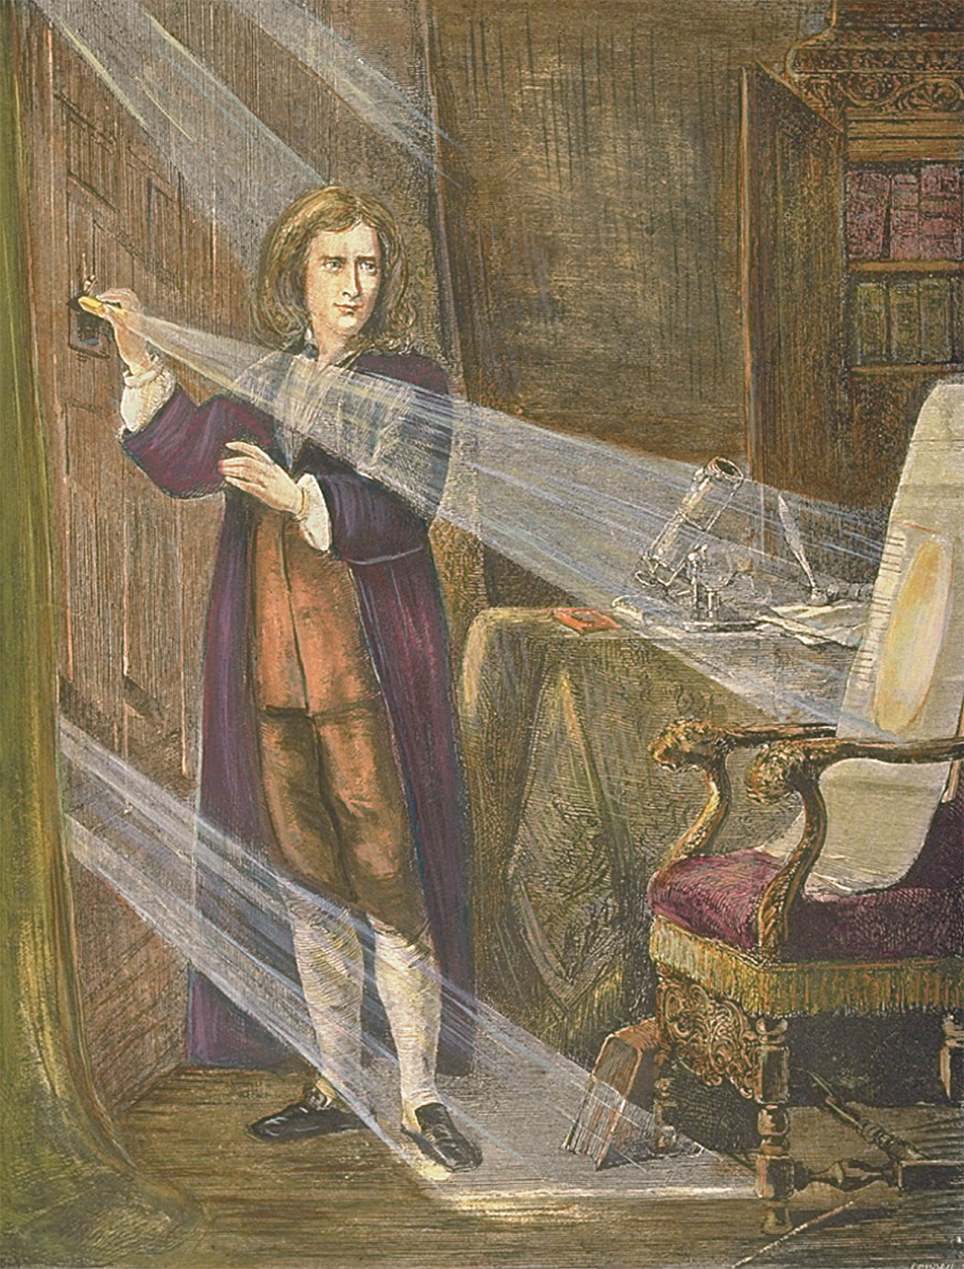
Sir Isaac Newton’s experiments dealing with light passing through a prism became a model for writers praising the experimental method. CORBIS/Bettmann
Notes:
Sir Isaac Newton’s experiments dealing with light passing through a prism became a model for writers praising the experimental method.
CORBIS/Bettmann

Slide 12
Philosophy Responds to Science
Scientific revolution ➔ major reexamination of Western philosophy
Nature as mechanism—clock metaphor; God as clockmaker
Purpose of studying nature changes:
Search for symbolic/sacramental meaning ➔ search for usefulness/utility
Path to salvation ➔ path to human physical improvement

Slide 13
Francis Bacon (1561–1626)
English lawyer, government official, historian, essayist
Considered father of empiricism, scientific experimentation
Real accomplishment was setting an intellectual tone conducive to scientific inquiry

Slide 14
Francis Bacon (1561–1626) (cont.)
Attacked scholastic adherence to intellectual authorities of the past
One of the first European writers to champion innovation and change as goals contributing to human improvement

Slide 15
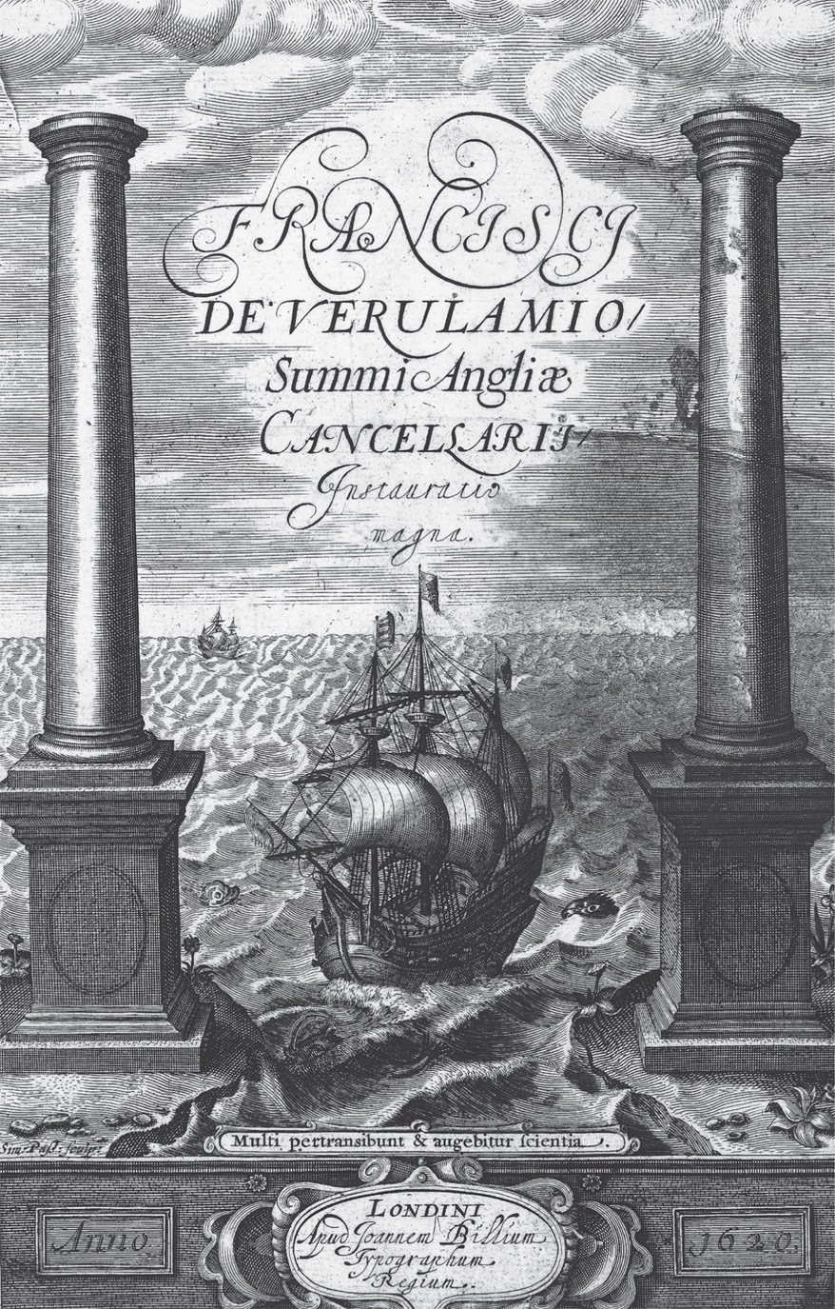
Published in 1620, Novum Organum (“new organ or instrument”) by Francis Bacon is one of the most important works of the scientific revolution. In this and other works Bacon attacked the long-held belief that most truth had already been discovered. This allegorical image, from the frontispiece of Novum Organum, shows a ship striking out for unknown territories, seeking, as did Bacon, for a new understanding of the natural world. The ship is flanked by the mythical pillars of Hercules that stand at the point where the Mediterranean meets the Atlantic— the realm of the unknown and unexplored. Courtesy of the Library of Congress
Notes:
Published in 1620, Novum Organum (“new organ or instrument”) by Francis Bacon is one of the most important works of the scientific revolution. In this and other works Bacon attacked the long-held belief that most truth had already been discovered. This allegorical image, from the frontispiece of Novum Organum, shows a ship striking out for unknown territories, seeking, as did Bacon, for a new understanding of the natural world. The ship is flanked by the mythical pillars of Hercules that stand at the point where the Mediterranean meets the Atlantic— the realm of the unknown and unexplored.
Courtesy of the Library of Congress

Slide 16
René Descartes (1596–1650)
Gifted mathematician, inventor of analytic geometry
Most important contribution: scientific method relying more on deduction (deriving specific facts from general principles) than empiricism
Discourse on Method (1637)—rejection of scholastic philosophy and education in favor of mathematical models; rejection of all intellectual authority except his own reason
Concluded (God-given) human reason was sufficient to comprehend the world
Divided world into two categories: mind (thinking) & body (extension)

Slide 17
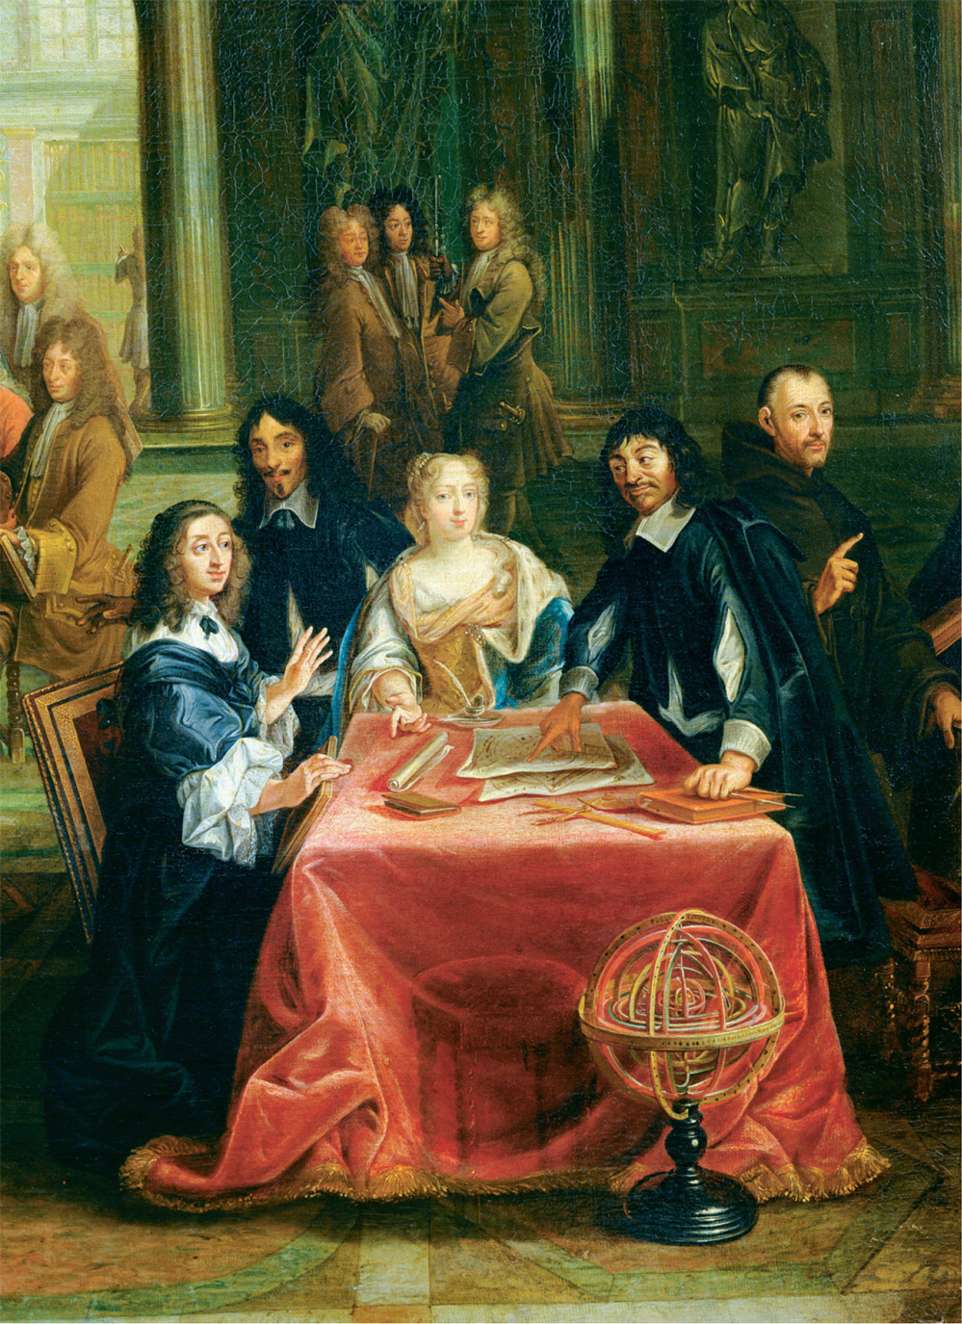
Queen Christina of Sweden (r. 1632–1654), shown here with French philosopher and scientist René Descartes, was one of many women from the elite classes interested in the new science. In 1649 she invited Descartes to live at her court in Stockholm, but he died a few months after moving to Sweden. Pierre-Louis the Younger Dumesnil (1698–1781), Christina of Sweden (1626–89) and her Court: Detail of the Queen and René Descartes (1596–1650) at the Table. Oil on canvas. Chateau de Versailles, France/Bridgeman Art Library
Notes:
Queen Christina of Sweden (r. 1632–1654), shown here with French philosopher and scientist René Descartes, was one of many women from the elite classes interested in the new science. In 1649 she invited Descartes to live at her court in Stockholm, but he died a few months after moving to Sweden.
Pierre-Louis the Younger Dumesnil (1698–1781), Christina of Sweden (1626–89) and her Court: Detail of the Queen and René Descartes (1596–1650) at the Table. Oil on canvas. Chateau de Versailles, France/Bridgeman Art Library

Slide 18
Thomas Hobbes (1588–1679)
Most original political philosopher of 17th c.
Enthusiastic supporter of New Science
Turmoil of English Civil War motivated his Leviathan (1651)
Leviathan: rigorous philosophical justification for absolutist government

Slide 19
Thomas Hobbes (1588–1679) (cont.)
Humans not basically social, but basically self-centered
State of nature is a state of war; life in this state is “solitary, poor, nasty, brutish, and short.”

Slide 20
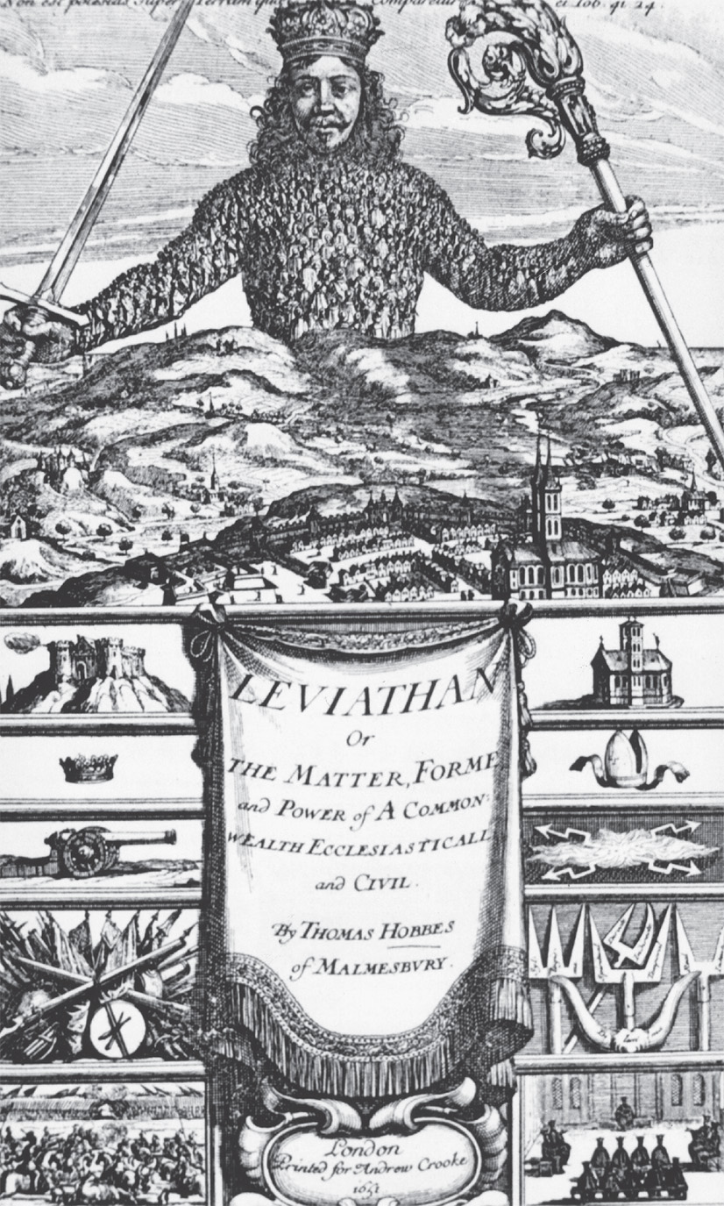
The famous title page illustration for Hobbes’s Leviathan. The ruler is pictured as absolute lord of his lands, but note that the ruler incorporates the mass of individuals whose self-interests are best served by their willing consent to accept him and cooperate with him. Courtesy of the Library of Congress
Notes:
The famous title page illustration for Hobbes’s Leviathan. The ruler is pictured as absolute lord of his lands, but note that the ruler incorporates the mass of individuals whose self-interests are best served by their willing consent to accept him and cooperate with him.
Courtesy of the Library of Congress

Slide 21
John Locke (1632–1704)
Most influential philosophical and political thinker of the 17th c.
Contrast with Hobbes
First Treatise of Government: argued against patriarchal models of government
Second Treatise of Government: government as necessarily responsible for and responsive to the governed
Humans basically creatures of reason and goodwill

Slide 22
John Locke (1632–1704) (cont.)
Letter Concerning Toleration (1689): argument for religious toleration
Essay Concerning Human Understanding (1690): described human mind at birth as a “blank slate” with content to be determined by sensory experience—reformist view, rejects Christian concept of original sin

Slide 23
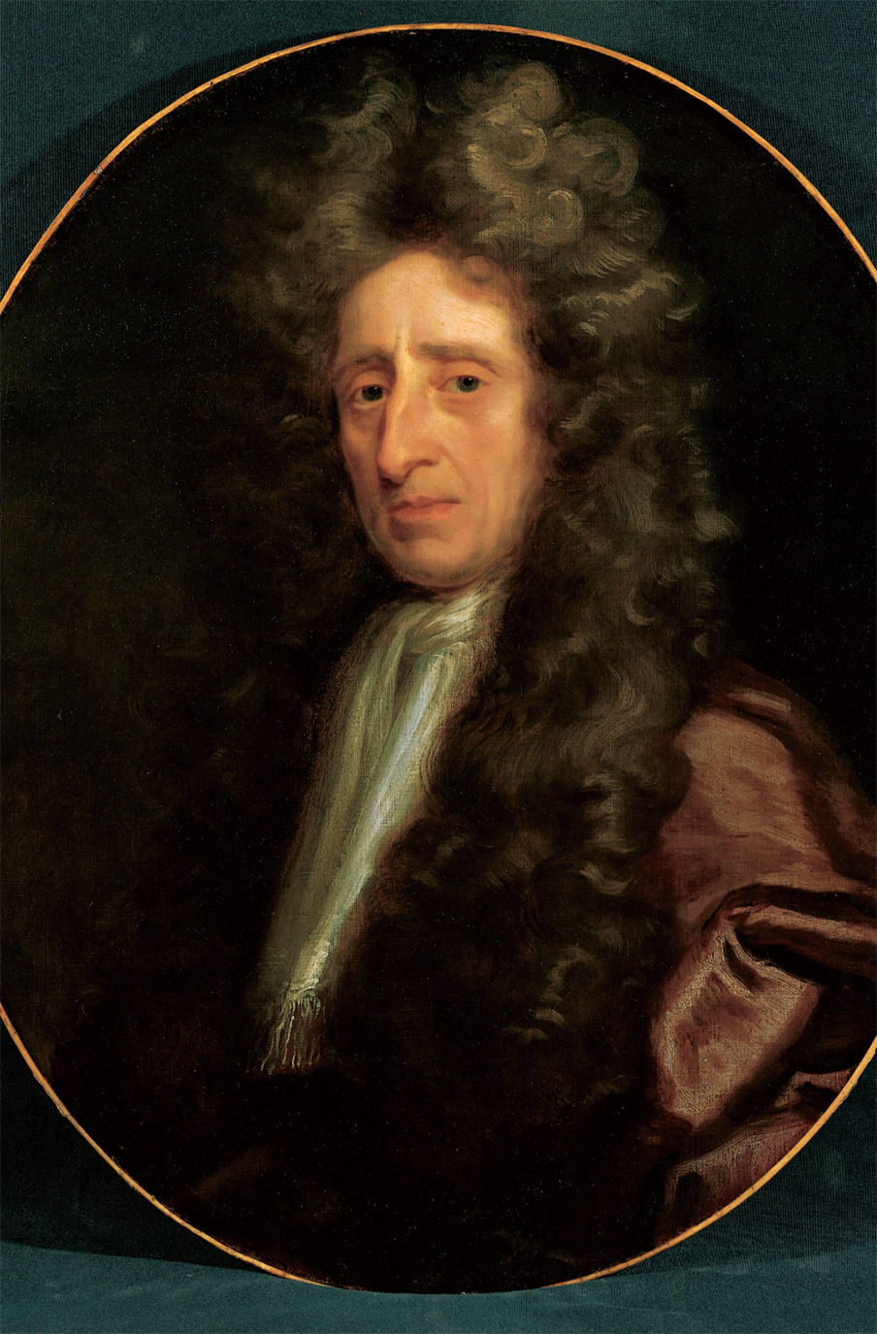
John Locke (1632–1704), defender of the rights of the people against rulers who think their power absolute. Everett Collection Inc/Alamy
Notes:
John Locke (1632–1704), defender of the rights of the people against rulers who think their power absolute. Everett Collection Inc/Alamy

Slide 24
The Rise of Academic Societies
The New Science threatened vested academic interests and was slow to gain ground in universities
Establishment of “institutions of sharing”:
Royal Society of London (1660)
Academy of Experiments (Florence, 1657)
French Academy of Science (1666)
Berlin Academy of Science (1700)

Slide 25
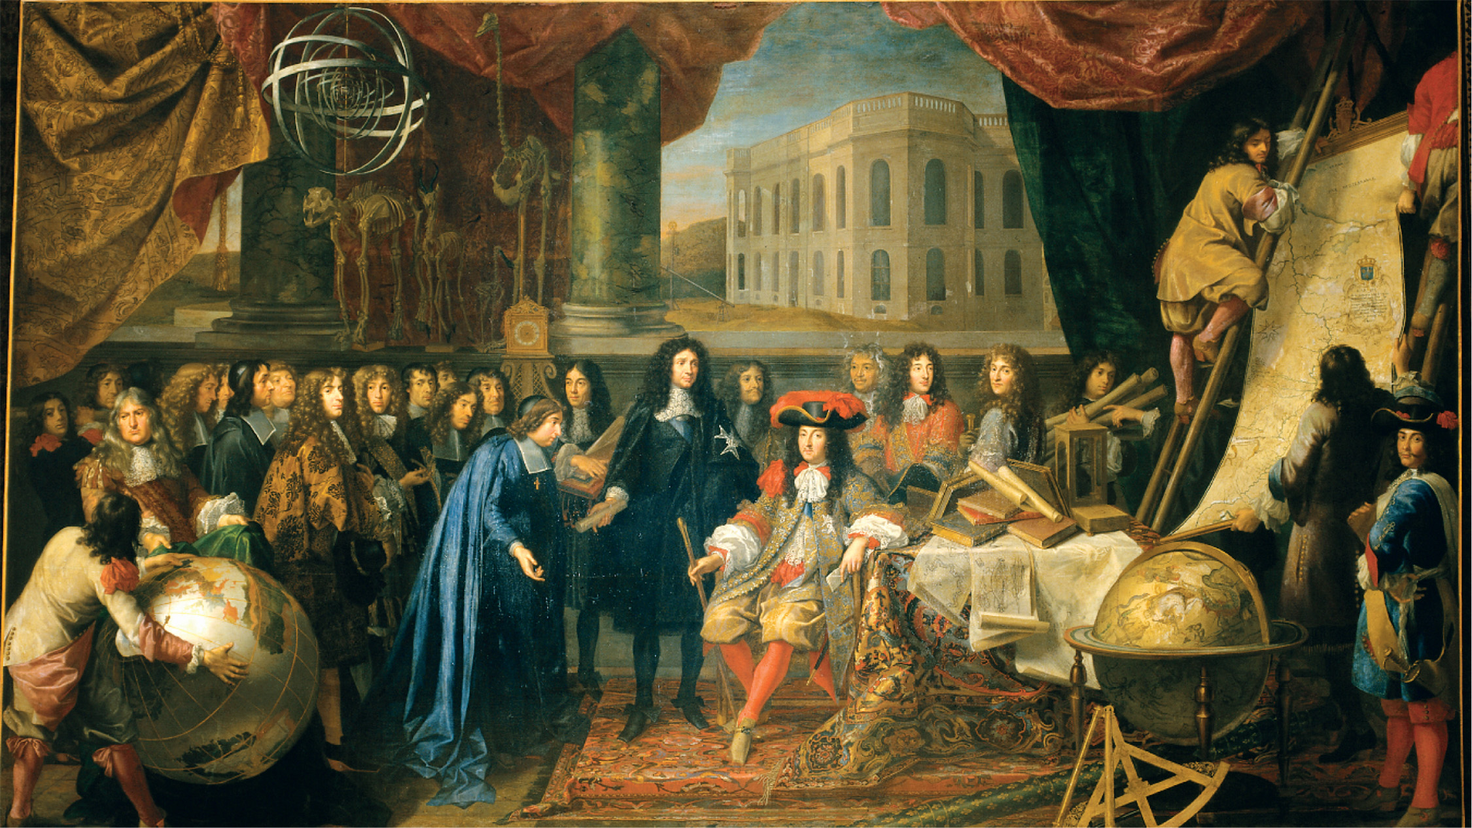
Colbert was Louis XIV’s most influential minister. He sought to expand the economic life of France and to associate the monarchy with the emerging new science from which he hoped might flow new inventions and productive technology. Here he is portrayed presenting members of the French Academy of Science to the monarch. On the founding of the French Academy. Henri Testelin (1616–1695) (after Le Brun). Minister of Finance Colbert presenting the members of the Royal Academy of Science (founded in 1667) to Louis XIV. Study for a tapestry. Photo: Gerard Blot. Chateaux de Versailles et de Trianon, Versailles, France. Reunion des Musées Nationaux/Art Resource, NY
Notes:
Colbert was Louis XIV’s most influential minister. He sought to expand the economic life of France and to associate the monarchy with the emerging new science from which he hoped might flow new inventions and productive technology. Here he is portrayed presenting members of the French Academy of Science to the monarch.
On the founding of the French Academy. Henri Testelin (1616–1695) (after Le Brun). Minister of Finance Colbert presenting the members of the Royal Academy of Science (founded in 1667) to Louis XIV. Study for a tapestry. Photo: Gerard Blot. Chateaux de Versailles et de Trianon, Versailles, France. Reunion des Musées Nationaux/Art Resource, NY

Slide 26
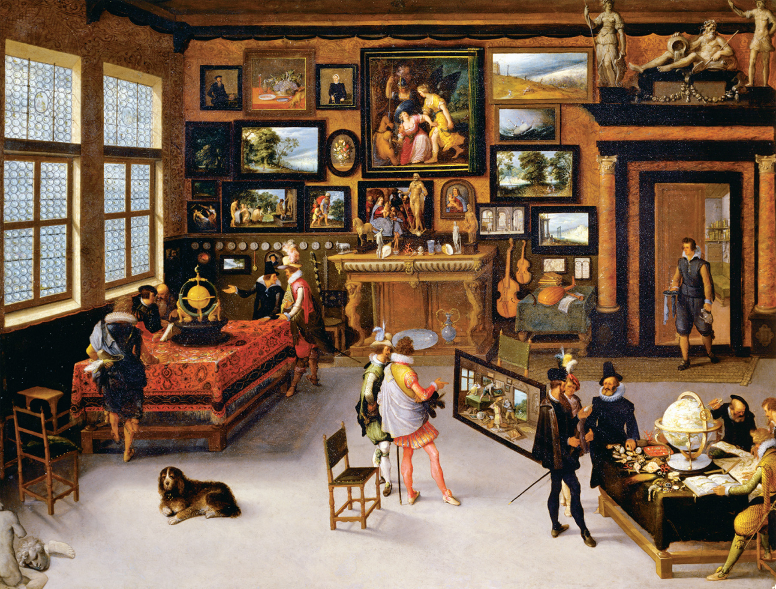
The Sciences and the Arts Painters during the seventeenth century were keenly aware that they lived in an age of expanding knowledge of nature and of the world. Adriaen van Stalbemt (1580–1662) portrayed this close interrelationship of The Sciences and the Arts. Across Europe various societies were founded to study the expanding realm of natural knowledge. As in this painting, women only were rarely admitted to the meetings of these societies or to the rooms where the new natural knowledge was pursued or discussed. Adriaen van Stalbemt (1580–1662), The Sciences and the Arts. Wood, 93 × 114 cm. Inv. 1405. Museo del Prado, Madrid, Spain. Photograph © Erich Lessing, Art Resource, NY
Notes:
The Sciences and the Arts Painters during the seventeenth century were keenly aware that they lived in an age of expanding knowledge of nature and of the world. Adriaen van Stalbemt (1580–1662) portrayed this close interrelationship of The Sciences and the Arts. Across Europe various societies were founded to study the expanding realm of natural knowledge. As in this painting, women only were rarely admitted to the meetings of these societies or to the rooms where the new natural knowledge was pursued or discussed. Adriaen van Stalbemt (1580–1662), The Sciences and the Arts. Wood, 93 × 114 cm. Inv. 1405. Museo del Prado, Madrid, Spain. Photograph © Erich Lessing, Art Resource, NY

Slide 27
Women in the Scientific Revolution
Generally excluded from the institutions of European intellectual life
Queen Christina of Sweden (r. 1623–1654): brought Descartes to Stockholm to design regulations for a new science academy

Slide 28
Women in the Scientific Revolution (cont.)
Margaret Cavendish (1623–1673)
Observations Upon Experimental Philosophy (1666)
Grounds of Natural Philosophy (1668)
Maria Winkelmann—accomplished German astronomer, excluded from Berlin Academy

Slide 29
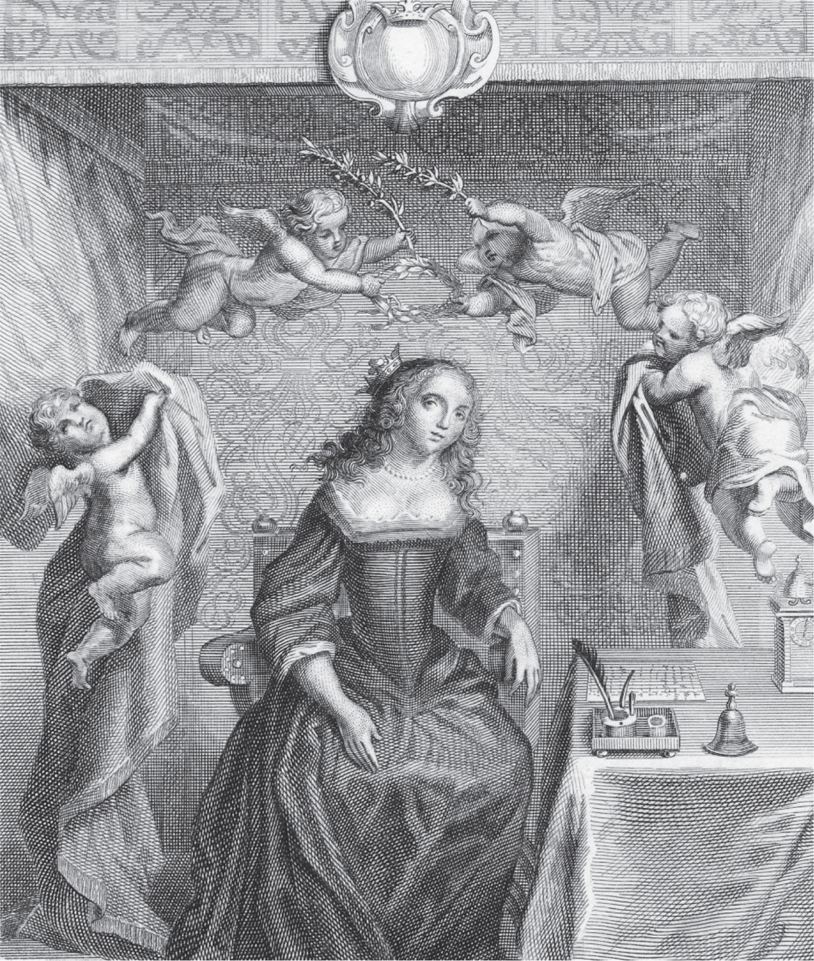
Margaret Cavendish, who wrote widely on scientific subjects, was the most accomplished woman associated with the new science in seventeenth-century England. ImageWorks/Mary Evans Picture Library Ltd.
Notes:
Margaret Cavendish, who wrote widely on scientific subjects, was the most accomplished woman associated with the new science in seventeenth-century England.
ImageWorks/Mary Evans Picture Library Ltd.

Slide 30
New Science and Religion
Three major issues:
Certain scientific theories and discoveries conflicted with Scripture
Who resolves such disputes: religious authorities or natural philosophers?
New science’s apparent replacement of spiritually significant universe with purely material one

Slide 31
New Science and Religion (cont.)
Representative incident: Roman Catholic authorities condemn Galileo, 1633—under house arrest for last nine years of his life
Catholic Inquisition places Copernicus’s On the Revolution of the Heavenly Spheres on Index of Prohibited Books, 1616

Slide 32
New Science and Religion (cont.)
Roman Catholic Church formally admits errors of biblical interpretation in Galileo’s case, 1992

Slide 33
Attempts to Reconcile Reason and Faith
Blaise Pascal (1623–1662), French mathematician
Opposed both dogmatism and skepticism
Erroneous belief in God is a safer bet than erroneous unbelief

Slide 34
Attempts to Reconcile Reason and Faith (cont.)
Francis Bacon
Two books of divine revelation: the Bible and nature
Since both books share the same author, they must be compatible
Economics: technological and economic innovation seen as part of a divine plan—man is to understand world and then put it into productive rational use

Slide 35
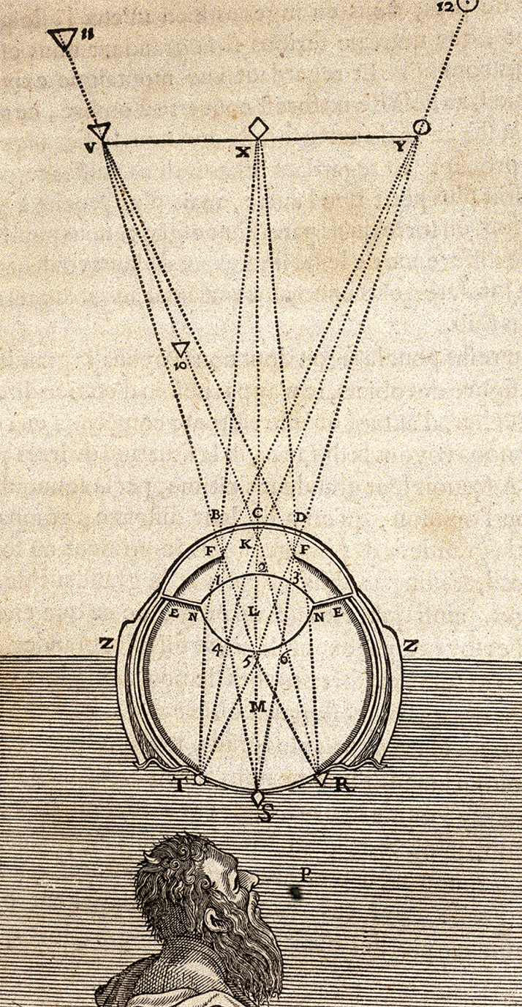
An illustration from Discourse on Method by René Descartes (1637). Courtesy of the Library of Congress
Notes:
An illustration from Discourse on Method by René Descartes (1637). Courtesy of the Library of Congress

Slide 36
English Approach to Science and Reason
Science and religion mutually supportive.
Natural universe became realm of law and regularity.
Physico-theology
John Ray, The Wisdom of God Manifested in His Works of Creation, 1690

Slide 37
Continuing Superstition
Belief in magic and the occult persisted through the end of the 17th c.
Witch hunts: 70,000–100,000 put to death, 1400–1700; 80% women
Village society: magic helped cope with natural disasters and disabilities
Christian clergy: practiced “high magic” (Eucharist, Penance, Confession, Exorcism)

Slide 38
Continuing Superstition (cont.)
Belief in magic and the occult persisted through the end of the 17th c.
Witches
80% were women
Misogyny, commonsensical reasons
Widows, midwives, and healers/herbalists targeted
Witch hunts end as science emerged and medicine advanced.

Slide 39
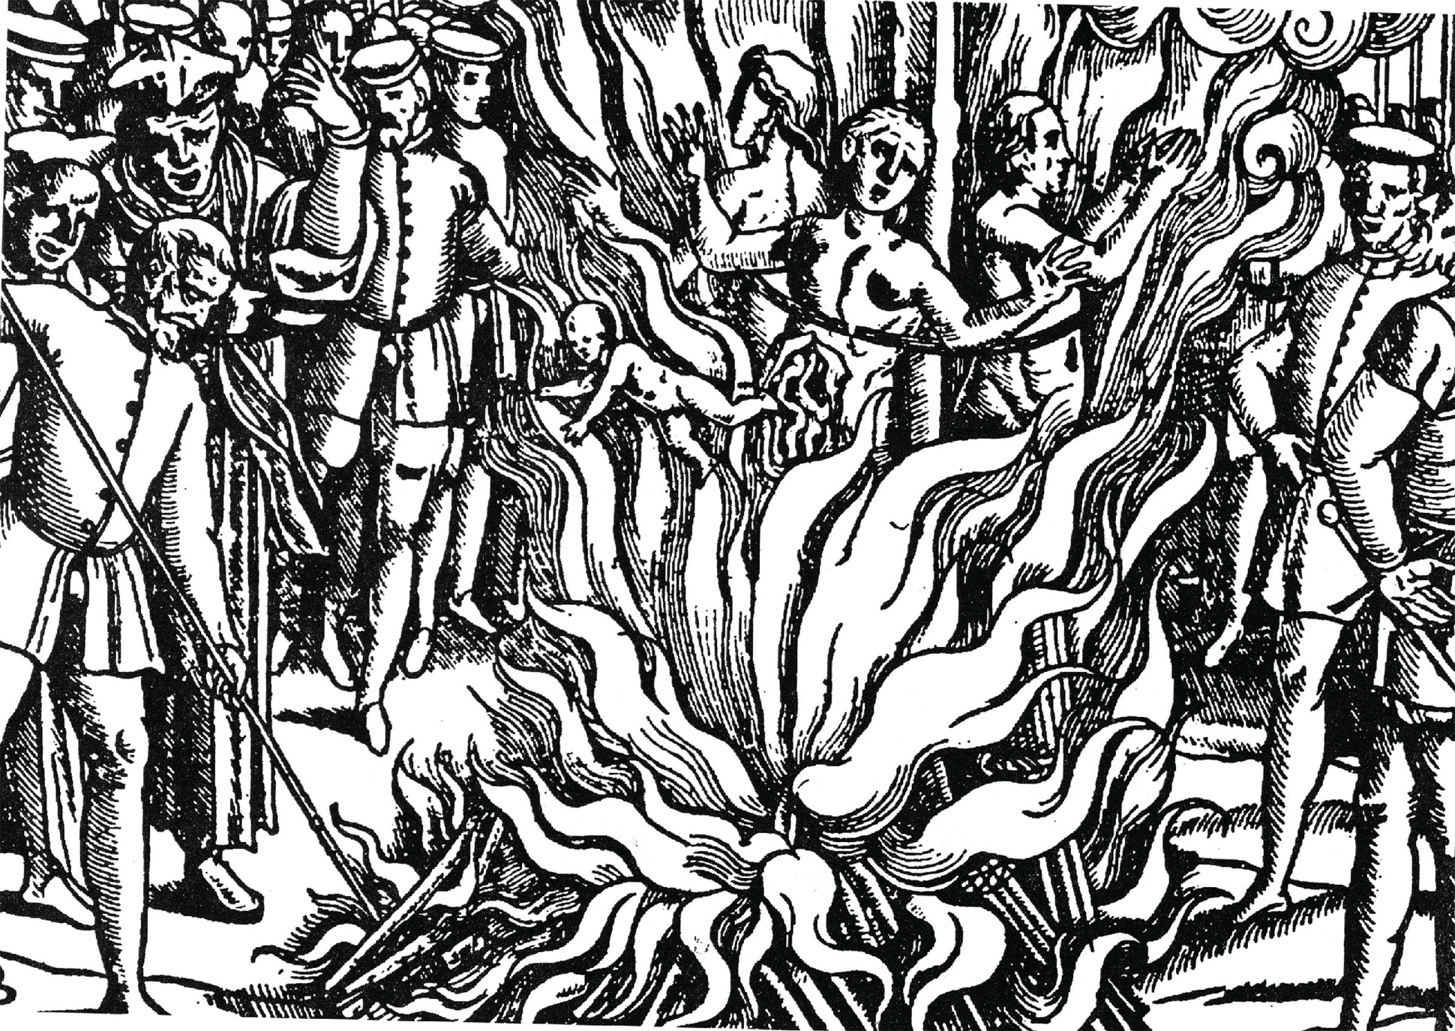
An engraving showing three women and a child being burned at the stake during the great witch trial of Schongau, 1589–1592. INTERFOTO/Alamy
Notes:
An engraving showing three women and a child being burned at the stake during the great witch trial of Schongau, 1589–1592.
INTERFOTO/Alamy

Slide 40
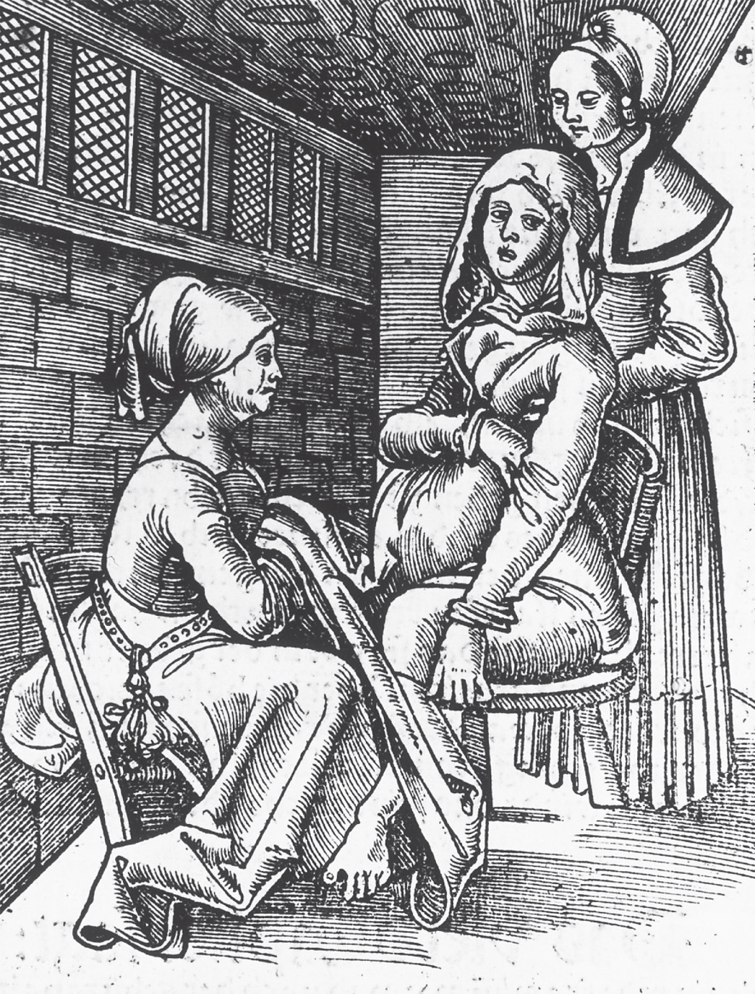
Until well into the eighteenth century, midwives oversaw the delivery of most children in Europe. CORBIS
Notes:
Until well into the eighteenth century, midwives oversaw the delivery of most children in Europe. CORBIS

Slide 41
Baroque Art
17th c. painting, sculpture, architecture
Subjects depicted in naturalistic rather than idealized manner
Michelangelo Caravaggio (1573–1610)
Portrayed scenes from the Bible and lives of saints.

Slide 42
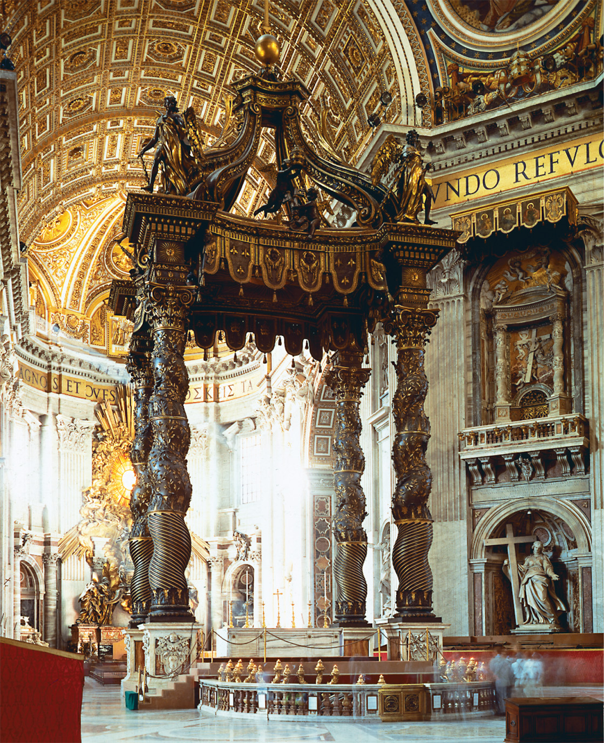
Bernini designed the elaborate Baldacchino that stands under the dome of St. Peter’s Basilica. It is one of the major examples of baroque interior decoration. Scala/Art Resource, NY
Notes:
Bernini designed the elaborate Baldacchino that stands under the dome of St. Peter’s Basilica. It is one of the major examples of baroque interior decoration.
Scala/Art Resource, NY

Slide 43
Baroque Art (cont.)
Associated with Roman Catholicism and absolutist politics.
Charles I employed Peter Paul Rubens
Was led through Ruben's design Banqueting Hall en route to his execution in 1649.
Louis XIV's palace at Versaille.

Slide 44
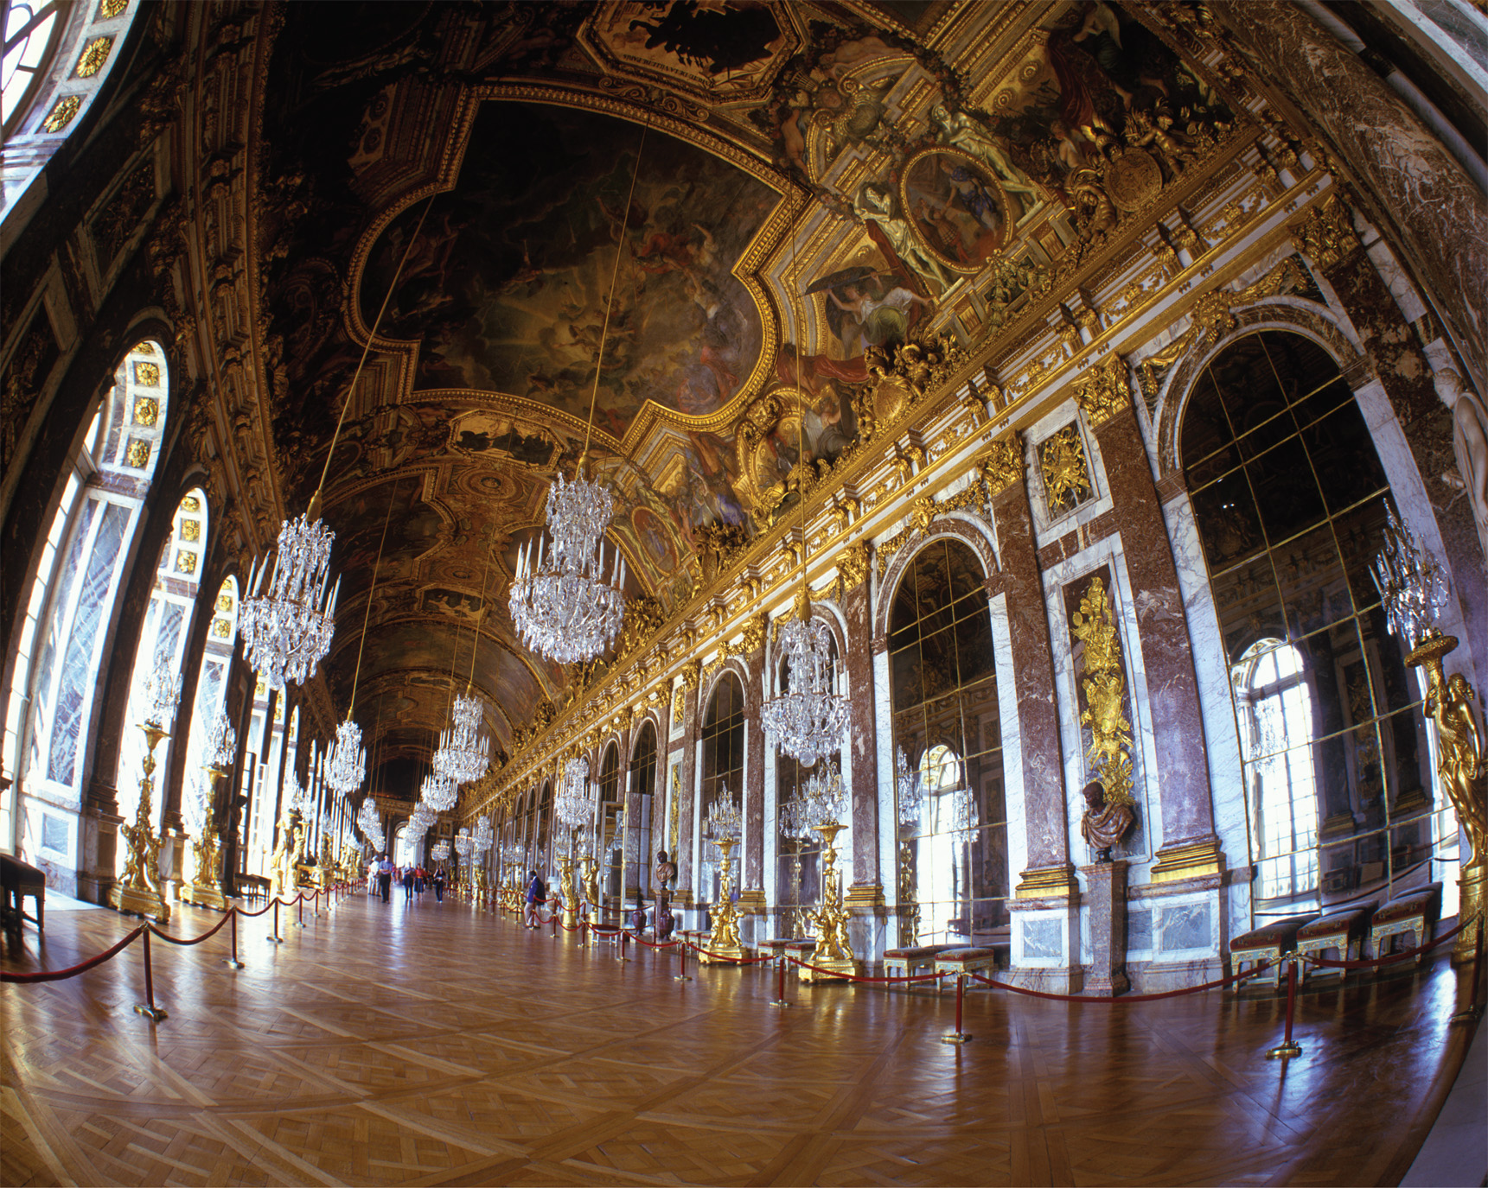
The Hall of Mirrors, palace at Versailles. © Russell Kord/Alamy
Notes:
The Hall of Mirrors, palace at Versailles. © Russell Kord/Alamy

