Slide 1
Chapter 15
Society and Economy Under
the Old Regime in the Eighteenth Century

Slide 2
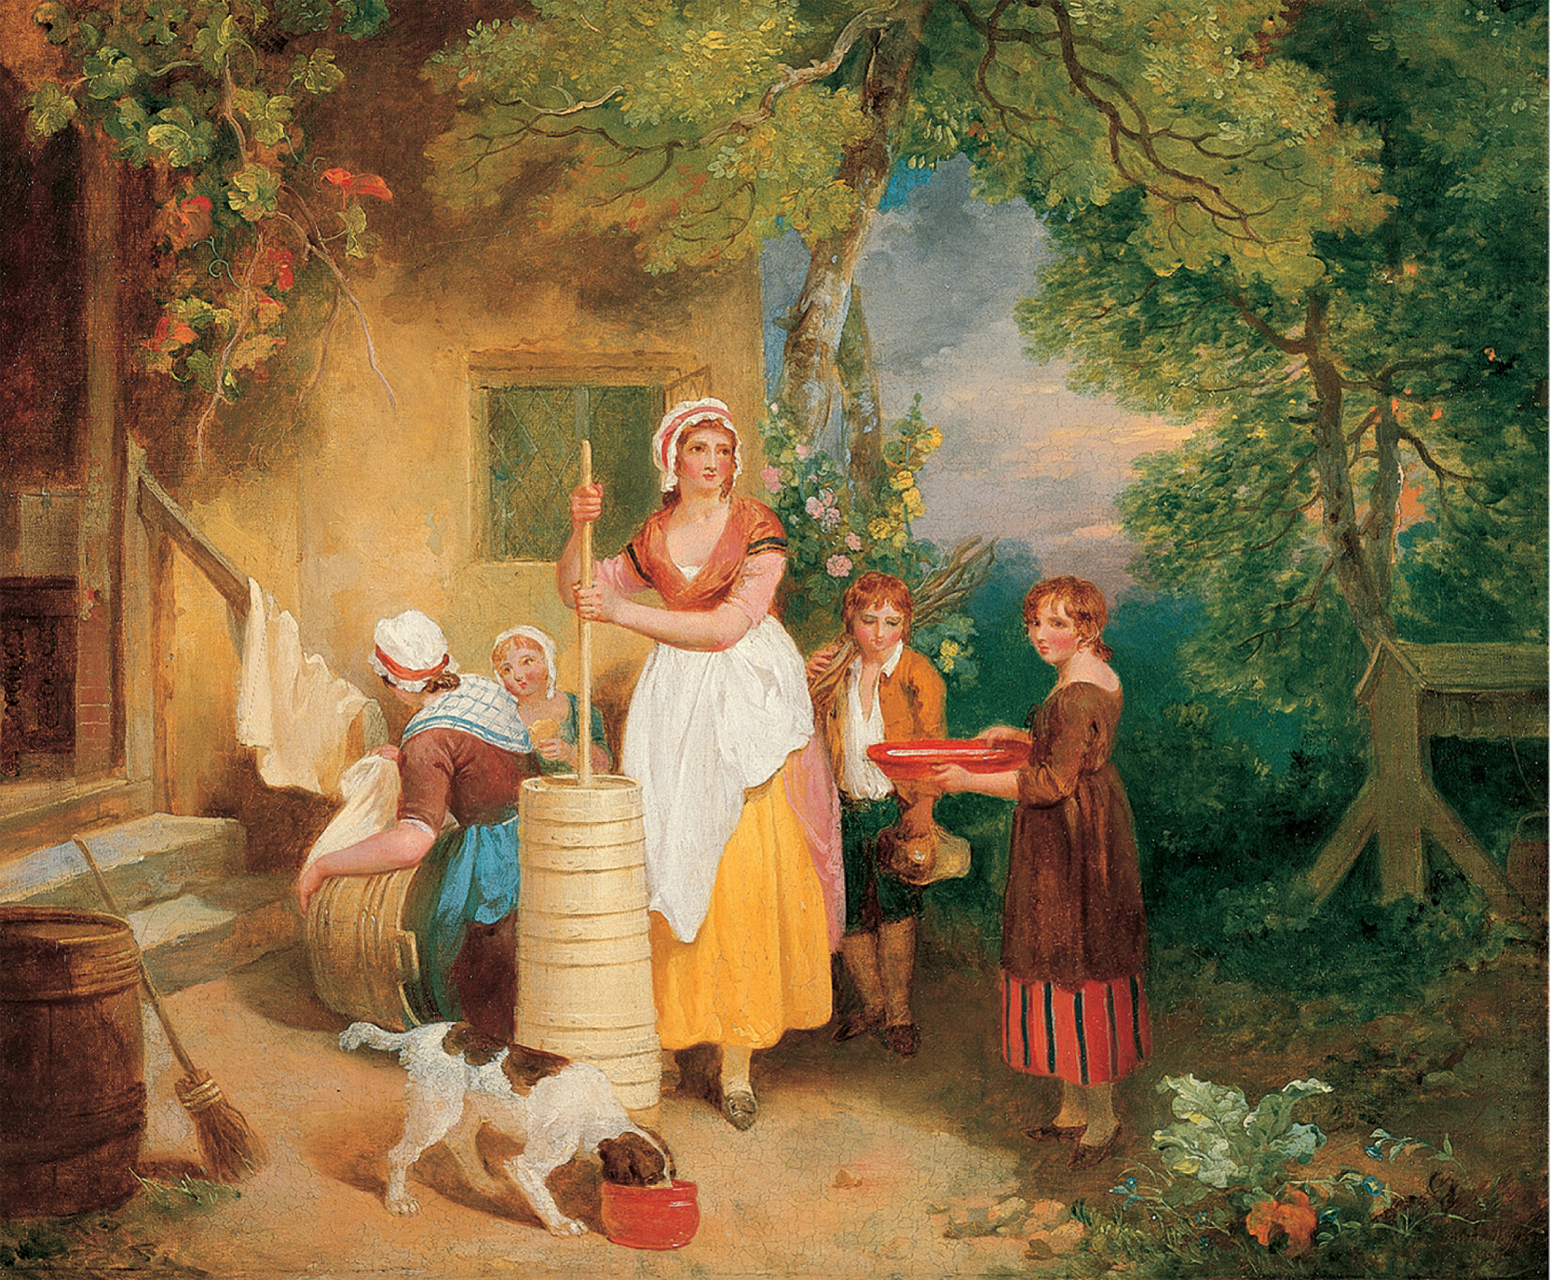
During the eighteenth century farm women normally worked in the home and performed such tasks as churning butter as well as caring for children. As time passed tasks such as making butter were mechanized and women were displaced from such work. Francis Wheatley (RA) (1747–1801) Morning, signed and dated 1799, oil on canvas, 171/2 × 211/2 in. (44.5 × 54.5 cm). Yale Center for British Art, Paul Mellon Collection, USA/ Bridgeman Art Library (B1977.14.120)
Notes:
During the eighteenth century farm women normally worked in the home and performed such tasks as churning butter as well as caring for children. As time passed tasks such as making butter were mechanized and women were displaced from such work.
Francis Wheatley (RA) (1747–1801) Morning, signed and dated 1799, oil on canvas, 171/2 × 211/2 in. (44.5 × 54.5 cm). Yale Center for British Art, Paul Mellon Collection, USA/ Bridgeman Art Library (B1977.14.120)

Slide 3
The Old Regime
Ancien régime: the patterns of social, political, and economic relationships in France before 1789; broadly, the life and institutions of pre-revolutionary Europe.

Slide 4
The Old Regime (cont.)
Hierarchical society characterized by:
Aristocratic elites with inherited legal privileges;
Established churches closely associated with the state and the aristocracy;
Urban labor force usually organized into guilds;
Rural peasantry subject to high taxes and feudal dues.

Slide 5
The Old Regime (cont.)
Tradition, hierarchy, privilege, corporate feeling
Little concept of “individual rights”—only group rights

Slide 6
The Aristocracy
1–5 % of population
Most social, political, economic power
Wealth based on land
Manual labor considered beneath them
Interest in economic growth, innovation (like commercial classes)

Slide 7
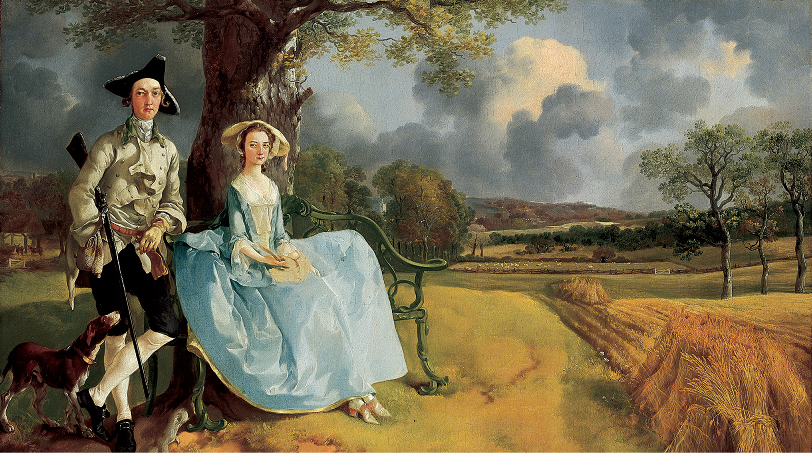
An Aristocratic Couple Portraits, such as this one of the English landowner, Robert Andrews and His Wife, by Thomas Gainsborough (1728–1788), contain many clues to the aristocratic dominance of landed society. National Gallery, London/Art Resource, NY
Notes:
An Aristocratic Couple Portraits, such as this one of the English landowner, Robert Andrews and His Wife, by Thomas Gainsborough (1728–1788), contain many clues to the aristocratic dominance of landed society.
National Gallery, London/Art Resource, NY

Slide 8
The Aristocracy (cont.)
British nobility—smallest, wealthiest, best defined, most socially responsible
About 400 families, eldest males of each in House of Lords
Owned about ¼ of all arable land
Few significant legal privileges, but great political power

Slide 9
The Aristocracy (cont.)
French nobility—less clear-cut; about 400,000 nobles
“Nobles of the sword”—nobility derived from military service
“Nobles of the robe”—from service in bureaucracy, or purchased
Some wealthy, some poor, but all shared certain hereditary privileges

Slide 10
The Aristocracy (cont.)
Eastern European nobilities
Military traditions important
Extensive repressive power over serfs

Slide 11
Aristocratic Resurgence
Europe-wide reaction to threat from expanding power of monarchies
Tried to preserve privileges by making nobility harder to attain
Pushed to reserve high-ranking military/government/church appointments for nobles
Sought to leverage existing noble-controlled institutions (British Parliament, French parlements, German provincial diets, etc.)
Tried to shore up wealth through new tax exemptions, raising rents

Slide 12
Peasants & Serfs
Lives of economic and social dependency, exploitation, vulnerability
Power of European landlords increased from west to east
French peasants: banalitiés (feudal dues); corveé (annual forced labor)
Habsburg serfs: near-slavery; robot (compulsory service to lord)
Russian serfs: worst off; noble wealth measured by number of serfs, not acres
Ottoman Empire (SE Europe): peasants nominally free; marginally empowered by scarcity of labor

Slide 13
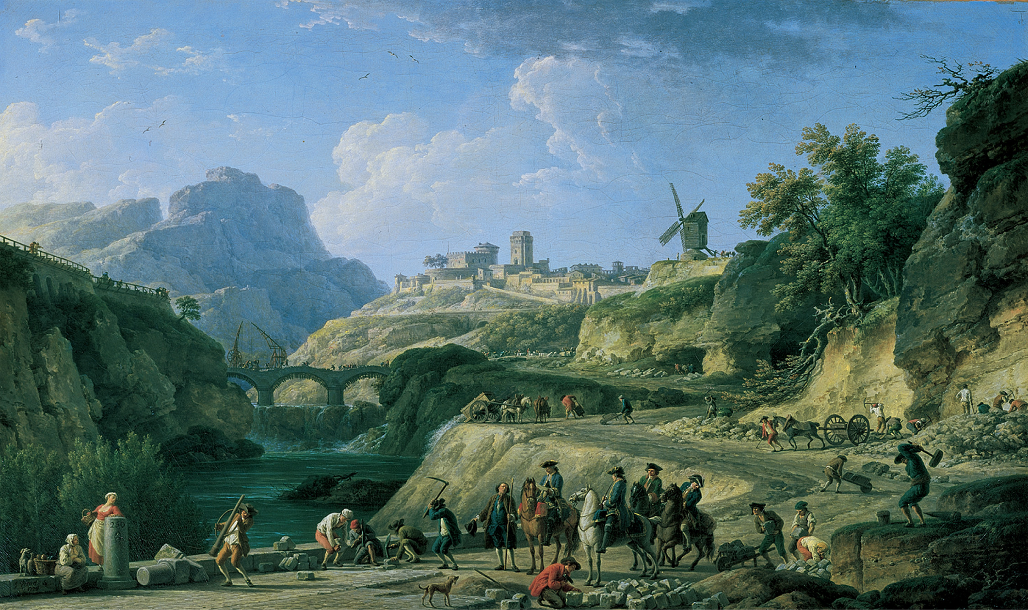
Eighteenth-century France had some of the best roads in the world, but they were often built with forced labor. French peasants were required to work part of each year on such projects. This system, called the corvée, was not abolished until the French Revolution in 1789. Louvre, Paris, France/Erich Lessing/Art Resource, NY
Notes:
Eighteenth-century France had some of the best roads in the world, but they were often built with forced labor. French peasants were required to work part of each year on such projects. This system, called the corvée, was not abolished until the French Revolution in 1789.
Louvre, Paris, France/Erich Lessing/Art Resource, NY

Slide 14
Peasant Rebellions
Russia: Pugachev’s Rebellion (1773–1775)—all of southern Russia; eventually crushed; largest 18th c. uprising
Eastern Europe: smaller revolts in Bohemia, Transylvania, Moravia, Austria
Western Europe: almost no revolts, but rural riots in England; usually attempts to assert traditional rights against innovations—thus conservative

Slide 15
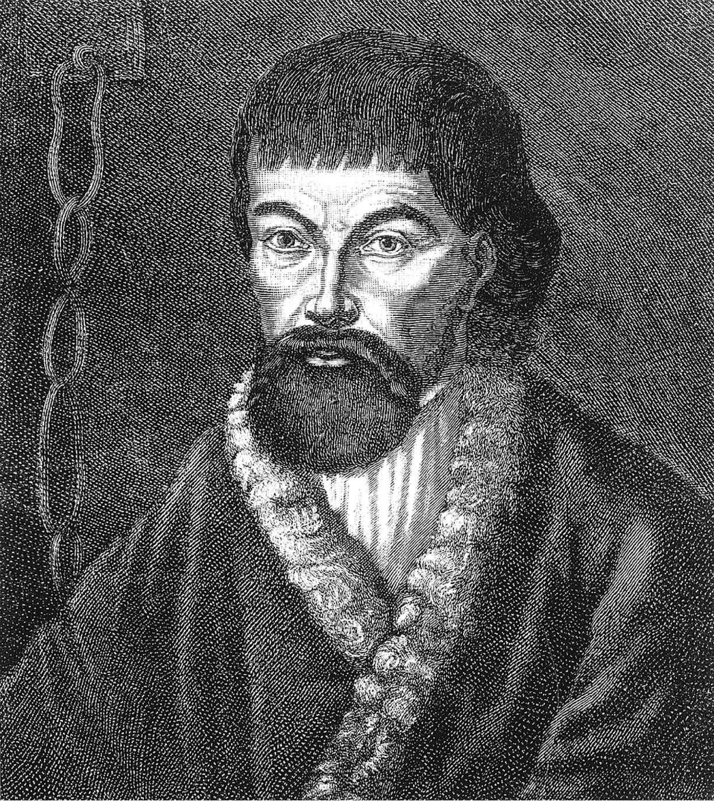
Emelyan Pugachev (1726–1775) led the largest peasant revolt in Russian history. In this contemporary propaganda picture he is shown in chains. An inscription in Russian and German was printed below the picture decrying the evils of revolution and insurrection. Bildarchiv Preussischer Kulturbesitz
Notes:
Emelyan Pugachev (1726–1775) led the largest peasant revolt in Russian history. In this contemporary propaganda picture he is shown in chains. An inscription in Russian and German was printed below the picture decrying the evils of revolution and insurrection.
Bildarchiv Preussischer Kulturbesitz

Slide 16
English Game Laws
1671–1831: English landowners had exclusive legal right to hunt game
Upheld superior status of aristocracy (over peasants) and landed gentry (over commercial classes)
Gentry hired gamekeepers to guard against poachers; killing deer by unauthorized persons became capital crime

Slide 17
English Game Laws (cont.)
Poaching nonetheless popular—a source of food for the hungry
Black market driven by urban demand for luxury meat
1831: laws rewritten to permit landowners to allow others to hunt

Slide 18
Family Structure
Family economy: family was basic unit of production and consumption in preindustrial Europe
Northwestern European households:
Nuclear family—married couple, children through early teens, servants; appx. 5–6 members average
Married late—average age 26 (men), 23 (women)
Servants—young people working in exchange for room, board, wages; not necessarily socially inferior to employers; normally ate with family

Slide 19
Family Structure (cont.)
Eastern European households
Marriage usually before 20, often arranged
Extended family—3-4 generations, 9-20 members or more in rural Russia
Aided by landlord’s need for labor

Slide 20
Family Economy
Living alone almost impossible and viewed with suspicion
All household members worked; work products went to family, not individual
Farming major occupation, but rarely adequate—one or more family members might work elsewhere and send wages home
Skilled artisans—father chief artisan, wife often sold the wares, children learned the trade
Western Europe: death of the father often meant disaster; high mortality rate meant high personal and economic vulnerability

Slide 21
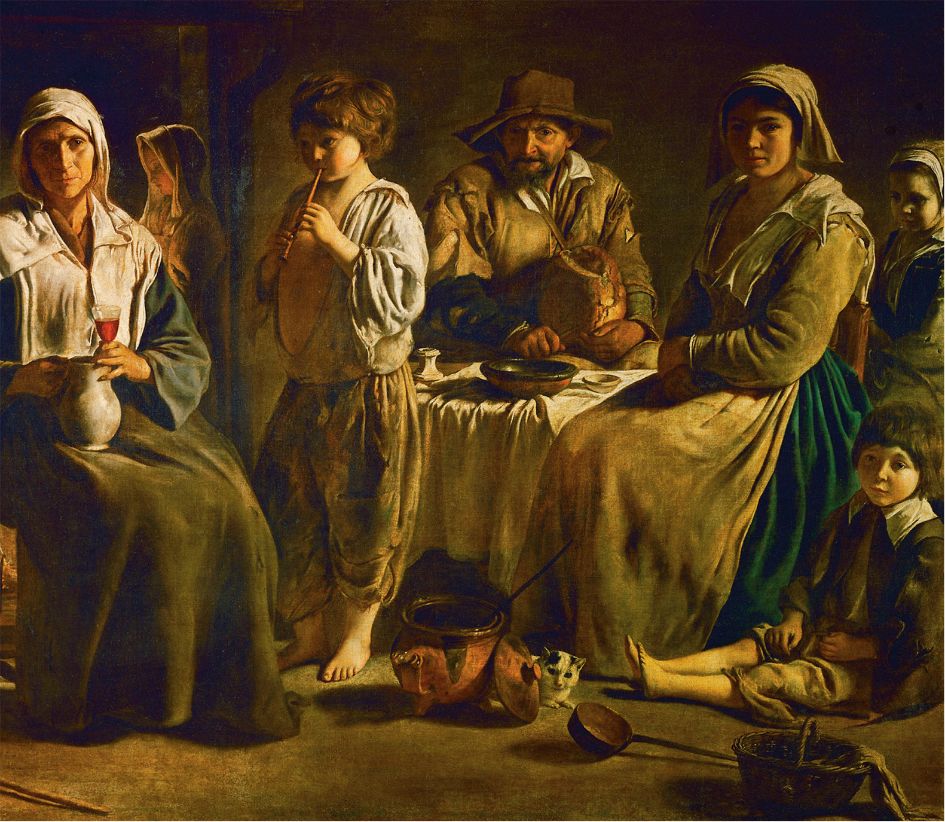
During the seventeenth century the French Le Nain brothers painted scenes of French peasant life. Although the images softened many of the harsh realities of peasant existence, the clothing and the interiors were based on actual models and convey the character of the life of better-off French peasants whose lives would have continued very much the same into the eighteenth century. Erich Lessing/Art Resource, NY
Copyright © 2010 Pearson Education, Inc., Upper Saddle River, NJ 07458. All rights reserved.
Notes:
During the seventeenth century the French Le Nain brothers painted scenes of French peasant life. Although the images softened many of the harsh realities of peasant existence, the clothing and the interiors were based on actual models and convey the character of the life of better-off French peasants whose lives would have continued very much the same into the eighteenth century.
Erich Lessing/Art Resource, NY

Slide 22
Women and the Family Economy
Women’s lives largely determined by their ability to establish and maintain a household
Marriage an economic necessity
Dominant concern was adequate food supply; necessity of limiting number of children—birth control

Slide 23
Children and the Family Economy
18th c. childbirth dangerous for both mother and child
Wet nursing industry—well-developed, necessary because full-time motherhood usually impossible
Birth of a child often meant increased economic hardship; some infanticide
“Foundling hospitals” established for abandoned children, usually victims of poverty or illegitimacy

Slide 24
Agricultural Revolution
Main goal of traditional peasant society was stable food supply
Resistance to changes that might endanger food supply
Vulnerability to poor harvests, fluctuations in price of grain (bread)
Slow rise in grain prices through 18th c. triggers series of innovations in farm production: Agricultural Revolution
Peasants often resisted and were brutally repressed

Slide 25
Agricultural Innovations
Dutch, 16th & 17th c.: found better ways to drain land; experimented with new crops (clover, turnips) used for animal fodder and soil restoration
English, 18th c.: biggest popularizers of earlier innovations
Jethro Tull (1674–1741)—agricultural experimenter; invented seed drill

Slide 26
Agricultural Innovations (cont.)
English, 18th c.: biggest popularizers of earlier innovations
Charles “Turnip” Townsend (1674–1738)—instituted crop rotation
Robert Bakewell (1725–1795)—improved methods of animal breeding

Slide 27
Agricultural Innovations (cont.)
Enclosure: replaced open-field or village method; created large tracts of farmland out of small plots, common land, and waste areas; put land into more productive use but caused turmoil for peasant farmers; commercialization of agriculture
Improvements more limited in the East

Slide 28
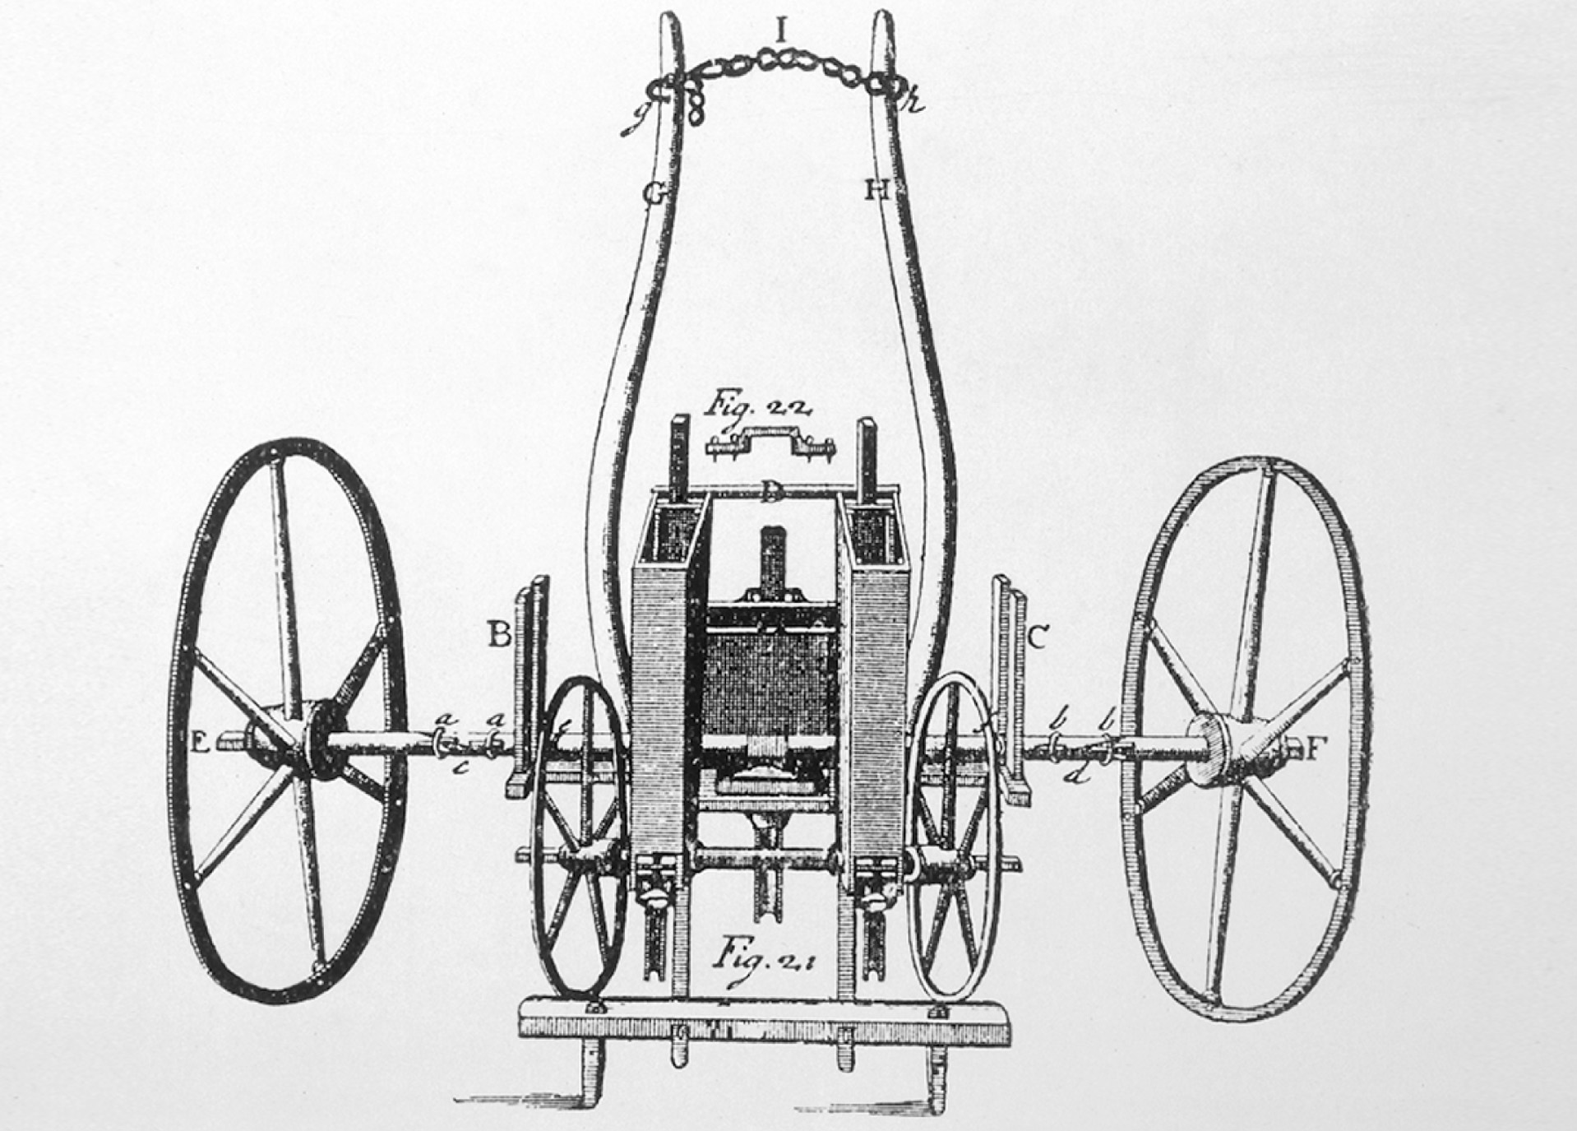
The English agricultural improver Jethro Tull devised this seed drill, which increased wheat crops by planting seed deep in the soil rather than just casting it randomly on the surface. Image Works/Mary Evans Picture Library Ltd.
Notes:
The English agricultural improver Jethro Tull devised this seed drill, which increased wheat crops by planting seed deep in the soil rather than just casting it randomly on the surface.
Image Works/Mary Evans Picture Library Ltd.

Slide 29
Population Increases
Approximate population of non-Ottoman Europe:
1700: 100–200 million
1800: 190 million
1850: 260 million
Put pressure on food prices, driving agricultural innovation and spurring the Industrial Revolution

Slide 30
18th c. Industrial Revolution
2nd half of 1800s: beginning of industrialization
Introduced virtually uninterrupted economic growth
Made possible the greatest production of goods and services in history
Carried a high social cost, though eventually did away with rampant poverty

Slide 31
Consumer Revolution
Production of new goods driven by increases in demand (learning to want things)
Clothing, buttons, toys, china, furniture, rugs, candlesticks, brass/ silver/ pewter/ glassware, watches, jewelry, soap, beer, wine, foods

Slide 32
Consumer Revolution (cont.)
Factors:
Growth in disposable income (causes uncertain)
New methods of entrepreneurial marketing
Development of fashion industry
Consumer economy became permanent feature of European economy, despite conflicts with Christian ethics

Slide 33
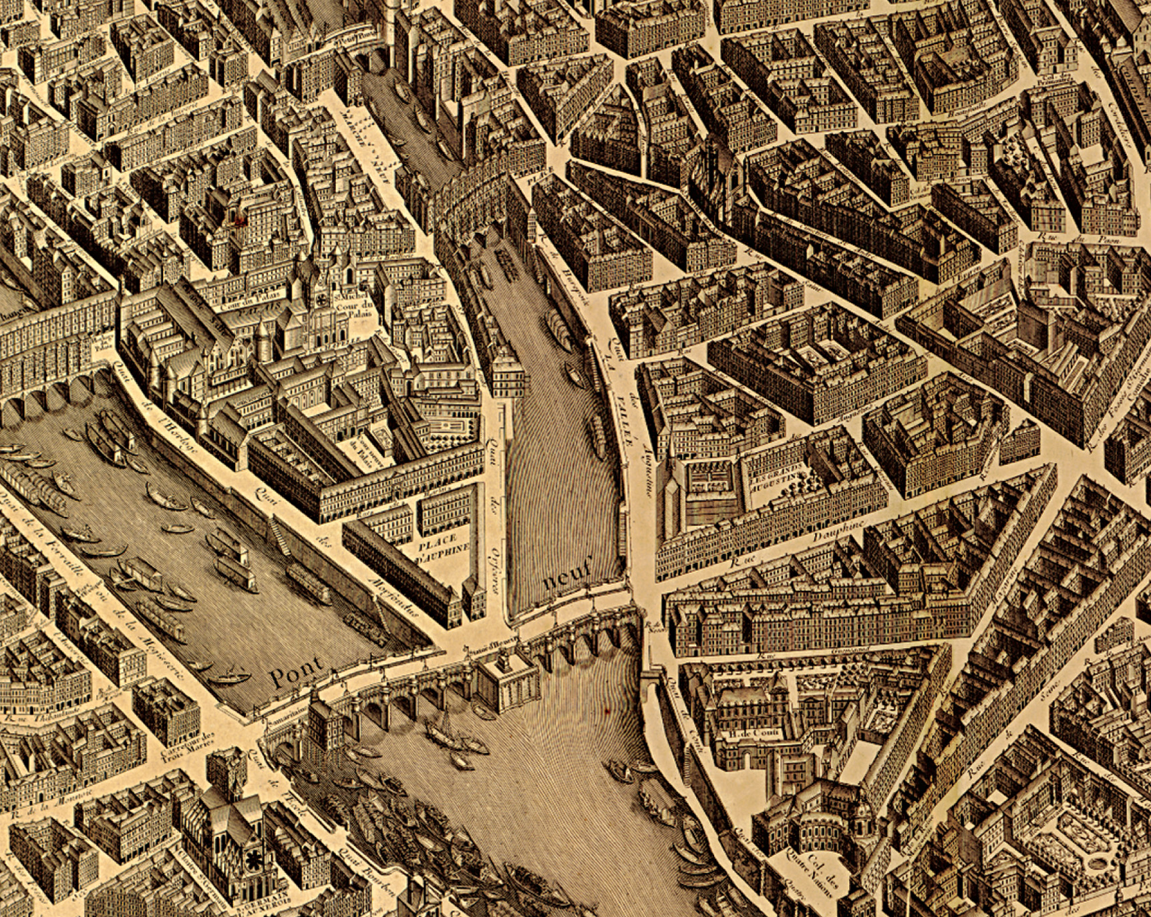
This is the detail of a 1739 map by Louis Bretez, a member of the Academy of Painting and Sculpture, showing an aerial view of the city of Paris. The primary function of the map was to reestablish Paris as the universal model of a capital city. Library of Congress
Notes:
This is the detail of a 1739 map by Louis Bretez, a member of the Academy of Painting and Sculpture, showing an aerial view of the city of Paris. The primary function of the map was to reestablish Paris as the universal model of a capital city.
Library of Congress

Slide 34
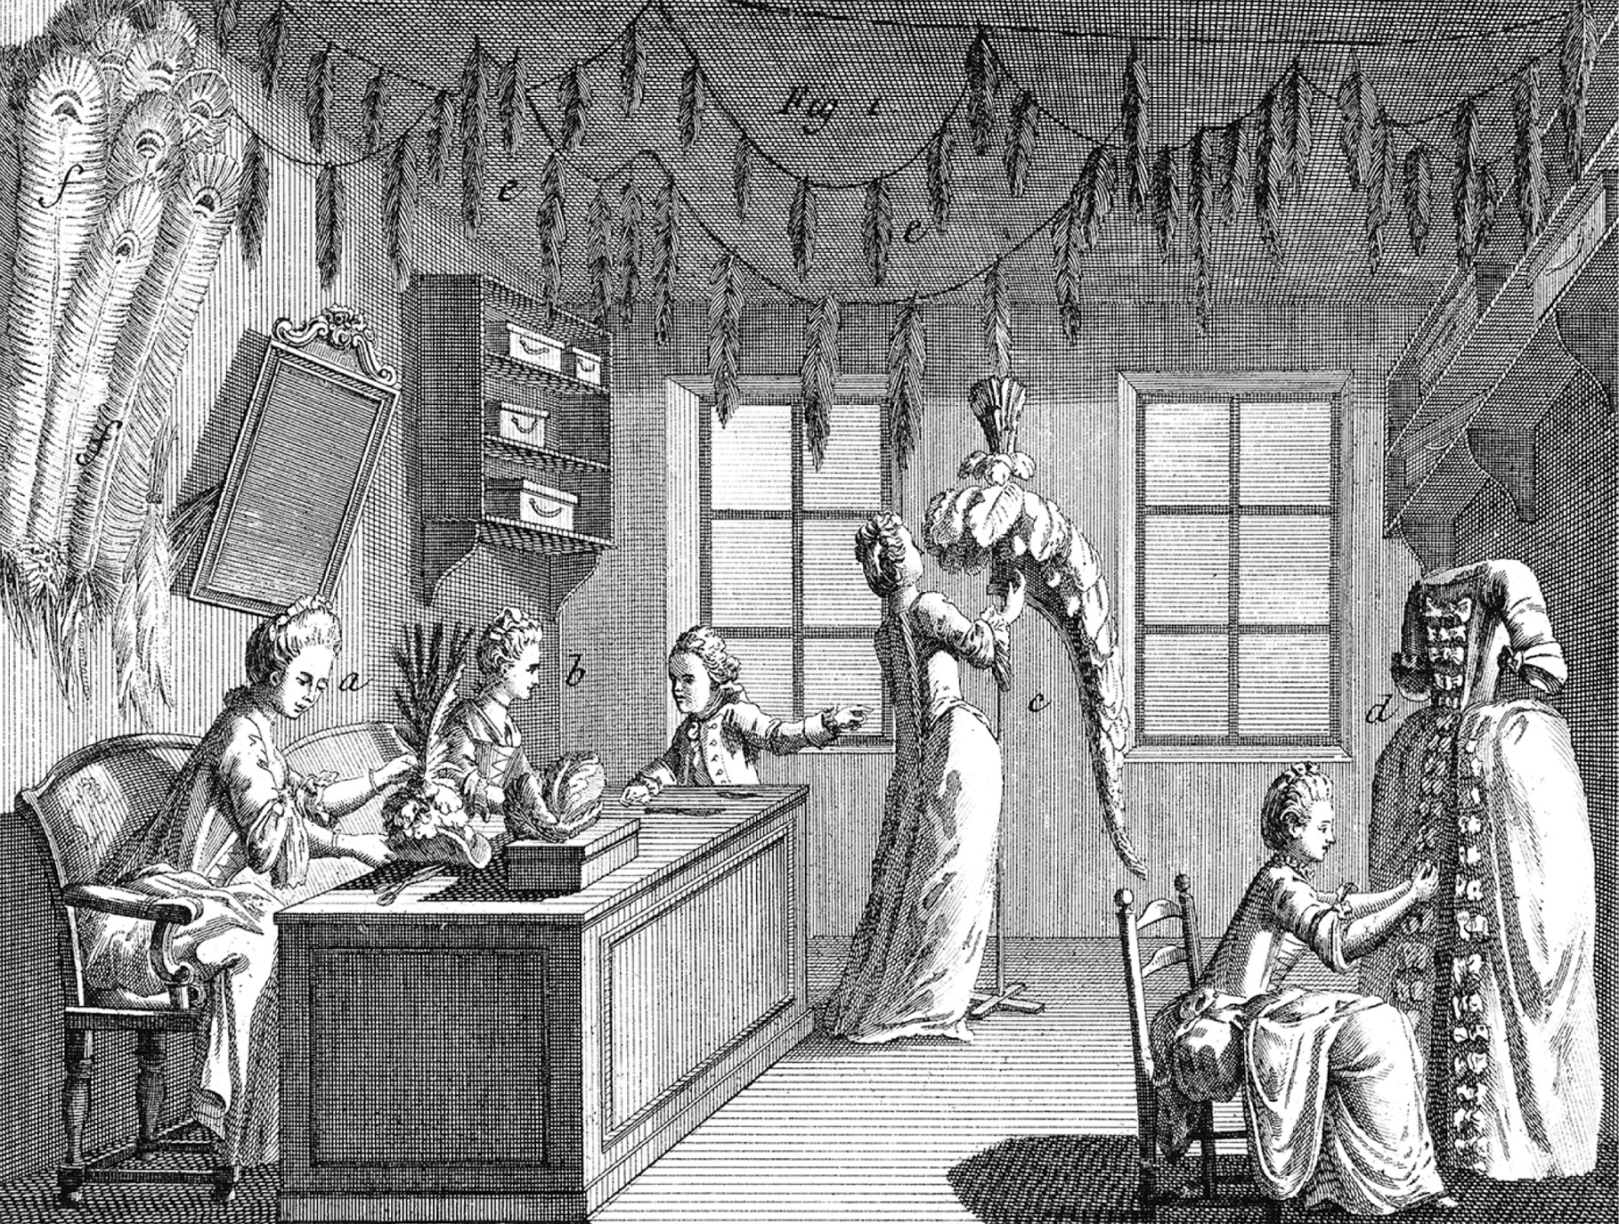
Consumption of all forms of consumer goods increased greatly in the eighteenth century. This engraving illustrates a shop, probably in Paris. Here women, working apparently for a woman manager, are making dresses and hats to meet the demands of the fashion trade. As the document on page 471 demonstrates, some women writers urged more such employment opportunities for women. Bildarchiv Preussischer Kulturbesitz
Notes:
Consumption of all forms of consumer goods increased greatly in the eighteenth century. This engraving illustrates a shop, probably in Paris. Here women, working apparently for a woman manager, are making dresses and hats to meet the demands of the fashion trade. As the document on page 471 demonstrates, some women writers urged more such employment opportunities for women.
Bildarchiv Preussischer Kulturbesitz

Slide 35
Industrialism in Great Britain
GB: industrial leader of Europe through mid-19th century
Factors:
London: largest city in Europe, center of fashion
Prominence of newspapers (advertising)
Largest free-trade area in Europe
Rich in coal & iron ore
Stable political structure, secure property, sound financial system
Comparatively high social mobility

Slide 36
Textile Production
Earliest industrial change took place in countryside, not cities
Domestic or putting-out system of textile production (family economy): urban textile merchants sent wool and other fibers to homes of peasants who spun thread and wove cloth

Slide 37
Textile Production (cont.)
Growing demand causes production bottlenecks, leading to famous inventions:
Spinning jenny, c. 1765 (James Hargreaves)—multiple spindles of thread spun on one machine; relieved bottleneck between spinners & weavers

Slide 38
Textile Production (cont.)
Growing demand causes production bottlenecks, leading to famous inventions:
Water frame, 1769 (Richard Arkwright)—water-powered device that produced purely cotton fabric, rather than cotton and linen; took cotton textile manufacture out of the home and into the factory
Cotton output increased 800%, 1780–1900

Slide 39
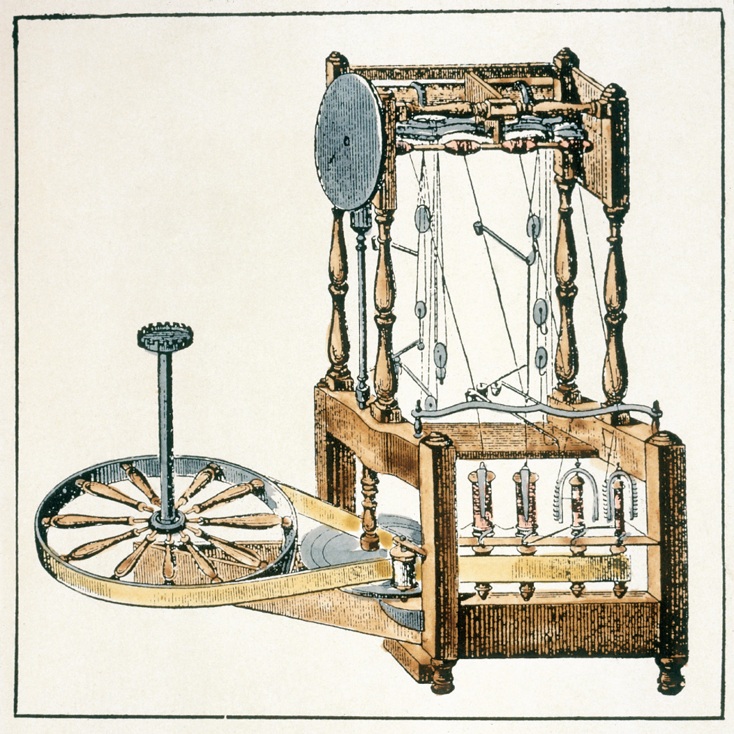
James Hargreaves’s spinning jenny permitted the spinning of numerous spindles of thread on a single machine. akg-images
Notes:
James Hargreaves’s spinning jenny permitted the spinning of numerous spindles of thread on a single machine.
akg-images

Slide 40
Steam Engine
James Watt, 1769—Scottish engineer and machine maker
Provided for the first time in history a steady and virtually unlimited source of inanimate power
Portable source of power not dependent on nature
Myriad industrial applications

Slide 41
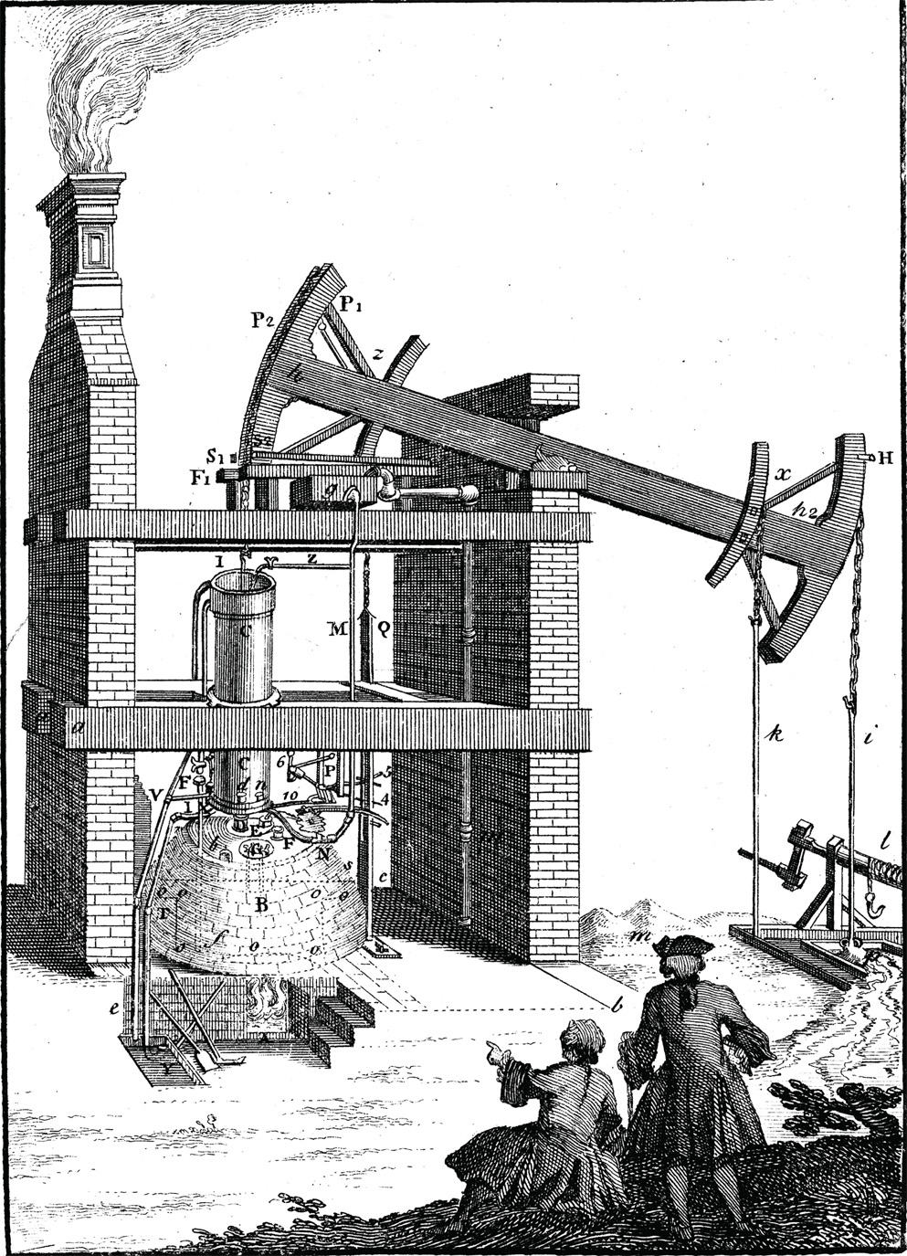
Newcomen’s steam engine had a major impact on the growth of industrialization 1747 © The Print Collector/Alamy
Notes:
Newcomen’s steam engine had a major impact on the growth of industrialization
1747 © The Print Collector/Alamy

Slide 42
Iron Production
Chief element of all heavy industry and land or sea transport
Production limitations, early 18th c.:
Charcoal rather than coke used to smelt ore
Before steam engine, furnaces couldn’t achieve high enough blasts
Limited demand
Elimination of first two problems eliminated the third

Slide 43
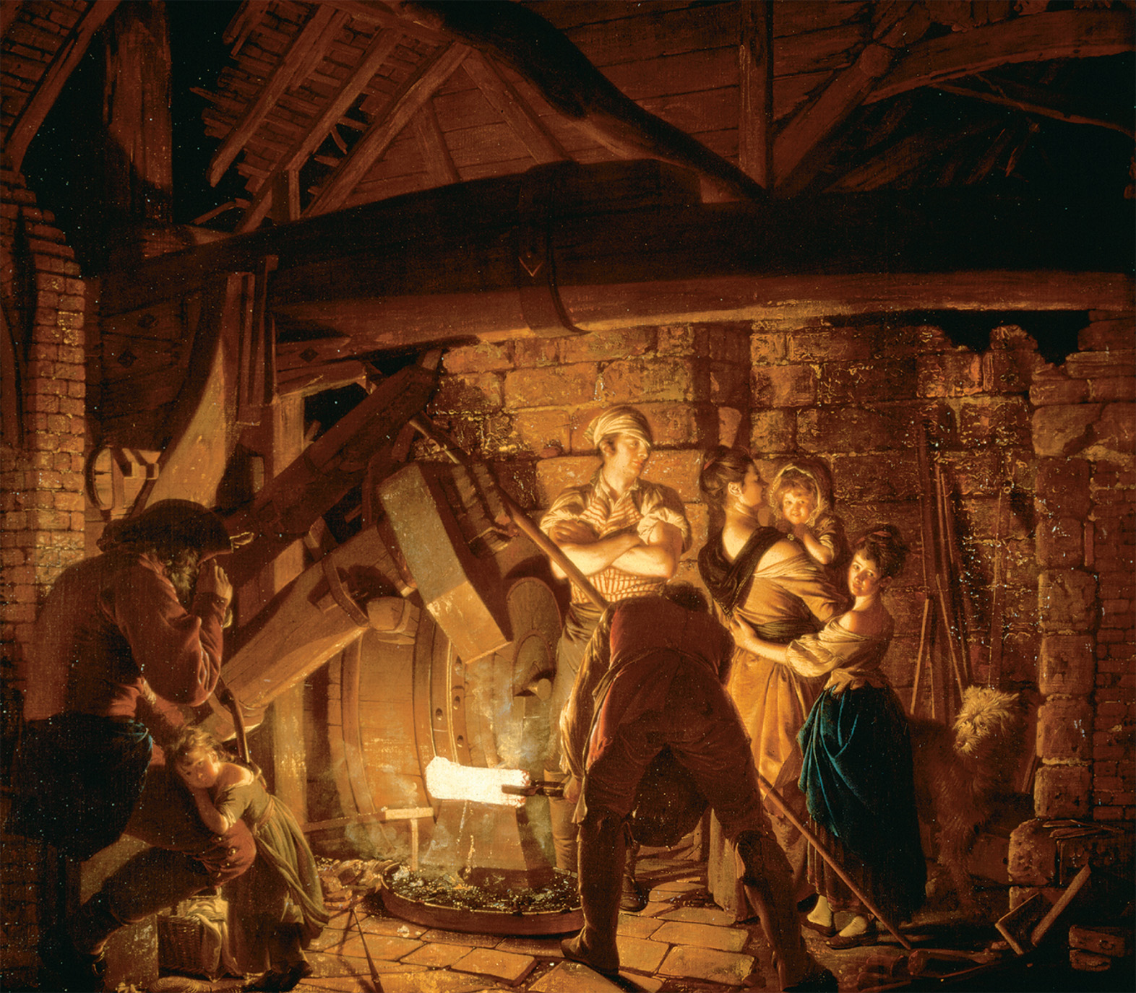
During the eighteenth century, most goods were produced in small workshops, such as this iron forge painted by Joseph Wright of Derby (1734–1797), or in the homes of artisans. Not until very late in the century, with the early stages of industrialization, did a few factories appear. In the small early workshops, it would not have been uncommon for the family of the owner to visit, as portrayed in this painting. The Iron Forge, 1772 (oil on canvas) by Joseph Wright of Derby (1734–1797). Broadlands Trust, Hampshire, UK/Bridgeman Art Library, London
Notes:
During the eighteenth century, most goods were produced in small workshops, such as this iron forge painted by Joseph Wright of Derby (1734–1797), or in the homes of artisans. Not until very late in the century, with the early stages of industrialization, did a few factories appear. In the small early workshops, it would not have been uncommon for the family of the owner to visit, as portrayed in this painting.
The Iron Forge, 1772 (oil on canvas) by Joseph Wright of Derby (1734–1797). Broadlands Trust, Hampshire, UK/Bridgeman Art Library, London

Slide 44
Impact on Working Women
Displaced many of women’s traditional economic roles in agriculture and textile manufacture as men took over heavy and skilled tasks and pushed women out
Women increasingly associated with work in the home rather than outside the home
Men’s pay began outstripping women’s

Slide 45
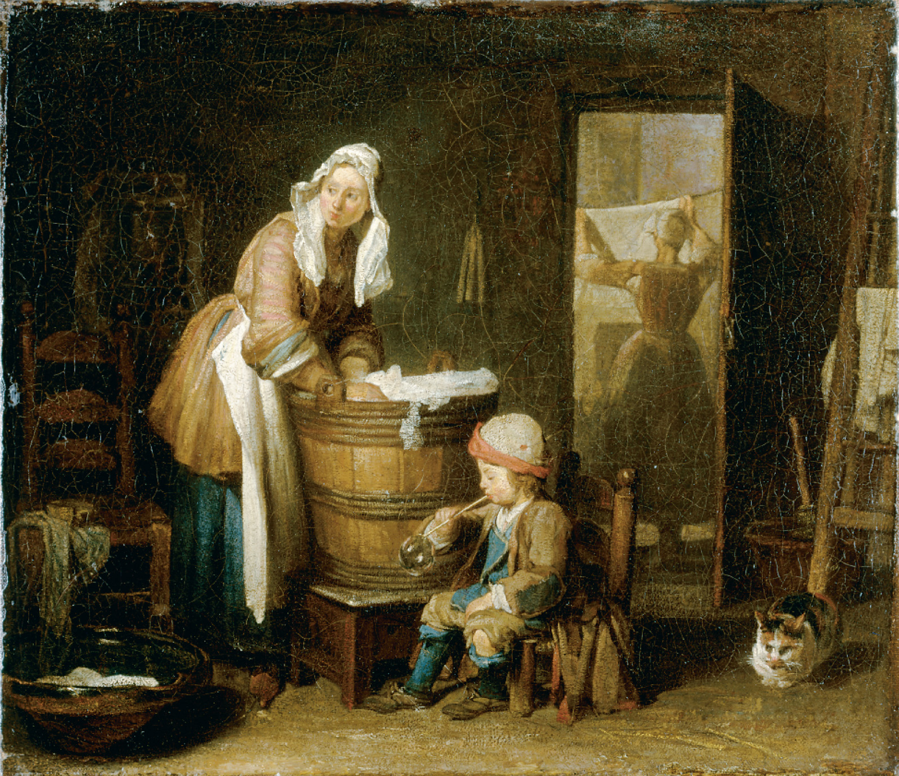
In the eighteenth century washing linen clothing by hand was a major task of women servants. Chardin, Jean-Baptise Simeon (1699–1779)/Hermitage, St. Petersburg, Russia/Scala/Art Resource, NY
Notes:
In the eighteenth century washing linen clothing by hand was a major task of women servants.
Chardin, Jean-Baptise Simeon (1699–1779)/Hermitage, St. Petersburg, Russia/Scala/Art Resource, NY

Slide 46
Growth of Cities
1500: 156 cities with more than 10,000 people; 4 with more than 100,000
1800: 363 with more than 10,000; 17 with more than 100,000
Greatest growth among capitals and ports, due to monarchical state-building and expansion of overseas trade

Slide 47
Urban Classes
Urban rich segregated from poor
Modern sanitation unknown, almost no pure water, farm animals roaming the streets
Upper Class: nobles, large merchants, bankers, financiers, clergy, government officials—the small oligarchy that ran the city

Slide 48
Urban Classes (cont.)
Middle Class (bourgeoisie): merchants, tradespeople, bankers, professionals; diverse and divided; normally supported reform, change, economic growth; feared poor, envied nobility

Slide 49
Urban Classes (cont.)
Artisans: grocers, butchers, fishmongers, carpenters, cabinetmakers, smiths, printers, tailors, etc.—largest group in any city; like peasants, were in many ways conservative; economically vulnerable; guilds still important

Slide 50
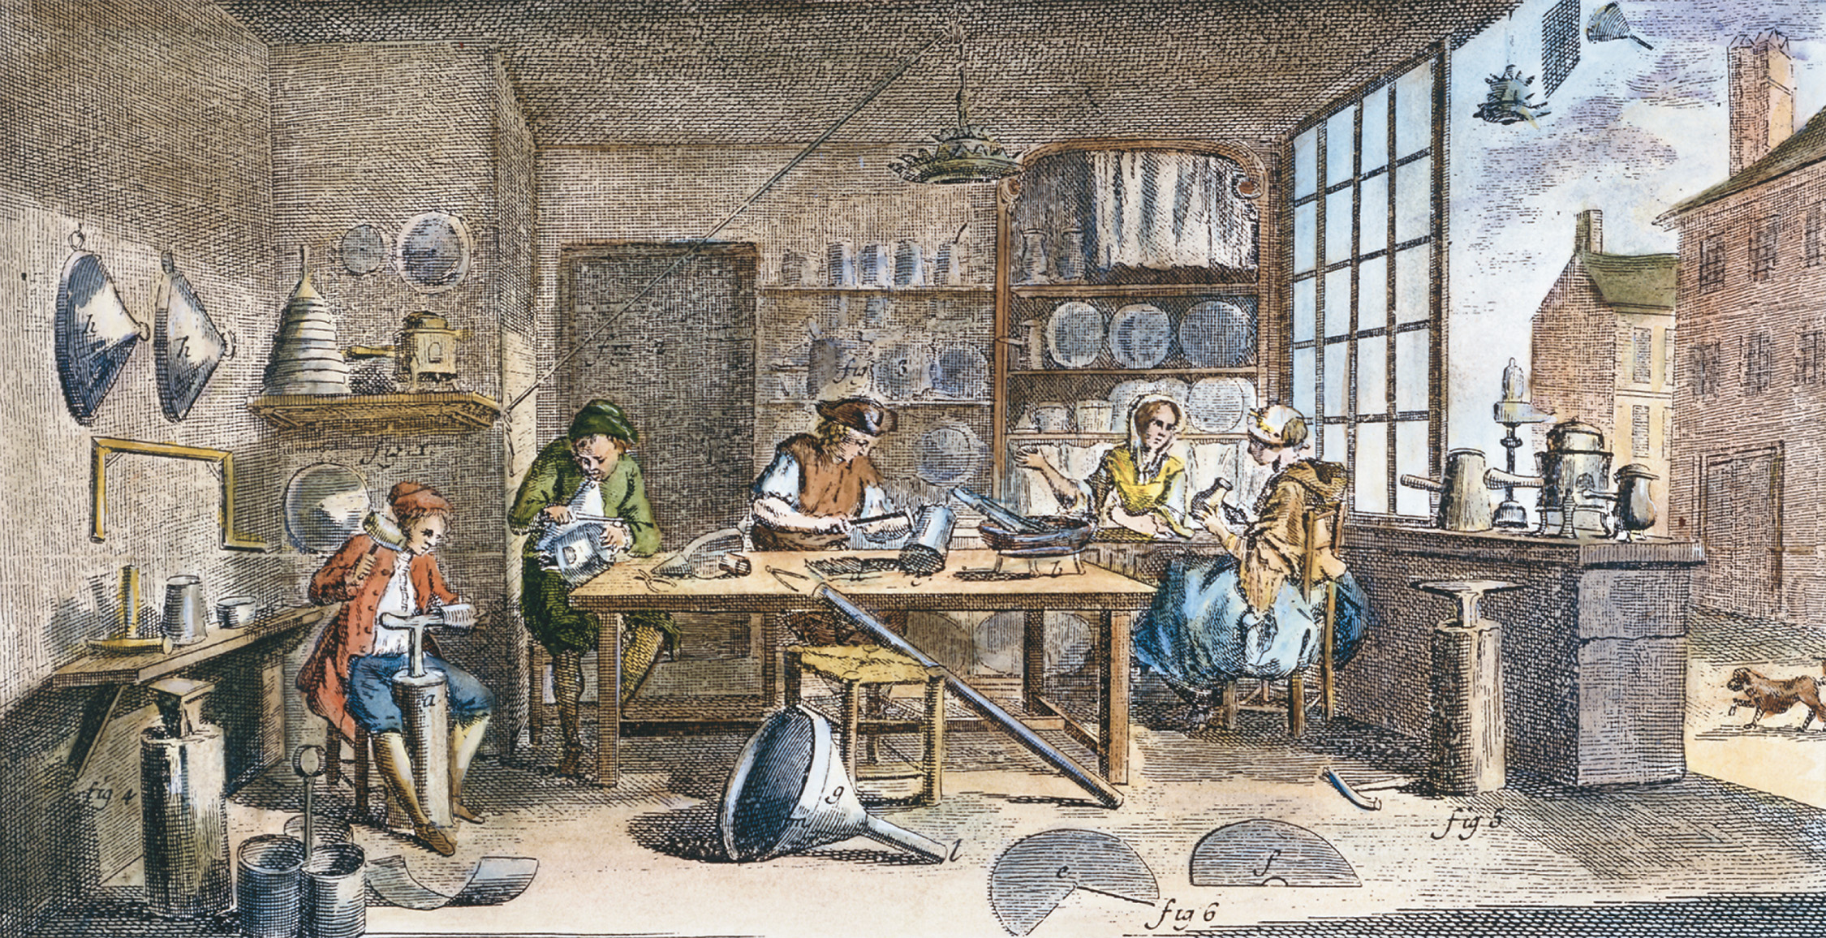
This engraving illustrates a metalworking shop such as might have been found in almost any town of significance in Europe. Most of the people employed in the shop probably belonged to the same family. Note that two women are also working. The wife may very well have been the person in charge of keeping the accounts of the business. The two younger boys might be children of the owner or apprentices in the trade, or both. The Granger Collection, New York
Notes:
This engraving illustrates a metalworking shop such as might have been found in almost any town of significance in Europe. Most of the people employed in the shop probably belonged to the same family. Note that two women are also working. The wife may very well have been the person in charge of keeping the accounts of the business. The two younger boys might be children of the owner or apprentices in the trade, or both.
The Granger Collection, New York

Slide 51
Urban Riots
Outlet for artisans’ displeasure, often over price of bread
Bread riots: leaders confiscate bread or grain and sell it for “just price,” with money returned to proprietors
Danger of bread riots restrained merchants’ greed
Highly ritualized social feature of Old Regime economy of scarcity

Slide 52
Urban Riots (cont.)
Other riots: religious
Riots became increasingly political toward end of 18th c.; often became a tool of upper classes—use “the crowd” against the monarchy, or against minorities

Slide 53
The Jewish Population
Most Jews lived in Eastern Europe
Commonly regarded as a kind of nonresident alien, usually denied citizenship privileges unless specifically granted
Lived everywhere in separate communities from non-Jews: ghettos in the city or primarily Jewish villages in countryside

Slide 54
The Jewish Population (cont.)
“The age of the ghetto”—did not mix with mainstream societies
A few became famous for helping rulers finance wars, but most lived in poverty

Slide 55
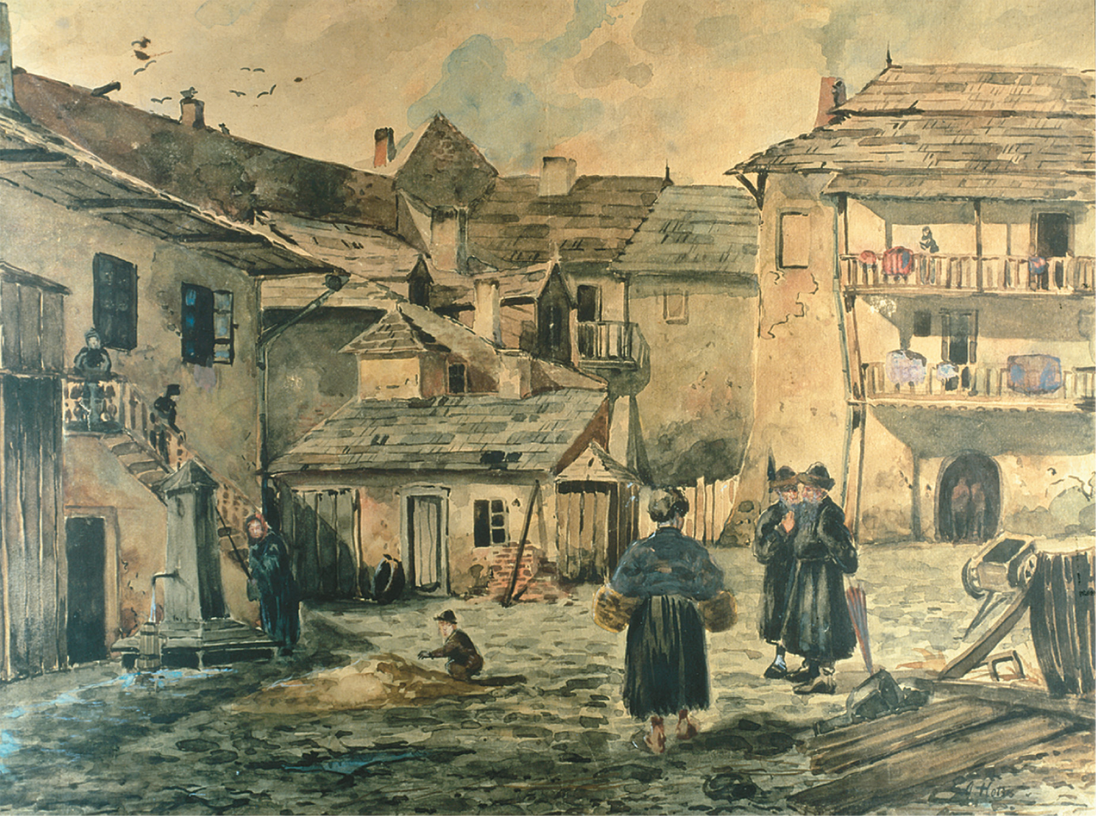
During the Old Regime, European Jews were separated from non-Jews, typically in districts known as ghettos. Relegated to the least desirable section of a city or to rural villages, most lived in poverty. This watercolor painting depicts a street in Kazimlesz, the Jewish quarter of Kraków, Poland. Judaica Collection, Max Berger, Vienna, Austria. Photograph © Erich Lessing/ Art Resource, NY
Notes:
During the Old Regime, European Jews were separated from non-Jews, typically in districts known as ghettos. Relegated to the least desirable section of a city or to rural villages, most lived in poverty. This watercolor painting depicts a street in Kazimlesz, the Jewish quarter of Kraków, Poland.
Judaica Collection, Max Berger, Vienna, Austria. Photograph © Erich Lessing/ Art Resource, NY

