Slide 1
Chapter 16
The Transatlantic Economy,
Trade Wars, and Colonial Revolution

Slide 2
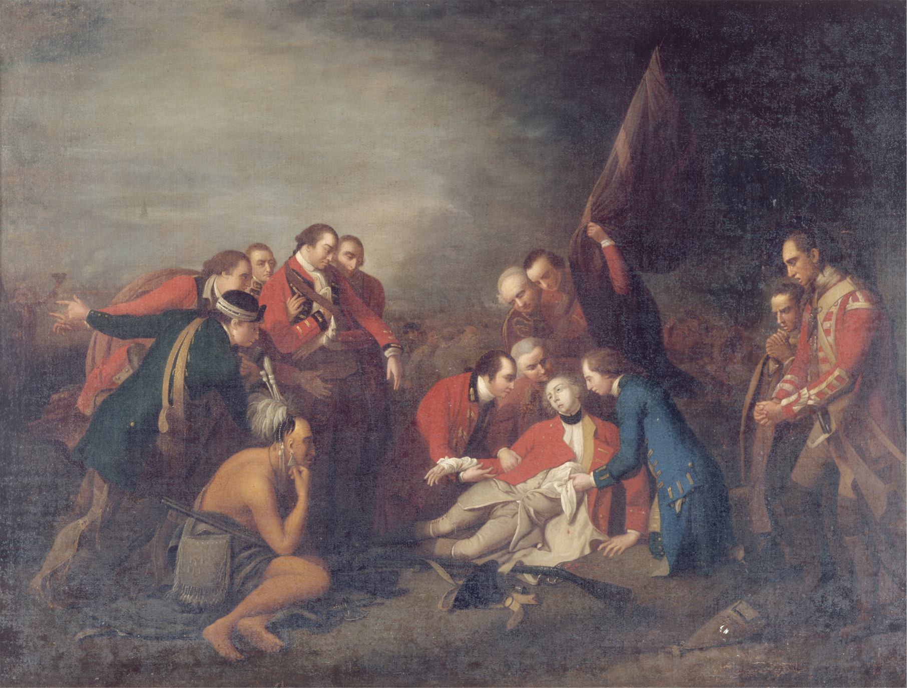
General James Wolfe was mortally wounded during his victory over the French at Quebec in 1759. This painting by American artist Benjamin West (1738–1820) became famous for portraying the dying Wolfe and the officers around him in poses modeled after classical statues. Quebec House, Westerham, Kent, Great Britain/National Trust Photo Library/John Hammond/Art Resource, NY
Notes:
General James Wolfe was mortally wounded during his victory over the French at Quebec in 1759. This painting by American artist Benjamin West (1738–1820) became famous for portraying the dying Wolfe and the officers around him in poses modeled after classical statues.
Quebec House, Westerham, Kent, Great Britain/National Trust Photo Library/John Hammond/Art Resource, NY

Slide 3
Overview
Mid-18th c. renewal of European warfare:
Austria vs. Prussia over dominance of central Europe
Great Britain vs. France for commercial & colonial supremacy

Slide 4
Overview (cont.)
Cost of these wars led to restructuring of taxation & finance, leading in turn to:
American Revolution
Continental enlightened absolutism
Continuing French financial crisis
Reform of Spanish South American empire

Slide 5
European Overseas Empires
Four phases of European contact with the New World:
Discovery, exploration, conquest, settlement—to end of 17th c.
Mercantile empires & great power trade rivalries; slavery; colonial independence—to 1820s
19th-c. empires in Africa & Asia
Decolonization, mid- to late-20th c.
Source of European world domination: technology (ships & guns)

Slide 6
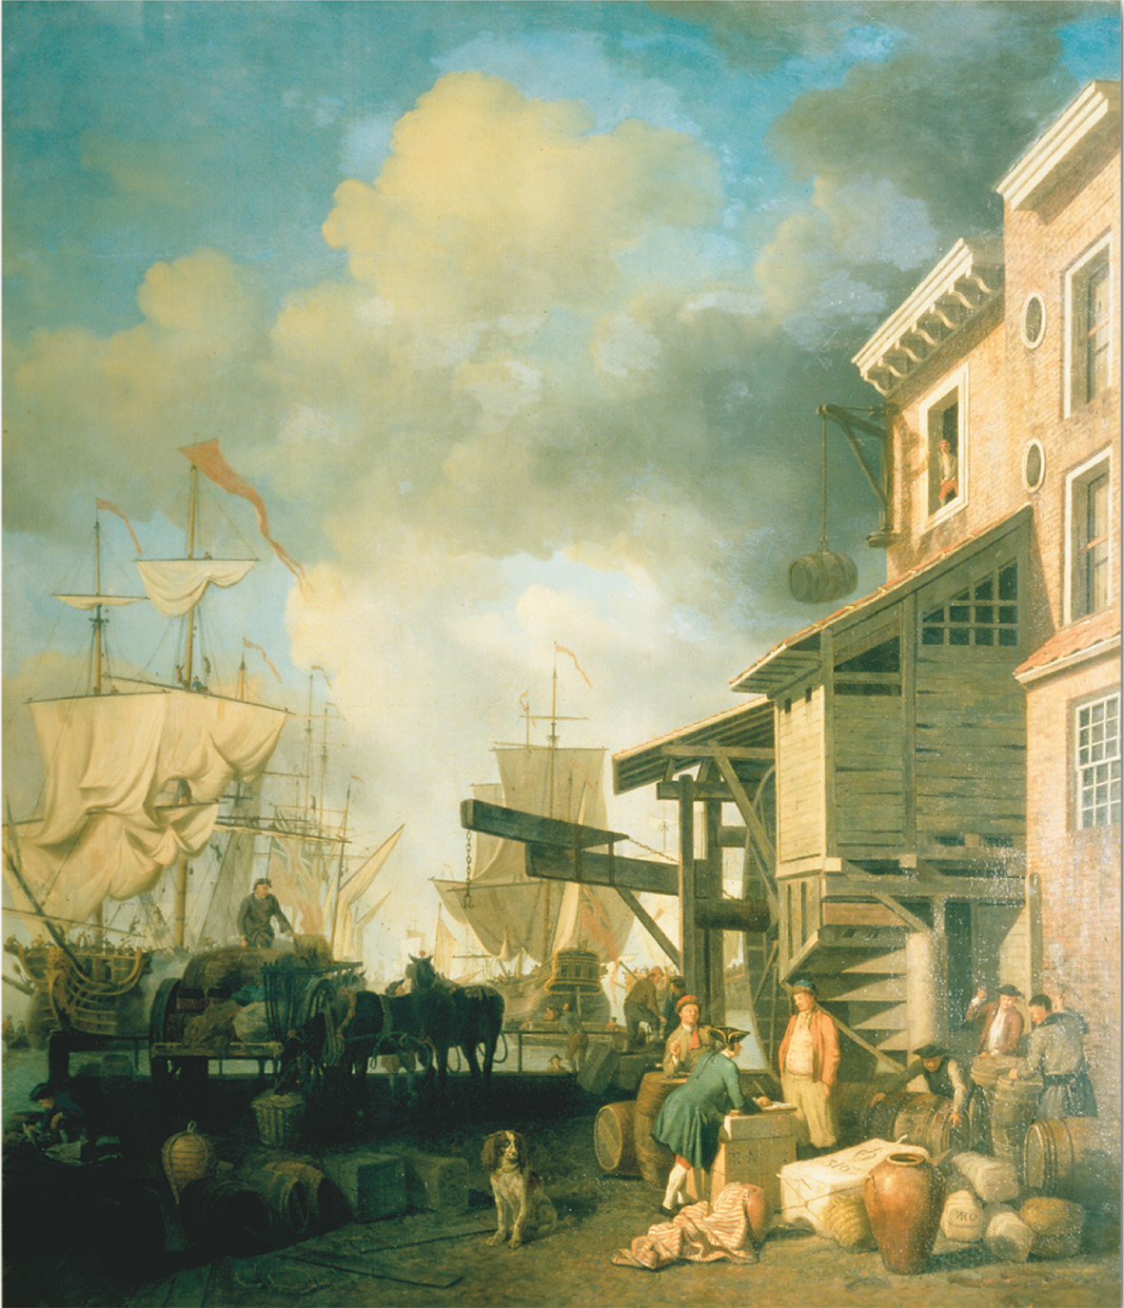
During the seventeenth and eighteenth centuries, European maritime nations established overseas empires and set up trading monopolies within them in an effort to magnify their economic strength. As this painting of the Old Custom House Quay in London suggests, trade from these empires and the tariffs imposed on it were expected to generate revenue for the home country. But behind many of the goods carried in the great sailing ships in the harbor and landed on these docks lay the labor of African slaves working on the plantations of North and South America. Samuel Scott “Old Custom House Quay” Collection. V & A Images, The Victoria and Albert Museum, London
Notes:
During the seventeenth and eighteenth centuries, European maritime nations established overseas empires and set up trading monopolies within them in an effort to magnify their economic strength. As this painting of the Old Custom House Quay in London suggests, trade from these empires and the tariffs imposed on it were expected to generate revenue for the home country. But behind many of the goods carried in the great sailing ships in the harbor and landed on these docks lay the labor of African slaves working on the plantations of North and South America.
Samuel Scott “Old Custom House Quay” Collection. V & A Images, The Victoria and Albert Museum, London

Slide 7
Mercantile Empires, Early 18th c. —Boundaries Set by 1713 Treaty of Utrecht
Spain: South America except for Brazil; Florida, Mexico, California & N. American Southwest; Central America; Caribbean possessions
Britain: N. Atlantic seaboard, Nova Scotia, Newfoundland; Caribbean possessions; trading posts on Indian subcontinent
France: St. Lawrence, Ohio, & Mississippi river valleys; Caribbean possessions; trading posts in India & West Africa
Netherlands: Surinam (S. America); Cape Colony (S. Africa); trading posts in West Africa, Sri Lanka, & India; also controlled trade with Java in SE Pacific

Slide 8
Mercantilist Goals
Underlying economic theory of 18th-c. empires was mercantilism
International trade as zero-sum game; whoever gets the most gold wins
Colonies meant to trade exclusively with home country; hard to enforce because it was more profitable to trade with other colonies

Slide 9
French–British Rivalry
N. American colonial quarrels over St. Lawrence River valley, upper New England, Ohio River valley; fishing rights, fur trade, Native American alliances
Biggest area of rivalry: West Indies—tobacco, cotton, indigo, coffee, sugar
India; trading posts called factories

Slide 10
The Spanish Colonial System
Colonial Government
The technical link between New World and Spain was crown of Castile
Top-down administration, almost no self-government

Slide 11
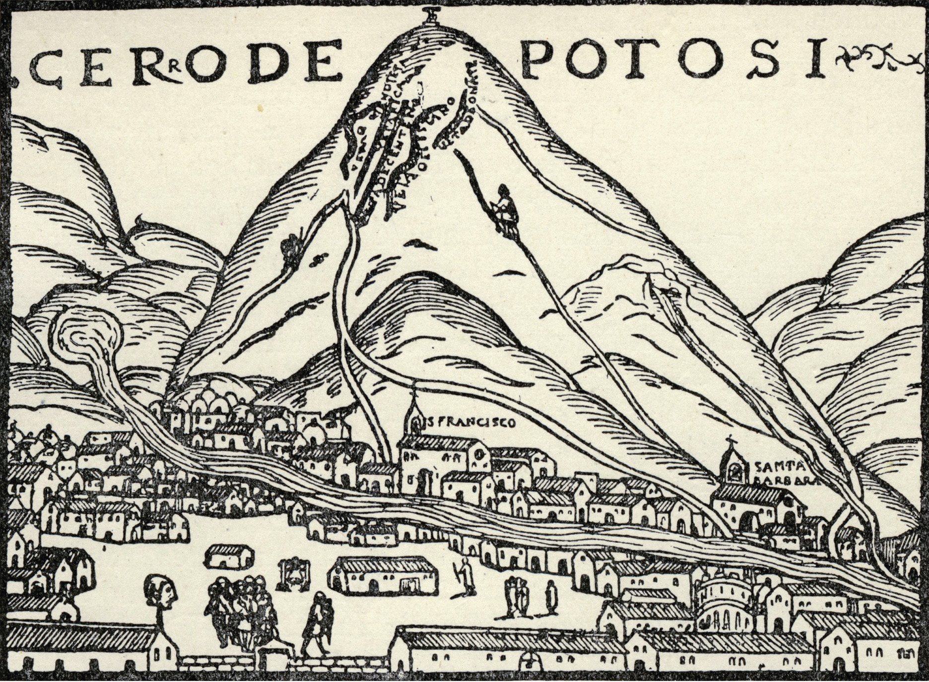
The Silver Mines of Potosí. The Spanish had discovered precious metals in their South American Empire early in the sixteenth century; the mines provided Spain with a vast treasure in silver until the eighteenth century. The silver mines of Potosí were worked by conscripted Indian laborers under extremely harsh conditions (note the head impaled on a stake in the foreground). © INTERFOTO/Alamy
Notes:
The Silver Mines of Potosí. The Spanish had discovered precious metals in their South American Empire early in the sixteenth century; the mines provided Spain with a vast treasure in silver until the eighteenth century. The silver mines of Potosí were worked by conscripted Indian laborers under extremely harsh conditions (note the head impaled on a stake in the foreground).
© INTERFOTO/Alamy

Slide 12
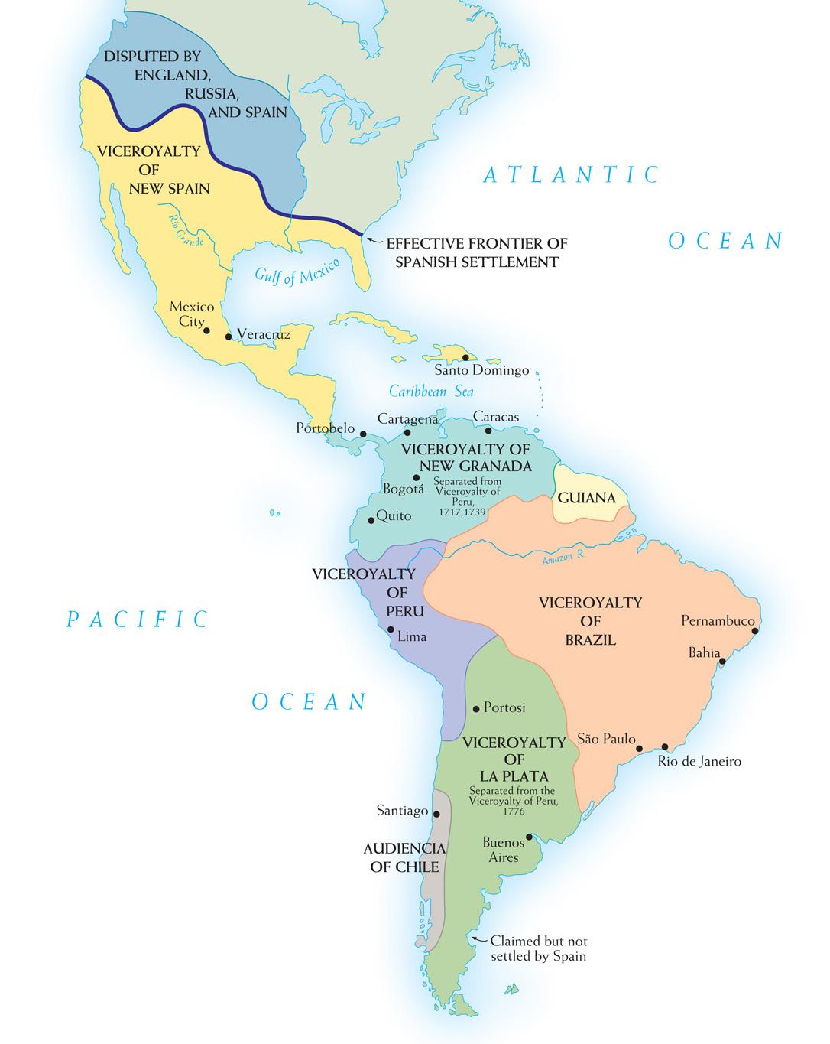
Map 16–1 VICEROYALTIES IN LATIN AMERICA IN 1780 The late eighteenth-century viceroyalties in Latin America display the effort of the Spanish Bourbon monarchy to establish more direct control of the colonies. They sought this control through the introduction of more royal officials and by establishing more governmental districts.
Notes:
Map 16–1 VICEROYALTIES IN LATIN AMERICA IN 1780 The late eighteenth-century viceroyalties in Latin America display the effort of the Spanish Bourbon monarchy to establish more direct control of the colonies. They sought this control through the introduction of more royal officials and by establishing more governmental districts.

Slide 13
Trade Regulation
Only one port authorized for use in American trade
Casa de Contración regulated all trade with New World
Functioned to serve Spanish commercial interests (precious-metal mines)
Flota system tried to ensure Spanish economic hegemony

Slide 14
Colonial Reform Under the Spanish Bourbon Monarchs
Crucial early 18th-c. change: War of the Spanish Succession (1701–1714) and Treaty of Utrecht replaced Spanish Habsburgs with Bourbons of France
Philip V (r. 1700–1714) and successors tried to revive decaying trade monopoly, suppress smuggling

Slide 15
Colonial Reform Under the Spanish Bourbon Monarchs (cont.)
Charles III (r. 1759–1788): most important imperial reformer—royal representatives favored over local councils; improved imperial economy, but introduced tensions between Spanish from Spain and creoles (Spanish born in America)

Slide 16
African Presence in Americas
Had always existed in some form in parts of Europe, but from 16th c., became fundamental to the British & Spanish imperial economies (plantation economy)
Driven by labor shortage
Supplied by internal African warfare: slave markets on West African coast—not imposed by Europeans, but preexisting

Slide 17
African Presence in Americas (cont.)
Began in 16th c. in Spanish America, 17th c. in British America
Slave trade grew in 18th c. because of low fertility rate and high mortality rate of established slaves—difficult to create stable self-reproducing population

Slide 18
West Indies, Brazil, and Sugar
More slaves transported to the W. Indies and Brazil than North America
African culture sustained in W. Indies
By 1725, 90% of Jamaican population consisted of black slaves
Sugar very profitable for plantation owners and merchants; slaves were overworked, malnourished, and vulnerable to new pathogens

Slide 19
Slavery and the Transatlantic Economy
Slave trade: dominated by Portuguese & Spanish in 16th c., Dutch in 17th c., and English in 18th c.
“Triangular trade”: Africa, West Indies, Europe

Slide 20
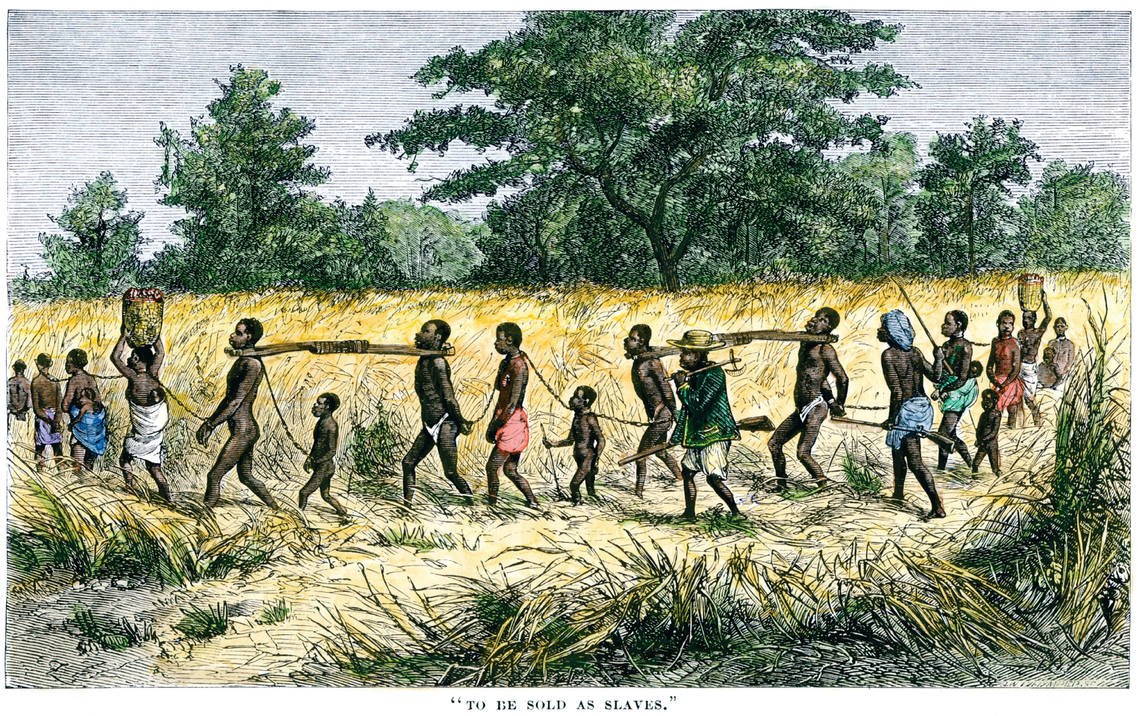
This eighteenth-century print shows bound African captives being forced to a slaving port. It was largely African middlemen who captured slaves in the interior and marched them to the coast. North Wind Picture Archives
Notes:
This eighteenth-century print shows bound African captives being forced to a slaving port. It was largely African middlemen who captured slaves in the interior and marched them to the coast.
North Wind Picture Archives

Slide 21
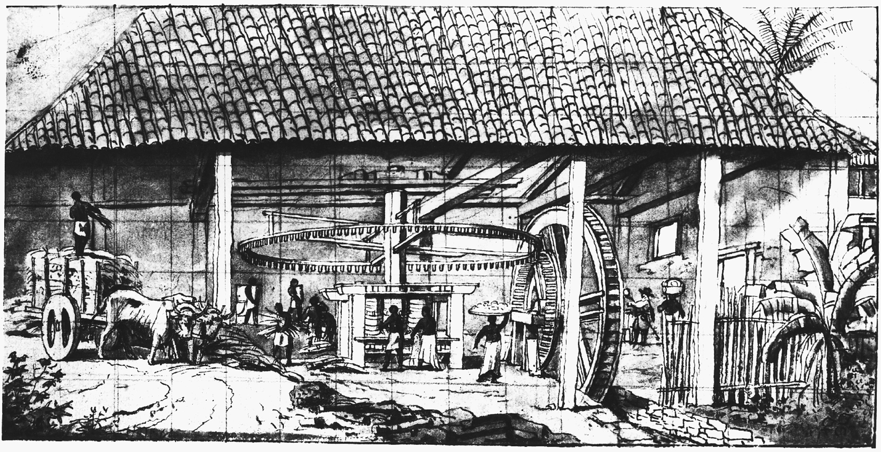
Sugar was both raised and processed on plantations such as this one in Brazil. Library of Congress
Notes:
Sugar was both raised and processed on plantations such as this one in Brazil.
Library of Congress

Slide 22
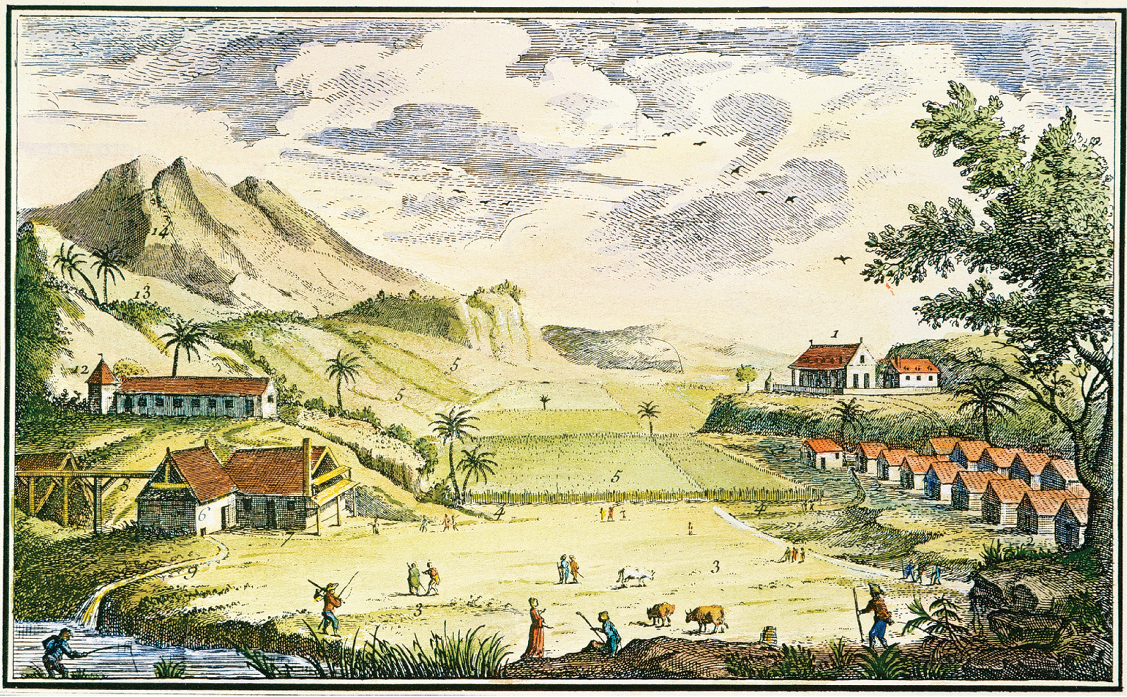
A Sugar Plantation in the West Indies West Indies Sugar plantations, owned by Europeans who often stayed only long enough to make their fortunes, were located on the fertile islands of the Caribbean. Employing slave laborers imported from Africa, the sugar plantations combined agricultural production of sugarcane and the industrial processing of it into sugar for export to Europe. Both stages were potentially deadly; the latter involved slaves working with dangerous machinery often near fires and hot metal equipment used in the distillation process. The Granger Collection, New York
Notes:
A Sugar Plantation in the West Indies West Indies Sugar plantations, owned by Europeans who often stayed only long enough to make their fortunes, were located on the fertile islands of the Caribbean. Employing slave laborers imported from Africa, the sugar plantations combined agricultural production of sugarcane and the industrial processing of it into sugar for export to Europe. Both stages were potentially deadly; the latter involved slaves working with dangerous machinery often near fires and hot metal equipment used in the distillation process.
The Granger Collection, New York

Slide 23
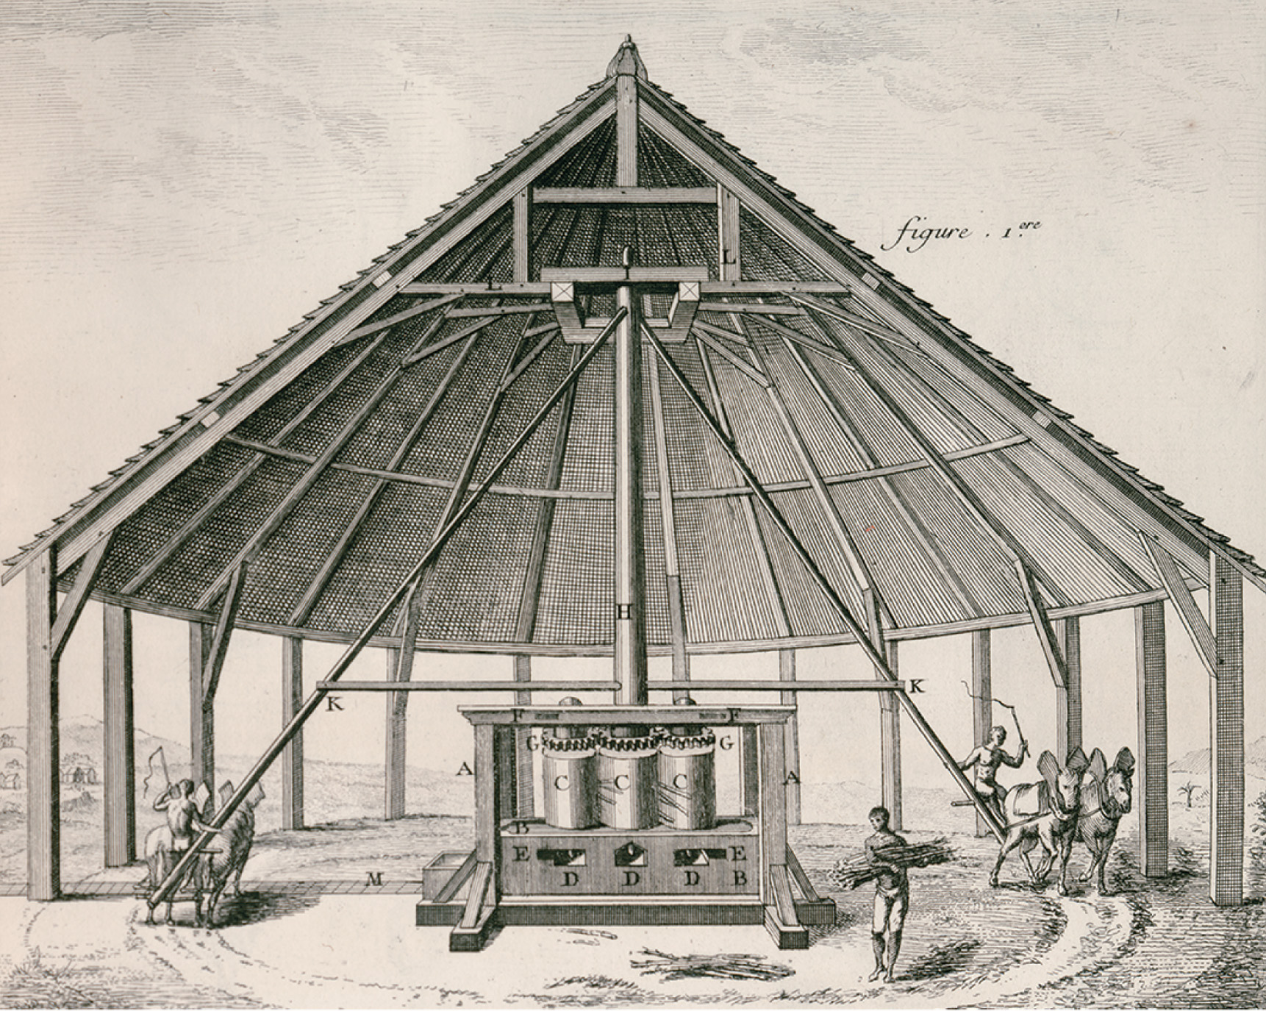
A Sugar Plantation in the West Indies West Indies Sugar plantations, owned by Europeans who often stayed only long enough to make their fortunes, were located on the fertile islands of the Caribbean. Employing slave laborers imported from Africa, the sugar plantations combined agricultural production of sugarcane and the industrial processing of it into sugar for export to Europe. Both stages were potentially deadly; the latter involved slaves working with dangerous machinery often near fires and hot metal equipment used in the distillation process. Denis Diderot, Encyclopedie, ou, Dictionnaire Raisonné des Sciences, des Arts et des Métiers. Recueil de Planches, sur les Sciences. (Paris, 1762), vol. 1. Special Collections, University of Virginia Library
Notes:
A Sugar Plantation in the West Indies West Indies Sugar plantations, owned by Europeans who often stayed only long enough to make their fortunes, were located on the fertile islands of the Caribbean. Employing slave laborers imported from Africa, the sugar plantations combined agricultural production of sugarcane and the industrial processing of it into sugar for export to Europe. Both stages were potentially deadly; the latter involved slaves working with dangerous machinery often near fires and hot metal equipment used in the distillation process.
Denis Diderot, Encyclopedie, ou, Dictionnaire Raisonné des Sciences, des Arts et des Métiers. Recueil de Planches, sur les Sciences. (Paris, 1762), vol. 1. Special Collections, University of Virginia Library

Slide 24
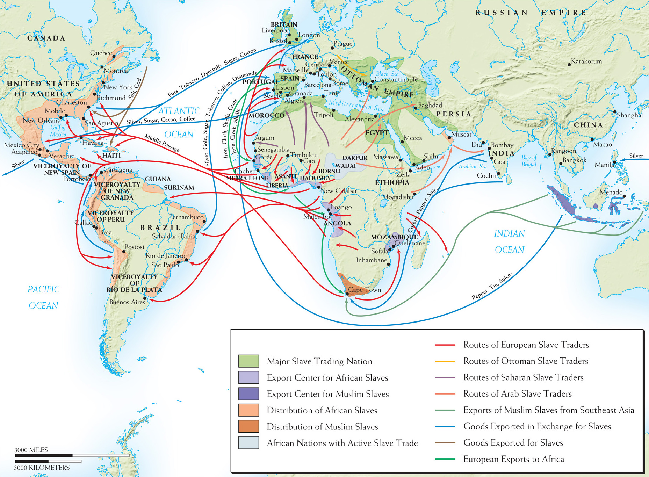
Map 16–2 THE SLAVE TRADE, 1400–1860 Slavery is an ancient institution and complex slave-trading routes were in existence in Africa, the Middle East, and Asia for centuries, but it was the need to supply labor for the plantations of the Americas that led to the greatest movement of peoples across the face of the earth.
Notes:
Map 16–2 THE SLAVE TRADE, 1400–1860 Slavery is an ancient institution and complex slave-trading routes were in existence in Africa, the Middle East, and Asia for centuries, but it was the need to supply labor for the plantations of the Americas that led to the greatest movement of peoples across the face of the earth.

Slide 25
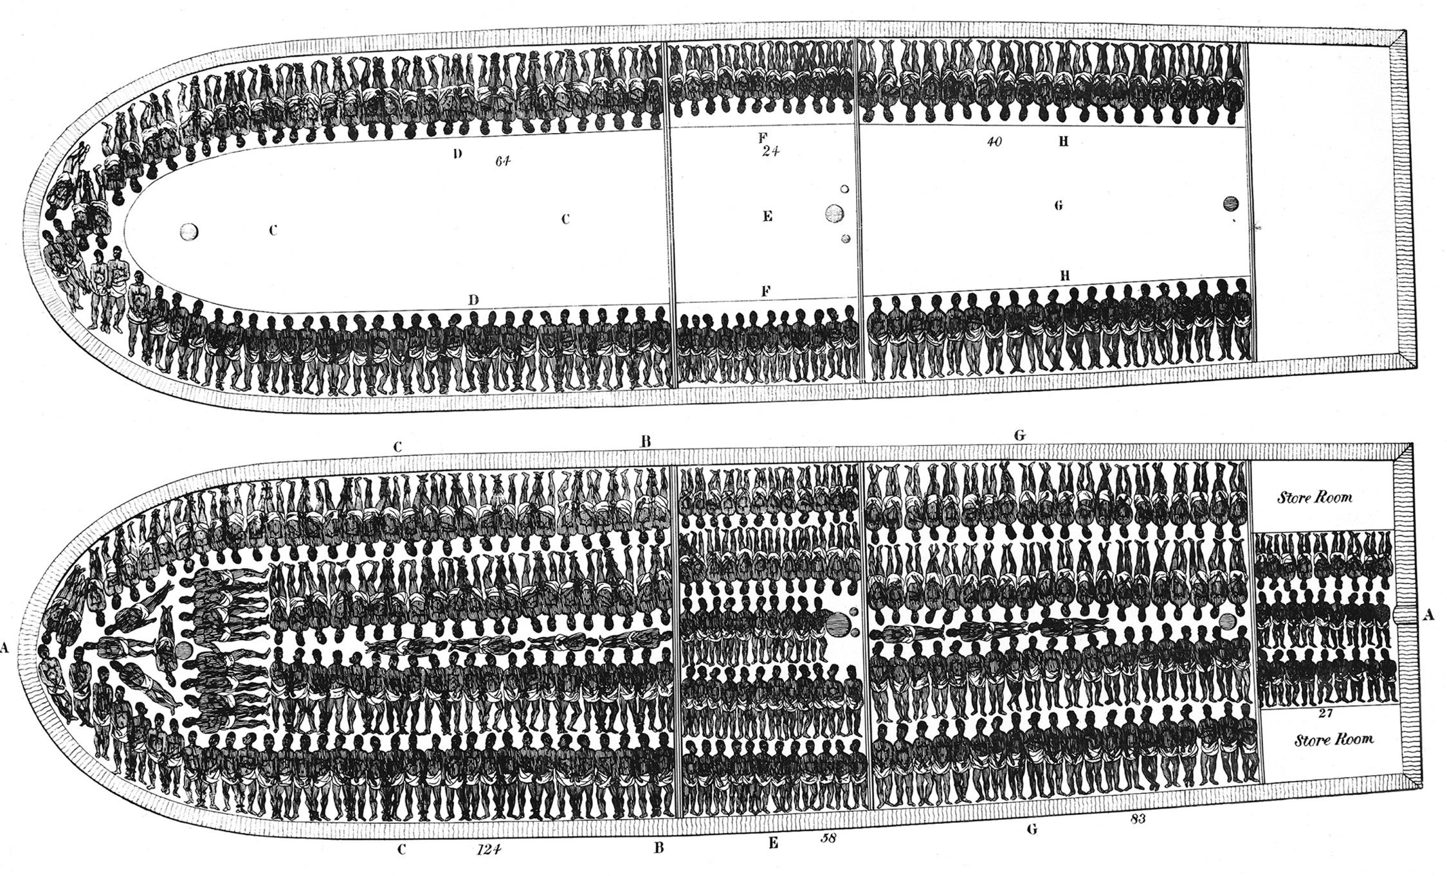
The Slave Ship Brookes This print records the main decks of the 320-ton slave ship Brookes. Library of Congress
Notes:
The Slave Ship Brookes This print records the main decks of the 320-ton slave ship Brookes.
Library of Congress

Slide 26
The Experience of Slavery
Estimated 9 million Africans or more brought to Americas over 4 centuries
“Seasoned” slaves worth more than those newly arrived
Maintenance of ethnic bonds in the New World—African language, religion

Slide 27
The Experience of Slavery (cont.)
Generally accepted that all the slaves in plantation societies led difficult lives with little variation
Some slaves mixed Christianity with African religions
One of the factors that continued slavery was racist ideology in European society

Slide 28
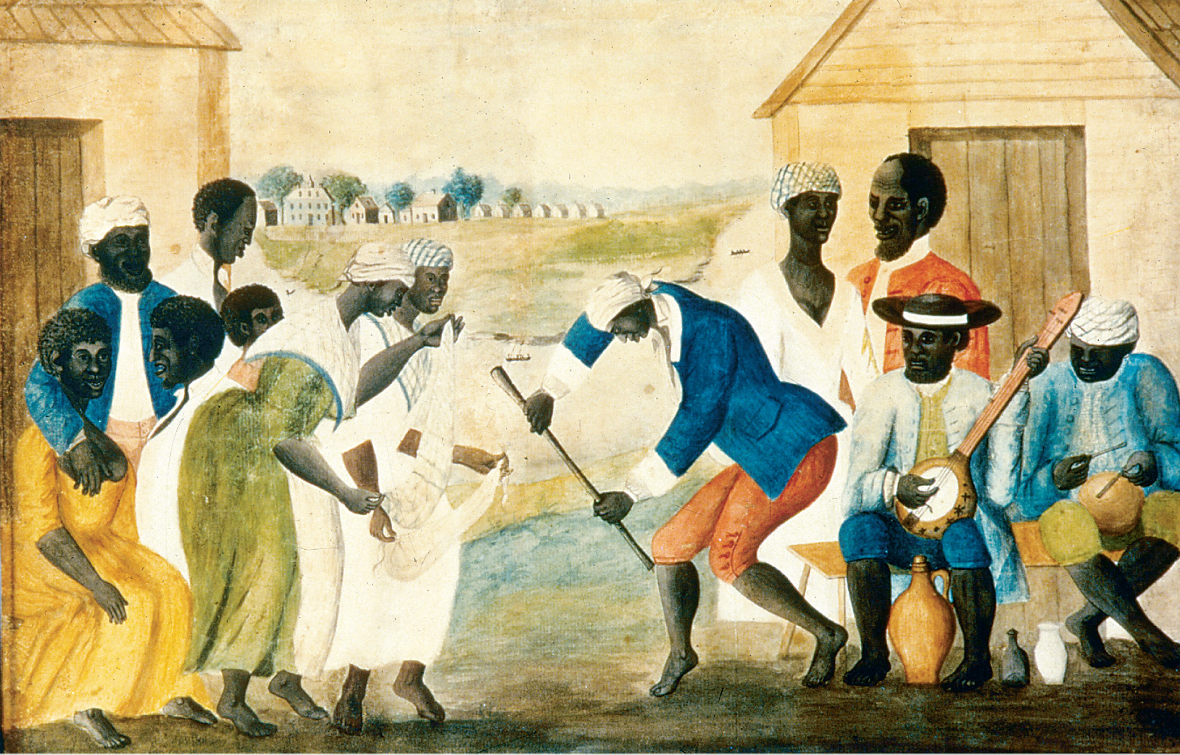
Slaves on the plantations of the American South were the chattel property of their masters, and their lives were grim. Some artists sought to disguise this harsh reality by depicting the lighter moments of slave society as in this scene of slaves dancing. MPI/Stringer/Archive Photos/Getty Images
Notes:
Slaves on the plantations of the American South were the chattel property of their masters, and their lives were grim. Some artists sought to disguise this harsh reality by depicting the lighter moments of slave society as in this scene of slaves dancing.
MPI/Stringer/Archive Photos/Getty Images

Slide 29
Mid-Eighteenth-Century Wars
War of Jenkins’ Ear (1739)
English-Spanish competition in West Indies
British declared war on Spain in 1739
Minor war but was opening encounter to series of European wars through 1815

Slide 30
War of the Austrian Succession (1740–1748)
Central & Eastern Europe
Prussia invades (Habsburg) Silesia; France & Spain back Prussia, England backs Austria
Maria Theresa maintains Hapsburg empire as a major political power
Ended with Treaty of Aix-la-Chapelle in 1748
Prussia retained Silesia, Spain renewed Treaty of Utrecht with Britain so they could import slaves from Spanish colonies

Slide 31
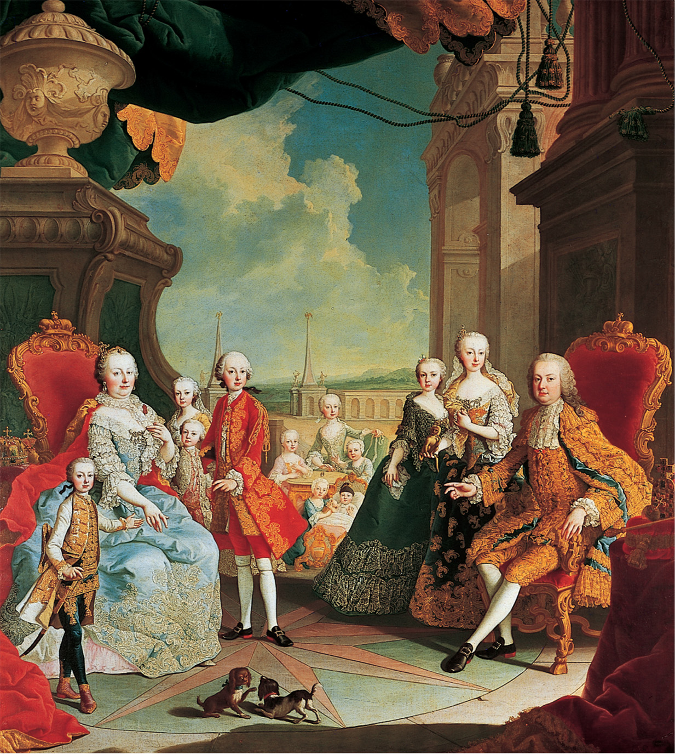
Maria Theresa of Austria provided the leadership that saved the Habsburg Empire from possible disintegration after the Prussian invasion of Silesia in 1740. Martin van Meytens: Kaiserin Maria Theresia mit ihrer Familie auf der Schloßterasse von Schönbrunn. Kunsthistorisches Museum, Vienna, Austria
Notes:
Maria Theresa of Austria provided the leadership that saved the Habsburg Empire from possible disintegration after the Prussian invasion of Silesia in 1740.
Martin van Meytens: Kaiserin Maria Theresia mit ihrer Familie auf der Schloßterasse von Schönbrunn. Kunsthistorisches Museum, Vienna, Austria

Slide 32
The “Diplomatic Revolution” of 1756
France and Britain clash in New England
Great Britain joined forces with Germany, Convention of Westminster
France and Austria agreed to defensive alliance

Slide 33
Seven Years’ War (1756–1763)
Frederick II (the Great) began war by invading German state of Saxony
England now backs Prussia, France backs Austria
Colonial theater: Britain, led by William Pitt the Elder, trounces France in N. America
Treaty of Paris of 1763 made Britain into a world power, through World War II

Slide 34
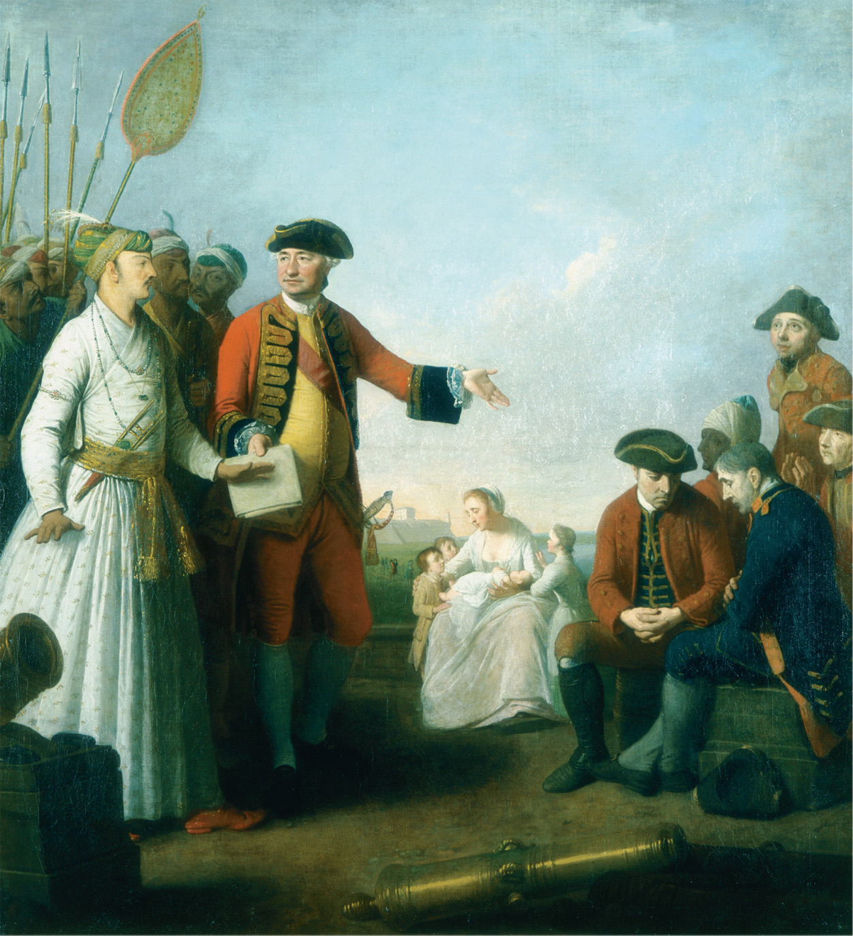
This scene, painted by artist Edward Penny, shows Robert Clive receiving a sum of money from Siraj-ud-daulah, the Mughal Nawab of Bengal, for injured officers and soldiers at Plassey. Clive’s victory in 1757 at the Battle of Plassey led to English domination of the Indian subcontinent for almost two centuries. Clive had won the battle largely through bribing many of the Nawab’s troops and potential allies. Erich Lessing/British Library, London, Great Britain/Art Resource, NY
Notes:
This scene, painted by artist Edward Penny, shows Robert Clive receiving a sum of money from Siraj-ud-daulah, the Mughal Nawab of Bengal, for injured officers and soldiers at Plassey. Clive’s victory in 1757 at the Battle of Plassey led to English domination of the Indian subcontinent for almost two centuries. Clive had won the battle largely through bribing many of the Nawab’s troops and potential allies.
Erich Lessing/British Library, London, Great Britain/Art Resource, NY

Slide 35
Europe and the American Revolution
Resistance to the Imperial Search for Revenue
Caused by problems of revenue collection common to all powers after Seven Years’ War
British tried to tax colonies to pay for war
Colonies responded that they wouldn’t be taxed without representation

Slide 36
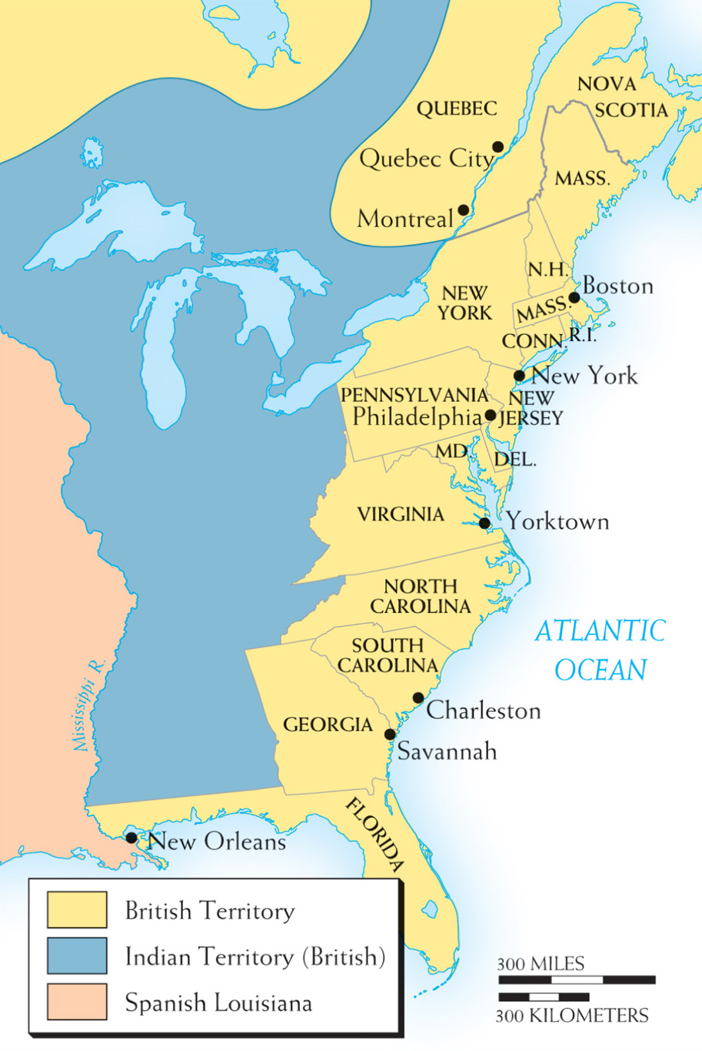
Map 16–3 NORTH AMERICA IN 1763 In the year of the victory over France, the English colonies lay along the Atlantic seaboard. The difficulties of organizing authority over the previous French territory in Canada and west of the Appalachian Mountains would contribute to the coming of the American Revolution.
Notes:
Map 16–3 NORTH AMERICA IN 1763 In the year of the victory over France, the English colonies lay along the Atlantic seaboard. The difficulties of organizing authority over the previous French territory in Canada and west of the Appalachian Mountains would contribute to the coming of the American Revolution.

Slide 37
The Crisis and Independence
Colonies resisted several measures designed to raise money, including Intolerable Acts
Thomas Paine’s Common Sense aroused revolutionary sentiments
Continental Congress declared Declaration of Independence

Slide 38
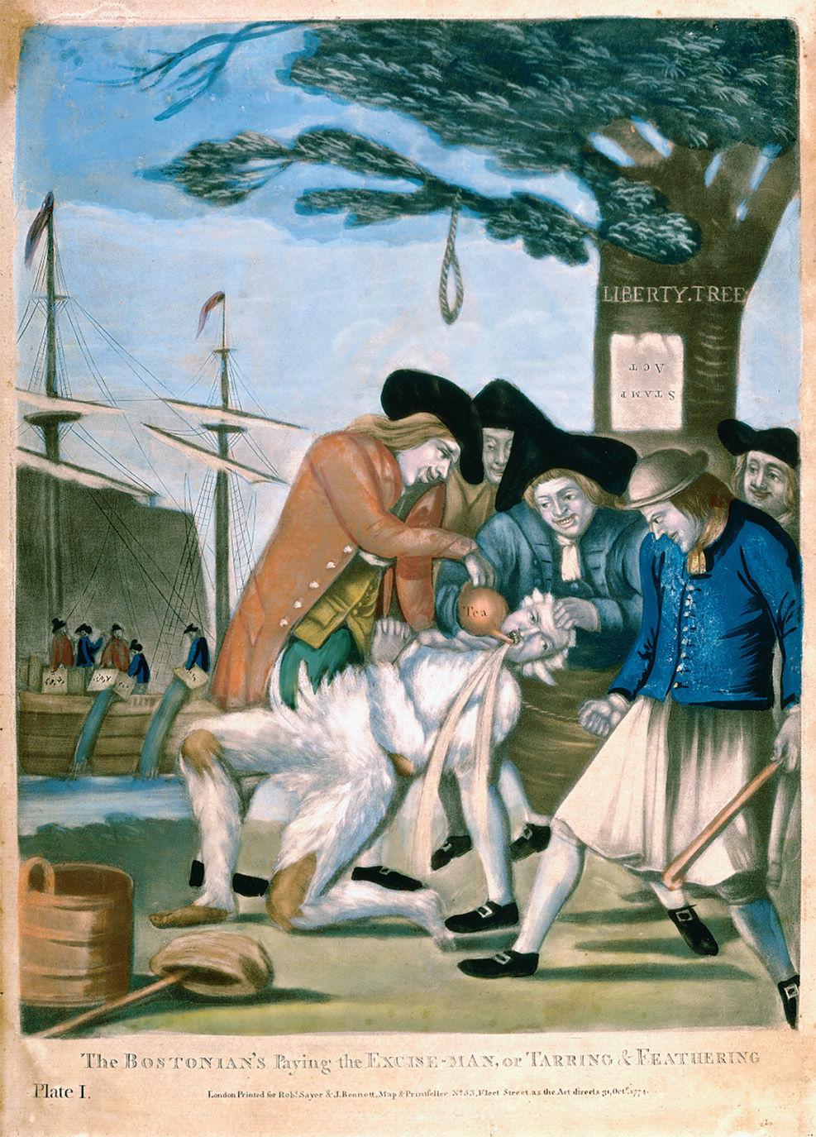
Many Americans fiercely objected to the British Parliament’s attempts to tax the colonies. This print of a British tax collector being tarred and feathered warned officials of what could happen to them if they tried to collect these taxes. Philip Dawe (c. 1750–c. 1785), The Bostonians Paying the Excise-Man or Tarring & Feathering. London, 1774. Colored Engraving. The Gilder Lehman Collection on deposit at the Pierpont Morgan Library. GL 4961.01. Private Collection/Art Resource, NY
Notes:
Many Americans fiercely objected to the British Parliament’s attempts to tax the colonies. This print of a British tax collector being tarred and feathered warned officials of what could happen to them if they tried to collect these taxes.
Philip Dawe (c. 1750–c. 1785), The Bostonians Paying the Excise-Man or Tarring & Feathering. London, 1774. Colored Engraving. The Gilder Lehman Collection on deposit at the Pierpont Morgan Library. GL 4961.01. Private Collection/Art Resource, NY

Slide 39
American Political Ideas
Influence of English ideas & events in America
Revolution of 1688
Writings of John Locke
America becomes familiar with British political writers, Commonwealthmen
John Trenchard and Thomas Gordon, Cato’s Letters (1720-1723)

Slide 40
Events in Great Britain
John Wilkes affair
Arrested after criticizing treaty with France in print
Elected several times to Parliament but king would not seat him

Slide 41
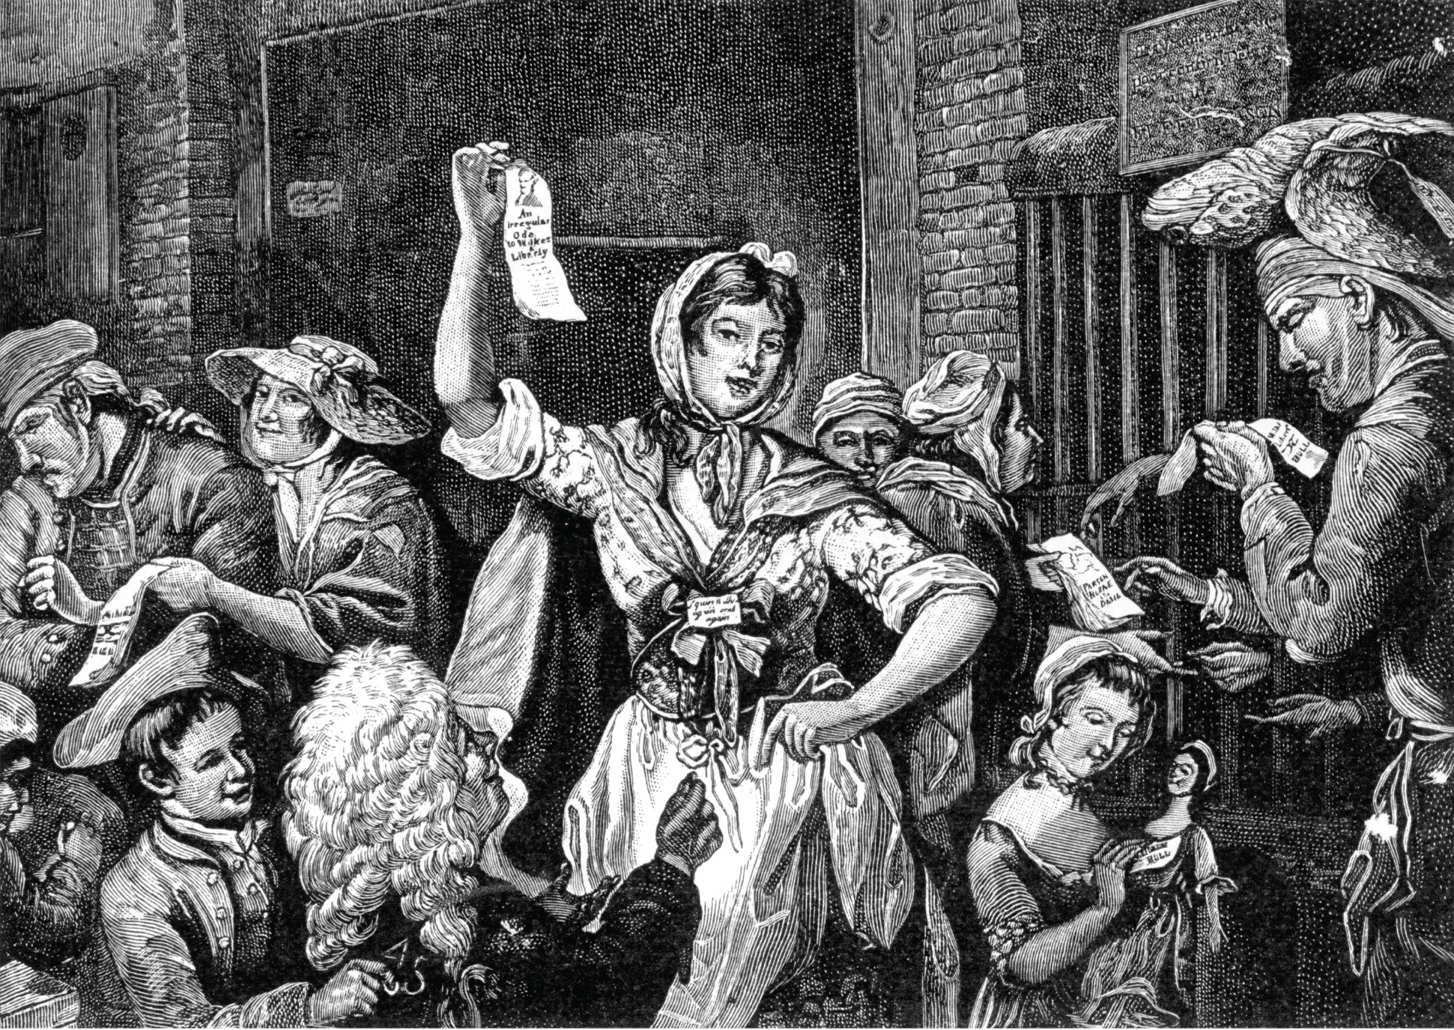
“Wilkes and Liberty” was a popular slogan among political radicals in England long after Wilkes’ 1763 arrest for seditious libel. In this 1771 mezzotint, “The City Chanters,” women sell ballads in front of the Fleet prison; one of the sheets is labeled “An Irregular Ode to Wilkes & Liberty.” Wilkes’ widespread popularity among the “middling and inferior set of people, who stand most in need of protection,” as he referred to his constituency, contributed to the ruling elites’ anxieties. © Timewatch Images/Alamy
Notes:
“Wilkes and Liberty” was a popular slogan among political radicals in England long after Wilkes’ 1763 arrest for seditious libel. In this 1771 mezzotint, “The City Chanters,” women sell ballads in front of the Fleet prison; one of the sheets is labeled “An Irregular Ode to Wilkes & Liberty.” Wilkes’ widespread popularity among the “middling and inferior set of people, who stand most in need of protection,” as he referred to his constituency, contributed to the ruling elites’ anxieties.
© Timewatch Images/Alamy

Slide 42
Events in Great Britain (cont.)
Influence of American ideas & events in Britain
Appeal to popular opinion
Broadly rejected monarchy, social hierarchies
Yorkshire Association Movement demanded changes in parliamentary elections

Slide 43
Broader Impact of American Revolution
Demonstrated to Europe possibility of government without kings
Idea of preserving traditional liberties
Rejected social status

Slide 44
The Columbian Exchange: Disease
Diseases enter the Americas
Smallpox
Typhus
Influenza
Native Americans highly susceptible, lacked immunity

Slide 45
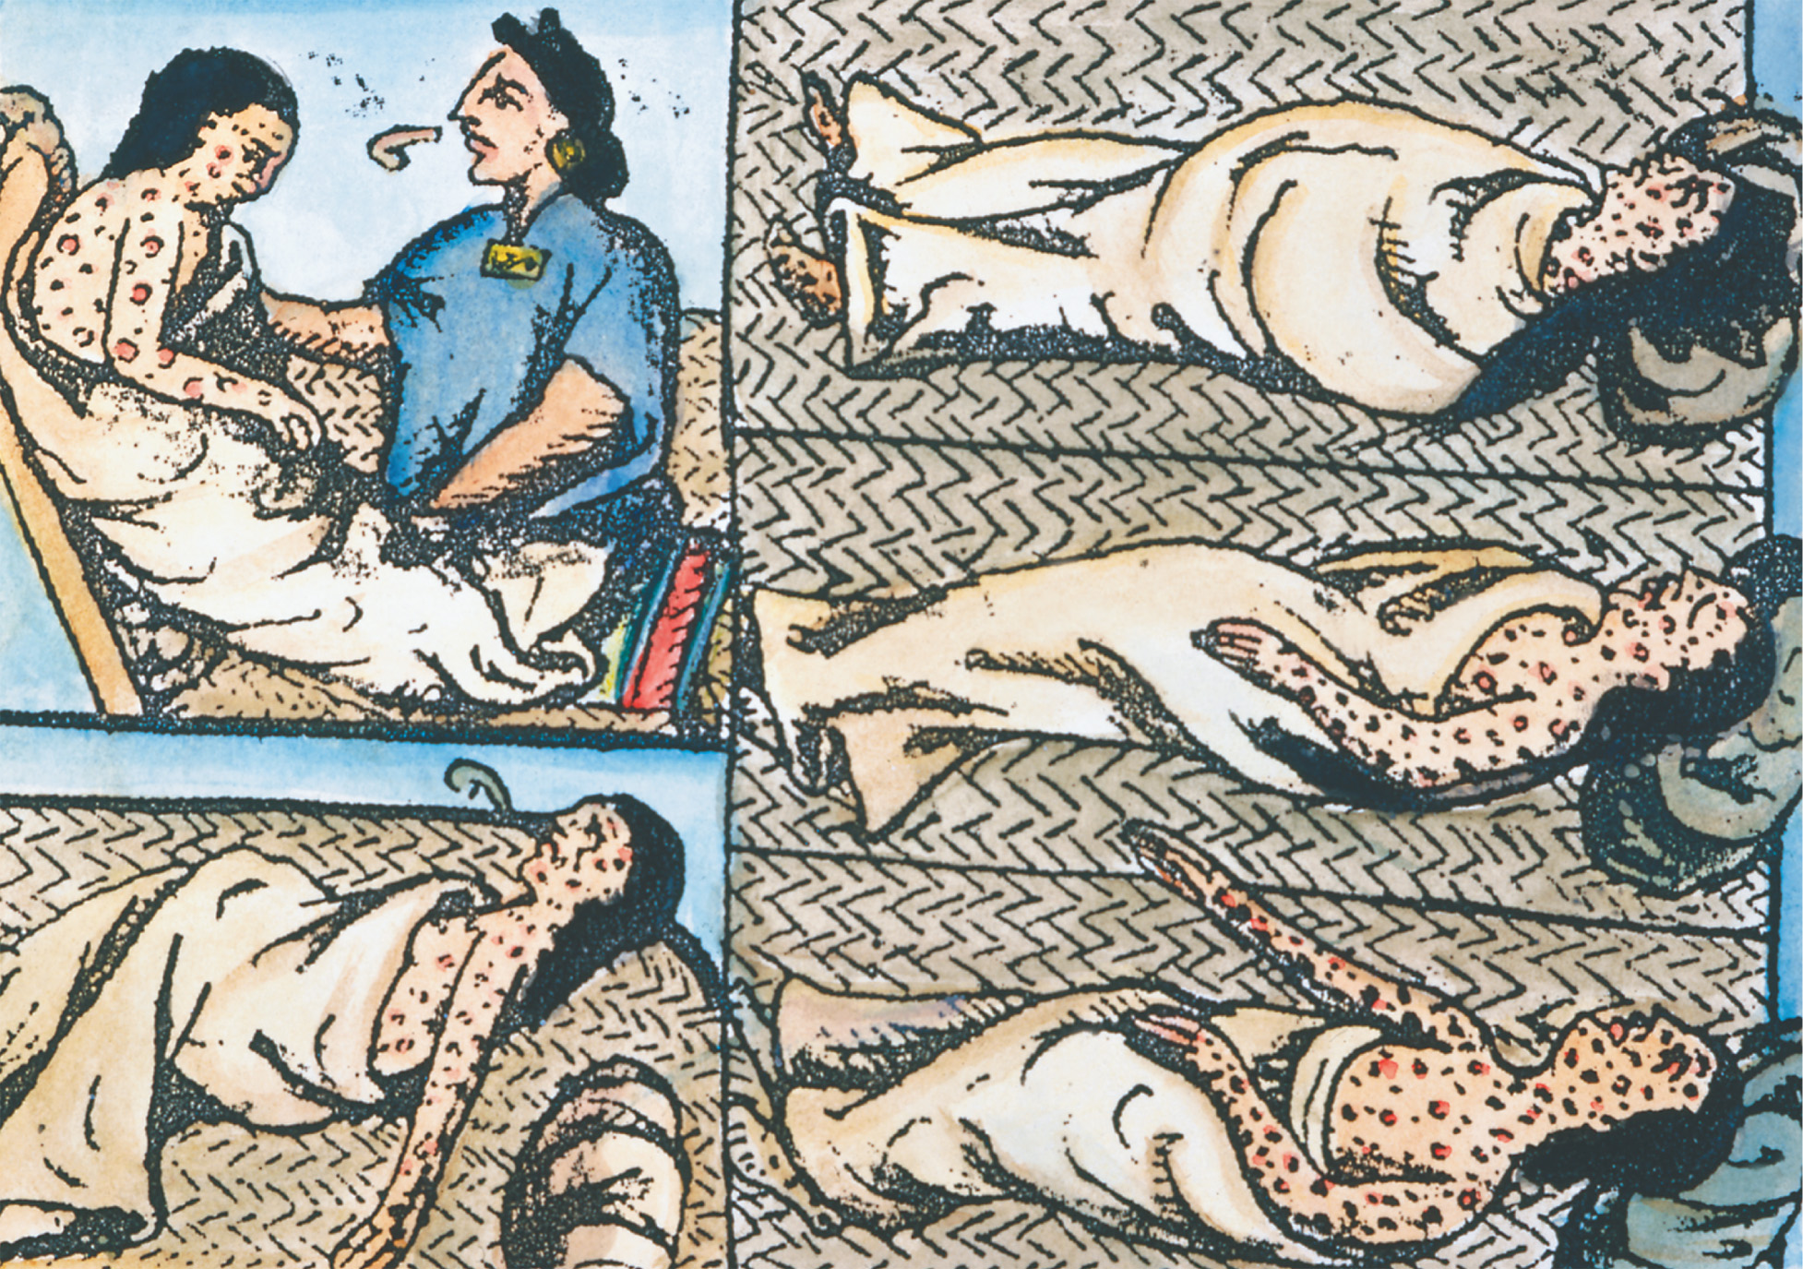
Nothing so destroyed the life of the Native Americans whom the Spanish encountered as the introduction of smallpox. With no immune defenses to this new disease, millions of Native Americans died of smallpox during the sixteenth and seventeenth centuries. The Granger Collection
Notes:
Nothing so destroyed the life of the Native Americans whom the Spanish encountered as the introduction of smallpox. With no immune defenses to this new disease, millions of Native Americans died of smallpox during the sixteenth and seventeenth centuries.
The Granger Collection

Slide 46
The Columbian Exchange: Animals, and Agriculture
European livestock
Pigs, cattle, goats, and sheep
Horses
Animal of conquest
Colonial Latin American culture

Slide 47
The Columbian Exchange: Animals, and Agriculture (cont.)
Plants
Fruits and vegetables
Sugarcane
Plantation economy
Slavery

Slide 48
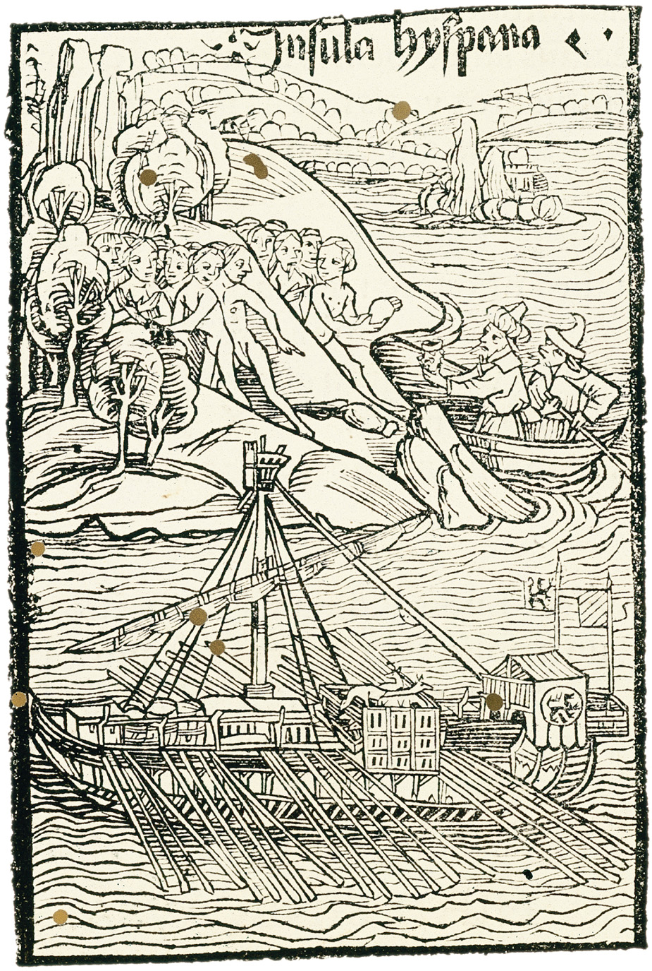
Within one year of Columbus’s encounter with the Americas, the event had been captured in this woodcut (c. 1493). Columbus’s several voyages, and those of later Europeans as well, introduced not only European warfare but also began a vast ecological exchange of plants, animals, and diseases between the Old and New Worlds. Courtesy of the Library of Congress
Notes:
Within one year of Columbus’s encounter with the Americas, the event had been captured in this woodcut (c. 1493). Columbus’s several voyages, and those of later Europeans as well, introduced not only European warfare but also began a vast ecological exchange of plants, animals, and diseases between the Old and New Worlds.
Courtesy of the Library of Congress

