Slide 1
Chapter 17
The Age of Enlightenment: Eighteenth-Century Thought

Slide 2
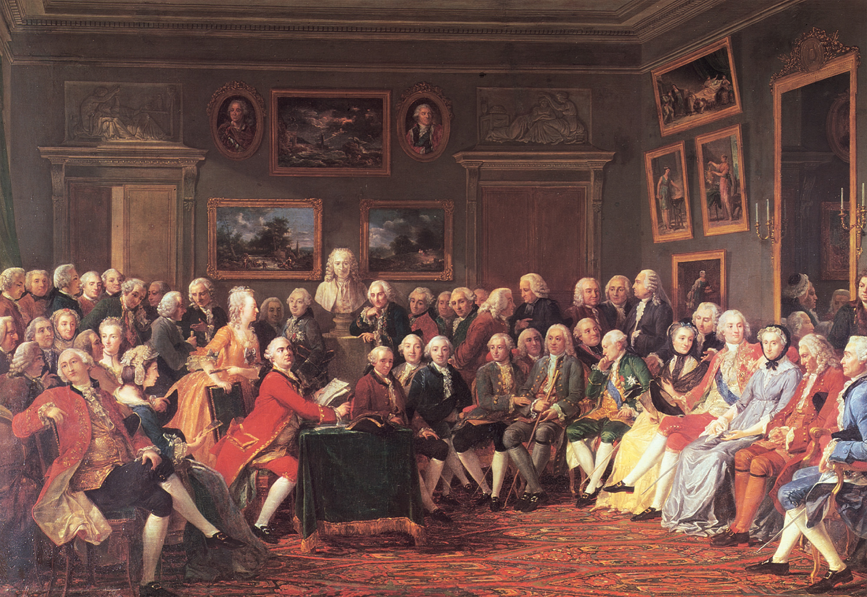
The salon of Madame Marie Thérèse Geoffrin (1699–1777) was one of the most important Parisian gathering spots for Enlightenment writers during the middle of the eighteenth century. Well-connected women such as Madame Geoffrin were instrumental in helping the philosophes they patronized to bring their ideas to the attention of influential people in French society and politics. Chateaux de Malmaison et Bois-Preau, Rueil-Malmaison/© RMN-Grand Palais/Art Resource, NY
Notes:
The salon of Madame Marie Thérèse Geoffrin (1699–1777) was one of the most important Parisian gathering spots for Enlightenment writers during the middle of the eighteenth century. Well-connected women such as Madame Geoffrin were instrumental in helping the philosophes they patronized to bring their ideas to the attention of influential people in French society and politics.
Chateaux de Malmaison et Bois-Preau, Rueil-Malmaison/© RMN-Grand Palais/Art Resource, NY

Slide 3
The Ideas of Isaac Newton
His law of universal gravitation showed the power of the human mind
Encouraged natural philosophers to approach nature directly
Insisted upon empirical rationalization to check rational explanation

Slide 4
The Ideas of John Locke
Argued all humans entered the world as a blank page
Argued experience shapes character
Rejected the Christian notion that sin permanently flawed humans
Humans can take charge of their own destiny

Slide 5
The Example of British Toleration and Political Stability
Religious toleration except for Unitarians and Roman Catholics
Freedom of speech and press
Limited monarchy
Courts protect citizens from arbitrary government action

Slide 6
Print Culture
The volume of printed materials increased; books, journals, magazines, daily newspapers
Religious versus secular – increasing number of books that were not religious led to criticism

Slide 7
Print Culture (cont.)
People of print
Joseph Addison and Richard Steele - published books on politeness and the value of books
Alexander Pope and Voltaire – become wealthy and famous from their writings

Slide 8
Print Culture (cont.)
Public opinion – the collective effect on political and social life of views discussed in the home, workplace, and places of leisure
Government had to answer to the people
Central European governments censored books in fear, confiscated offending titles, and imprisoned authors

Slide 9
The Philosophes
People who favored change, championed reform, and advocated toleration
Could be found at universities and coffee houses
Usually supported expansion of trade, improvement of agriculture and transportation, invention of new manufacturing industries
Adept at attracting wealthy supporters

Slide 10
Voltaire, The First Philosophe
Imprisoned at the Bastille for offending the French
Went into exile in England

Slide 11
Voltaire, the First Philosophe (cont.)
Published works
1733 – Letters on the English – praised the British for their freedoms, especially of religion, and criticized the French
1738 – Elements of the Philosophy of Newton – popularized the theories of Newton after his death
1759 – Candide – satire attacking war, religious persecution, and unwarranted optimism about the human condition

Slide 12
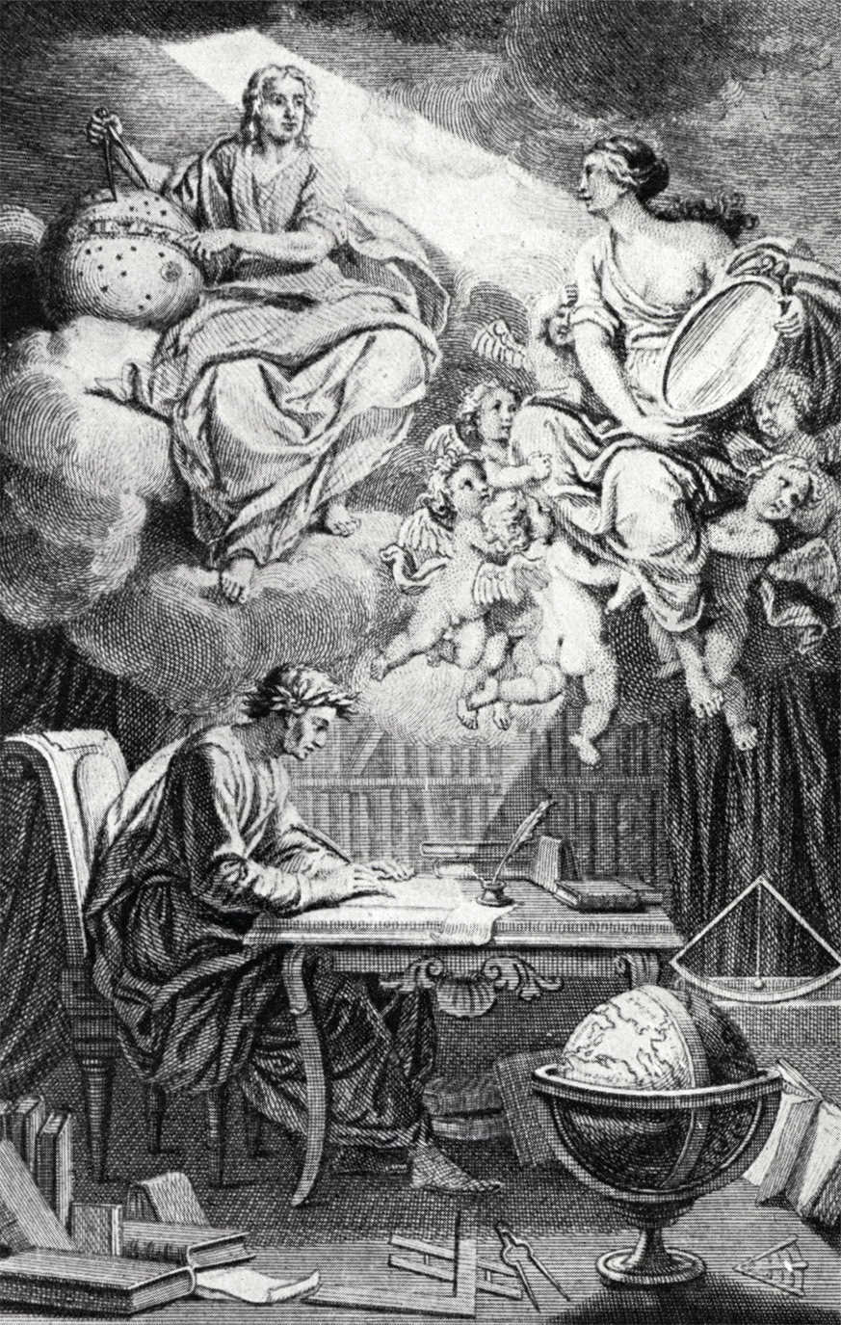
The frontispiece to Voltaire’s 1738 work, “Elements of the Philosophy of Newton” shows Voltaire writing by a light deflected from the celestial Newtown by a woman, his muse and lover, Emilie Du Chatelet. Du Chatelet helped Voltaire work through and come to understand Newton’s Principia Mathematica during the course of her own translations. © Lebrecht Music and Arts Photo Library/Alamy
Notes:
The frontispiece to Voltaire’s 1738 work, “Elements of the Philosophy of Newton” shows Voltaire writing by a light deflected from the celestial Newtown by a woman, his muse and lover, Emilie Du Chatelet. Du Chatelet helped Voltaire work through and come to understand Newton’s Principia Mathematica during the course of her own translations.
© Lebrecht Music and Arts Photo Library/Alamy

Slide 13
The Enlightenment and Religion
Many but not all Enlightenment thinkers challenged the church and its concepts of “original sin.”
The church was not just challenged for its thoughts, but for its practices
Not paying taxes
Involvement in politics
Literary censorship
Ecrasez l’infame!

Slide 14
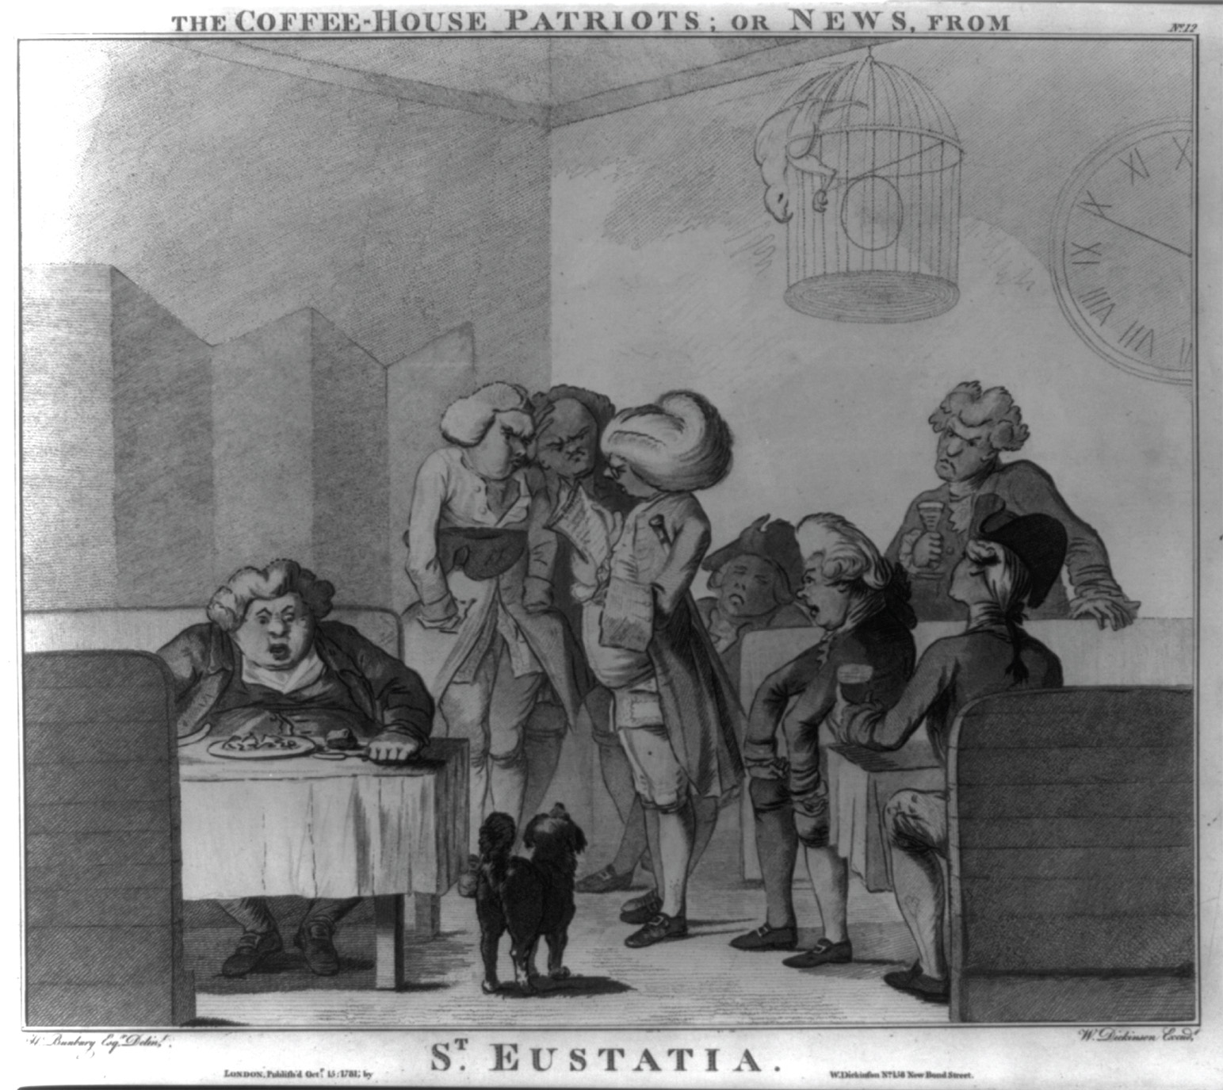
W. Dickinson, “The Coffeehouse Patriots; or news, from St. Eustatia” (London, 15 October 1781). Satirical attacks on coffeehouse patrons, who in this cartoon are accused of putting their own business interests ahead of political allegiance to the crown, were common by the late eighteenth century. The men of commerce gathered in the center of the room, sharing a newspaper, are upset by the news that St. Eustatius, a Dutch Caribbean port used by British merchants for illegal trade with the American colonies, had been captured by the British. The furnishings and animals were all typical of the London coffeehouse of the late eighteenth century. Library of Congress
Notes:
W. Dickinson, “The Coffeehouse Patriots; or news, from St. Eustatia” (London, 15 October 1781). Satirical attacks on coffeehouse patrons, who in this cartoon are accused of putting their own business interests ahead of political allegiance to the crown, were common by the late eighteenth century. The men of commerce gathered in the center of the room, sharing a newspaper, are upset by the news that St. Eustatius, a Dutch Caribbean port used by British merchants for illegal trade with the American colonies, had been captured by the British. The furnishings and animals were all typical of the London coffeehouse of the late eighteenth century.
Library of Congress

Slide 15
Deism – Religion and Reason Combined
Deism - new set of ideas that combined religion & reason
tolerant, reasonable, capable of encouraging virtuous living
Philosophes sought:
religion without fanaticism & intolerance
religious life that depended on human reason not church authority

Slide 16
Deism – Religion and Reason Combined
Two major points of the creed:
belief in the existence of God, which they thought the contemplation of nature could empirically justify
Belief in life after death, when rewards & punishments would be meted out according to virtue of life on earth

Slide 17
Deism – Religion and Reason Combined
John Toland - Christianity Not Mysterious (1696) – promoted religion as natural and rational, rather than supernatural and mystical
Differed from Newton & Locke in this sense:
Both Newton & Locke considered themselves as Christians even if not traditionally orthodox

Slide 18
Religious Toleration Literary Works
John Locke – Letter Concerning Toleration (1689) – set forth toleration as prime requisite for a virtuous life
Voltaire – Treatise on Tolerance (1763) – wanted answers to why the Roman Catholic Church in Toulouse executed Huguenot Jean Calas
Gothold Lessing – Nathan the Wise (1779) – called for religious tolerance of all religions, not just Christianity

Slide 19
Radical Enlightenment Texts
David Hume – Inquiry Into Human Nature (1748) – no empirical evidence that miracles exist
Voltaire – Philosophical Dictionary (1764) – using humor, pointed out inconsistencies in the Bible and the immoral acts of Biblical heroes

Slide 20
Radical Enlightenment Texts (cont.)
Edward Gibbon – Decline and Fall of the Roman Empire (1776) – explains the rise of Christianity through natural causes
Immanuel Kant – Religion within the Limits of Reason Alone (1793) – religion as a humane force through which there can be virtuous living

Slide 21
The Enlightenment and Judaism
Jewish Thinkers
Baruch Spinoza – Ethics – closely identified God with nature and linked the spiritual to the material world
Theologico-Political Treatise (1670) – called on both Jews and Christians to use reason in religious matters
Excommunicated from his synagogue for his beliefs

Slide 22
The Enlightenment and Judaism (cont.)
Jewish Thinkers
Moses Mendelsohn – argued differently from Spinoza that you could combine loyalty to Judaism with rational thought
Jerusalem (1783) – argued for religious toleration and the religious distinction of Jewish communities

Slide 23
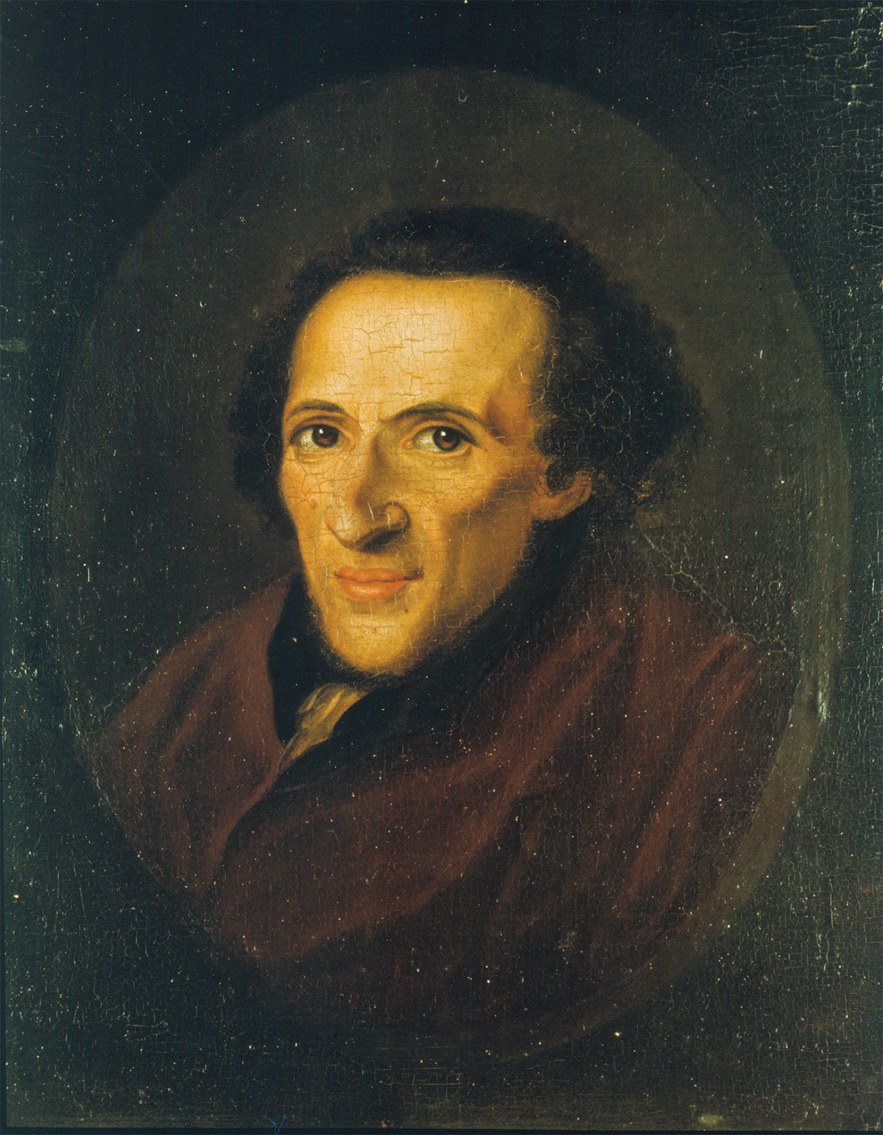
Moses Mendelssohn, the leading philosopher of the Jewish enlightenment, was often called the “Jewish Socrates.” bpk, Berlin/Staatsbibliothek zu Berlin, Stiftung Preussischer Kulturbesitz, Berlin, Germany/Ruth Schacht. Mendelssohn Archive/Art Resource, NY
Notes:
Moses Mendelssohn, the leading philosopher of the Jewish enlightenment, was often called the “Jewish Socrates.”
bpk, Berlin/Staatsbibliothek zu Berlin, Stiftung Preussischer Kulturbesitz, Berlin, Germany/Ruth Schacht. Mendelssohn Archive/Art Resource, NY

Slide 24
Islam in Enlightenment Thought
Christians viewed Islam as a false religion and its founder Muhammad as an imposter
Philosophes critical of Islam
Voltaire’s Fanaticism (1742) – cited Islam as one more example of religious fanaticism
Charles de Montesquieu – Spirit of the Law (1748) – stated Islam’s passivity made it subject to political despotism

Slide 25
Islam in Enlightenment Thought (cont.)
Philosophes Positive about Islam
Deists Toland and Gibbon viewed Islam in a positive light
Lady Mary Wortley Montagu – Turkish Embassy Letters (1716-1718) – praised Ottoman society / felt women were freer

Slide 26
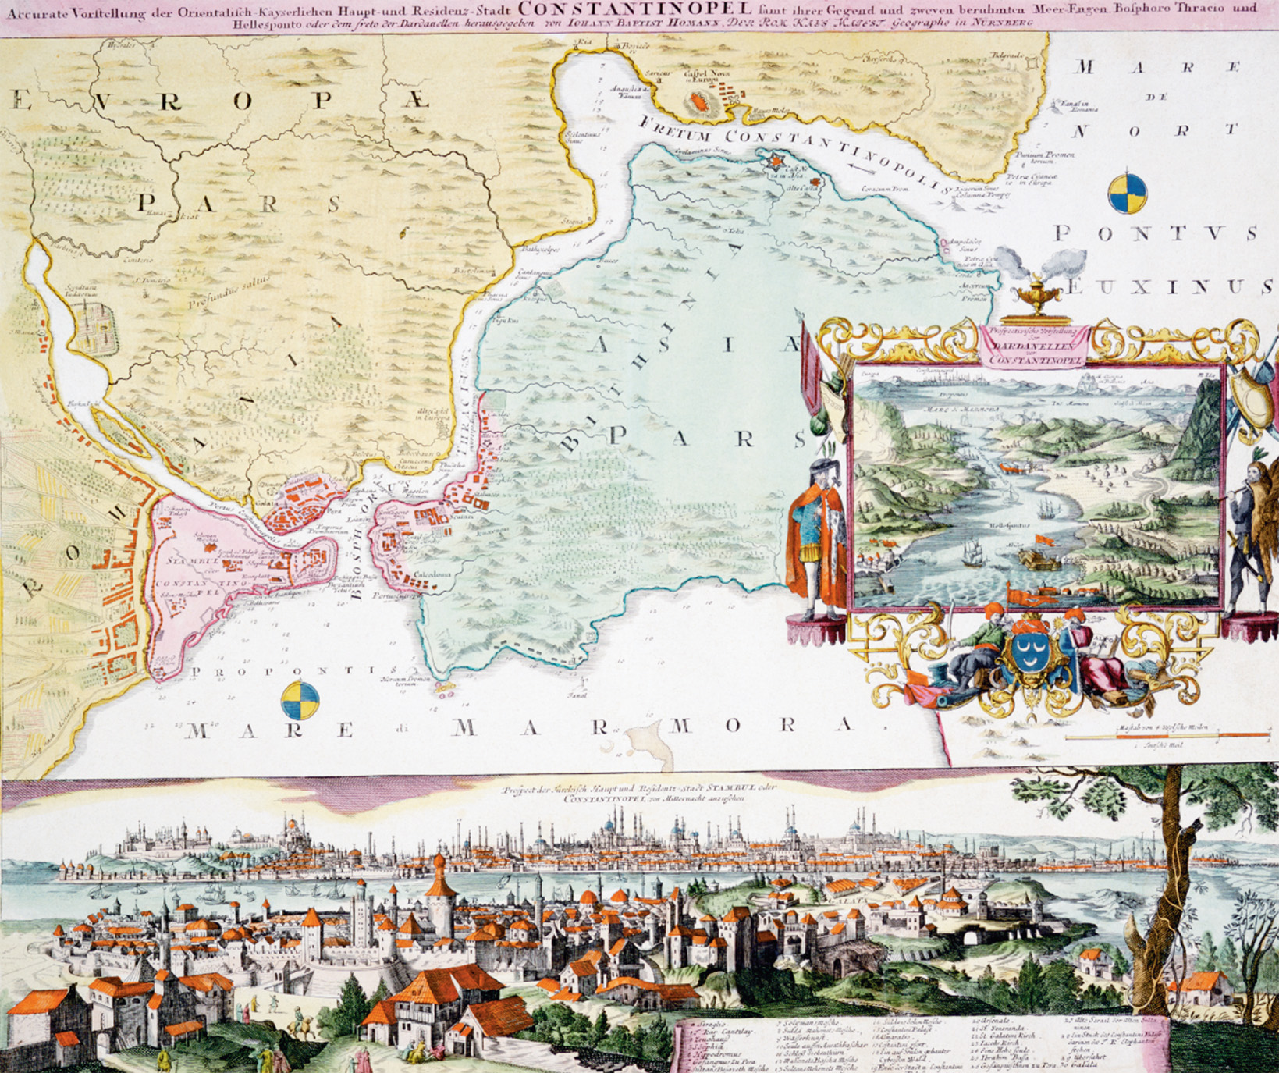
Few Europeans visited the Ottoman Empire. What little they knew about it came from reports of travelers and from illustrations such as this 1710 view of Constantinople, the empire’s capital. © Historical Picture Archive/CORBIS
Notes:
Few Europeans visited the Ottoman Empire. What little they knew about it came from reports of travelers and from illustrations such as this 1710 view of Constantinople, the empire’s capital.
© Historical Picture Archive/CORBIS

Slide 27
The Encyclopedia
Edited by Denis Diderot and Jean Le Rond d’Alembert
Collective work of more than one hundred authors
Had important information about 18th century social and economic life
Between 14,000 and 16,000 copies sold before 1789
Aimed to secularize learning

Slide 28
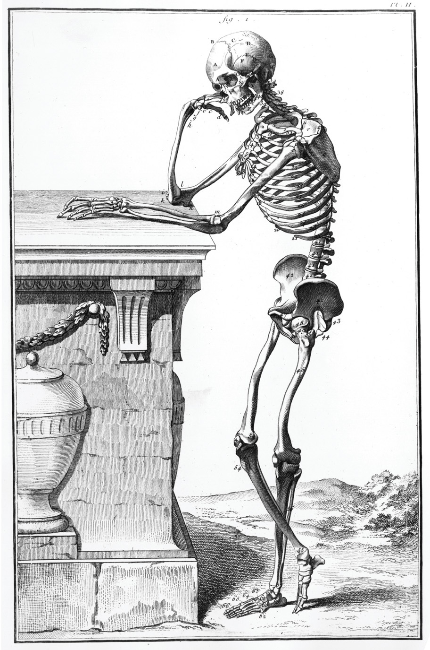
“Anatomy,” one of the many illustrations included in Diderot’s Encyclopedia, provided labels for each of the bones in an articulated skeleton that were then identified and named in the text. bpk, Berlin/Engraving by A.J. Defehrt (1723–1774). From “Encyclopédie” by Denis Diderot and Jean le Rond d’Alembert/Art Resource, NY
Notes:
“Anatomy,” one of the many illustrations included in Diderot’s Encyclopedia, provided labels for each of the bones in an articulated skeleton that were then identified and named in the text.
bpk, Berlin/Engraving by A.J. Defehrt (1723–1774). From “Encyclopédie” by Denis Diderot and Jean le Rond d’Alembert/Art Resource, NY

Slide 29
Becarria and Reform of Criminal Law
Becarria wrote On Crimes and Punishment (1764)
Spoke out against torture and capital punishment
Wanted speedy trials
Purpose of punishment should be to deter further crimes
Purpose of laws is to guarantee happiness for as many human beings as possible

Slide 30
The Physiocrats and Economic Freedom
Physiocrats were economic reformers in France
Leaders were Francois Quesnay and Pierre Dupont de Nemours
Believed primary role of government was to protect property and to permit its owners to use it freely

Slide 31
Adam Smith
Wrote Inquiry into the Nature and Causes of the Wealth of Nations (1776)
Most famous work of the Enlightenment
Argued best way to create economic growth is for people to pursue their own selfish self-interests

Slide 32
Adam Smith (cont.)
Founder of laissez-faire economic thought – a limited role of the government in the economy
Four-stage theory – human societies classified as the following:
Hunting and gathering
Pastoral or herding
Agricultural
Commercial – society at its highest level

Slide 33
Political Thought of the Philosophers
Most thought came from France
Proposed solutions included aristocratic reform, democracy, absolute monarchy

Slide 34
Montesquieu and Spirit of Laws (1748)
Concluded that no single set of political laws could apply to all people, at all times, in all places
Best government for a country depended on country’s size, population, social and religious customs, economic structure, traditions, and climate

Slide 35
Montesquieu and Spirit of Laws (1748) (cont.)
Believed in separation of powers so one part of the government would not be completely in control

Slide 36
Jean Jacques Rousseau: A Radical Critique of Modern Society
His written works:
Discourse on the Moral Effects of the Arts and Sciences (1750) – contended that the process of civilization and the Enlightenment had corrupted human nature
Discourse on the Origin of Inequality (1755) – blamed much of the evil in the world on the uneven distribution of property
The Social Contract (1762) – society is more important than its individual members and each person can maintain individual freedom while being a loyal member of a larger community
His philosophies later influence the French and American Revolutions

Slide 37
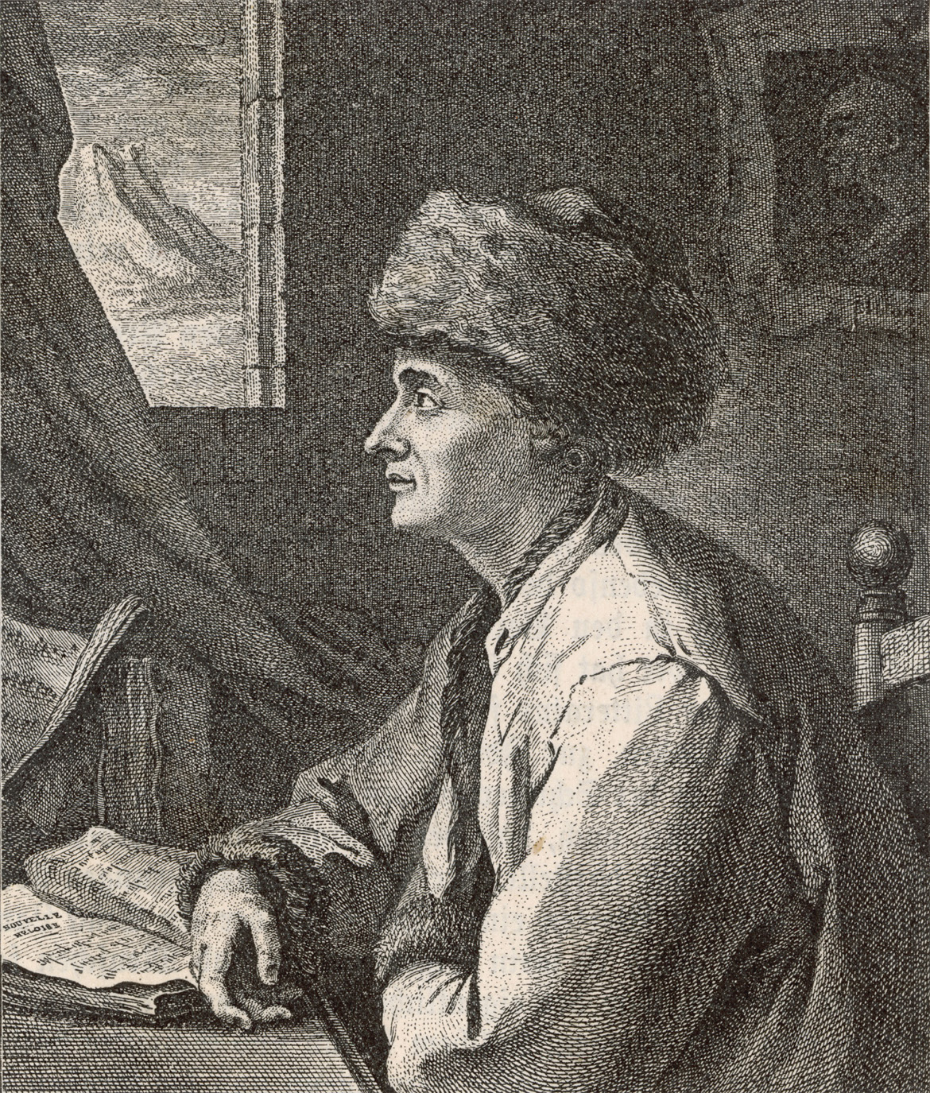
In this image of Rousseau sitting at his desk in Neufchatel, Switzerland, the writer wears his favorite Armenian hat, which became notorious during his 1766 visit to England. Rousseau was often depicted admiring the Swiss landscape. © Mary Evans Picture Library/Alamy
Notes:
In this image of Rousseau sitting at his desk in Neufchatel, Switzerland, the writer wears his favorite Armenian hat, which became notorious during his 1766 visit to England. Rousseau was often depicted admiring the Swiss landscape.
© Mary Evans Picture Library/Alamy

Slide 38
Enlightened Critics of European Empires
A few philosophers of the Enlightenment criticized the Europeans on moral grounds
Conquest of the Americas
Treatment of the Native Americans
Enslavement of Africans
Three Ideas from the Critics
(1) “Human beings deserve some modicum of moral and political respect simply because they are human beings”

Slide 39
Enlightened Critics of European Empires (cont.)
Three Ideas from the Critics
(2) Different cultures should have been respected and understood, not destroyed
(3) Human beings may develop distinct cultures possessing intrinsic values that cannot be compared because each culture possesses deep inner social and linguistic complexities that make any simple comparison impossible

Slide 40
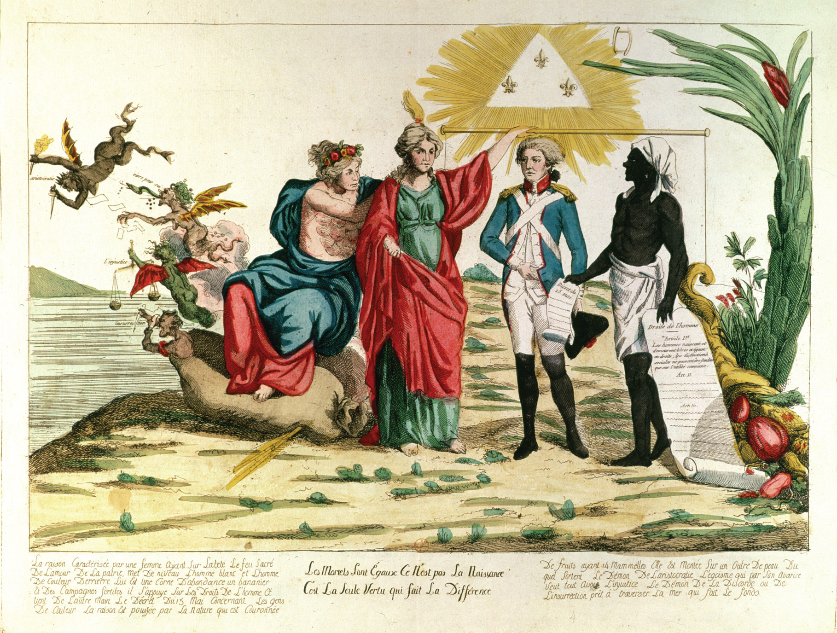
The caption of this image is taken from Voltaire’s play, Mahomet, and reads “All mortals are equal; it is not birth but virtue that makes the difference.” “All Mortals are Equal, it is not Birth but Virtue that Makes the Difference,” 1793 (coloured engraving), French School, (18th century)/Bibliotheque Nationale, Paris, France/ The Bridgeman Art Library
Notes:
The caption of this image is taken from Voltaire’s play, Mahomet, and reads “All mortals are equal; it is not birth but virtue that makes the difference.”
“All Mortals are Equal, it is not Birth but Virtue that Makes the Difference,” 1793 (coloured engraving), French School, (18th century)/Bibliotheque Nationale, Paris, France/ The Bridgeman Art Library

Slide 41
Women in the Thought and Practice of the Enlightenment
Montesquieu believed in equality of the sexes but had a traditional view of family and marriage
The Encyclopedia suggested ways to improve women’s lives, but did not suggest reform
Rousseau – felt women should be subordinate to men
Mary Wollstonecraft – A Vindication of the Rights of Woman (1792) – defended equality of women with men based on human reason

Slide 42
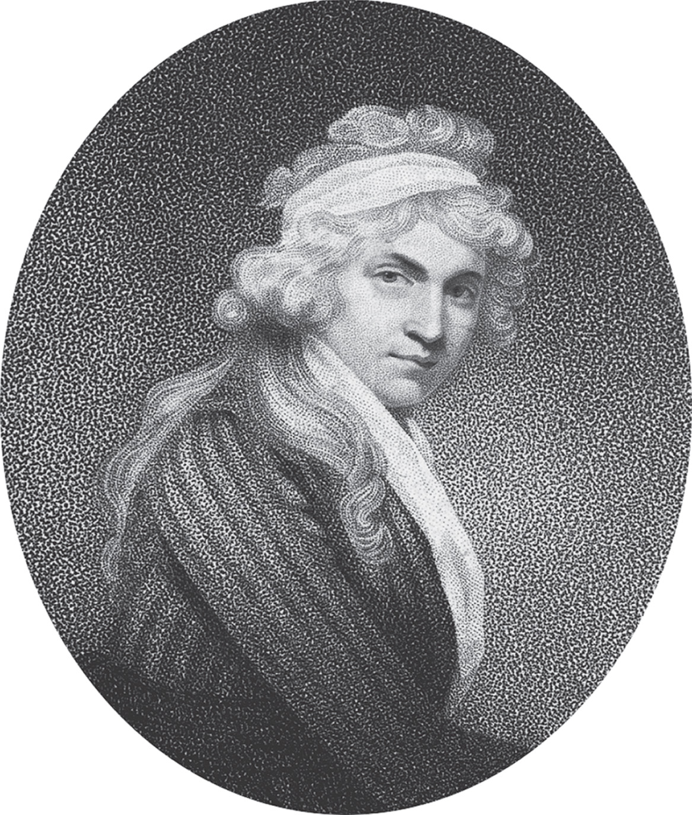
Mary Wollstonecraft in her A Vindication of the Rights of Woman defended equality of women with men on the grounds of men and women sharing the capacity of human reason. CORBIS/Bettmann
Notes:
Mary Wollstonecraft in her A Vindication of the Rights of Woman defended equality of women with men on the grounds of men and women sharing the capacity of human reason.
CORBIS/Bettmann

Slide 43
Rococo and Neoclassical Styles in Eighteenth-Century Art
Rococo style of art embraced lavish decoration with pastel colors
Became style of French aristocracy
Famous artists included Jean-Antoine Watteau, Francois Boucher, and Jean-Honore Fragonard
Neo-classical style art focused on the ancient world
Concerned with public life more than the intimate families of Rococo
Famous artists included Jacques-Louis David and Jean Antoine Houdon

Slide 44
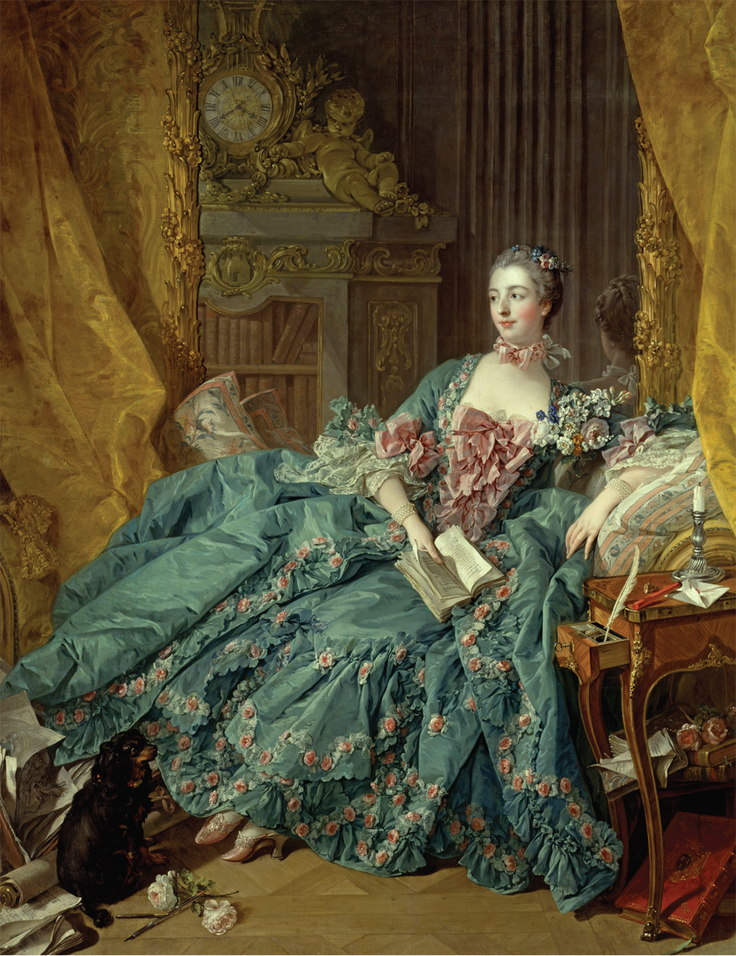
In this 1756 portrait of Madame de Pompadour, painted by the French artist François Boucher, the opulence of her lifestyle is as prominent as the features of her face. bpk, Berlin/Alte Pinakothek, Bayerische Staatsgemaeldesammlungen, Munich, Germany/Art Resource, NY
Notes:
In this 1756 portrait of Madame de Pompadour, painted by the French artist François Boucher, the opulence of her lifestyle is as prominent as the features of her face.
bpk, Berlin/Alte Pinakothek, Bayerische Staatsgemaeldesammlungen, Munich, Germany/Art Resource, NY

Slide 45
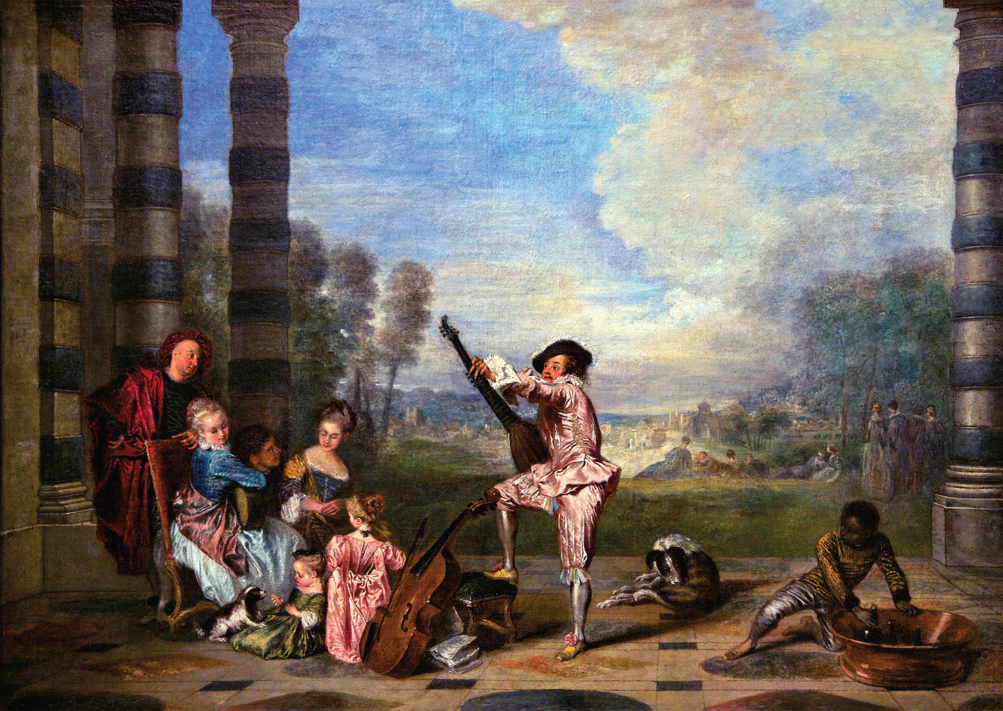
Jean-Antoine Watteau, The Music Party (1718). This oil painting portrays young French aristocrats enjoying a leisurely musical serenade. Men, women, children, and pets repose to the left, while an African servant—another sign of the party’s high status—cools champagne behind the musician’s back. © Peter Barritt/Alamy
Notes:
Jean-Antoine Watteau, The Music Party (1718). This oil painting portrays young French aristocrats enjoying a leisurely musical serenade. Men, women, children, and pets repose to the left, while an African servant—another sign of the party’s high status—cools champagne behind the musician’s back.
© Peter Barritt/Alamy

Slide 46
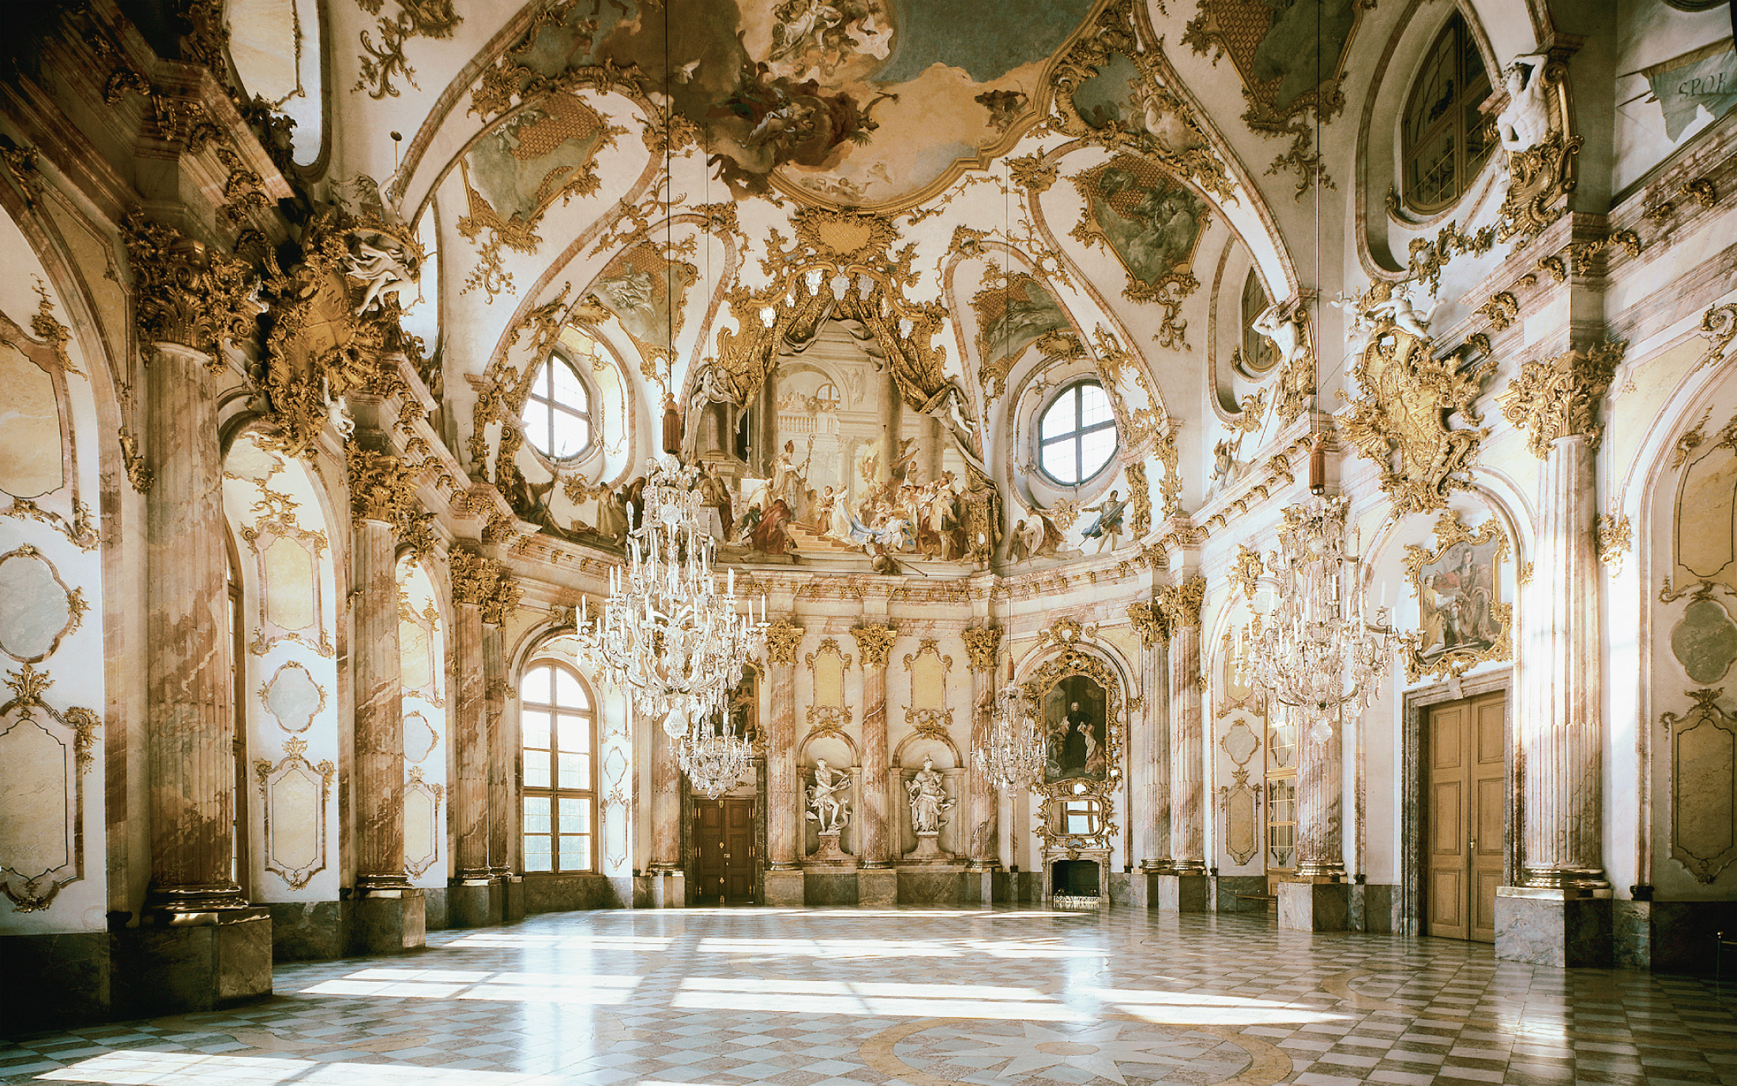
The color, the light, and the elaborate decorative details associated with Rococo style are splendidly exemplified in the Imperial Hall (Kaisarsaal) built in Würzburg, Bavaria, according to the design of Balthasar Neumann (1687–1753). Art Resource, NY
Notes:
The color, the light, and the elaborate decorative details associated with Rococo style are splendidly exemplified in the Imperial Hall (Kaisarsaal) built in Würzburg, Bavaria, according to the design of Balthasar Neumann (1687–1753).
Art Resource, NY

Slide 47
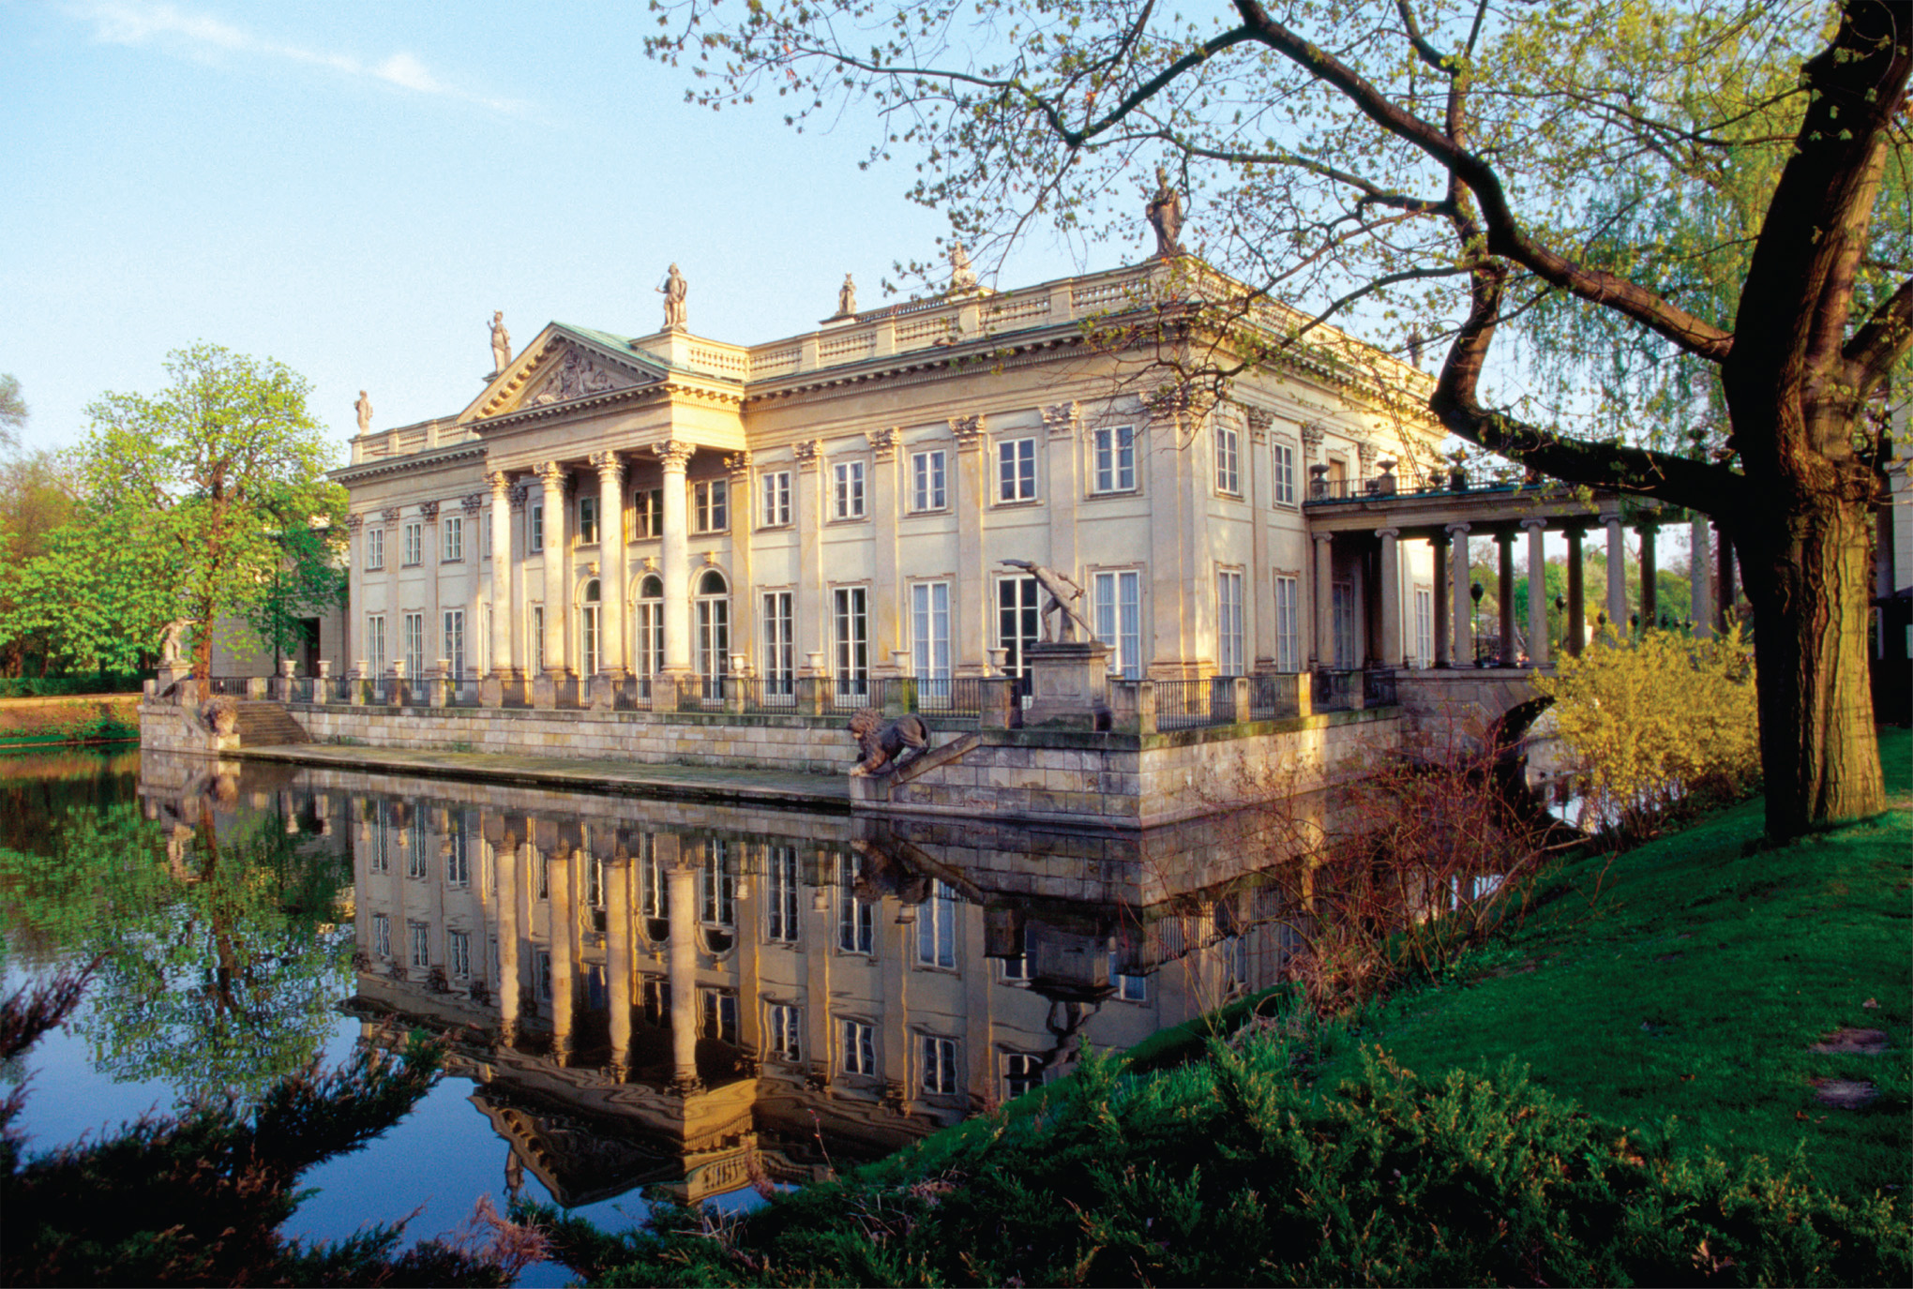
The passion for neoclassical architecture stretched from France to the eastern reaches of Europe. This palace in Warsaw was designed in 1764 to 1795 by Domenico Merlini for the King of Poland, Stanisław August Poniatowski (1732– 1798). © LOOK. Die Bildagentur der Fotografen GmbH/Alamy
Notes:
The passion for neoclassical architecture stretched from France to the eastern reaches of Europe. This palace in Warsaw was designed in 1764 to 1795 by Domenico Merlini for the King of Poland, Stanisław August Poniatowski (1732– 1798).
© LOOK. Die Bildagentur der Fotografen GmbH/Alamy

Slide 48
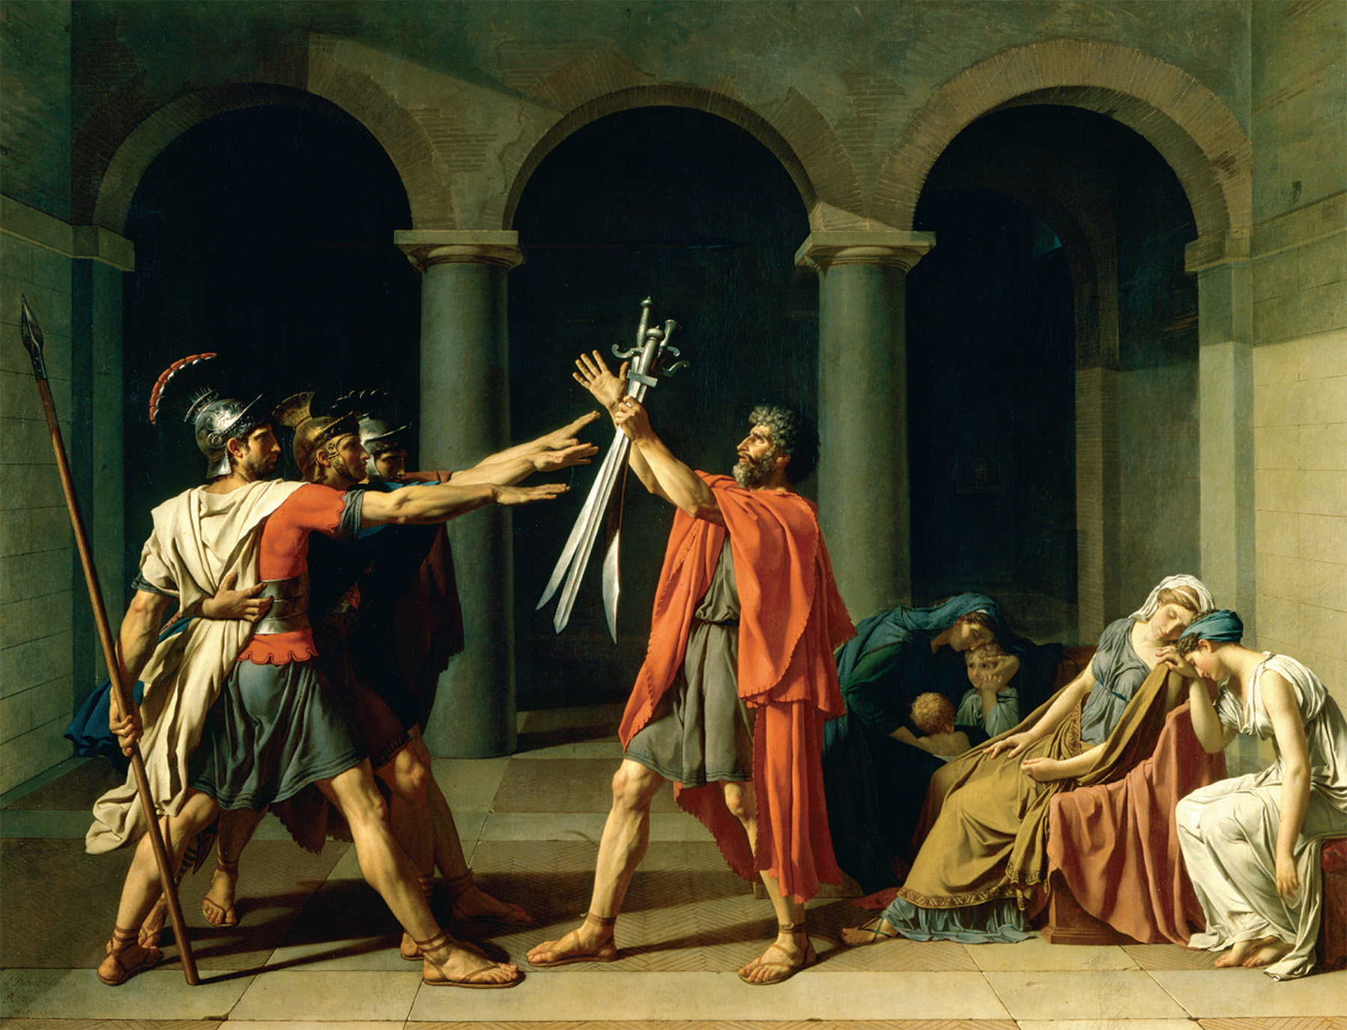
Jacques-Louis David completed The Oath of the Horatii in 1784. Like many of his other works, it used themes from the supposedly morally austere ancient Roman Republic to criticize the political life of his own day. David intended the painting to contrast ancient civic virtue with the luxurious aristocratic culture of contemporary France. Jacques-Louis David, The Oath of the Horatii. 1784–1785. © Réunion des Musees Nationaux, Paris, France/Art Resource, NY
Notes:
Jacques-Louis David completed The Oath of the Horatii in 1784. Like many of his other works, it used themes from the supposedly morally austere ancient Roman Republic to criticize the political life of his own day. David intended the painting to contrast ancient civic virtue with the luxurious aristocratic culture of contemporary France.
Jacques-Louis David, The Oath of the Horatii. 1784–1785. © Réunion des Musees Nationaux, Paris, France/Art Resource, NY

Slide 49
Enlightened Absolutism
Defined as the form of monarchical government in which the central absolutist administration was strengthened at cost of the church, parliament, or diets
Monarchs
Frederick II of Prussia
Joseph II of Austria
Catherine II of Russia

Slide 50
Frederick the Great of Prussia
Promotion through merit – work and education rather than birth would decide who ruled Prussia
Religious toleration – for every Christian, Muslim, or Jew
Administrative and economic reforms – legal reform included abolishing torture and limiting number of capital crimes

Slide 51
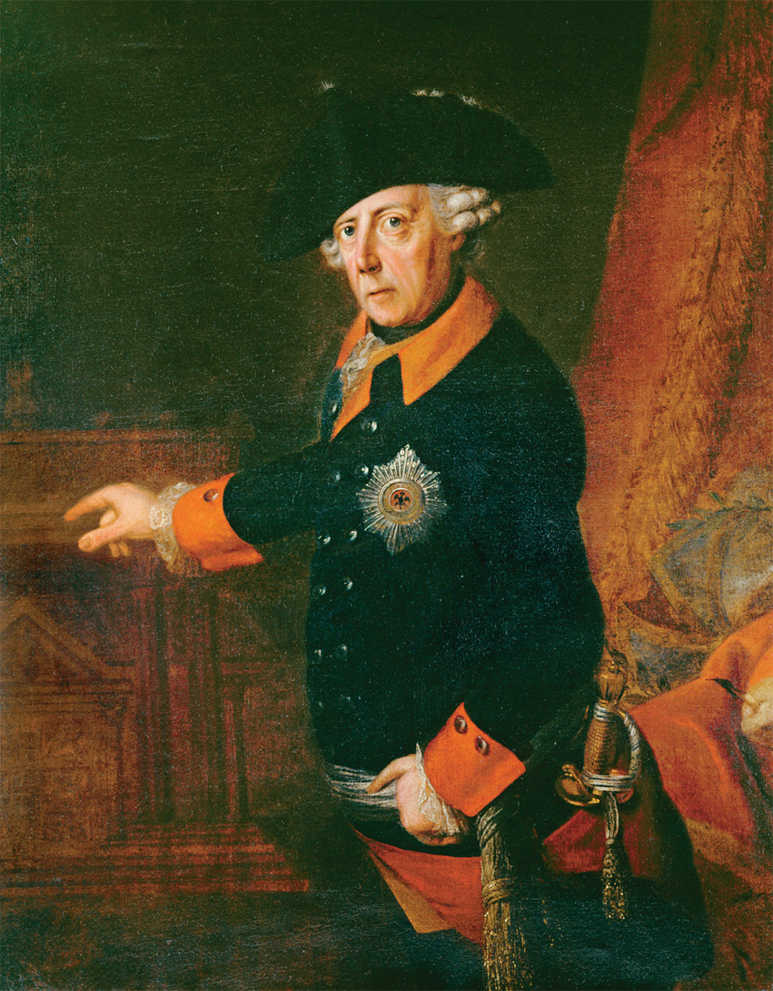
Frederick II of Prussia became known as Frederick the Great after his victories in the Seven Years’ Wars. This portrait of 1763 shows him at the time of those triumphs when he had permanently secured the position of Prussia as a major European power. He was equally interested in the economic development of Prussia. Erich Lessing/Art Resource, NY
Notes:
Frederick II of Prussia became known as Frederick the Great after his victories in the Seven Years’ Wars. This portrait of 1763 shows him at the time of those triumphs when he had permanently secured the position of Prussia as a major European power. He was equally interested in the economic development of Prussia.
Erich Lessing/Art Resource, NY

Slide 52
Joseph II of Austria
Centralization of authority – aimed to extend the empire at the expense of Poland, Bavaria, and the Ottoman Empire
Ecclesiastical policies – religious toleration and bringing the Roman Catholic Church under royal control
Economic and Agrarian Reform
Improved transportation and trade
Abolished serfdom
Land taxation

Slide 53
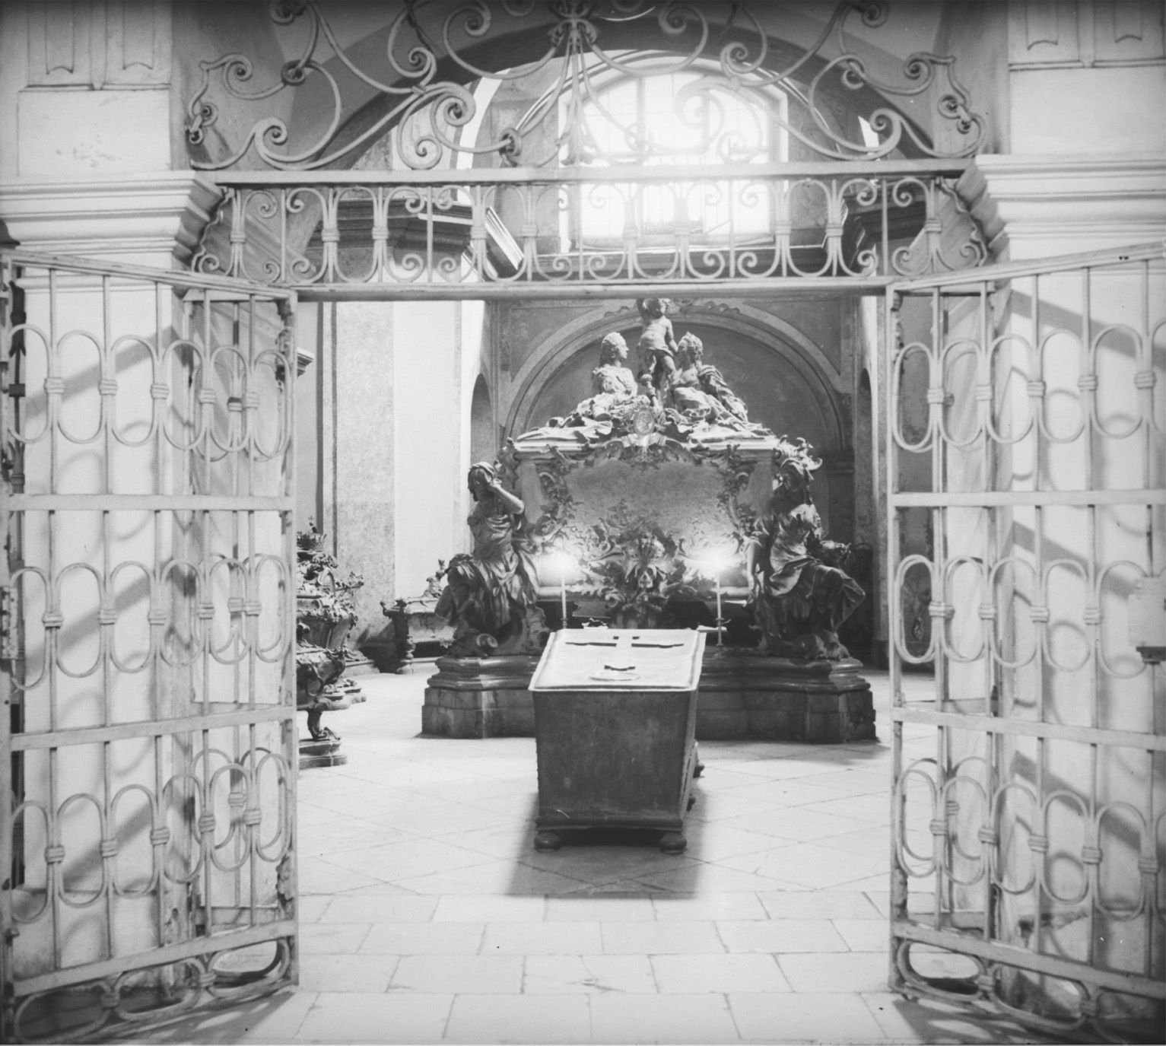
Joseph’s coffin was placed in the Capuchin crypt directly in front of his parents’ monument. Joseph had ordered that his sarcophagus be simple in design and constructed of copper, with no embellishment but a cross. The contrast with the elaborate sarcophagus of his parents, Maria Theresa and Francis Stephen, could not be more stark. Austrian National Library, Picture Archive, 118.173 STE
Notes:
Joseph’s coffin was placed in the Capuchin crypt directly in front of his parents’ monument. Joseph had ordered that his sarcophagus be simple in design and constructed of copper, with no embellishment but a cross. The contrast with the elaborate sarcophagus of his parents, Maria Theresa and Francis Stephen, could not be more stark.
Austrian National Library, Picture Archive, 118.173 STE

Slide 54
Catherine the Great of Russia
Limited administrative reform – local control of the nobility
Economic growth – opened up trade and favored the expansion of the urban middle class
Territorial expansion – to warm weather ports along the Baltic and Black Seas

Slide 55
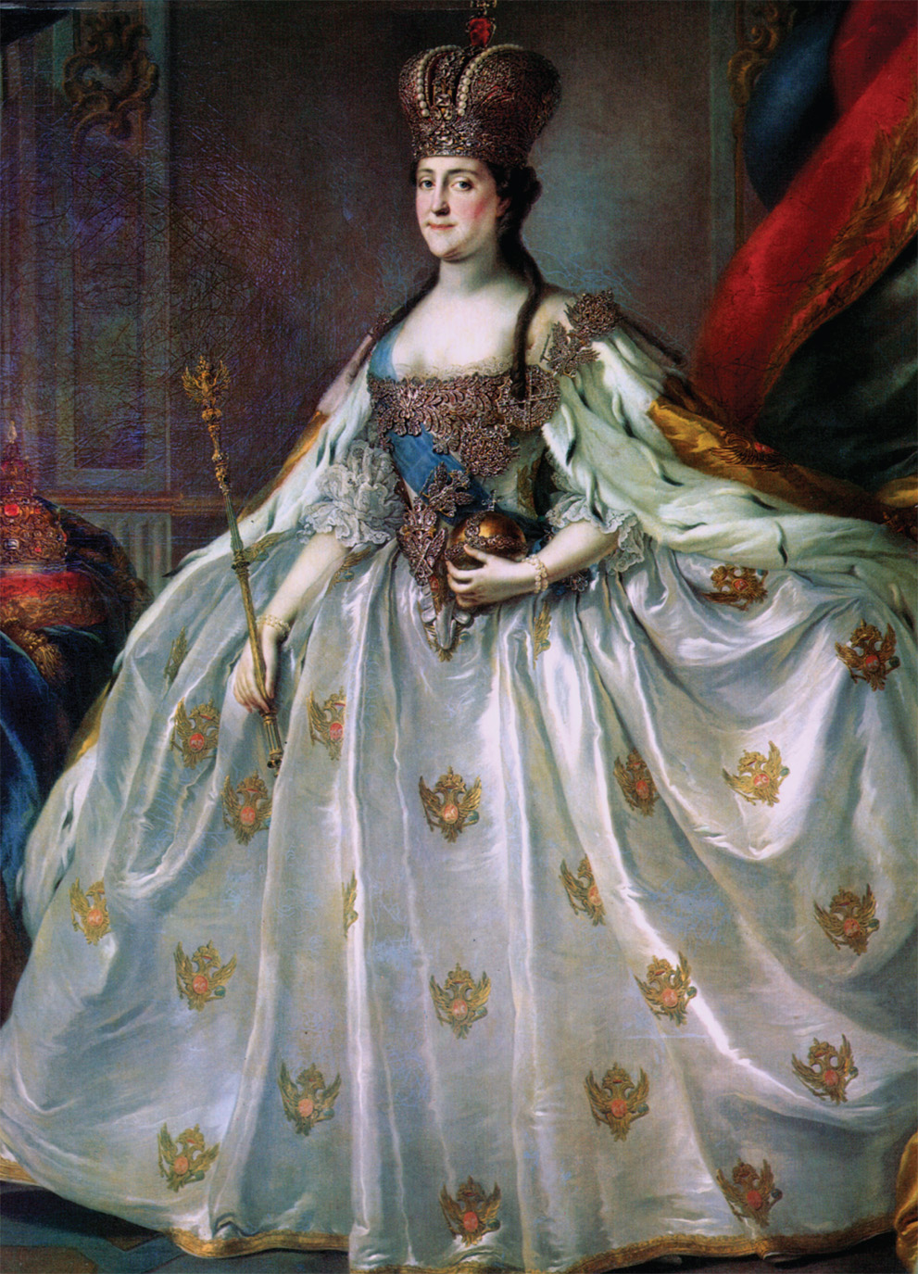
Catherine the Great ascended to the Russian throne after the murder of her husband. She tried initially to enact major reforms, but she never intended to abandon absolutism. She assured nobles of their rights and by the end of her reign had imposed press censorship. The Granger Collection
Notes:
Catherine the Great ascended to the Russian throne after the murder of her husband. She tried initially to enact major reforms, but she never intended to abandon absolutism. She assured nobles of their rights and by the end of her reign had imposed press censorship.
The Granger Collection

Slide 56
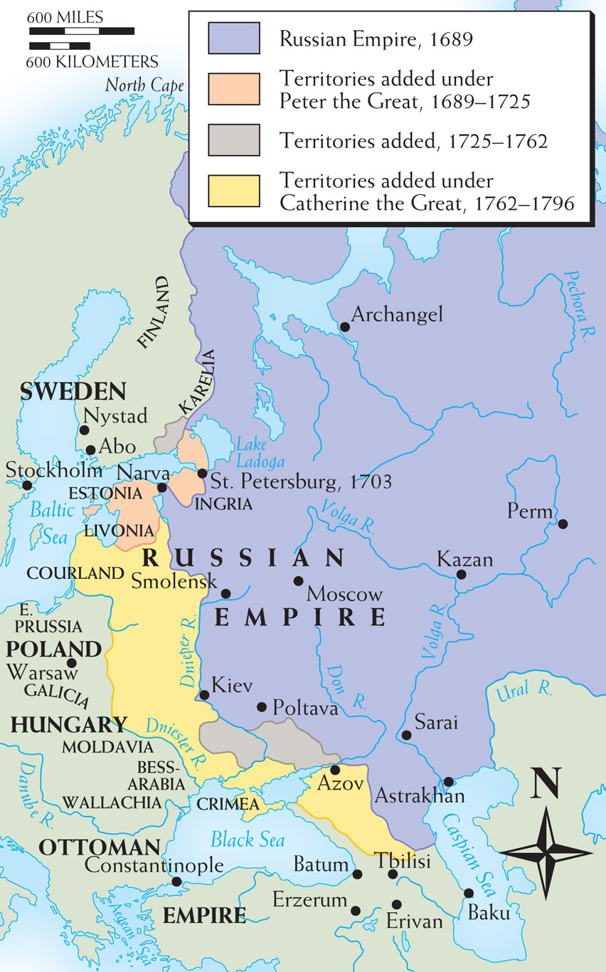
Map 17–1 EXPANSION OF RUSSIA, 1689–1796 The overriding territorial aim of the two most powerful Russian monarchs of the 18th century, Peter the Great (in the first quarter of the century) and Catherine the Great (in the last half of the century) was to secure navigable outlets to the sea in both the north and the south for Russia’s vast empire; hence Peter’s push to the Baltic Sea and Catherine’s to the Black Sea. Russia also expanded into Central Asia and Siberia during this time period.
Notes:
Map 17–1 EXPANSION OF RUSSIA, 1689–1796 The overriding territorial aim of the two most powerful Russian monarchs of the 18th century, Peter the Great (in the first quarter of the century) and Catherine the Great (in the last half of the century) was to secure navigable outlets to the sea in both the north and the south for Russia’s vast empire; hence Peter’s push to the Baltic Sea and Catherine’s to the Black Sea. Russia also expanded into Central Asia and Siberia during this time period.

Slide 57
The Partitions of Poland
Land split by Russia, Austria, and Prussia
Proved that without a strong bureaucracy, monarchy, and army, a nation could not survive

Slide 58
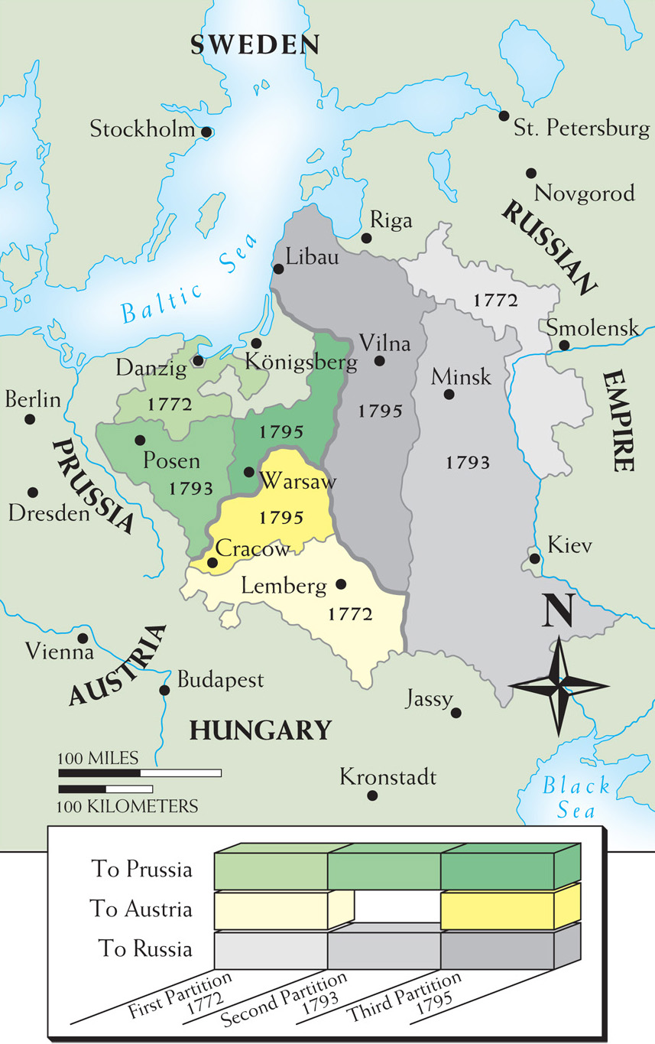
Map 17–2 PARTITIONS OF POLAND, 1772, 1793, AND 1795. The callous eradication of Poland from the map displayed 18th-century power politics at its most extreme. Poland, without a strong central government, fell victim to the strong absolute monarchies of central and eastern Europe.
Notes:
Map 17–2 PARTITIONS OF POLAND, 1772, 1793, AND 1795. The callous eradication of Poland from the map displayed 18th-century power politics at its most extreme. Poland, without a strong central government, fell victim to the strong absolute monarchies of central and eastern Europe.

Slide 59
The End of the Eighteenth Century in Central and Eastern Europe
Nations became more conservative and politically more repressive
Fading monarchs
Frederick the Great of Prussia – grew remote with age and left the aristocracy to fill government posts
Joseph II of Austria – in response to criticism turned to censorship and the secret police
Catherine the Great of Russia – peasant uprisings led to fears of social and political upheaval

