Slide 1
Chapter 21
Economic Advances and Social Unrest (1830–1850)

Slide 2
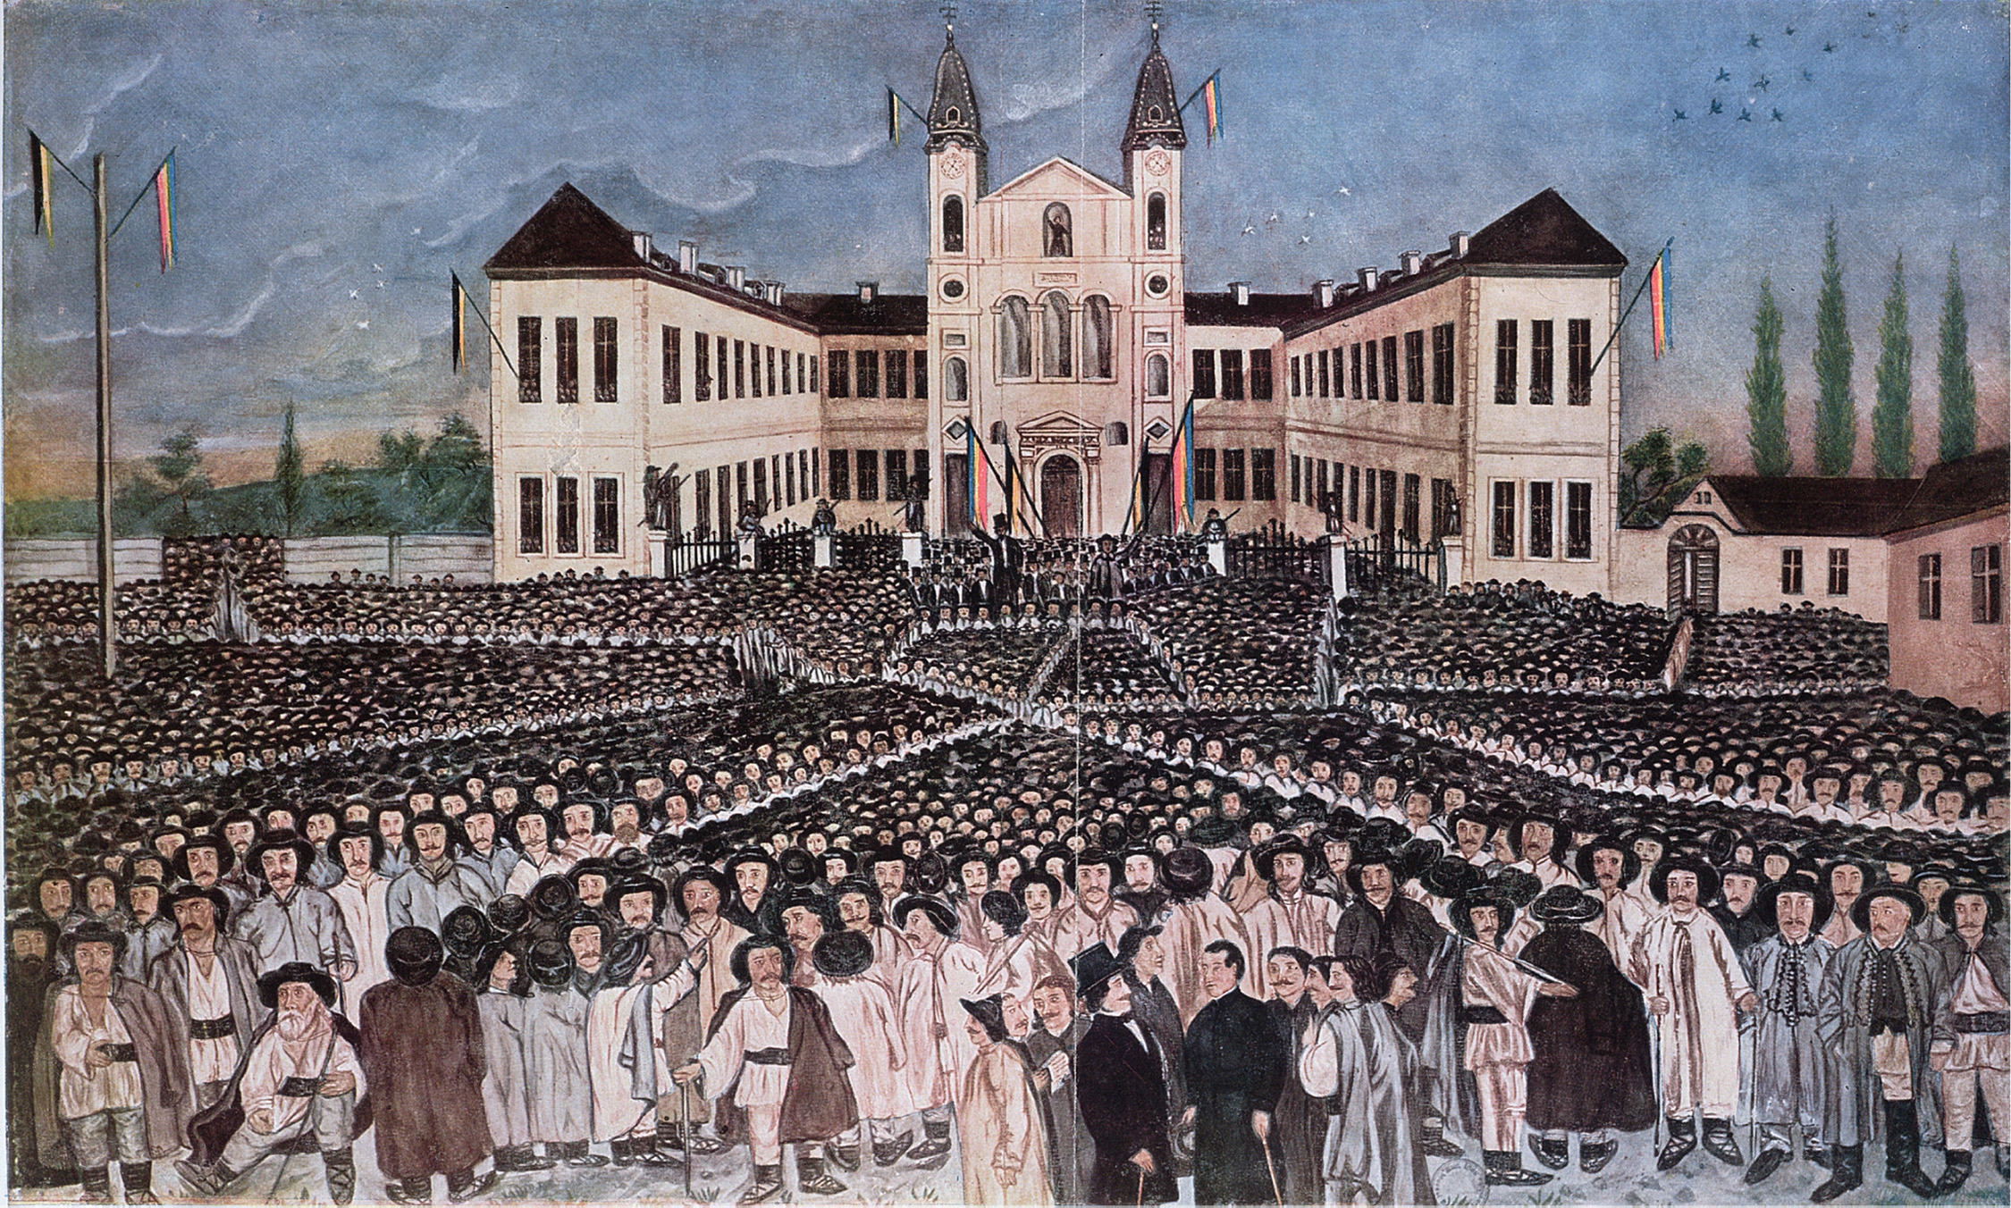
Romanian peasants rally at Blaj in Transylvania on May 15, 1848. In 1848 Ana Ipatescu helped to lead Transylvanian revolutionaries against Russian rule. Transylvania is part of present-day Romania. The revolutions of 1848 in Eastern Europe were primarily uprisings of nationalist groups. Although generally repressed in the revolutions of that year, subject nationalities would prove a source of political upheaval and unrest in the region throughout the rest of the century, ultimately providing the spark for the outbreak of World War I. The Rally of the Romanian Peasants at Blaj in Transylvania on the 15th of May, 1848 (colour lithograph). Hungarian School/Private Collection/Archives Charmet/The Bridgeman Art Library International
Notes:
Romanian peasants rally at Blaj in Transylvania on May 15, 1848. In 1848 Ana Ipatescu helped to lead Transylvanian revolutionaries against Russian rule. Transylvania is part of present-day Romania. The revolutions of 1848 in Eastern Europe were primarily uprisings of nationalist groups. Although generally repressed in the revolutions of that year, subject nationalities would prove a source of political upheaval and unrest in the region throughout the rest of the century, ultimately providing the spark for the outbreak of World War I.
The Rally of the Romanian Peasants at Blaj in Transylvania on the 15th of May, 1848 (colour lithograph). Hungarian School/Private Collection/Archives Charmet/The Bridgeman Art Library International

Slide 3
Industrial Society in Europe
Population and migration – population explosion in Europe leads more and more people to live in the cities
Life is tough in the city – inadequate housing and sanitation, disease and crime
In rural areas, serfdom is abolished in Prussia, Austria, and Russia

Slide 4
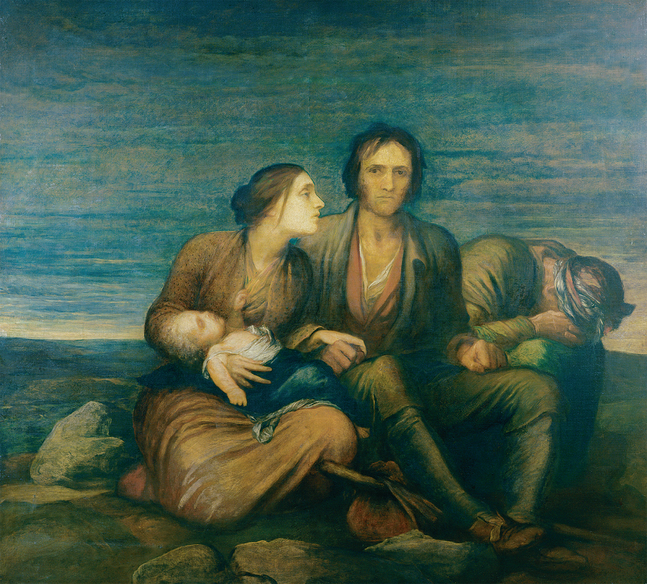
Painter George Frederick Watts’ 1850 depiction of a scene set during the Irish Potato Famine. So many people starved during the famine that workhouses could not shelter them all. © Trustees of the Watts Gallery, Compton, Surrey, UK/The Bridgeman Art Library
Notes:
Painter George Frederick Watts’ 1850 depiction of a scene set during the Irish Potato Famine. So many people starved during the famine that workhouses could not shelter them all.
© Trustees of the Watts Gallery, Compton, Surrey, UK/The Bridgeman Art Library

Slide 5
Railroads
Railways built in England, Belgium, France, and Germany
Easier and faster movement of people and products
Birth of even more industrialization (iron and steel industries)

Slide 6
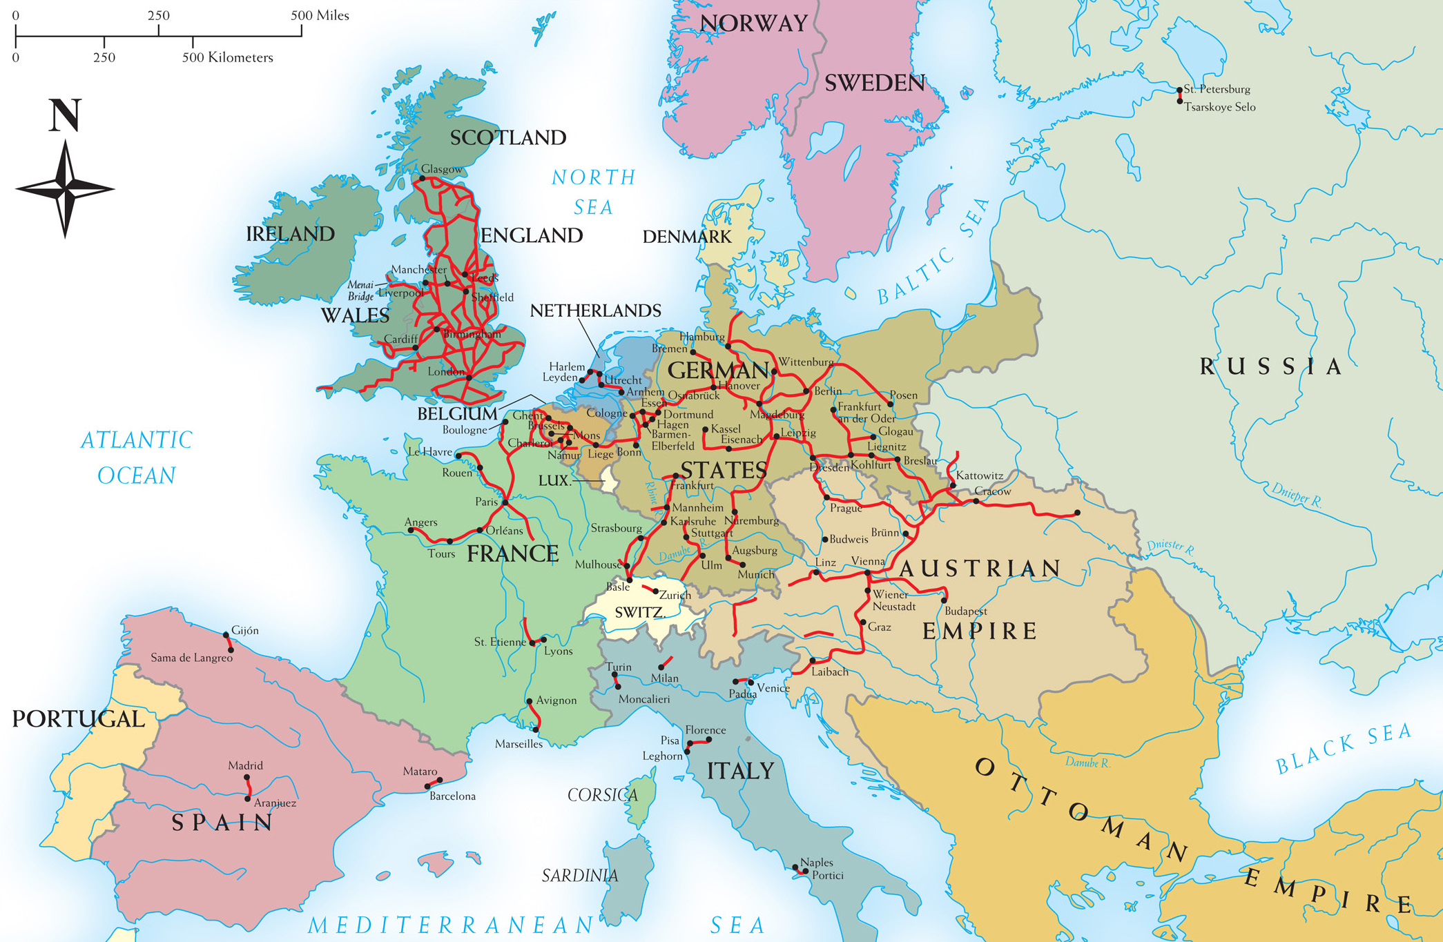
Map 21–1 EUROPEAN RAILROADS IN 1850 A mid-century Britain had the most extensive rail network, and the most industrialized economy, in Europe, but rail lines were expanding rapidly in France, the German states, and Austria. Southern and eastern Europe had few railways, and the Ottoman Empire had none.
Notes:
Map 21–1 EUROPEAN RAILROADS IN 1850 A mid-century Britain had the most extensive rail network, and the most industrialized economy, in Europe, but rail lines were expanding rapidly in France, the German states, and Austria. Southern and eastern Europe had few railways, and the Ottoman Empire had none.

Slide 7
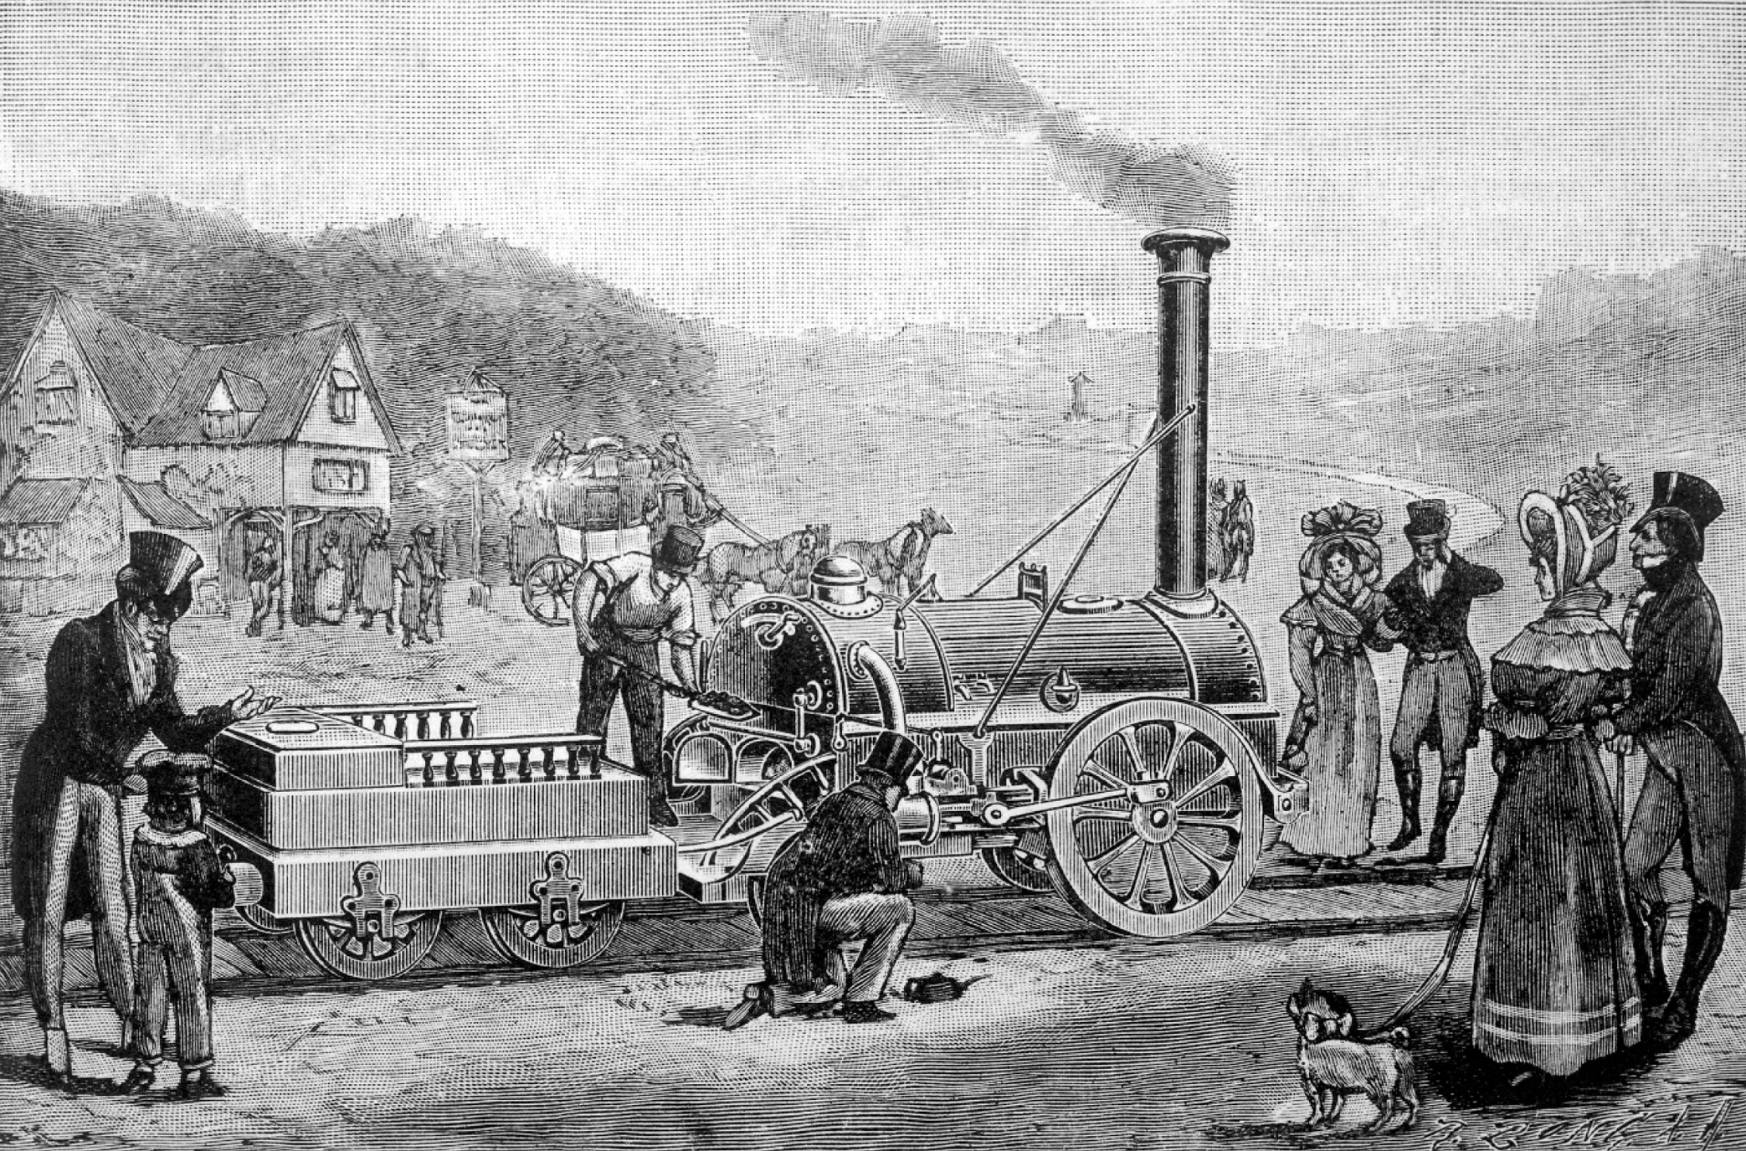
George Stephenson (1781–1848) invented the locomotive in 1814, but the “Rocket,” his improved design shown here, did not win out over other competitors until 1829. In the following two decades the spread of railways transformed the economy of Western Europe. Image Works/Mary Evans Picture Library Ltd.
Notes:
George Stephenson (1781–1848) invented the locomotive in 1814, but the “Rocket,” his improved design shown here, did not win out over other competitors until 1829. In the following two decades the spread of railways transformed the economy of Western Europe.
Image Works/Mary Evans Picture Library Ltd.

Slide 8
Labor
Split of workforce – some held steady jobs with good wages, others were the working poor who held jobs with low wages and poor conditions

Slide 9
Labor (cont.)
Wage-labor force – proletarianization – workers’ labor becomes a commodity of the labor marketplace
The factory owner supplies the materials, while the workers contribute their labor for a wage
Laborers subjected to rules, punishments, and scolding (lateness, drunkenness, etc.)

Slide 10
Labor (cont.)
Guild system – an association of merchants or craftsmen that offered protection to its members and set rules for their work and products
Confection – goods, such as shoes, are produced in standard sizes rather than specifically for one customer
Led to more division of labor
Sometimes lower wages and worker unrest

Slide 11
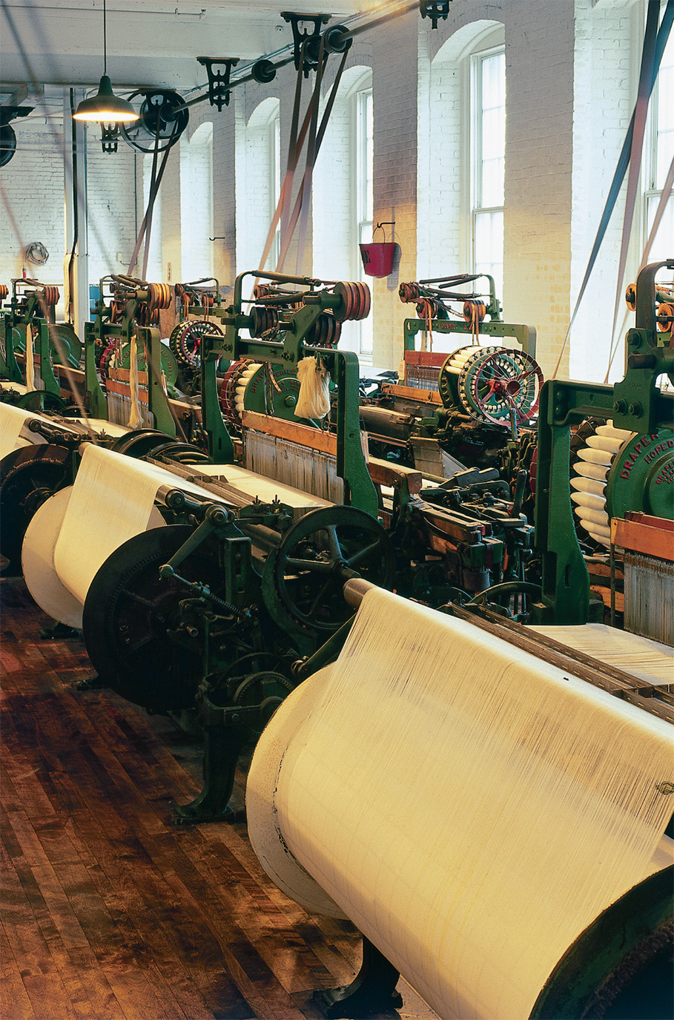
Power looms used in the mass production of textiles during the Industrial Revolution. Dorling Kindersley Medical Library/David Lyons © Dorling Kindersley. Courtesy of the Boott Cotton Mills Museum, Lowell, Massachusetts
Notes:
Power looms used in the mass production of textiles during the Industrial Revolution. Dorling Kindersley Medical Library/David Lyons © Dorling Kindersley. Courtesy of the Boott Cotton Mills Museum, Lowell, Massachusetts

Slide 12
British Chartism
Chartism – workers in Britain looking for social reform
Six Points of the Charter – never passed by Parliament
Split of Chartists between those who advocated violence and those who wanted to use peaceful means
Movement ends in 1848, when economy improves drastically in Britain

Slide 13
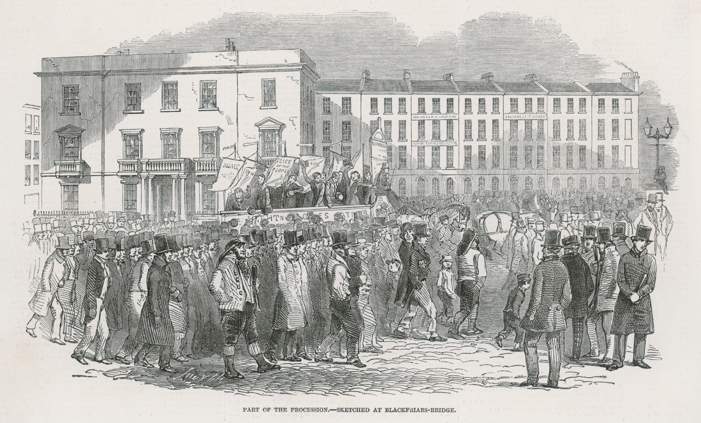
In the 1830s and 1840s, the Chartists circulated petitions throughout Britain demanding political reform. Here the petitions are being taken to Parliament in a vast ceremonious procession. © Mary Evans Picture Library/ Alamy
Notes:
In the 1830s and 1840s, the Chartists circulated petitions throughout Britain demanding political reform. Here the petitions are being taken to Parliament in a vast ceremonious procession.
© Mary Evans Picture Library/ Alamy

Slide 14
Early Factory System and the Family
In the early factory system, roles in the family stayed mainly the same; fathers employed their wives and children
Newer, easier to use machines led to the employment of unmarried women and children in the factories
Wages for skilled laborers became high enough that some children were able to leave the factory and go to school

Slide 15
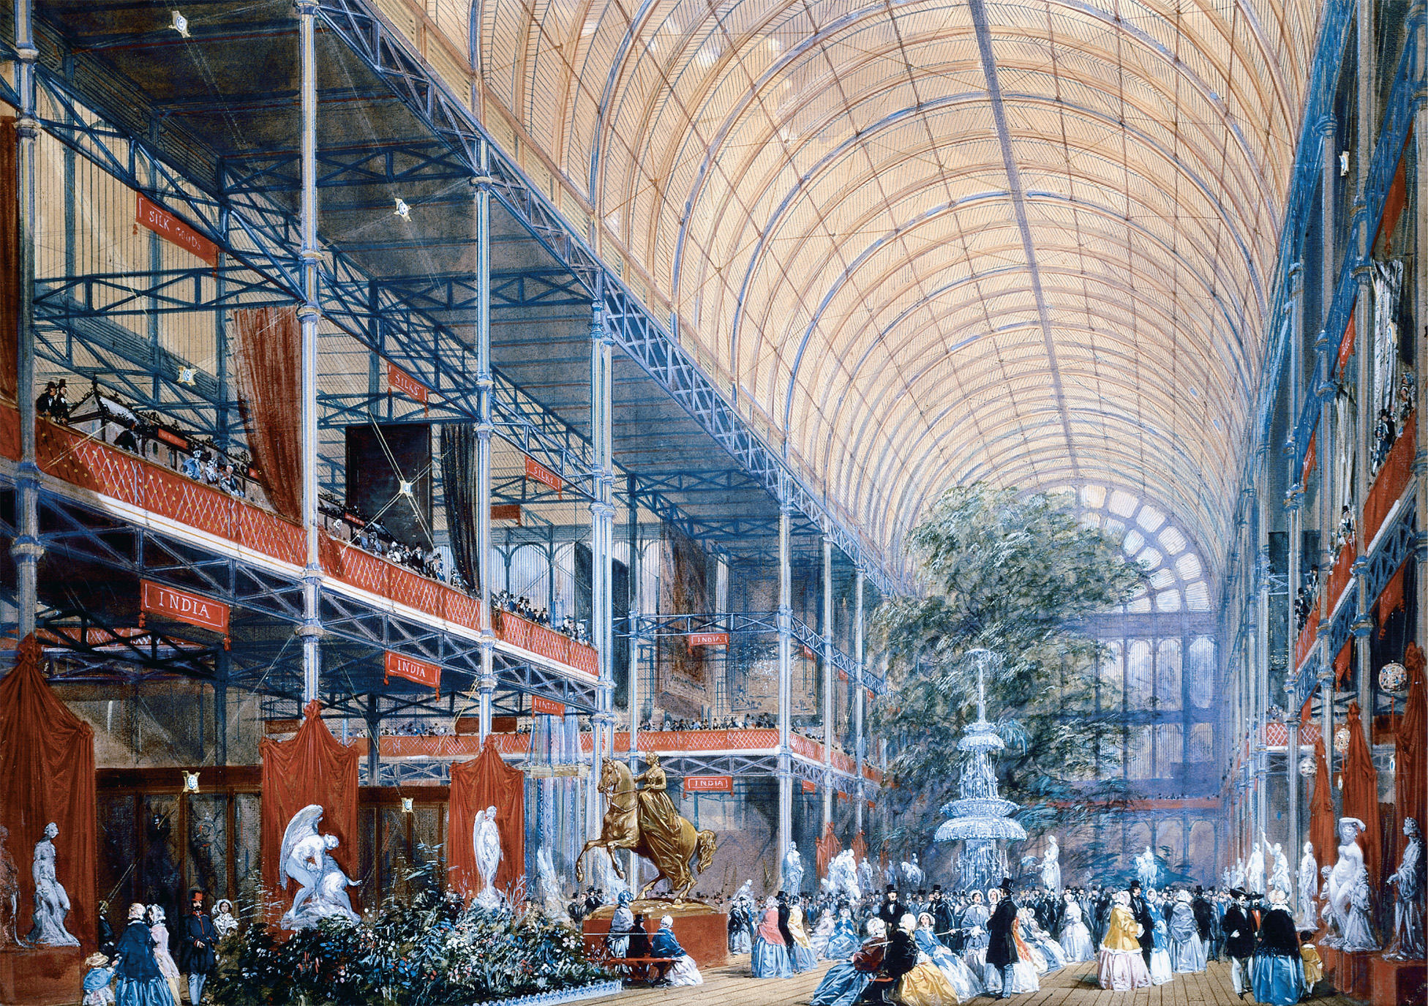
The Great Exhibition in London The Great Exhibition of 1851 was held in London to celebrate progress in industry and commerce achieved through the new industrial order. Its organizers invited governments and businesses from around the globe to display the products they manufactured. The organizers generally supported free trade and believed the displays would demonstrate the value of peaceful commerce. London's Crystal Palace during the International Exhibition of 1851. Victoria & Albert Museum, London, Great Britain/Art Resource, NY
Notes:
The Great Exhibition in London The Great Exhibition of 1851 was held in London to celebrate progress in industry and commerce achieved through the new industrial order. Its organizers invited governments and businesses from around the globe to display the products they manufactured. The organizers generally supported free trade and believed the displays would demonstrate the value of peaceful commerce. London's Crystal Palace during the International Exhibition of 1851. Victoria & Albert Museum, London, Great Britain/Art Resource, NY

Slide 16
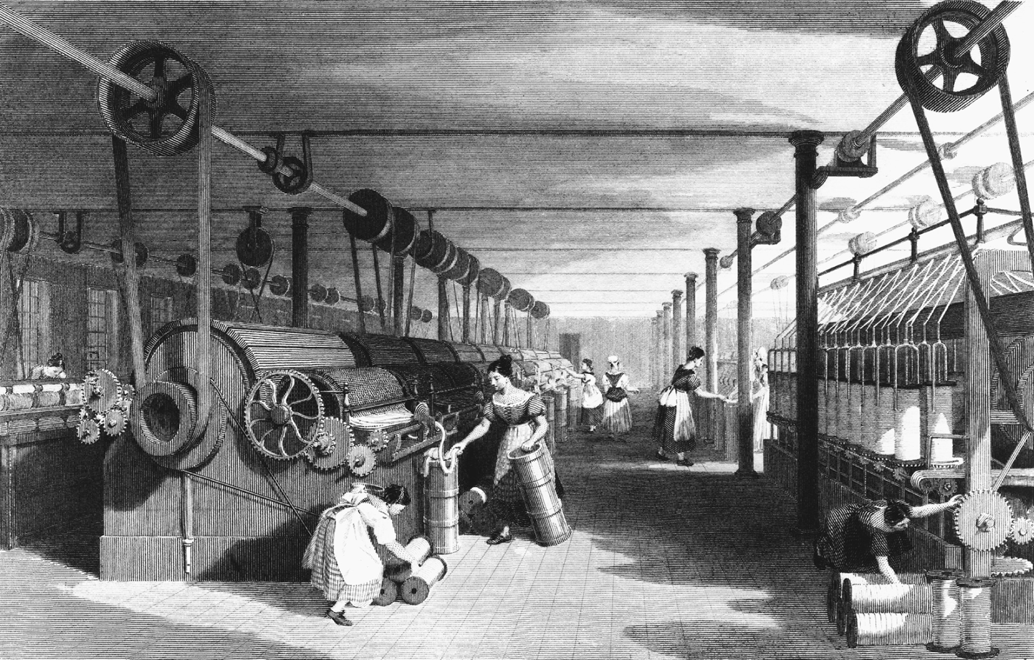
Notes:
As textile production became increasingly automated in the nineteenth century, textile factories required fewer skilled workers and more unskilled attendants. To fill these unskilled positions, factory owners turned increasingly to unmarried women and widows, who worked for lower wages than men and were less likely to form labor organizations.
Courtesy of the Library of Congress

Slide 17
Child Labor
The English Factory Act of 1833 – forbade employment of children under nine and limited work day to nine hours for children between 9-13
Education requirement (factories had to provide two hours of education) starts the process of nurturing children from the home to the classroom

Slide 18
Child Labor (cont.)
1847 – Parliament passes a ten-hour workday
Due to the ability to find wage employment in the same city as their parents, children of families in industrial cities remained at home with their families

Slide 19
Women’s Roles in Industrial Revolution
Could be associated with domestic duties such as housekeeping, food preparation, child rearing and nurturing, and household management
Or with unskilled cottage industries (mostly single or widowed women)

Slide 20
Opportunities for Women in Employment in Industrial Revolution
Women in the factories were mostly young, unmarried, or widows working low-skilled jobs, who would leave if they got married
Women at home or on the land
In France – largest group of women worked on the land
In England – largest group of women worked as domestic servants
Many, due to low wages, turned to prostitution as a second job

Slide 21
The Working Class Marriage
Women would leave the workforce to live on their husband’s earnings once married
Marriage less of an economic partnership
Married women only worked outside the home when forced to
Women took care of the home, not just for the wage-earning husband, but the children as well

Slide 22
Crime and Order During the Industrial Revolution
As populations in the cities increased, so did crime rates, especially theft and arson
New police forces – kept order, protected property and lives, investigated crime, apprehended offenders
Appeared in France in 1828
In England in 1829 – the “bobbies”
In Germany in 1848

Slide 23
Crime and Order During the Industrial Revolution (cont.)
Prison reform
Instead of being housed together with all others, offenders of serious crimes are sent to transportation – to South Wales, Australia
Goals of prisons change from punishment to reform

Slide 24
Crime and Order During the Industrial Revolution (cont.)
Prison reform
Prisoners isolated from each other – often led to mental health problems
Prisoners learn skills or a trade
Some of the worst French criminals sent to Devil’s Island in South America

Slide 25
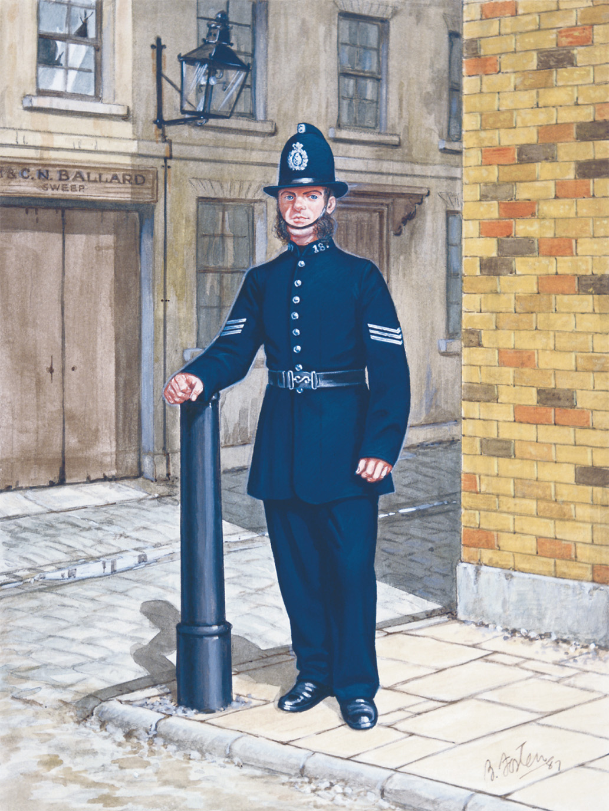
London policeman. Professional police forces did not exist before the early nineteenth century. The London police force was created in 1829. A Sergeant of 1865 (colour litho), Fosten, Bryan (b.1928)/Private Collection/Peter Newark Pictures/The Bridgeman Art Library
Notes:
London policeman. Professional police forces did not exist before the early nineteenth century. The London police force was created in 1829.
A Sergeant of 1865 (colour litho), Fosten, Bryan (b.1928)/Private Collection/Peter Newark Pictures/The Bridgeman Art Library

Slide 26
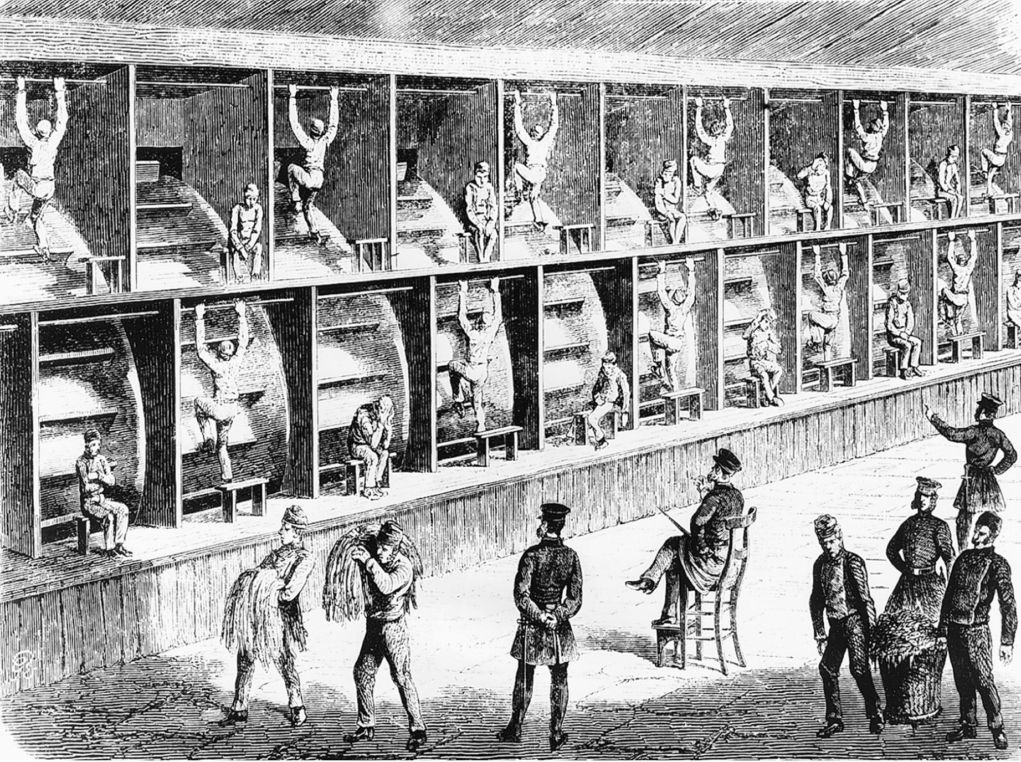
In many prisons, treadmills like these were the only source of exercise available to English prisoners. Bildarchiv Preussischer Kulturbesitz/Art Resource, NY
Notes:
In many prisons, treadmills like these were the only source of exercise available to English prisoners.
Bildarchiv Preussischer Kulturbesitz/Art Resource, NY

Slide 27
Government Policies Based on Classical Economics
Jeremy Bentham believed in utilitarianism – greatest happiness for the greatest amount of people
Poor Law – set out to make poverty the least desirable of all social situations; reformed workhouses
Repeal of Corn Laws – tariffs in Britain abolished, leading to lower food prices and lower wages at no real cost to the worker

Slide 28
Utopian Socialism
Often advocated for the creation of ideal communities and questioned capitalism
Count Claude Henri de Saint-Simon – did not want to redistribute wealth, but rather have it managed by experts – a large group of directors organizing and coordinating the activities of individuals and groups to achieve social harmony

Slide 29
Utopian Socialism (cont.)
Robert Owen – saw no incompatibility between a humane industrial environment and a good profit
Envisioned communities where people such as factory and farm workers lived together and shared their resources
New Harmony, Indiana – fails due to quarrels among workers

Slide 30
Utopian Socialism (cont.)
Charles Fourier – advocated the construction of phalanxes – agrarian communities where people did different tasks everyday, instead of the same task over and over again

Slide 31
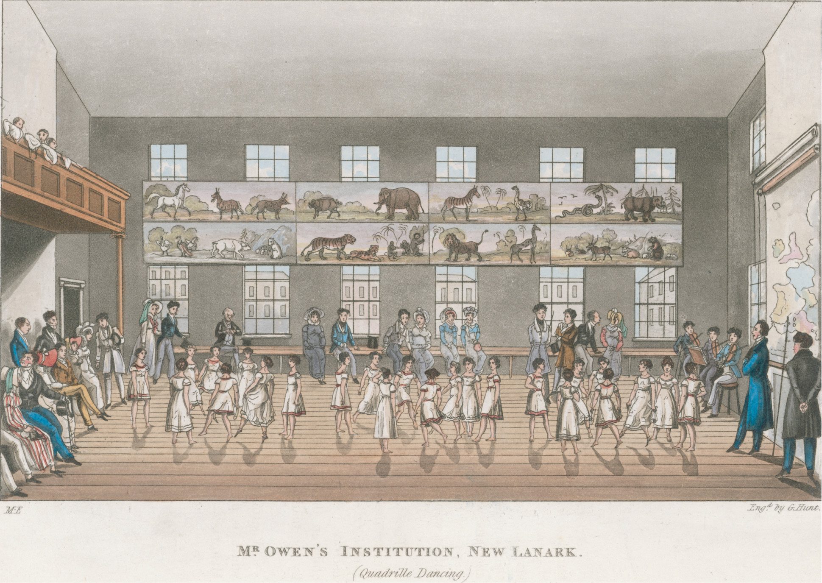
Robert Owen, a Scottish industrialist and early socialist, created an ideal industrial community at New Lanark, Scotland. He believed deeply in the power of education and saw that the children of workmen received sound educations. © Mary Evans Picture Library/Alamy
Notes:
Robert Owen, a Scottish industrialist and early socialist, created an ideal industrial community at New Lanark, Scotland. He believed deeply in the power of education and saw that the children of workmen received sound educations.
© Mary Evans Picture Library/Alamy

Slide 32
Anarchists
Rejected both industry and the dominance of government
Auguste Blanqui – called for the violent overthrow of capitalism
Pierre-Joseph Proudhon – peacefully advocated for mutualism – a system of small businesses and cooperatives that exchanged goods based on mutual recognition of the labor required to produce them

Slide 33
Karl Marx and Marxism
Karl Marx – believed class conflict would eventually lead to the triumph of the industrial proletariat over the bourgeoisie and the abolition of private property and social class – came to be known as Marxism

Slide 34
Karl Marx and Marxism (cont.)
Friedrich Engels
Published The Condition of the Working Class in England – presented a devastating picture of working conditions in industrial life
Joined with Marx to write Communist Manifesto – called for more radical change than socialism – the outright abolition of private property, rather than just redistribution

Slide 35
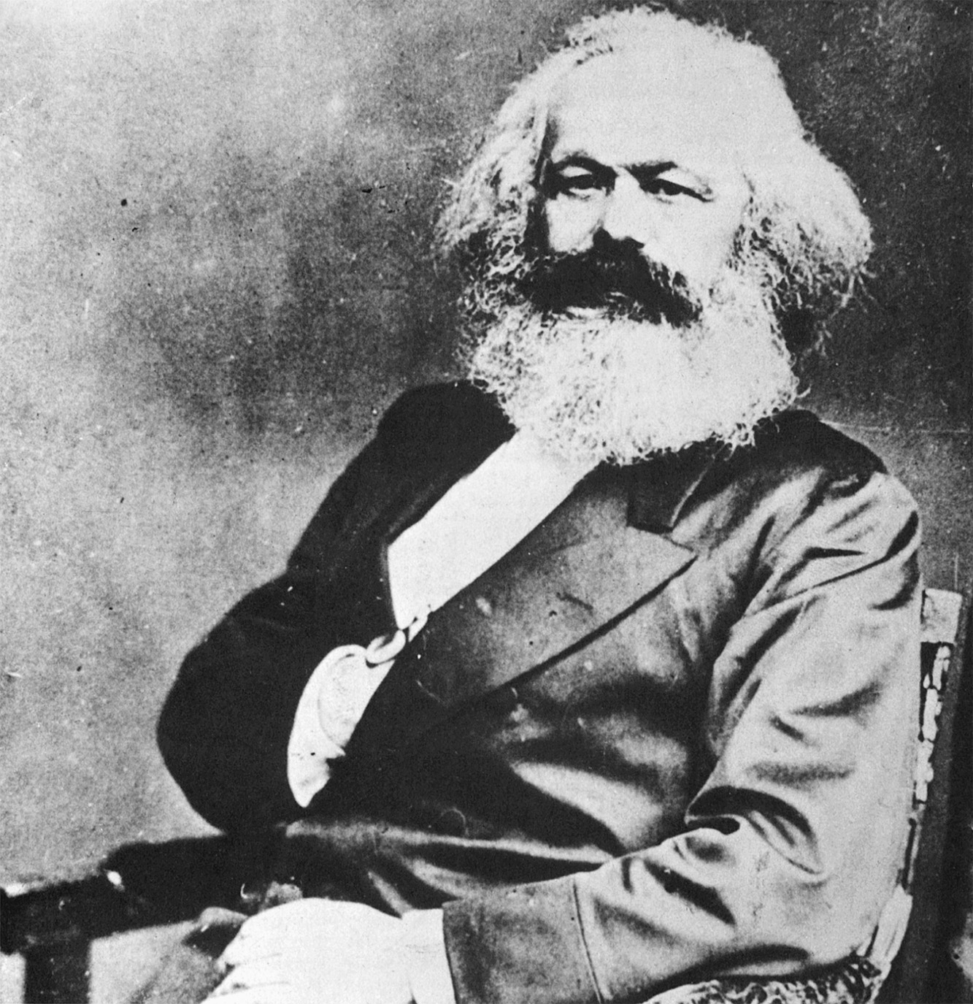
Karl Marx’s communist philosophy became the most widespread of the many varieties of socialism, but his monumental work became subject to varying interpretations, criticisms, and revisions that continue to this day. Library of Congress
Notes:
Karl Marx’s communist philosophy became the most widespread of the many varieties of socialism, but his monumental work became subject to varying interpretations, criticisms, and revisions that continue to this day.
Library of Congress

Slide 36
1848
A series of liberal and nationalistic revolutions occur in response to food shortages, unemployment, and poor working conditions
Revolutions occur in France, Austria, Italian, and German states

Slide 37
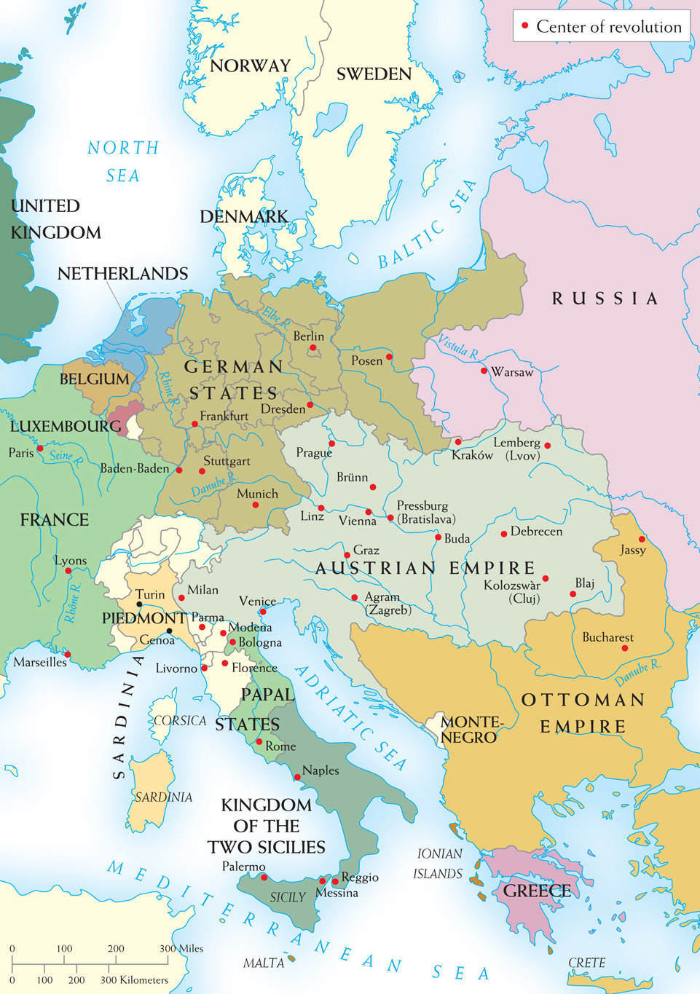
Map 21–2 CENTERS OF REVOLUTION IN 1848–1849 The revolution that toppled the July monarchy in Paris in 1848 soon spread to Austria and many of the German and Italian states. Yet by the end of 1849, most of these uprisings had been suppressed.
Notes:
Map 21–2 CENTERS OF REVOLUTION IN 1848–1849 The revolution that toppled the July monarchy in Paris in 1848 soon spread to Austria and many of the German and Italian states. Yet by the end of 1849, most of these uprisings had been suppressed.

Slide 38
Revolution in France
Liberal revolution – led by Louis Blanc, who wanted a social and political revolution
An election of the General Assembly based on universal male suffrage leads to the election of moderates and conservatives
Revolution is put down by conservative troops, killing nearly 3,500 people

Slide 39
Revolution in France (cont.)
Louis Napoleon – the election of “Little Napoleon” leads to a dictatorship in which Louis is crowned Emperor Napoleon III
Frenchwomen (1848) – feminists demand full domestic equality, right to serve in the military, and voting rights, but are defeated and not allowed to participate in politics; the movement is eradicated by 1852

Slide 40
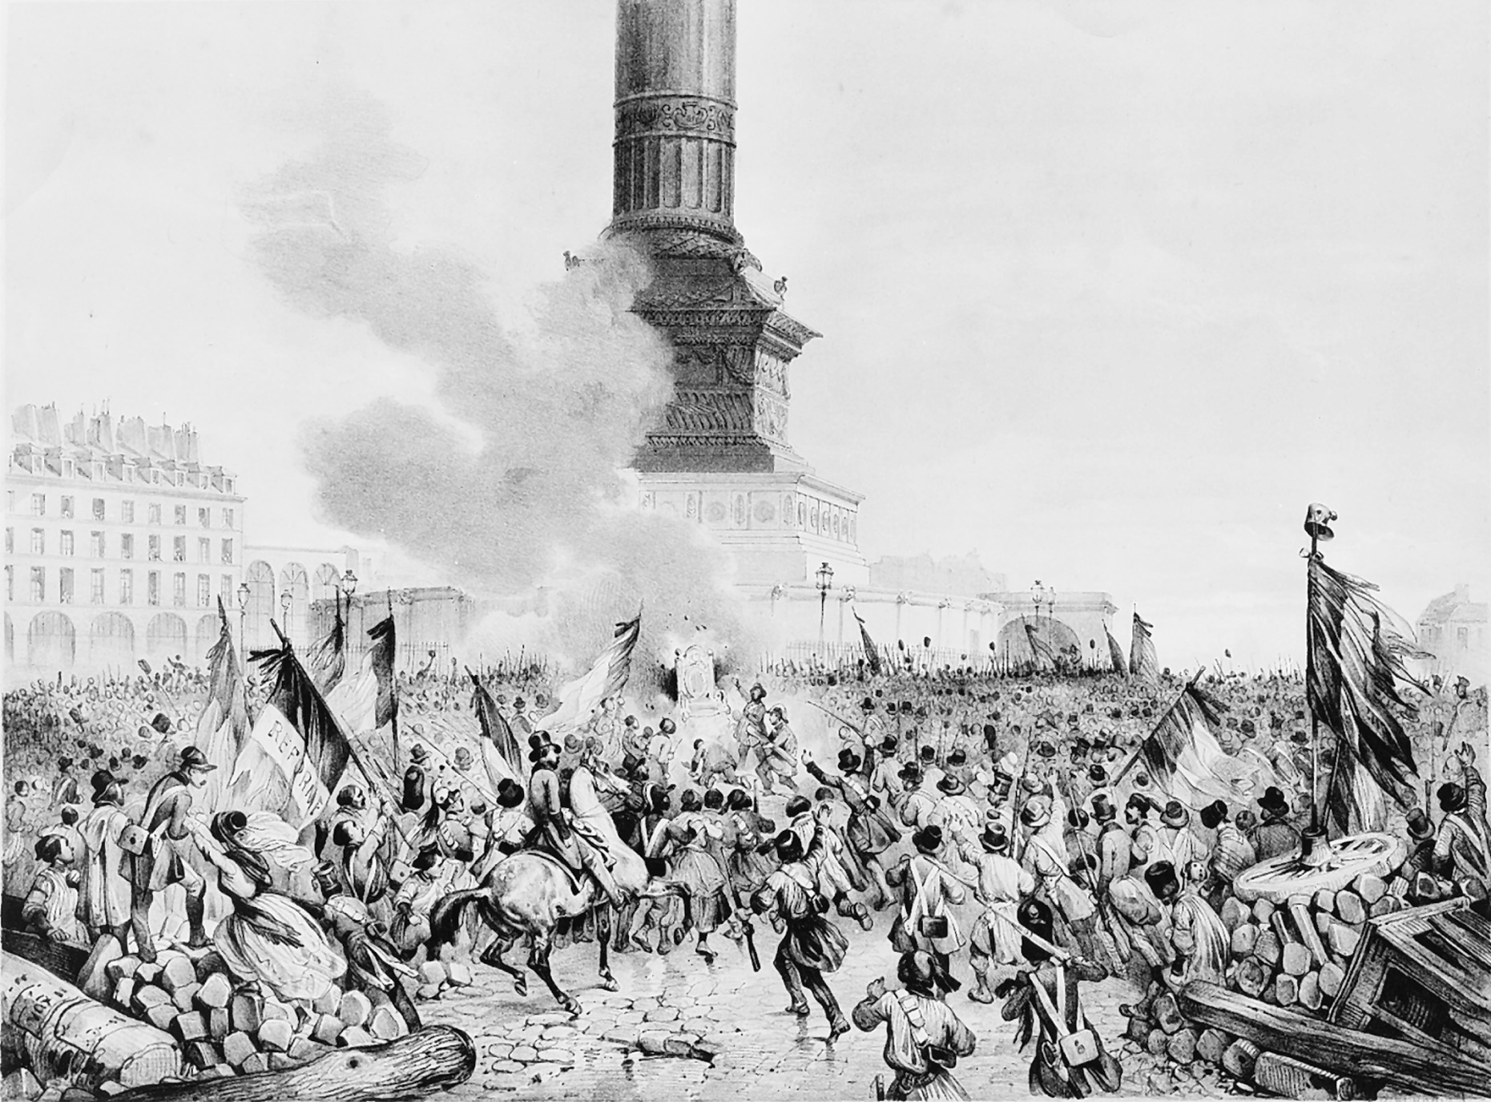
During the February days of the French Revolution of 1848, crowds in Paris burned the throne of Louis Philippe. Bildarchiv Preussischer Kulturbesitz/Art Resource, NY
Notes:
During the February days of the French Revolution of 1848, crowds in Paris burned the throne of Louis Philippe.
Bildarchiv Preussischer Kulturbesitz/Art Resource, NY

Slide 41
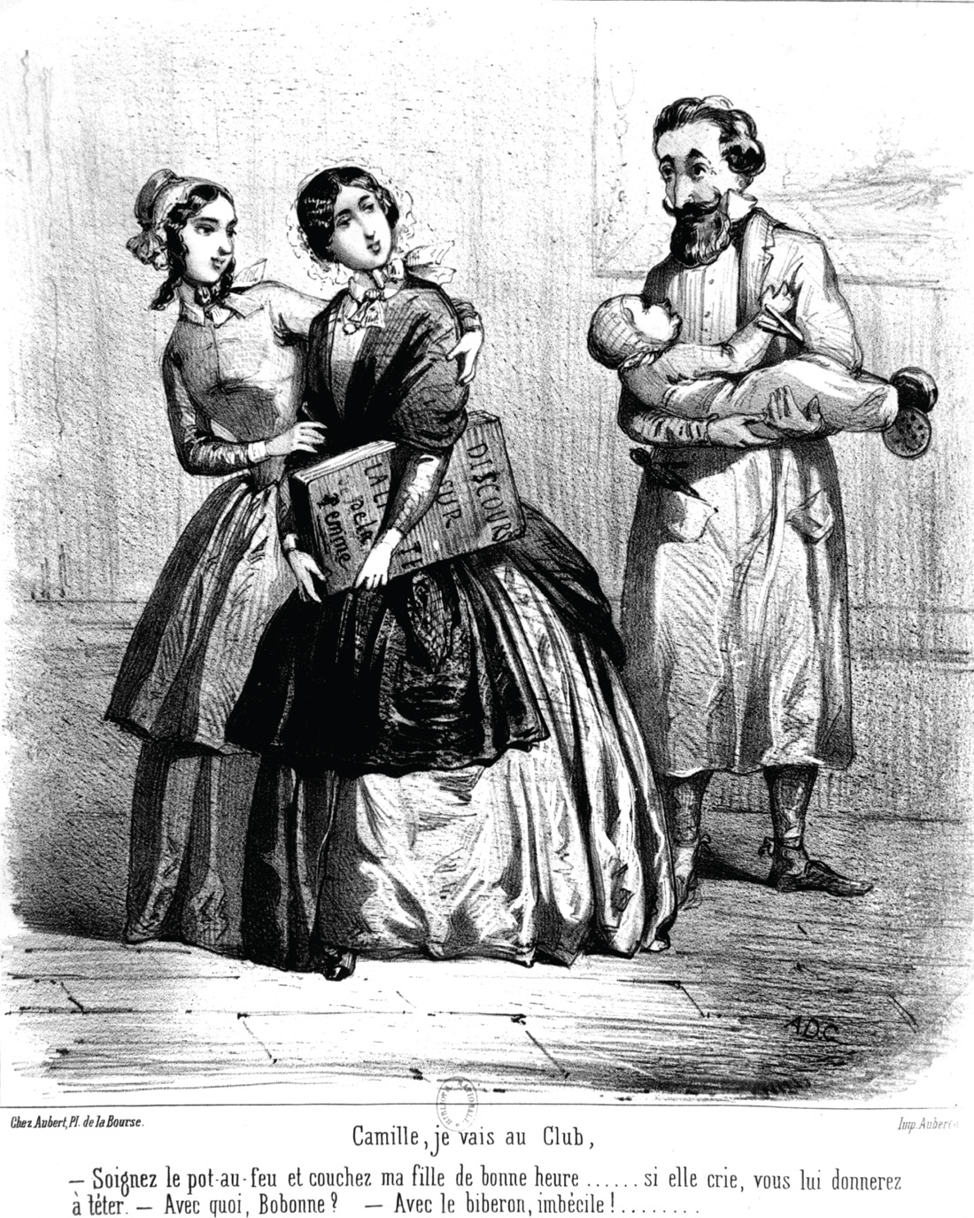
Women who hoped the principles of 1848 would apply to their own political rights were sorely disappointed. Fear that women’s political participation would lead to the emasculation of their husbands played into a strong backlash against nascent feminism. In this 1848 cartoon, a woman tells her husband she’s going to the club, leaving him to care for their infant daughter. © Photos 12/Alamy
Notes:
Women who hoped the principles of 1848 would apply to their own political rights were sorely disappointed. Fear that women’s political participation would lead to the emasculation of their husbands played into a strong backlash against nascent feminism. In this 1848 cartoon, a woman tells her husband she’s going to the club, leaving him to care for their infant daughter.
© Photos 12/Alamy

Slide 42
The Hapsburg Empire
The Vienna Uprising – the abolishment of serfdom by the Hungarian diet quells the Hungarian independence movement

Slide 43
The Hapsburg Empire (cont.)
The Magyar Revolt
Magyars wanted to establish a separate Hungarian state with local controls, while still under the emperor
Fails as Romanians, Croatians, and Serbs, who would have been under Magyar rule, prefer to be with the Hapsburgs to preserve their national identity

Slide 44
The Hapsburg Empire (cont.)
Czech Nationalism – Czech nationalists wanted a unified Slavic state, but their nationalistic efforts were repressed by the Germans and the middle class
Rebellion in Northern Italy – a revolt against Hapsburg domination leads to war in 1848-1849; in August 1849, helped by the Russians, the revolt is finally crushed

Slide 45
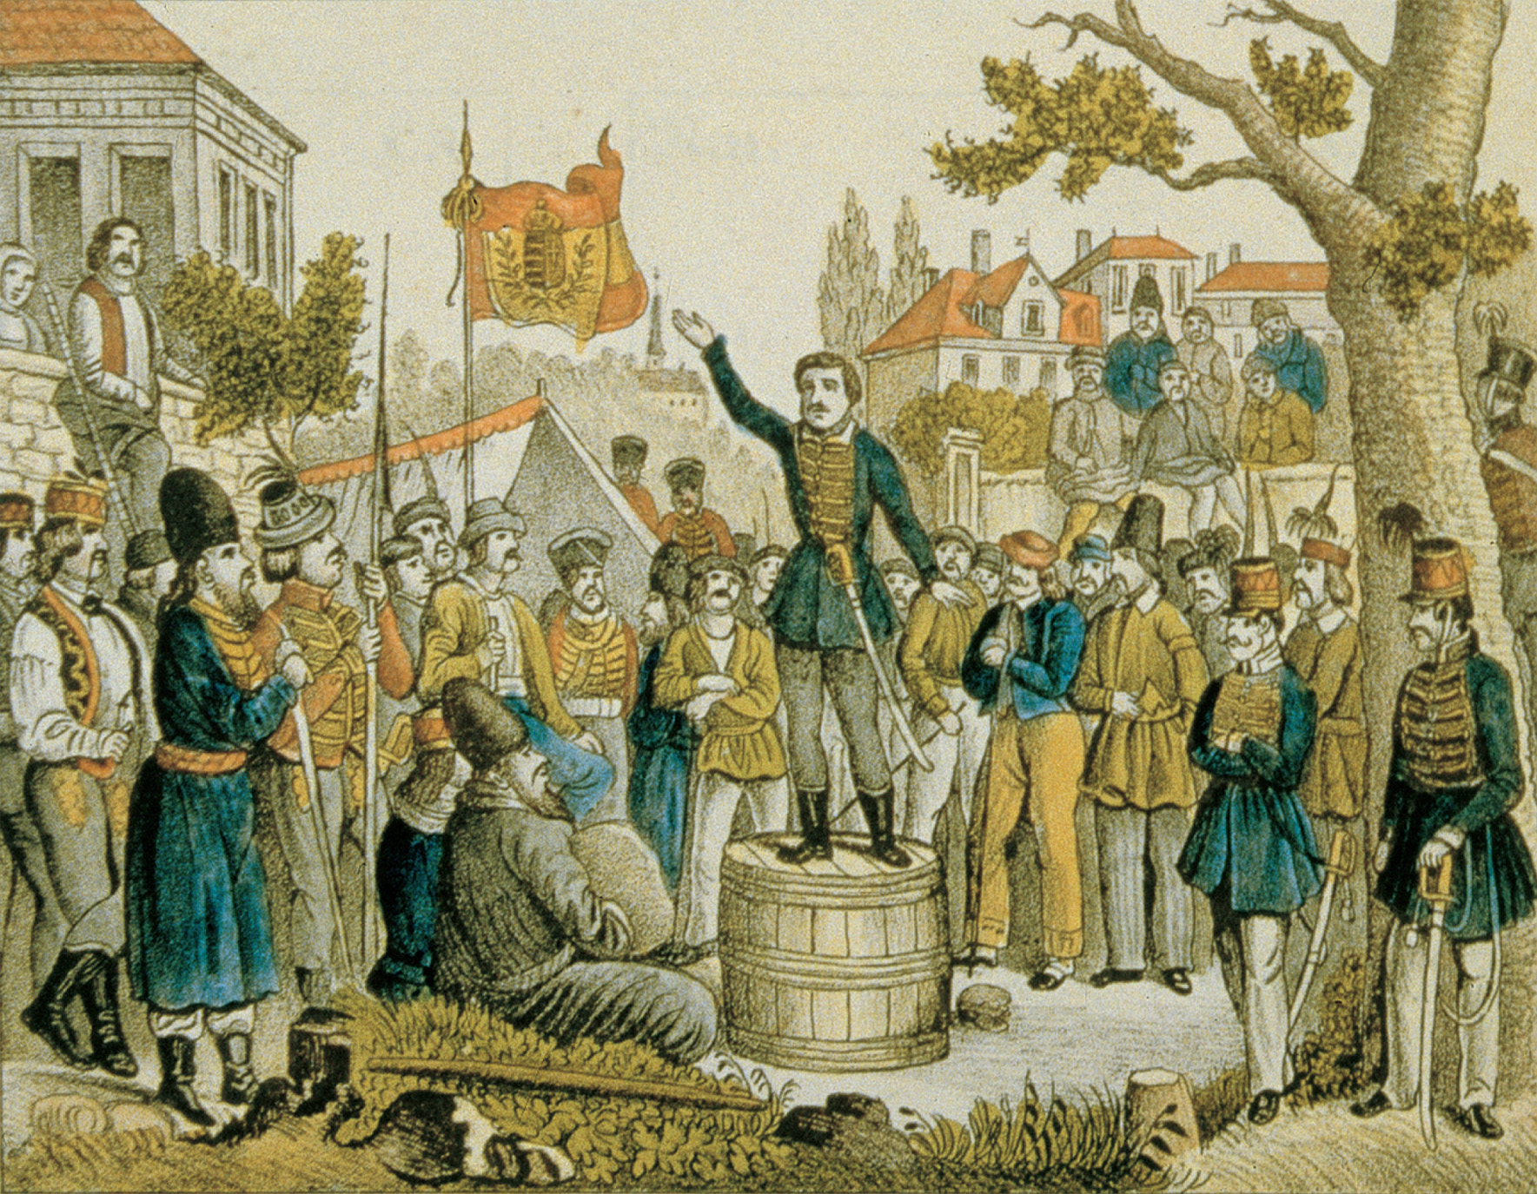
Louis Kossuth, a Hungarian nationalist, seeking to raise troops to fight for Hungarian independence during the revolutionary disturbances of 1848. Bildarchiv Preussischer Kulturbesitz/Art Resource, NY
Notes:
Louis Kossuth, a Hungarian nationalist, seeking to raise troops to fight for Hungarian independence during the revolutionary disturbances of 1848.
Bildarchiv Preussischer Kulturbesitz/Art Resource, NY

Slide 46
Italy: Republicanism Defeated
Nationalists wanted a united Italian state under Pope Pius IX
Radicals, however, wanted a republican form of government; radicals are led by
Giuseppe Mazzini
Giuseppe Garibaldi
Radicals are defeated by the nationalists and by French forces
Pope Pius IX – renounces his liberalism and becomes arch conservative

Slide 47
Germany: Liberalism Defeated
Revolution in Prussia
Frederick William IV – announces Prussia will help unify Germany, ending the Prussian monarchy
Frederick and his conservative supporters ignore the liberals and allow three-tier voting based on ability to pay taxes; only 5% of the population elected one-third of the Prussian Parliament

Slide 48
Germany: Liberalism Defeated (cont.)
The Frankfurt Parliament – intended to write a moderately liberal constitution for a united Germany
Marked a split between German liberals and German working class
Wanted a unified Germany, with Prussian leadership
William IV of Prussia rejects German unification and the Parliament dissolves

Slide 49
Abolition of Slavery
Slavery spreads to the Americas
Crusade to end chattel slavery
Writers portray slaves as embodying a lost human virtue
Religious movements: most important force
Slave revolts
Haiti succeeds
Virginia, South Carolina, Demarra, and Jamaica suppressed

Slide 50
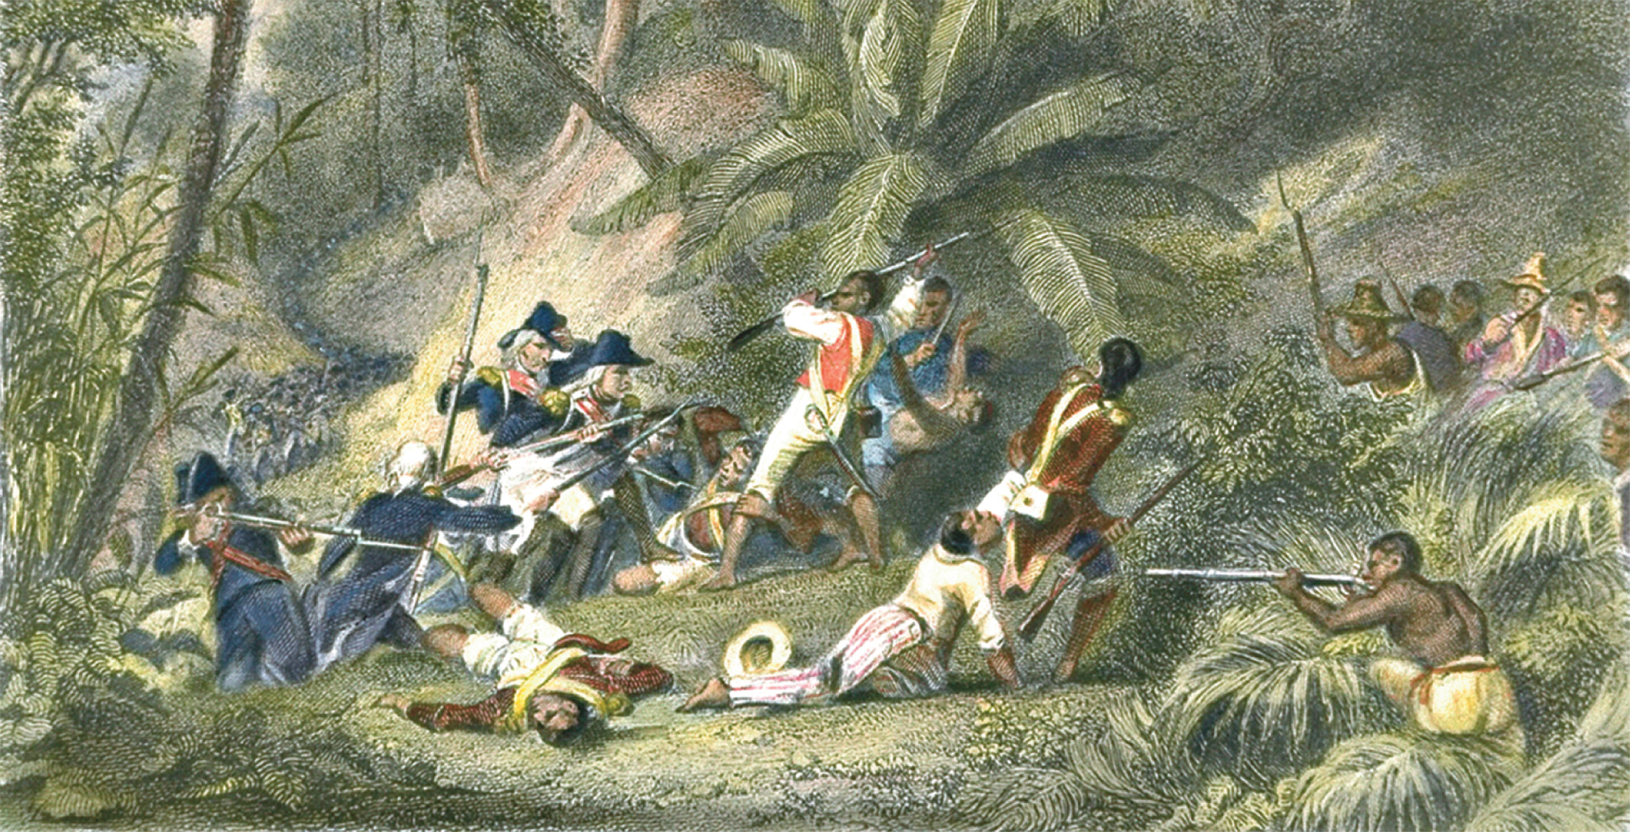
The slave revolt on the French island of St. Domingue achieved the largest emancipation of slaves in the eighteenth century. In this print, Toussaint L’Ouverture leads the revolt. CORBIS/Bettmann
Notes:
The slave revolt on the French island of St. Domingue achieved the largest emancipation of slaves in the eighteenth century. In this print, Toussaint L’Ouverture leads the revolt.
CORBIS/Bettmann

Slide 51
Abolition of Slavery (cont.)
Economic pressures
Due to exhausting soil from sugar cultivation
Price of sugar falling; less need for slaves
Abolishing slavery in the New World
1848 in West Indies
1863, Emancipation Proclamation in U.S.
1865, Thirteenth Amendment in U.S.

Slide 52
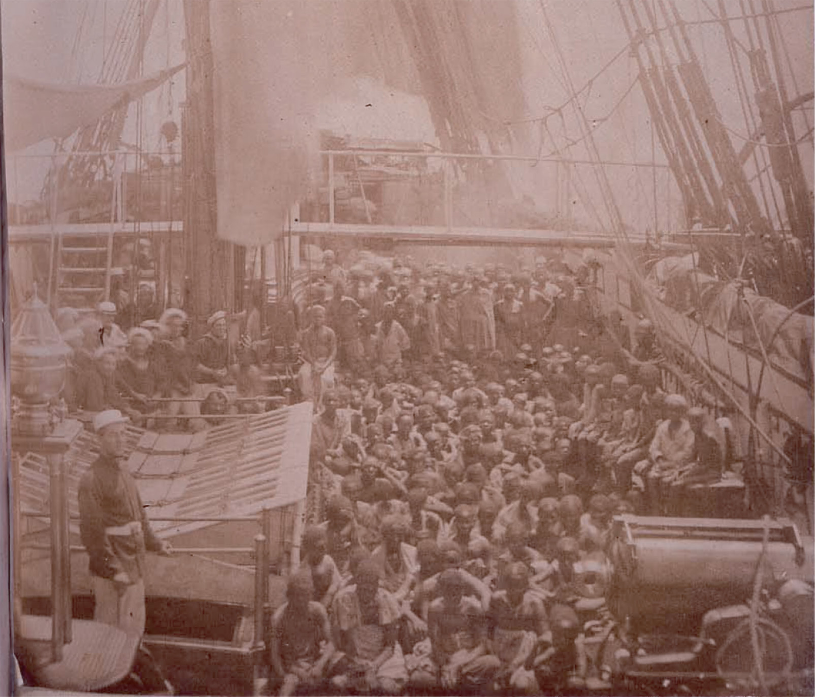
After 1833, the British Royal Navy patrolled the African coasts attempting to intercept slave-trading ships. In 1868, the British ship HMS Daphne captured a slaving ship and freed the slaves. A British lieutenant, John Armstrong Challice, included photographs of the freed slaves in his report to the Foreign Office as part of his efforts to apply pressure to ending the slave trade out of Zanzibar. National Archives (UK) Catalogue reference: FO 84/1310 (b)
Notes:
After 1833, the British Royal Navy patrolled the African coasts attempting to intercept slave-trading ships. In 1868, the British ship HMS Daphne captured a slaving ship and freed the slaves. A British lieutenant, John Armstrong Challice, included photographs of the freed slaves in his report to the Foreign Office as part of his efforts to apply pressure to ending the slave trade out of Zanzibar.
National Archives (UK) Catalogue reference: FO 84/1310 (b)

Slide 53
Abolition of Slavery (cont.)
Africa and the end of slavery
Reformers wanted to spread Christianity and “civilization”
Effort to reform African economy in 1841
Spread of the reform movement into Asia

