Slide 1
Chapter 22
The Age of Nation-States

Slide 2
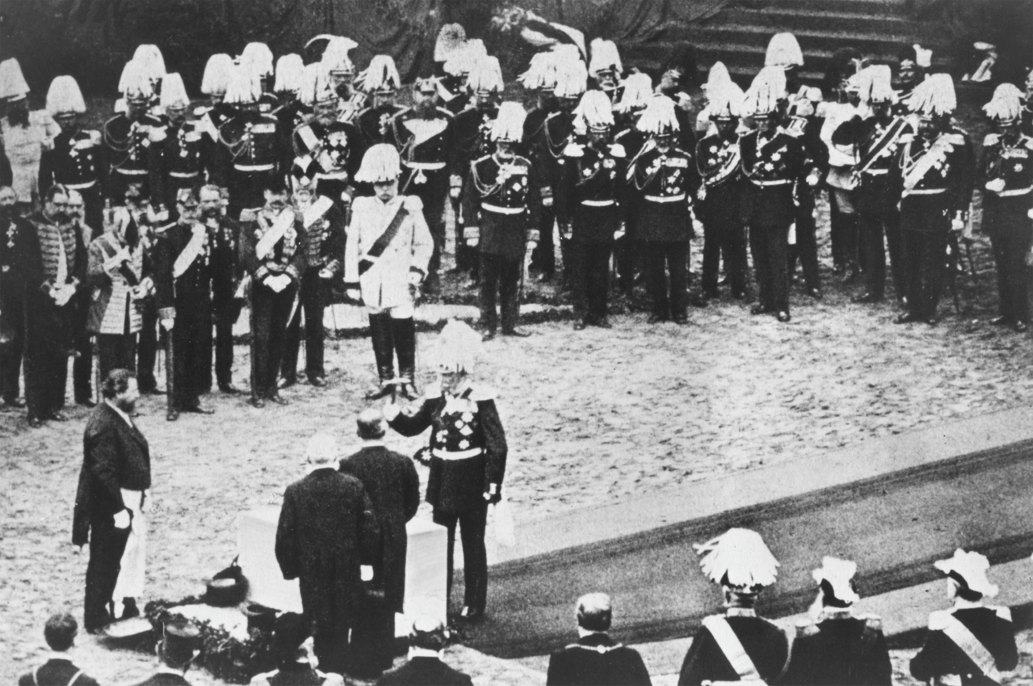
William I, the new emperor of Germany, lays the cornerstone of the Reichstag (German parliament) building in Berlin. Although William I was head of state, it is Bismarck who stands out, as usual, in his white uniform. ullstein bild/The Granger Collection, NYC— All rights reserved
Notes:
William I, the new emperor of Germany, lays the cornerstone of the Reichstag (German parliament) building in Berlin. Although William I was head of state, it is Bismarck who stands out, as usual, in his white uniform.
ullstein bild/The Granger Collection, NYC— All rights reserved

Slide 3
The Crimean War (1853–1856)
War erupts between Russia and Ottoman Empire when Russia attempts to extend its influence into Ottoman territory
France and Britain join the Ottomans; to Russia’s surprise and displeasure, the Austrians and Prussians remain neutral

Slide 4
The Crimean War (1853–1856) (cont.)
Poorly equipped and poorly organized troops lead to massive suffering on both sides
Helped by French and British forces, the Ottomans defeat the Russians

Slide 5
The Crimean War (1853–1856) (cont.)
Results of war:
Russia gives up land around Danube River and Black Sea
Russia renounces its claims to protect Orthodox Christians in Ottoman Empire
Image of invincible Russia crushed
Concert of Europe dissolved

Slide 6
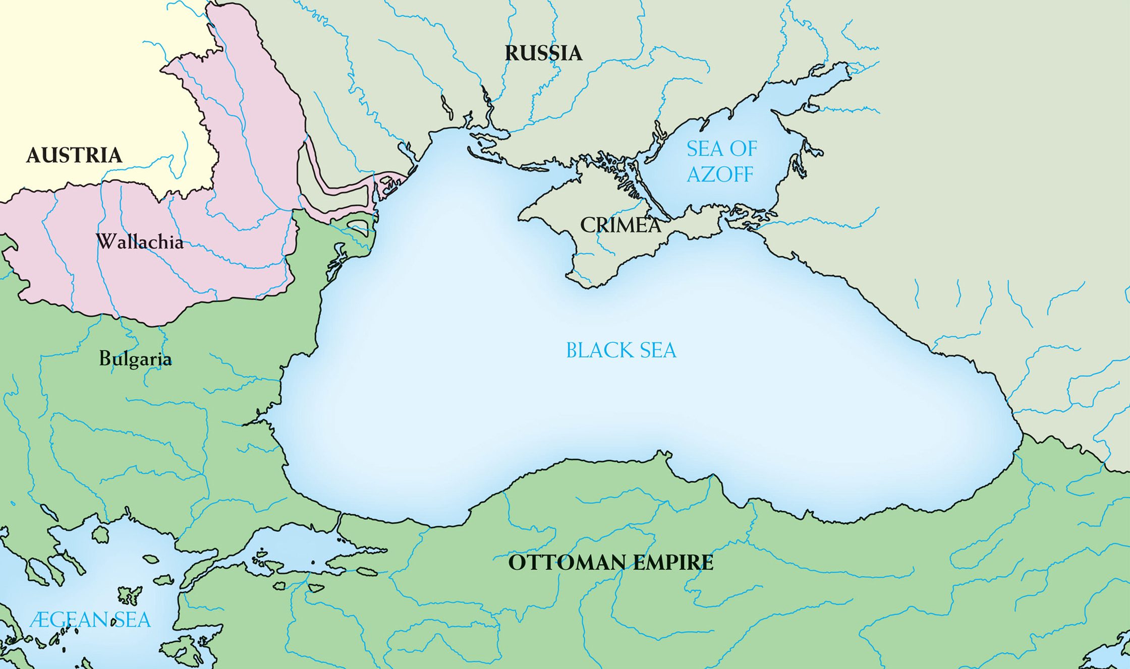
Map 22–1 The Crimean War Although named after the Crimean Peninsula, the Crimean War was actually fought across the entire northern and eastern coasts of the Black Sea.
Notes:
Map 22–1 The Crimean War Although named after the Crimean Peninsula, the Crimean War was actually fought across the entire northern and eastern coasts of the Black Sea.

Slide 7
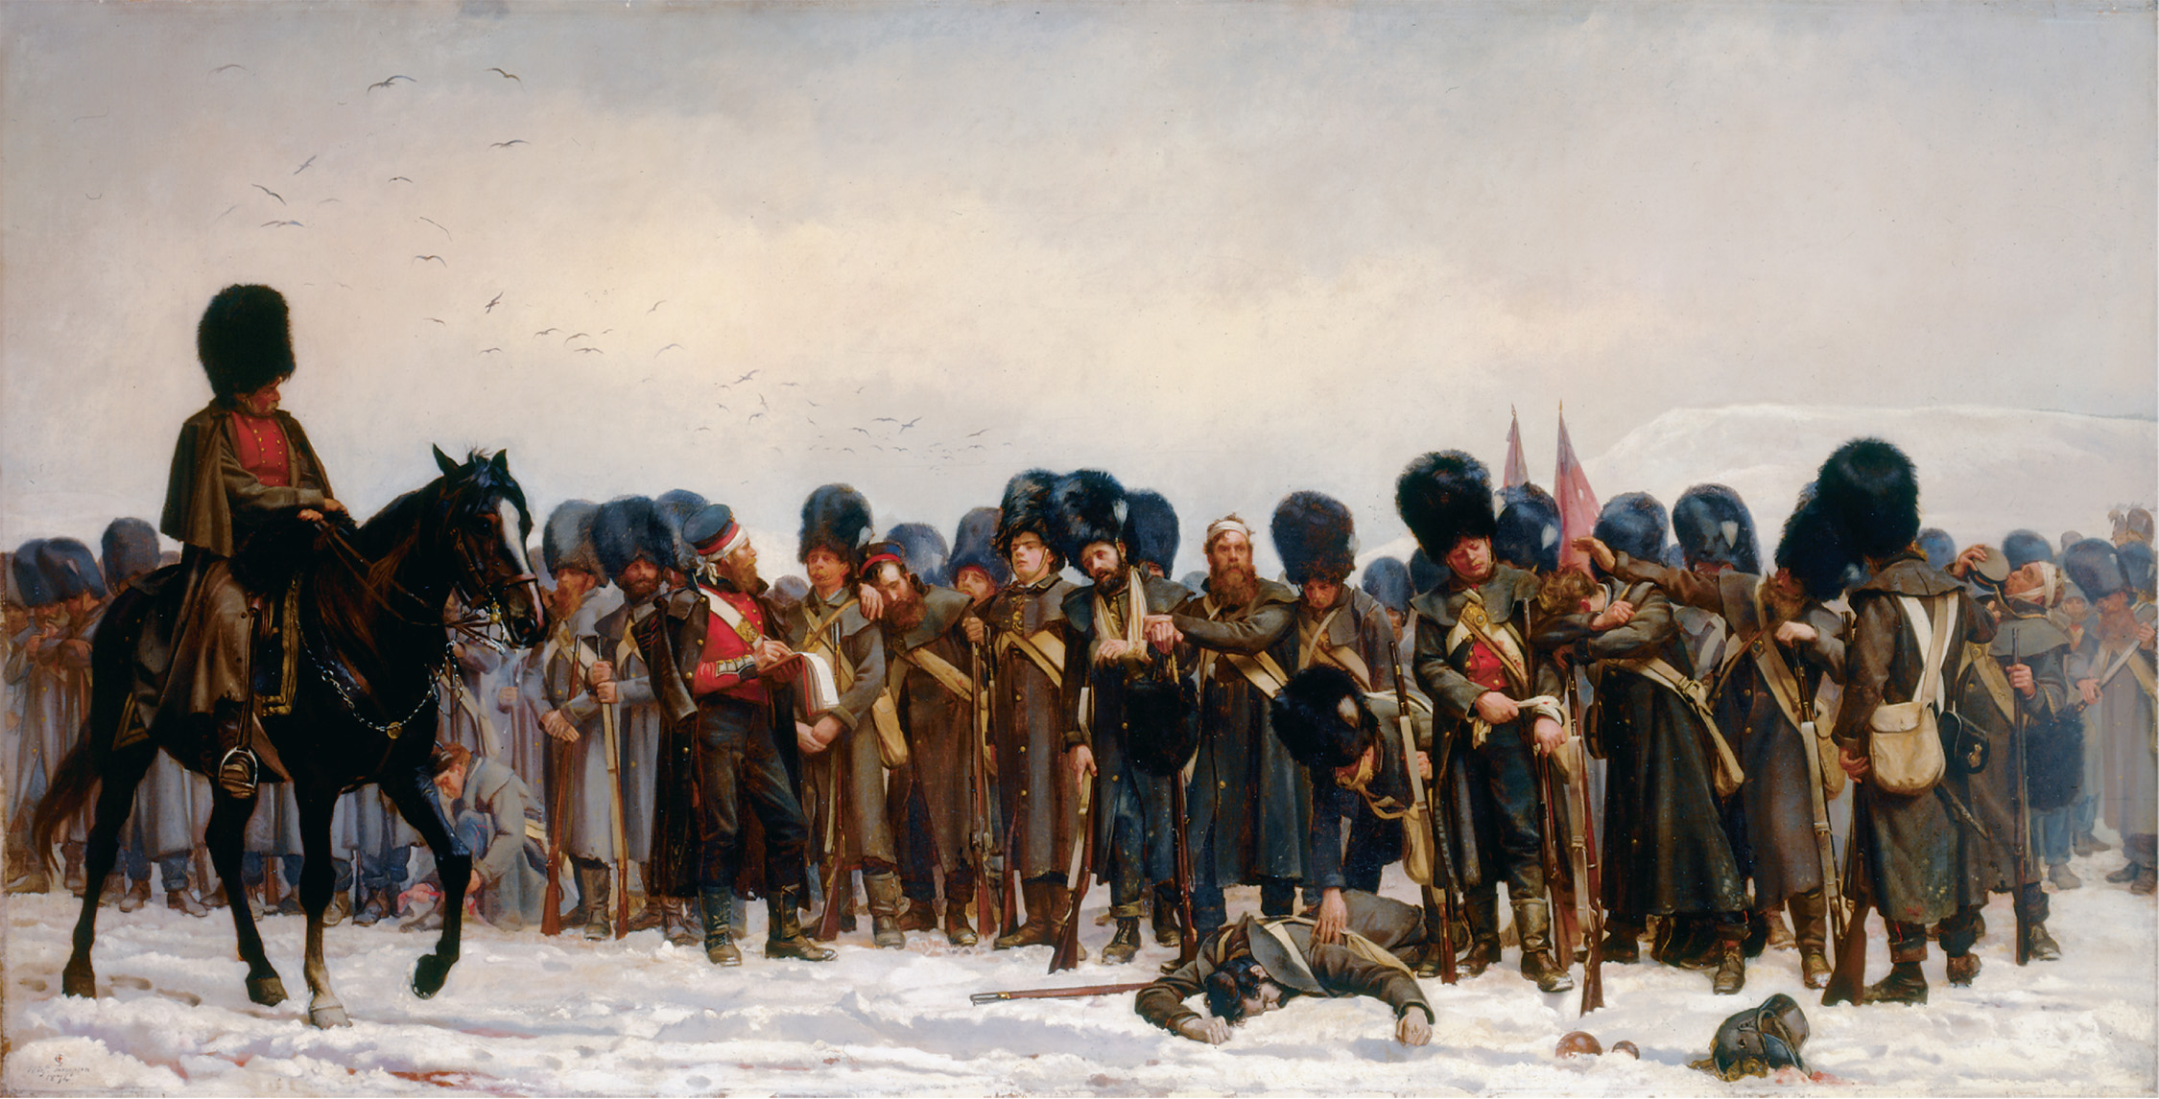
In this painting, completed two decades after the war, Elizabeth Thomson, Lady Butler, emphasizes the suffering of ordinary troops as well as their comradeship. Lady Elizabeth Thompson Butler (1846–1933), The Roll Call: Calling the Roll after an Engagement, Crimea. The Royal Collection © 2005, Her Majesty Queen Elizabeth II. Photo by SC
Notes:
In this painting, completed two decades after the war, Elizabeth Thomson, Lady Butler, emphasizes the suffering of ordinary troops as well as their comradeship.
Lady Elizabeth Thompson Butler (1846–1933), The Roll Call: Calling the Roll after an Engagement, Crimea. The Royal Collection © 2005, Her Majesty Queen Elizabeth II. Photo by SC

Slide 8
The Ottomans’ Reforms Make Empire More “European”
Tanzimat – reorganization of the empire
Liberalized economy
Ended tax farming
Freedom of religion
In some regions of the empire, local rulers made reforms hard to enforce
Reforms an attempt to modernize and secularize the empire

Slide 9
The Ottomans’ Reforms Make Empire More “European” (cont.)
Hatti-i-Humayun – spelled out rights of non-Muslims
Equal opportunities in the military, state employment, and admission to state schools
Abolished torture
Granted property rights

Slide 10
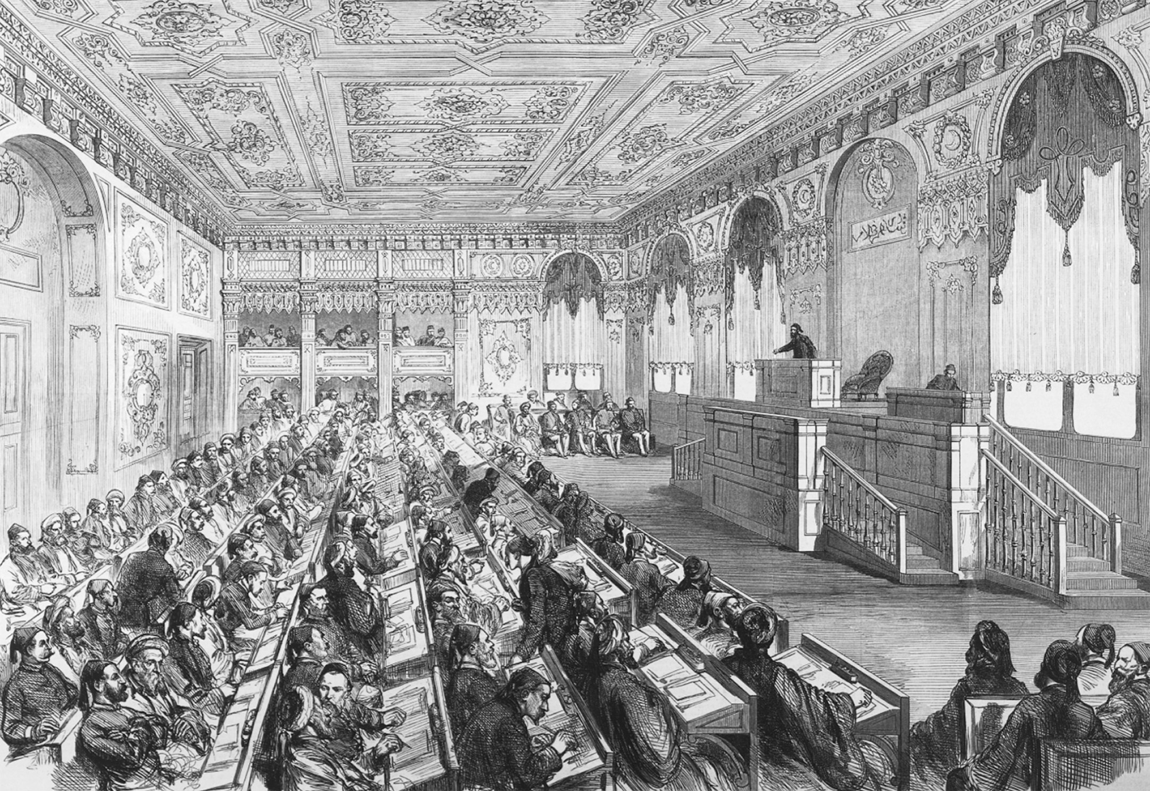
Ottoman reformers established a parliament in 1877, but the sultan retained most political authority. Illustrated London News of April 14, 1877. Mary Evans Picture Library Ltd.
Notes:
Ottoman reformers established a parliament in 1877, but the sultan retained most political authority.
Illustrated London News of April 14, 1877. Mary Evans Picture Library Ltd.

Slide 11
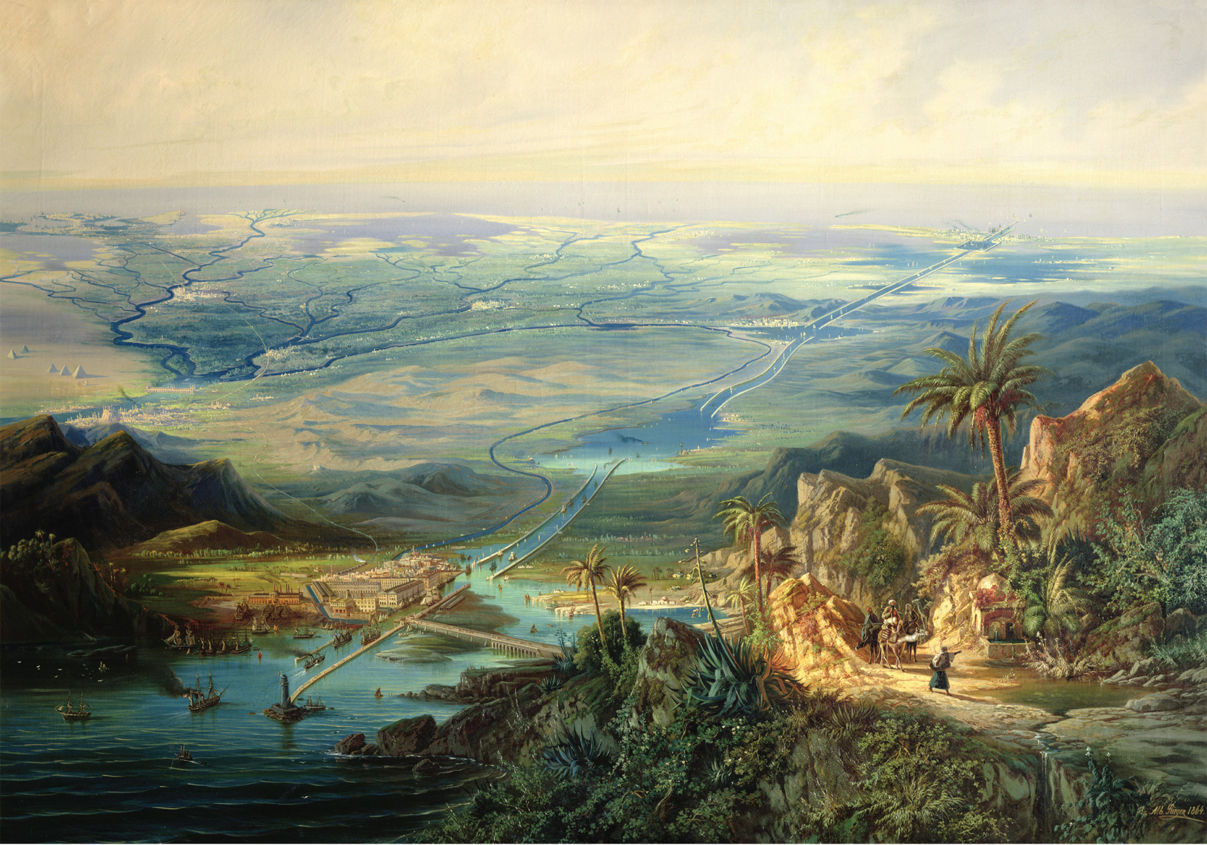
Until the third quarter of the nineteenth century, ships sailing between the Indian Ocean and the Mediterranean Sea or Atlantic Ocean had to navigate all the way around Africa, or to portage their goods overland across the Suez Isthmus, which separated the Red Sea from the Mediterranean Sea. In the mid-1850s, the viceroy of Egypt agreed to a bold plan: the Frenchman Ferdinand de Lesseps, using plans drawn up by Tyrolian engineer Alois Negrelli, proposed to dig a canal across the isthmus and open it to traffic from all nations. The canal’s construction began in 1859, and was completed ten years later. The construction of the canal came to symbolize European technological superiority at the same time that British critics condemned Egypt’s use of slave labor. Albert Rieger (1832–1905), The Suez Canal (1864; oil on canvas). Museo Civico Rivoltello, Trieste, Italy/Alinari/The Bridgeman Art Library International
Notes:
Until the third quarter of the nineteenth century, ships sailing between the Indian Ocean and the Mediterranean Sea or Atlantic Ocean had to navigate all the way around Africa, or to portage their goods overland across the Suez Isthmus, which separated the Red Sea from the Mediterranean Sea. In the mid-1850s, the viceroy of Egypt agreed to a bold plan: the Frenchman Ferdinand de Lesseps, using plans drawn up by Tyrolian engineer Alois Negrelli, proposed to dig a canal across the isthmus and open it to traffic from all nations. The canal’s construction began in 1859, and was completed ten years later. The construction of the canal came to symbolize European technological superiority at the same time that British critics condemned Egypt’s use of slave labor.
Albert Rieger (1832–1905), The Suez Canal (1864; oil on canvas). Museo Civico Rivoltello, Trieste, Italy/Alinari/The Bridgeman Art Library International

Slide 12
Italian Unification and the Republicans
Carbonari – ineffective romantic republican society in Italy
Giuseppe Mazzini and Giuseppe Garibaldi – Italian nationalists who led guerilla warfare in the 1850s
Italian moderates frightened by these uprisings

Slide 13
Count Camillo Cavour
Minister of Piedmont transformed Italy into a nation-state under a constitutional monarchy, rather than a republic
Became prime minister under Victor Emmanuel I; advocated:
Free trade
Railway expansion
Agricultural improvements
Wanted to defeat Austria, with France’s help, to unite Italy

Slide 14
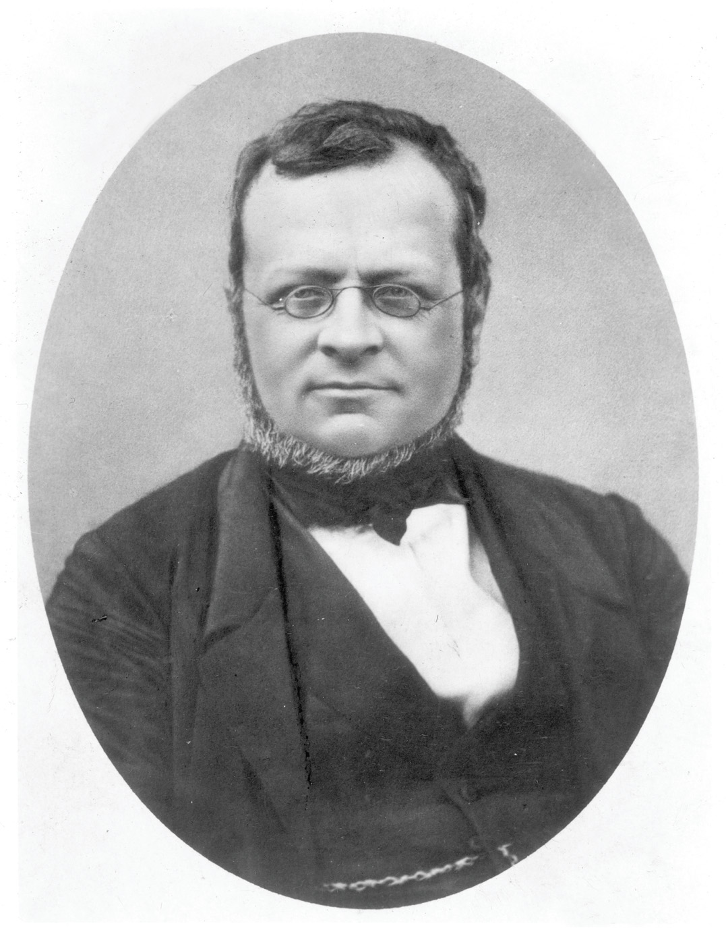
Count Camillo Cavour (1810–1861), whom the Russian thinker Alexander Herzen once called a “fat bespectacled little bourgeois of genius,” used an opportunistic alliance with France against Austria and military interventions in the Papal States and southern Italy to secure Italian unification under King Victor Emmanuel II of Piedmont, rather than as the republic that Mazzini and Garibaldi had advocated. He was not, in fact, bourgeois, but was the son of a count. The Granger Collection, NYC—All rights reserved
Notes:
Count Camillo Cavour (1810–1861), whom the Russian thinker Alexander Herzen once called a “fat bespectacled little bourgeois of genius,” used an opportunistic alliance with France against Austria and military interventions in the Papal States and southern Italy to secure Italian unification under King Victor Emmanuel II of Piedmont, rather than as the republic that Mazzini and Garibaldi had advocated. He was not, in fact, bourgeois, but was the son of a count.
The Granger Collection, NYC—All rights reserved

Slide 15
Movement Toward Unification
French sympathies – Cavour and Napoleon III plot to provoke a war in Italy that would lead to the defeat of Austria
War with Austria – the Italians of Piedmont defeat the Austrians, driving the Austrians from Northern Italy, but France betrays Cavour and leaves Lombardy under Austrian control

Slide 16
Movement Toward Unification (cont.)
Garibaldi’s campaign – his nationalism overtakes his republicanism and he unites Southern Italy with the Piedmont area under Cavour.

Slide 17
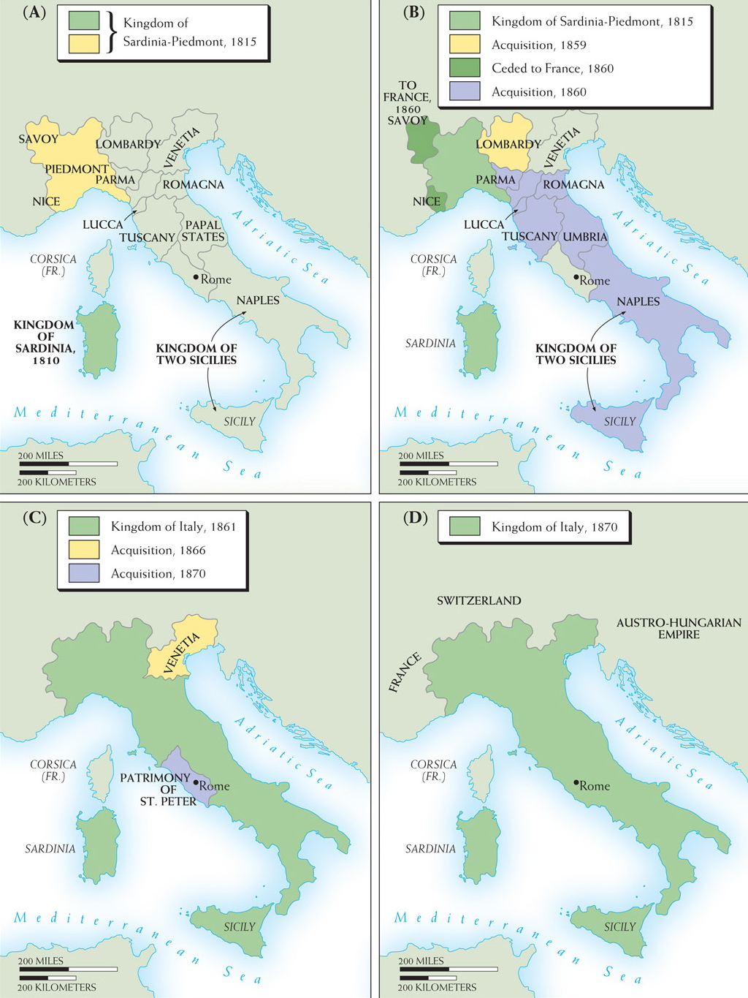
Map 22–1 THE UNIFICATION OF ITALY Beginning with the association of Sardinia and Piedmont by the Congress of Vienna in 1815, unification was achieved through the expansion of Piedmont between 1859 and 1870. Both Cavour’s statesmanship and the campaigns of ardent nationalists played large roles.
Notes:
Map 22–1 THE UNIFICATION OF ITALY Beginning with the association of Sardinia and Piedmont by the Congress of Vienna in 1815, unification was achieved through the expansion of Piedmont between 1859 and 1870. Both Cavour’s statesmanship and the campaigns of ardent nationalists played large roles.

Slide 18
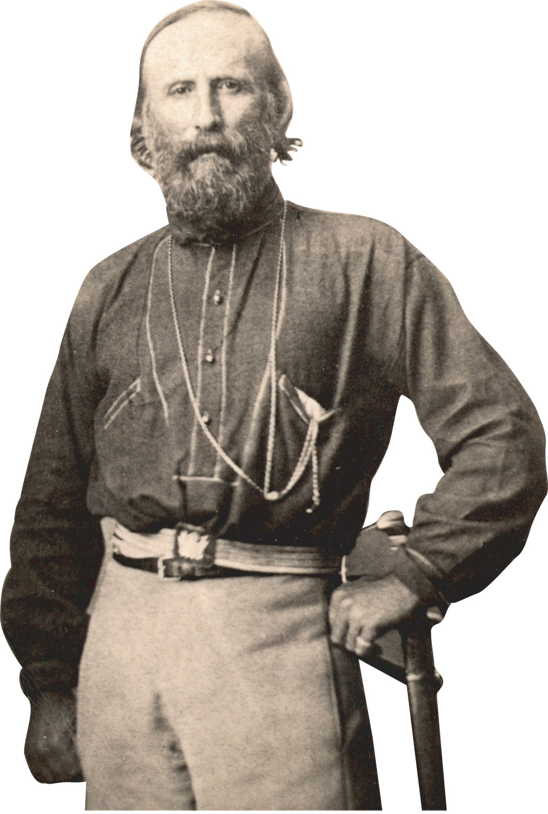
General Giuseppe Garibaldi (1807–1882). Universal Images Group/Getty Images
Notes:
General Giuseppe Garibaldi (1807–1882).
Universal Images Group/Getty Images

Slide 19
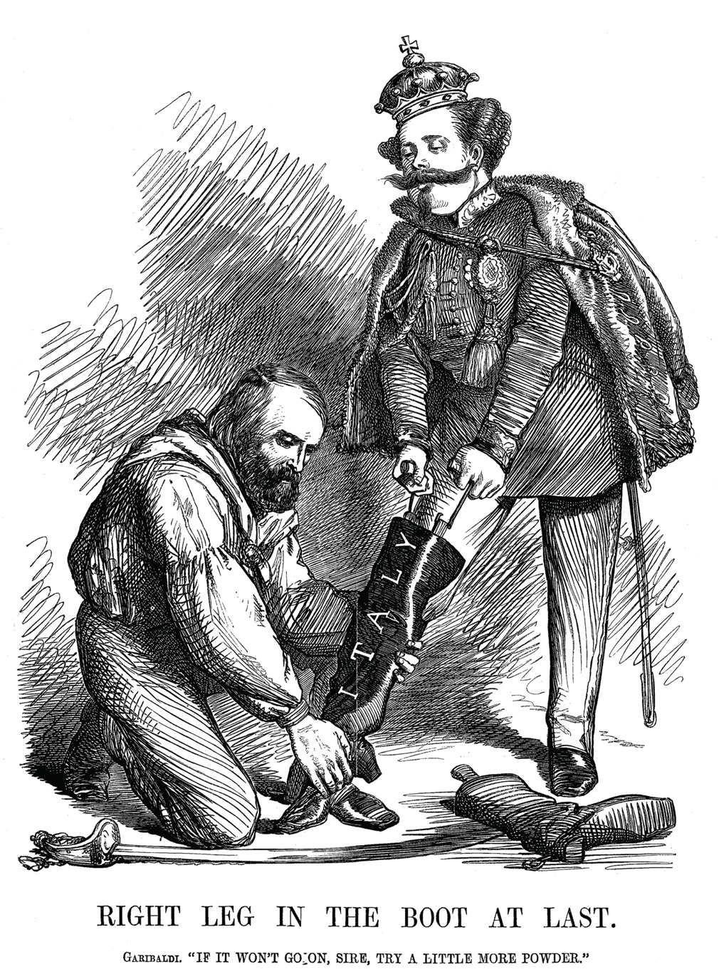
In this Punch cartoon from November 1860, Garibaldi’s decision to accept Victor Emmanuel as king of Italy is portrayed as submission. Garibaldi ultimately decided that achieving Italian unification— and avoiding Civil War—was more important than pursuing his radical social and political goals. © World History Archive/Alamy
Notes:
In this Punch cartoon from November 1860, Garibaldi’s decision to accept Victor Emmanuel as king of Italy is portrayed as submission. Garibaldi ultimately decided that achieving Italian unification— and avoiding Civil War—was more important than pursuing his radical social and political goals.
© World History Archive/Alamy

Slide 20
The New Italian State
Victor Emanuel II is named King of Italy (1861)
Tensions high between industrialized Piedmont in the north and rural, poor southern Italy
Conservative constitutional monarchy put into place, but Parliament is filled with corruption
Venetia in 1866 and Rome (minus Vatican City) in 1870 become part of Italy

Slide 21
German Unification
Created by a conservative army, the monarchy, and the prime minister of Prussia, Frederick William IV
Frederick wanted to end the stalemate between him and the liberal Parliament

Slide 22
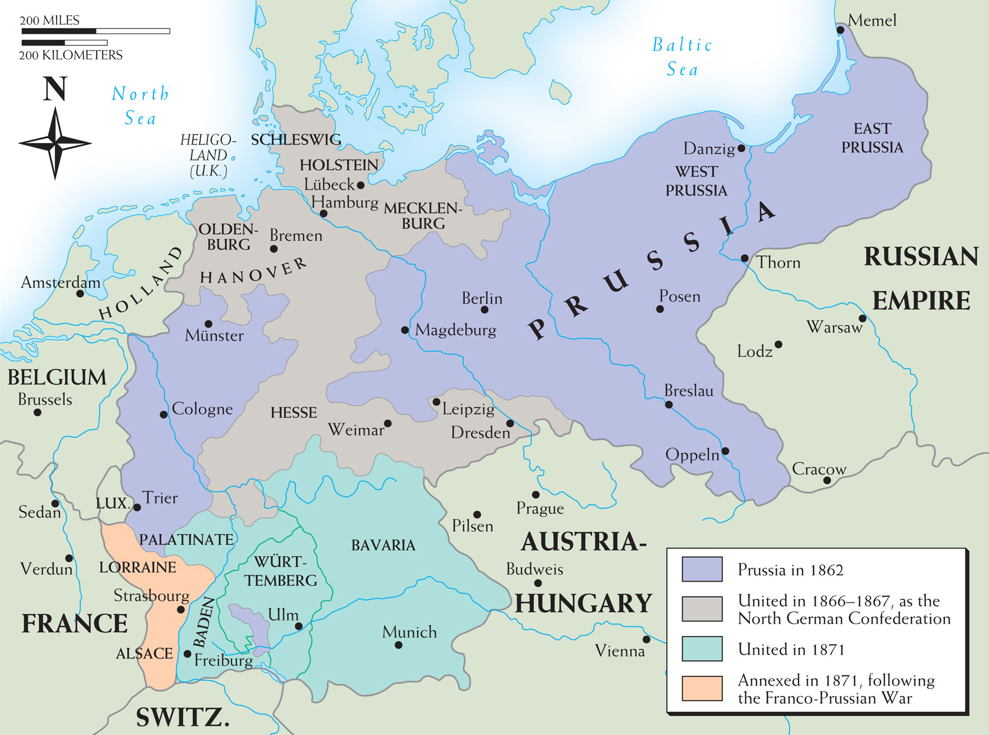
Map 22–3 THE UNIFICATION OF GERMANY Under Bismarck’s leadership, and with the strong support of its royal house, Prussia used diplomatic and military means, on both the German and international stages, to forcibly unify the German states into a strong national entity.
Notes:
Map 22–3 THE UNIFICATION OF GERMANY Under Bismarck’s leadership, and with the strong support of its royal house, Prussia used diplomatic and military means, on both the German and international stages, to forcibly unify the German states into a strong national entity.

Slide 23
Otto von Bismarck
Would be more responsible for reshaping European history than anybody else for the next 30 years (1860s–1890s)
The idea of German unification helped Frederick outflank the liberals of the Prussian Parliament
Led Prussia into three wars, then spent nineteen years fighting for peace

Slide 24
Bismarck’s Wars and Government
The Danish War (1864) – Prussia together with Austria easily defeats Denmark to take over northern states of Schleswig (Prussia) and Holstein (Austria)
The Austro-Prussian War (1866) – Austria defeated – Italy gets Venetia and Austrian Hapsburgs excluded from German affairs

Slide 25
Bismarck’s Wars and Government (cont.)
Diplomacy
Gained Russian sympathy by supporting the suppression of Poland
Persuaded Napoleon III to stay neutral in Austrian-Prussian conflicts
Promised Venetia to Italy if they supported Prussia

Slide 26
Bismarck’s Wars and Government (cont.)
The North German Confederation – Prussia now a federation with two houses
Bundesrat – federal council composed of members appointed by governments of the states
Reichtag – chosen by universal male suffrage; had very little power
Nationalism overtakes the concerns of liberalism and Germany, in effect, becomes a military monarchy

Slide 27
The Franco-Prussian War
France declares war on Prussia when Bismarck makes it appear that William I of Prussia insulted France
Prussia crushes France and captures Napoleon III
William becomes emperor of united Germany
German unification a blow to liberalism, France, and the Hapsburg empire

Slide 28
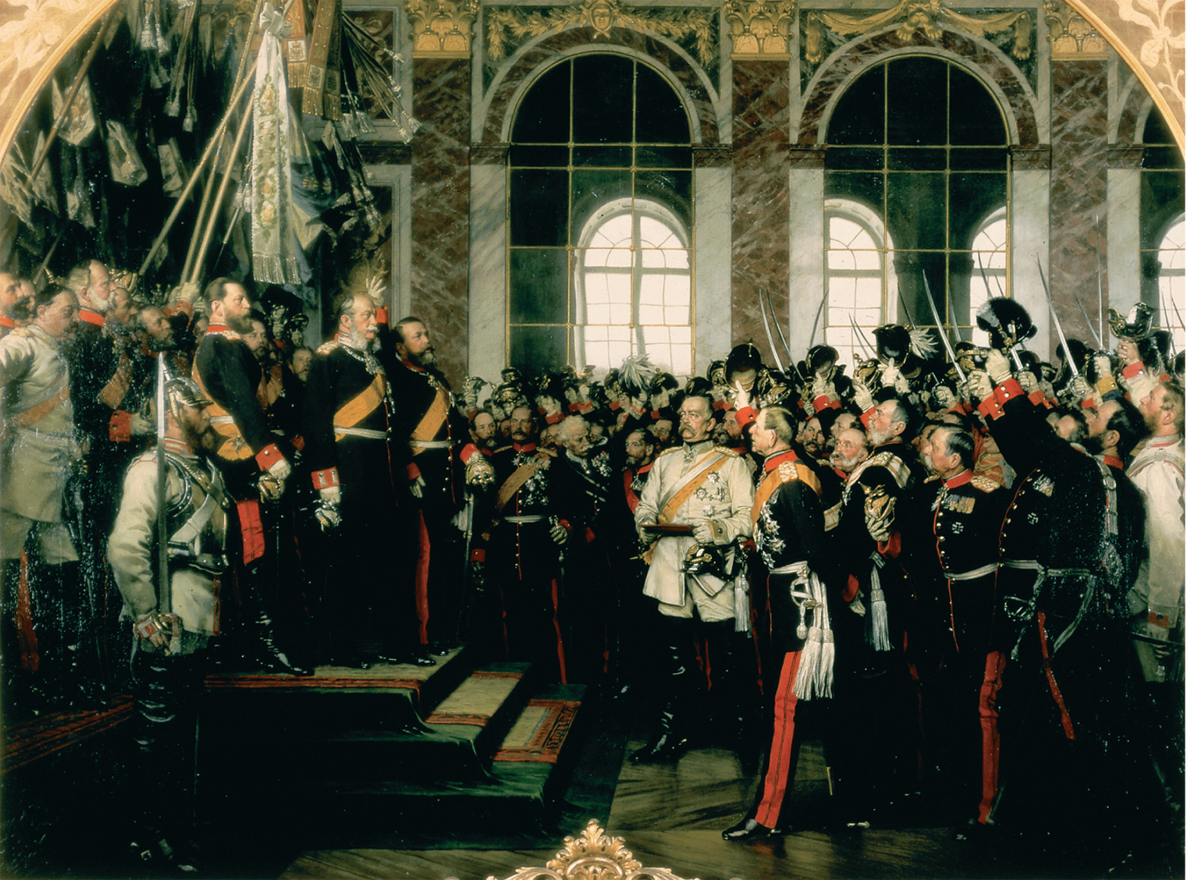
The proclamation of the German Empire in the Hall of Mirrors at Versailles, January 18, 1871, after the defeat of France in the Franco-Prussian War. Kaiser Wilhelm I is standing at the top of the steps under the flags. The viewer’s eye, however, is drawn to Bismarck, who stands in the center in a white uniform. Anton von Werner, “Die Proklamierung des Deutschen Kaiserreiches,” Bildarchiv Preussischer Kulturbesitz/Art Resource, NY
Notes:
The proclamation of the German Empire in the Hall of Mirrors at Versailles, January 18, 1871, after the defeat of France in the Franco-Prussian War. Kaiser Wilhelm I is standing at the top of the steps under the flags. The viewer’s eye, however, is drawn to Bismarck, who stands in the center in a white uniform.
Anton von Werner, “Die Proklamierung des Deutschen Kaiserreiches,” Bildarchiv Preussischer Kulturbesitz/Art Resource, NY

Slide 29
France Goes From Empire to Third Republic
France’s defeat in the Franco-Prussian war spelled the end of the liberal empire
The Paris Commune – radicals and socialists attempt to govern Paris away from the rest of France, but are put down by the National Assembly at the cost of 20,000 lives; victory for the nation-state

Slide 30
France Goes From Empire to Third Republic (cont.)
The Third Republic – when quarreling monarchists can’t agree on a new king, the National Assembly turns to a republican system:
Chamber of Deputies elected by universal male suffrage
Senate chosen indirectly
President elected by both legislative houses

Slide 31
The Hapsburg Empire
The empire in the 1840s–1860s remained dynastic, absolutist, and agrarian as compared with the rest of Europe
Austria’s defeat by France in 1859 and Prussia in 1866 confirms that a new government is needed

Slide 32
The Hapsburg Dual Monarchy
Francis Joseph issues February Patent, which sets up a bicameral imperial government or Reichsrat
Francis Joseph and the Magyars come up with Compromise or Ausgleich of 1867, setting up a dual monarchy known as Austria-Hungary to replace Hapsburg empire

Slide 33
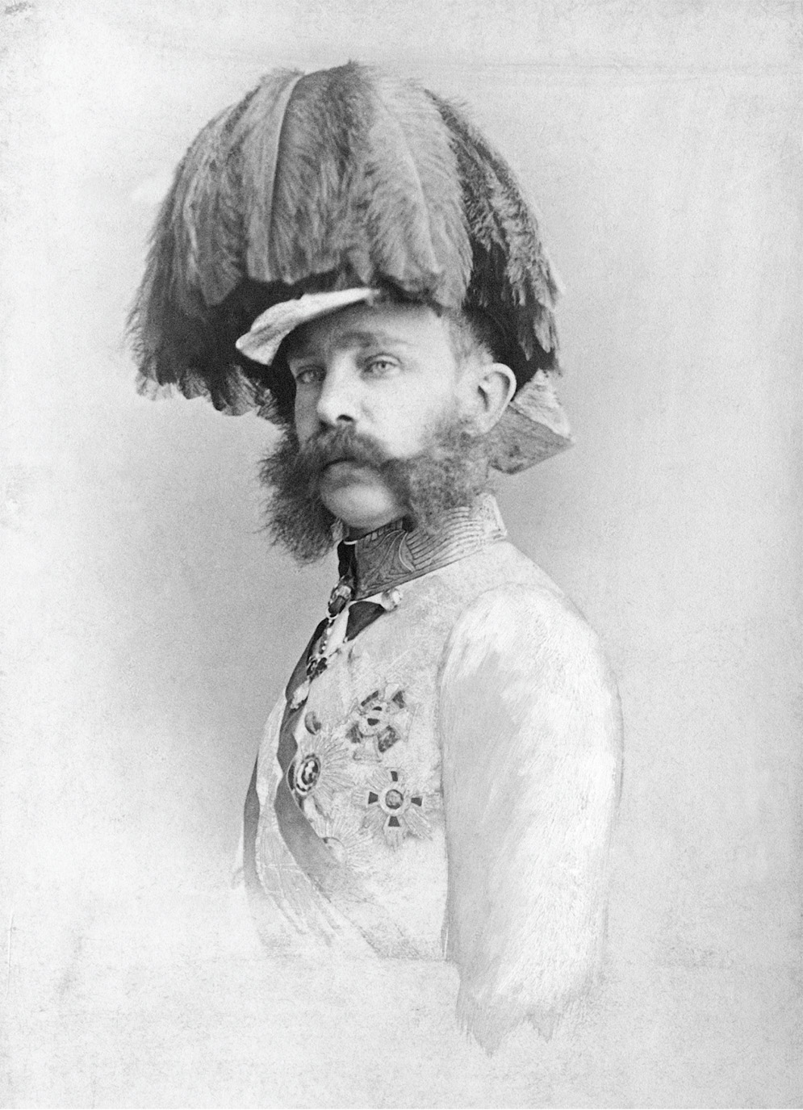
Francis Joseph (1830–1916) ruled Austria and then Austria-Hungary from 1848 until his death. In this 1865 photo, the young emperor is shown in military gala attire, one of his preferred uniforms. His devotion to the Austrian army made it difficult for him to share control over the military with parliament, which contributed to chronic underfunding. © DIZ Muenchen GmbH, Sueddeutsche Zeitung Photo/Alamy
Notes:
Francis Joseph (1830–1916) ruled Austria and then Austria-Hungary from 1848 until his death. In this 1865 photo, the young emperor is shown in military gala attire, one of his preferred uniforms. His devotion to the Austrian army made it difficult for him to share control over the military with parliament, which contributed to chronic underfunding.
© DIZ Muenchen GmbH, Sueddeutsche Zeitung Photo/Alamy

Slide 34
Nationalism and Unrest
The Magyars now had nationality as they basically controlled the Hungary part of Austria-Hungary
The Ruthenians, Romanians, Croatians, and especially the Czechs, oppose the Compromise of 1867
Consequences of nationalism are two World Wars and unrest today

Slide 35
Nationalism and Unrest (cont.)
Francis Joseph makes German and Czech equal languages and enacts universal male suffrage in Austria, but not Hungary, throwing the Reichsrat into chaos
Wanting to be linked by a common race and language, Croats, Poles, Ukrainians, Romanians, Italians, Bosnians, and Serbs all look toward nationalism

Slide 36
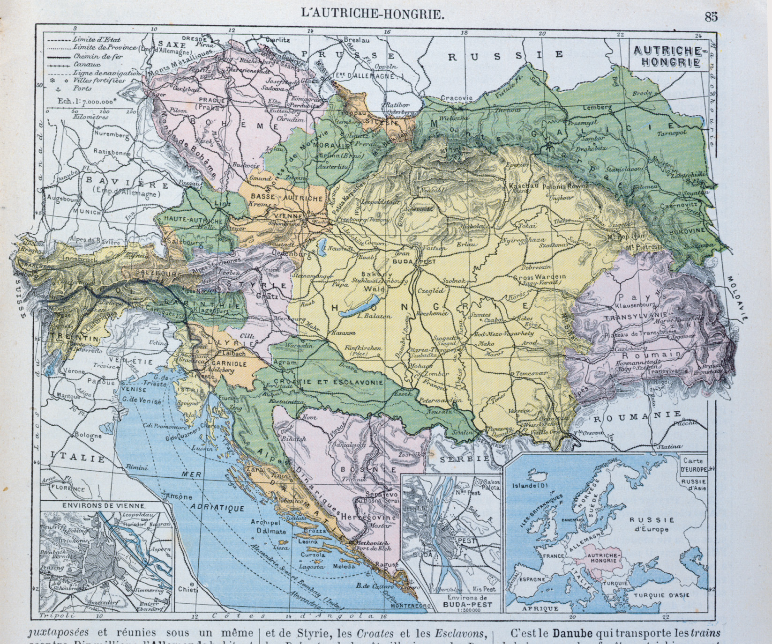
Nationalities within the Habsburg Empire. The Habsburg census forced residents to choose one single “language of daily use.” The many bilingual people in the empire were thus statistically presented as members of a single nationality. As a result, in ethno-linguistic maps the empire appeared as a patchwork of many different nationalities. This both underestimated the sense of unity within the empire and overestimated the homogeneity of the various “national” regions. This map, taken from a 1905 French school textbook, is typical of that phenomenon. Map of the Austro-Hungarian empire, illustration from a French geography school textbook, 1905 (colour litho), French School (20th century). Private Collection/Archives Charmet/The Bridgeman Art Library International
Notes:
Nationalities within the Habsburg Empire. The Habsburg census forced residents to choose one single “language of daily use.” The many bilingual people in the empire were thus statistically presented as members of a single nationality. As a result, in ethno-linguistic maps the empire appeared as a patchwork of many different nationalities. This both underestimated the sense of unity within the empire and overestimated the homogeneity of the various “national” regions. This map, taken from a 1905 French school textbook, is typical of that phenomenon.
Map of the Austro-Hungarian empire, illustration from a French geography school textbook, 1905 (colour litho), French School (20th century). Private Collection/Archives Charmet/The Bridgeman Art Library International

Slide 37
Russian Reforms under Alexander II
Serfdom abolished
Benefits – serfs gain rights to marry without permission, to buy and sell land, to sue in court, and to pursue trades
Drawback – over a forty-nine year period, serfs have to pay back, including interest, their landlords in order to receive their land

Slide 38
Russian Reforms under Alexander II (cont.)
Local government reform – local government run by zemstvos, a system of provincial and county councils, which proved to be largely ineffective
Judicial reform – included equality before the law, impartial hearings, uniform procedures, judicial independence, and trial by jury

Slide 39
Russian Reforms under Alexander II (cont.)
Military reform – service requirements lowered from twenty-five to fifteen years and discipline is relaxed slightly
Repression in Poland – Poland basically becomes a Russian province under Russian laws and language

Slide 40
Russian Revolutionaries
People or groups not satisfied by Alexander’s reforms
Alexander Herzen – started a movement called populism, based on the communal life of peasants
Vera Zasulich – attempted to assassinate the military governor of St. Petersburg
The People’s Will – terrorist group that assassinated Alexander II

Slide 41
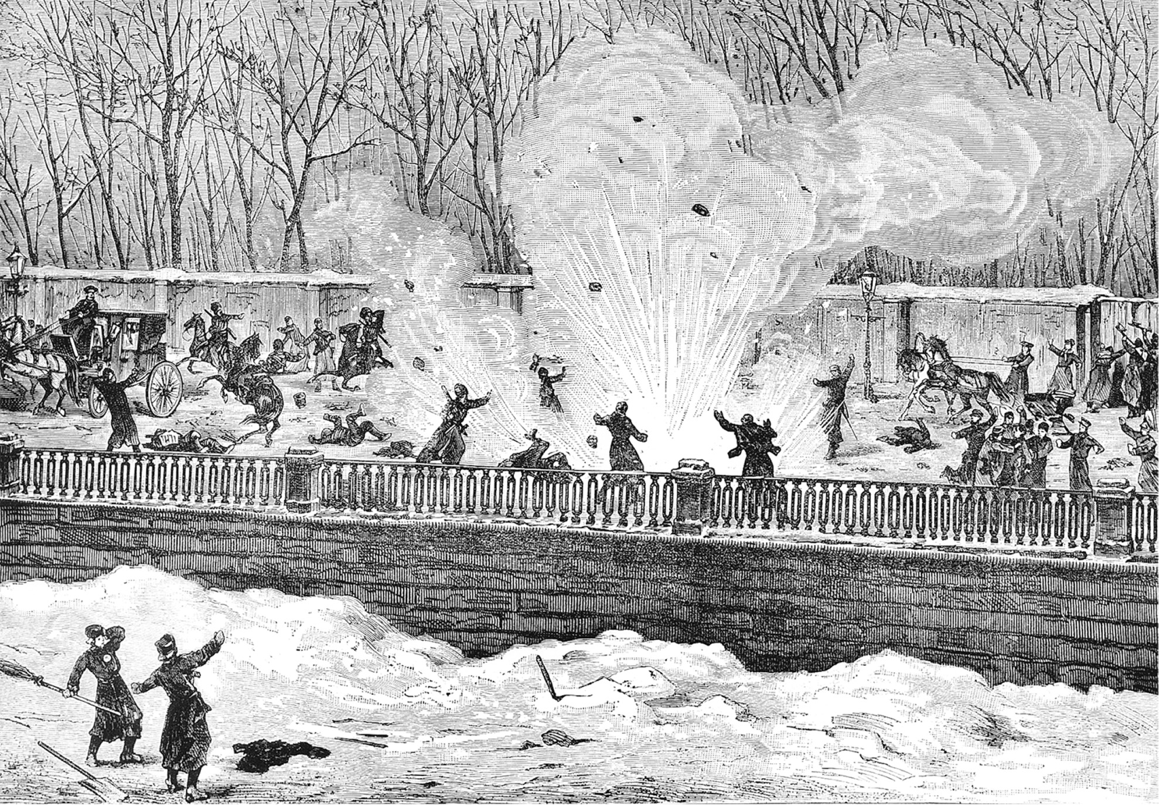
Tsar Alexander II (r. 1855–1881) was assassinated on March 1, 1881. The assassins first threw a bomb that wounded several Imperial guards. When the tsar stopped his carriage to see the wounded, the assassins threw a second bomb, killing him. Bildarchiv Preussischer Kulturbesitz/ Art Resource, NY
Notes:
Tsar Alexander II (r. 1855–1881) was assassinated on March 1, 1881. The assassins first threw a bomb that wounded several Imperial guards. When the tsar stopped his carriage to see the wounded, the assassins threw a second bomb, killing him.
Bildarchiv Preussischer Kulturbesitz/ Art Resource, NY

Slide 42
Alexander III
Autocratic and repressive
Rolled back his father’s reforms
Strengthened secret police and censorship of the press

Slide 43
Great Britain – The Second Reform Act (1867)
Surprisingly, the Conservatives in the House of Commons, led by Benjamin Disraeli, allow a large number of working class males to vote
The new prime minister elected, however, is a liberal, William Gladstone

Slide 44
The Great Ministry of Gladstone
Freedom of religion and class
Competitive exams replace patronage for civil service
Voting by secret ballot
The Education Act of 1870 – established that the government, not the church, would run the elementary schools

Slide 45
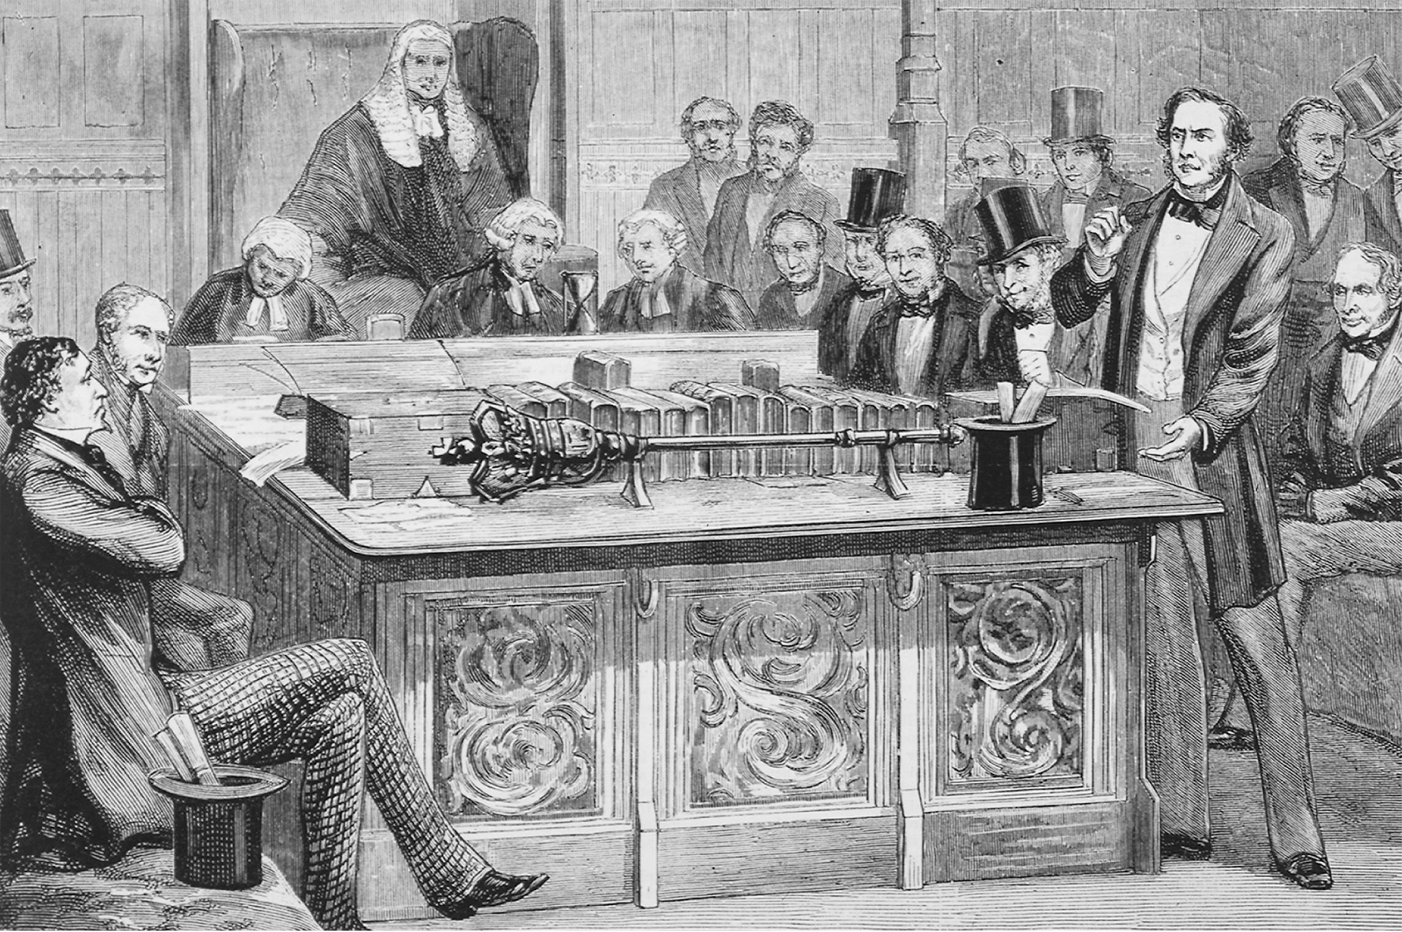
A House of Commons Debate. William Ewart Gladstone, standing on the right, is attacking Benjamin Disraeli, who sits with legs crossed and arms folded. Gladstone served in the British Parliament from the 1830s through the 1890s. Four times the Liberal Party prime minister, he was responsible for guiding major reforms through Parliament. Disraeli, regarded as the founder of modern British conservatism, served as prime minister from 1874 to 1880. Mary Evans Picture Library
Notes:
A House of Commons Debate. William Ewart Gladstone, standing on the right, is attacking Benjamin Disraeli, who sits with legs crossed and arms folded. Gladstone served in the British Parliament from the 1830s through the 1890s. Four times the Liberal Party prime minister, he was responsible for guiding major reforms through Parliament. Disraeli, regarded as the founder of modern British conservatism, served as prime minister from 1874 to 1880.
Mary Evans Picture Library

Slide 46
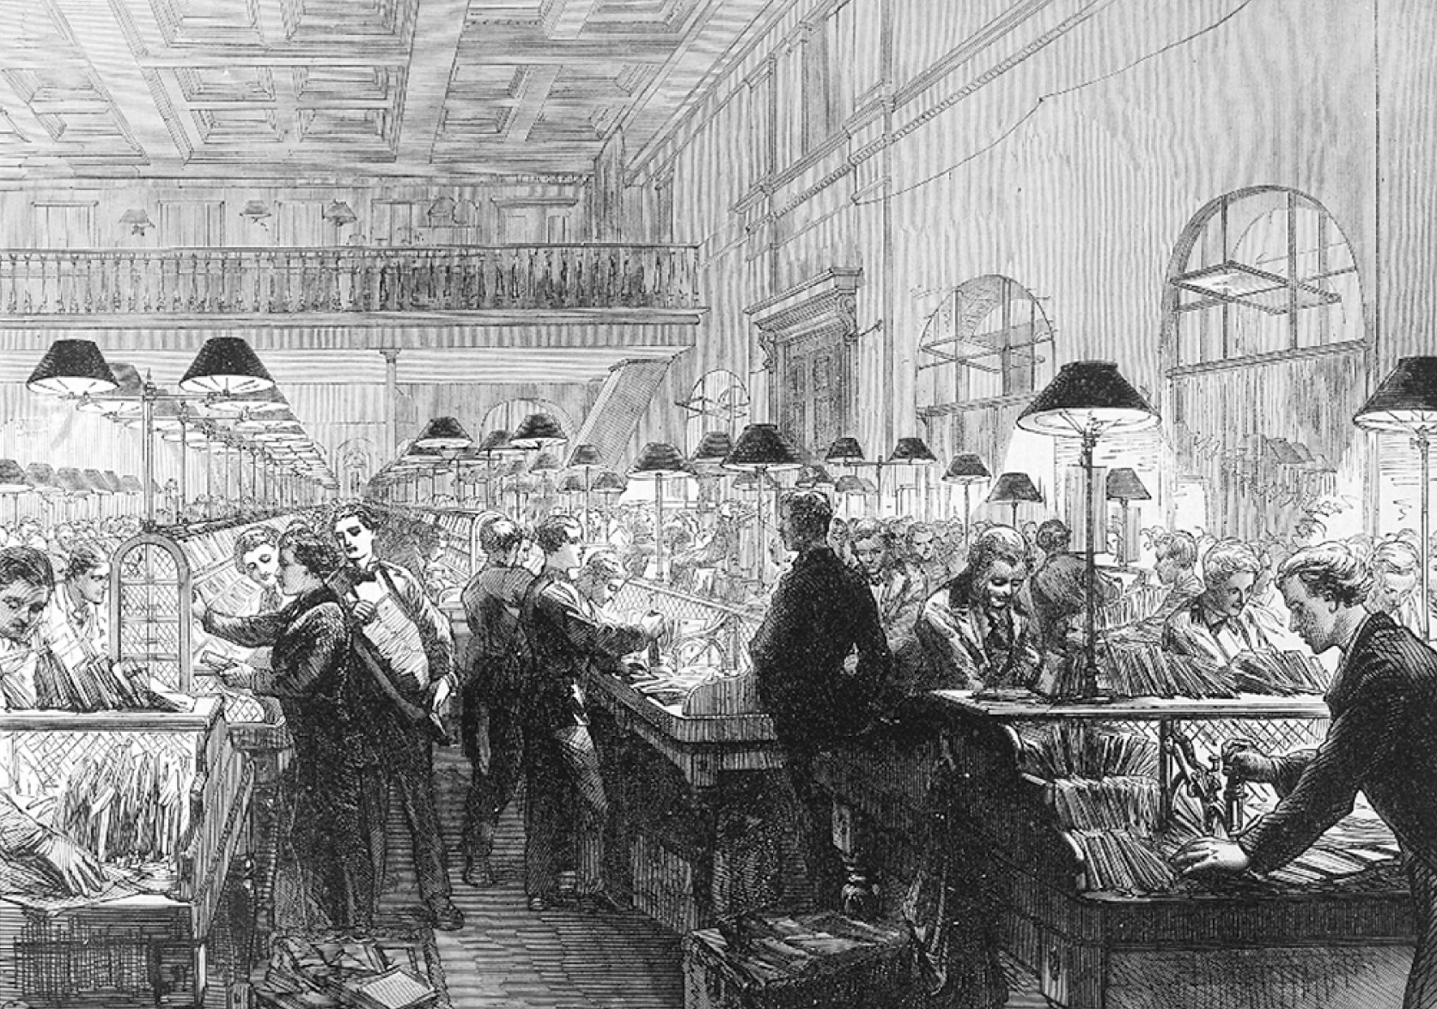
With the new British postal system, the volume of mail vastly increased, as did the number of postal workers involved in sorting and delivering it. Illustrated London News Ltd/Mary Evans Picture Library
Notes:
With the new British postal system, the volume of mail vastly increased, as did the number of postal workers involved in sorting and delivering it.
Illustrated London News Ltd/Mary Evans Picture Library

Slide 47
Disraeli as Prime Minister
Public Health Act of 1875 – reaffirmed duty of the state to interfere with private property to protect health and physical well-being
Artisan Dwelling Act of 1875 – government becomes actively involved in providing housing for the working class
Protection of trade unions and the allowance of picket lines

Slide 48
The Irish Question
Gladstone, again prime minister in 1880, has to deal with the Irish wanting home rule – Irish control of local government
Irish Catholics no longer had to pay for the Anglican Church
Compensation provided for Irish tenants who were evicted from their land
Tenant rights established
Coercion Act passed to restore law and order to Ireland

Slide 49
The Irish Question (cont.)
Home rule, supported by Gladstone, is defeated over and over again between 1886 and 1914, when the rule was finally passed, but then suspended due to World War I

