Slide 1
Chapter 23
The Building of European Supremacy:
Society and Politics to World War I

Slide 2
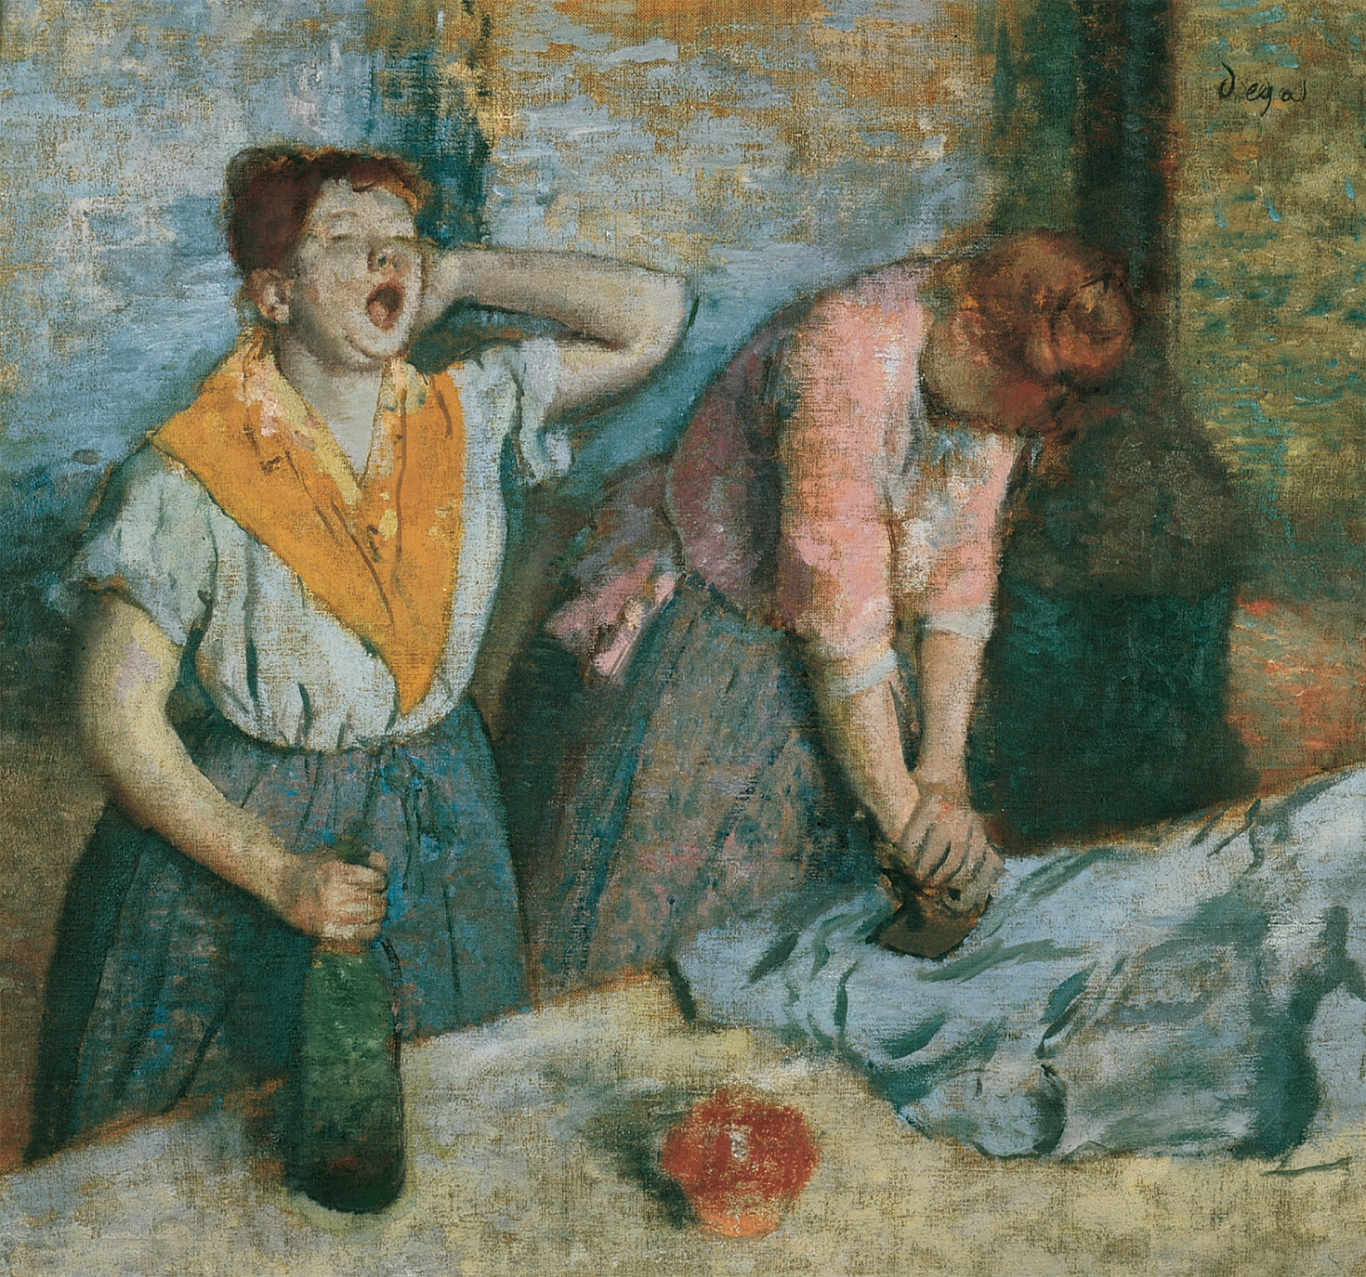
Women laundry workers. Although new opportunities opened to them in the late nineteenth century, many working-class women, like these women ironing in a laundry, remained in traditional occupations. As the wine bottle suggests, alcoholism was a problem for women as well as men engaged in tedious work. Edgar Degas (1834–1917), “Two Laundresses” (c. 1884). Réunion des Musées Nationaux/Art Resource, NY
Notes:
Women laundry workers. Although new opportunities opened to them in the late nineteenth century, many working-class women, like these women ironing in a laundry, remained in traditional occupations. As the wine bottle suggests, alcoholism was a problem for women as well as men engaged in tedious work.
Edgar Degas (1834–1917), “Two Laundresses” (c. 1884). Réunion des Musées Nationaux/Art Resource, NY

Slide 3
Population Trends and Migration
Population rises in Europe until 1910 when it levels off
Population rates continue to rise in underdeveloped nations and areas leading to food shortages
People continue to move from rural to urban areas
Between 1846 and 1932, 50 million Europeans leave their homeland to go to the United States, Canada, South Africa, Australia, Brazil, and Argentina

Slide 4
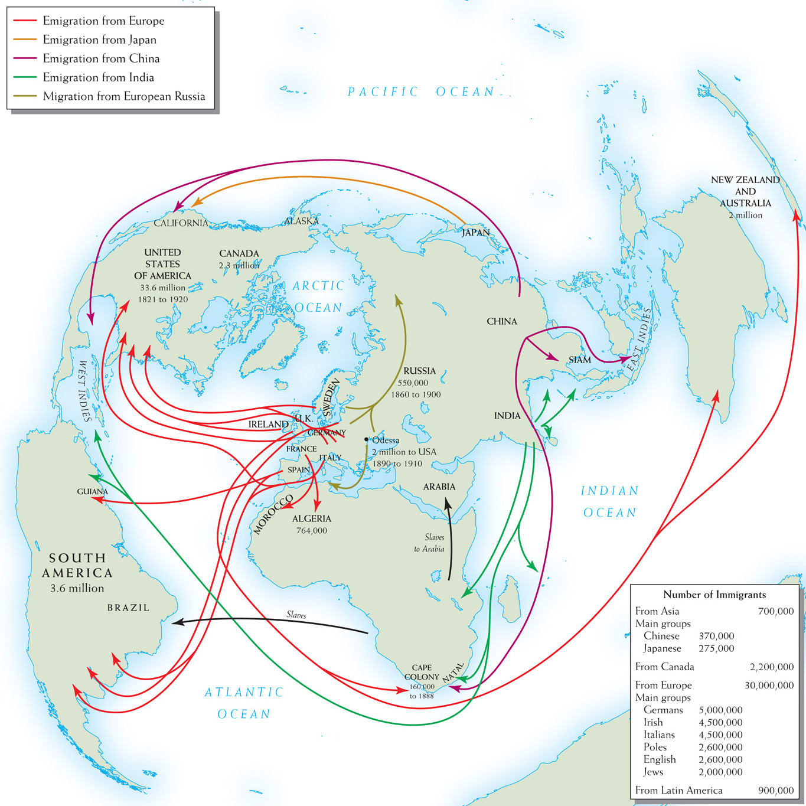
Map 23–1 PATTERNS OF GLOBAL MIGRATION, 1840–1900 Emigration was a global process by the late 19th century. But more immigrants went to the United States than to every other nation combined.
Notes:
Map 23–1 PATTERNS OF GLOBAL MIGRATION, 1840–1900 Emigration was a global process by the late 19th century. But more immigrants went to the United States than to every other nation combined.

Slide 5
New Industries
New industries emerge in third quarter of the 19th century, leading to the Second Industrial Revolution
New industries included: steel, chemicals, electricity, and oil
Bessemer process – new way to mass produce steel cheaply revolutionizes the steel industry

Slide 6
New Industries (cont.)
Solway process – uses alkali production to make new soaps, dyes, and plastics
Electricity changes how people live and travel

Slide 7
New Industries (cont.)
Automobiles
Gottlieb Daimler – invents modern internal combustion engine, leading to automobiles
Henry Ford – American, who through the assembly line made the auto accessible to the masses
Autos lead to the growth of the oil industry

Slide 8
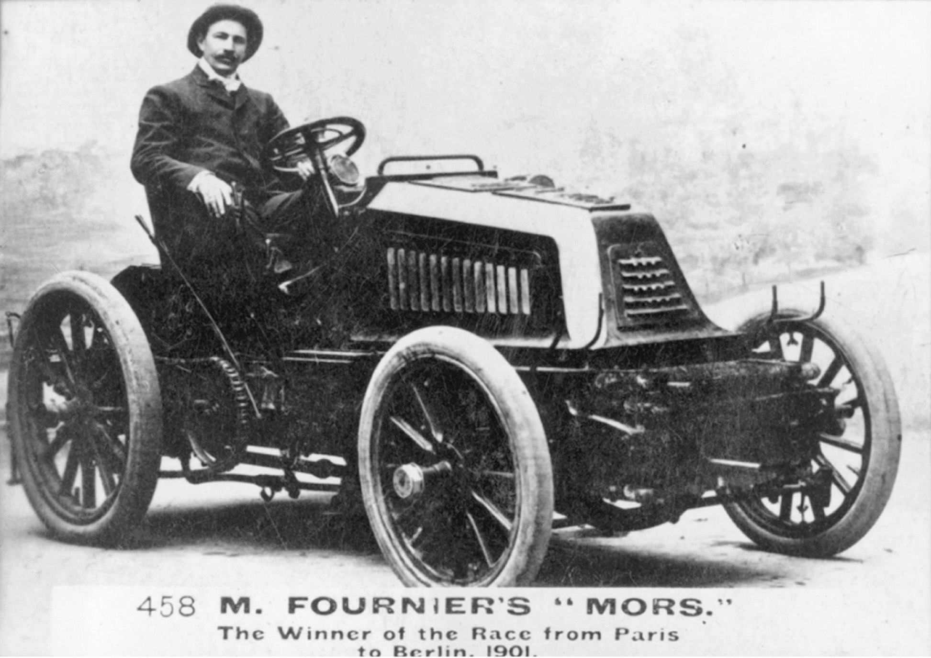
The invention and commercialization of automobiles soon led to auto races in Europe and North America. Here Henri Fournier, the winner of the 1901 Paris to Berlin Motor Car Race, sits in his winning racing car manufactured by the Paris-based auto firm of Emile and Louis Mors. Getty Images Inc.–Hulton Archive Photos
Notes:
The invention and commercialization of automobiles soon led to auto races in Europe and North America. Here Henri Fournier, the winner of the 1901 Paris to Berlin Motor Car Race, sits in his winning racing car manufactured by the Paris-based auto firm of Emile and Louis Mors.
Getty Images Inc.–Hulton Archive Photos

Slide 9
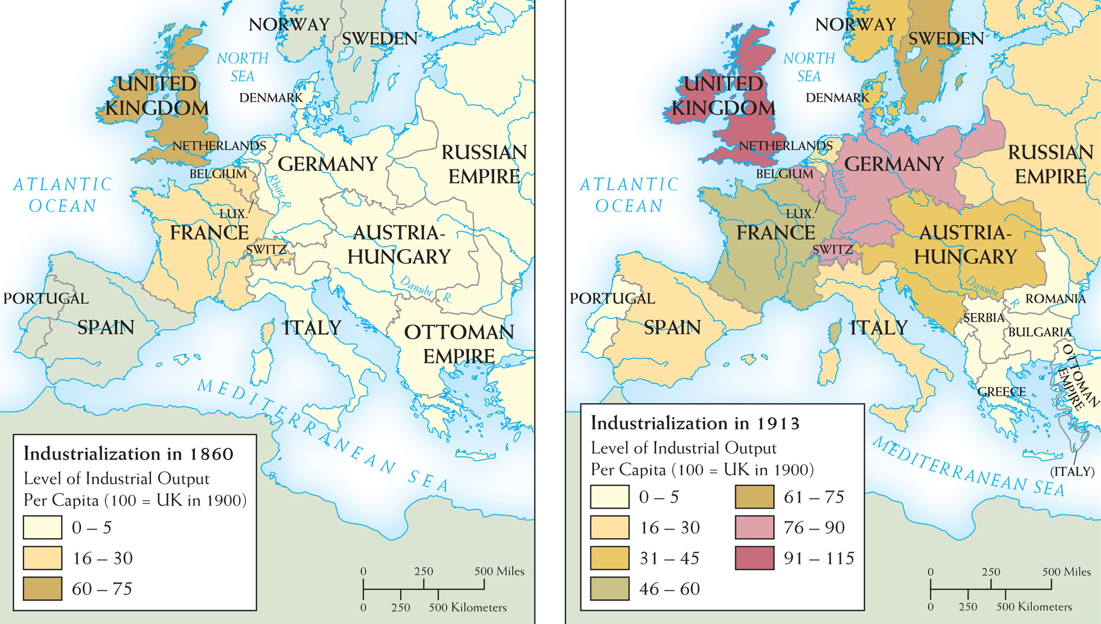
Map 23–2 EUROPEAN INDUSTRIALIZATION, 1860–1913 In 1860 Britain was far more industrialized than other European countries. In the following half-century, industrial output rose significantly, if unevenly, across much of Western Europe, especially in the new German Empire. The economies of the Balkan states and the Ottoman Empire, however, remained largely agricultural.
Notes:
Map 23–2 EUROPEAN INDUSTRIALIZATION, 1860–1913 In 1860 Britain was far more industrialized than other European countries. In the following half-century, industrial output rose significantly, if unevenly, across much of Western Europe, especially in the new German Empire. The economies of the Balkan states and the Ottoman Empire, however, remained largely agricultural.

Slide 10
Economic Difficulties
Bad weather and foreign competition make it tough for European industries in the last quarter of the century
Stagnation, pockets of unemployment, bad working conditions, strikes, and other forms of labor unrest emerge
Expansion of industry and consumer demand bring Europe out of stagnation by late in the century

Slide 11
Ascendancy in the Middle Class
Social distinctions of the middle class
Owners and managers – lived like an aristocracy
Comfortable small entrepreneurs and professional people (teachers, librarians, shopkeepers) – incomes permitted private homes and large quantities of furniture, education, and vacations

Slide 12
Ascendancy in the Middle Class
Social distinctions of the middle class
“White collar workers” – formed lower middle class – petite bourgeoisie – such as secretaries, retail clerks, lower level bureaucrats – spent money on consumer goods that made them “look” middle class
Tensions mount between the classes

Slide 13
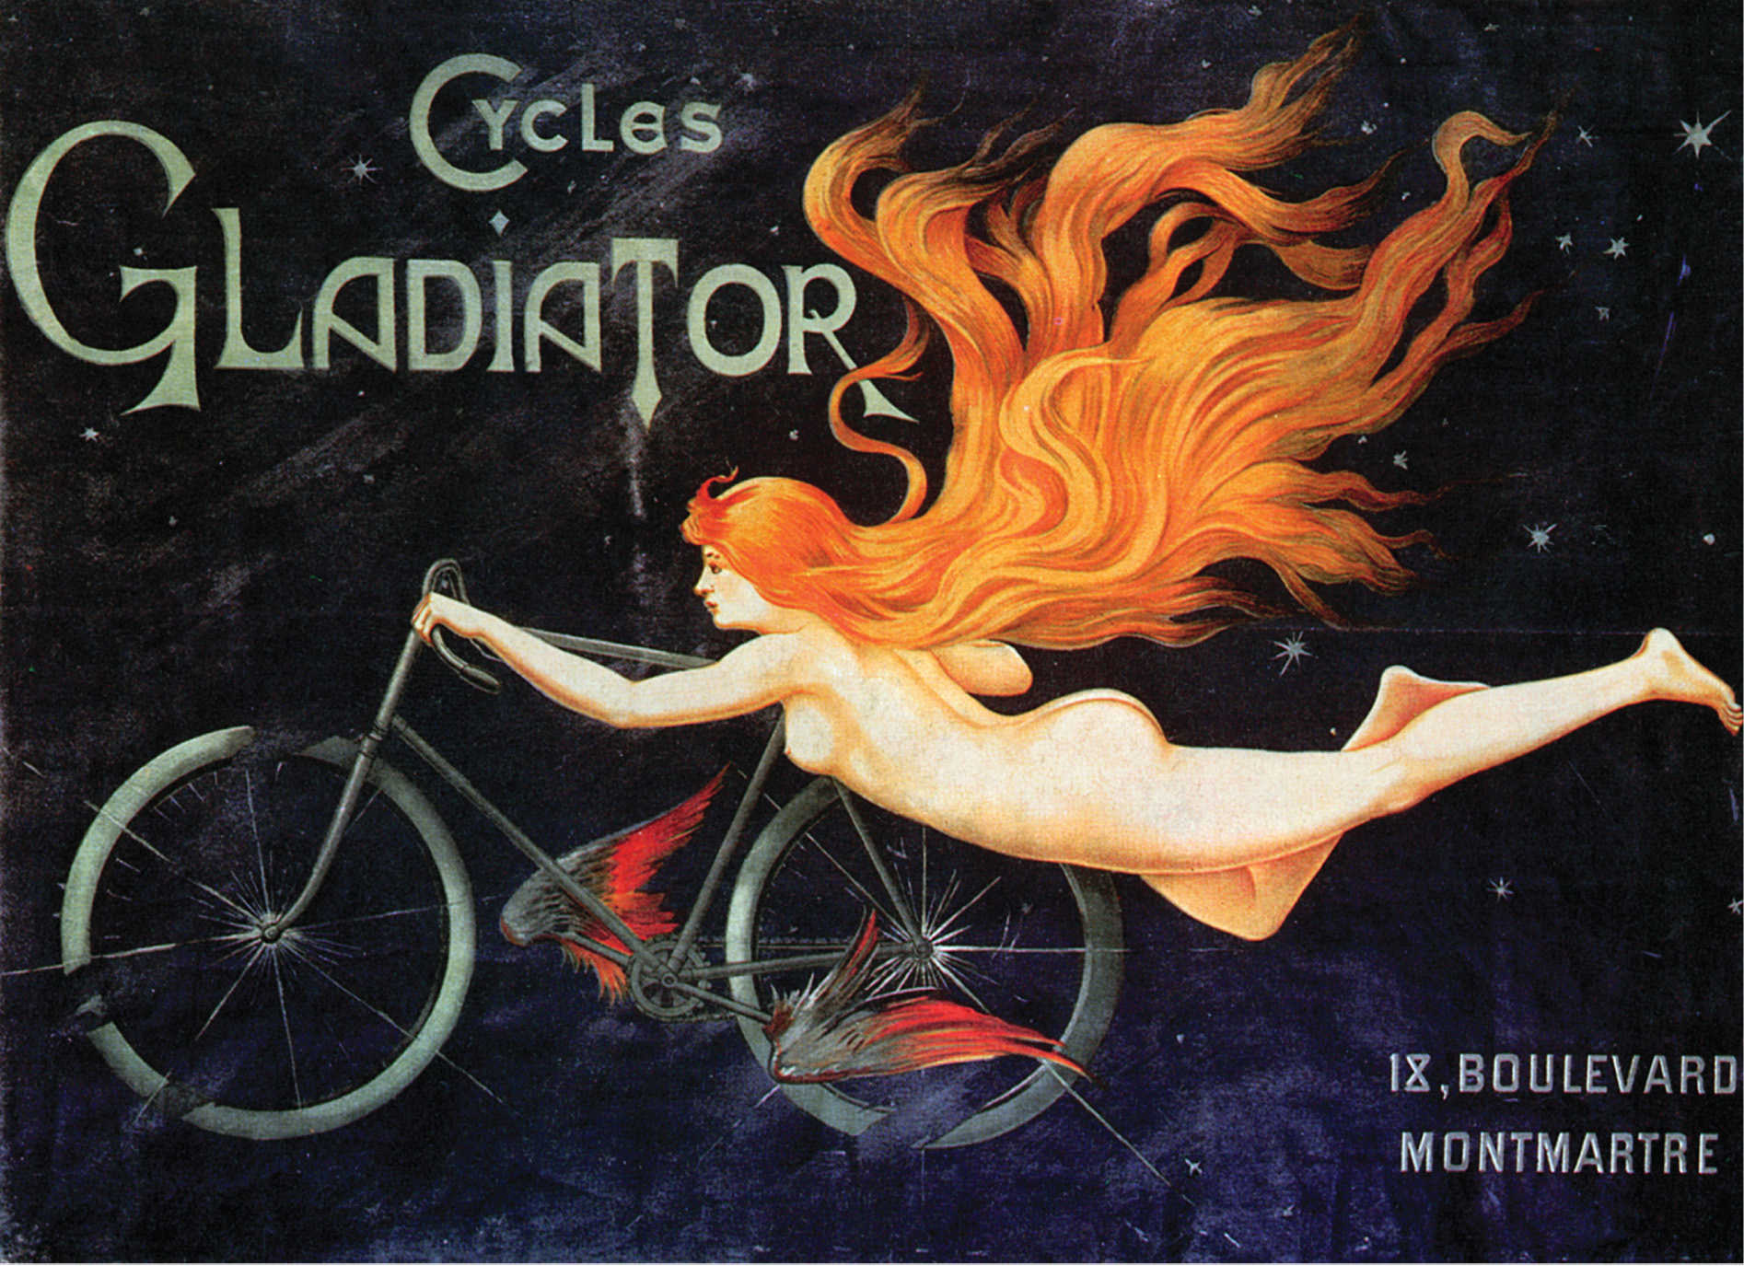
The bicycle helped liberate women's lives, but as this French advertising poster (c. 1905) suggests, it also was associated with glamour and sexual independence. The Granger Collection, NYC—All rights reserved
Notes:
The bicycle helped liberate women's lives, but as this French advertising poster (c. 1905) suggests, it also was associated with glamour and sexual independence.
The Granger Collection, NYC—All rights reserved

Slide 14
The Redesign of Cities
The New Paris
Paris rebuilt for political purposes – to discourage riots and accommodate the creation of thousands of government jobs
Department stores, office complexes, apartments for the middle class, and a subway are built

Slide 15
The Redesign of Cities (cont.)
The New Paris
Arts and architecture – Paris Opera, Eiffel Tower, and Basilica of the Sacred Heart built
Suburbs – to get away from the congestion of the city, many middle-class residents move to communities just outside the urban centers

Slide 16
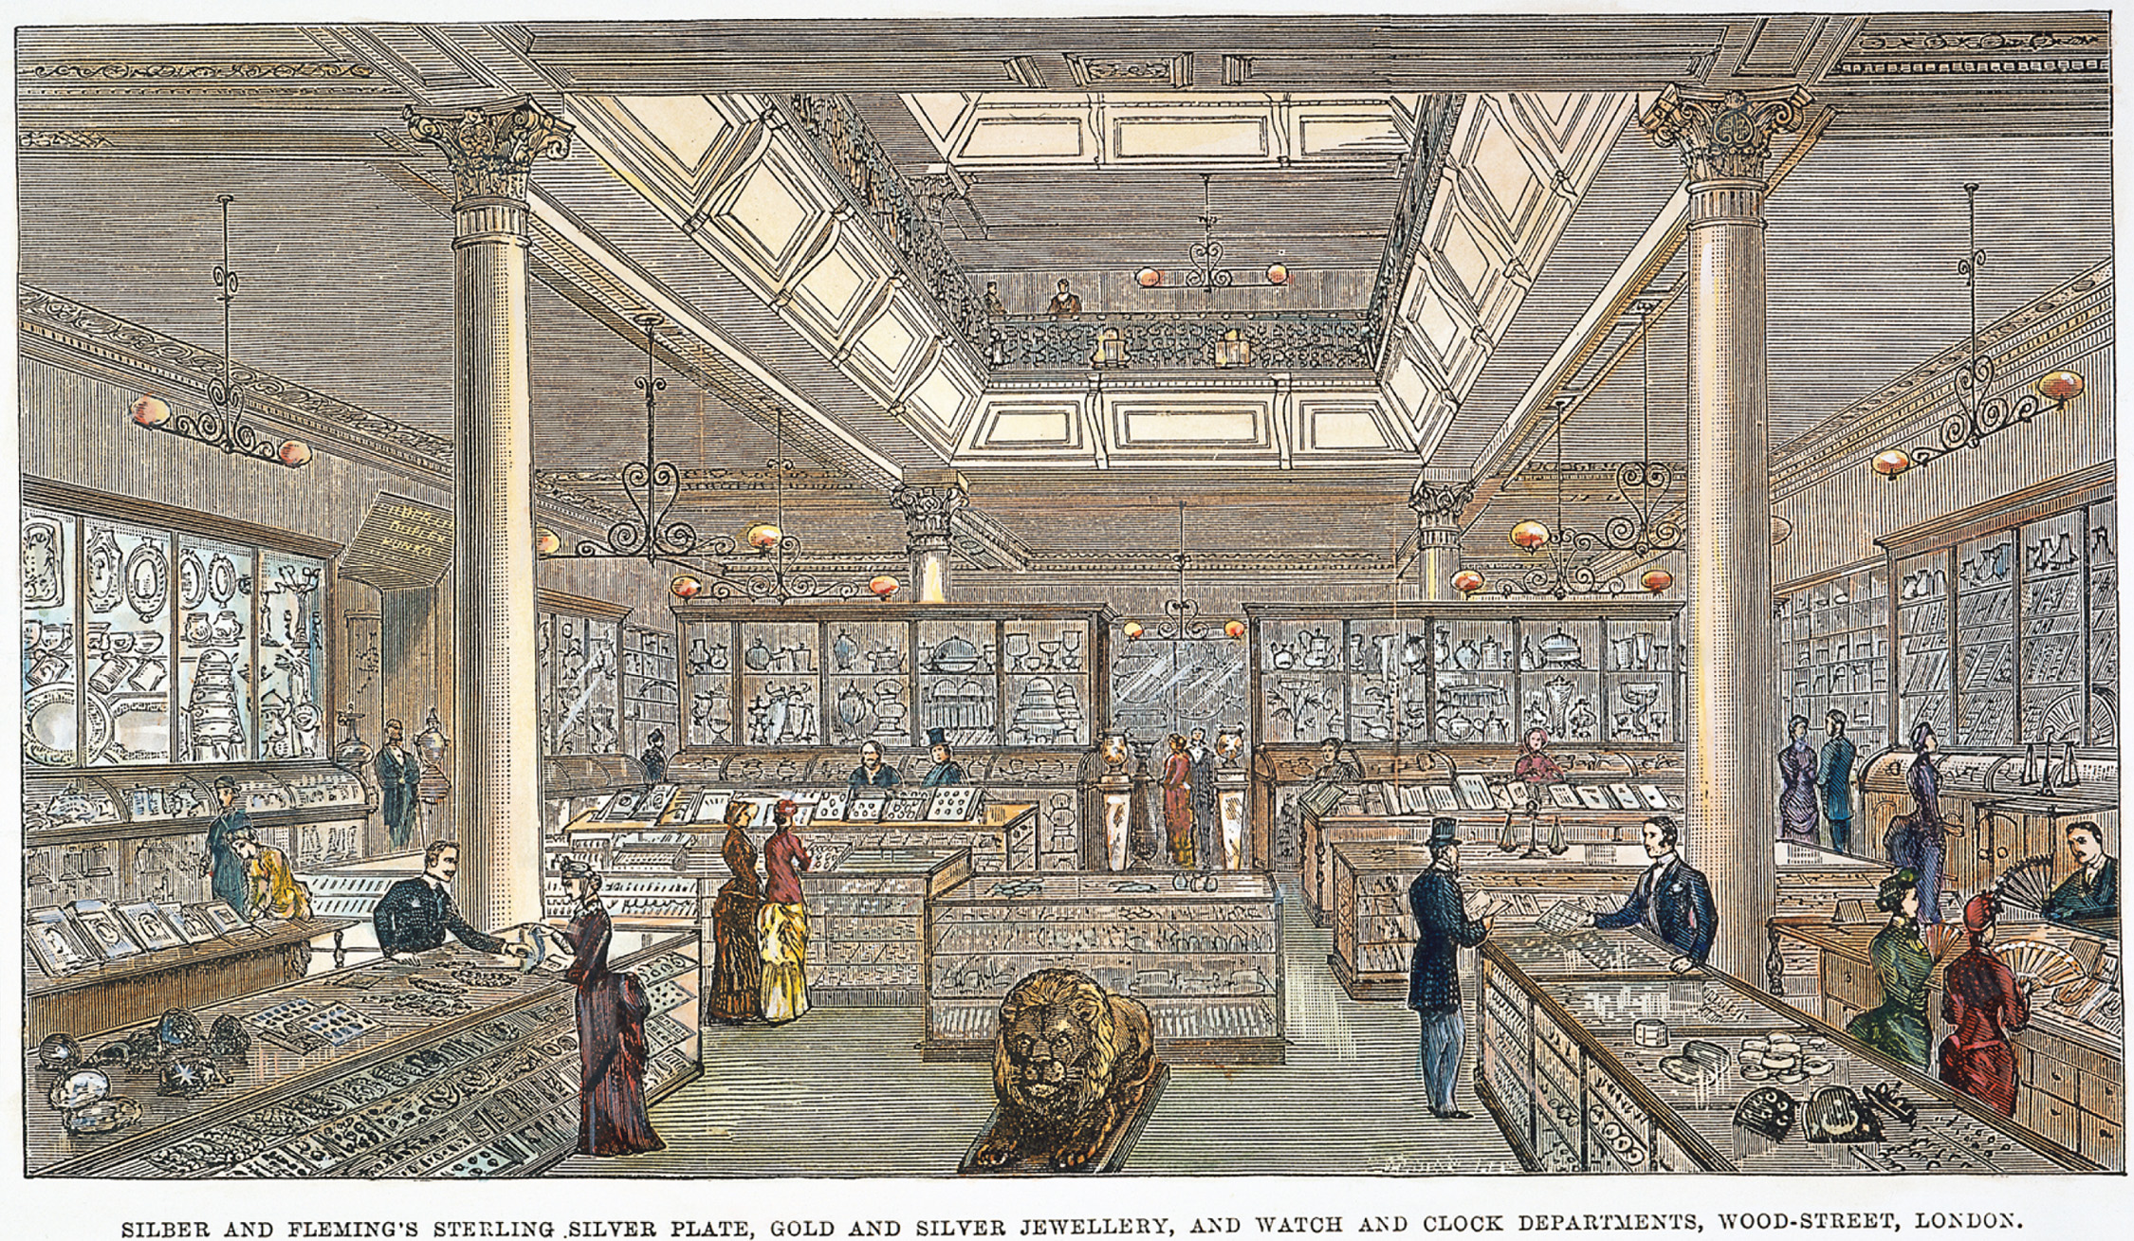
Department stores, such as Silber and Fleming in London, allowed middle-class men and women to view the wide variety of new consumer goods. The Granger Collection, NYC—All rights reserved
Notes:
Department stores, such as Silber and Fleming in London, allowed middle-class men and women to view the wide variety of new consumer goods.
The Granger Collection, NYC—All rights reserved

Slide 17
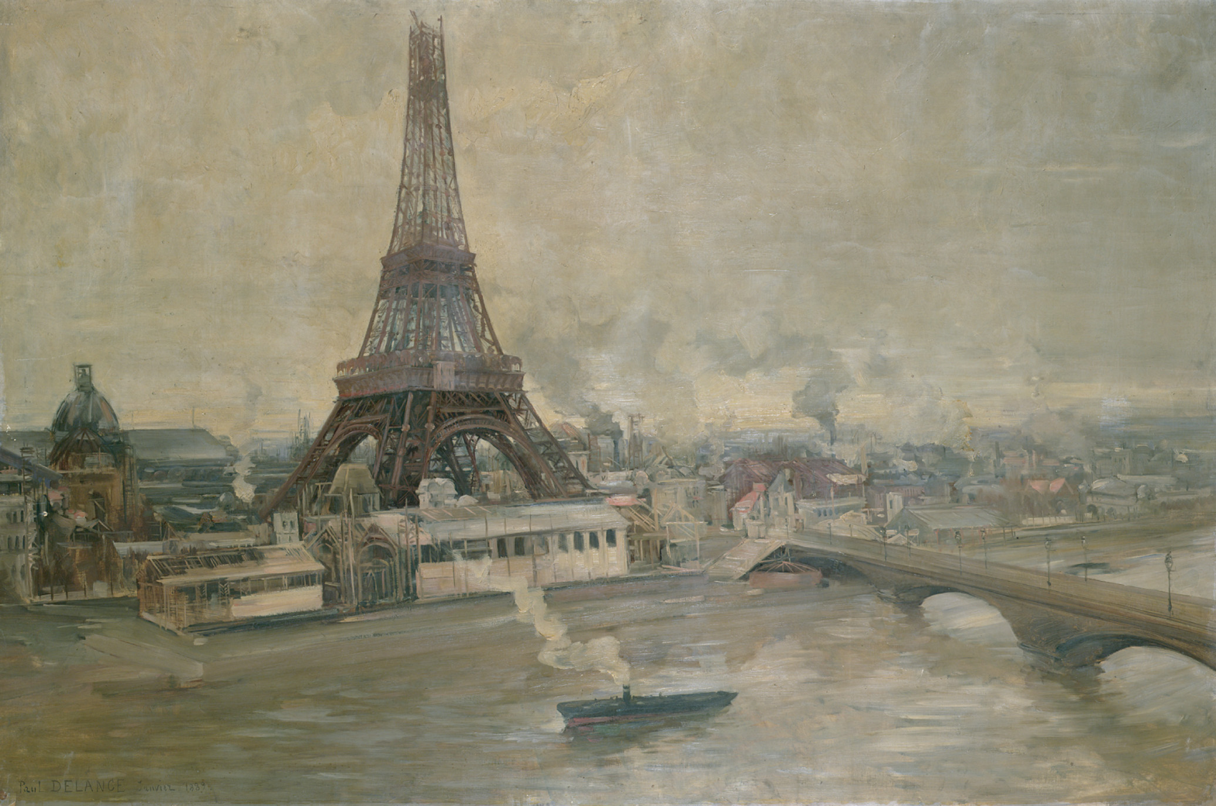
The Eiffel Tower, shown under construction in this painting, was to become a symbol of the newly redesigned Paris and its steel structure a symbol of French industrial strength. The Construction of the Eiffel Tower, January 1889 (oil on canvas), Delance, Paul Louis (1848–1924)/Musee de la Ville de Paris, Musee Carnavalet, Paris, France/ Giraudon/The Bridgeman Art Library
Notes:
The Eiffel Tower, shown under construction in this painting, was to become a symbol of the newly redesigned Paris and its steel structure a symbol of French industrial strength.
The Construction of the Eiffel Tower, January 1889 (oil on canvas), Delance, Paul Louis (1848–1924)/Musee de la Ville de Paris, Musee Carnavalet, Paris, France/ Giraudon/The Bridgeman Art Library

Slide 18
Urban Sanitation
Cholera – believed to be caused by filth and smell, touched all classes and reached epidemic proportions in 1830's and 1840's
Water and sewer systems – disposed of human waste and provided clean drinking water

Slide 19
Urban Sanitation (cont.)
Government involvement in public health
Private property could be condemned if deemed unhealthy
New building regulations

Slide 20
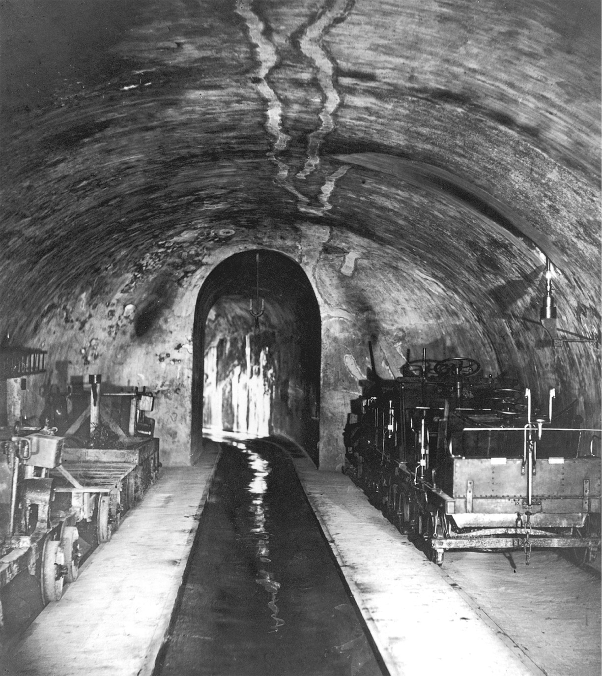
A major feature of the reconstruction of mid-nineteenth-century Paris under the Emperor Napoleon II was a vast new sewer system to provide for drainage in the city. Sewer workmen could travel the length of the structure on small rail cars. Even today tourists still may visit parts of the mid-city Paris sewer system. Nadar/Stringer/ Hulton Archive/Getty Images
Notes:
A major feature of the reconstruction of mid-nineteenth-century Paris under the Emperor Napoleon II was a vast new sewer system to provide for drainage in the city. Sewer workmen could travel the length of the structure on small rail cars. Even today tourists still may visit parts of the mid-city Paris sewer system.
Nadar/Stringer/ Hulton Archive/Getty Images

Slide 21
Housing Reform / the Middle Class
Middle class reformers believed cheap, adequate housing would alleviate social and political discontent
Private philanthropy attacked the housing problem

Slide 22
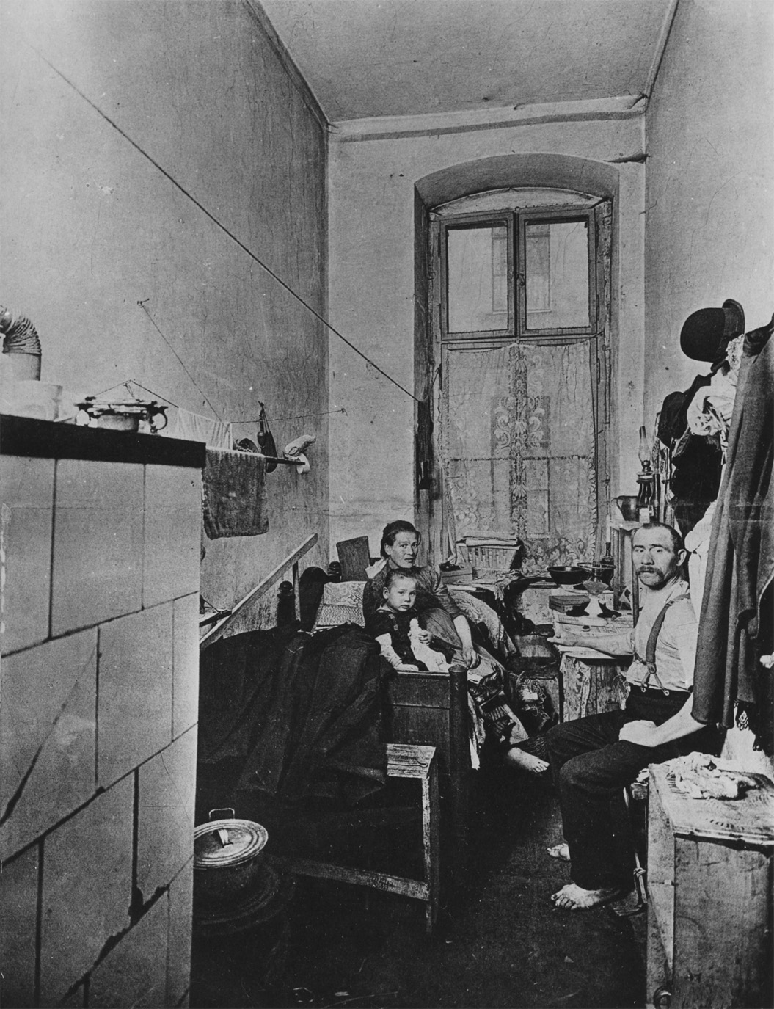
Many urban working-class families lived in cramped quarters without indoor plumbing, such as this apartment in Berlin. Deutsches Historisches Museum
Notes:
Many urban working-class families lived in cramped quarters without indoor plumbing, such as this apartment in Berlin.
Deutsches Historisches Museum

Slide 23
Barriers for Women in Late 19th Century
Property – until last quarter of century, most women in Europe could not own property; everything was in their husband's name – only Britain changed this in 1882 with the Married Women's Property Act
Family law – divorce was difficult to obtain, men had legal control of the children, and contraception and abortion were illegal
Education
Could not attend universities until late 19th century
Lack of secondary education for women
Women with professional jobs were considered radicals and faced discrimination

Slide 24
New Employment for Women
New jobs – included secretaries, clerks, and shop assistants – still paid low wages
Withdrawal from labor force – married women work less and less due to:
Industries preferring unmarried women
Men living longer
Social expectations of married women

Slide 25
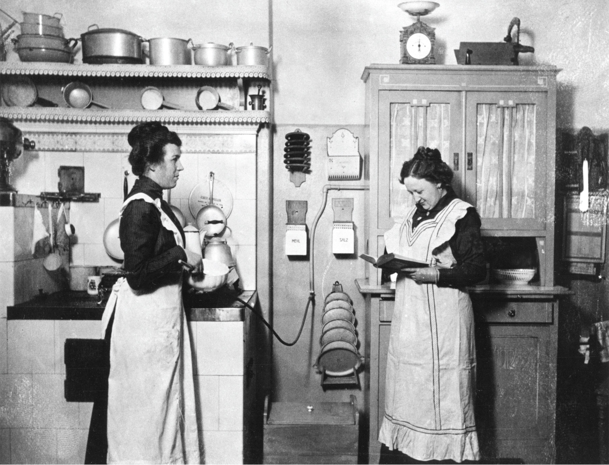
In the late nineteenth century, up until World War I, the most common occupation for urban working-class women remained domestic service. These women are employed in the kitchen of a middle-class household in Germany. Bildarchiv Preussischer Kulturbesitz/Art Resource, NY
Notes:
In the late nineteenth century, up until World War I, the most common occupation for urban working-class women remained domestic service. These women are employed in the kitchen of a middle-class household in Germany.
Bildarchiv Preussischer Kulturbesitz/Art Resource, NY

Slide 26
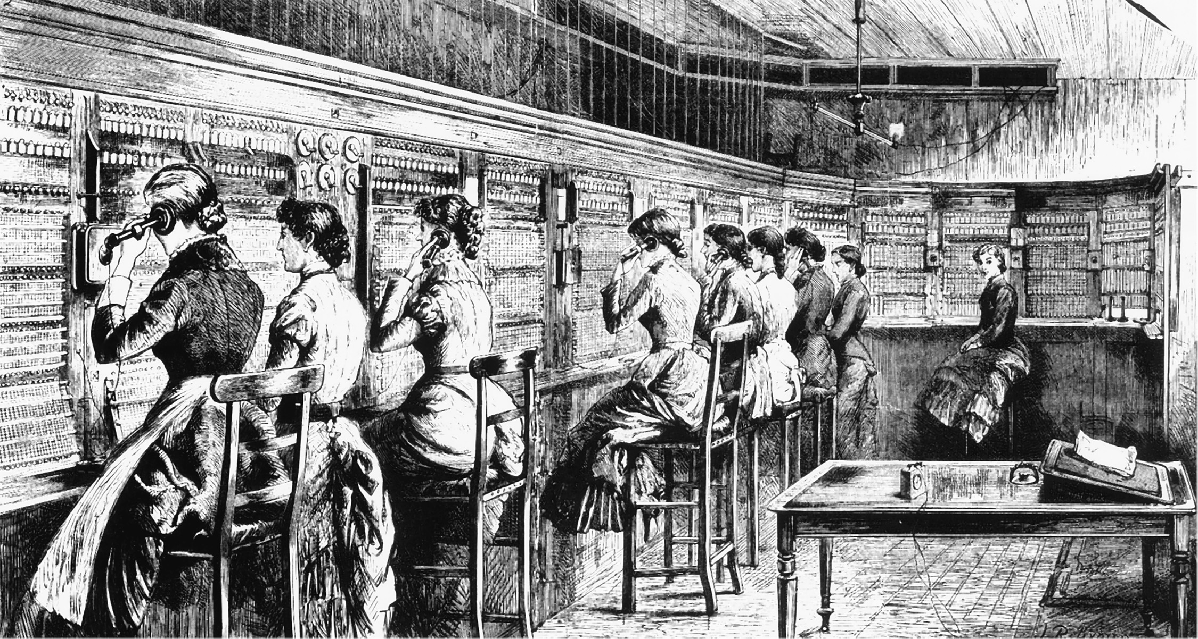
Women working in the London Central Telephone Exchange. The invention of the telephone opened new employment opportunities for women. Image Works/Mary Evans Picture Library Ltd.
Notes:
Women working in the London Central Telephone Exchange. The invention of the telephone opened new employment opportunities for women.
Image Works/Mary Evans Picture Library Ltd.

Slide 27
Working-Class Women
Putting-out system – manufacturer would purchase material, then put it out to the tailors
Subject to layoffs when demand for products slowed
Had low wages and subject to exploitation

Slide 28
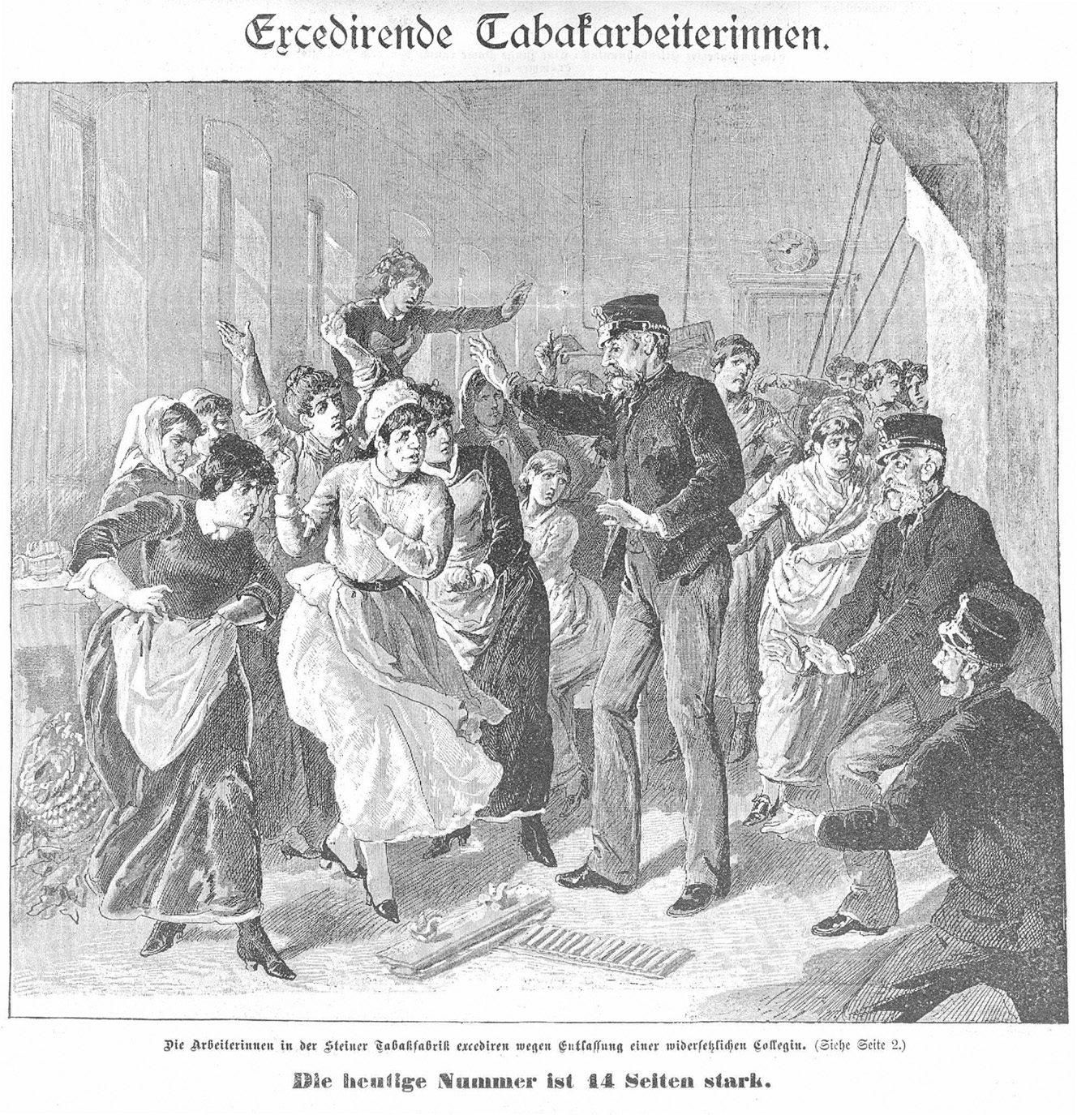
Working-class women were often portrayed as violating middleclass norms of good “feminine” behavior. In this 1886 etching, tobacco workers in a factory protest the dismissal of one of their colleagues. Austrian National Image Library, 460.376-B
Notes:
Working-class women were often portrayed as violating middleclass norms of good “feminine” behavior. In this 1886 etching, tobacco workers in a factory protest the dismissal of one of their colleagues.
Austrian National Image Library, 460.376-B

Slide 29
Prostitution
Women displaced in an overcrowded work force turned to prostitution
Most large 19th-century cities had legal prostitution
Usually low-skill workers with little education; customers were working class men

Slide 30
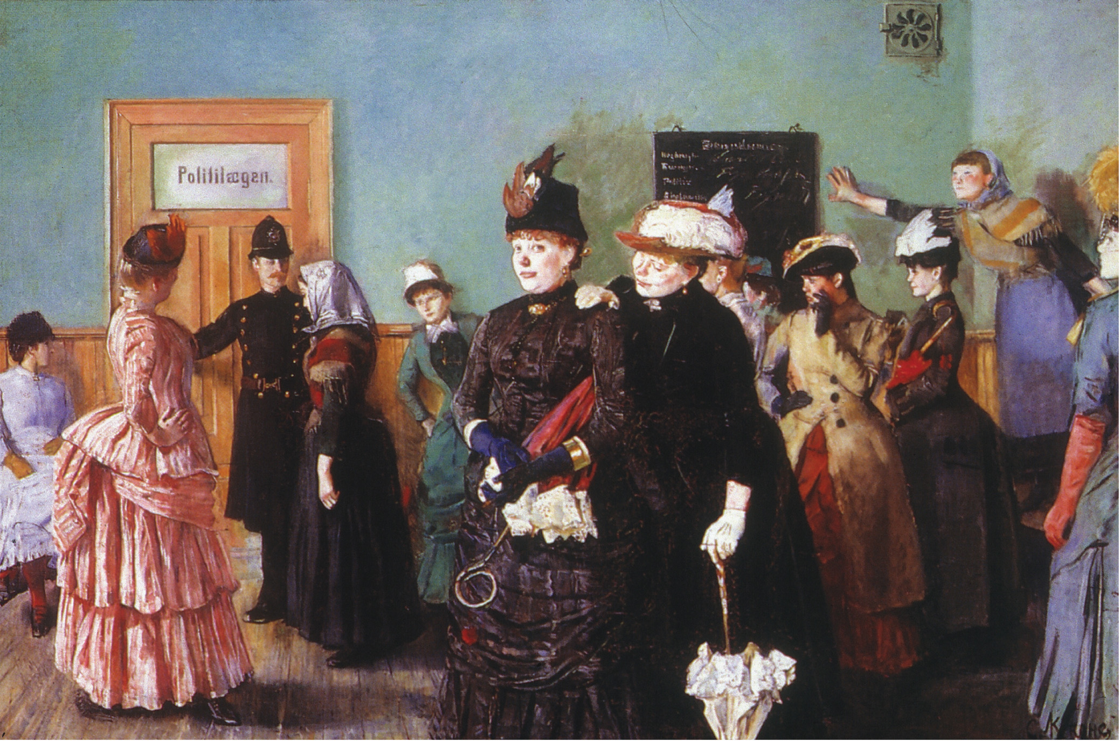
Realist Norwegian painter Christian Krogh (1852–1925) believed that art should portray contemporary social issues. In this painting, “Albertine in the Police Doctor's Waiting Room,” he shows a roomful of prostitutes waiting to be checked for venereal disease. While most are garishly dressed, the simply dressed “Albertine” (being gestured into the next room by a policeman) suggests the poverty that drew many women to prostitution. The Granger Collection, NYC—All rights reserved
Notes:
Realist Norwegian painter Christian Krogh (1852–1925) believed that art should portray contemporary social issues. In this painting, “Albertine in the Police Doctor's Waiting Room,” he shows a roomful of prostitutes waiting to be checked for venereal disease. While most are garishly dressed, the simply dressed “Albertine” (being gestured into the next room by a policeman) suggests the poverty that drew many women to prostitution.
The Granger Collection, NYC—All rights reserved

Slide 31
Middle Class Women
Domesticity – oversaw virtually all domestic management and child care
Religion – assured the religious instruction of their children and prayer was a major part of their daily lives
Charity – worked with poor youth, poor young women, schools for infants, and societies for visiting the poor
Sexuality – less sexual repression, and due to contraceptives and the cost of having children, had smaller families

Slide 32
Rise of Feminism
Obstacles – many women did not support the feminist movement because
They were sensitive to class and economic interests
They cared more about national unity and patriotism
Religious women were uncomfortable with radical secularists

Slide 33
Rise of Feminism (cont.)
Women's suffrage in Britain – suffrage – the movement for women to vote
Millicent Fawcett – led the moderate National Union of Women's Suffrage Societies
Emmeline Pankhurst – led the more radical Women's Social and Political Union, which encouraged strikes, arson, and vandalism

Slide 34
Rise of Feminism (cont.)
Women's suffrage in Britain – suffrage – the movement for women to vote
Women given right to vote in Britain in 1918
British suffrage movement was highly influential in the United States
Political feminism – women granted right to vote in France (after World War II) and Germany (1919)

Slide 35
Rise of Feminism (cont.)
Union of German Women's Organizations – founded in 1894, supported suffrage, but more concerned about education, social conditions, and political conditions

Slide 36
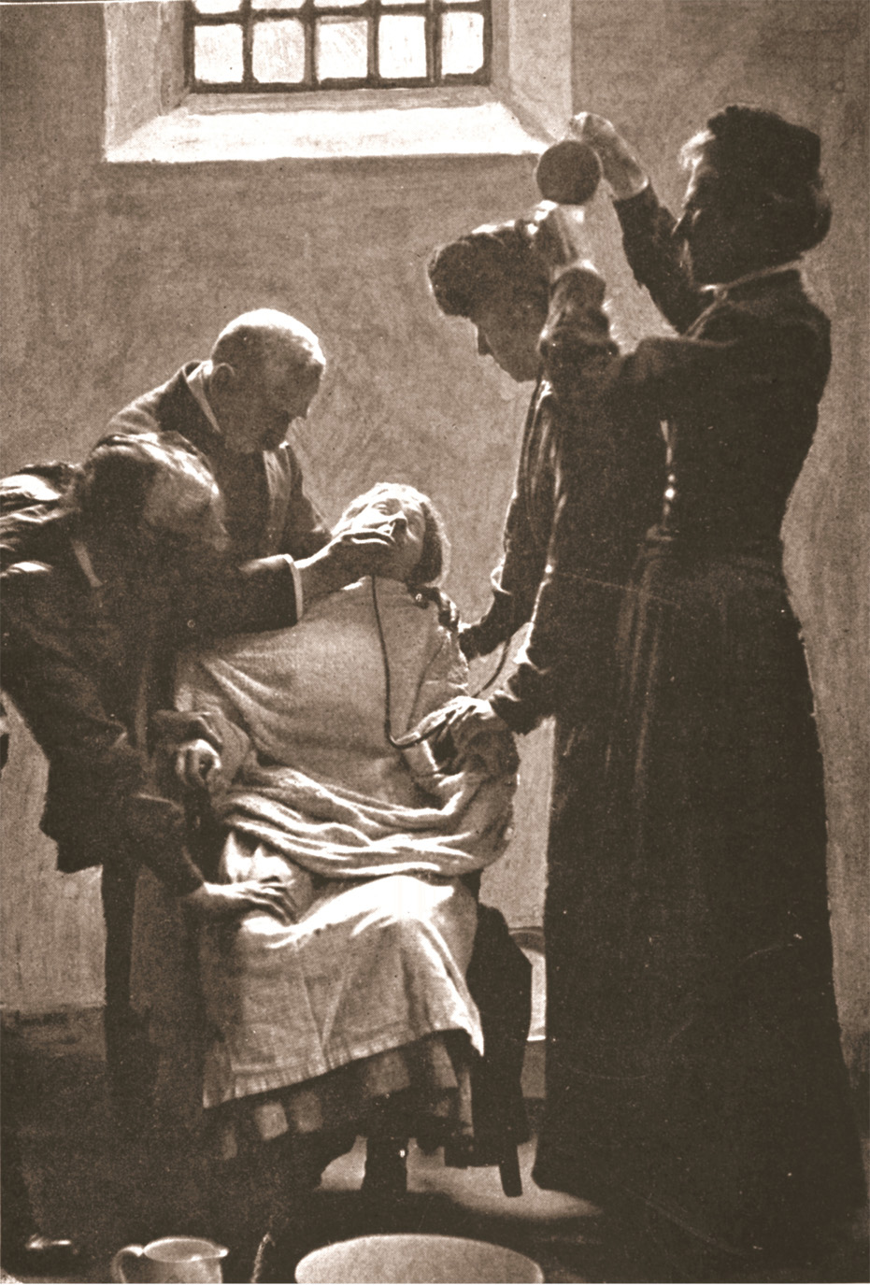
When advocates of women's suffrage went on hunger strike, they were forcibly fed in prison. When they refused to open their mouths, feeding tubes were inserted into their nostrils, as in this 1909 photograph taken in Holloway Prison in London. Suffragette being force-fed with the nasal tube in Holloway Prison, 1909 (sepia photo), English photographer (20th century). Private Collection/The Stapleton Collection/ The Bridgeman Art Library International
Notes:
When advocates of women's suffrage went on hunger strike, they were forcibly fed in prison. When they refused to open their mouths, feeding tubes were inserted into their nostrils, as in this 1909 photograph taken in Holloway Prison in London.
Suffragette being force-fed with the nasal tube in Holloway Prison, 1909 (sepia photo), English photographer (20th century). Private Collection/The Stapleton Collection/ The Bridgeman Art Library International

Slide 37
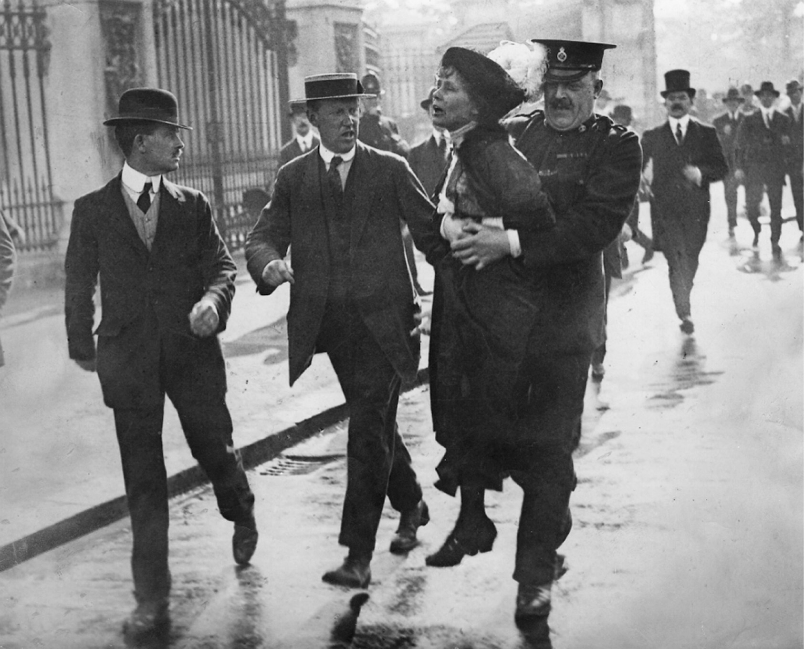
Emmeline Pankhurst (1857–1928) was frequently arrested for forcibly advocating votes for British women. Jimmy Sime/Stringer/ Hulton Archive/Getty Images
Notes:
Emmeline Pankhurst (1857–1928) was frequently arrested for forcibly advocating votes for British women.
Jimmy Sime/Stringer/ Hulton Archive/Getty Images

Slide 38
Jewish Citizenship
First half of 19th century, Jews in Western Europe began to gain equal citizenship
Still, many Jews could not own land and were subject to discriminatory taxes

Slide 39
Russian Jews
Government to the Jews
Limited book publications
Restricted areas where they could live
Banned them from state service
Excluded them from higher education
Pogroms – organized riots against Jewish neighborhoods, supported by the government

Slide 40
Opportunities for Jews
Western Europe – very open to Jews at all levels (government, education, intermarriage with Christians)
Many Jews from Eastern Europe migrate to Western Europe or the United States
Anti-Semitism – discrimination against Jews, increases in Western Europe during later stages of 19th century, especially in France and Germany

Slide 41
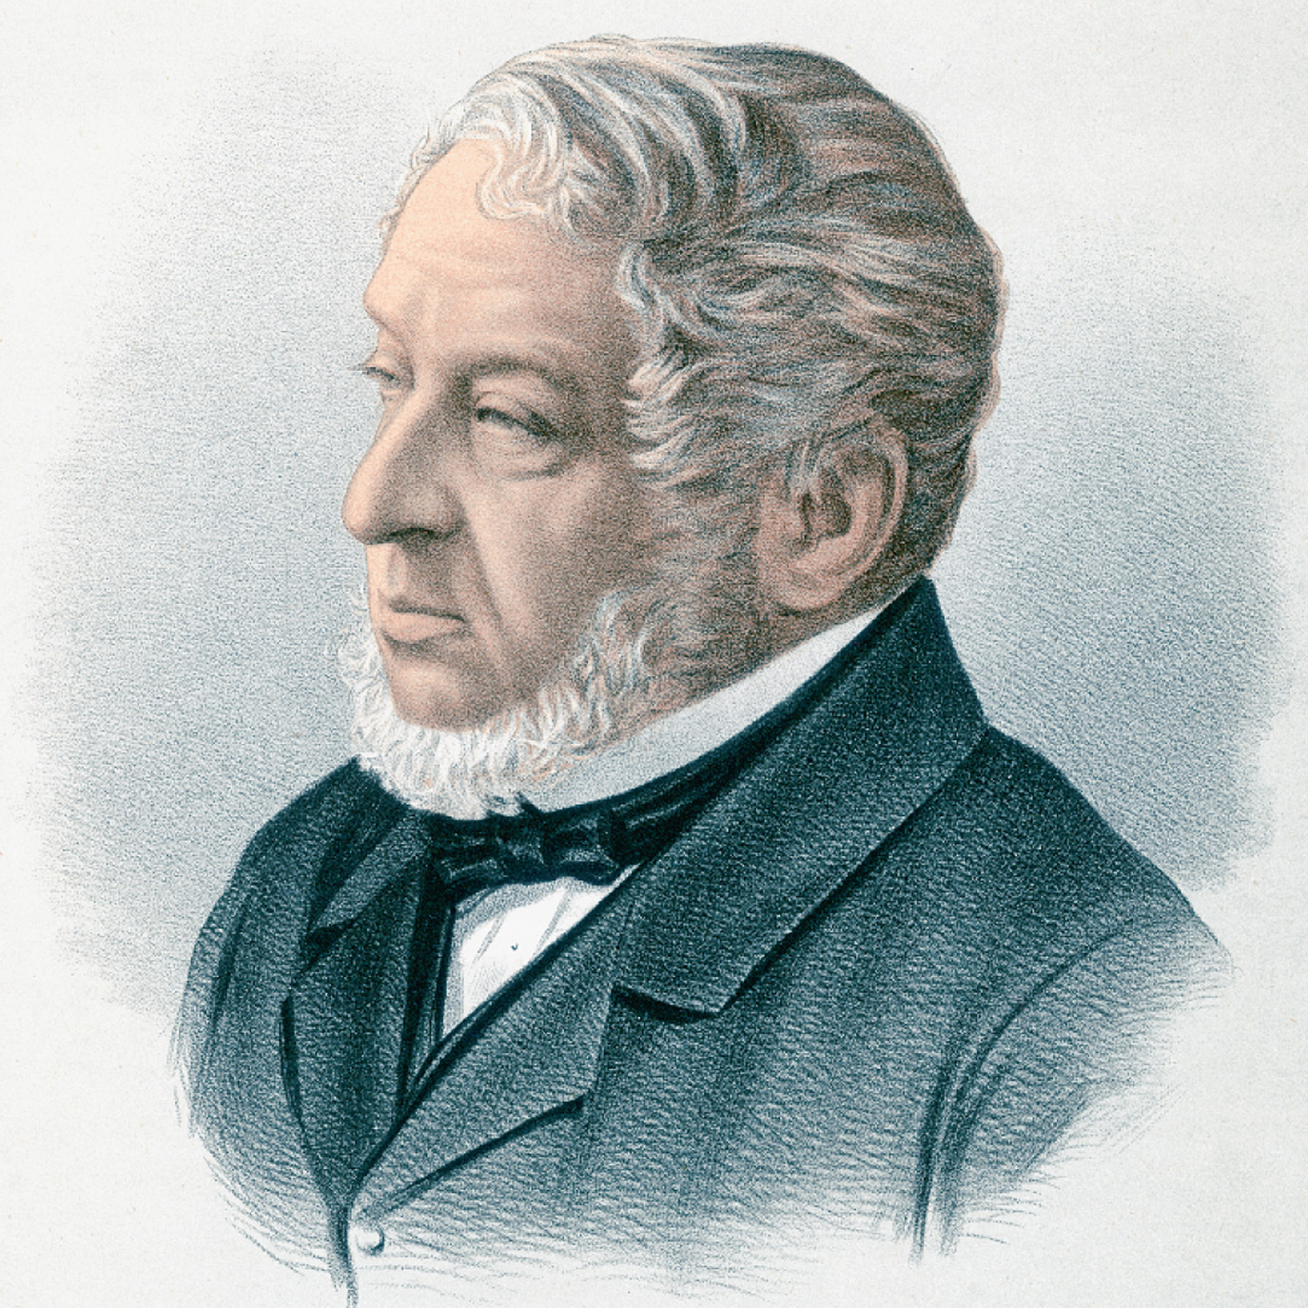
Because many major financial institutions of nineteenth-century Europe were owned by wealthy Jewish families, anti-Semitic political figures often blamed them for economic hard times. The most famous such family was the Rothschilds, who controlled banks in several countries. The head of the London branch was Lionel Rothschild (1808–1879). He was elected to Parliament several times but was not seated because he would not take the required Christian oath. After the requirement of that oath was abolished in 1858, he sat in Parliament from 1858 until 1874. Hulton Archive/Stringer/Archive Photos/Getty Images
Notes:
Because many major financial institutions of nineteenth-century Europe were owned by wealthy Jewish families, anti-Semitic political figures often blamed them for economic hard times. The most famous such family was the Rothschilds, who controlled banks in several countries. The head of the London branch was Lionel Rothschild (1808–1879). He was elected to Parliament several times but was not seated because he would not take the required Christian oath. After the requirement of that oath was abolished in 1858, he sat in Parliament from 1858 until 1874.
Hulton Archive/Stringer/Archive Photos/Getty Images

Slide 42
Trade Unionism
Unions allowed in Europe in late 19th century
Unions worked for improvement in wages and working conditions
Unions often engaged in long strikes
Despite growth of unions, most of Europe's labor force never unionized

Slide 43
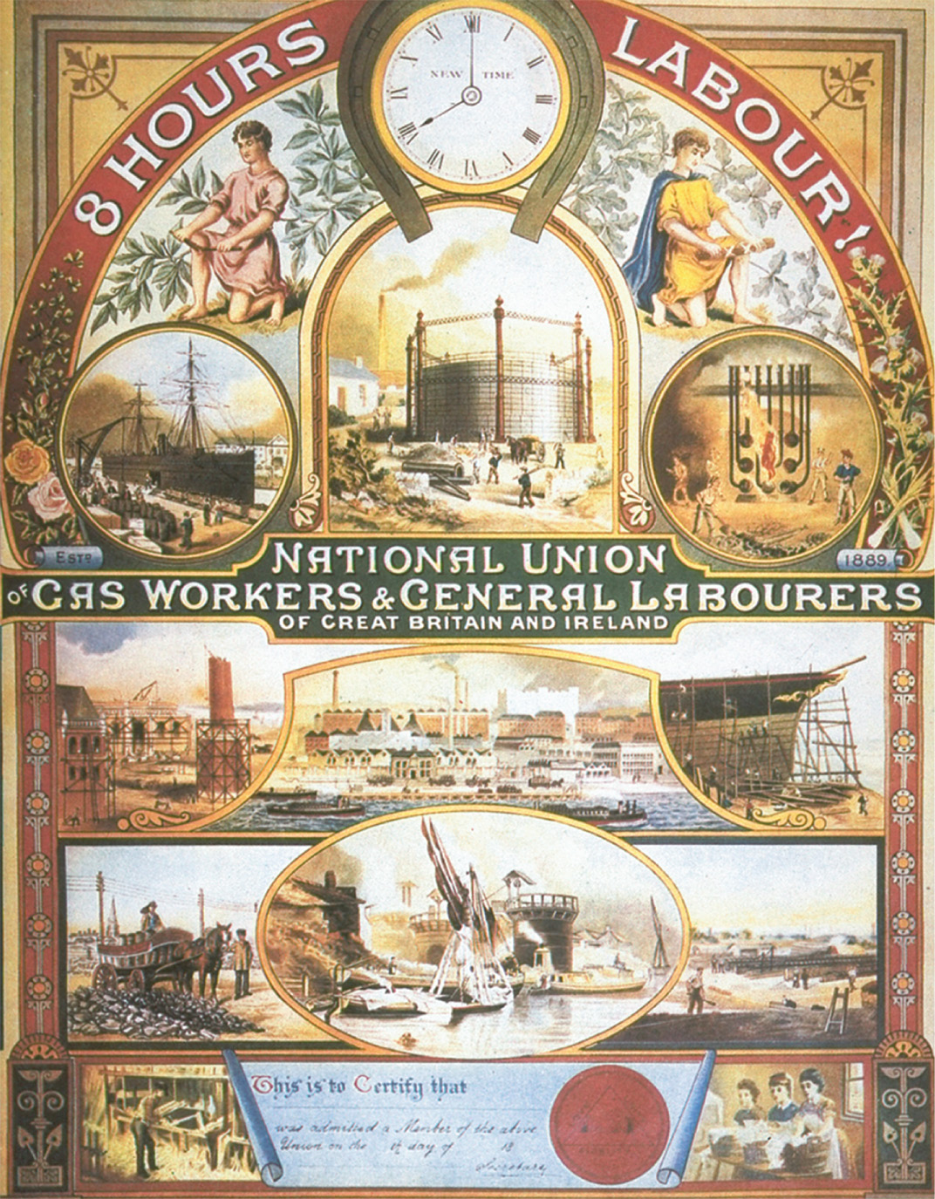
Trade unions continued to grow in late-nineteenth-century Great Britain. The effort to curb the unions eventually led to the formation of the Labour Party. The British unions often had quite elaborate membership certificates, such as this one for the National Union of Gas Workers and General Labourers of Great Britain and Ireland. The Granger Collection
Notes:
Trade unions continued to grow in late-nineteenth-century Great Britain. The effort to curb the unions eventually led to the formation of the Labour Party. The British unions often had quite elaborate membership certificates, such as this one for the National Union of Gas Workers and General Labourers of Great Britain and Ireland.
The Granger Collection

Slide 44
Political Parties
Universal male suffrage brings organized political parties
Political parties with their workers, newspapers, offices, social life, and discipline mobilize new voters
Socialist parties were divided on whether to accept social reform or start a revolution

Slide 45
The First International
British and French trade unionists form the First International, made up of socialists, anarchists, and Polish nationalists
Although short-lived, its updates on labor groups and conditions led to Marxism becoming the most important strand of socialism

Slide 46
Social Reform in Great Britain
British socialism – non-Marxist – most influential group was the Fabian Society, which favored gradual, peaceful approach to social reform
Under Liberal Chancellor David Lloyd George, Britain regulates trade, provides unemployment benefits and health care
Conservative House of Lords upset with the spending of the Liberal House of Commons in the Parliament

Slide 47
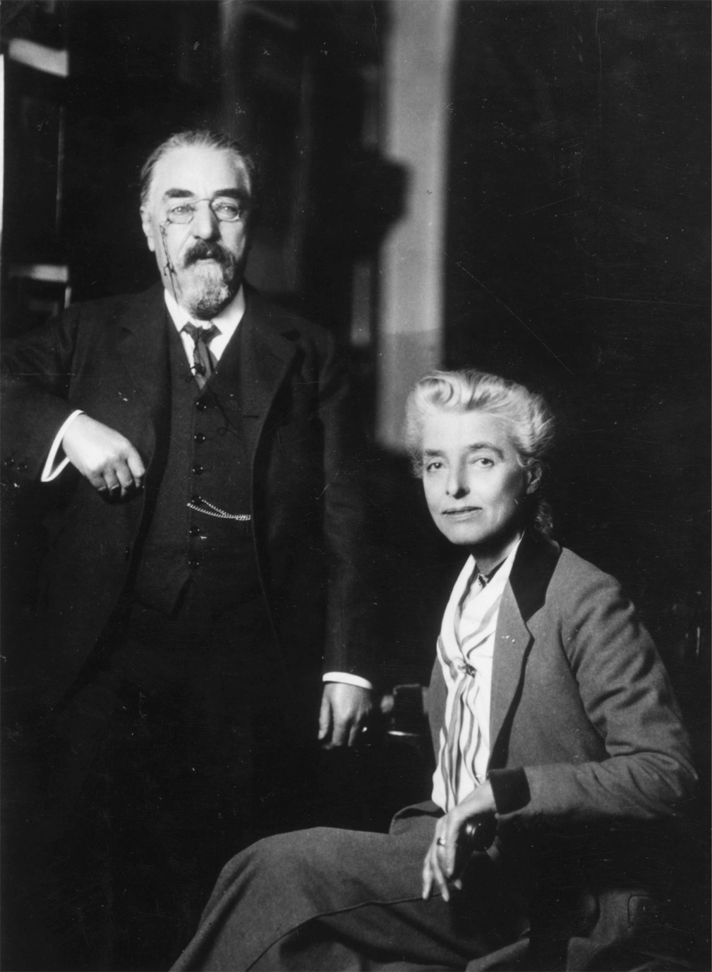
Beatrice and Sidney Webb. These most influential British Fabian Socialists, shown in a photograph from the 1920s, wrote many books on governmental and economic matters, served on special parliamentary commissions, and agitated for the enactment of socialist policies. Hulton Archive/Stringer/Getty Images
Notes:
Beatrice and Sidney Webb. These most influential British Fabian Socialists, shown in a photograph from the 1920s, wrote many books on governmental and economic matters, served on special parliamentary commissions, and agitated for the enactment of socialist policies.
Hulton Archive/Stringer/Getty Images

Slide 48
French Opportunism Rejected
Opportunism – participation by socialists in the cabinets – is rejected by Congress
French socialists form their own party
French workers often voted socialist, but avoided political action
Non-socialist labor unions looked to strikes as their main labor tactic

Slide 49
Social Democrats and Revisionism in Germany
Bismarck represses German Social Democratic Party (SPD)
Anti-socialist laws passed by Reichstag actually strengthen the numbers of the SPD
Programs created such as accident insurance, disability, and old age pensions as a conservative alternative to socialist policies

Slide 50
Social Democrats and Revisionism in Germany (cont.)
The Erfurt Program – supported Marxist ideas of the collapse of capitalism, but wanted to pursue goals through legislative action, not revolution
Revisionism – German socialists' ideas of achieving humane social equality without having a revolution; founded by Eduard Bernstein

Slide 51
Social Democrats and Revisionism in Germany (cont.)
Critics of Revisionism felt that evolution toward socialism would not work in militaristic, authoritative Germany

Slide 52
Industrial Growth in Russia
Count Sergei Witte – first Russian minister of communications and later finance minister, wanted to modernize Russian economy through:
Economic development
Protective tariffs
High taxes
Russian currency on gold standard

Slide 53
Industrial Growth in Russia (cont.)
Steel, iron, and textile industries expand as Trans-Siberian Railroad is completed (1903)
Social unrest – growth of industry does not improve lives of the peasants, many of whom have to work on the land of prosperous farmers known as kulaks

Slide 54
Industrial Growth in Russia (cont.)
Liberal party formed by the local councils (zemstvos) wanted a constitutional monarchy to further civil liberties and social progress

Slide 55
Vladimir Lenin
Future leader of the communist revolution
Led Social Democrats who rejected the German ideas of gradual socialism and called for a revolution

Slide 56
Vladimir Lenin (cont.)
Social Democratic Party split into two:
Lenin's faction: the majority or Bolsheviks
The moderate faction: the minority or Mensheviks
Wanted to unite workers and peasants to overthrow the tsar (idea came about in 1905, but revolution didn't occur until 1917)

Slide 57
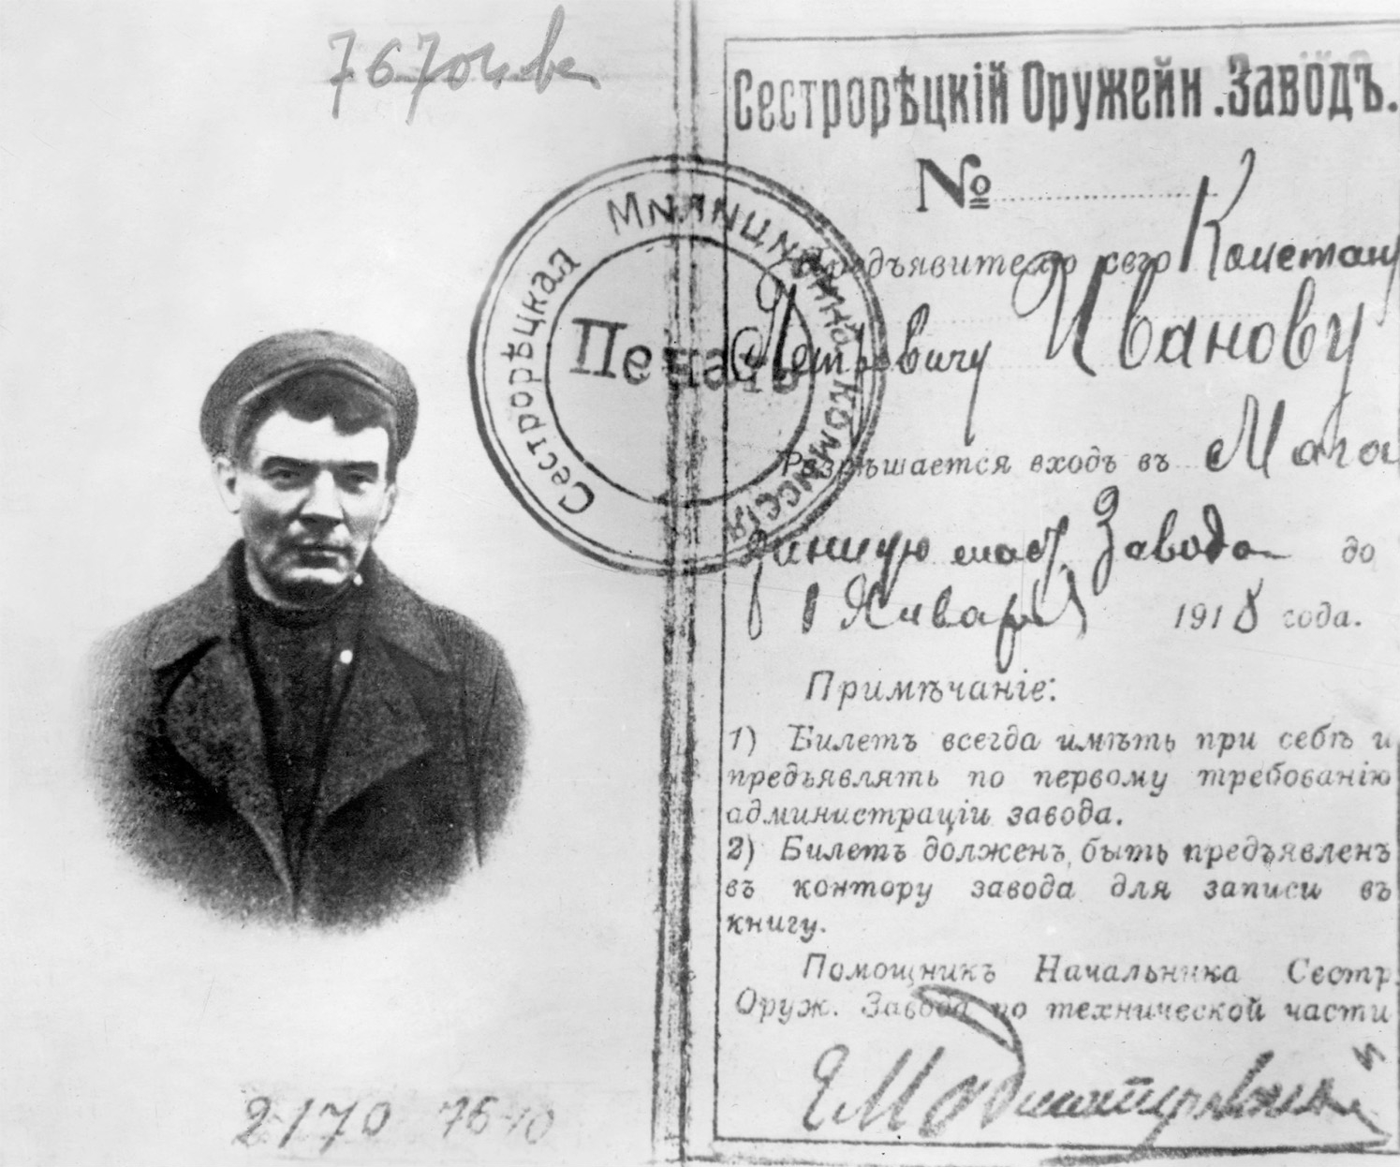
Lenin had been banned from Russia, and had to return to St. Petersburg using an assumed name and in disguise. He traveled using this passport, issued to him under the assumed name of Konstantin Petrovich Ivanov. Rue des Archives/The Granger Collection, NYC—All rights reserved
Notes:
Lenin had been banned from Russia, and had to return to St. Petersburg using an assumed name and in disguise. He traveled using this passport, issued to him under the assumed name of Konstantin Petrovich Ivanov.
Rue des Archives/The Granger Collection, NYC—All rights reserved

Slide 58
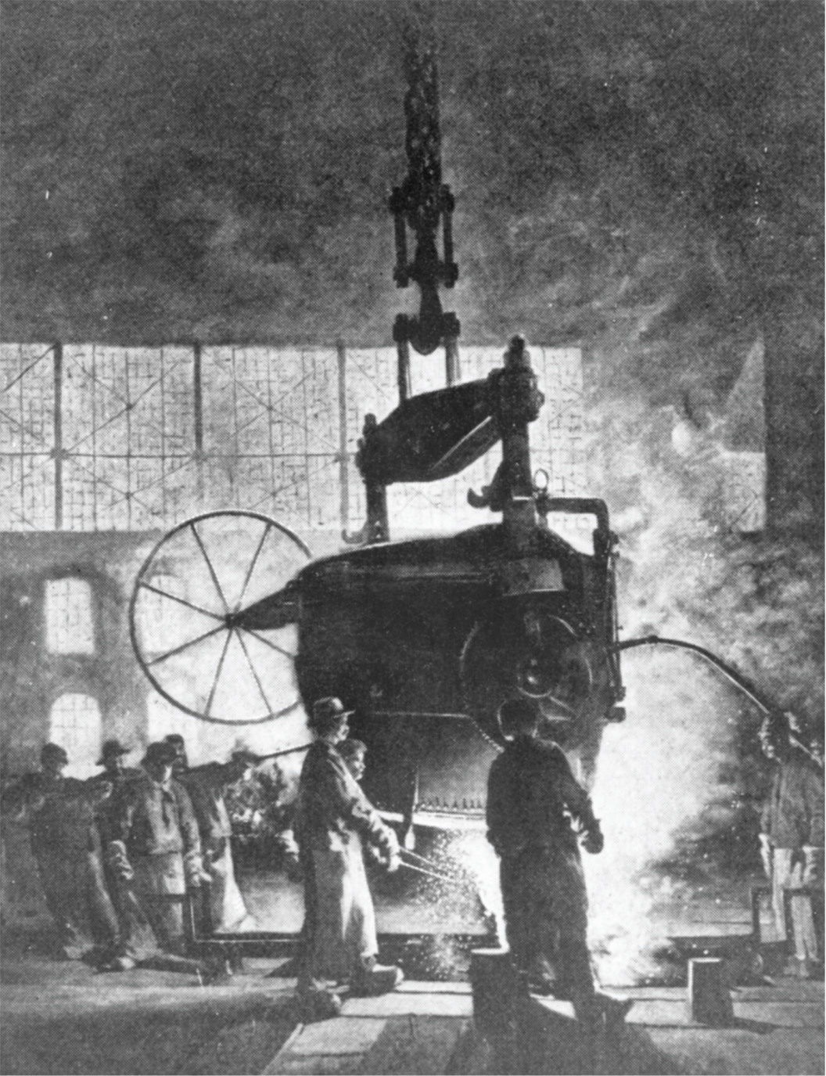
By the close of the nineteenth century, European socialists had come to doubt whether the industrial proletariat around the world, such as these workers in the Krupp steel works around 1910, would or could actually bring about a revolution as predicted by Marx. Eduard Bernstein thought democratic social change would improve the lot of workers. Lenin believed an elite revolutionary party would produce such radical change. Krupp was one of many Germany companies that introduced paternalistic benefits to workers, such as modern housing projects subsidized by the company, in an effort to show that cooperation did more to improve workers' lives than violent revolution would. Stringer/Hulton Archive/Getty Images
Notes:
By the close of the nineteenth century, European socialists had come to doubt whether the industrial proletariat around the world, such as these workers in the Krupp steel works around 1910, would or could actually bring about a revolution as predicted by Marx. Eduard Bernstein thought democratic social change would improve the lot of workers. Lenin believed an elite revolutionary party would produce such radical change. Krupp was one of many Germany companies that introduced paternalistic benefits to workers, such as modern housing projects subsidized by the company, in an effort to show that cooperation did more to improve workers' lives than violent revolution would.
Stringer/Hulton Archive/Getty Images

Slide 59
The Revolution of 1905
Bloody Sunday – tsar's troops violently put down a protest, leading ordinary Russians to no longer trust the tsar
Worker groups called the soviets – not the tsar – basically controlled city of St. Petersburg
Nicholas II issues October Manifesto promising a constitutional government

Slide 60
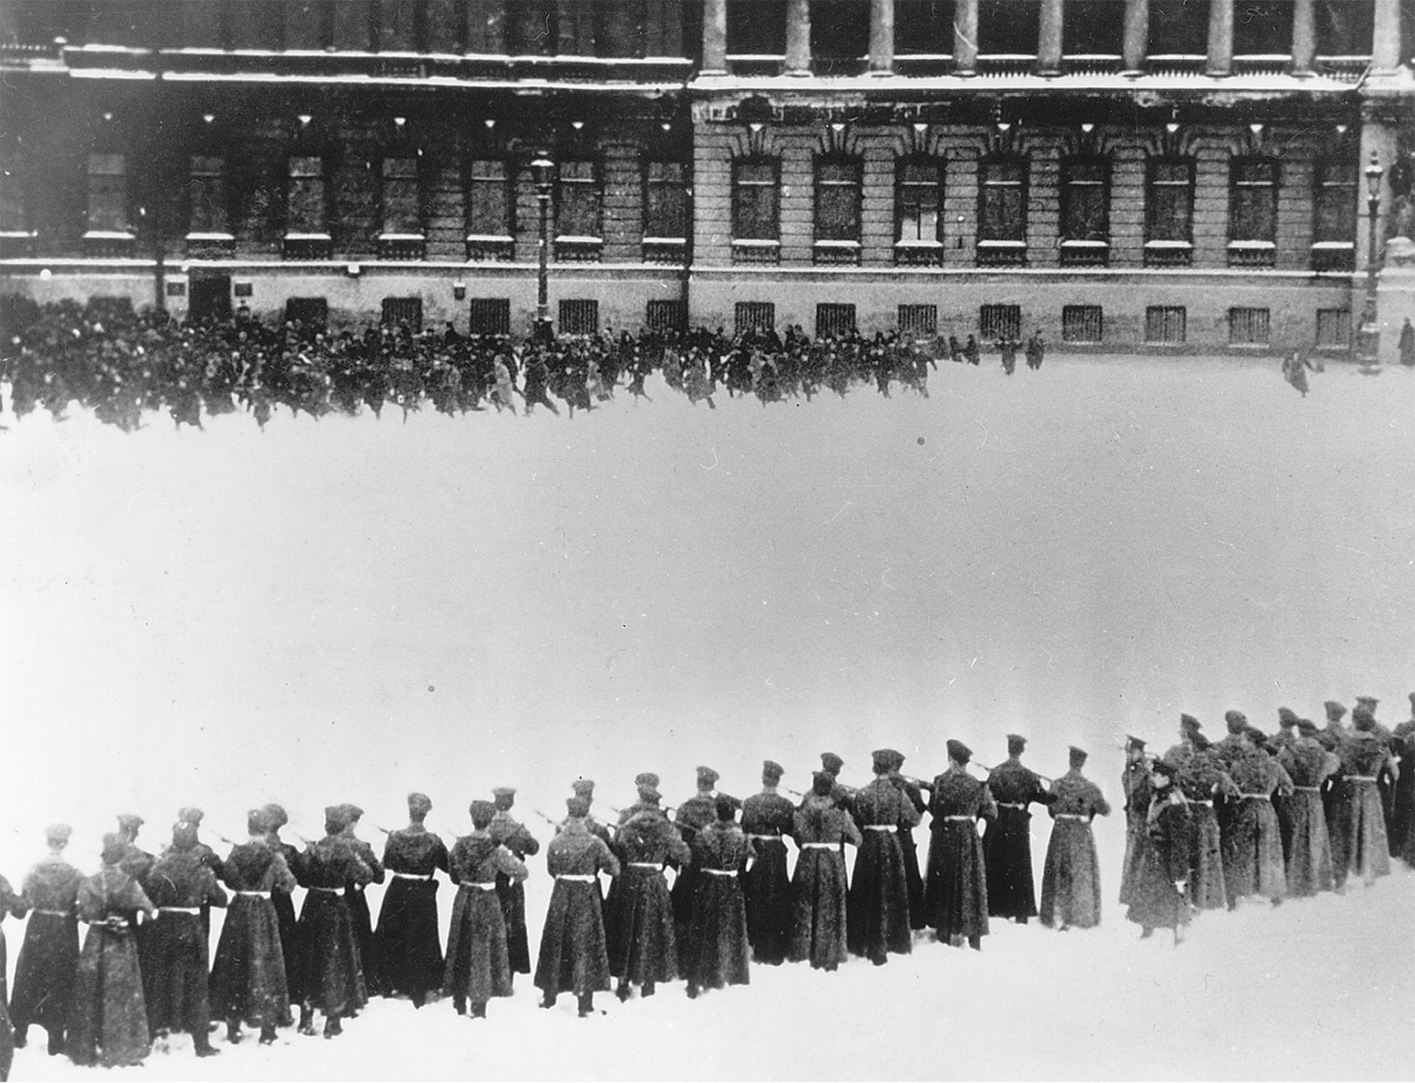
Bloody Sunday, St. Petersburg 1905 On Bloody Sunday, January 22, 1905, troops of Tsar Nicholas II fired on a peaceful procession of workers at the Winter Palace who sought to present a petition for better working and living conditions. The scene portrayed here depicts one of the enduring images of events leading to the subsequent Russian Revolutions of 1905 and 1917. It figured in at least two movies: the 1925 anti-tsarist Soviet silent film called “The Ninth of January,” and “Nicholas and Alexandra,” the lavish 1971 movie that was sympathetic to the tsar and blamed Bloody Sunday on frightened and incompetent officials. While Nicholas had not ordered the troops to fire and was not even in St. Petersburg on Bloody Sunday, the event all but destroyed any chance of reconciliation between the tsarist government and the Russian working class. Bildarchiv Preussischer Kulturbesitz/Art Resource. NY
Notes:
Bloody Sunday, St. Petersburg 1905 On Bloody Sunday, January 22, 1905, troops of Tsar Nicholas II fired on a peaceful procession of workers at the Winter Palace who sought to present a petition for better working and living conditions. The scene portrayed here depicts one of the enduring images of events leading to the subsequent Russian Revolutions of 1905 and 1917. It figured in at least two movies: the 1925 anti-tsarist Soviet silent film called “The Ninth of January,” and “Nicholas and Alexandra,” the lavish 1971 movie that was sympathetic to the tsar and blamed Bloody Sunday on frightened and incompetent officials. While Nicholas had not ordered the troops to fire and was not even in St. Petersburg on Bloody Sunday, the event all but destroyed any chance of reconciliation between the tsarist government and the Russian working class.
Bildarchiv Preussischer Kulturbesitz/Art Resource. NY

Slide 61
The Revolution of 1905 (cont.)
Representative body, the Duma, put into place in 1907 – conservative in nature, basically kept the power of the tsar in place
P.A. Stolypin – replaced Witte as finance minister
Represses socialist rebellion, including execution of rebellious peasants
Improves agricultural production by encouraging individual ownership

Slide 62
The Revolution of 1905 (cont.)
P.A. Stolypin – replaced Witte as finance minister
Assassinated by a social revolutionary
Grigory Efimovich Rasputin – replaced Stolypin because supposedly his wife could heal the tsar's hemophiliac son; uncouth and strange; tsar's power is undermined after 1911

