Slide 1
Chapter 19
The Age of Napoleon and the Triumph of Romanticism

Slide 2
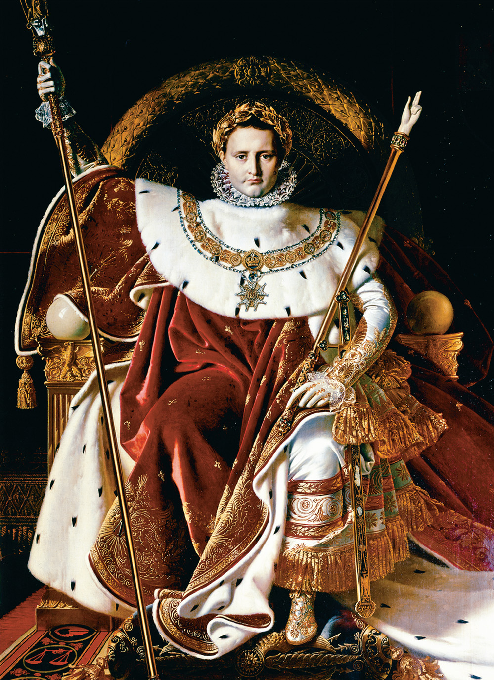
This portrait of Napoleon on his throne by Jean Ingres (1780–1867) shows him in the splendor of an imperial monarch who embodies the total power of the state. Jean Auguste Dominique Ingres (1780–1867), Napoleon on His Imperial Throne, 1806. Oil on canvas, 259 × 162 cm. Musée des Beaux-Arts, Rennes. Photograph © Erich Lessing/Art Resource, NY
Notes:
This portrait of Napoleon on his throne by Jean Ingres (1780–1867) shows him in the splendor of an imperial monarch who embodies the total power of the state.
Jean Auguste Dominique Ingres (1780–1867), Napoleon on His Imperial Throne, 1806. Oil on canvas, 259 × 162 cm. Musée des Beaux-Arts, Rennes. Photograph © Erich Lessing/Art Resource, NY

Slide 3
Napoleon Bonaparte
Napoleon Bonaparte – born to a poor family in Corsica, he became a French artillery officer and a Jacobin
Leads coup d’etat to prevent restoration of the Bourbon monarchy
Preserves the republic

Slide 4
Early Military Victories
Napoleon’s armies take over Italy and Switzerland by defeating Austrian and Sardinian armies
Invades Egypt
French fleet cut off from France by Englishman Horatio Nelson
Russians join Austrians, Ottomans, and British to form Second Coalition

Slide 5
Year VIII Constitution
Napoleon pushes one of the Directors, Abbe Sieyes, aside
Establishes the rule of one man – The First Consul – Napoleon

Slide 6
The Consulate in France (1799-1804)
In effect, ended the Revolution of the Third Estate
Third Estate members and peasants had achieved their goals so the Consulate was supported
Abolished hereditary privilege (Third Estate)
Destroyed feudal system (peasants)

Slide 7
Suppression of Opponents by Napoleon
Makes peace with all of France’s enemies by 1802
Suppresses opposition at home
Offers general amnesty to men of all political factions as long as they pledge loyalty to him
Employes the secret police
Bourbon duke of Enghien executed for a royalist plot of which he was innocent

Slide 8
Concordat with the Roman Catholic Church
Napoleon reestablishes Christianity in France with agreement with Pope Pius VII
Still, state had authority over the church through The Organic Articles of 1802

Slide 9
The Napoleonic Code
Safeguarded all forms of property
Conservative attitudes toward women and labor remained
Property was distributed among all children; males and females
Women needed husband’s consent to dispose of property

Slide 10
Napoleon’s Dynasty
Another new constitution makes Napoleon Emperor of the French
Napoleon crowns himself Napoleon I

Slide 11
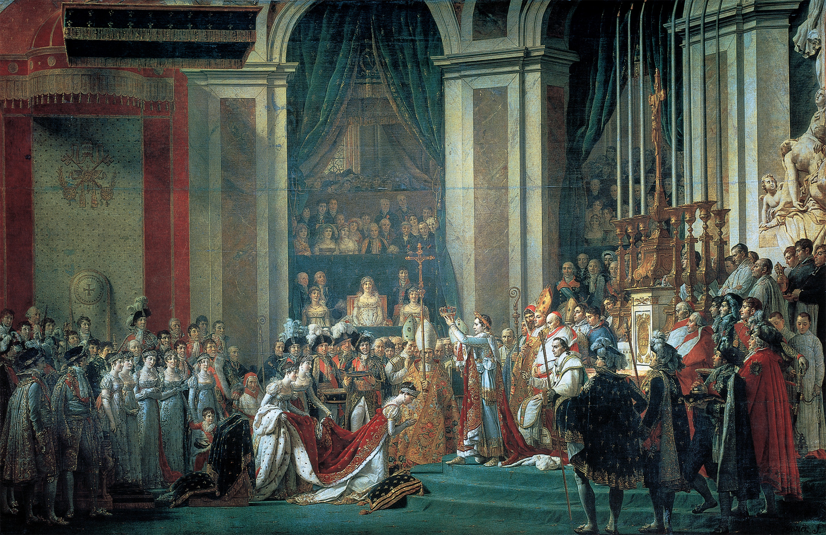
The Coronation of Napoleon Jacques-Louis David recorded the elaborate coronation of Napoleon in a monumental painting that revealed the enormous political and religious tensions of that event, which involved the kind of ritual and ceremony associated with the monarchy of the ancien régime. Jacques-Louis David (1748–1825), Consecration of the Emperor Napoleon I and Coronation of Empress Josephine, 1806–07. Louvre, (Museum), Paris, France/Scala/Art Resource, NY
Notes:
The Coronation of Napoleon Jacques-Louis David recorded the elaborate coronation of Napoleon in a monumental painting that revealed the enormous political and religious tensions of that event, which involved the kind of ritual and ceremony associated with the monarchy of the ancien régime.
Jacques-Louis David (1748–1825), Consecration of the Emperor Napoleon I and Coronation of Empress Josephine, 1806–07. Louvre, (Museum), Paris, France/Scala/Art Resource, NY

Slide 12
Haitian Revolution
Francois-Dominique Toussaint L’Ouverture – former slave leads successful slave revolt against white Frenchmen and freed mulattos in Haiti (1791)

Slide 13
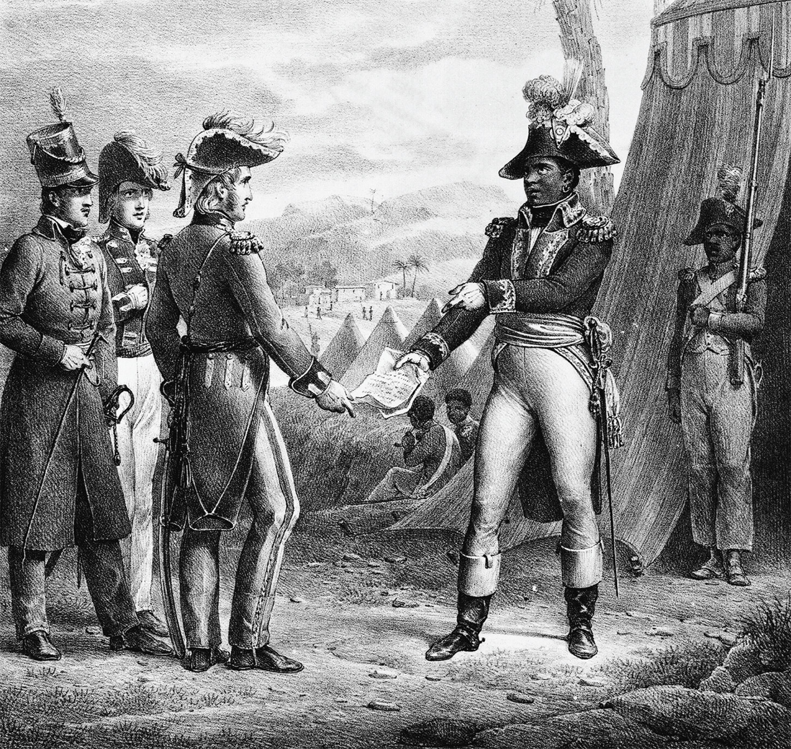
Toussaint L’Ouverture (1746–1803) began the revolt that led to Haitian independence in 1804. Library of Congress
Notes:
Toussaint L’Ouverture (1746–1803) began the revolt that led to Haitian independence in 1804.
Library of Congress

Slide 14
Napoleon’s Empire
Army gets involved in Haiti, Dutch Republic, Italy, Switzerland, and the reorganization of Germany
British naval supremacy – the British under Lord Nelson destroy French and Spanish forces at the Battle of Trafalgar
Defeats Austria and Russia at Austerlitz – becomes King of Italy
Defeats Russia and Prussia to control all of Germany

Slide 15
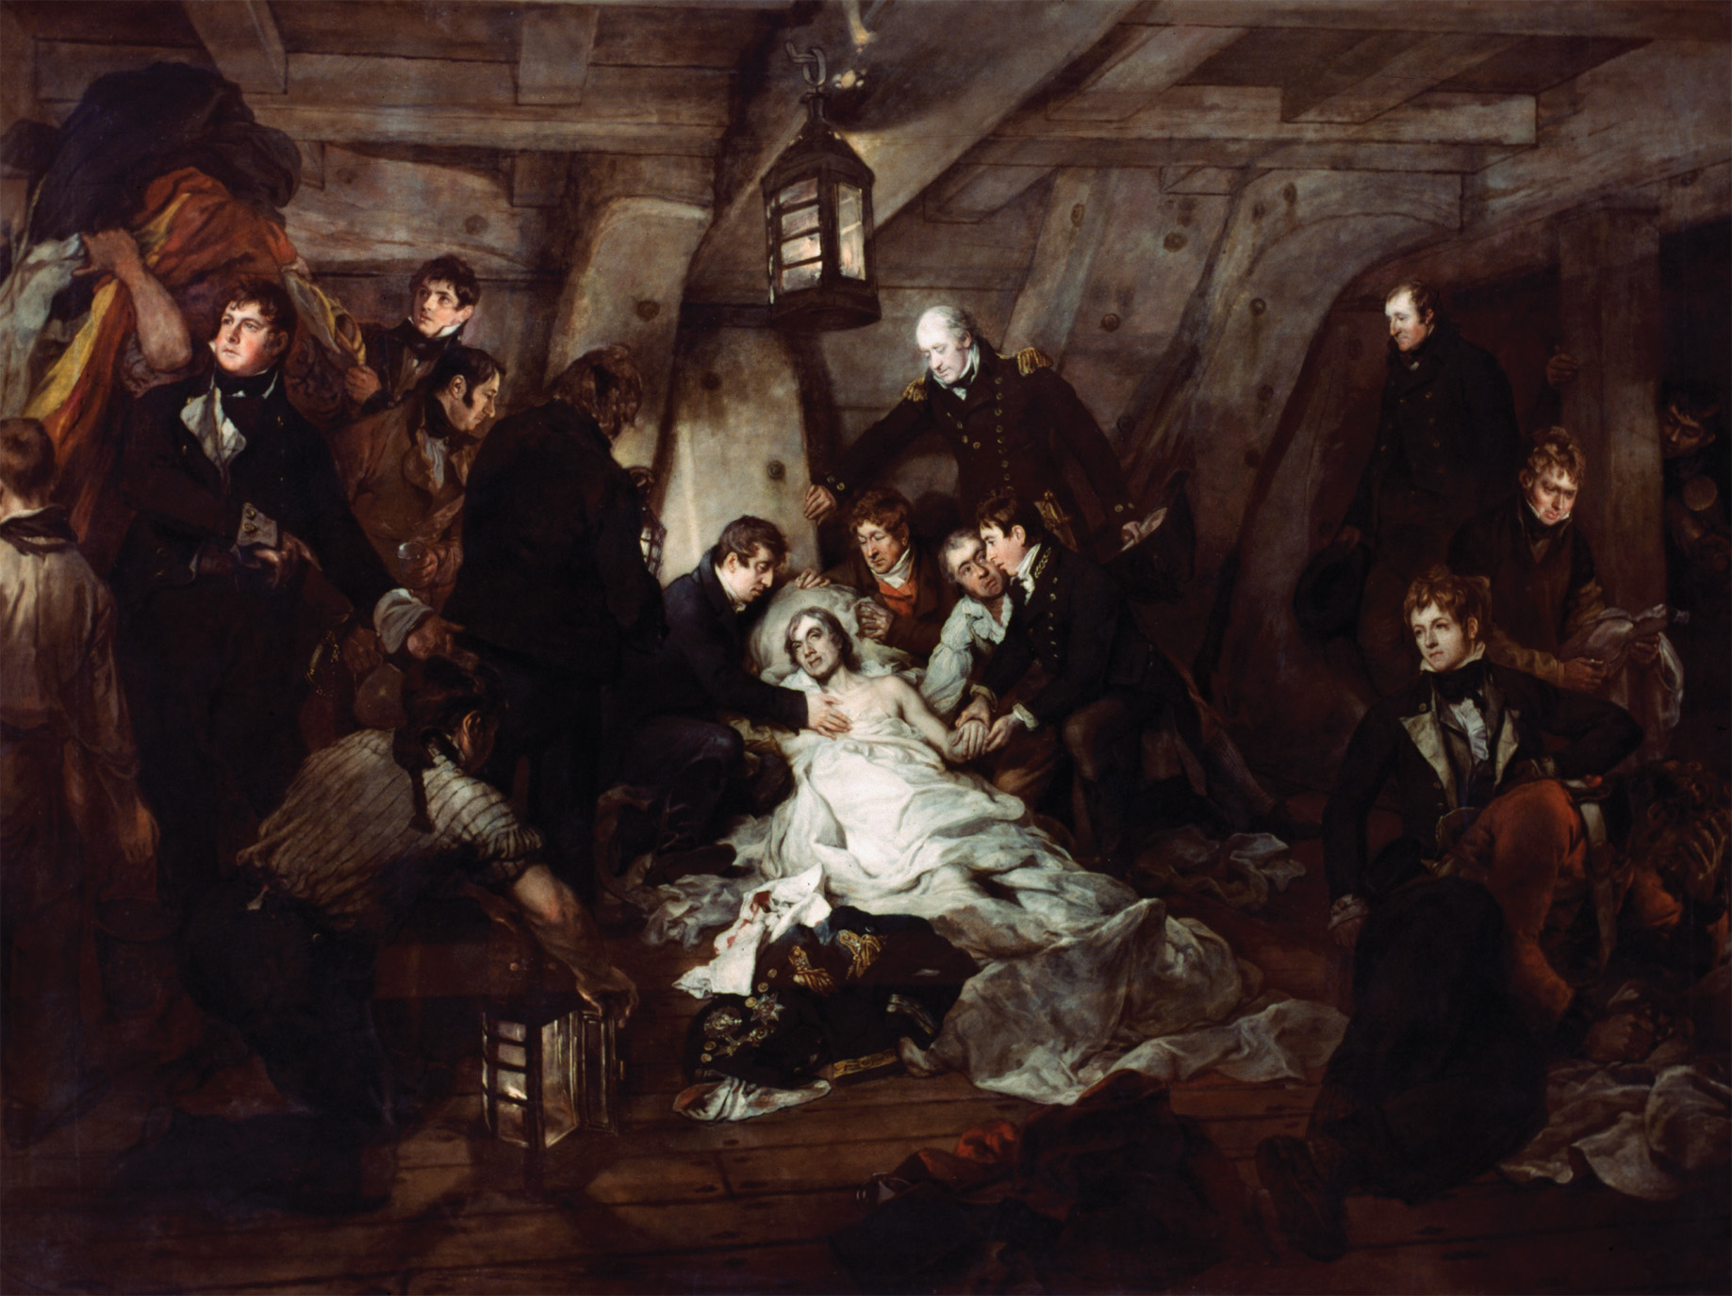
By the time this painting was completed in 1807, Nelson was already a hero in Britain. Here he is depicted on his deathbed aboard his ship the Victory, during the British defeat of French and Spanish fleets at the Battle of Trafalgar in 1805. The lighting that illuminates Nelson’s suffering face evokes religious paintings and suggests martyrdom. Arthur William Devis, “The Death of Nelson.” Oil on canvas. The Granger Collection, NYC— All rights reserved.
Notes:
By the time this painting was completed in 1807, Nelson was already a hero in Britain. Here he is depicted on his deathbed aboard his ship the Victory, during the British defeat of French and Spanish fleets at the Battle of Trafalgar in 1805. The lighting that illuminates Nelson’s suffering face evokes religious paintings and suggests martyrdom.
Arthur William Devis, “The Death of Nelson.” Oil on canvas. The Granger Collection, NYC— All rights reserved

Slide 16
Treaty of Tilsit
Prussia and Russia make peace with Napoleon and become allies
Prussia loses half its territory
Napoleon gave satellite states to his family members

Slide 17
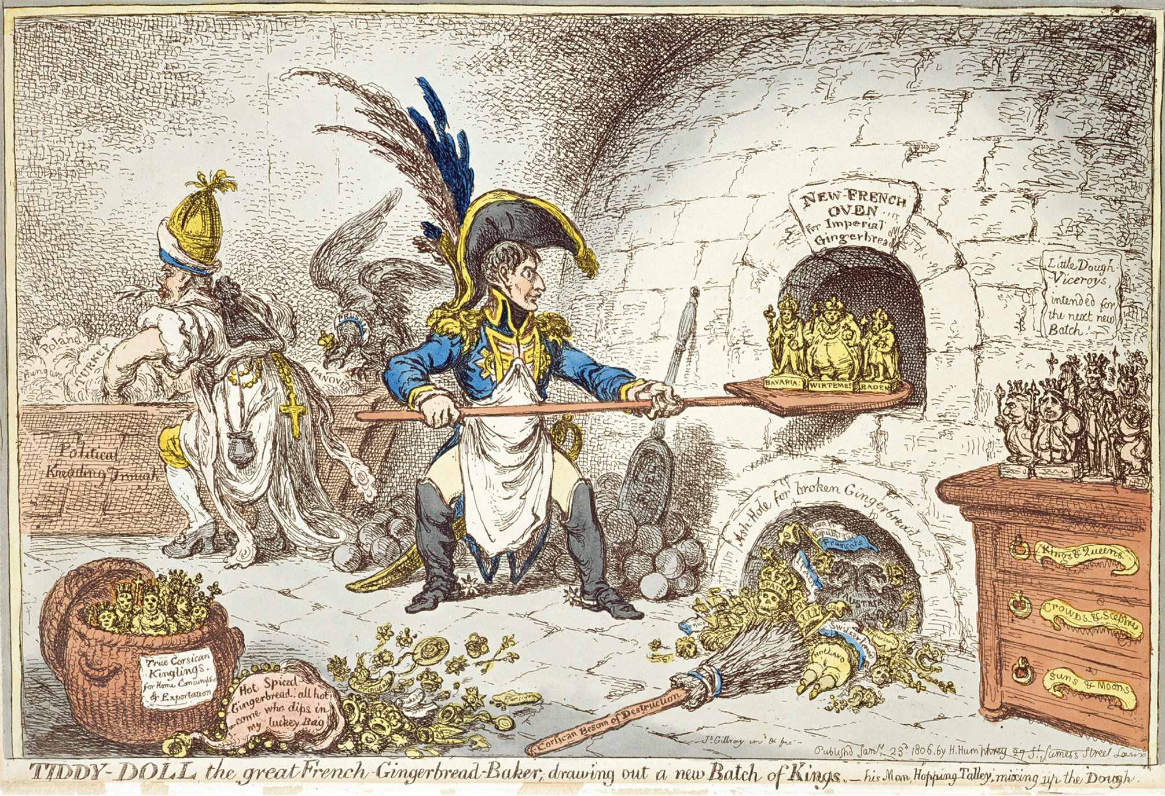
In this 1806 caricature by the famous English artist James Gillray, Napoleon is shown as a baker who creates new kings as easily as gingerbread cookies. His new allies in the Rhine Confederation, including the rulers of Württemberg, Bavaria, and Saxony, are placed in the “New French Oven for Imperial Gingerbread.” ‘Tiddy- Doll, the Great French Gingerbread Maker, Drawing Out a New Batch of Kings. His Man, Hopping Talley, Mixing Up the Dough’, pub. by Hannah Humphrey, 23rd January 1806 (aquatint), Gillray, James (1757–1815). Leeds Museums and Galleries (City Art Gallery) U.K./The Bridgeman Art Library International
Notes:
In this 1806 caricature by the famous English artist James Gillray, Napoleon is shown as a baker who creates new kings as easily as gingerbread cookies. His new allies in the Rhine Confederation, including the rulers of Württemberg, Bavaria, and Saxony, are placed in the “New French Oven for Imperial Gingerbread.”
‘Tiddy- Doll, the Great French Gingerbread Maker, Drawing Out a New Batch of Kings. His Man, Hopping Talley, Mixing Up the Dough’, pub. by Hannah Humphrey, 23rd January 1806 (aquatint), Gillray, James (1757–1815). Leeds Museums and Galleries (City Art Gallery) U.K./The Bridgeman Art Library International

Slide 18
The Continental System
Napoleon wanted to cut Britain off from the main European continent
Milan Decree of 1807 – attempted to stop neutral nations from trading with Britain
Plan fails because of British control of the seas
Tariff policies favor France
Caused resentment of foreign merchants
System not enforced
Leads eventually to Napoleon’s downfall

Slide 19
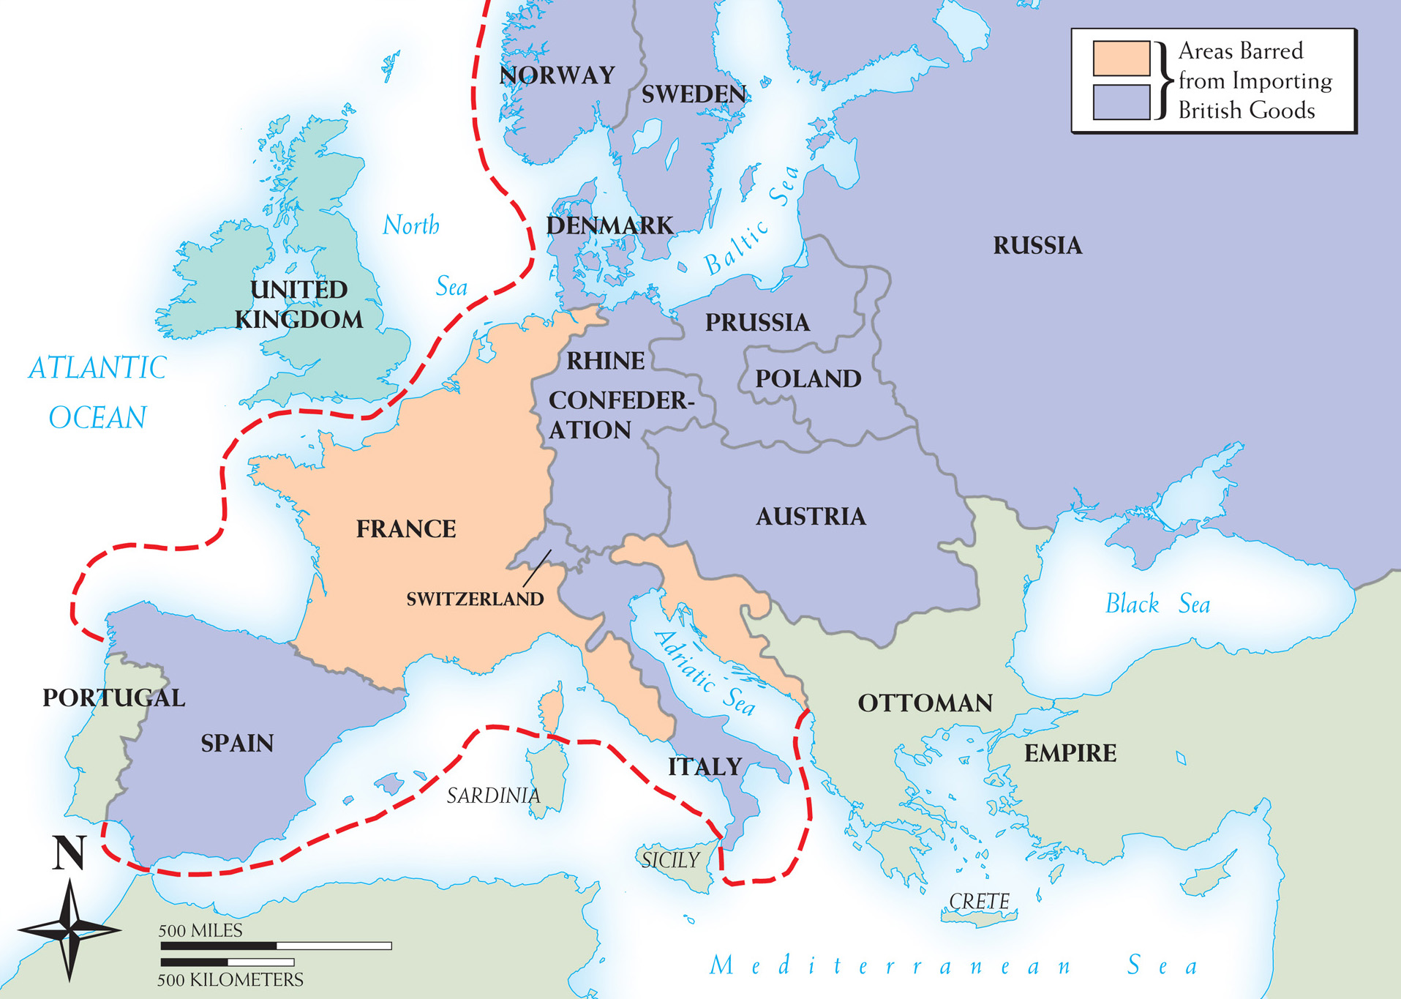
Map 19–1 THE CONTINENTAL SYSTEM, 1806–1810 Napoleon hoped to cut off all British trade with the European continent and thereby drive the British from the war.
Notes:
Map 19–1 THE CONTINENTAL SYSTEM, 1806–1810 Napoleon hoped to cut off all British trade with the European continent and thereby drive the British from the war.

Slide 20
German Nationalism and Prussian Reform
Many German nationalists wanted a united German state without Napoleon
Prussia abolished serfdom
Junker nobility still owns most of the land
Many landless laborers
Attempted to increase military through reforms
Abolished inhumane military punishments
Opened officer corps to commoners
Promotions on basis of merit

Slide 21
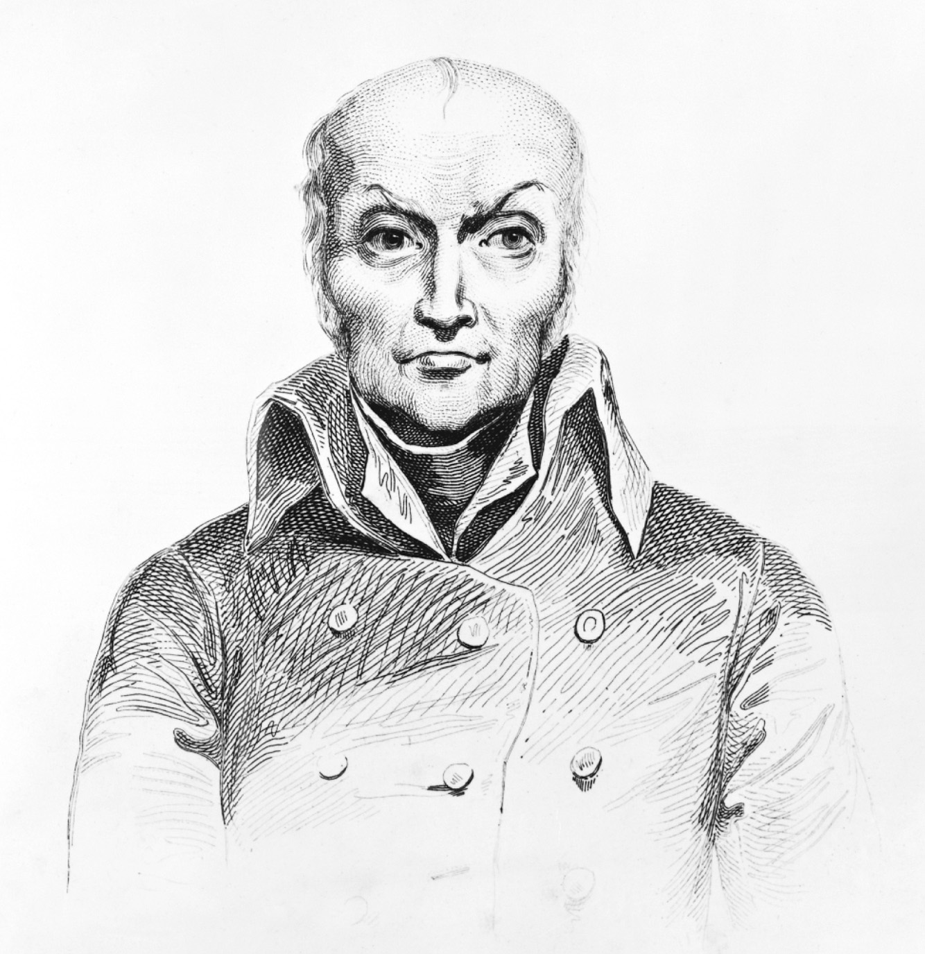
Nicholas Appert (1749–1841) invented canning as a way of preserving food nutritiously. Canned food could be transported over long distances without spoiling. Private Collection/ Bridgeman Art Library
Notes:
Nicholas Appert (1749–1841) invented canning as a way of preserving food nutritiously. Canned food could be transported over long distances without spoiling.
Private Collection/ Bridgeman Art Library

Slide 22
Spanish and Austrian Wars of Liberation
Spain
Napoleon’s brother Joseph on throne
Peasants and clergy rebel
Spanish guerrilla forces and English army under Duke Wellington hasten Napoleon’s defeat
Austria
Defeated at Battle of Wagram
Napoleon divorces his wife Josephine and marries Austrian archduchess Marie Louise

Slide 23
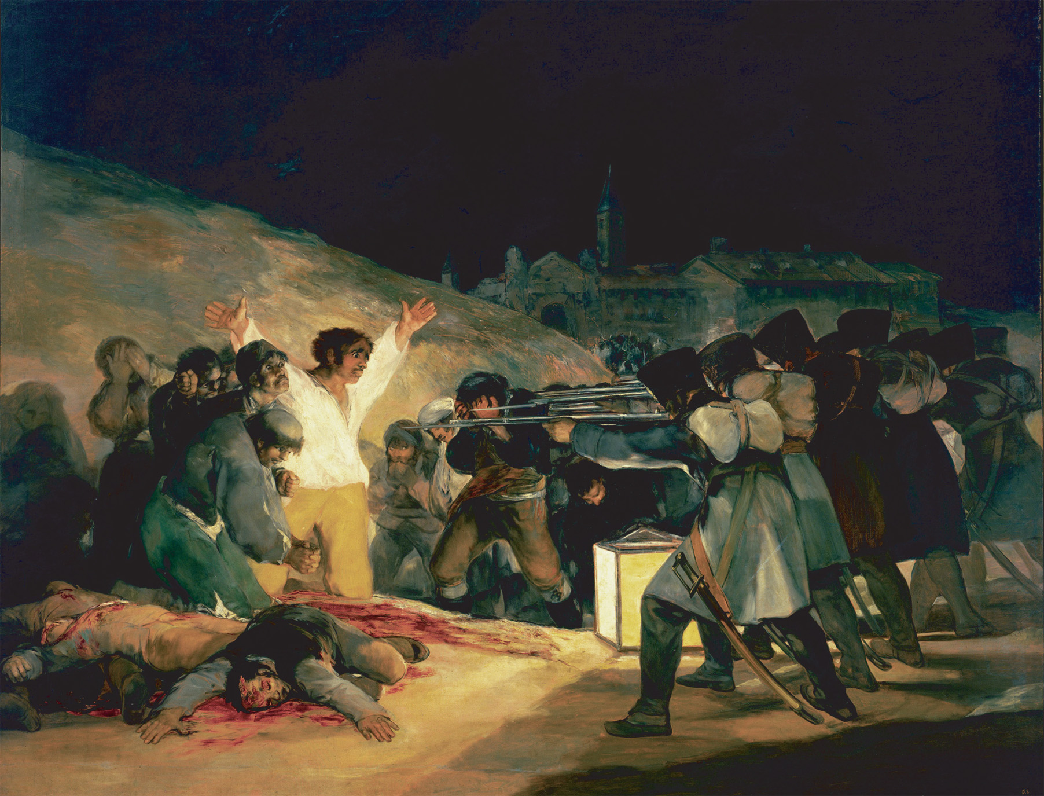
Francisco de Goya y Lucientes recorded Napoleon’s troops executing Spanish guerilla fighters who had rebelled against the French occupation in The Third of May, 1808. PRISMA/VWPICS/© Visual&Written SL / Alamy
Notes:
Francisco de Goya y Lucientes recorded Napoleon’s troops executing Spanish guerilla fighters who had rebelled against the French occupation in The Third of May, 1808.
PRISMA/VWPICS/© Visual&Written SL / Alamy

Slide 24
Disaster for Napoleon in Russia
War with Austria, annexation of Holland, and marriage to Marie Louise angered Alexander of Russia
Invasion of Russia
Russia’s “scorched earth” policy – destroying food and supplies and then retreating – erodes Napoleon’s Grand Army
Napoleon wanted to take over Russian capital – Moscow
Russians burn down Moscow leaving Napoleon there in winter
Napoleon loses half a million men

Slide 25
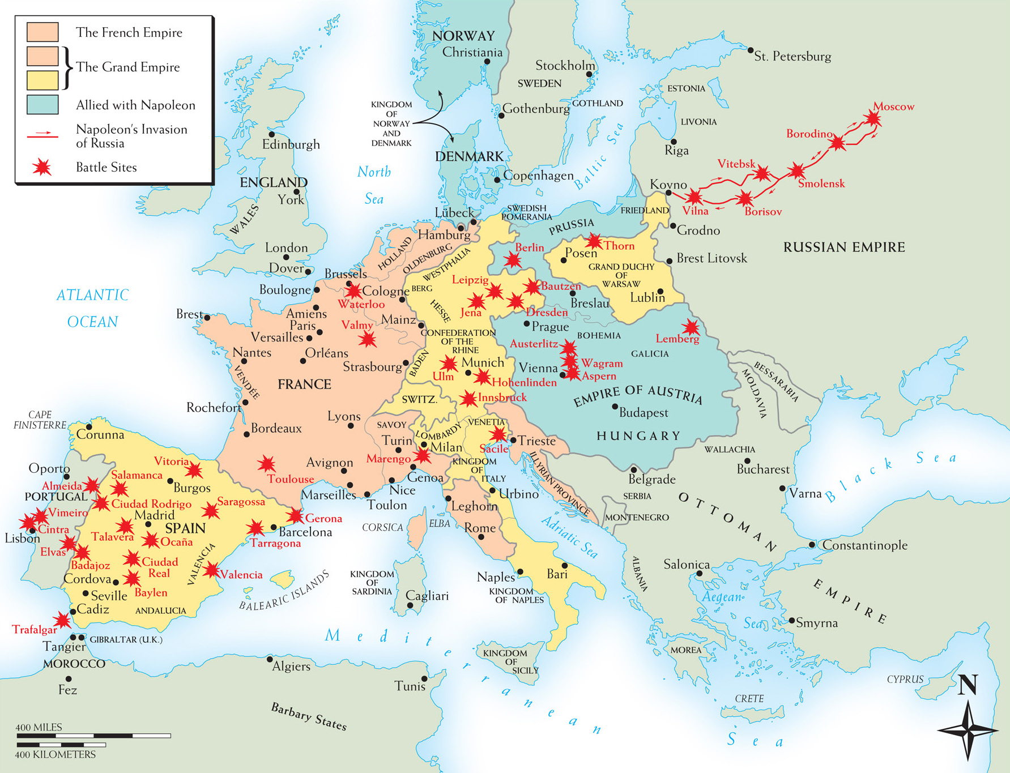
Map 19–2 NAPOLEONIC EUROPE IN LATE 1812 By mid-1812 the areas shown in peach were incorporated into France, and most of the rest of Europe was directly controlled by or allied with Napoleon. But Russia had withdrawn from the failing Continental System, and the decline of Napoleon was about to begin.
Notes:
Map 19–2 NAPOLEONIC EUROPE IN LATE 1812 By mid-1812 the areas shown in peach were incorporated into France, and most of the rest of Europe was directly controlled by or allied with Napoleon. But Russia had withdrawn from the failing Continental System, and the decline of Napoleon was about to begin.

Slide 26
European Coalition
Combined forces of Russia, Prussia, Austria, and Great Britain form allied army
Napoleon defeats allies at Dresden
Defeated at Leipzig in Battle of Nations
Allied armies take over Paris
Napoleon abdicates throne in March, 1814 and is exiled to island of Elba

Slide 27
New Borders
Quadruple Alliance – Britain, Austria, Russia, and Prussia meet at the Congress of Vienna to decide new European borders
Establishment of kingdom of Netherlands
Prussia and Austria gain territory west of France and in Italy
Alexander of Russia reluctantly gets only part of Poland

Slide 28
New Borders (cont.)
French Bourbon monarchy restored
France joins in discussions under Talleyrand in hopes of appealing to Russia

Slide 29
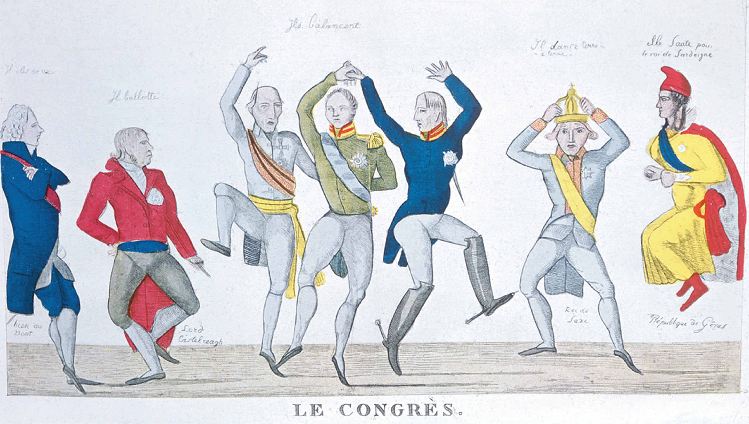
In this political cartoon of the Congress of Vienna, Tallyrand simply watches which way the wind is blowing, Castlereagh hesitates, while the monarchs of Russia, Prussia, and Austria form the dance of the Holy Alliance. The king of Saxony holds on to his crown and the republic of Geneva pays homage to the kingdom of Sardinia. bpk, Berlin/Art Resource, NY
Notes:
In this political cartoon of the Congress of Vienna, Tallyrand simply watches which way the wind is blowing, Castlereagh hesitates, while the monarchs of Russia, Prussia, and Austria form the dance of the Holy Alliance. The king of Saxony holds on to his crown and the republic of Geneva pays homage to the kingdom of Sardinia.
bpk, Berlin/Art Resource, NY

Slide 30
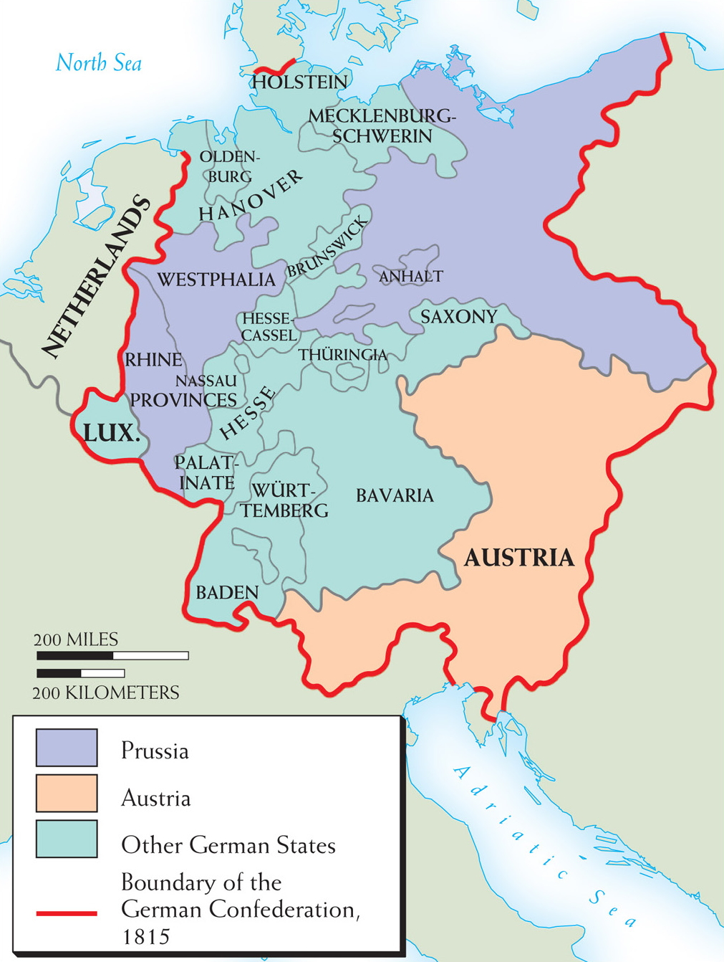
Map 19–3 THE GERMAN STATES AFTER 1815 The German states continued to cooperate in a loose confederation, but maintained their independence. Independence was not restored to the small principalities that had been eliminated during the Napoleonic era.
Notes:
Map 19–3 THE GERMAN STATES AFTER 1815 The German states continued to cooperate in a loose confederation, but maintained their independence. Independence was not restored to the small principalities that had been eliminated during the Napoleonic era.

Slide 31
The Hundred Days
Napoleon, still with many supporters, attempts to retake France
Napoleon defeated again at Battle of Waterloo
Exiled for good to tiny island of St. Helena
Austria, Prussia, Russia form Holy Alliance, based on Christian principles; England does not join

Slide 32
The Hundred Days (cont.)
Quadruple Alliance reformed in 1815 to maintain peace in Europe
New Congress of Vienna remains intact for half a century and prevents general war for a hundred years

Slide 33
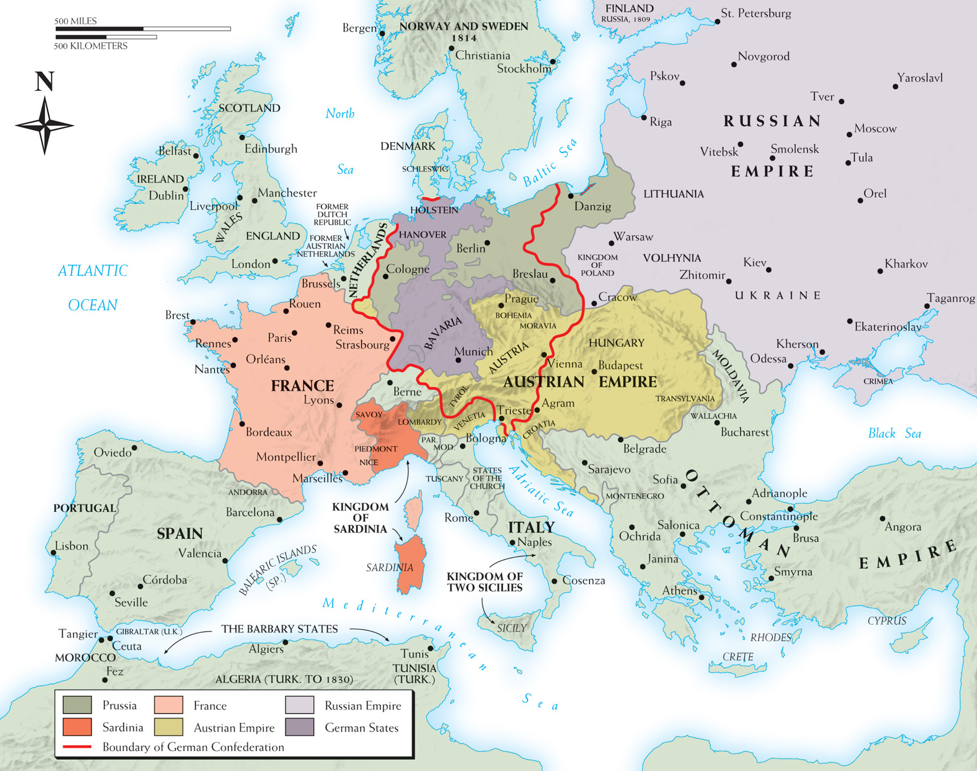
Map 19–4 EUROPE 1815, AFTER THE CONGRESS OF VIENNA The Congress of Vienna achieved the post-Napoleonic territorial adjustments shown on the map. The most notable arrangements dealt with areas along France’s borders (the Netherlands, Prussia, Switzerland, and Piedmont) and in Poland and northern Italy.
Notes:
Map 19–4 EUROPE 1815, AFTER THE CONGRESS OF VIENNA The Congress of Vienna achieved the post-Napoleonic territorial adjustments shown on the map. The most notable arrangements dealt with areas along France’s borders (the Netherlands, Prussia, Switzerland, and Piedmont) and in Poland and northern Italy.

Slide 34
The Romantic Movement
Romanticism – intellectual movement that was a reaction against the Enlightenment
Urged a revival of Christianity
Focused on art, music, and literature of medieval times

Slide 35
Romantic Questioning of Reason
Rousseau and education – his work Emile (1762) stressed the difference between children and adults
Children should be raised with maximum freedom
Adults should allow children to reason
Kant and reason – in his works The Critique of Pure Reason (1781) and The Critique of Practical Reason (1788)
Sought rationalism of Enlightenment
Humans have categorical imperative – an innate sense of moral duty or awareness

Slide 36
English Romantic Writers
Samuel Taylor Coleridge – wrote Gothic poems of the supernatural
William Wordsworth – wrote, sometimes with Coleridge, about how humans lose their childlike imagination as they get older

Slide 37
English Romantic Writers (cont.)
Lord Byron – rebel Romanticist, who wrote about personal liberty and mocked his own beliefs in famous works such as Don Juan (1819)
Mary Godwin Shelley – daughter of Mary Wollstonecraft, wrote Frankenstein: or, The Modern Prometheus; considered the first science fiction novel

Slide 38
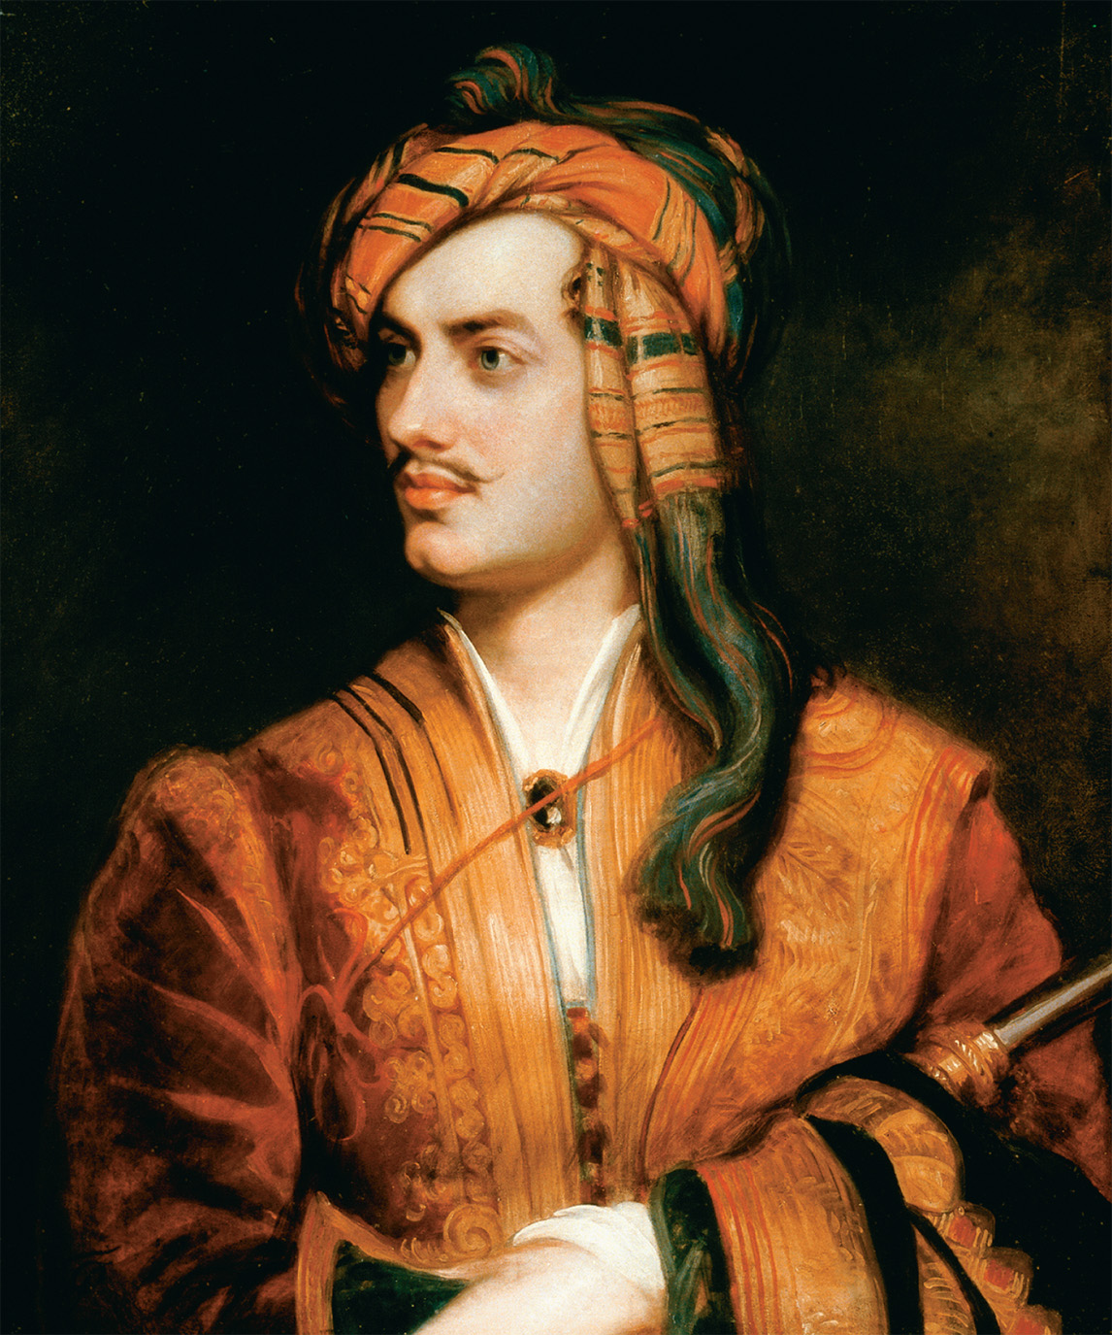
George Gordon, Lord Byron (1788–1824), chose Albanian attire for this portrait. A famous supporter of the Greek Revolution, which would cost him his life (he died of fever in Greece in 1824), Byron proudly suggested he was capable of embodying many different personalities and participating in different cultural traditions. In England, his personal life was considered scandalous. The Granger Collection, New York
Notes:
George Gordon, Lord Byron (1788–1824), chose Albanian attire for this portrait. A famous supporter of the Greek Revolution, which would cost him his life (he died of fever in Greece in 1824), Byron proudly suggested he was capable of embodying many different personalities and participating in different cultural traditions. In England, his personal life was considered scandalous.
The Granger Collection, New York

Slide 39
German Romantic Writers
Friedrich Schlegel – Progressive who attacked prejudices against women in novels such as Lucinde (1799)
Johann Wolfgang von Goethe – writings were part Romantic mode / part criticism of Romantic excess
Faust – Part I (1808) – long dramatic poem about man who makes a pact with the devil
Faust – Part II (1832) – taken through many mythological adventures, man dedicates his life to humankind

Slide 40
Romantic Art
Neo-Gothicism
Supported the church and saw liberalism as evil
Style of art seen in architecture and paintings

Slide 41
Romantic Art (cont.)
Nature
Sublime – subjects from nature arouse strong emotions and raise questions about how much we control our lives
Famous naturalists include Caspar David Friedrich and Joseph Mallord William Turner

Slide 42
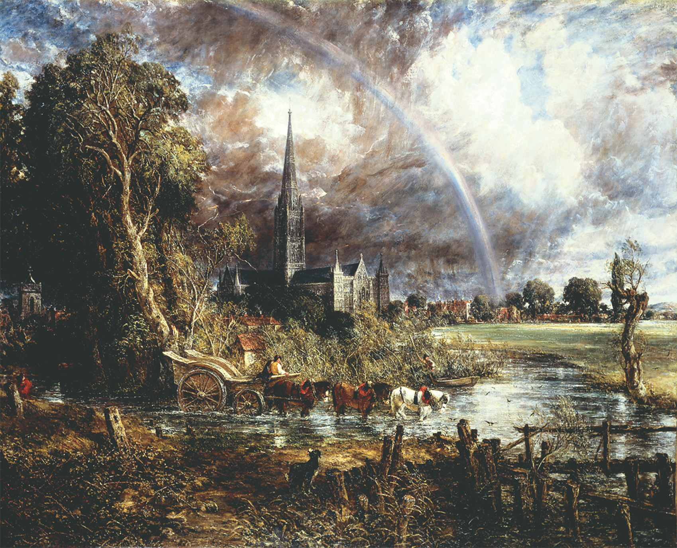
John Constable’s Salisbury Cathedral from the Meadows displays the appeal of Romantic art to both medieval monuments and the sublime power of nature. Art Resource, NY. © The National Gallery, London
Notes:
John Constable’s Salisbury Cathedral from the Meadows displays the appeal of Romantic art to both medieval monuments and the sublime power of nature.
Art Resource, NY. © The National Gallery, London

Slide 43
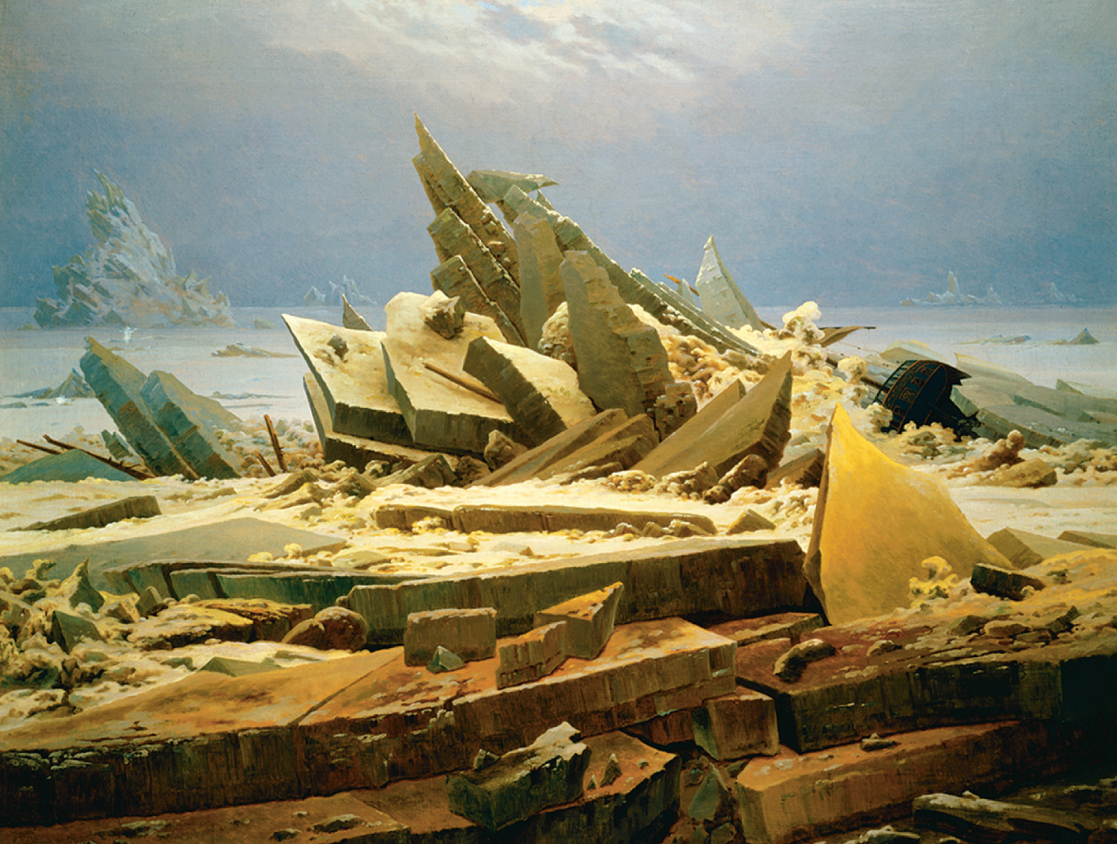
Caspar David Friedrich’s The Polar Sea illustrated the power of nature to diminish the creations of humankind as seen in the wrecked ship on the right of the painting. Kunsthalle, Hamburg, Germany/A.K.G., Berlin/ SuperStock
Notes:
Caspar David Friedrich’s The Polar Sea illustrated the power of nature to diminish the creations of humankind as seen in the wrecked ship on the right of the painting.
Kunsthalle, Hamburg, Germany/A.K.G., Berlin/ SuperStock

Slide 44
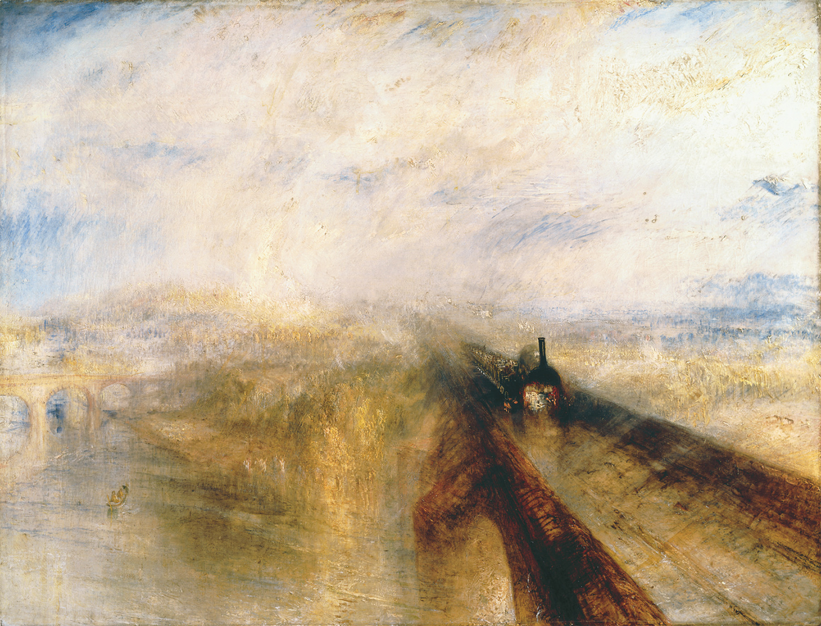
Joseph Mallord William Turner’s Rain, Steam, and Speed—The Great Western Railway captured the tensions many Europeans felt between their natural environment and the new technology of the industrial age. Joseph Mallord William Turner, 1775–1851, Rain, Steam, and Speed—The Great Western Railway 1844. Oil on canvas, 90.8 × 121.9. The National Gallery, London/Art Resource, NY
Notes:
Joseph Mallord William Turner’s Rain, Steam, and Speed—The Great Western Railway captured the tensions many Europeans felt between their natural environment and the new technology of the industrial age.
Joseph Mallord William Turner, 1775–1851, Rain, Steam, and Speed—The Great Western Railway 1844. Oil on canvas, 90.8 × 121.9. The National Gallery, London/Art Resource, NY

Slide 45
Romantic Religion
Methodism – revolt against deism and rationalism, stressed inward, heartfelt religion; its leader was John Wesley
Continental Religion – religious developments based on feeling
Chateaubriand – The Genius of Christianity (1802) – essence of religion is passion / foundation of faith is emotion
Scleiermacher – Speeches on Religion to Its Cultured Despisers (1799) – religion as an intuition or feeling of absolute dependence on an infinite reality

Slide 46
Romantic Views of Nationalism and History
Johann Gottfried Herder – German Romantic
Critic of European colonialism
Human beings develop organically
The Grimm Brothers, famous fairy tale writers, were his followers

Slide 47
Romantic Views of Nationalism and History (cont.)
Georg Wilhelm Friedrich Hegel – German Romantic philosopher
Believed a predominant set of ideas, thesis, is at odds with another set of ideas, antithesis; the patterns clash, resulting in a new synthesis that emerges as the new thesis in a vicious cycle
All cultures are valuable because they are all part of this clash

Slide 48
Islam and Romanticism
Islam seen in a more positive light than during the Enlightenment
Under Napoleon, learning about Islam became an important part of French intellectual life
Rosetta Stone – found on one of Napoleon’s expeditions, became the key to unlocking Egyptian hieroglyphics

Slide 49
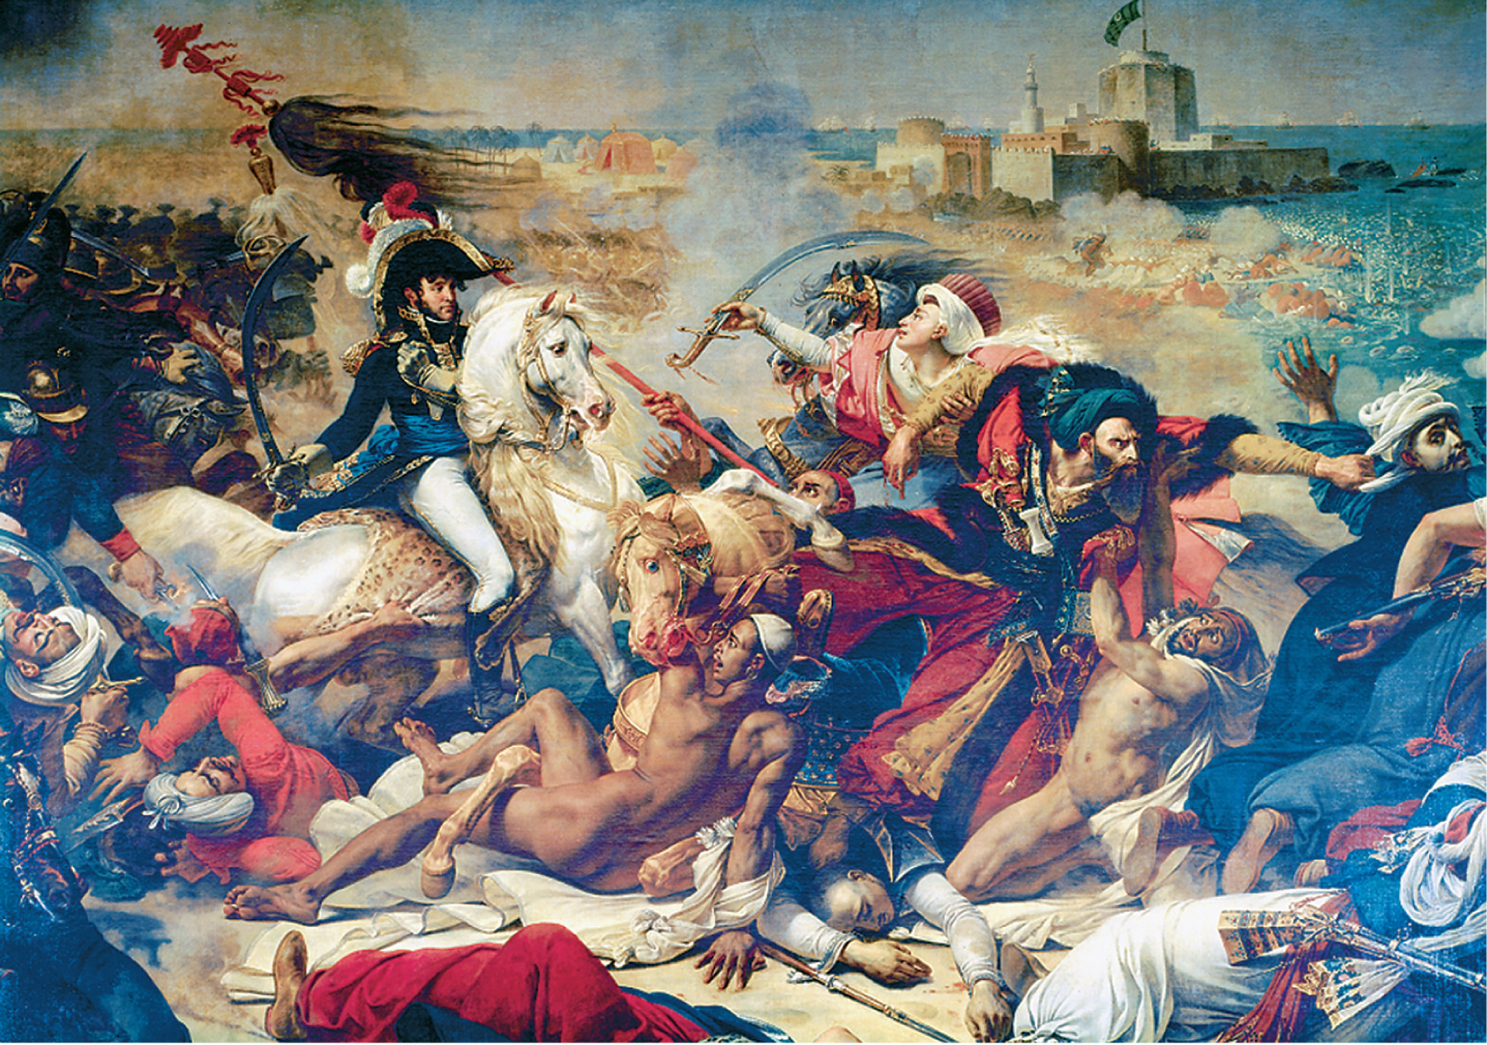
When Napoleon invaded Egypt in 1799, he met stiff resistance. On July 25, however, the French won a decisive victory. This painting of that battle by Baron Antoine Gros (1771–1835) emphasizes French heroism and Muslim defeat. Such an outlook was typical of European views of Arabs and the Islamic world. Antoine Jean Gros (1771–1835). Detail, Battle of Aboukir, July 25, 1799, c. 1806. Oil on canvas. Chateaux de Versailles et de Trianon, Versailles, France. Giraudon/Art Resource, NY
Notes:
When Napoleon invaded Egypt in 1799, he met stiff resistance. On July 25, however, the French won a decisive victory. This painting of that battle by Baron Antoine Gros (1771–1835) emphasizes French heroism and Muslim defeat. Such an outlook was typical of European views of Arabs and the Islamic world.
Antoine Jean Gros (1771–1835). Detail, Battle of Aboukir, July 25, 1799, c. 1806. Oil on canvas. Chateaux de Versailles et de Trianon, Versailles, France. Giraudon/Art Resource, NY

