Slide 1
Chapter 20
The Conservative Order
and the Challenges of Reform (1815–1832)

Slide 2
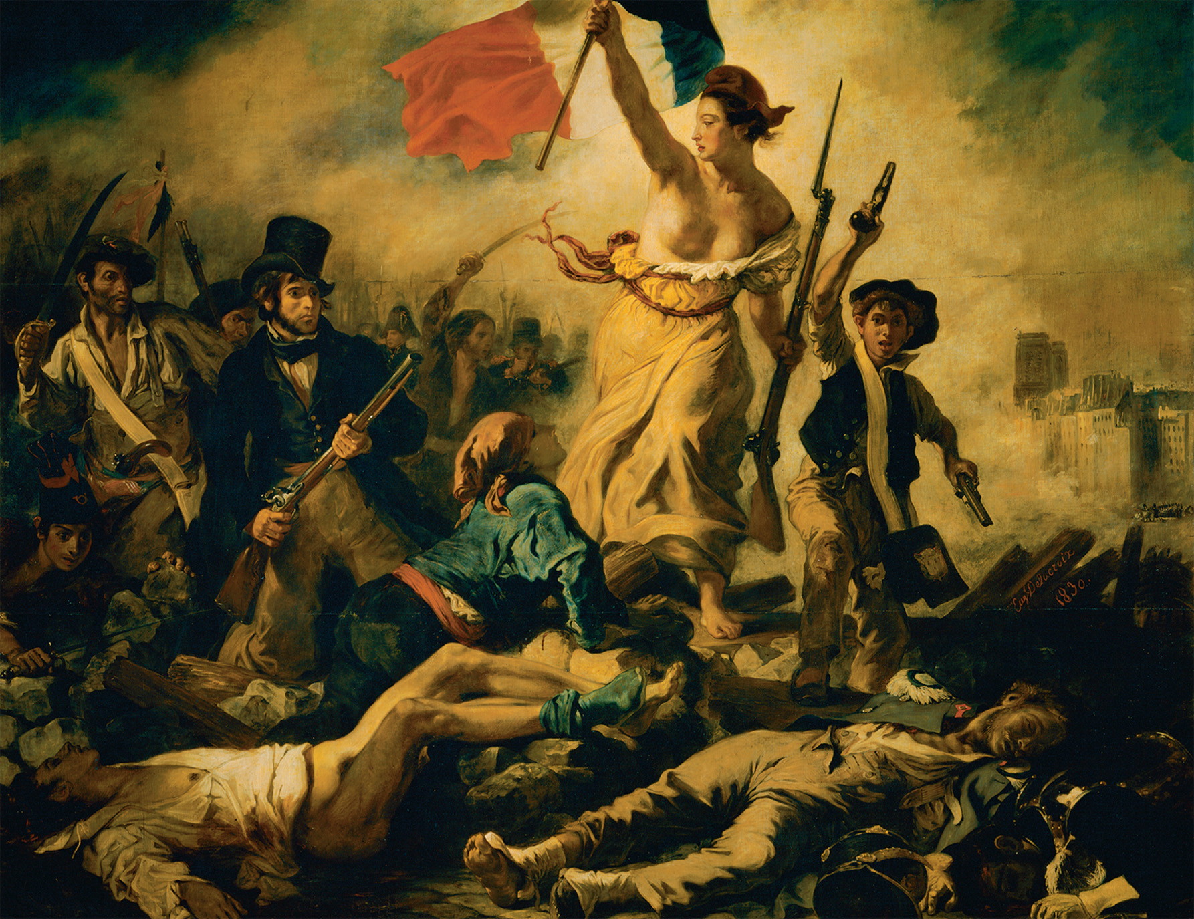
In 1830, revolution again erupted in France as well as elsewhere on the Continent. Eugène Delacroix’s Liberty Leading the People was the most famous image recalling that event. Note how he portrays persons from different social classes and occupations joining the revolution led by the figure of Liberty. Eugène Delacroix (1798–1863), Liberty Leading the People, 1830. Oil on canvas, 260 × 325 cm—RF 129. Musée du Louvre, Paris, France/Scala/Art Resource, NY
Notes:
In 1830, revolution again erupted in France as well as elsewhere on the Continent. Eugène Delacroix’s Liberty Leading the People was the most famous image recalling that event. Note how he portrays persons from different social classes and occupations joining the revolution led by the figure of Liberty.
Eugène Delacroix (1798–1863), Liberty Leading the People, 1830. Oil on canvas, 260 × 325 cm—RF 129. Musée du Louvre, Paris, France/Scala/Art Resource, NY

Slide 3
The Conservative International Order
The Concert of Europe – nations from the Congress of Vienna agree that one nation cannot take major action in international affairs without working with the others

Slide 4
The Conservative International Order (cont.)
The congress system – the Congress of Vienna removes troops from France after they had paid their war reparations
Tsar Alexander I of Russia wants to keep Quadruple Alliance and uphold existing borders
Castlereagh, representing Britain, feels Alliance was only to stop French aggression

Slide 5
Domestic Political Order
Despite Castlereagh’s resistance, most European statesmen believed that preventing domestic unrest was the key to maintaining international peace

Slide 6
Conservative Outlooks
Conservative pillars were legitimate monarchies, aristocracies, and established churches
Did not want written constitutions
Disliked Enlightenment

Slide 7
Nationalism
Nationalism – people are brought together by common bonds of language, customs, culture, and history
Developed in Europe in late 18th and early 19th centuries

Slide 8
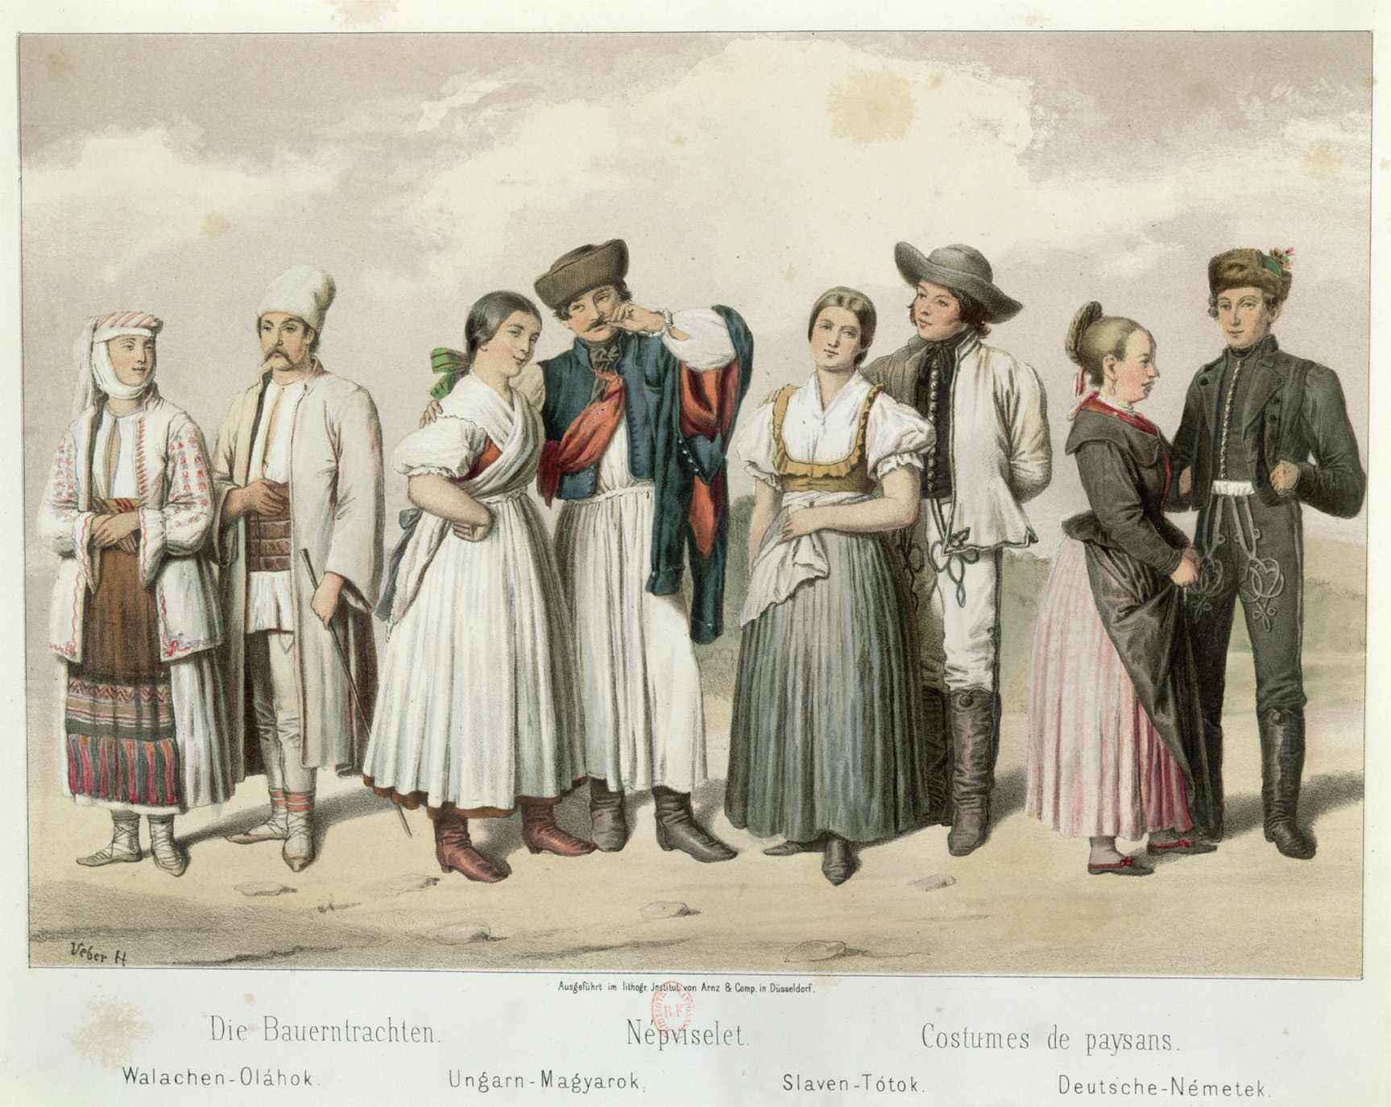
The celebration of nationalism included attempts to classify different groups of people according to language, religion, and culture. Sketches of differing regional folk costumes both celebrated diversity and institutionalized difference. This mid-nineteenth-century lithograph includes images of the peasant attire of the different national groups in Hungary. From left to right, these are “Walachians” (Romanians), Hungarians, “Slavs” (Slovaks), and Germans. Costumes of Peasants, from ‘Esquisses de la Vie Populaire en Hongroie’ by Gabriel de Pronay, 1855 (colour litho), Veber, H. (fl.1855). Bibliotheque Nationale, Paris, France/Archives Charmet/The Bridgeman Art Library International
Notes:
The celebration of nationalism included attempts to classify different groups of people according to language, religion, and culture. Sketches of differing regional folk costumes both celebrated diversity and institutionalized difference. This mid-nineteenth-century lithograph includes images of the peasant attire of the different national groups in Hungary. From left to right, these are “Walachians” (Romanians), Hungarians, “Slavs” (Slovaks), and Germans.
Costumes of Peasants, from ‘Esquisses de la Vie Populaire en Hongroie’ by Gabriel de Pronay, 1855 (colour litho), Veber, H. (fl.1855). Bibliotheque Nationale, Paris, France/Archives Charmet/The Bridgeman Art Library International

Slide 9
Vienna Settlement Opponents
Nationalists felt nations should be based on ethnicity, not monarchies and dynasties (Congress of Vienna) as basis for national unity
Nations should be based on qualities of people not rulers
There was confusion, though, because of minority groups

Slide 10
Creating Nations
Nations were created based on unifying languages
National languages replaced local dialects
Taught in schools
Printed articles made it easier to reinforce national language over dialects

Slide 11
Meaning of Nationhood
Some people argued nationalism was based on eliminating dynastic states and having administrative and economic efficiency
Others argued nations were created and kept on the basis of the divine order of things
Not all ethnic groups ended up becoming nations, as groups needed to be large enough to establish an economy

Slide 12
Nationalistic Pressure
Nationalists challenged political status quo in six different European areas:
England brought Ireland under British rule in 1800, causing problems for two centuries
Germany pitted Austria and Prussia against one another
Italy sought to take over Italian peninsula from Austria

Slide 13
Nationalistic Pressure (cont.)
Nationalists challenged political status quo in six different European areas:
Poland struggled with Russia over independence
Eastern Europe – Hungarians, Czechs, and Slovenes sought independence from Austria

Slide 14
Nationalistic Pressure (cont.)
Nationalists challenged political status quo in six different European areas:
Serbs, Greeks, Albanians, Romanians, and Bulgarians sought independence from the Ottomans and Russians
In each area, nationalistic feelings ebbed and flowed

Slide 15
Early 19th Century Liberals
Political Goals – liberals were usually educators or wealthy, excluded from the political process; looked for:
Legal equality
Religious toleration
Freedom of the press
Written constitutions

Slide 16
Early 19th Century Liberals (cont.)
Economic Goals
Wanted free trade
Less government regulation
Social impediments to economic reform
Thomas Malthus contended that population would outstrip food supply, making conditions worse for working class
David Ricardo saw vicious cycle in which wages were raised, population would increase, and labor market would expand, thus lowering wages and leading to fewer children

Slide 17
Early 19th Century Liberals (cont.)
Relationship of Nationalism to Liberalism
Could be inconsistent with liberalism
Some nationalists wanted to dominate particular national or ethnic groups within a particular region
Could also be compatible with liberalism
Nationalists could gain liberal support by espousing their ideas on representative governments, civil liberties, and economic freedom

Slide 18
Dynastic Integrity of the Hapsburg Empire
Hapsburg nationalism in Austria felt threatened by a large number of different ethnic groups
Austrian Prince Klemens von Metternich – felt Austria had to dominate the German Confederation to keep it from developing its own constitution

Slide 19
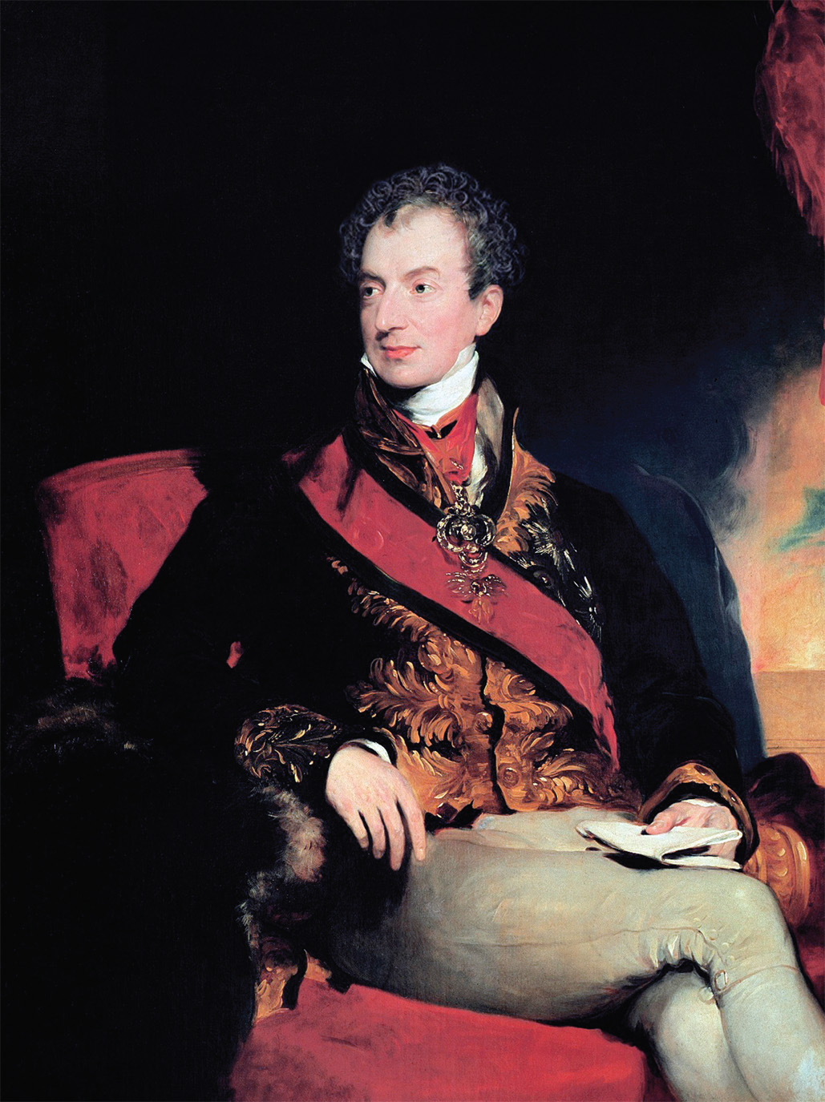
Prince Klemens von Metternich (1773–1859) epitomized nineteenth-century conservatism. Sir Thomas Lawrence (1769–1830), Clemens Lothar Wenzel, Prince Metternich (1773–1859), © World History Archive/Alamy
Notes:
Prince Klemens von Metternich (1773–1859) epitomized nineteenth-century conservatism.
Sir Thomas Lawrence (1769–1830), Clemens Lothar Wenzel, Prince Metternich (1773–1859), © World History Archive/Alamy

Slide 20
Defeat of Prussian Reform
Frederick William III – Prussian leader who created Council of State, which established eight provincial diets
Junkers dominated the diets, keeping the bond between the monarchy and the landholders

Slide 21
Burschenschaften and the Carlsbad Decrees
Burschenschaften – student association of German nationalists
Often Anti-Semitic
One member, Karl Sand, murdered dramatist August von Kotzebue and was summarily executed for the crime
Carlsbad Decrees – ordered by Metternich – dissolved the Burschenschaften

Slide 22
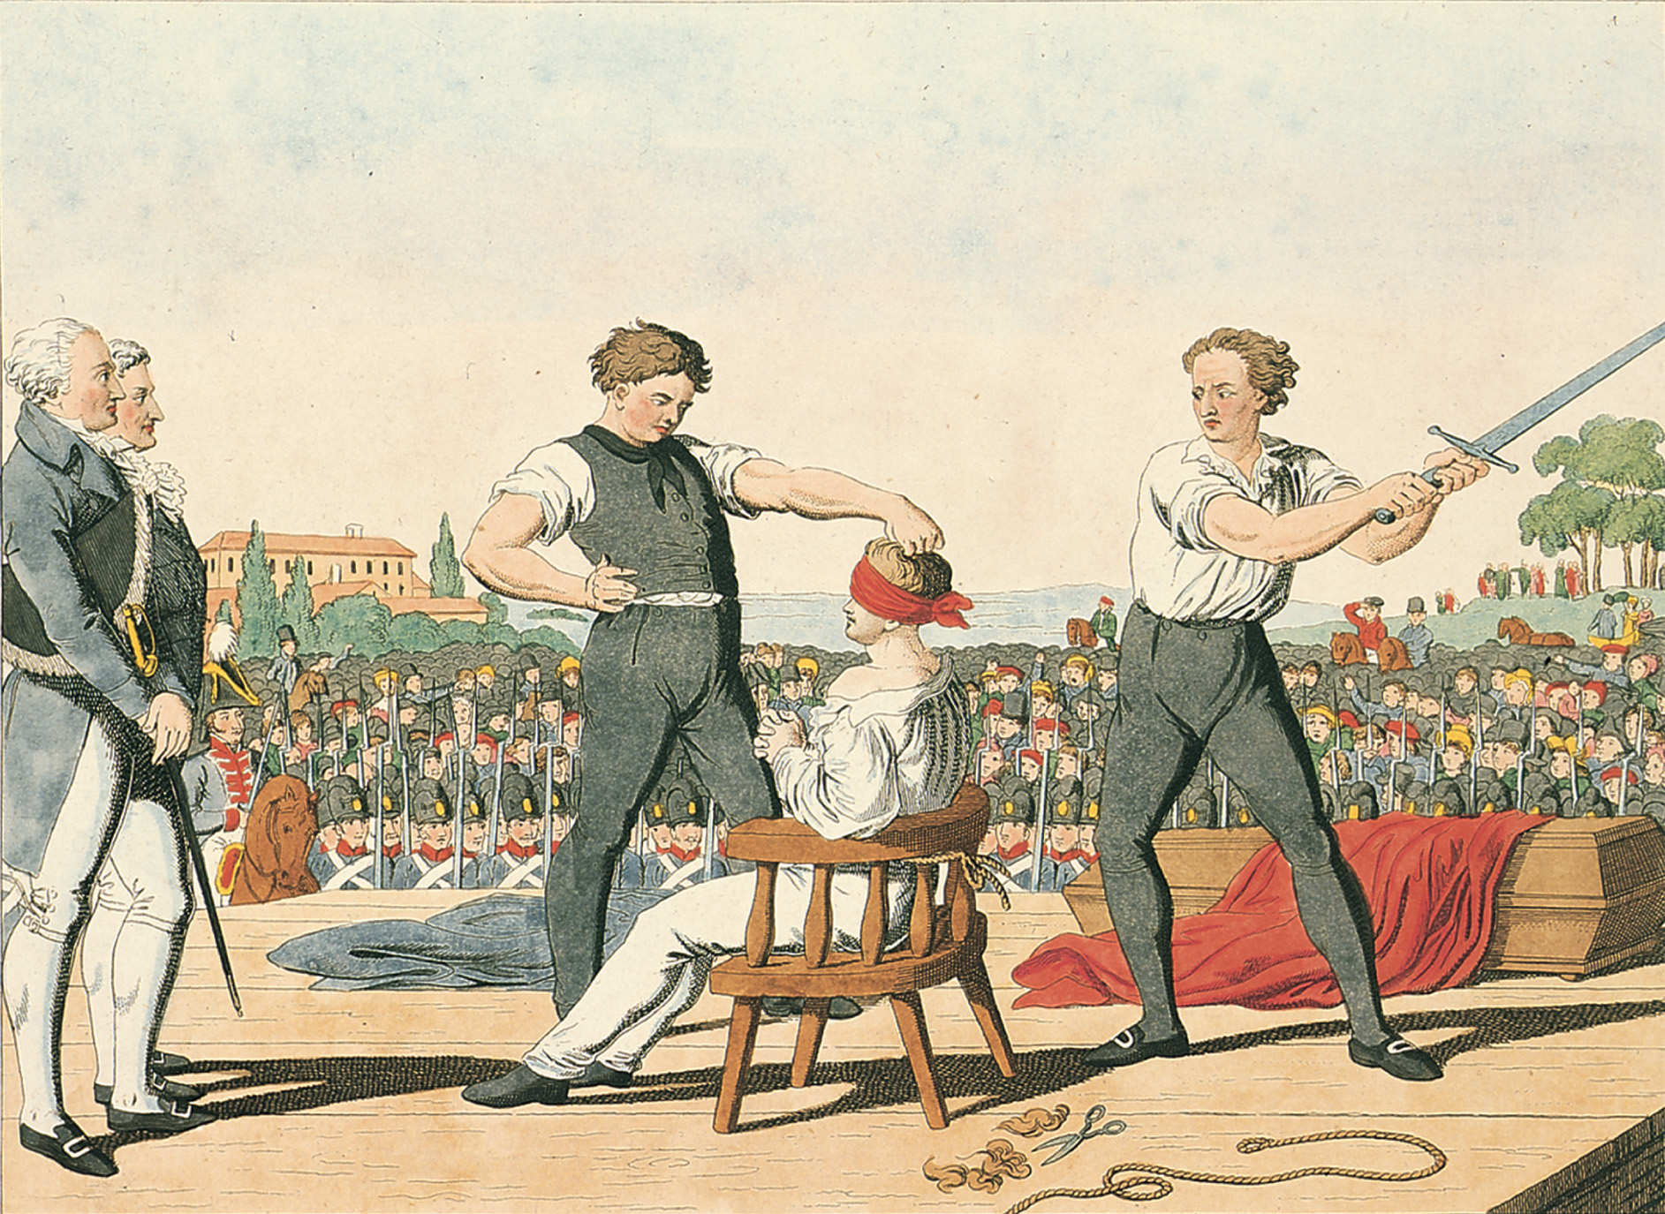
In May 1820, Karl Sand, a German student and a member of a Burschenschaft, was executed for his murder of the conservative playwright August von Kotzebue the previous year. In the eyes of many young German nationalists, Sand was a political martyr. Bildarchiv Preussischer Kulturbesitz/Art Resource, NY
Notes:
In May 1820, Karl Sand, a German student and a member of a Burschenschaft, was executed for his murder of the conservative playwright August von Kotzebue the previous year. In the eyes of many young German nationalists, Sand was a political martyr.
Bildarchiv Preussischer Kulturbesitz/Art Resource, NY

Slide 23
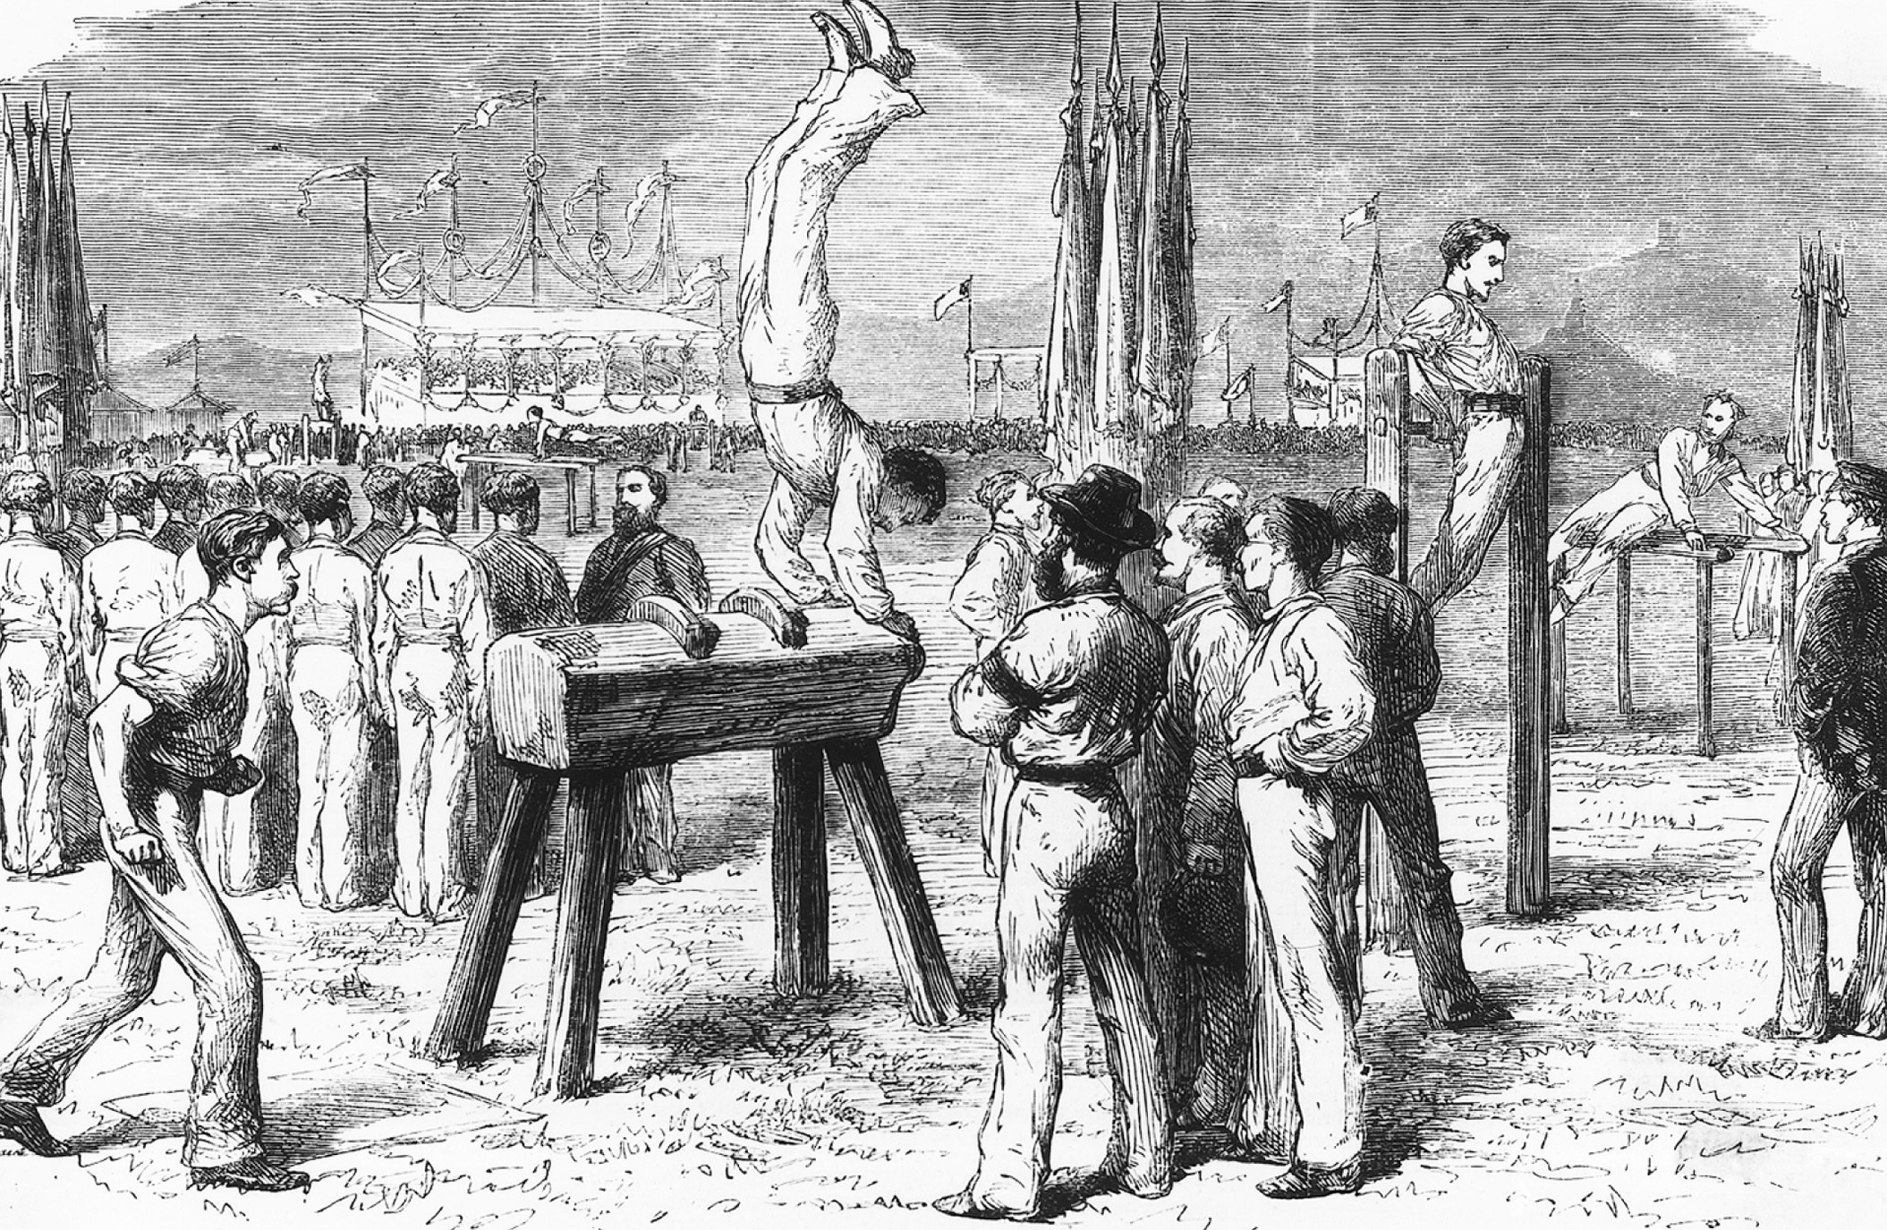
Jahn encouraged German gymnasts to use athletic equipment in their exercises. Here at a Bonn gymnastic festival in 1872 an athlete works out on a pommel horse, a piece of athletic equipment that predated Jahn, but the design of which he improved. Also note the athletic clothing, which emphasizes egalitarian social relations among the athletes. © Bettmann/CORBIS—All rights reserved
Notes:
Jahn encouraged German gymnasts to use athletic equipment in their exercises. Here at a Bonn gymnastic festival in 1872 an athlete works out on a pommel horse, a piece of athletic equipment that predated Jahn, but the design of which he improved. Also note the athletic clothing, which emphasizes egalitarian social relations among the athletes.
© Bettmann/CORBIS—All rights reserved

Slide 24
Postwar Repression in Great Britain
Lord Liverpool – sought to protect the interests of the wealthy
Corn Law – raised prices on corn
Excise and income tax – both wealthy and poor paid

Slide 25
Postwar Repression in Great Britain (cont.)
Discontent from masses
Leaders of the low social orders called for changes
Had unruly mass meeting at Spa Fields near London
Liverpool, in response, passes Coercion Acts of 1817, which suspended habeas corpus and outlawed seditious gathering

Slide 26
Continued Repression in Great Britain
Peterloo Massacre – eleven radical protesters killed by militia at meeting in Manchester, England
Cato Street Conspiracy – plot by radicals to blow up British cabinet failed

Slide 27
Continued Repression in Great Britain (cont.)
Six Acts passed:
Forbade large, unauthorized meetings
Raised fines for seditious libel
Trials speeded up for political agitators
Increased newspaper taxes
Prohibited training of armed groups
Allowed local officials to search homes

Slide 28
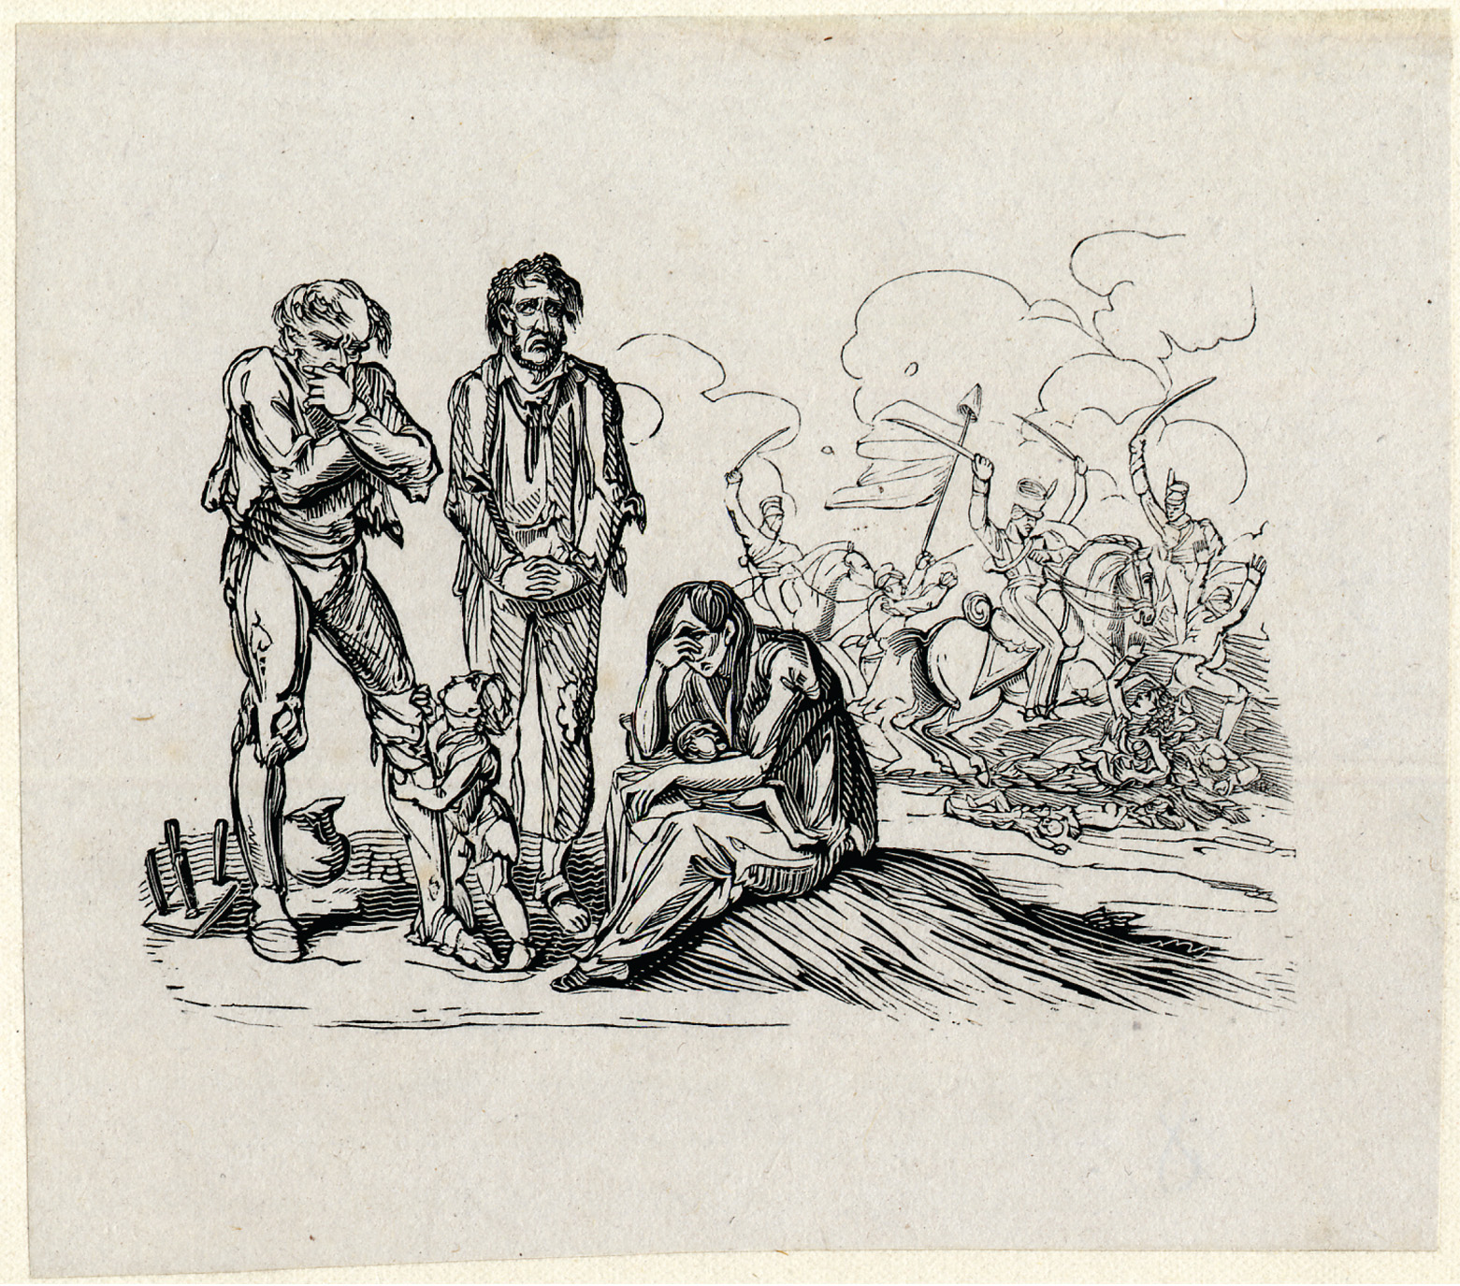
The famous cartoonist George Cruikshank highlights the poverty and desperation of the British working class in the foreground of this 1819 etching, “These are the People All Tatter’d and Torn.” In the background, mounted militia slash at women and children lying on the ground, in allusion to the Peterloo Massacre. © The Trustees of the British Museum
Notes:
The famous cartoonist George Cruikshank highlights the poverty and desperation of the British working class in the foreground of this 1819 etching, “These are the People All Tatter’d and Torn.” In the background, mounted militia slash at women and children lying on the ground, in allusion to the Peterloo Massacre.
© The Trustees of the British Museum

Slide 29
The Bourbon Restoration
Louis XVIII – becomes monarch in 1814 and agrees to be constitutional monarch
The Charter – provided for a hereditary monarchy and a bicameral legislature
Guaranteed most of the Declaration of the Rights of Man and Citizen
Religious toleration – but Roman Catholicism official religion

Slide 30
The Bourbon Restoration (cont.)
Ultraroyalism – as revenge for the Revolution, royalists in the south and west of France practically drive the liberals out of politics and into a near illegal status

Slide 31
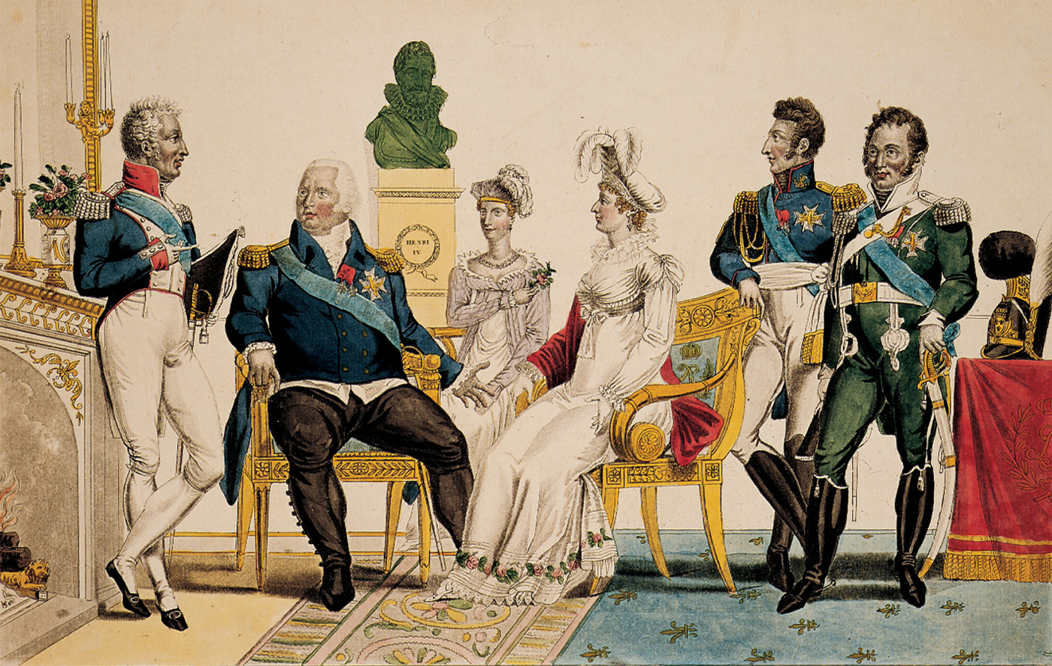
The French Bourbons were restored to the throne in 1815 but would rule only until 1830. This picture shows Louis XVIII, seated, second from left, and his brother, the count of Artois, who would become Charles X, standing on the left. Notice the bust of Henry IV in the background, placed there to associate the restored rulers with their popular late-sixteenth–early-seventeenth-century forebear. Bildarchiv Preussischer Kulturbesitz/Art Resource, NY
Notes:
The French Bourbons were restored to the throne in 1815 but would rule only until 1830. This picture shows Louis XVIII, seated, second from left, and his brother, the count of Artois, who would become Charles X, standing on the left. Notice the bust of Henry IV in the background, placed there to associate the restored rulers with their popular late-sixteenth–early-seventeenth-century forebear.
Bildarchiv Preussischer Kulturbesitz/Art Resource, NY

Slide 32
The Spanish Revolution of 1820
Spain revolts against its Bourbon monarch, Ferdinand VII
France, with permission from Austria, Prussia, and Russia, but not Britain, under the Congress of Verona, moves in to restore order and keep Ferdinand VII in power

Slide 33
The Spanish Revolution of 1820 (cont.)
France gains land
English foreign minister, George Canning, attempts to stop further European colonization in Latin America by abiding by the Monroe Doctrine

Slide 34
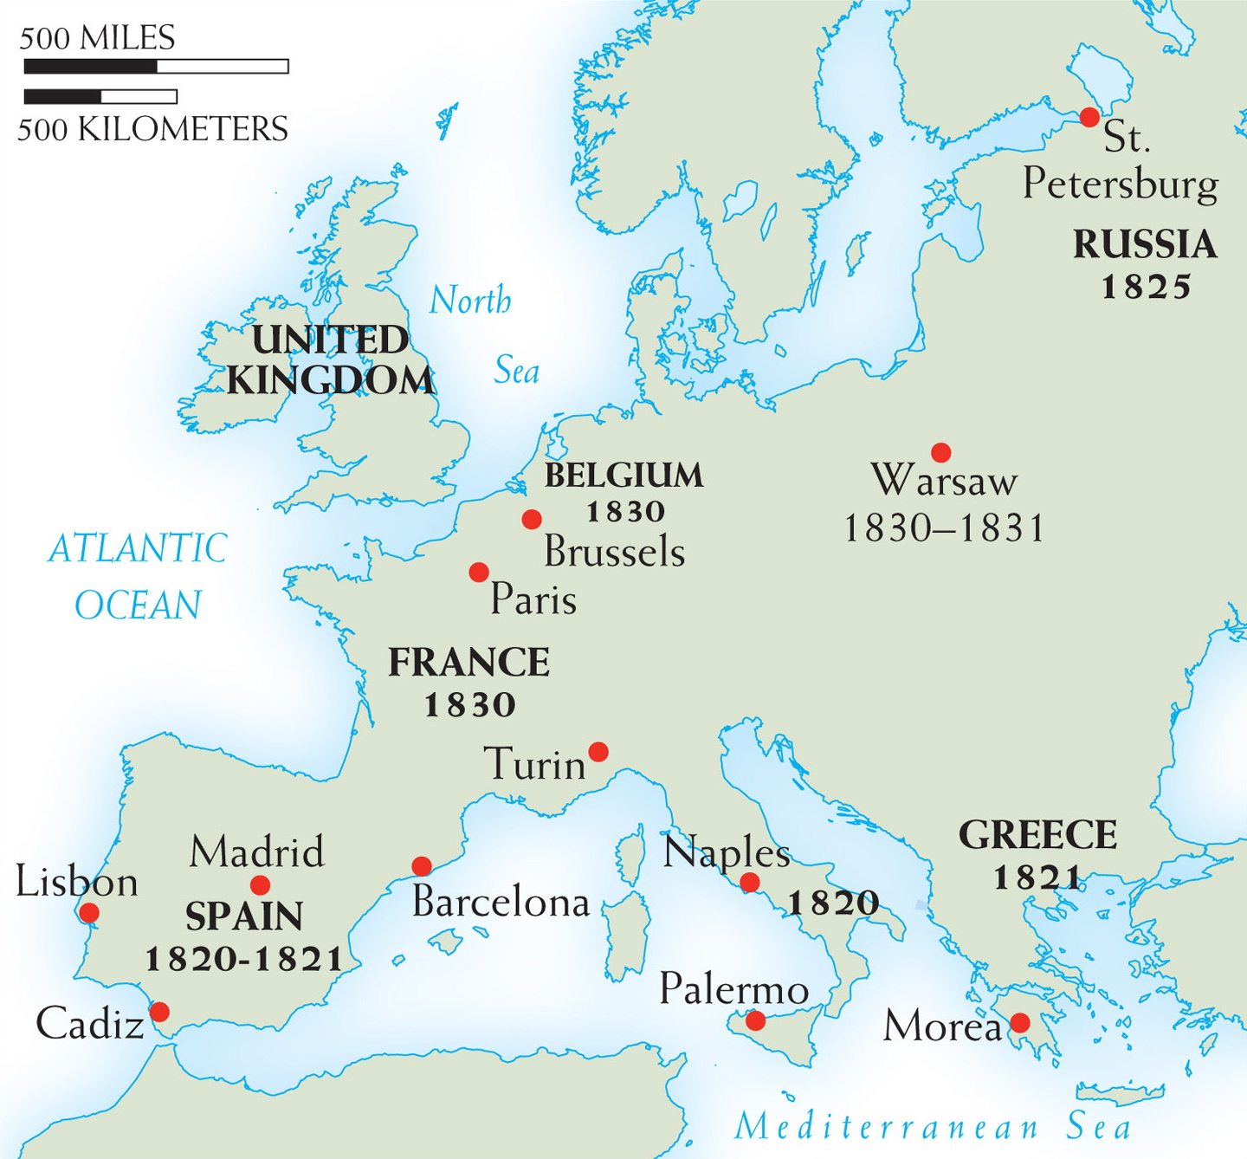
Map 20–1 Centers of Revolution, 1820–1831 The conservative order imposed by the great powers in post-Napoleonic Europe was challenged by various uprisings and revolutions, beginning in 1820–1821 in Spain, Naples, and Greece and spreading to Russia, Poland, France, and Belgium later in the decade.
Notes:
Map 20–1 Centers of Revolution, 1820–1831 The conservative order imposed by the great powers in post-Napoleonic Europe was challenged by various uprisings and revolutions, beginning in 1820–1821 in Spain, Naples, and Greece and spreading to Russia, Poland, France, and Belgium later in the decade.

Slide 35
Revolt Against Ottoman Rule
The Greek Revolution of 1821 – Greece revolts against Ottoman rule in 1821
Britain, France, and Russia conclude that an independent Greece would benefit strategic interests
Otto I is declared first king of the new Greek kingdom

Slide 36
Revolt Against Ottoman Rule (cont.)
Serbian Independence of 1830 – granted by the Ottoman sultan after years of revolts and fighting
Serbia comes under the protection of Russia in 1820s
1856 – officially under the protection of the great powers, but still has special relationship with Russia

Slide 37
Suppression and Revolt in Russia
Unrest in the Army
Southern Society – led by Pestel, called for the end of serfdom, a representative government, and independence for Poland
Northern Society – favored constitutional monarchy and the end of serfdom

Slide 38
Suppression and Revolt in Russia (cont.)
Decembrist Revolt – when Nicholas becomes tsar after Alexander I, some army officers refuse to swear allegiance to him and the revolt is put down violently
Rule of Nicholas I – very little reform, still had serfdom, presence of secret police

Slide 39
Suppression and Revolt in Russia (cont.)
Official Nationality
Russian Orthodox Church provides basis for morality, education, and intellectual life
Unrestrained power of the tsar
Polish Uprising – Poland’s independence movement in 1832 repressed by Nicholas I, who issues Organic Statute declaring Poland an integral part of Russian empire

Slide 40
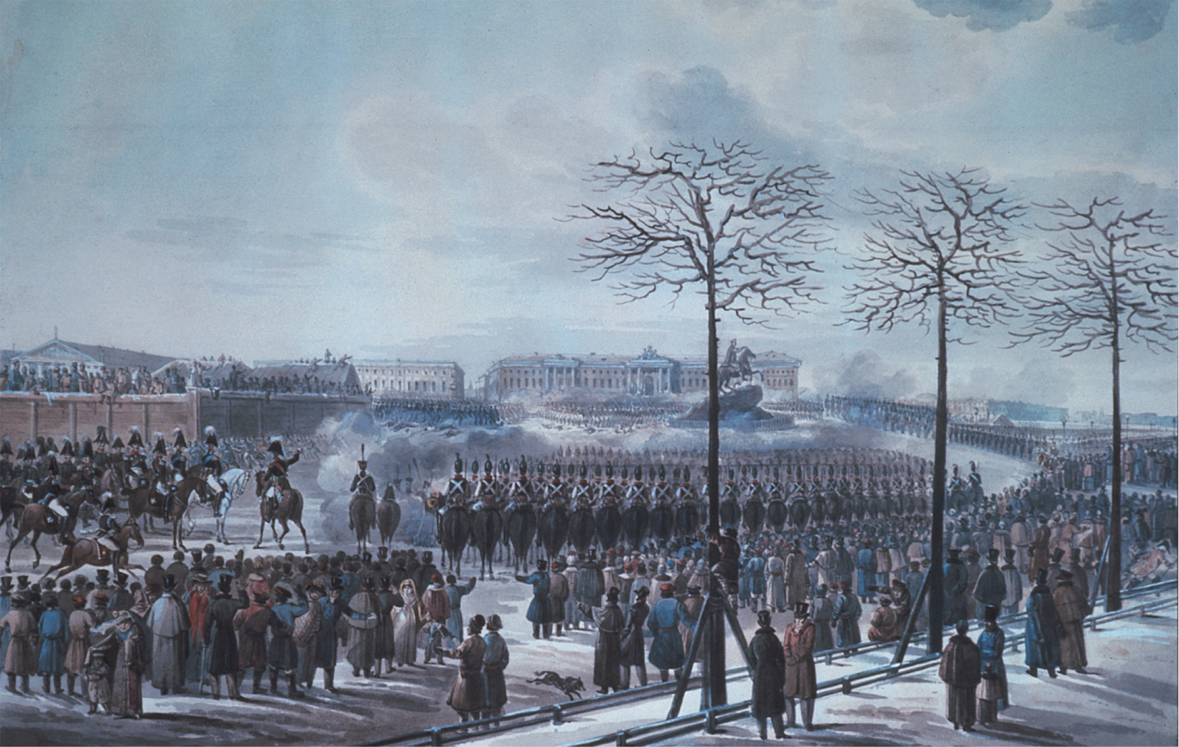
When the Moscow regiment refused to swear allegiance to the new tsar, Nicholas I, instead demanding his brother Constantine be proclaimed tsar and that a constitution be issued, Nicholas ordered the cavalry and artillery to attack them. Although a total failure, the Decembrist Revolt came to symbolize the yearnings of all Russian liberals in the nineteenth century for a constitutional government. Karl Kolman (1786–1846), The Insurrection of the Decembrists at Senate Square, St. Petersburg on 14th December, 1825 (w/c on paper) by Russian School (nineteenth century). Private Collection/Archives Charmet/Bridgeman Art Library
Notes:
When the Moscow regiment refused to swear allegiance to the new tsar, Nicholas I, instead demanding his brother Constantine be proclaimed tsar and that a constitution be issued, Nicholas ordered the cavalry and artillery to attack them. Although a total failure, the Decembrist Revolt came to symbolize the yearnings of all Russian liberals in the nineteenth century for a constitutional government.
Karl Kolman (1786–1846), The Insurrection of the Decembrists at Senate Square, St. Petersburg on 14th December, 1825 (w/c on paper) by Russian School (nineteenth century). Private Collection/Archives Charmet/Bridgeman Art Library

Slide 41
Revolution in France (1830)
Charles X
Paid sums of money to aristocrats who lost land in Revolution
Restored rule of primogeniture
Sacrilege punishable by death
Installed ultraroyalist cabinet in 1829 in response to liberals

Slide 42
Revolution in France (1830) (cont.)
In response to military victories in North Africa, Charles X issues The Four Ordinances:
Restricted freedom of the press
Dissolved liberal Chamber of Deputies
Limited franchise to wealthiest members
Called for new elections

Slide 43
Revolution in France (1830) (cont.)
Revolution of 1830 – Charles X abdicates throne, ending Bourbon Dynasty and putting more liberal government in charge

Slide 44
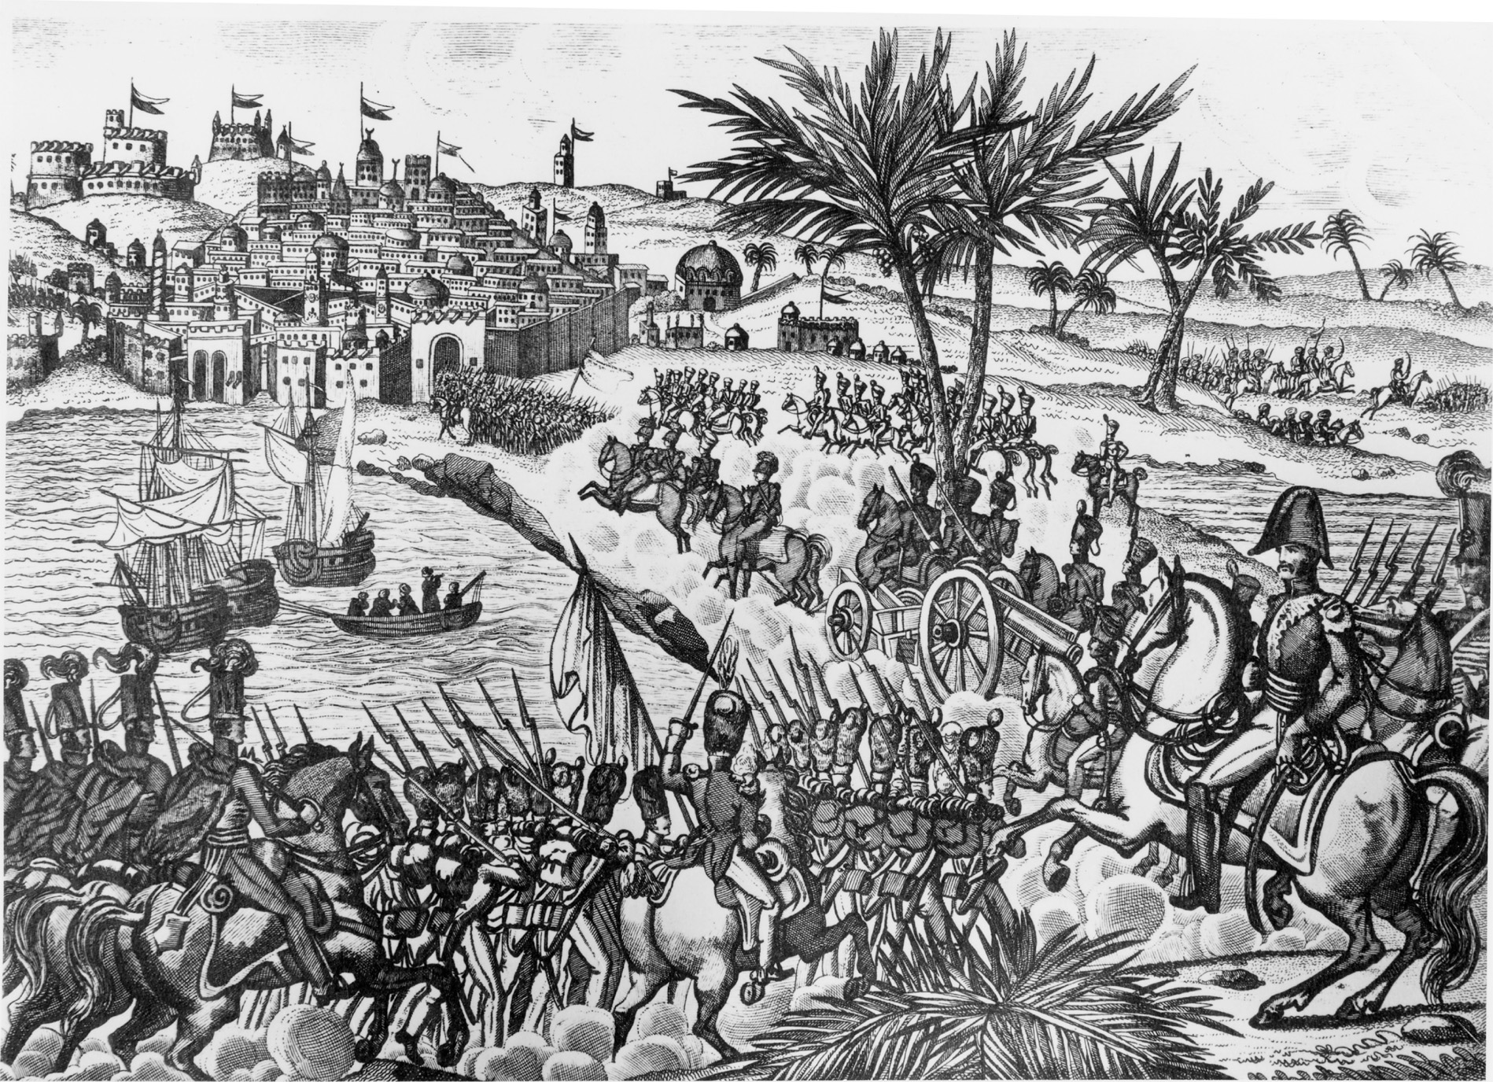
On July 5, 1830, French forces captured Algiers, which France would continue to rule until 1962. Note how this drawing contrasts the power and modernity of the French conquerors with the almost medieval appearance of the Algerian defenses. Snark/Art Resource, NY
Notes:
On July 5, 1830, French forces captured Algiers, which France would continue to rule until 1962. Note how this drawing contrasts the power and modernity of the French conquerors with the almost medieval appearance of the Algerian defenses.
Snark/Art Resource, NY

Slide 45
Louis Philippe
The monarchy under Louis Philippe was politically liberal
Freedom of religion
Freedom of press
But socially conservative
Little regard for lower classes
Revolts of working class put down violently
Expanded territories in North Africa

Slide 46
Independence for Belgium
Belgium becomes independent from Holland in 1830
British make sure Belgium’s independence is accepted as long as the new nation remains neutral in European affairs

Slide 47
Reform in Britain
Lord Liverpool, although conservative, allows some reform such as greater economic freedom and permission for there to be labor organizations
Whig ministry reforms House of Commons, replacing boroughs with fewer voters with representatives from other districts and raising number of voters by 50%
Originally rejected by House of Lords
After riots, William IV created third reform bill in 1832

Slide 48
Reform in Britain (cont.)
Catholic Emancipation Act – allowed for Catholics to be in Parliament; passed to keep order in Ireland
Great Reform Bill – expanded size of England’s electorate, but did not eliminate property qualifications for voting or grant suffrage for women

Slide 49
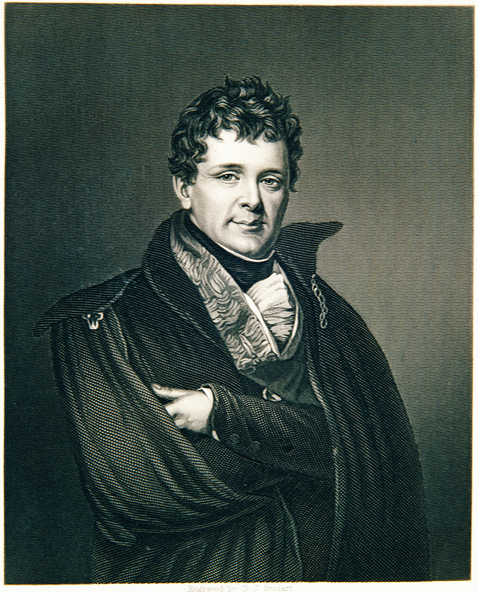
Beginning in the 1820s Daniel O’Connell revolutionized the organization of Irish politics. He created a grassroots organization and collected funds to finance Irish nationalist activities. He was also known as one of the great public speakers of his generation. © Chris Hellier/CORBIS—All rights reserved
Notes:
Beginning in the 1820s Daniel O’Connell revolutionized the organization of Irish politics. He created a grassroots organization and collected funds to finance Irish nationalist activities. He was also known as one of the great public speakers of his generation.
© Chris Hellier/CORBIS—All rights reserved

Slide 50
Wars of Independence in South America
France loses Haiti, Portugal loses Brazil, and Spain withdraws from all except Cuba and Puerto Rico
Creole revolutionaries were inspired by Haitian revolutionaries

Slide 51
Creole Discontent
Creoles – persons of Spanish descent born in the South American colonies
Creoles resented the peninsulares, white people who were born in Spain, who seemed to get all the political advantages
When Latin American countries won their independence, creoles received equal rights

Slide 52
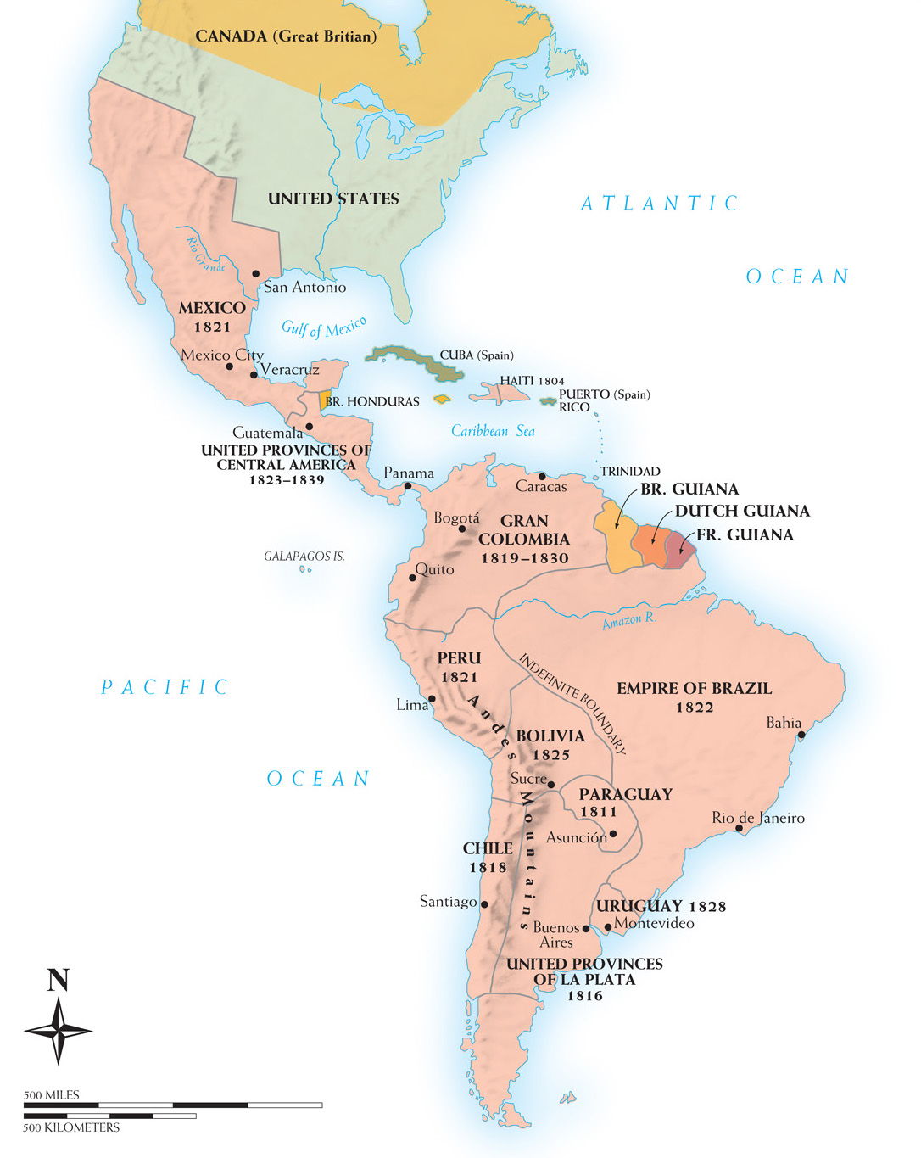
Map 20–2 LATIN AMERICA IN 1830 By 1830 most of Latin America had been liberated from Europe. This map shows the initial borders of the states of the region with the dates of their independence. The United Provinces of La Plata formed the nucleus of what later became Argentina.
Notes:
Map 20–2 LATIN AMERICA IN 1830 By 1830 most of Latin America had been liberated from Europe. This map shows the initial borders of the states of the region with the dates of their independence. The United Provinces of La Plata formed the nucleus of what later became Argentina.

Slide 53
Two South American Independence Leaders
Jose de San Martín – led independence movements in Chile and Peru, later becoming Protector of Peru
Simón Bolívar – independence leader of Venezuela; later leads fight at Battle of Ayacucho, which ends Spain’s control in Latin America

Slide 54
New Spain
Area from what is now the Southwest United States to Mexico
Battle of philosophies between conservative Spanish and Creole groups and the liberal monarchy of Spain
Augustin de Iturbide declares Mexico independent from Spain in 1821 and is declared emperor

Slide 55
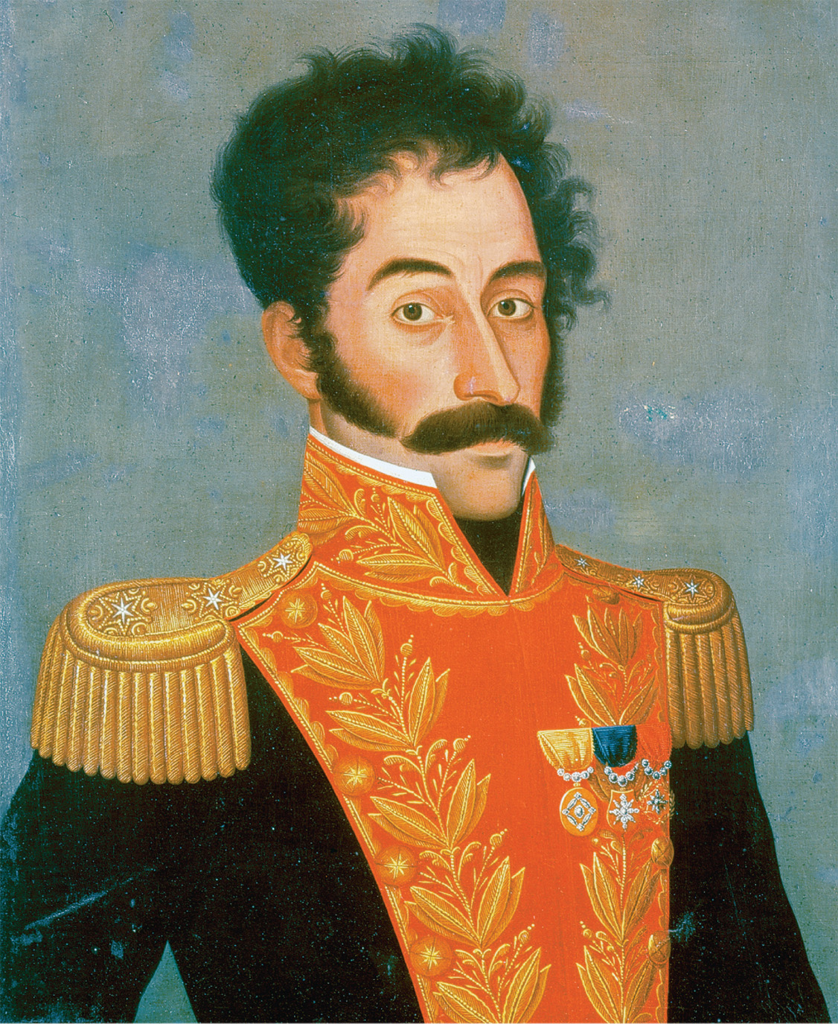
Simón Bolívar. Bolívar was the liberator of much of Latin America. He inclined toward a policy of political liberalism. Pictorial Press Ltd/Alamy
Notes:
Simón Bolívar. Bolívar was the liberator of much of Latin America. He inclined toward a policy of political liberalism.
Pictorial Press Ltd/Alamy

Slide 56
Brazilian Independence
Dom Pedro becomes emperor of an independent Brazil in 1822
Peaceful revolution makes Brazil independent from Portugal
Political and social elites in Brazil wanted to avoid destructive wars
Slavery preserved

