Slide 1
Chapter 24
The Birth of Modern European Thought

Slide 2
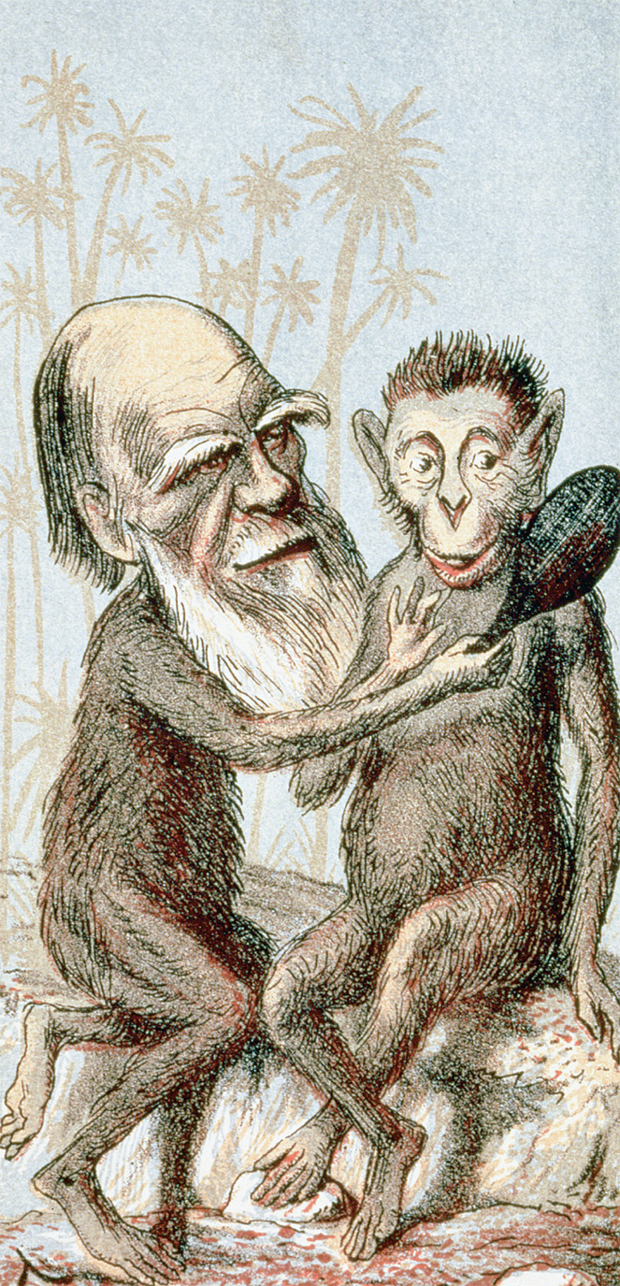
Darwin’s theories about the evolution of humankind from the higher primates aroused enormous controversy. This caricature shows him with a monkey’s body holding a mirror to an apelike creature. National History Museum, London, UK/Bridgeman Art Library
Notes:
Darwin’s theories about the evolution of humankind from the higher primates aroused enormous controversy. This caricature shows him with a monkey’s body holding a mirror to an apelike creature.
National History Museum, London, UK/Bridgeman Art Library

Slide 3
Advances in Reading and Primary Education
85% literacy rates in Britain, France, Belgium, Netherlands, Germany, and Scandinavia; far lower rates in Italy, Spain, Russia, Austria-Hungary, and the Balkans
Liberals and conservatives call for more primary education and literacy

Slide 4
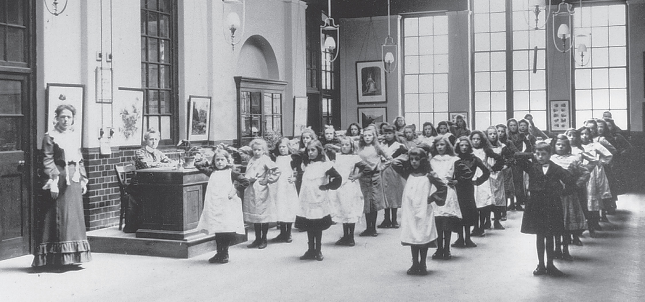
Public education became widespread in Europe during the second half of the nineteenth century and women came to dominate the profession of school teaching, especially at the elementary level. This 1905 photograph shows English schoolchildren going through morning drills. © Hulton-Deutsch Collection/CORBIS
Notes:
Public education became widespread in Europe during the second half of the nineteenth century and women came to dominate the profession of school teaching, especially at the elementary level. This 1905 photograph shows English schoolchildren going through morning drills.
© Hulton-Deutsch Collection/CORBIS

Slide 5
Reading Material
Number of newspapers, books, magazines, mail-order catalogs, and libraries grow rapidly
Sometimes the publications were mediocre, catering to sensationalism, scandal, and pornography
Still, new reading materials led to a popularization of knowledge

Slide 6
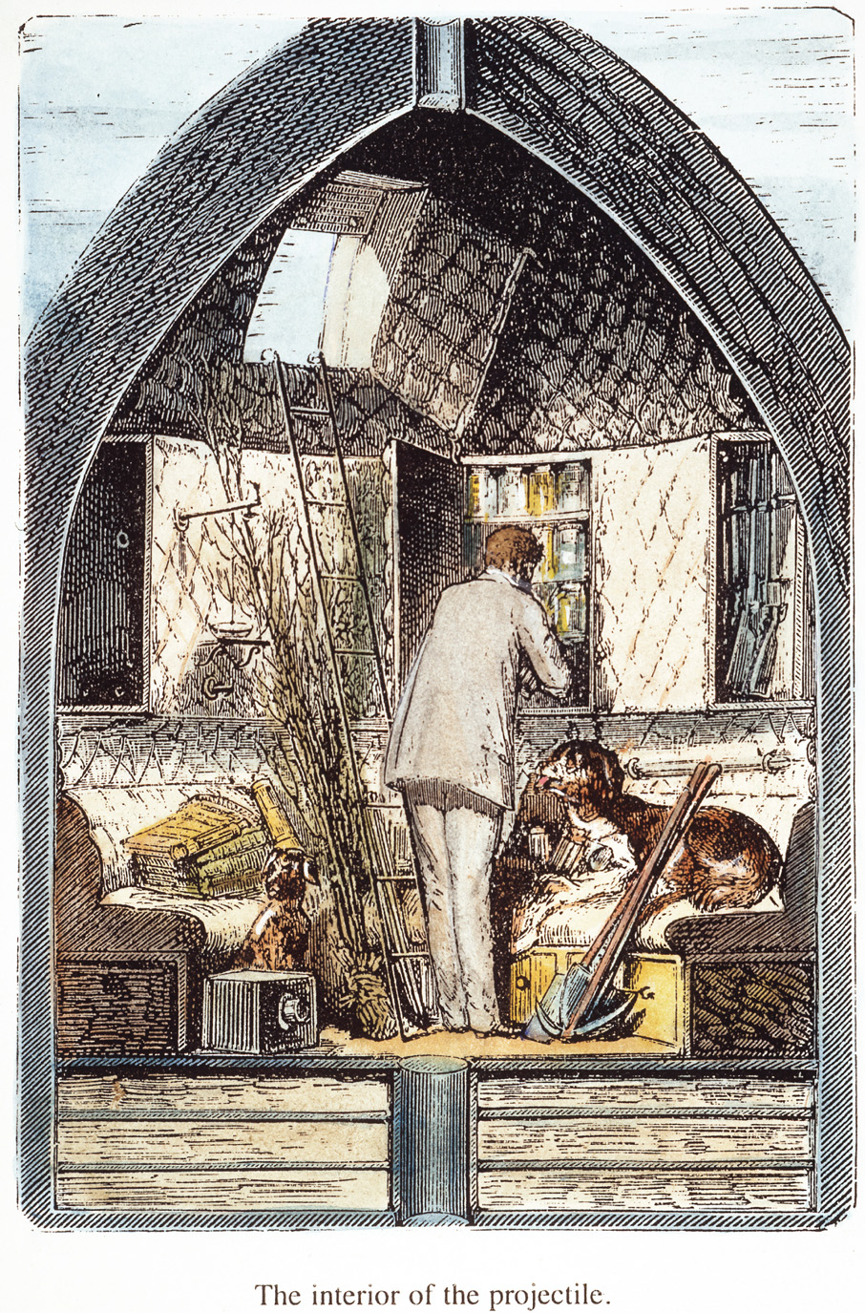
The interior of the projectile launched to the moon is shown in this illustration from an early edition of From the Earth to the Moon. The Granger Collection, NYC—All rights reserved
Notes:
The interior of the projectile launched to the moon is shown in this illustration from an early edition of From the Earth to the Moon.
The Granger Collection, NYC—All rights reserved

Slide 7
Auguste Comte
Developed positivism - a philosophy of human intellectual development based on science
Considered “father” of modern sociology

Slide 8
Auguste Comte (cont.)
Wrote The Positive Philosophy in which he argued human thought has three stages:
(1) Theological – physical nature explained by divinity
(2) Metaphysical – abstract principles explained by operative agencies of nature
(3) Positive – explanations of nature become matters of exact description of phenomena

Slide 9
Evolution
Jean-Baptiste Lamarck – first modern European thinker to develop a comprehensive theory of evolutionary change
Charles Lyell, who developed the theory of “uniformitarianism,” was another major contributor to new theories of evolution in the nineteenth century

Slide 10
Evolution (cont.)
In On the Origin of Species, Charles Darwin formulates principle of natural selection, which explained how species evolved over time
Together with Alfred Russel Wallace, Darwin comes up with natural selection – principle of survival of the fittest
Theory undermines deistic argument for the existence of God
In Descent of Man, Darwin applies principle of evolution to human beings

Slide 11
Science and Ethics
Herbert Spencer – British philosopher who believed in Social Darwinism, whereby society progresses through competition, where the strong defeat the weak
Thomas Henry Huxley – strongly supported Darwin, but opposed Spenser; declared the physical process of evolution was at odds with human ethical development

Slide 12
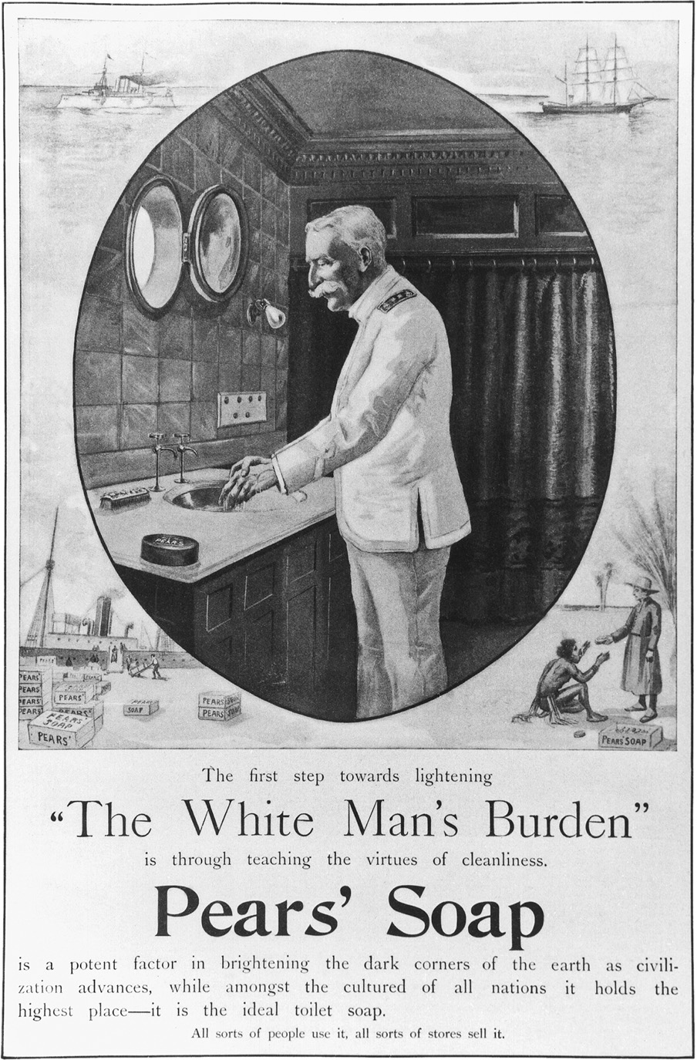
Racism was often a by-product of Social Darwinist theory. At the turn of the twentieth century, racism permeated many facets of popular life. This ad for Pears’ Soap caters to the racist attitudes held by many whites during this time. Library of Congress/Colliers, October 4, 1899
Notes:
Racism was often a by-product of Social Darwinist theory. At the turn of the twentieth century, racism permeated many facets of popular life. This ad for Pears’ Soap caters to the racist attitudes held by many whites during this time.
Library of Congress/Colliers, October 4, 1899

Slide 13
Christianity Under Siege / Intellectual Skepticism
History – writers question the historical accuracy of the Bible, citing no genuine historical evidence
Science – Darwin and other scientists doubt the story of Creation, citing that the Earth is much older than the Bible
Morality
Liberal intellectuals question the cruelty and sacrifices mentioned in the Bible
Friedrich Nietzsche – felt Christianity glorified weakness, rather than strength
Movement towards secularism

Slide 14
Conflict Between Church and State
Great Britain – churches opposed improvements in government schools because it raised the costs of church schools; Education Act of 1902 – provided state support for religious and non-religious schools
France – public schools expanded, religious teachings replaced by civic training, and Napoleonic Concordat ended separation of church and state

Slide 15
Conflict Between Church and State (cont.)
Germany
Education secularized in 1870-1871 under Bismarck
“May Laws” of 1873 – require priests to be educated in German schools and pass state examinations
Bismarck’s Kulturkampf (“cultural struggle”) provokes Catholic resentment against the German state

Slide 16
Religious Revival
Church revivals occur in Britain, Ireland, and France
Cult of the miracle at Lourdes grows

Slide 17
Late 19th Century and the Roman Catholic Church
Pope Pius IX after Italian unification turns from liberal to conservative, issuing Syllabus of Errors – sets Catholic Church against science, philosophy, and politics
Papal infallibility – pope is incapable of error on the issues of faith and morals
Pope Leo XIII – Pius’ successor, moderate who defended religious education and religious control of marriage but also wanted a corporate society based on moral religious principles rather than socialist or capitalist ideals
Pius X – rejected modernism and required all priests to take an anti-Modernist oath

Slide 18
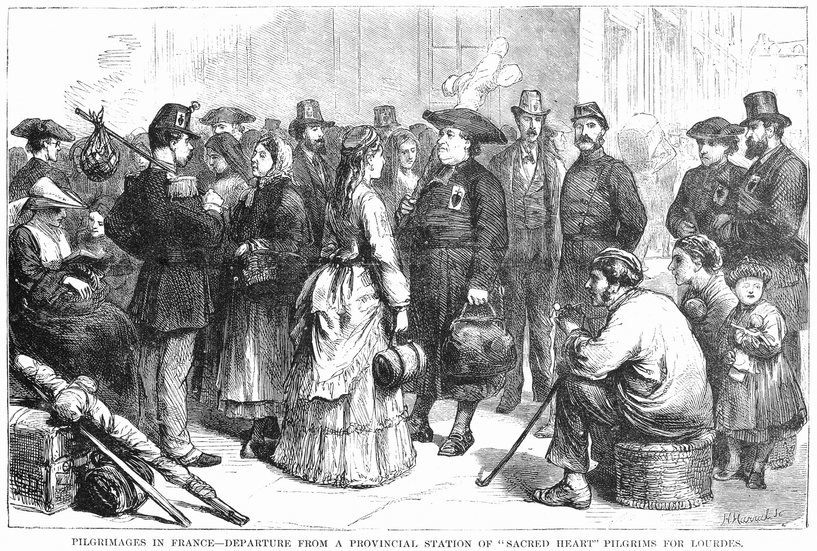
This 1873 wood engraving shows pilgrims who have arrived in a train station near Lourdes, and are preparing to proceed to their destination on foot. The Granger Collection, NYC—All rights reserved
Notes:
This 1873 wood engraving shows pilgrims who have arrived in a train station near Lourdes, and are preparing to proceed to their destination on foot. The Granger Collection, NYC—All rights reserved

Slide 19
Late 19th Century and Islam
Anti-Islamic thought
Islam considered to be a religion incapable of developing scientific ideas
Europeans championed the superiority of the white race and Christianity
Eventually some Christian missionaries become more sympathetic to Muslims
The Salafi movement, along with some Islamic leaders, want to modernize Islam but reject Western principles; its effects are still felt today

Slide 20
Science Toward the 20th Century – the Physics Revolution
Few scientists believed they could portray the “truth” about physical reality, instead offering hypotheses or symbolic models of nature
X-rays and radiation – major steps in the study of the atom and radioactive materials

Slide 21
Science Toward the 20th Century – the Physics Revolution (cont.)
Max Planck – quantum theory of energy – energy is a series of discrete quantities rather than a continuous stream
Albert Einstein – theory of relativity – time and space do not exist separately, but rather as a combined continuum

Slide 22
Science Toward the 20th Century – the Physics Revolution (cont.)
Werner Heisenberg – uncertainty principle – behavior of subatomic particles is a matter of statistical probability rather than exactly determinable cause and effect

Slide 23
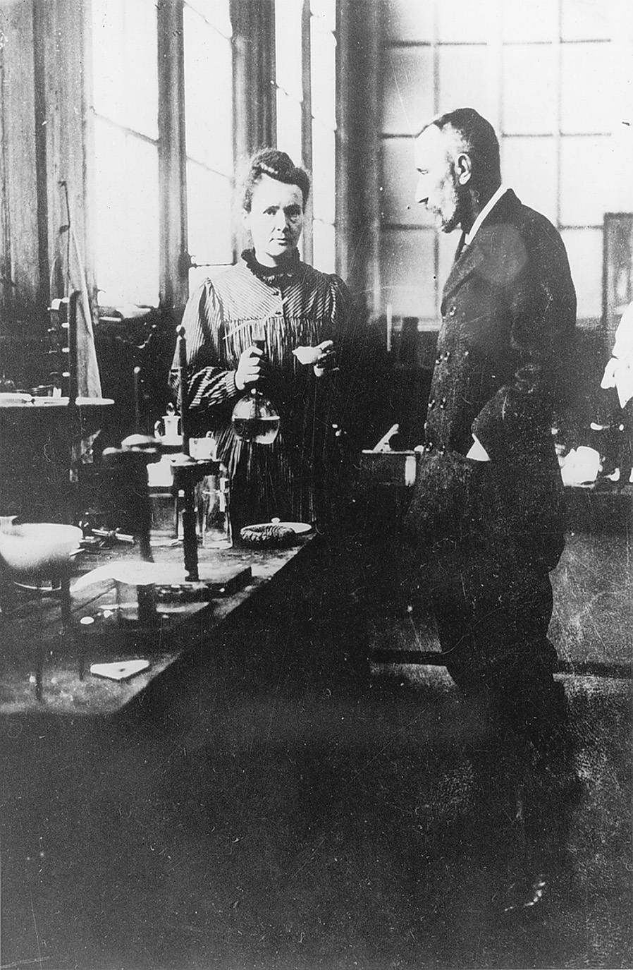
Marie Skłodowska Curie (1869–1934) and Pierre Curie (1859– 1906) were two of the most important figures in the advance of physics and chemistry. Skłodowska Curie was born in Warsaw (Russian Poland) but worked in France for most of her life. She is credited with the discovery of radium, for which she was awarded the Nobel Prize in Chemistry in 1911. The Granger Collection, New York
Notes:
Marie Skłodowska Curie (1869–1934) and Pierre Curie (1859– 1906) were two of the most important figures in the advance of physics and chemistry. Skłodowska Curie was born in Warsaw (Russian Poland) but worked in France for most of her life. She is credited with the discovery of radium, for which she was awarded the Nobel Prize in Chemistry in 1911.
The Granger Collection, New York

Slide 24
Realist and Naturalist Literature of Early 20th Century
Realist and naturalist writers brought scientific objectivity and observation to their work, portraying the hypocrisy and brutality of the bourgeois life
Famous early realist writers included Charles Dickens, Honore de Balzac, and George Eliot

Slide 25
Realist and Naturalist Literature of Early 20th Century (cont.)
Gustave Flaubert and Emile Zola
Flaubert in Madame Bovary (1857) describes colorless and hapless search for love by a woman
Zola wrote of alcoholism, prostitution, adultery, and labor strife

Slide 26
Realist and Naturalist Literature of Early 20th Century (cont.)
Henrik Ibsen and George Bernard Shaw
Ibsen in his works strips away the illusory mask of middle-class morality
Shaw defended Ibsen and wrote against romanticism and false respectability

Slide 27
Modernism in Literature of Early 20th Century
Modernism – critical of middle class society, but more concerned with beauty than social issues
Keynesian economics – John Maynard Keynes claimed governments spent their way out of depressions by running deficits to encourage employment and the production of goods

Slide 28
Modernism in Literature of Early 20th Century (cont.)
Famous modernist writers:
Virginia Woolf – portrayed individuals seeking to make their way in a world with most 19th century social and moral certainties removed
Thomas Mann – explored social experience of middle-class Germans
James Joyce – wrote famous novel, Ulysses (1922)

Slide 29
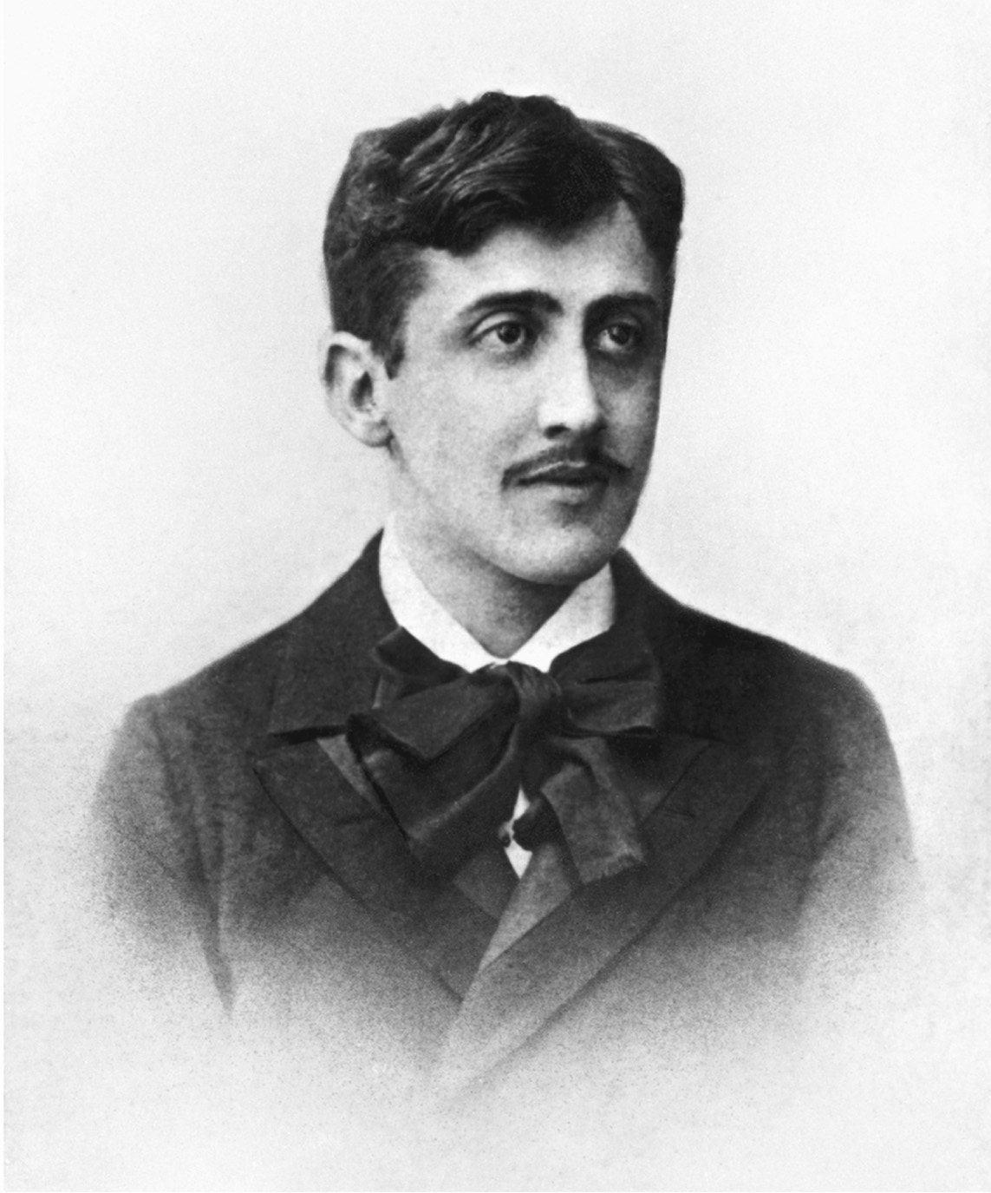
Marcel Proust’s multivolume In Search of Time Past (A la Recherche du Temps Perdu), which was published between 1913 and 1927, was one of the most significant modernist novels. © Bettmann/CORBIS
Notes:
Marcel Proust’s multivolume In Search of Time Past (A la Recherche du Temps Perdu), which was published between 1913 and 1927, was one of the most significant modernist novels.
© Bettmann/CORBIS

Slide 30
Modern Art
Impressionism
Concentrated on modern life, using light, color, and the momentary, largely unfocused visual experience of the social landscape
Famous impressionists included Edward Manet, Claude Monet, Pierre-Auguste Renoir, and Edgar Degas

Slide 31
Modern Art (cont.)
Post-Impressionism
Form and structure, rather than the impression of the movement, marked these works
Famous post-impressionists included Georges Seurat, Paul Cezanne, Vincent Van Gogh, and Paul Gauguin

Slide 32
Modern Art (cont.)
Cubism
Instead of painting as a window to the real world, painting was an autonomous realm of art itself with no purpose beyond itself
Famous cubists were Georges Braque and Pablo Picasso

Slide 33
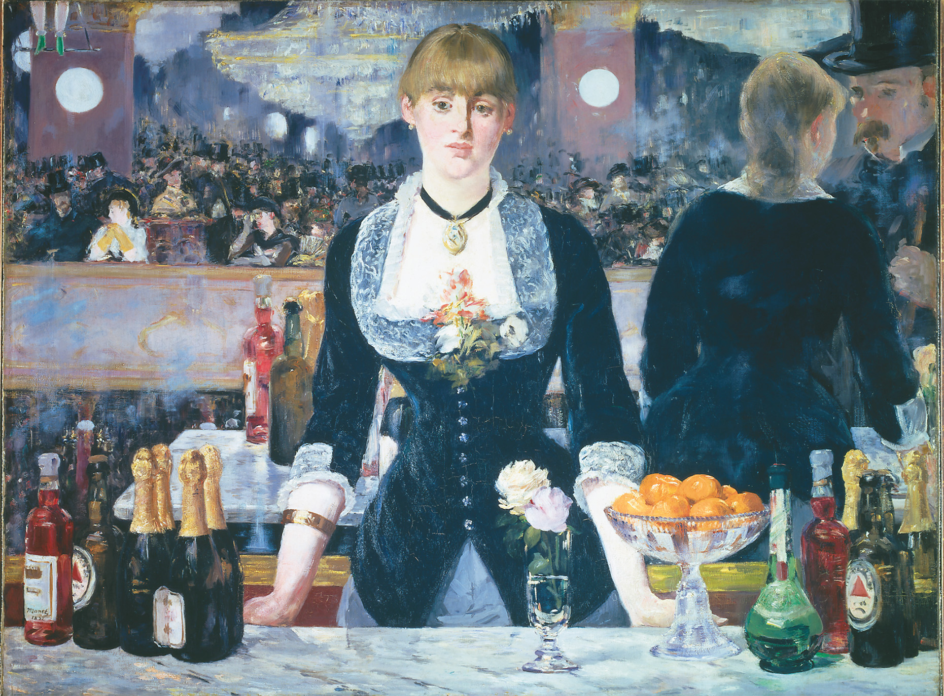
Édouard Manet (1832–1883), A Bar at the Folies-Bergère, 1882. Oil on canvas, 96 × 130 cm./Peter Barritt/SuperStock/Alamy
Notes:
Édouard Manet (1832–1883), A Bar at the Folies-Bergère, 1882. Oil on canvas, 96 × 130 cm./Peter Barritt/SuperStock/Alamy

Slide 34
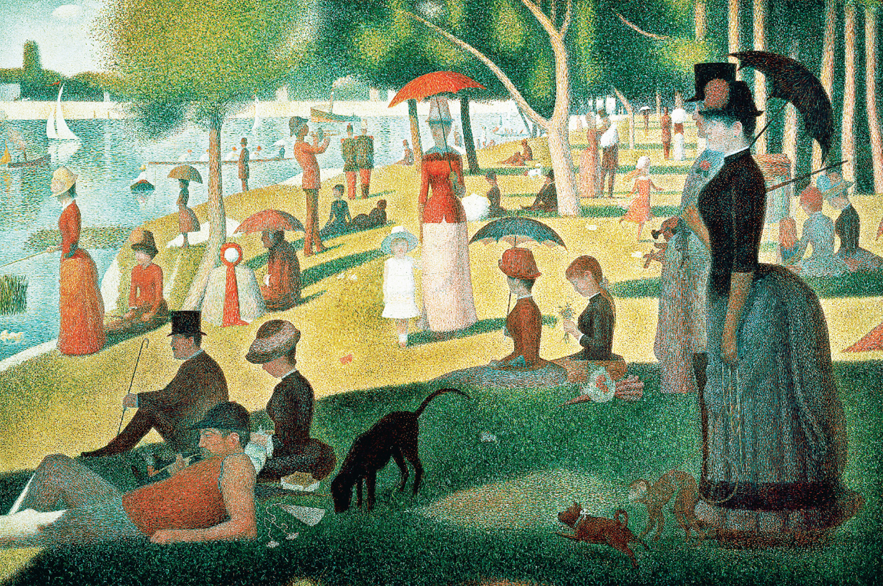
Georges Seurat, A Sunday Afternoon on the Island of La Grande Jatte, 1884–1886. Oil on canvas. 81 3/4 × 121 1/4 in. (2.07 × 3.08 m). Helen Birch Bartlett Memorial Collection. 1926.224. Reproduction, The Art Institute of Chicago. Photograph ©, The Art Institute of Chicago—All rights reserved
Notes:
Georges Seurat, A Sunday Afternoon on the Island of La Grande Jatte, 1884–1886.
Oil on canvas. 81 3/4 × 121 1/4 in. (2.07 × 3.08 m). Helen Birch Bartlett Memorial Collection. 1926.224. Reproduction, The Art Institute of Chicago. Photograph ©, The Art Institute of Chicago—All rights reserved

Slide 35
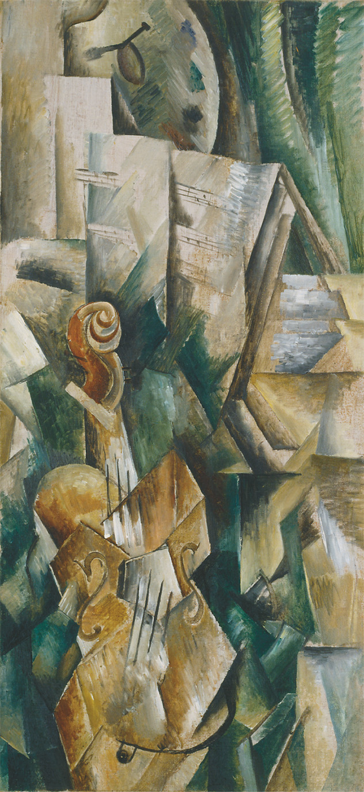
Georges Braque, Violin and Palette 1909–1910. Autumn 1909. Oil on canvas. 91.7 × 42.8 cm (36 1/8 × 16 7/8 inches). Solomon R. Guggenheim Museum, New York, 54.1412. Photograph by Lee B. Ewing © The Solomon R. Guggenheim Foundation, New York. © 2004 Artists Rights Society (ARS), New York/ADAGP, Paris
Notes:
Georges Braque, Violin and Palette 1909–1910. Autumn 1909.
Oil on canvas. 91.7 × 42.8 cm (36 1/8 × 16 7/8 inches). Solomon R. Guggenheim Museum, New York, 54.1412. Photograph by Lee B. Ewing © The Solomon R. Guggenheim Foundation, New York. © 2004 Artists Rights Society (ARS), New York/ADAGP, Paris

Slide 36
Friedrich Nietzsche
Questioned rational thinking, Christianity, democracy, nationalism, science, and progress
In The Birth of Tragedy (1872), he argued the non-rational aspects of human nature are as noble as rational characteristics

Slide 37
Friedrich Nietzsche (cont.)
Declared the death of God
Critical of racism and anti-Semitism
Sought the heroism he saw in the Greek Homeric age
Appealed to feelings and emotions in questioning rationalism

Slide 38
Psychoanalysis – Freud and Jung
Sigmund Freud’s early theories
Early studies were on psychic disorders
Theorized that human beings are sexual from birth through adulthood
Sexuality is one of the bases of mental order and disorder
Freud and dreams – argued that unconscious drives and desires contribute to conscious behavior

Slide 39
Psychoanalysis – Freud and Jung (cont.)
Freud’s later thought – internal mind is based on the struggle of three entities
Id – amoral, irrational, driving instincts of sexual gratification
Superego – the external moral imperatives and expectations imposed on the personality by society and culture
Ego – mediates the impulses of the id with the morals of the superego

Slide 40
Psychoanalysis – Freud and Jung (cont.)
Carl Jung – Freud’s student who departs from his teacher’s theories and believes collective memories along with personal experience constitute a human being’s soul; saw value in religion

Slide 41
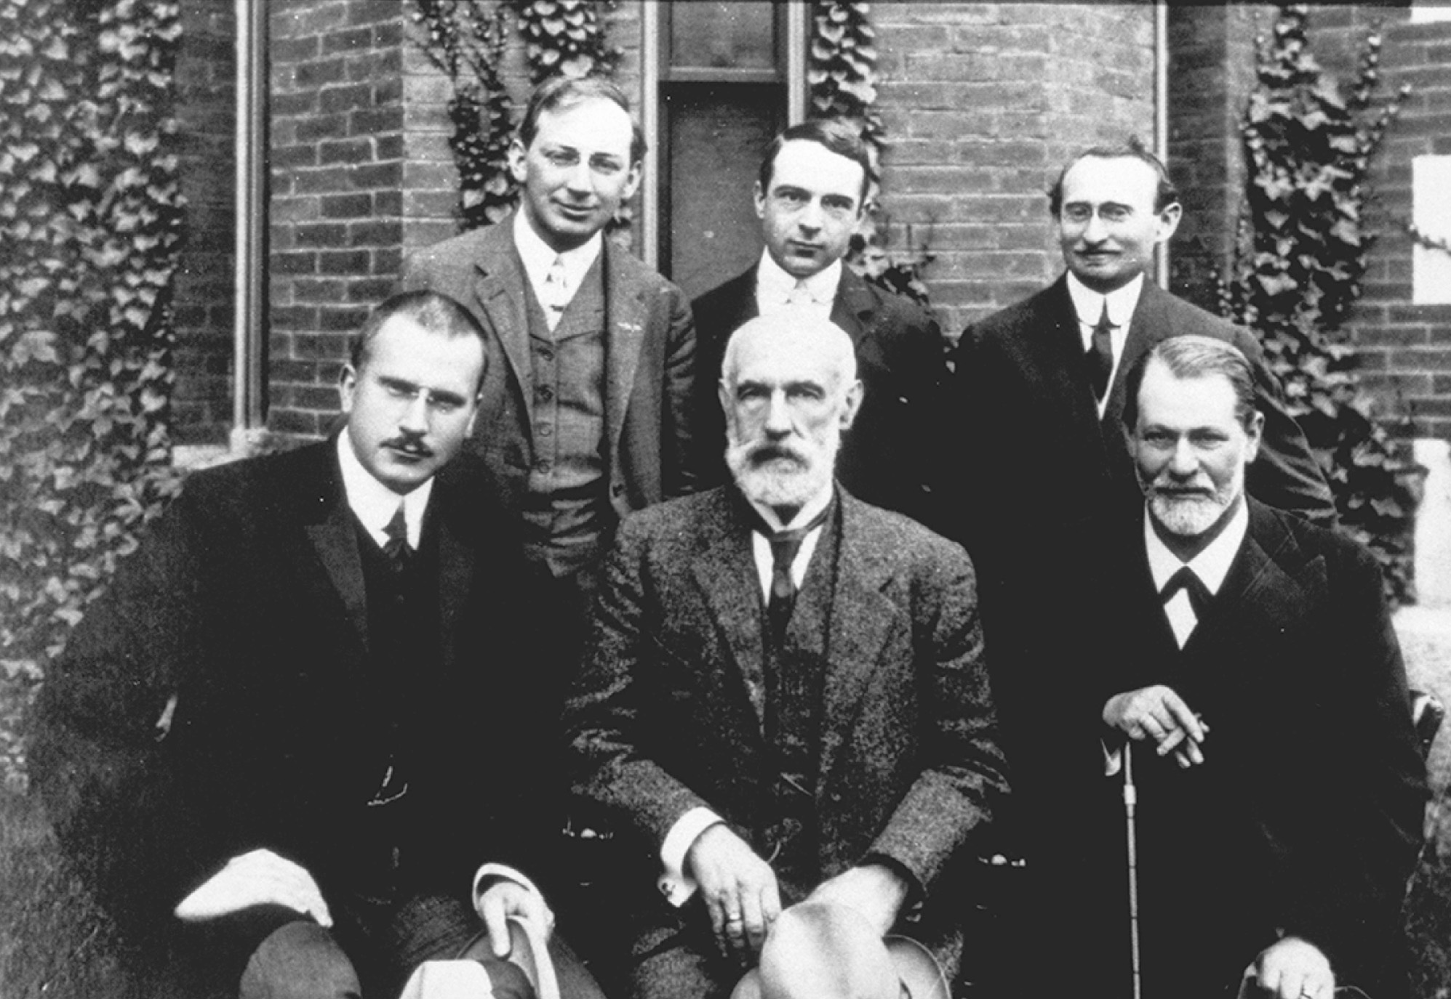
In 1909 Freud and his then-devoted disciple Carl Jung visited Clark University in Worcester, Massachusetts, during Freud’s only trip to the United States. Here Freud sits on the right holding a cane. Jung is sitting on the far left. Archives of the History of American Psychology—The University of Akron. Courtesy Clark University, Special Collections
Notes:
In 1909 Freud and his then-devoted disciple Carl Jung visited Clark University in Worcester, Massachusetts, during Freud’s only trip to the United States. Here Freud sits on the right holding a cane. Jung is sitting on the far left.
Archives of the History of American Psychology—The University of Akron. Courtesy Clark University, Special Collections

Slide 42
Retreat from Rationalism in Politics
Max Weber
Saw bureaucratization as the basic feature of modern social life
People develop their own self-worth from large organizations
Non-economic factors might account for developments in human history
Collective Behavior – the belief in the necessity of collectively shared ideals in society; proponents of this theory differed from Weber

Slide 43
Racism
The pseudoscientific theory that biological features of race determine human character and worth
Count Arthur de Gobineau – in his four volume Inequality of the Human Races (1853-1854), argued the white Aryan race was being weakened by inferior yellow and black races

Slide 44
Racism (cont.)
Houston Stuart Chamberlain – anti-Semite who believed through genetics a superior race could be developed
Late-century nationalism – nationality defined itself through race and blood; opposed the ideas of liberalism and socialism; contributed to racism throughout Europe and North America against African and Native-Americans

Slide 45
Anti-Semitism and Zionism
Anti-Semitism seen in Vienna with the Christian Socialist Party, in Germany with the ultraconservative chaplain Adolf Stoecker, and the Dreyfus affair in France
Zionist movement – the movement to found a separate Jewish state led by Theodor Herzl; Herzl’s ideas eventually lead to the birth of the state of Israel

Slide 46
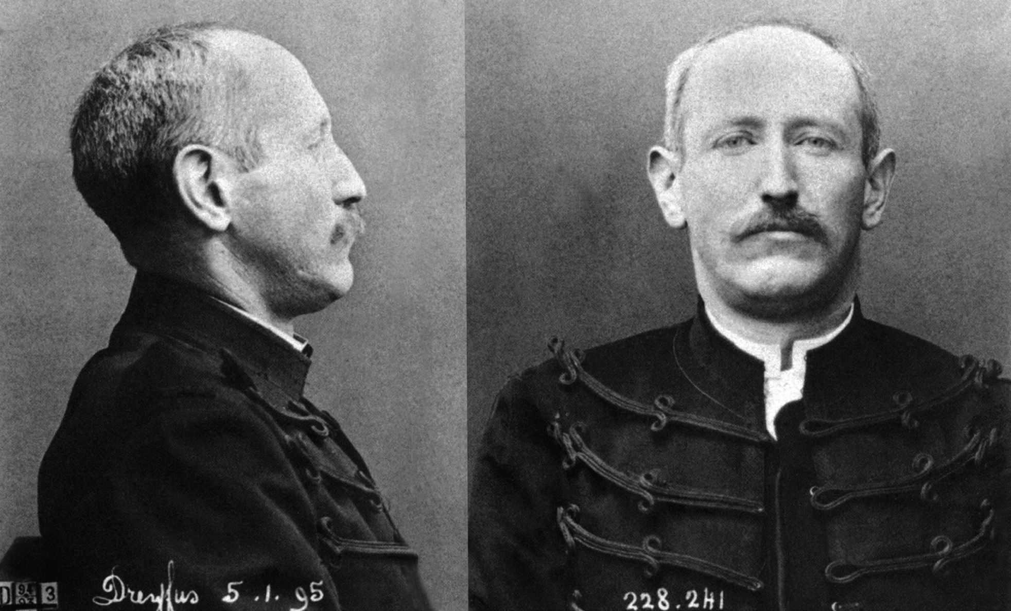
Photographs of Alfred Dreyfus taken in January 1895, after his sentencing to life imprisonment for treason in 1894. The photograph shows him in uniform, but stripped of all the signs and insignia of his rank. The trial and conviction of Captain Dreyfus provoked the most serious crisis of the Third Republic. Rue des Archives/The Granger Collection, NYC—All rights reserved
Notes:
Photographs of Alfred Dreyfus taken in January 1895, after his sentencing to life imprisonment for treason in 1894. The photograph shows him in uniform, but stripped of all the signs and insignia of his rank. The trial and conviction of Captain Dreyfus provoked the most serious crisis of the Third Republic.
Rue des Archives/The Granger Collection, NYC—All rights reserved

Slide 47
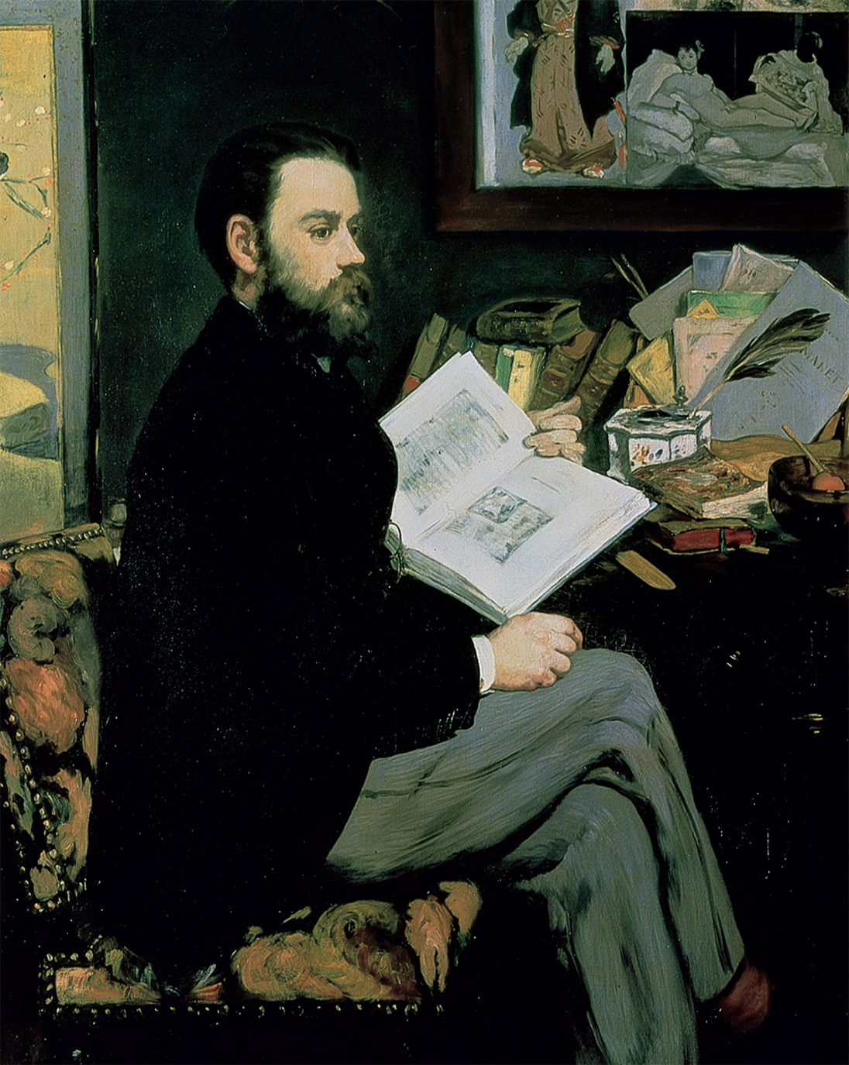
Emile Zola of France was the master of the realistic novel. Oil on canvas, 146.5 × 114 cm. Réunion des Musées Nationaux/Art Resource, Inc.
Notes:
Emile Zola of France was the master of the realistic novel. Oil on canvas, 146.5 × 114 cm. Réunion des Musées Nationaux/Art Resource, Inc.

Slide 48
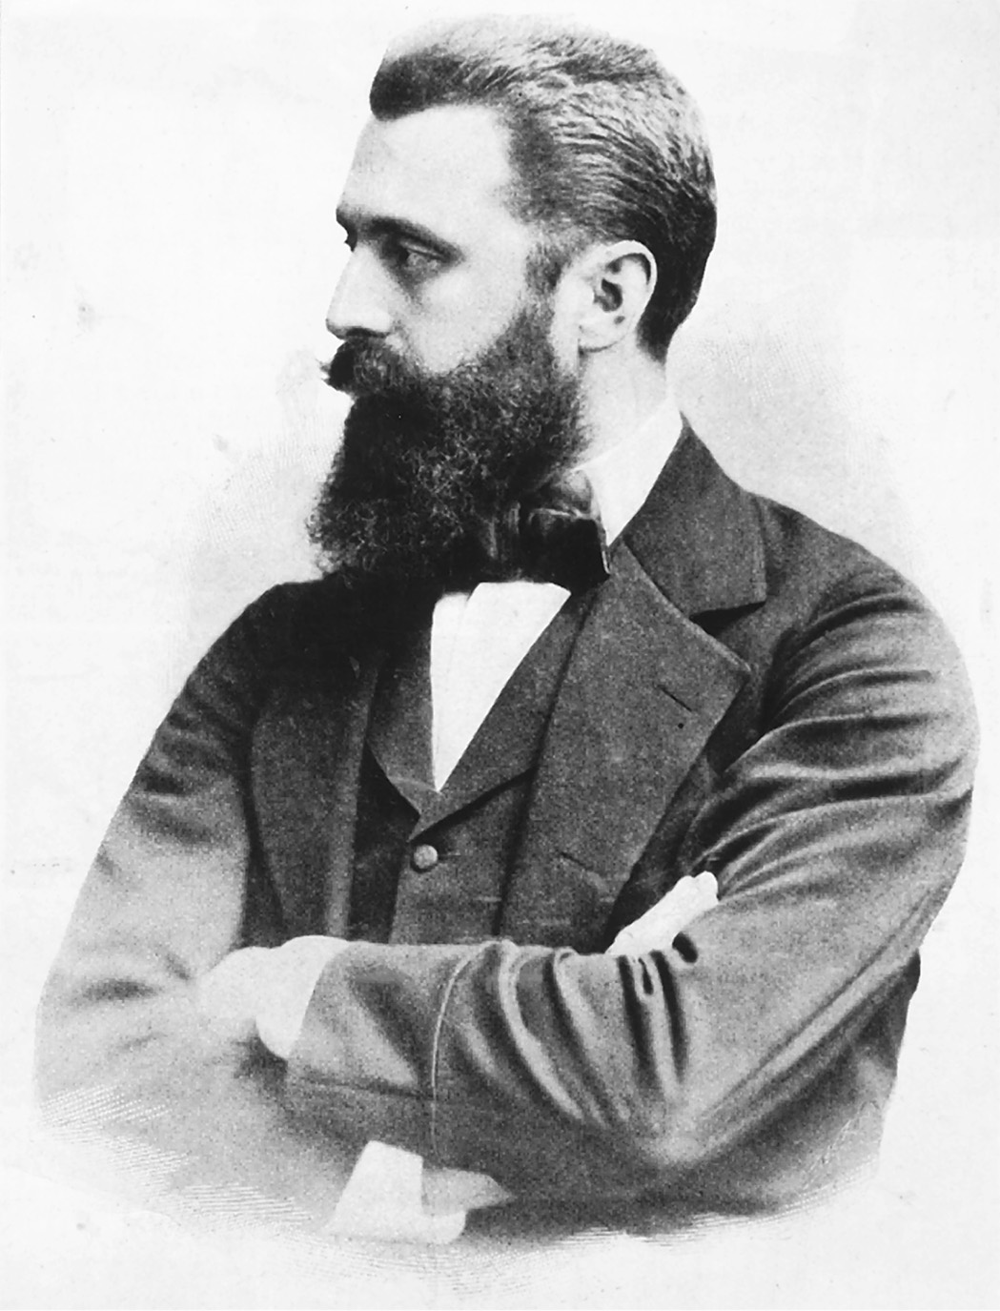
Theodor Herzl’s visions of a Jewish state would eventually lead to the creation of the state of Israel in 1948. Hulton Archive/Getty Images
Notes:
Theodor Herzl’s visions of a Jewish state would eventually lead to the creation of the state of Israel in 1948.
Hulton Archive/Getty Images

Slide 49
Antifeminism in Late-Century Thought
Famous intellectuals Charles Darwin, T.H. Huxley, Karl Vogt, Sigmund Freud, Auguste Comte, Emile Durkheim, Max Weber, and Herbert Spencer all believed women were born inferior to men
Distinguished women psychoanalysts Karen Horney and Melanie Klein challenged especially Freud’s view on women that they would be mothers destined to lead unhappy mental lives

Slide 50
New Feminism – Sexual Morality
Feminists were outraged by Contagious Diseases Act (1864), which in Britain gave the police permission to force women to undergo examinations for venereal diseases (act was repealed in 1886)
Austrian feminists combated the government regulation of prostitution

Slide 51
New Feminism – Sexual Morality (cont.)
In Germany, feminists form Mothers’ Protection League, which contended that both married and unmarried mothers required the help of the state for pregnancy and child care

Slide 52
New Feminism – Women Defining Their Own Lives
Some women became active in socialist circles
Virginia Woolf – wrote A Room of One’s Own (1929) – argued that women should have separate intellectual and psychological philosophies from men
World War I – feminism becomes grouped with sexual immorality and extreme political radicalism, leading to repression by such leaders as Lenin and Stalin

Slide 53
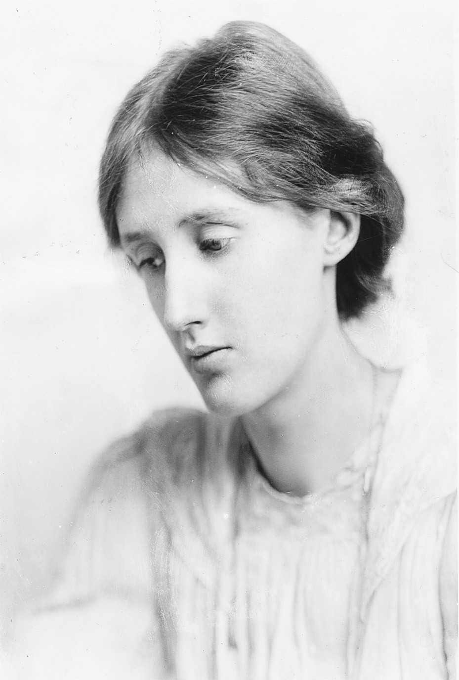
Virginia Woolf charted the changing sentiments of a world with most of the nineteenth-century social and moral certainties removed. In A Room of One’s Own, quoted in the document selection on p. 778, she also challenged some of the accepted notions of feminist thought, asking whether women writers should bring to their work any separate qualities they possessed as women, and concluding that men and women writers should strive to share each other’s sensibilities. George C. Beresford/Hulton Archive/Getty Images
Notes:
Virginia Woolf charted the changing sentiments of a world with most of the nineteenth-century social and moral certainties removed. In A Room of One’s Own, quoted in the document selection on p. 778, she also challenged some of the accepted notions of feminist thought, asking whether women writers should bring to their work any separate qualities they possessed as women, and concluding that men and women writers should strive to share each other’s sensibilities.
George C. Beresford/Hulton Archive/Getty Images

