Slide 1
Chapter 26
Alliances, War, and a Troubled Peace

Slide 2
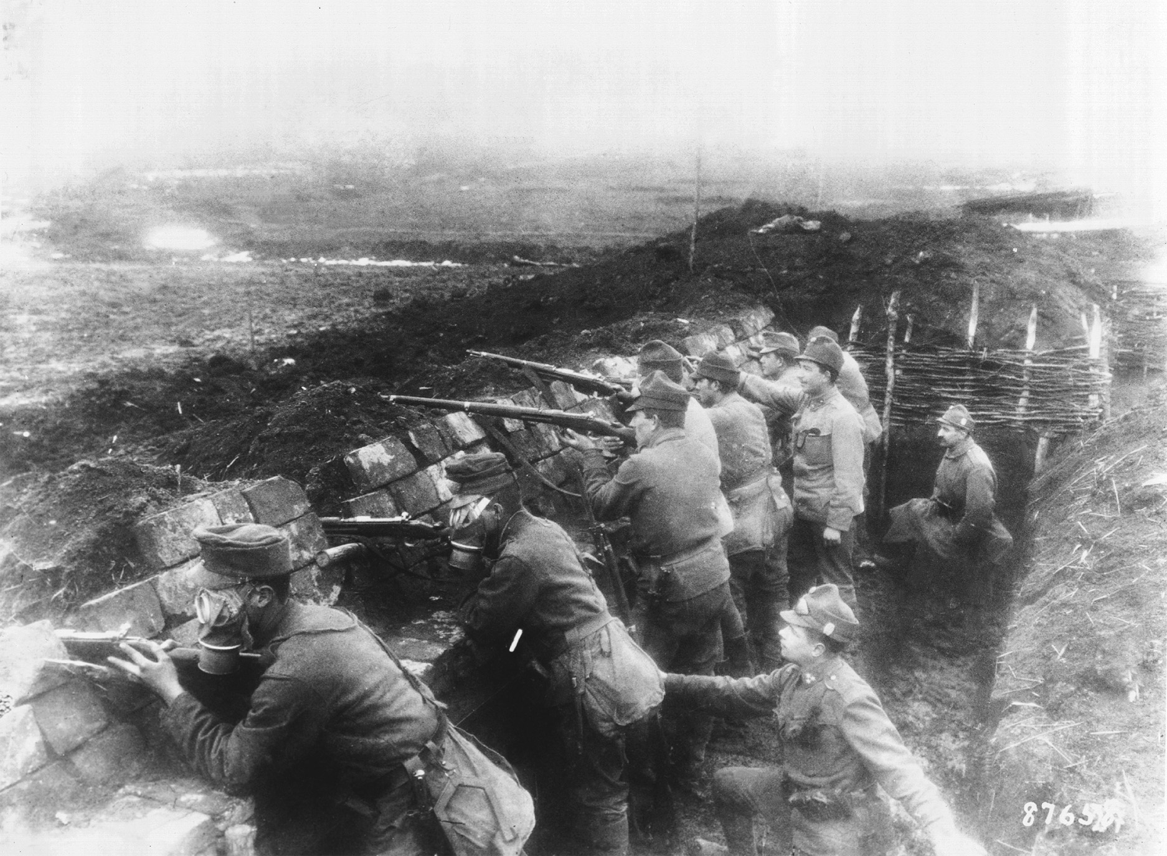
World War I produced unprecedented destruction and loss of life. Rather than a war of rapid movement, much combat occurred along stationary trenches dug in both Western and Eastern Europe. Here, Austro-Hungarian troops fight from trenches on the eastern front wearing gas masks. The use of poison gas was one of the innovations of the war and was generally condemned after the war. National Archives and Records Administration
Notes:
World War I produced unprecedented destruction and loss of life. Rather than a war of rapid movement, much combat occurred along stationary trenches dug in both Western and Eastern Europe. Here, Austro-Hungarian troops fight from trenches on the eastern front wearing gas masks. The use of poison gas was one of the innovations of the war and was generally condemned after the war.
National Archives and Records Administration

Slide 3
Emergence of the German Empire and the Alliance Systems (1873–1890)
The appearance of a German Empire upset the balance of power in Europe.
The German Empire was a nation of great wealth, industrial capacity, military power, and population.

Slide 4
Emergence of the German Empire and the Alliance Systems (1873–1890) (cont.)
The forces of nationalism threatened Austria with disintegration.
After its defeat in the Franco-Prussian War, the French were no longer a dominant Western European power and were concerned about Prussia.

Slide 5
Bismarck’s Leadership
Bismarck wanted to avoid war in the Balkans and preserve Germany’s territorial integrity and established the Three Emperors’ League with Austria and Russia.
After the League collapsed, the Treaty of San Stefano freed the Balkan Slavic states from Ottoman rule and the Russians gained some territory.

Slide 6
Bismarck’s Leadership (cont.)
The 1878 Congress of Berlin settled the Eastern Question unsatisfactorily, and the south Slavic question remained a threat to European peace.

Slide 7
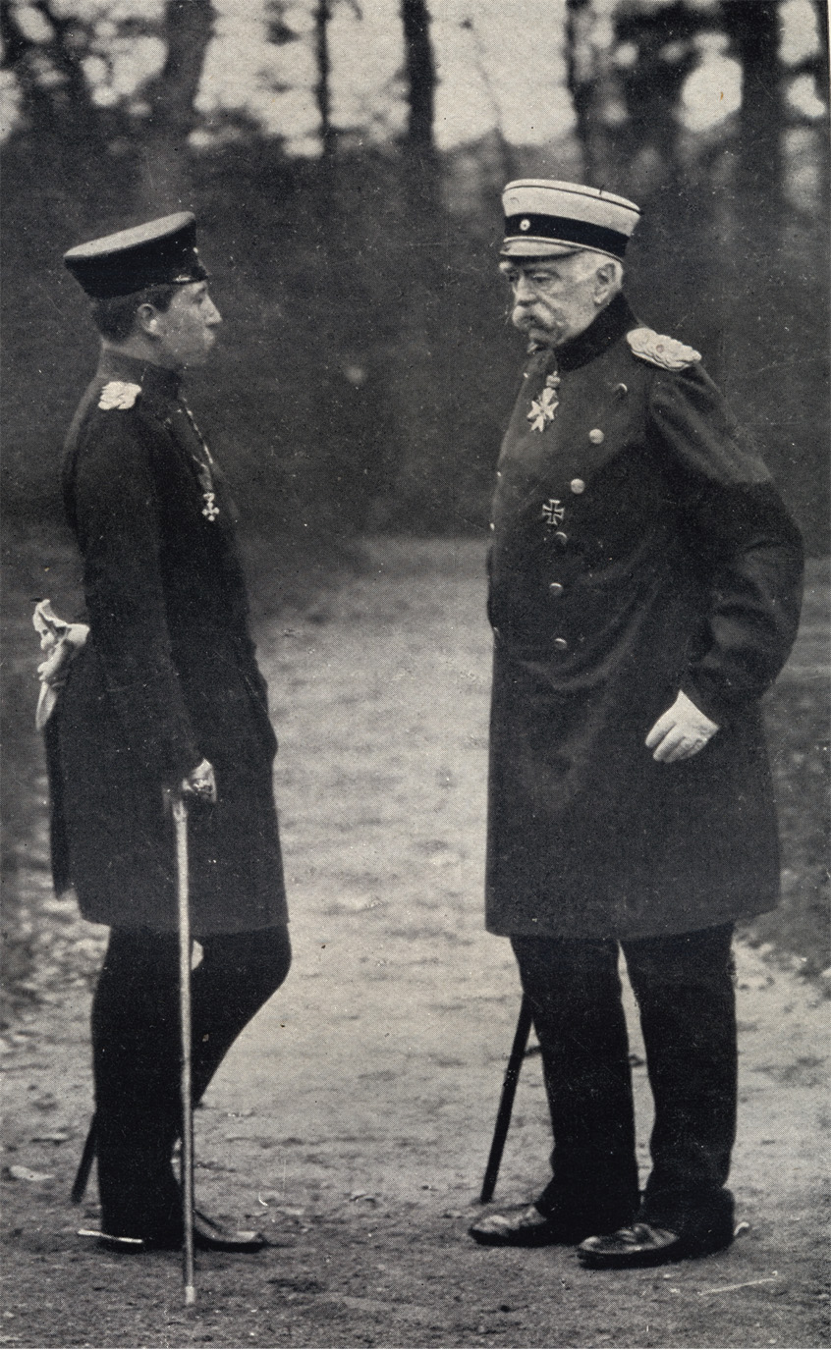
Bismarck and the young Kaiser William II meet in 1888. The two disagreed over many issues, and in 1890 William dismissed the aged chancellor. © Classic Image/Alamy
Notes:
Bismarck and the young Kaiser William II meet in 1888. The two disagreed over many issues, and in 1890 William dismissed the aged chancellor.
© Classic Image/Alamy

Slide 8
Bismarck’s Leadership (cont.)
Germany and Austria agreed to a mutual defense treaty from Russia known as the Dual Alliance, which was later joined by Italy. By Bismarck’s retirement he was allied with Austria, Russia, and Italy while on good terms with Britain.
The ascension of the pugilistic and nationalistic William II threatened future European stability.

Slide 9
Forging the Triple Entente (1890–1907)
France, concerned with security against Germany, invested in Russia, which in turn proffered a mutual defense treaty against Germany.
William II instigated a naval buildup in an attempt to emulate Britain, which simply produced more ships.
The 1904 Entente Cordiale represented a major step in aligning Britain with France.

Slide 10
Forging the Triple Entente (1890–1907) (cont.)
After Germany attempted to pressure France and the international community into colonial concessions in Germany, Britain and France arranged an alliance that made their military forces mutually dependent by 1914.
In 1907, Britain concluded an agreement much like the Entente Cordiale, this time with Russia.

Slide 11
Forging the Triple Entente (1890–1907) (cont.)
The Triple Entente of Britain, Russia, and France were aligned against the Triple Alliance of Germany, Austria-Hungary, and the unreliable Italy.

Slide 12
The Road to War (1908–1914)
Austria annexed Bosnia. The actions strained relations between Russia, who had an agreement with Austria, and France and Britain. At the same time, Germany pledged to support Austria, putting Austria in control of German foreign policy.
After the Second Moroccan Crisis, Britain and France moved closer together, creating a de facto alliance.

Slide 13
The Road to War (1908–1914) (cont.)
After Two Balkan Wars, Austria concluded Serbian territorial expansion by threatening to use force in Albania. The Alliance system was bending under the strain of international pressures.

Slide 14
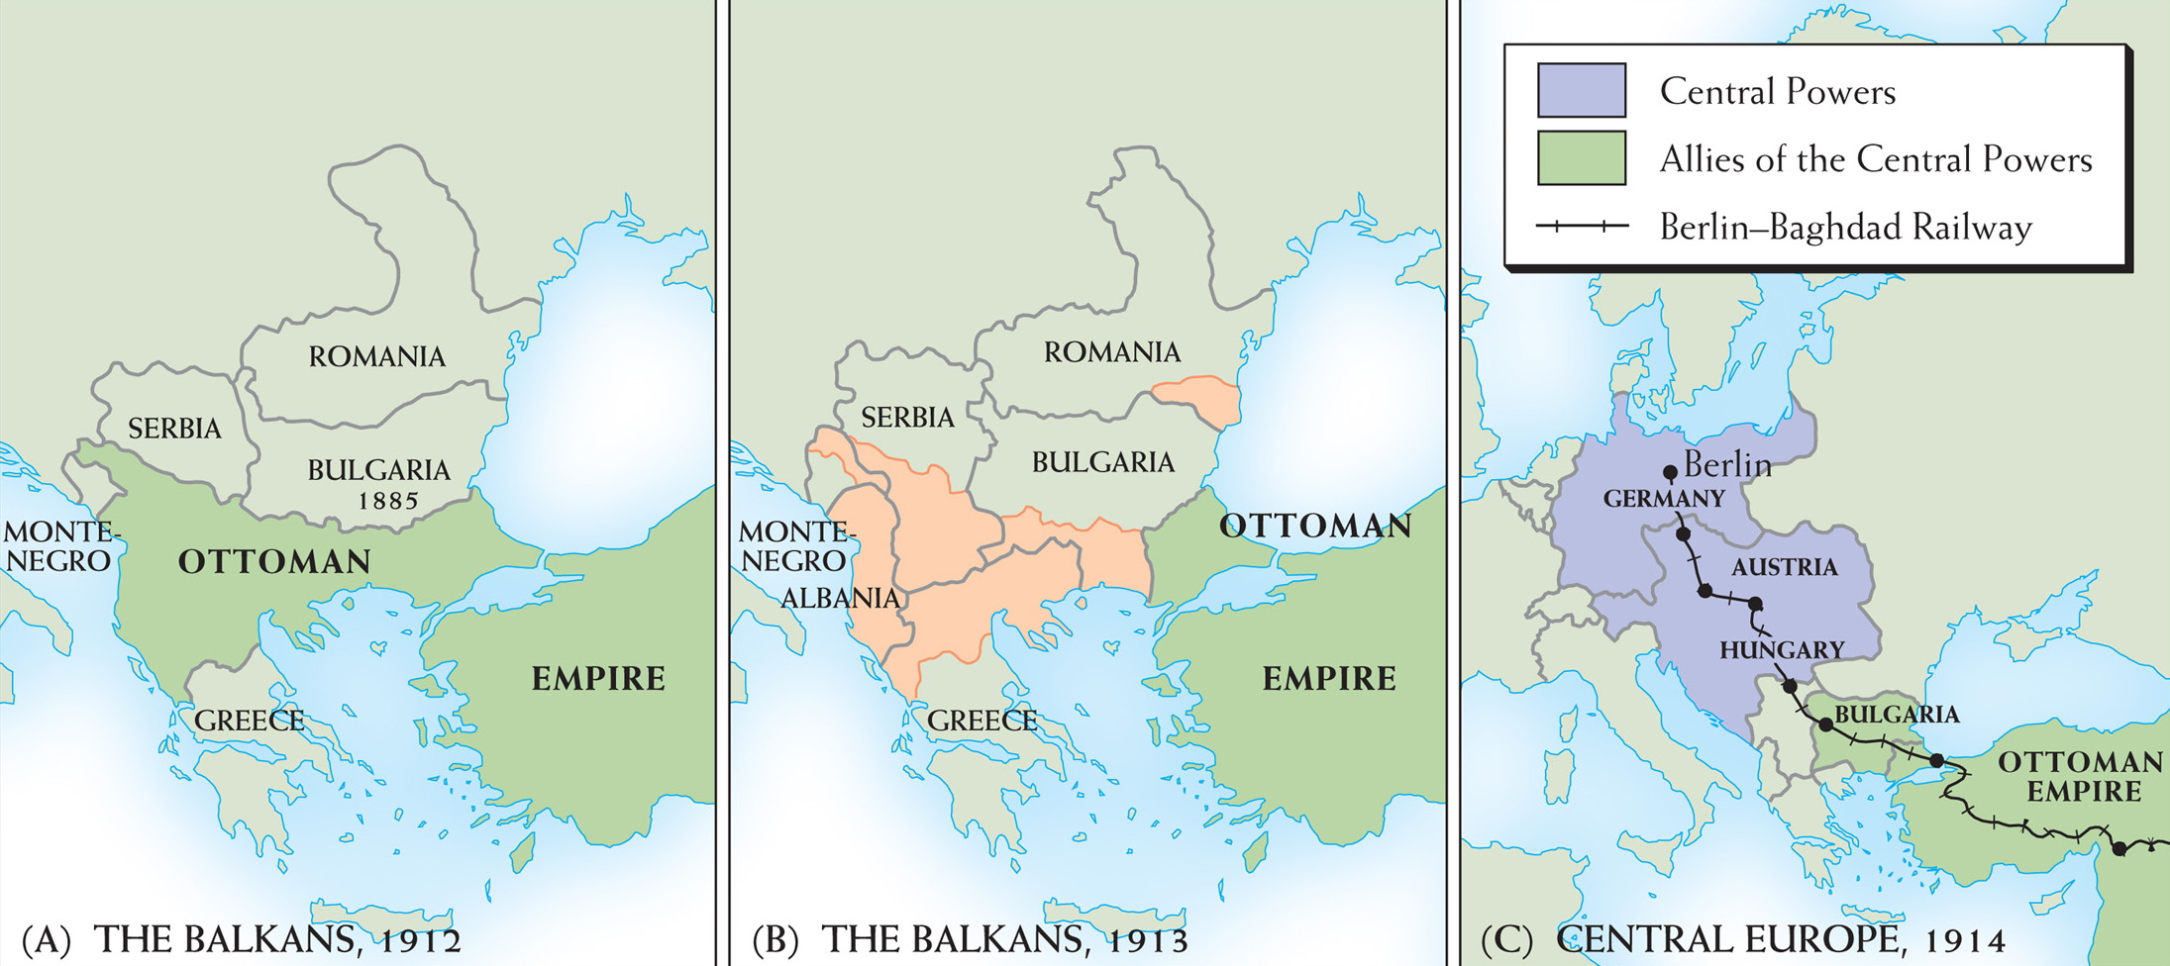
Map 26–1 THE BALKANS, 1912–1913 Two maps show the Balkans (a) before and (b) after the two Balkan wars; note the Ottoman retreat. In (c), we see the geographical relationship of the Central Powers and their Bulgarian and Turkish allies.
Notes:
Map 26–1 THE BALKANS, 1912–1913 Two maps show the Balkans (a) before and (b) after the two Balkan wars; note the Ottoman retreat. In (c), we see the geographical relationship of the Central Powers and their Bulgarian and Turkish allies.

Slide 15
Sarajevo and the Outbreak of War (June–August 1914)
The heir to the Austrian throne, Archduke Franz Ferdinand, is assassinated in Sarajevo with the aid of Serbian nationalists.

Slide 16
Sarajevo and the Outbreak of War (June–August 1914) (cont.)
The assassination caused outrage in Europe, but Austria was slow to respond to Serbia, which it was determined to invade. Germany pledged to support Austria, and Russia, building up its military, was likely to defend Serbia while drawing in France.
Austria mobilized, Russia mobilized, Germany declared war on Russia, and the next day declared war on France. Germany invaded Belgium, drawing Britain into the war, Germany invaded France, and then Britain declared war on Germany.

Slide 17
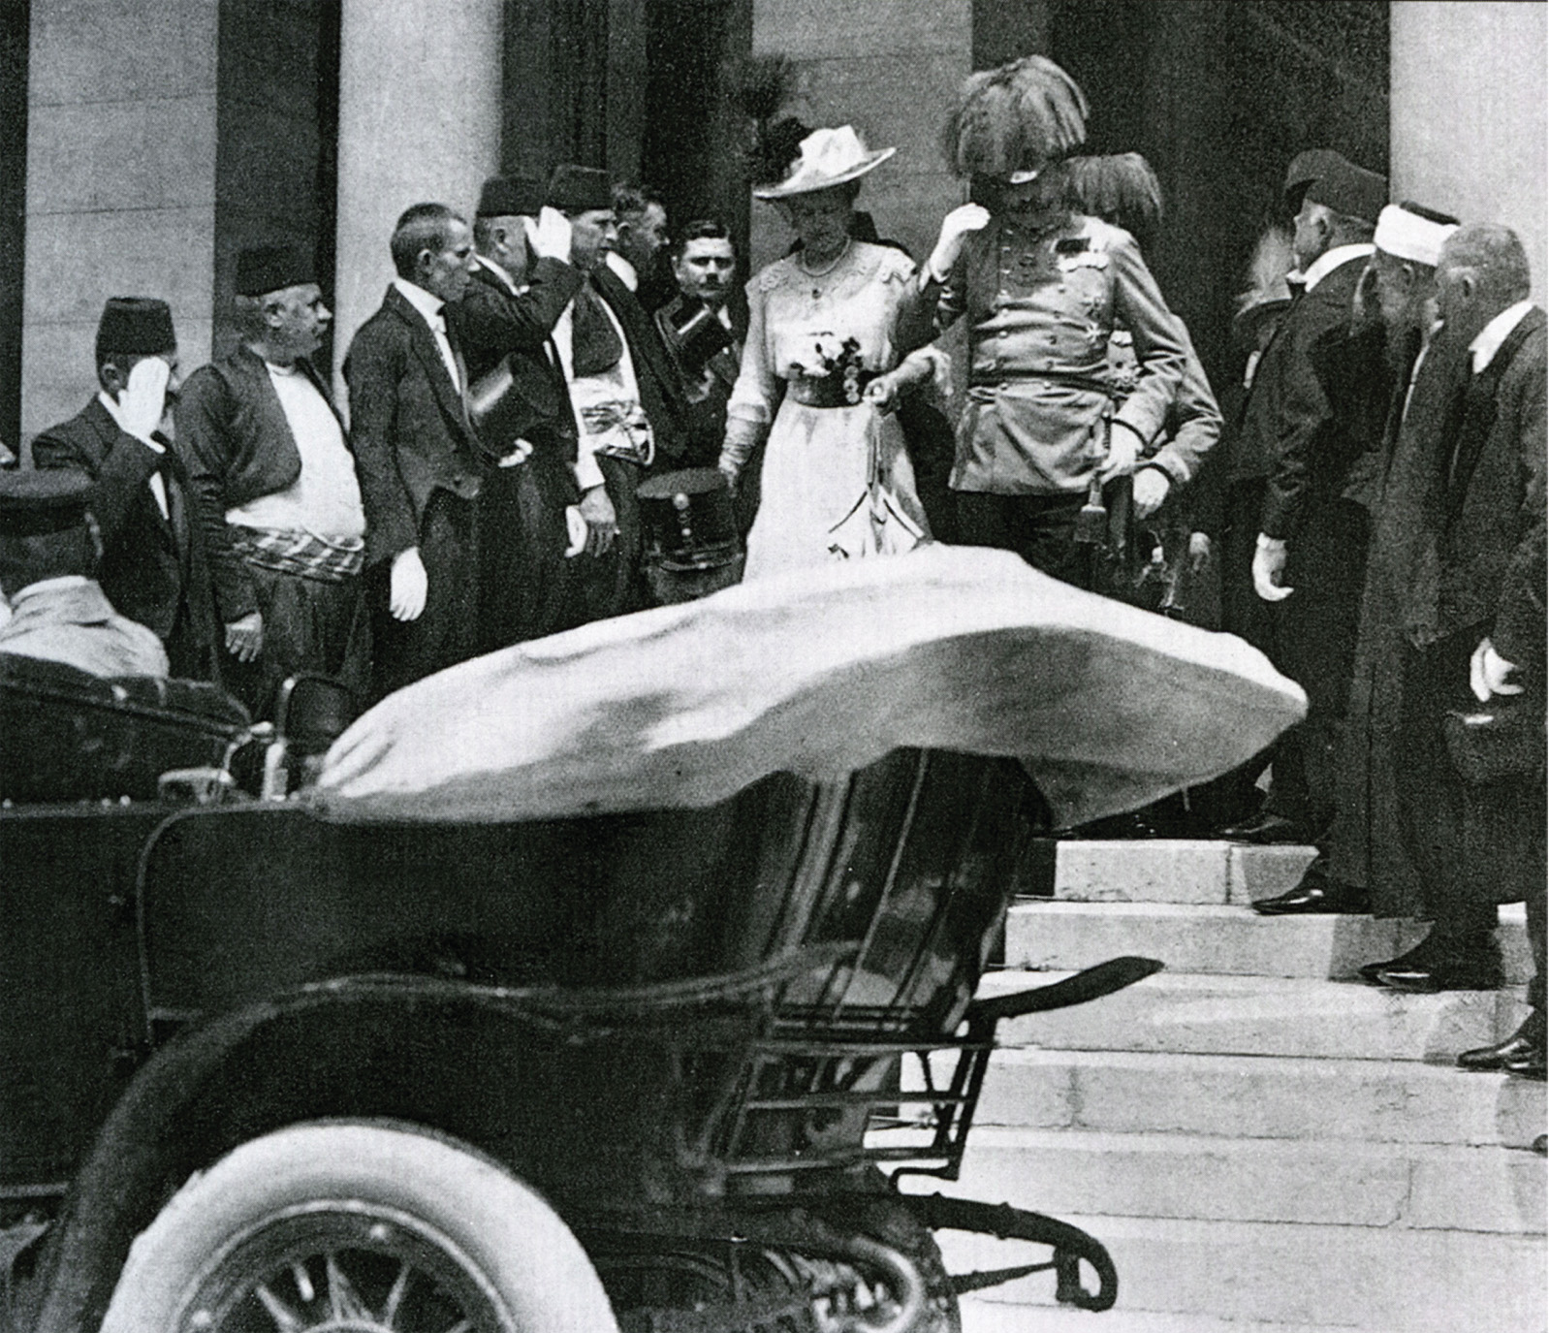
The Austrian archduke Francis Ferdinand and his wife in Sarajevo on June 28, 1914. Later in the day the royal couple was assassinated by young revolutionaries trained and supplied in Serbia, igniting the crisis that led to World War I. © Pictorial Press/Alamy
Notes:
The Austrian archduke Francis Ferdinand and his wife in Sarajevo on June 28, 1914. Later in the day the royal couple was assassinated by young revolutionaries trained and supplied in Serbia, igniting the crisis that led to World War I. © Pictorial Press/Alamy

Slide 18
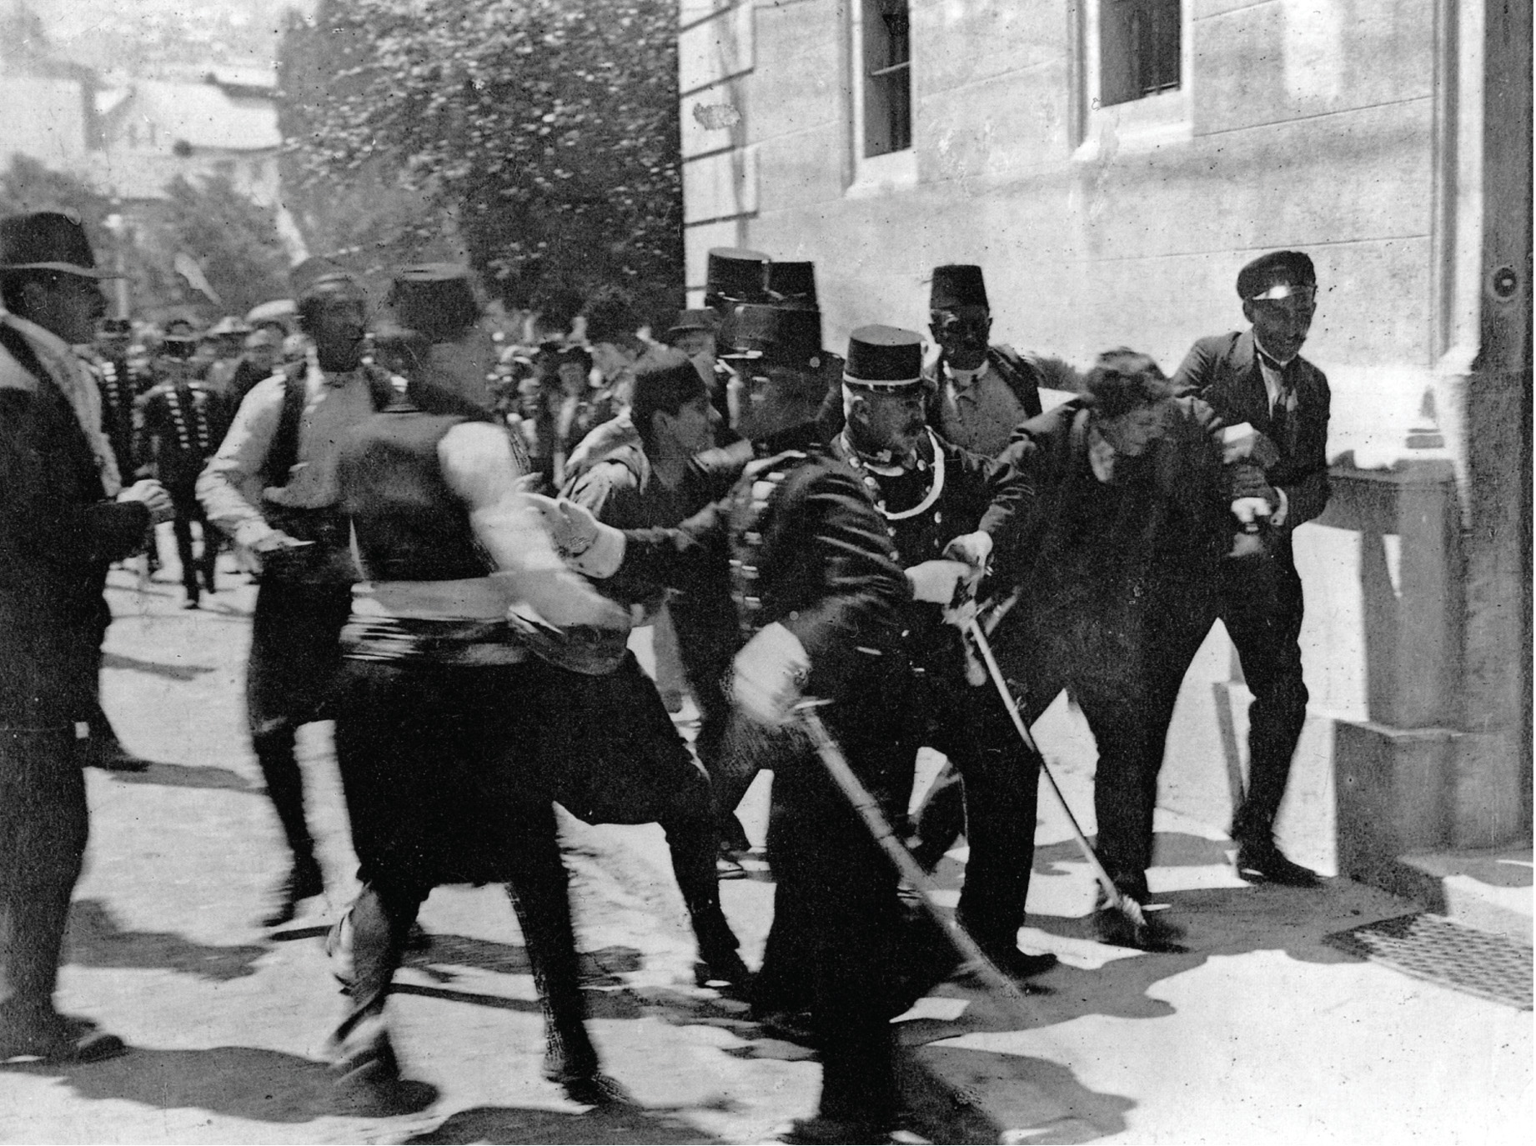
The Austrian archduke Francis Ferdinand and his wife in Sarajevo on June 28, 1914. Later in the day the royal couple was assassinated by young revolutionaries trained and supplied in Serbia, igniting the crisis that led to World War I. Moments after the assassination the Austrian police captured one of the assassins. © Pictorial Press/Alamy
Notes:
Moments after the assassination the Austrian police captured one of the assassins. © Pictorial Press/Alamy

Slide 19
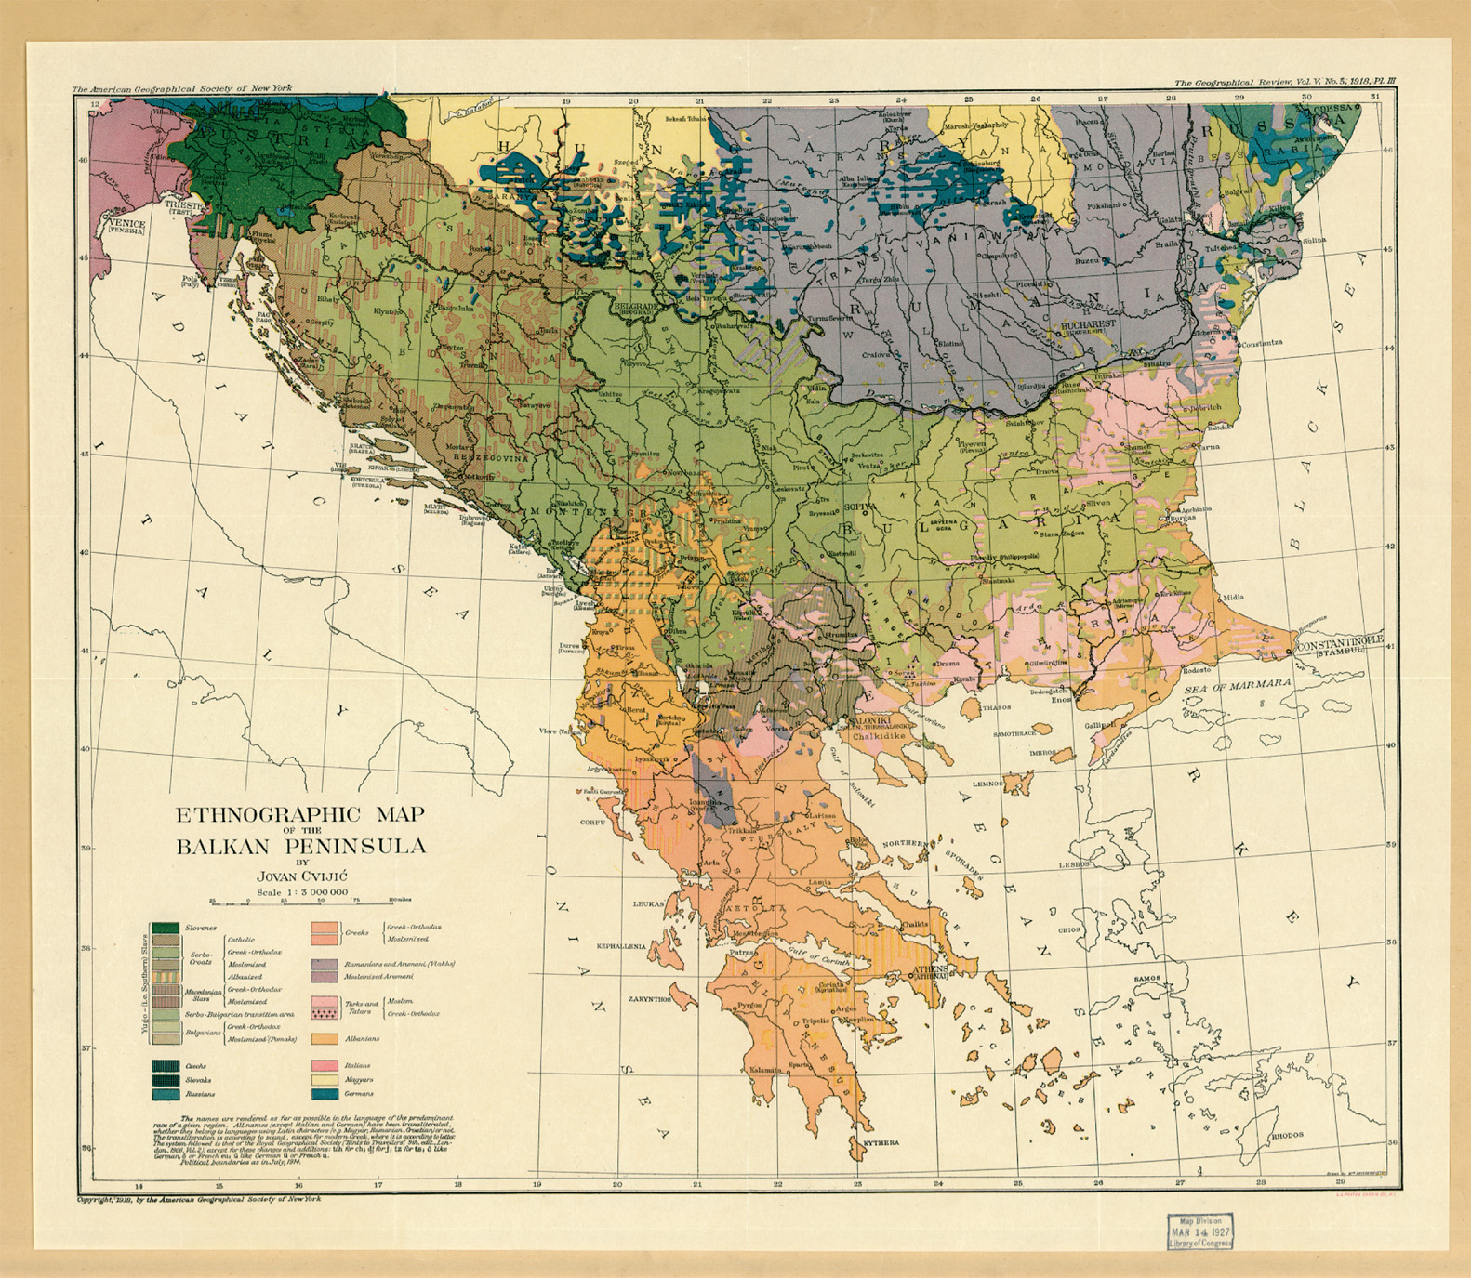
This ethnographic map of the Balkan Peninsula, made by a Serbian nationalist named Jovan Cviji’cin in 1918, served as inspiration for the campaign of ethnic cleansing that would devastate the region once known as Yugoslavia. Library of Congress
Notes:
This ethnographic map of the Balkan Peninsula, made by a Serbian nationalist named Jovan Cviji’cin in 1918, served as inspiration for the campaign of ethnic cleansing that would devastate the region once known as Yugoslavia.
Library of Congress

Slide 20
Strategies and Stalemate: 1914–1917
All over the Continent people welcomed war, unaware of the horrors of modern warfare, which included rationing and hardship for women.
After initial German and French failures on the Western front, the war devolved into trench warfare over a few hundred yards of land.

Slide 21
Strategies and Stalemate: 1914–1917 (cont.)
The British introduced the tank in 1916, which was the answer to the terrible effectiveness of the machine gun defensively.
In the East, both sides appealed to nationalistic sentiment in the areas the enemy held. Some of the groups roused included the Irish, the Flemings, the Poles, the Czechs, the Slovaks, the Slavs, and Muslims.

Slide 22
Strategies and Stalemate: 1914–1917 (cont.)
The Germans introduced submarine warfare, especially around the British Isles, to try and cut off enemy supply lines to the Continent.
Continued German submarine warfare, including sinking the British liner Lusitania with many Americans aboard, led the United States to declare war on Germany in 1917.

Slide 23
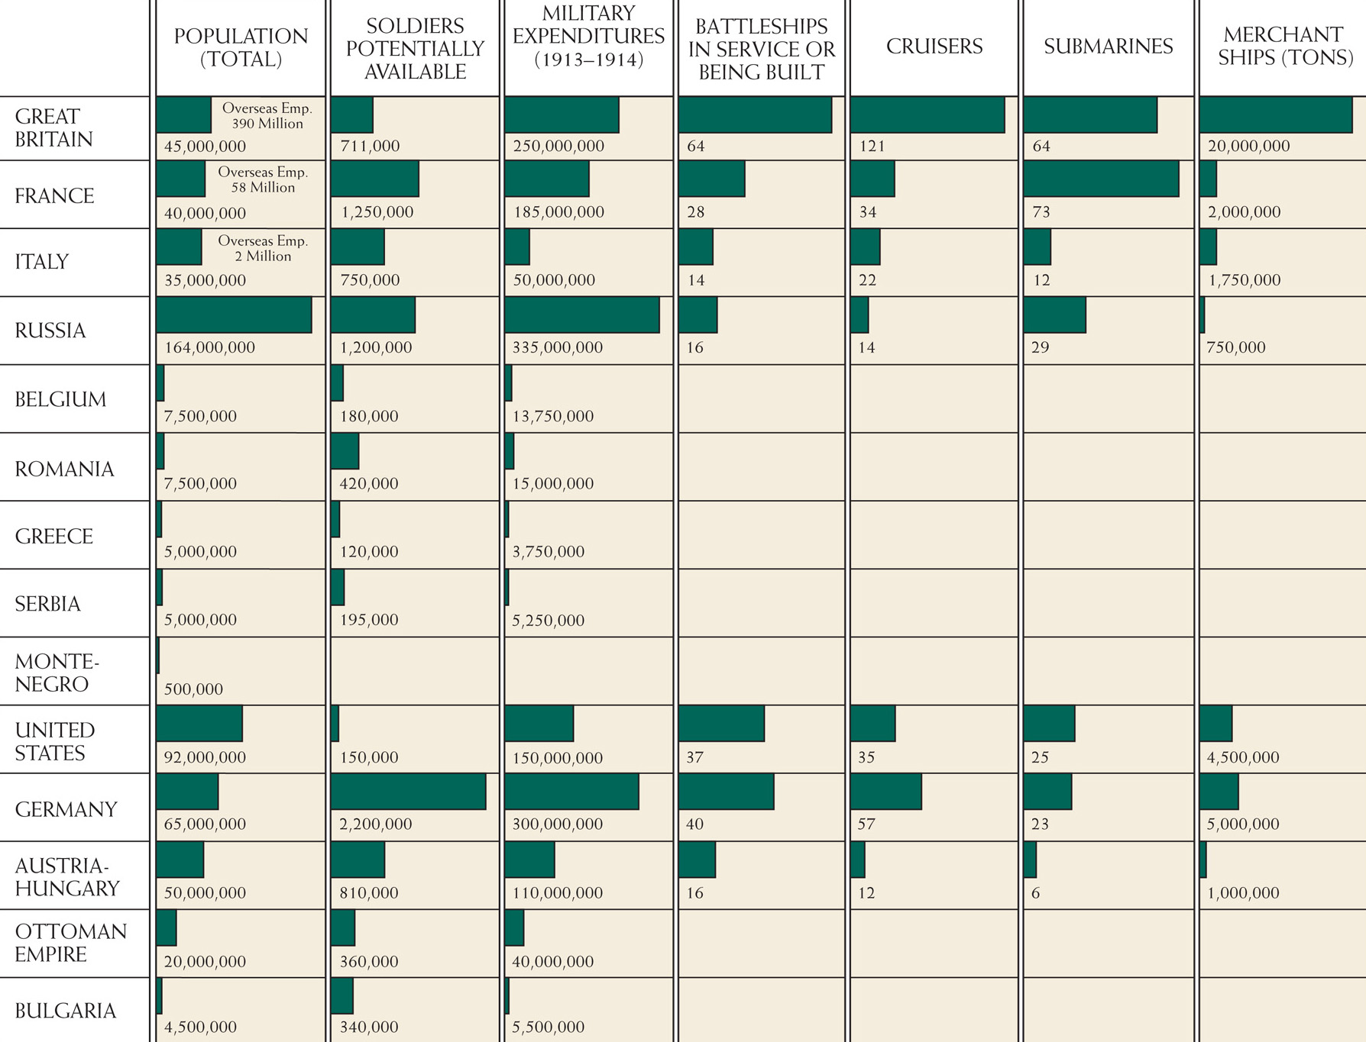
Relative strengths of the combatants in World War I.
Notes:
Relative strengths of the combatants in World War I.

Slide 24
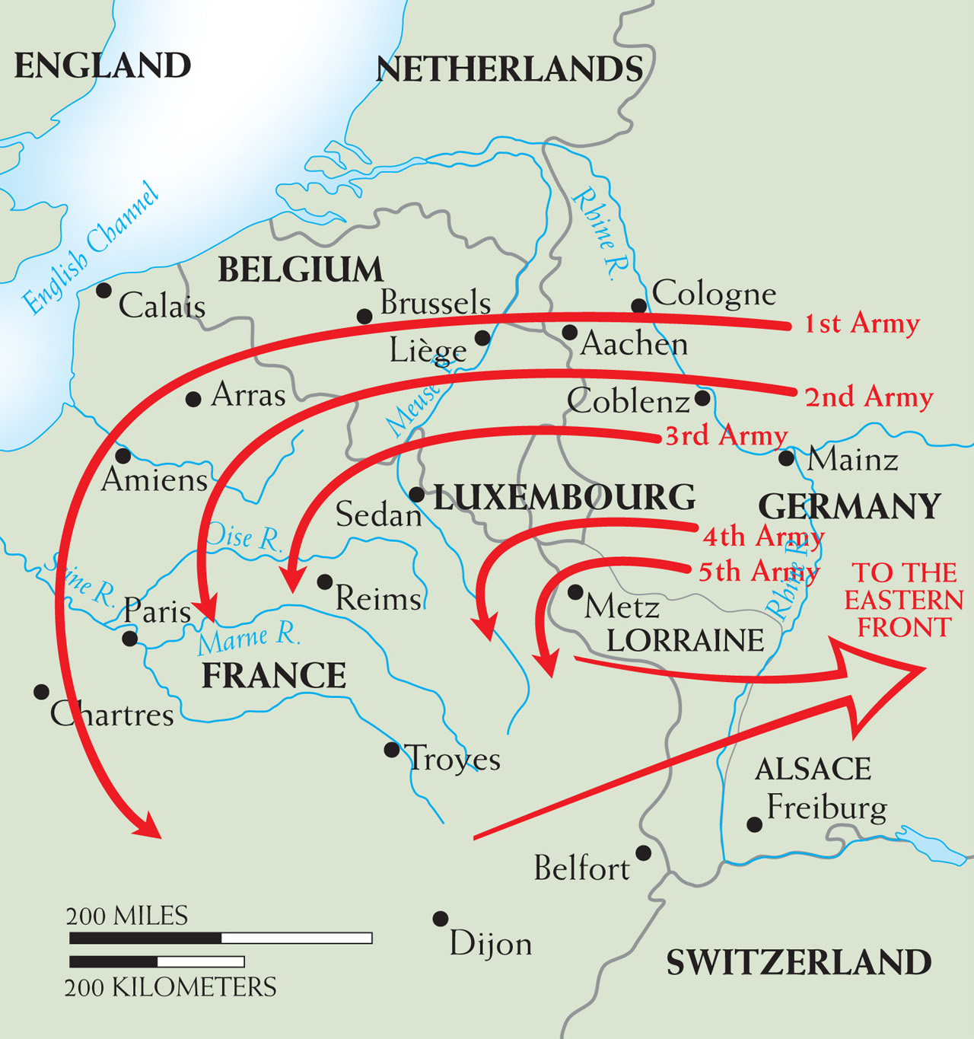
Map 26–2 THE SCHLIEFFEN PLAN OF 1905 Germany’s grand strategy for quickly winning the war against France in 1914 is shown by the wheeling arrows on the map. In the original plan, the crushing blows at France were to be followed by the release of troops for use against Russia on Germany’s eastern front. The plan, however, was not adequately implemented, and the war on the western front became a long contest in place.
Notes:
Map 26–2 THE SCHLIEFFEN PLAN OF 1905 Germany’s grand strategy for quickly winning the war against France in 1914 is shown by the wheeling arrows on the map. In the original plan, the crushing blows at France were to be followed by the release of troops for use against Russia on Germany’s eastern front. The plan, however, was not adequately implemented, and the war on the western front became a long contest in place.

Slide 25
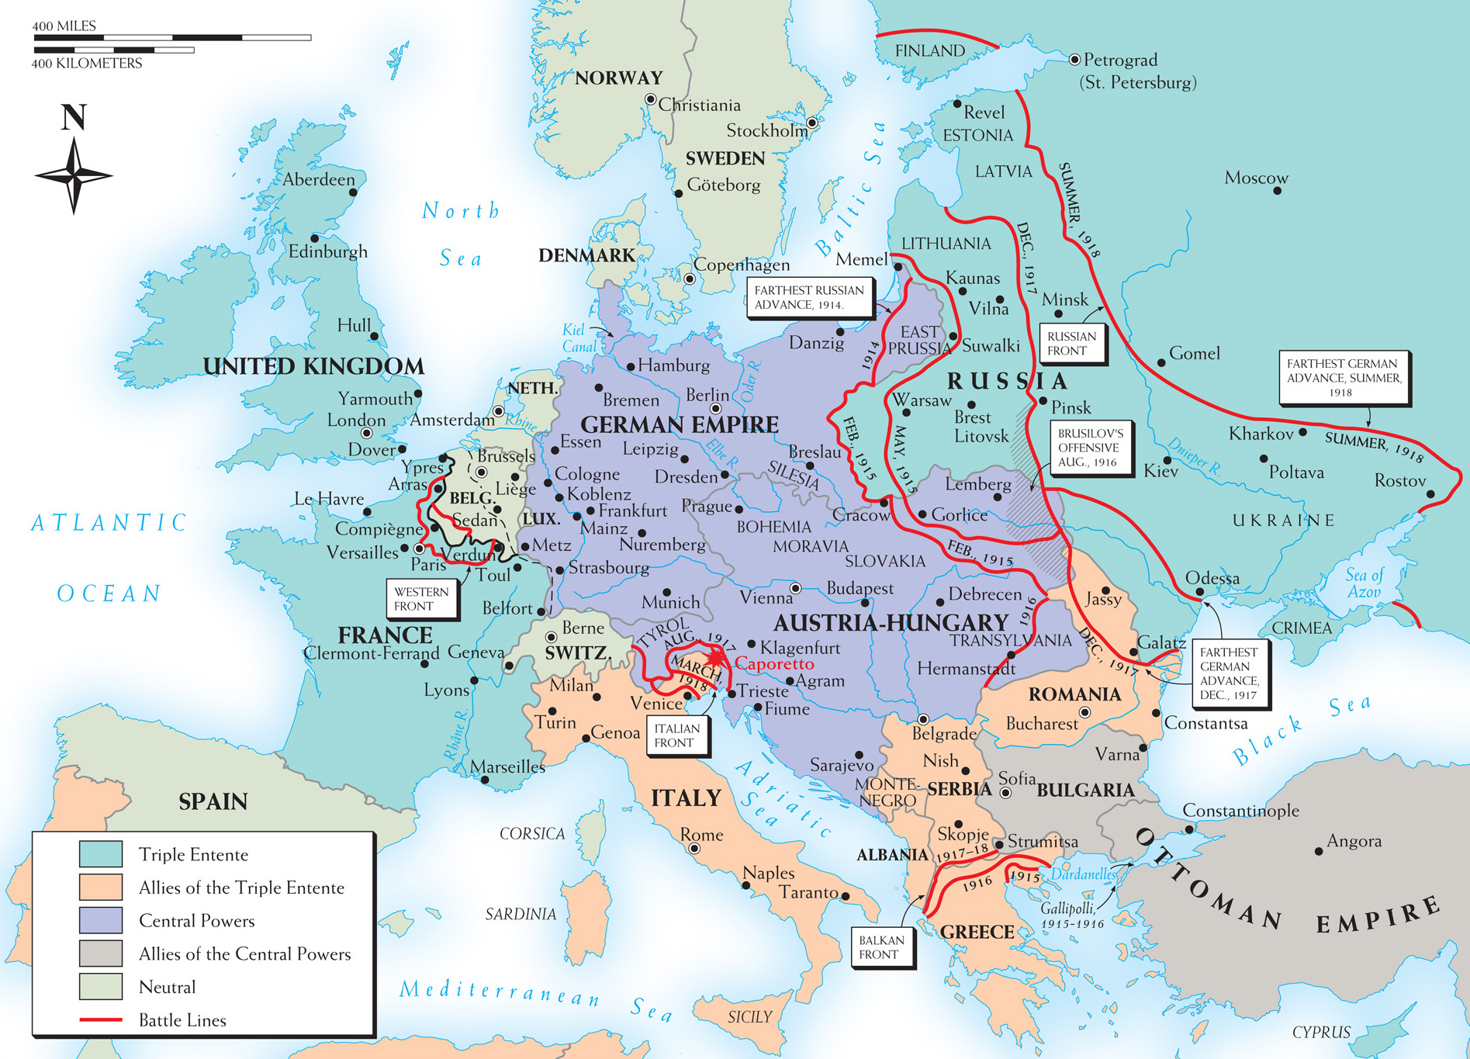
Map 26–3 WORLD WAR I IN EUROPE Despite the importance of military action in the Far East, in the Arab world, and at sea, the main theaters of activity in World War I were in the European areas.
Notes:
Map 26–3 WORLD WAR I IN EUROPE Despite the importance of military action in the Far East, in the Arab world, and at sea, the main theaters of activity in World War I were in the European areas.

Slide 26
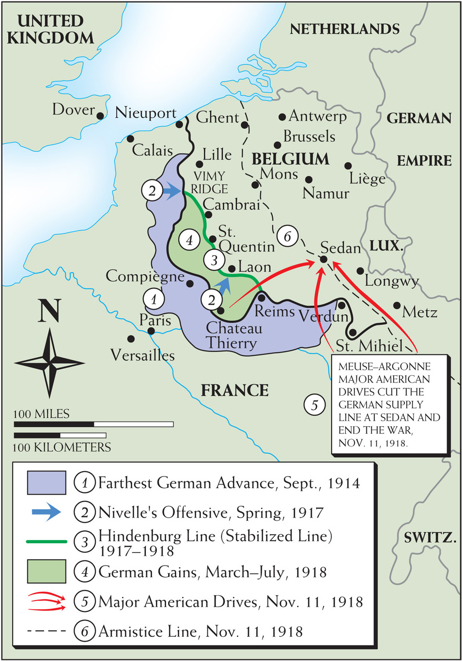
Map 26–4 THE WESTERN FRONT, 1914–1918 This map shows the crucial western front in detail.
Notes:
Map 26–4 THE WESTERN FRONT, 1914–1918 This map shows the crucial western front in detail.

Slide 27
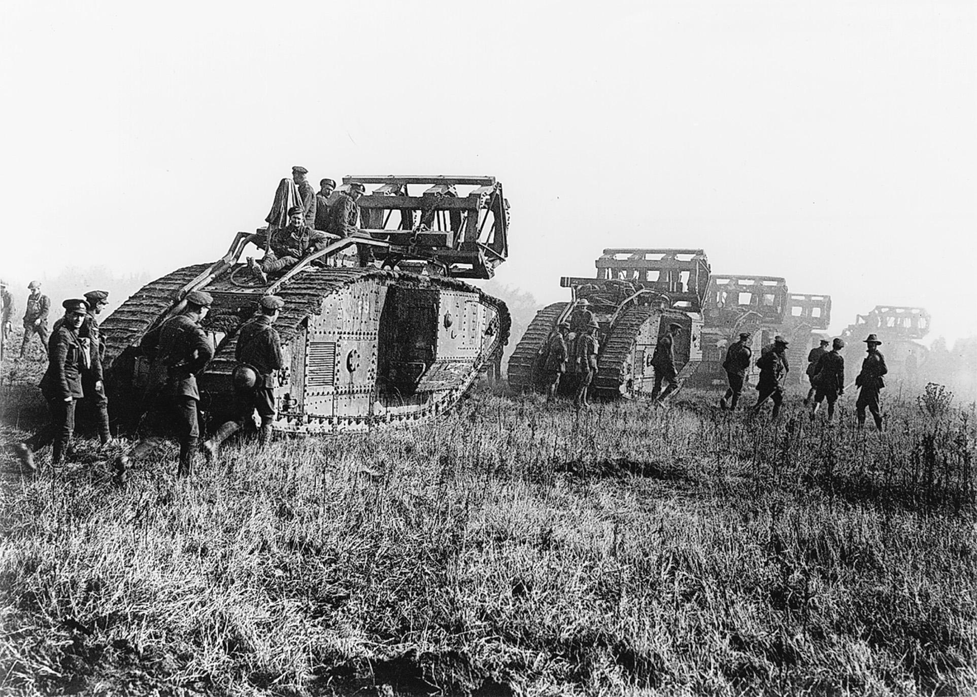
British tanks moving toward the Battle of Cambrai in Flanders late in 1917. Tanks were impervious to machine-gun fire. Had they been used in great numbers, they might have broken the stalemate in the west. Bildarchiv Preussischer Kulturbesitz/Art Resource, NY
Notes:
British tanks moving toward the Battle of Cambrai in Flanders late in 1917. Tanks were impervious to machine-gun fire. Had they been used in great numbers, they might have broken the stalemate in the west.
Bildarchiv Preussischer Kulturbesitz/Art Resource, NY

Slide 28
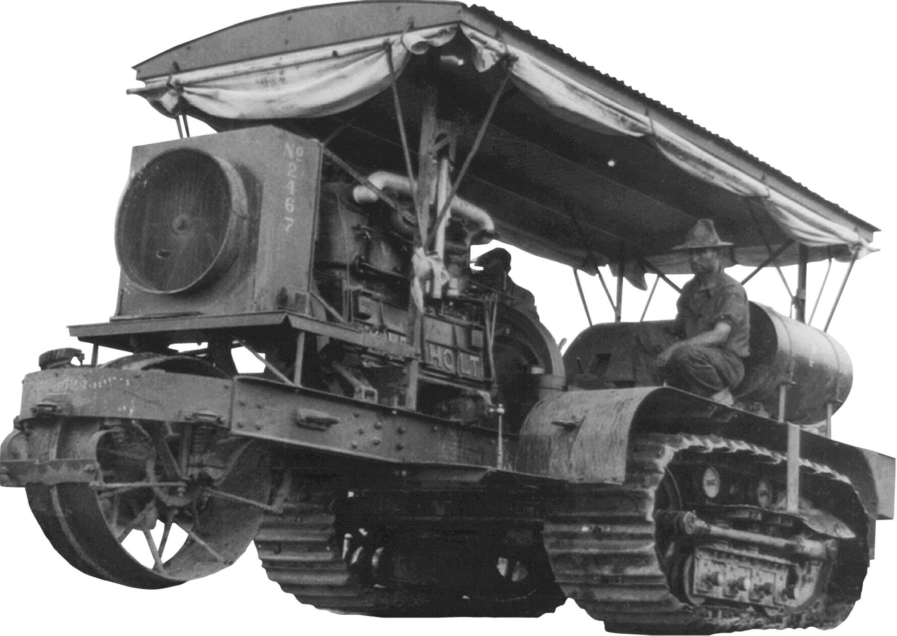
Warfare frequently proves a source of technological innovation. Such was true of World War I, which witnessed the development of numerous new weapons. Among the most important of these was the tank—an armored vehicle using a caterpillar track rather than wheels for transport. The caterpillar track had been invented in Great Britain but was then purchased by the American Holt tractor company, which devised a caterpillar tractor in the first decade of the century to cultivate areas with either wet or loose earth where a wheeled vehicle would sink into the ground. During World War I the British modified the caterpillar tractor by introducing a heavily armored closed compartment for a crew armed with machine guns. These early slow-moving tanks could drive over trenches, small hills, and rough terrain and through mud and thus bring mobility to the combat zones where trench warfare had made any kind of effective assault on enemy troops difficult. The tank was used primarily by Britain, France, and the United States in relatively small numbers in World War I, but later rapidly moving tanks became one of the major weapons of later twentieth-century warfare. Library of Congress
Notes:
Warfare frequently proves a source of technological innovation. Such was true of World War I, which witnessed the development of numerous new weapons. Among the most important of these was the tank—an armored vehicle using a caterpillar track rather than wheels for transport. The caterpillar track had been invented in Great Britain but was then purchased by the American Holt tractor company, which devised a caterpillar tractor in the first decade of the century to cultivate areas with either wet or loose earth where a wheeled vehicle would sink into the ground. During World War I the British modified the caterpillar tractor by introducing a heavily armored closed compartment for a crew armed with machine guns. These early slow-moving tanks could drive over trenches, small hills, and rough terrain and through mud and thus bring mobility to the combat zones where trench warfare had made any kind of effective assault on enemy troops difficult. The tank was used primarily by Britain, France, and the United States in relatively small numbers in World War I, but later rapidly moving tanks became one of the major weapons of later twentieth-century warfare.
Library of Congress

Slide 29
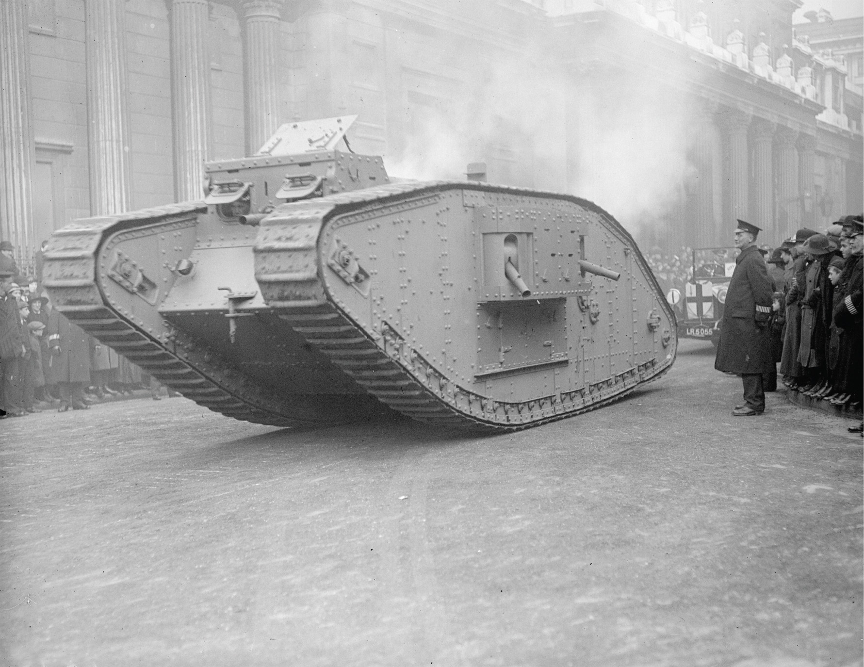
Warfare frequently proves a source of technological innovation. Such was true of World War I, which witnessed the development of numerous new weapons. Among the most important of these was the tank—an armored vehicle using a caterpillar track rather than wheels for transport. The caterpillar track had been invented in Great Britain but was then purchased by the American Holt tractor company, which devised a caterpillar tractor in the first decade of the century to cultivate areas with either wet or loose earth where a wheeled vehicle would sink into the ground. During World War I the British modified the caterpillar tractor by introducing a heavily armored closed compartment for a crew armed with machine guns. These early slow-moving tanks could drive over trenches, small hills, and rough terrain and through mud and thus bring mobility to the combat zones where trench warfare had made any kind of effective assault on enemy troops difficult. The tank was used primarily by Britain, France, and the United States in relatively small numbers in World War I, but later rapidly moving tanks became one of the major weapons of later twentieth-century warfare. Topical Press Agency/Stringer/Hulton Archive/Getty Images
Notes:
Warfare frequently proves a source of technological innovation. Such was true of World War I, which witnessed the development of numerous new weapons. Among the most important of these was the tank—an armored vehicle using a caterpillar track rather than wheels for transport. The caterpillar track had been invented in Great Britain but was then purchased by the American Holt tractor company, which devised a caterpillar tractor in the first decade of the century to cultivate areas with either wet or loose earth where a wheeled vehicle would sink into the ground. During World War I the British modified the caterpillar tractor by introducing a heavily armored closed compartment for a crew armed with machine guns. These early slow-moving tanks could drive over trenches, small hills, and rough terrain and through mud and thus bring mobility to the combat zones where trench warfare had made any kind of effective assault on enemy troops difficult. The tank was used primarily by Britain, France, and the United States in relatively small numbers in World War I, but later rapidly moving tanks became one of the major weapons of later twentieth-century warfare. Topical Press Agency/Stringer/Hulton Archive/Getty Images

Slide 30
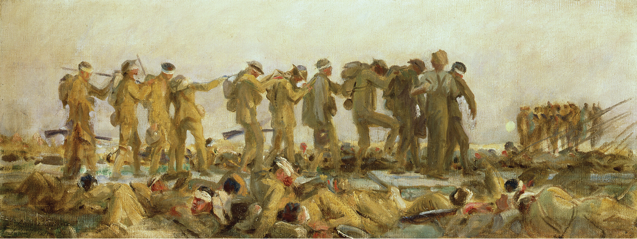
The use of poison gas (by both sides) during World War I and its dreadful effects—blinding, asphyxiation, burned lungs—came to symbolize the horrors of modern war. This painting shows a group of British soldiers being guided to the rear after they were blinded by mustard gas on the western front. Gassed, an oil study, 1918–19 (oil on canvas), Sargent, John Singer (1856–1925). Private Collection/ Photo © Christie’s Images/The Bridgeman Art Library International.
Notes:
The use of poison gas (by both sides) during World War I and its dreadful effects—blinding, asphyxiation, burned lungs—came to symbolize the horrors of modern war. This painting shows a group of British soldiers being guided to the rear after they were blinded by mustard gas on the western front.
Gassed, an oil study, 1918–19 (oil on canvas), Sargent, John Singer (1856–1925). Private Collection/ Photo © Christie’s Images/The Bridgeman Art Library International.

Slide 31
The Russian Revolution
The incompetent government of Nicholas II led to internal disorder in Russia.
Peasant discontent plagued the countryside.
In the absence of Nicholas II, incompetent government officials attempted to keep order as the members of Russia’s parliament remained unsatisfied.

Slide 32
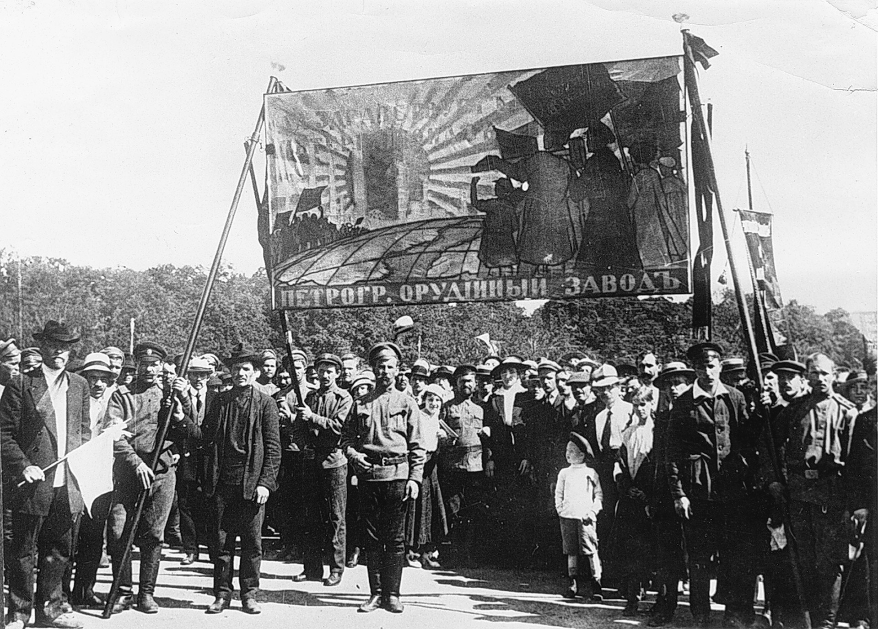
Petrograd munitions workers demonstrating in 1917. Ria-Novosti/Sovfoto/Eastfoto
Notes:
Petrograd munitions workers demonstrating in 1917.
Ria-Novosti/Sovfoto/Eastfoto

Slide 33
The Provisional Government
After the abdication of the tsar, the provisional government continued to support the war effort.
After one failed coup attempt, a second coup led by Lenin and Trotsky was successful in November.

Slide 34
The Communist Dictatorship
The government nationalized the land and turned it over to peasants.
Russia was taken out of the war.
The Treaty of Brest-Litovsk yielded Poland, Finland, the Baltic states, and Ukraine to Germany.
After a three year battle between the Red Army, controlled by Lenin, and the White Russians, who opposed the revolution, Lenin’s Bolshevik forces were in firm control.

Slide 35
The End of World War I
With Russia out of the war, Germany, in control of important European resources like food, could focus on the western front.
The deadlock continued through 1917 although American involvement would change the tide of the war.

Slide 36
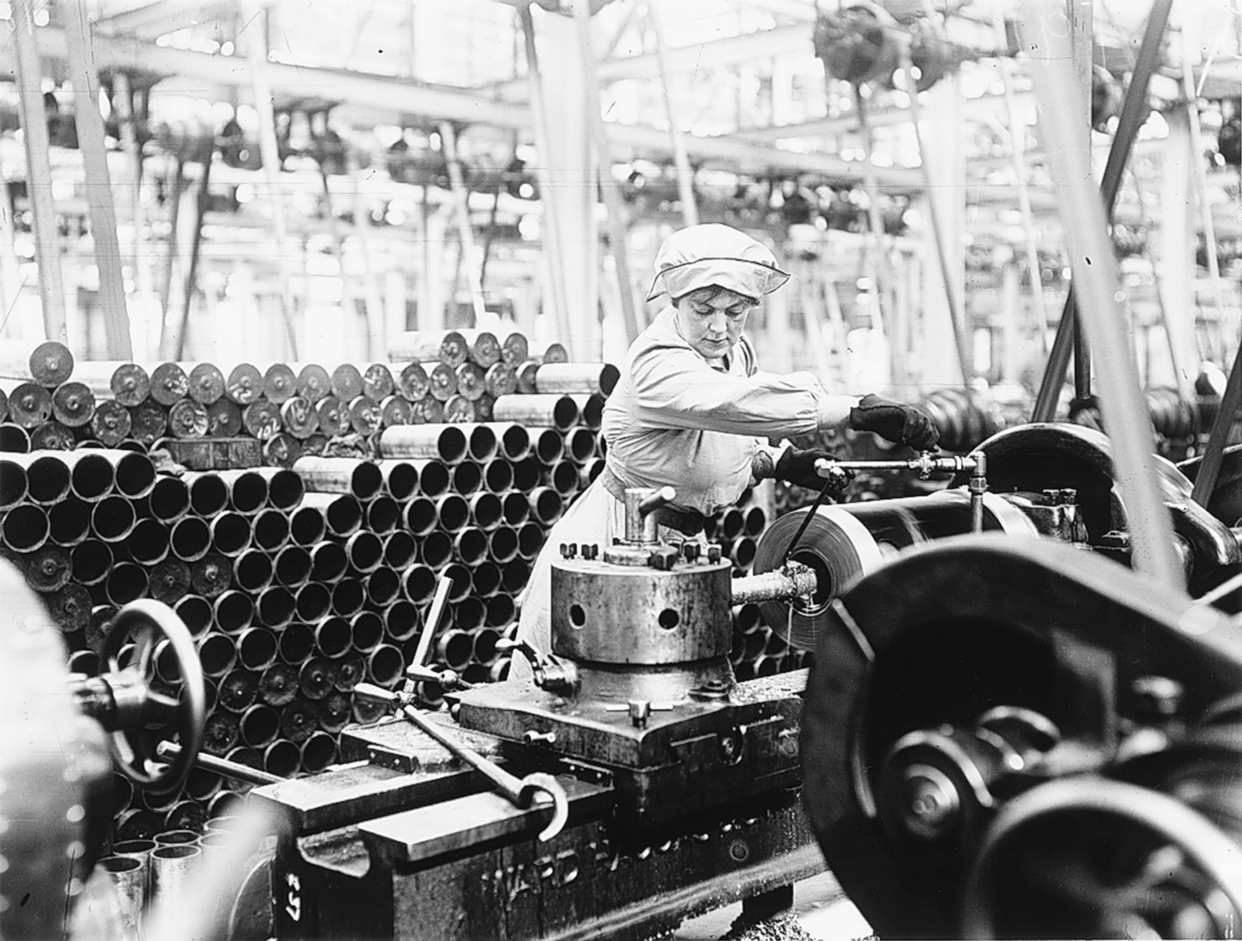
Women munitions workers in England. World War I demanded more from the civilian populations than had previous wars, resulting in important social changes. The demands of the munitions industries and a shortage of men (so many of whom were in uniform) brought many women out of traditional roles at home and into factories and other war-related work. Stringer/Hulton Archive/Getty Images
Notes:
Women munitions workers in England. World War I demanded more from the civilian populations than had previous wars, resulting in important social changes. The demands of the munitions industries and a shortage of men (so many of whom were in uniform) brought many women out of traditional roles at home and into factories and other war-related work.
Stringer/Hulton Archive/Getty Images

Slide 37
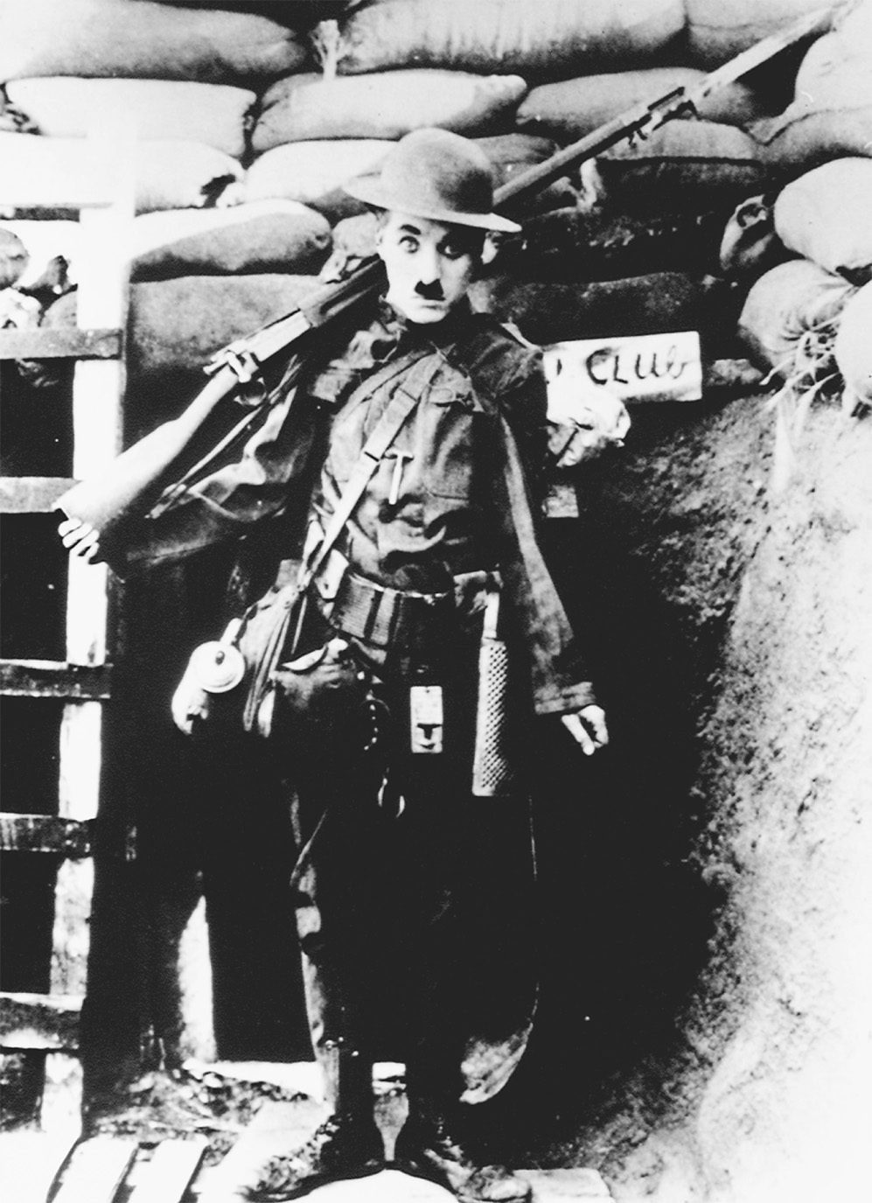
Charlie Chaplin in Shoulder Arms. © Sunset Boulevard/CORBIS Sygma
Notes:
Charlie Chaplin in Shoulder Arms.
© Sunset Boulevard/CORBIS Sygma

Slide 38
Germany’s Last Offensive
In March, the Germans mounted a final unsuccessful offensive.
With Austria, Bulgaria, and Turkey essentially out of the war, the German army was finished.

Slide 39
Germany’s Last Offensive (cont.)
Germany set up a new government to be established on democratic principles and asked for peace based on the Fourteen Points that were the Americans’ war aims.
Fourteen Points included self-determination for nationalities, open diplomacy, freedom of the seas, and the establishment of a League of Nations to keep the peace.

Slide 40
The Armistice
Germans felt betrayed by the terms of the treaty.
Casualties on both sides came to ten million dead and over twenty million wounded.
The financial resources of Europe were badly strained and much of Europe was in debt to Americans.

Slide 41
The Armistice (cont.)
The Great War undermined ideals of Enlightenment progress and humanism.
The aftermath of the Great War paved the way for the Second World War and many of the horrors of the rest of the century.

Slide 42
The End of the Ottoman Empire
Its new leaders, the Young Turks, saw their nation divided amongst Britain and France. In its wake was the new republic of Turkey.
The Arab portions of the old empire were divided into a collection of artificial states with no historical reality, governed by foreign administrators.

Slide 43
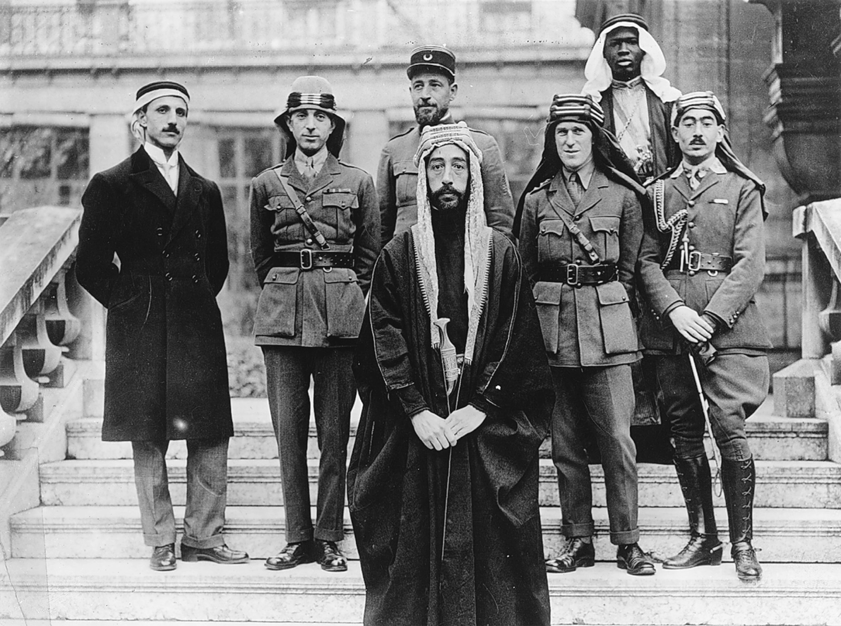
The Allies promoted Arab efforts to secure independence from Turkey in an effort to remove Turkey from the war. Delegates to the peace conference of 1919 in Paris included British colonel T. E. Lawrence, who helped lead the rebellion, and representatives from the Middle Eastern region. Prince Feisal, the third son of King Hussein, stands in the foreground of this picture; Colonel T. E. Lawrence is in the middle row, second from the right; and Brigadier General Nuri Pasha Said of Baghdad is second from the left. CORBIS/Bettmann
Notes:
The Allies promoted Arab efforts to secure independence from Turkey in an effort to remove Turkey from the war. Delegates to the peace conference of 1919 in Paris included British colonel T. E. Lawrence, who helped lead the rebellion, and representatives from the Middle Eastern region. Prince Feisal, the third son of King Hussein, stands in the foreground of this picture; Colonel T. E. Lawrence is in the middle row, second from the right; and Brigadier General Nuri Pasha Said of Baghdad is second from the left.
CORBIS/Bettmann

Slide 44
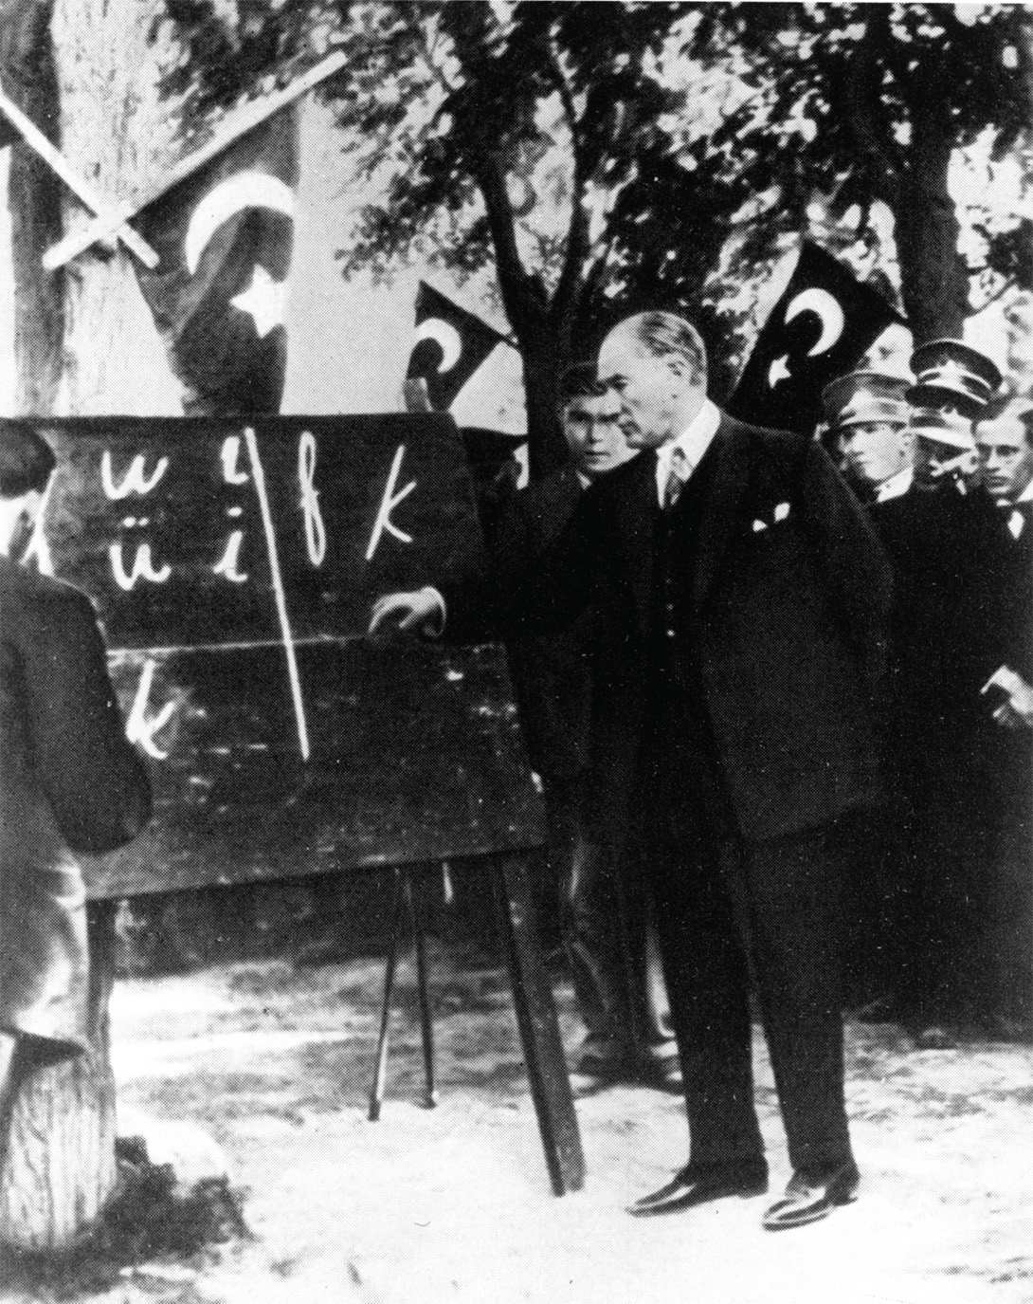
Ataturk (1881–1938), the father of the Turkish Republic, sought to modernize his country by forcing Turks to adopt Western ways, including the Latin alphabet. Here he is shown teaching the alphabet as president in 1928. akg-images/Newscom
Notes:
Ataturk (1881–1938), the father of the Turkish Republic, sought to modernize his country by forcing Turks to adopt Western ways, including the Latin alphabet. Here he is shown teaching the alphabet as president in 1928.
akg-images/Newscom

Slide 45
Obstacles the Peacemakers Faced
Public opinion was a major force in politics.
Many of Europe’s ethnic groups agitated for attention.
Wilson’s idealism conflicted with the practical war aims of the victorious powers.
Some nations had competing claims for land.
The victorious nations feared the spread of Bolshevism.

Slide 46
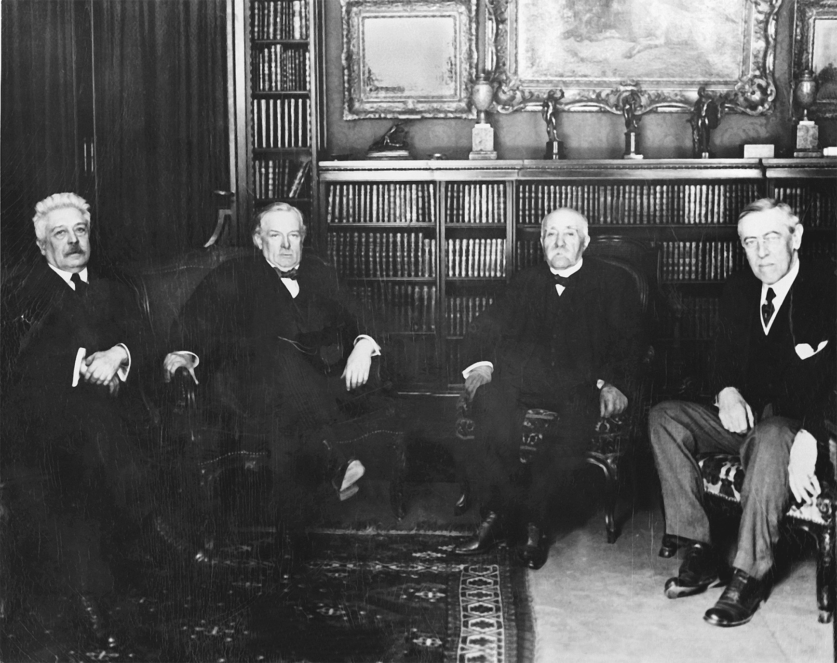
“The Big Four” attending the Paris peace conference in 1919: Vittorio Orlande, premier of Italy; David Lloyd George, prime minister of Great Britain; Georges Clemenceau, premier of France; and Woodrow Wilson, president of the United States (left to right). National Archives and Records Administration
Notes:
“The Big Four” attending the Paris peace conference in 1919: Vittorio Orlande, premier of Italy; David Lloyd George, prime minister of Great Britain; Georges Clemenceau, premier of France; and Woodrow Wilson, president of the United States (left to right).
National Archives and Records Administration

Slide 47
The Peace
The Soviet Union and Germany were excluded from the peace conference for the Treaty of Versailles.
The League of Nations was established.
Colonial areas would be encouraged to advance toward independence.

Slide 48
The Peace (cont.)
Germany ceded Alsace-Lorraine to France, part of the Rhine was declared a demilitarized zone, and German military limitations were established.
Germany was forced to pay all of the damages to the Allies, known as reparations, and the war guilt clause gave Germany sole responsibility for the war.

Slide 49
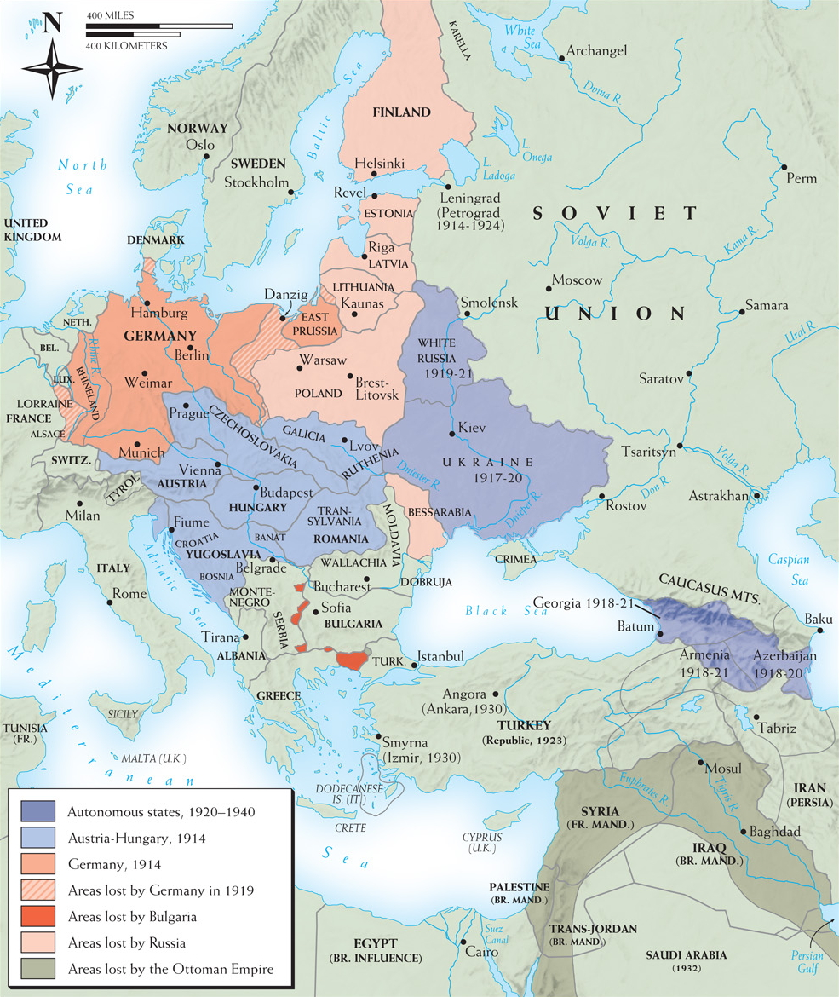
Map 26–5 WORLD WAR I PEACE SETTLEMENT IN EUROPE AND THE MIDDLE EAST The map of central and eastern Europe, as well as that of the Middle East, underwent drastic revision after World War I. The enormous territorial losses suffered by Germany, Austria-Hungary, the Ottoman Empire, Bulgaria, and Russia were the other side of the coin represented by gains for France, Italy, Greece, and Romania and by the appearance or reappearance of at least eight new independent states from Finland in the north to Yugoslavia in the south. The mandate system for former Ottoman territories outside Turkey proper laid foundations for several new, mostly Arab, states in the Middle East. In Africa, the mandate system placed the former German colonies under British, French, and South African rule. (See Map 25–2, page 833.)
Notes:
Map 26–5 WORLD WAR I PEACE SETTLEMENT IN EUROPE AND THE MIDDLE EAST The map of central and eastern Europe, as well as that of the Middle East, underwent drastic revision after World War I. The enormous territorial losses suffered by Germany, Austria-Hungary, the Ottoman Empire, Bulgaria, and Russia were the other side of the coin represented by gains for France, Italy, Greece, and Romania and by the appearance or reappearance of at least eight new independent states from Finland in the north to Yugoslavia in the south. The mandate system for former Ottoman territories outside Turkey proper laid foundations for several new, mostly Arab, states in the Middle East. In Africa, the mandate system placed the former German colonies under British, French, and South African rule. (See Map 25–2, page 833.)

Slide 50
Evaluating the Peace
The peace violated some idealistic principles.
It left many minorities outside the borders of their national homelands.
By excluding Germany and Russia, the settlement ignored the reality of their European influence.
Germany felt cheated.

