Slide 1
Chapter 25
The Age of Western Imperialism

Slide 2
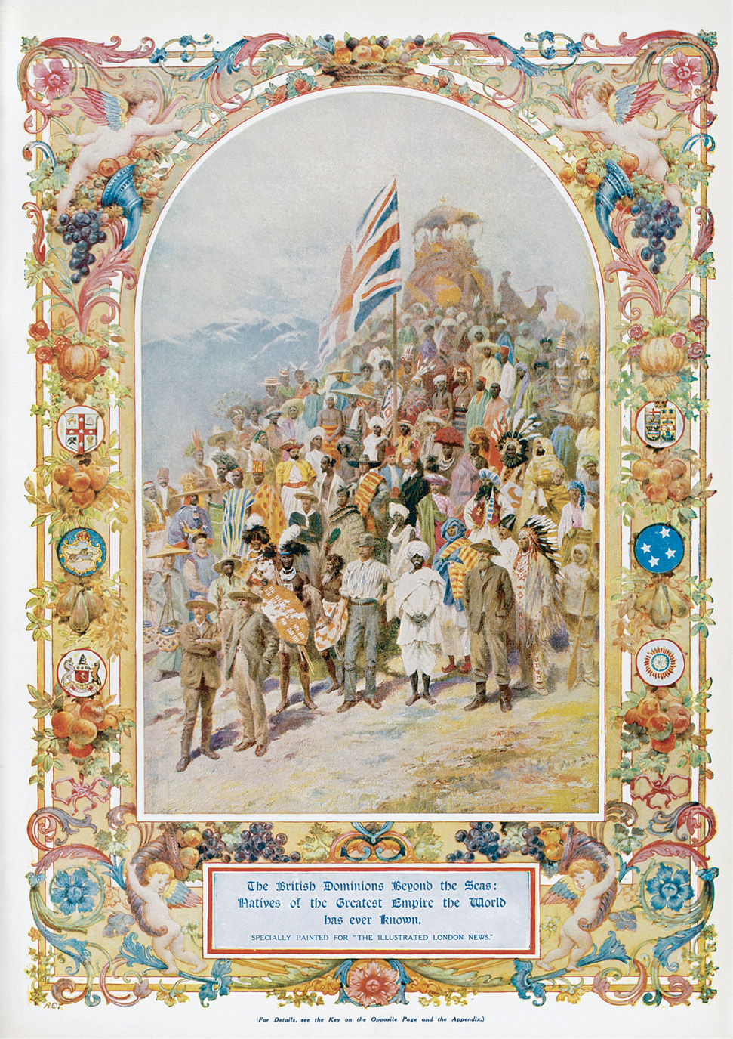
The global British Empire dominated the nineteenth-century European imperial experience. The empire was popularized in newspapers, books, and novels, as well as in thousands of illustrations and photographs. This illustration seeks to portray the worldwide reach of the British Empire and the varied peoples whom it governed abroad and, at the same time, as seen in the caption, how it sought to build domestic pride in the imperial achievement. Similar illustrations could be found portraying the empires of France, Germany, the Netherlands, Belgium, and Russia. “Citizens of the British Empire, the Greatest Empire the world has ever known...” 1911, London Illustrated News. Mary Evans Picture Library
Notes:
The global British Empire dominated the nineteenth-century European imperial experience. The empire was popularized in newspapers, books, and novels, as well as in thousands of illustrations and photographs. This illustration seeks to portray the worldwide reach of the British Empire and the varied peoples whom it governed abroad and, at the same time, as seen in the caption, how it sought to build domestic pride in the imperial achievement. Similar illustrations could be found portraying the empires of France, Germany, the Netherlands, Belgium, and Russia.
“Citizens of the British Empire, the Greatest Empire the world has ever known...” 1911, London Illustrated News. Mary Evans Picture Library

Slide 3
The Close of the Age of Early Modern Colonization
The era of early modern European expansion saw a conflict among European powers for dominance in North America, the establishment of trading posts in Africa and Asia, Dutch dominance in Indonesia, and British dominance in India.
The collapse of Spain, Portugal, and France as colonial powers left Britain as Europe’s most powerful imperialist nation.

Slide 4
The Age of British Imperial Dominance
Imperialism of Free Trade
The Industrial Revolution and British imperialism
Free trade and military conflict
The Opium Wars
British Settler Colonies
Canada, Australia, New Zealand

Slide 5
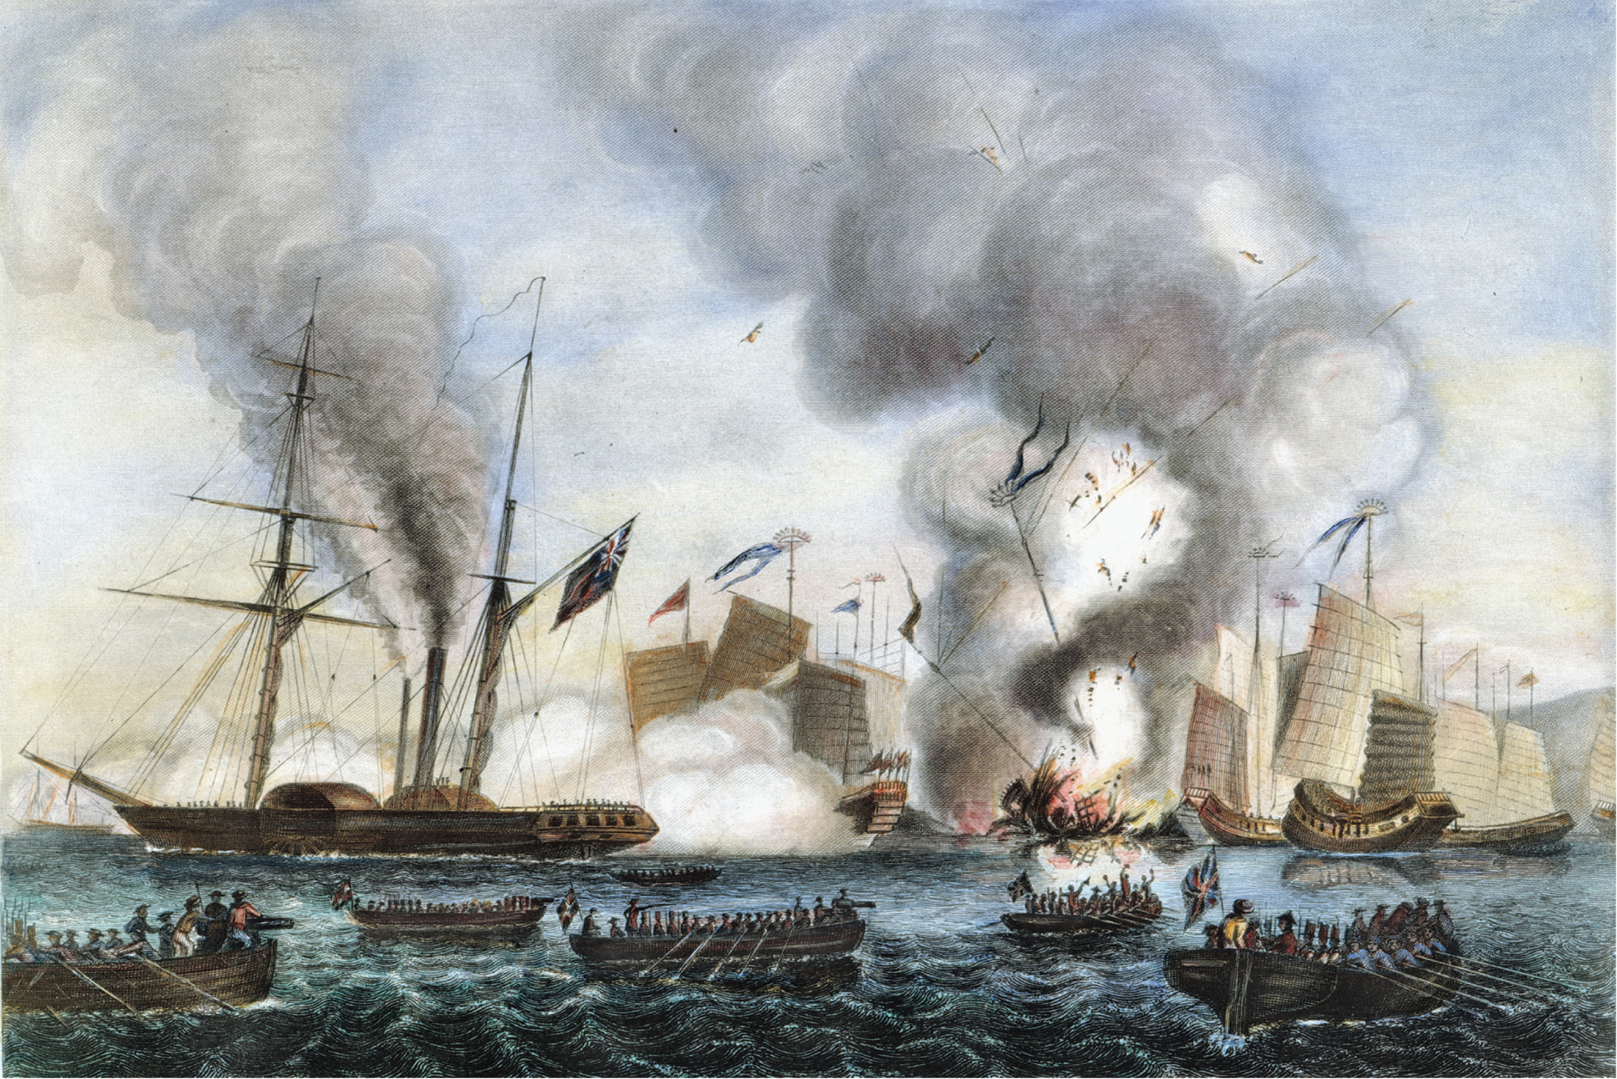
Armed Chinese junks were no match for British warships during the first Opium War. The war ended in 1842 with the Treaty of Nanjing. The Granger Collection, NYC—All rights reserved
Notes:
Armed Chinese junks were no match for British warships during the first Opium War. The war ended in 1842 with the Treaty of Nanjing.
The Granger Collection, NYC—All rights reserved

Slide 6
India – The Jewel in the Crown of the British Empire
British shift away from Atlantic to Asia
Challenges of controlling India
Vast heterogeneous population
Complex social and economic conditions
Non-Western religions
The East India Company
Changing rationale for British rule in India
The 1857 Sepoy Rebellion

Slide 7
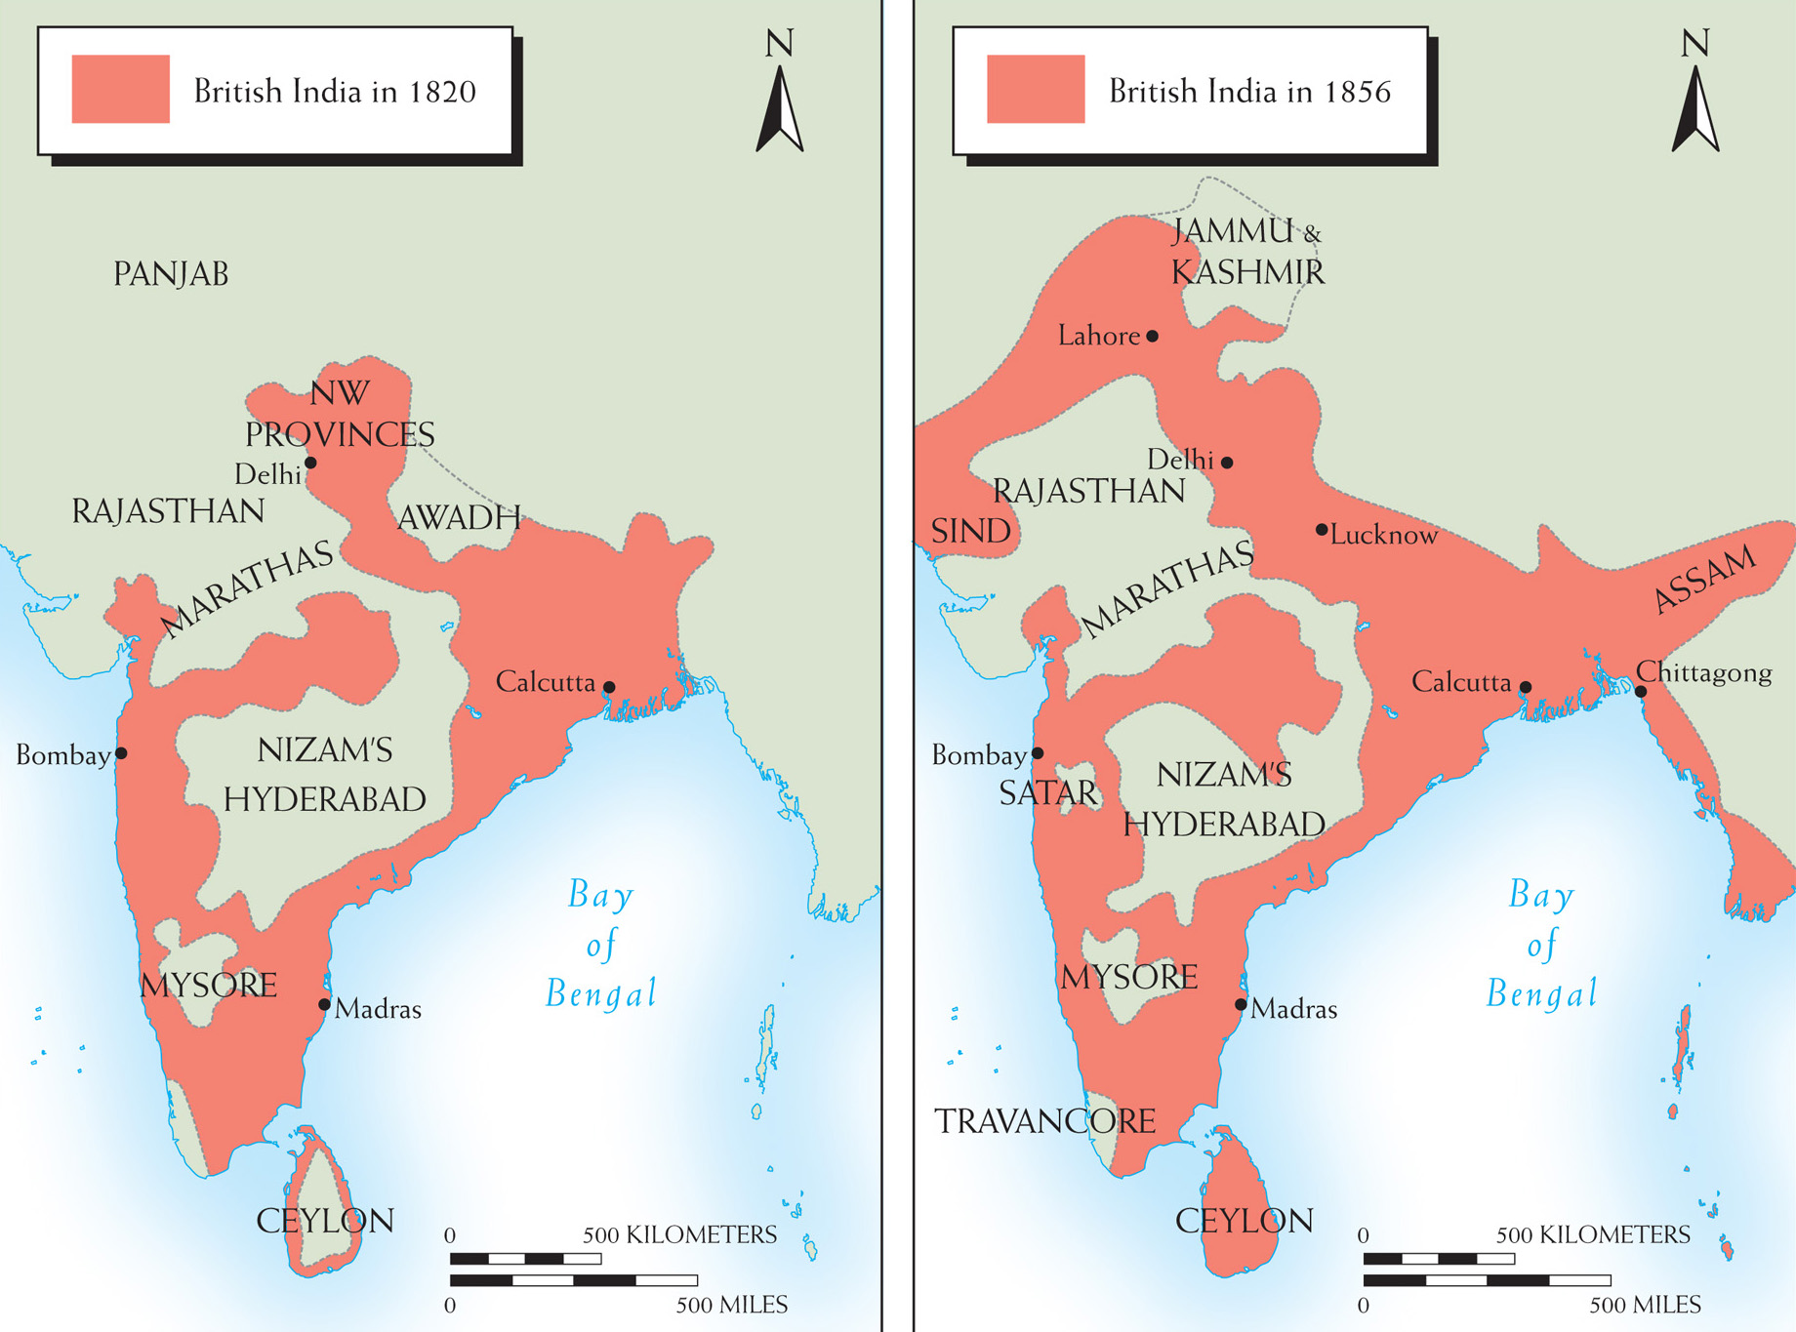
Map 25–1 BRITISH INDIA, 1820 and 1856.
Notes:
Map 25–1 BRITISH INDIA, 1820 and 1856.

Slide 8
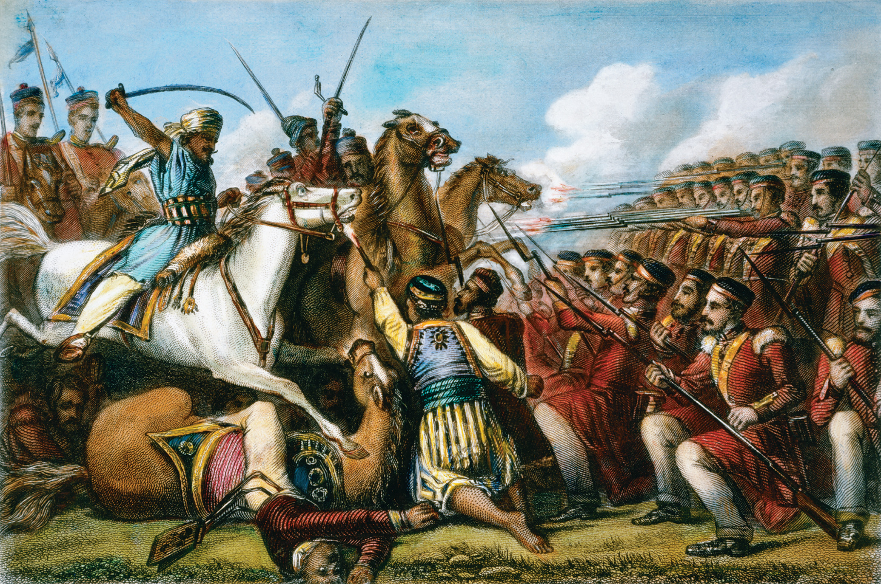
The mutinous sepoy cavalry attacking a British infantry division at the Battle of Cawnpore in 1857. Although the uprising was suppressed, it was not easily forgotten. In its aftermath the British reorganized the government of India. The Granger Collection, New York
Notes:
The mutinous sepoy cavalry attacking a British infantry division at the Battle of Cawnpore in 1857. Although the uprising was suppressed, it was not easily forgotten. In its aftermath the British reorganized the government of India.
The Granger Collection, New York

Slide 9
The New Imperialism, 1870 – 1914
Expansion of Western control between 1870 and 1900
What was “new” about the new imperialism?
More intentionally imperial and involved direct control by Westerners
Occurred over a brief period of time and involved many nations
Few settlers

Slide 10
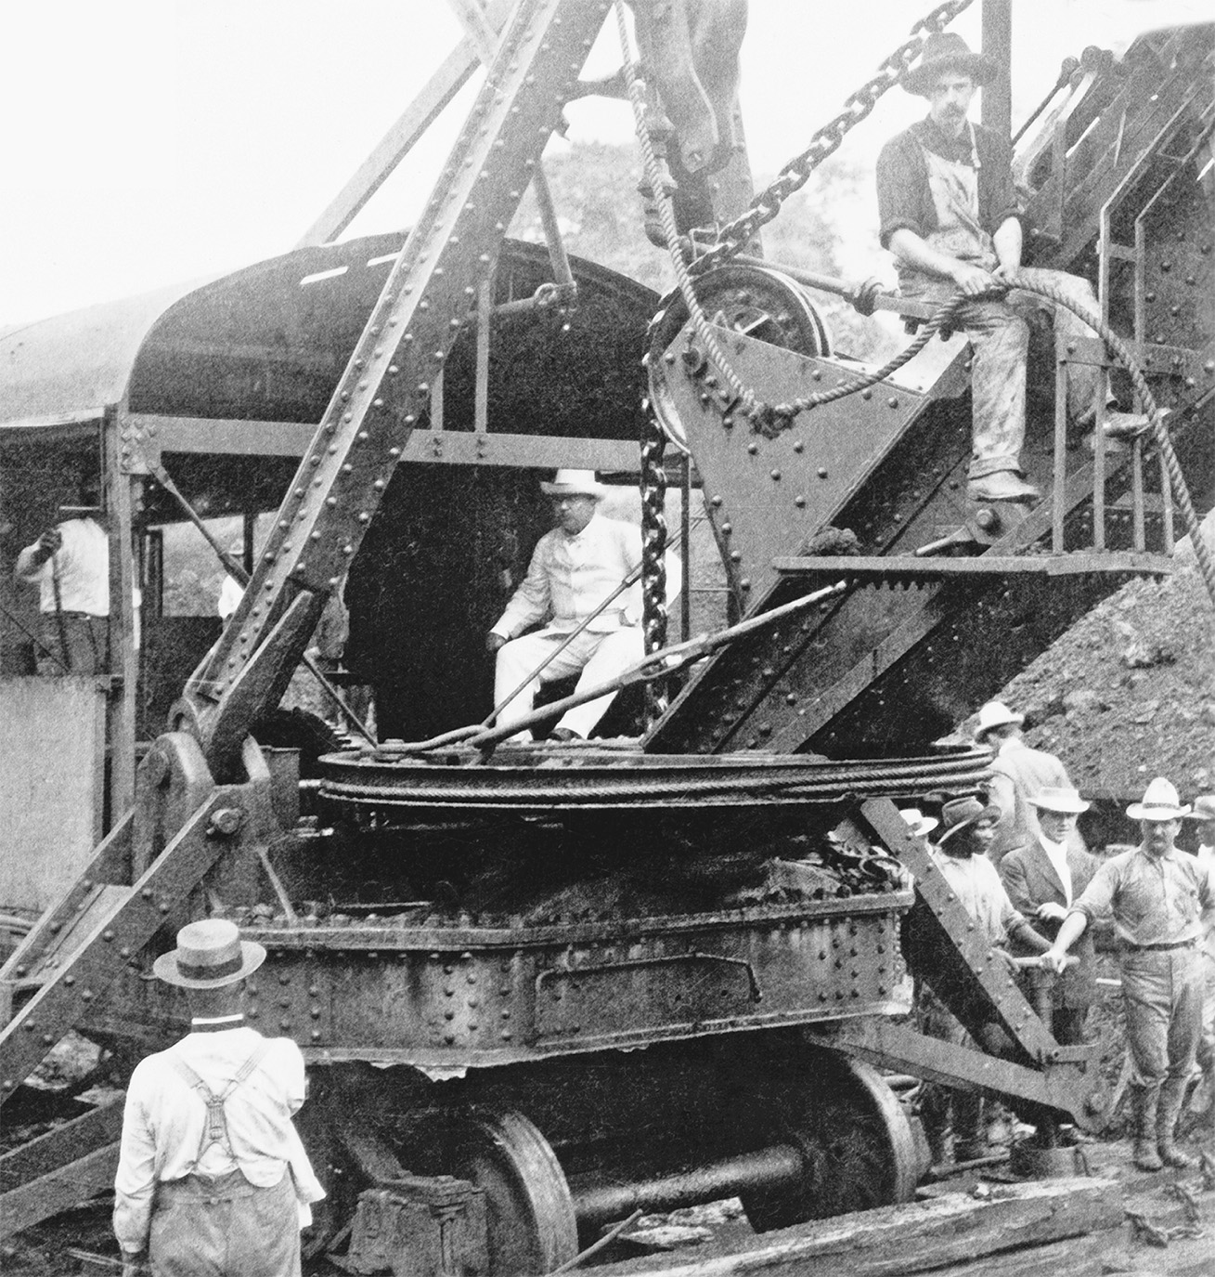
President Theodore Roosevelt at the controls of a steam shovel during construction of the Panama Canal in 1906. The Panama Canal serves as an example of U.S. imperialist ventures in the Western Hemisphere. Library of Congress
Notes:
President Theodore Roosevelt at the controls of a steam shovel during construction of the Panama Canal in 1906. The Panama Canal serves as an example of U.S. imperialist ventures in the Western Hemisphere.
Library of Congress

Slide 11
Motives for the New Imperialism
Economic motives cannot account for the entire impetus behind New Imperialism
Social Darwinist groups claimed Europeans had an obligation to civilize “backward” peoples
Religious groups agitated for the spread of Christianity
Some suggested imperialism be used to attract attention away from social policy

Slide 12
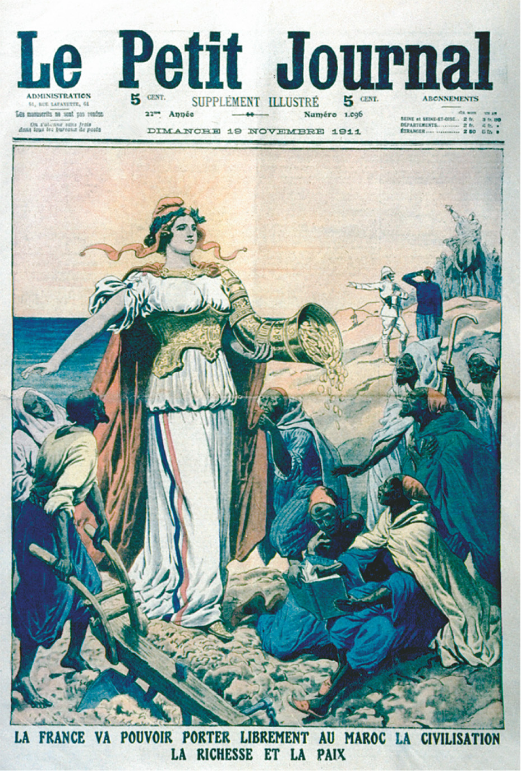
The French in Morocco Many imperialists—European, American, and Asian—claimed altruistic motives for their acquisition of colonies. The French, especially, have always taken pride in bringing “French civilization” to the lands France ruled. This cover of a magazine appeared in November 1911, the year when the French decision to extend and tighten their control of Morocco sparked a serious international crisis. It is a good example of how France justified its colonial empire as a “mission civilitrice,” a vocation to bring civilization to “backward” peoples. The Granger Collection, New York
Notes:
The French in Morocco Many imperialists—European, American, and Asian—claimed altruistic motives for their acquisition of colonies. The French, especially, have always taken pride in bringing “French civilization” to the lands France ruled. This cover of a magazine appeared in November 1911, the year when the French decision to extend and tighten their control of Morocco sparked a serious international crisis. It is a good example of how France justified its colonial empire as a “mission civilitrice,” a vocation to bring civilization to “backward” peoples. The Granger Collection, New York

Slide 13
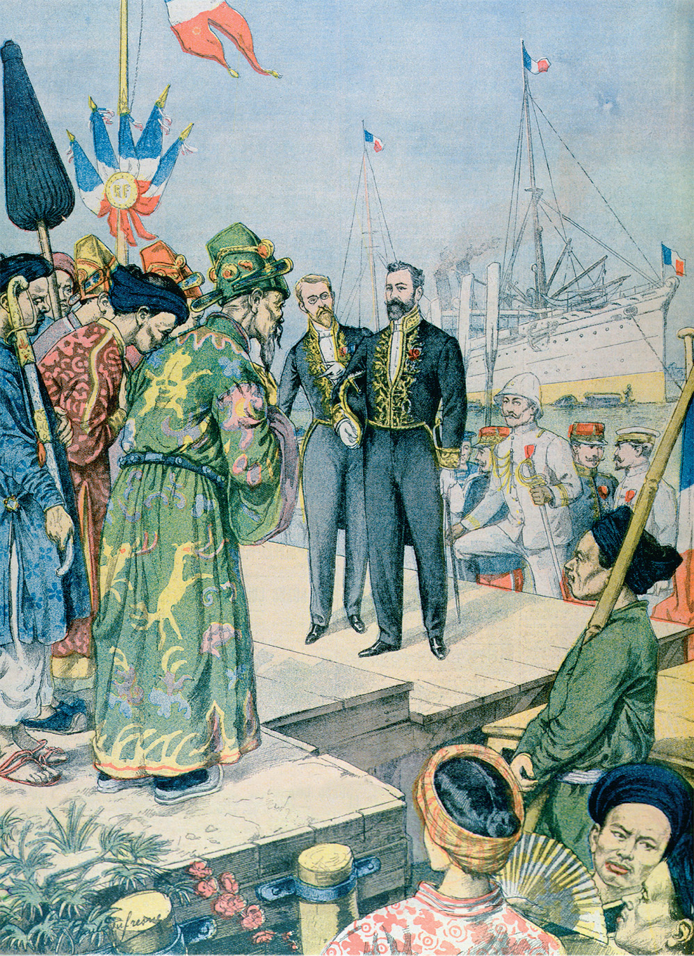
Arrival in Saigon of Paul Beau (1857–1927), governor general of Indo-China 1902–1907, from Le Petit Journal, November 1902. Arrival in Saigon of Paul Beau (1857–1927), Governor General of Indo-China 1902–07, from ‘Le Petit Journal’, November 1902 (colour engraving), Dufresne, Charles Georges (1876–1938)/Private Collection/Archives Charmet/The Bridgeman Art Library
Notes:
Arrival in Saigon of Paul Beau (1857–1927), governor general of Indo-China 1902–1907, from Le Petit Journal, November 1902. Arrival in Saigon of Paul Beau (1857–1927), Governor General of Indo-China 1902–07, from ‘Le Petit Journal’, November 1902 (colour engraving), Dufresne, Charles Georges (1876–1938)/Private Collection/Archives Charmet/The Bridgeman Art Library

Slide 14
The Partition of Africa
Between the late 1870s and 1900, European powers divided the entire continent among themselves, motivated by economic and political competition
The nations used a variety of rationalizations to justify their actions
Important African raw materials include ivory, rubber, minerals, diamonds, and gold
Berlin Conference
Mapped out which European nation had access to certain parts of Africa
European nations appointed administrators to supervise their African possessions

Slide 15
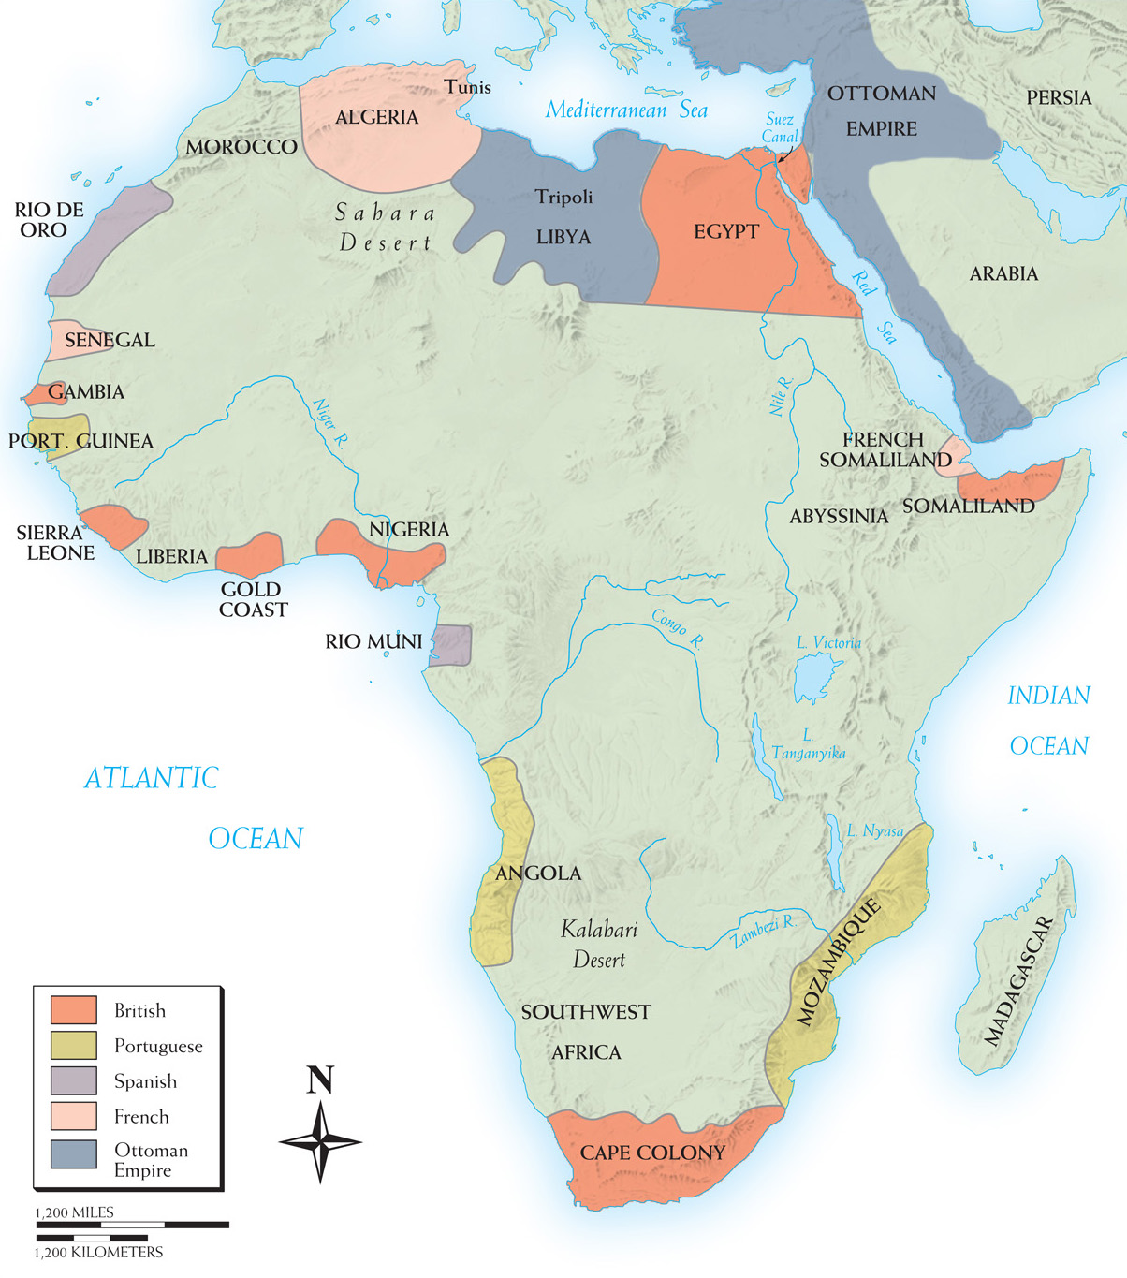
Map 25–2 IMPERIAL EXPANSION IN AFRICA TO 1880 Until the 1880s, few European countries held colonies in Africa, mostly on its fringes.
Notes:
Map 25–2 IMPERIAL EXPANSION IN AFRICA TO 1880 Until the 1880s, few European countries held colonies in Africa, mostly on its fringes.

Slide 16
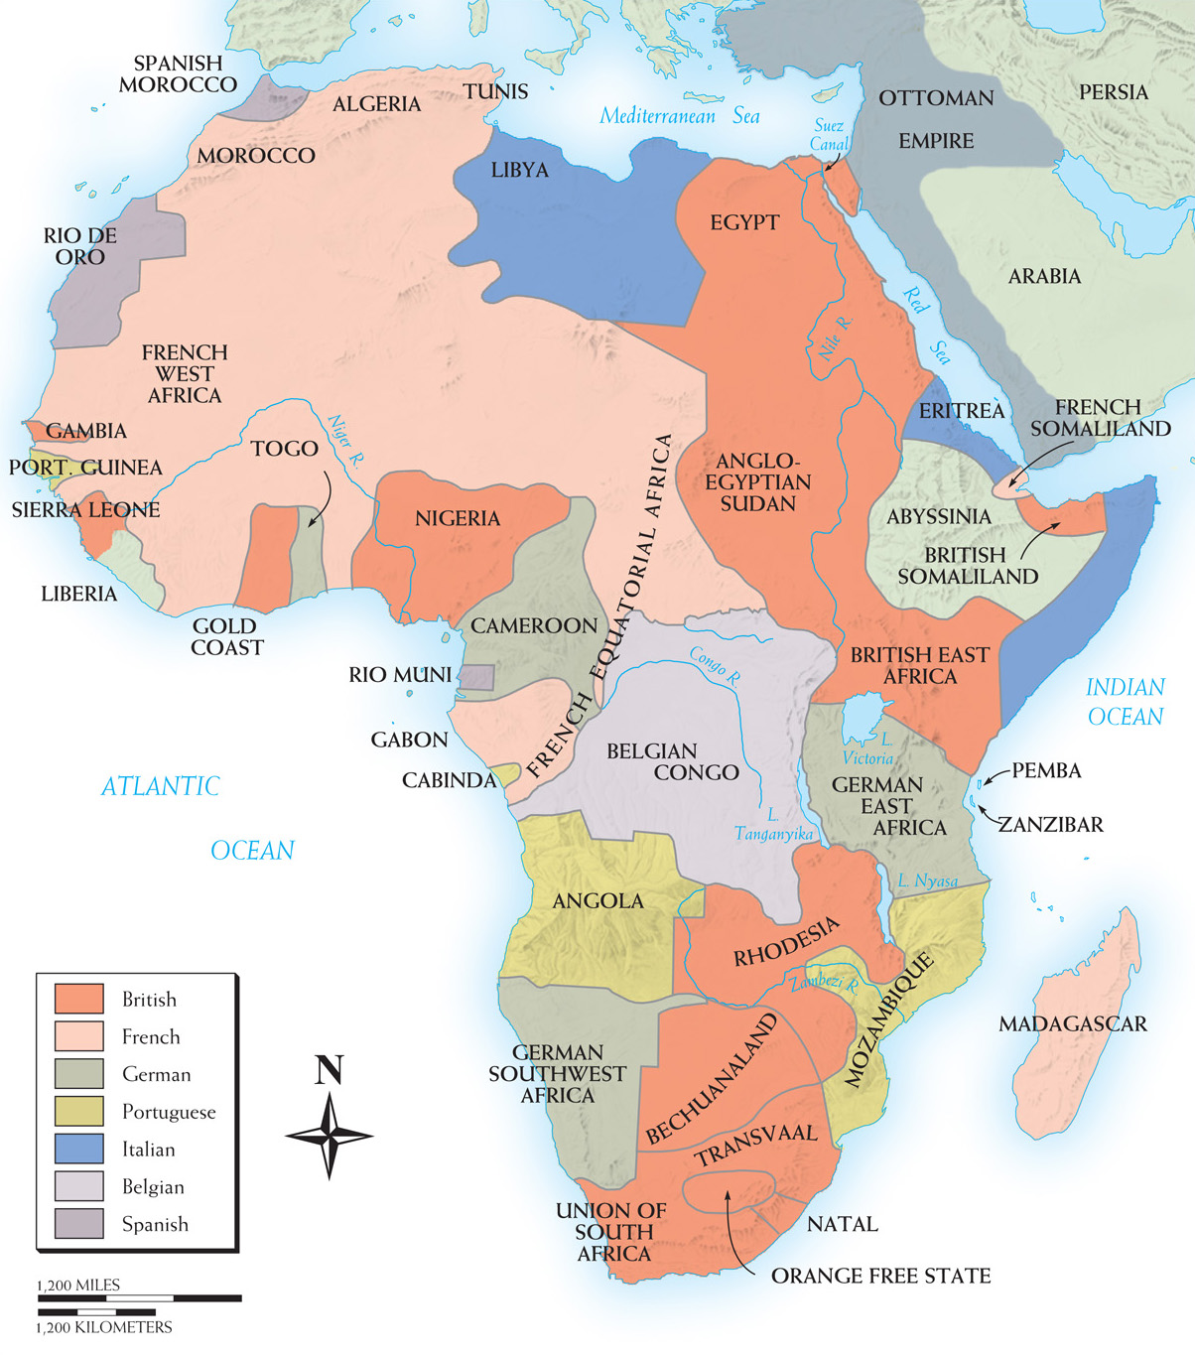
Map 25–3 PARTITION OF AFRICA, 1880–1914 Before 1880, the European presence in Africa was largely the remains of early exploration by old imperialists and did not penetrate the heart of the continent. By 1914, the occupying powers included most large European states; only Liberia and Abyssinia (Ethiopia) remained independent.
Notes:
Map 25–3 PARTITION OF AFRICA, 1880–1914 Before 1880, the European presence in Africa was largely the remains of early exploration by old imperialists and did not penetrate the heart of the continent. By 1914, the occupying powers included most large European states; only Liberia and Abyssinia (Ethiopia) remained independent.

Slide 17
North Africa
Technically part of Ottoman Empire
Pressure applied diplomatically and through investments and loans to exert influence on the area

Slide 18
Egypt
Sold cotton as a cash crop on the international market
Financed the Suez Canal through foreign loans
The bankrupt government was overthrown by the army in 1881
Britain defeated the army and installed administrators to ensure repayment of their loans for the Suez Canal and access to the path to India

Slide 19
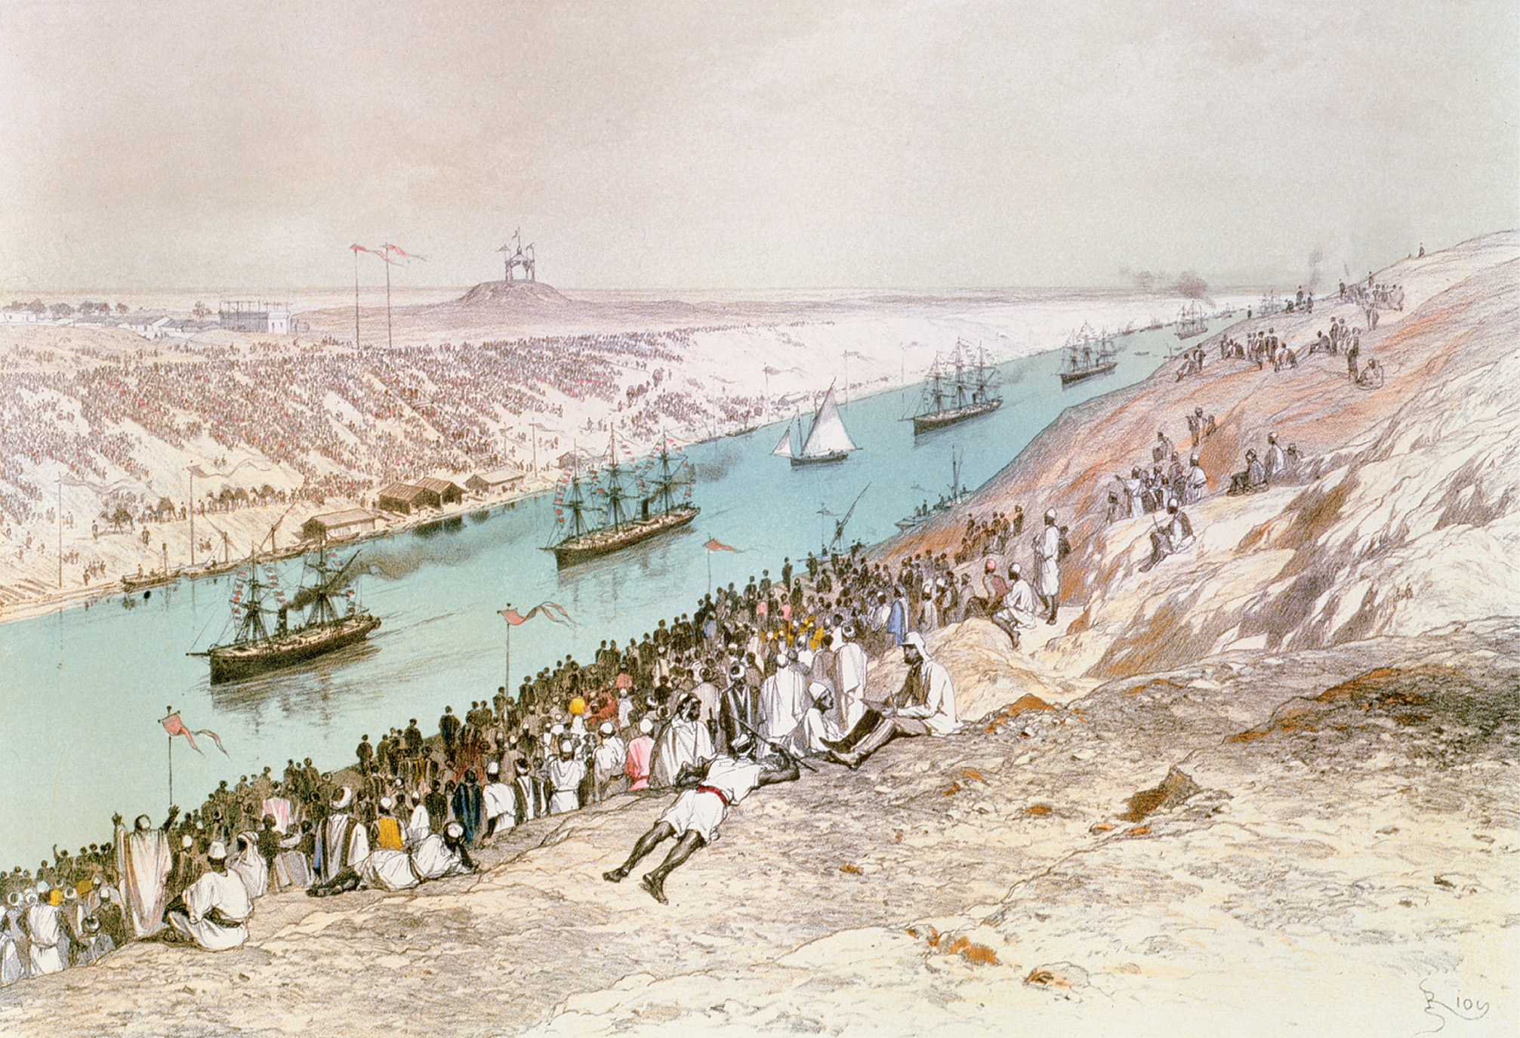
The opening of the Suez Canal in 1869, linking Asia and Europe, was a major engineering achievement. It also became a major international waterway, reducing the distance from London to Bombay by half. The Inauguration Procession of the Suez Canal at El-Guisr in 1865, from ‘Voyage Pittoresque a travers l’Isthme de Suez’ by Marius Fontane, engraved by Jules Didier (1831–c.80) 1869–70 (colour litho), Riou, Edouard (1833–1900)/Bibliotheque des Arts Decoratifs, Paris, France/Archives Charmet/ The Bridgeman Art Library
Notes:
The opening of the Suez Canal in 1869, linking Asia and Europe, was a major engineering achievement. It also became a major international waterway, reducing the distance from London to Bombay by half.
The Inauguration Procession of the Suez Canal at El-Guisr in 1865, from ‘Voyage Pittoresque a travers l’Isthme de Suez’ by Marius Fontane, engraved by Jules Didier (1831–c.80) 1869–70 (colour litho), Riou, Edouard (1833–1900)/Bibliotheque des Arts Decoratifs, Paris, France/Archives Charmet/ The Bridgeman Art Library

Slide 20
West Africa
France controlled much of sub-Saharan Africa
The British had four West African colonies: Sierra Leone, Gambia, the Gold Coast (now Ghana), and Nigeria

Slide 21
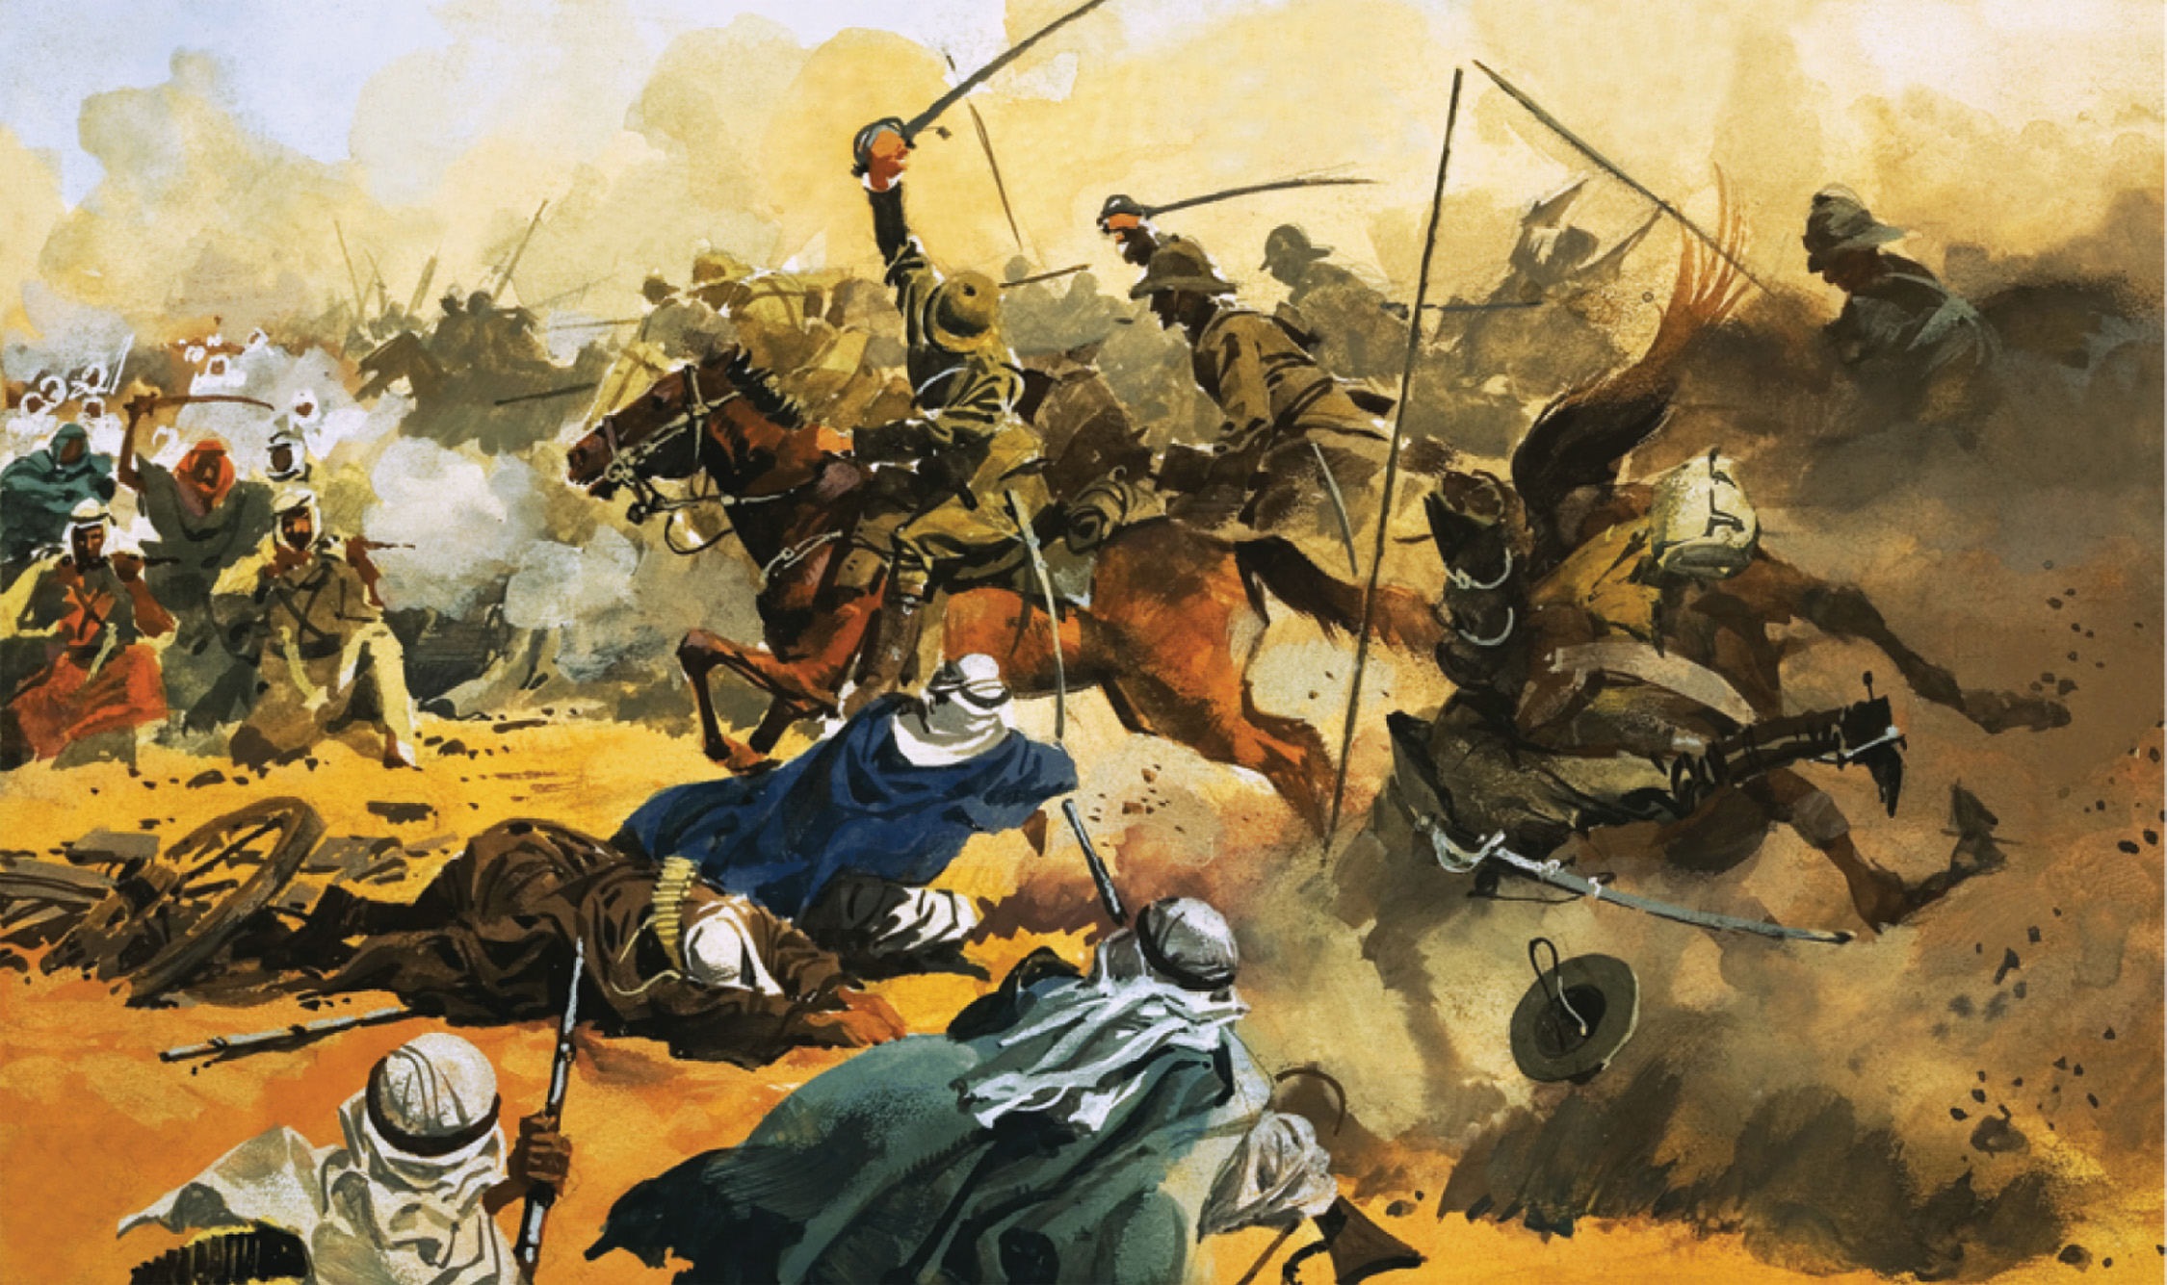
The battle of Omdurman, fought on September 2, 1898, and described in the Churchill feature on page 800, demonstrated the capacity of European forces armed with the most modern weapons— in this case, a British army composed of British, Egyptian, and Sudanese troops, commanded by Major General Sir Horatio Kitchener—to decimate a vast Sudanese force armed with less advanced weapons. In the battle, which occurred near Khartoum, the British encircled the Sudanese forces. Approximately 10,000 African warriors were killed, while British losses numbered forty-eight men. The 21st Lancers lead the battle against the Arab stronghold at Omdurman in 1897, Tacconi, Ferdinando (1922–2006). Private Collection/© Look and Learn/The Bridgeman Art Library International
Notes:
The battle of Omdurman, fought on September 2, 1898, and described in the Churchill feature on page 800, demonstrated the capacity of European forces armed with the most modern weapons— in this case, a British army composed of British, Egyptian, and Sudanese troops, commanded by Major General Sir Horatio Kitchener—to decimate a vast Sudanese force armed with less advanced weapons. In the battle, which occurred near Khartoum, the British encircled the Sudanese forces. Approximately 10,000 African warriors were killed, while British losses numbered forty-eight men.
The 21st Lancers lead the battle against the Arab stronghold at Omdurman in 1897, Tacconi, Ferdinando (1922–2006). Private Collection/© Look and Learn/The Bridgeman Art Library International

Slide 22
Belgian Congo
King Leopold financed Henry Morton Stanley’s African explorations on his behalf
Berlin Conference codified his “treaties” with local tribes
Leopold cultivated the image of a humanitarian ruler while imposing brutal conditions on those who lived in the Congo
In thirty years as ruler, approximately one-half of the Congo population were victims of murder, exploitation, starvation, and disease

Slide 23
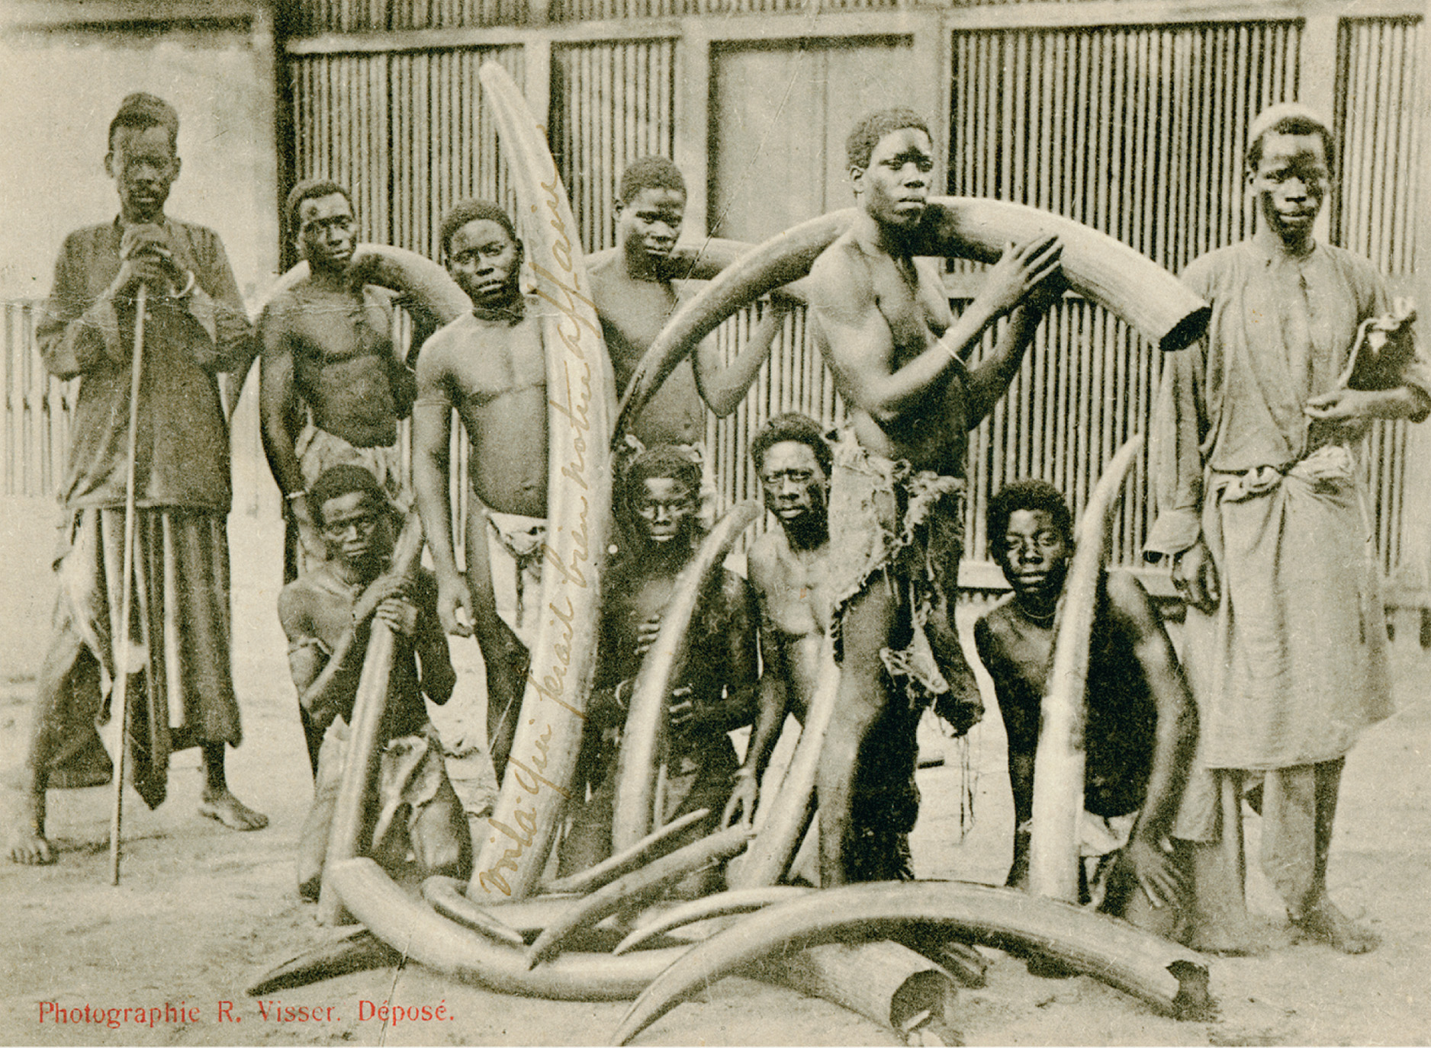
Ivory was a prized possession used for decorative purposes and jewelry. Caravan with Ivory, French Congo, (now the Republic of the Congo). Robert Visser (1882–1894). c. 1890–1900, postcard, collotype. Publisher unknown, c. 1900. Postcard 1912. Image No. EEPA 1985-140792. Eliot Elisofon Photographic Archives. National Museum of African Art, Smithsonian Institution
Notes:
Ivory was a prized possession used for decorative purposes and jewelry.
Caravan with Ivory, French Congo, (now the Republic of the Congo). Robert Visser (1882–1894). c. 1890–1900, postcard, collotype. Publisher unknown, c. 1900. Postcard 1912. Image No. EEPA 1985-140792. Eliot Elisofon Photographic Archives. National Museum of African Art, Smithsonian Institution

Slide 24
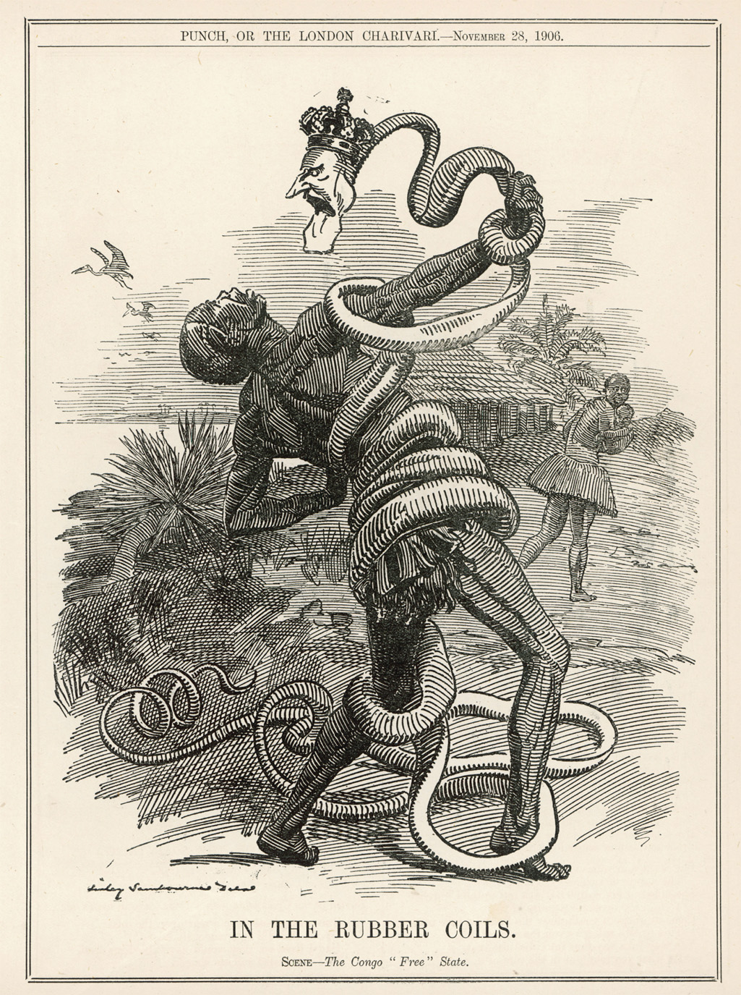
In this 1906 cartoon, King Leopold II is depicted as a snake squeezing a Congolese rubber worker to death in his coils. In the background, a woman flees in horror, clutching a baby. Leopold’s policies in Belgium led directly to the death of half of the native population of his territory in only thirty years. © Mary Evans Picture Library/Alamy
Notes:
In this 1906 cartoon, King Leopold II is depicted as a snake squeezing a Congolese rubber worker to death in his coils. In the background, a woman flees in horror, clutching a baby. Leopold’s policies in Belgium led directly to the death of half of the native population of his territory in only thirty years.
© Mary Evans Picture Library/Alamy

Slide 25
German Empire in Africa
In 1884 and 1885, Germany established protectorates over South-West Africa (today Namibia), Togoland, the Cameroons, and Tanganyika
German imperialism was short-lived, involved few Germans, and produced no significant economic returns
Genocide in South-West Africa
1904 Genocide against the Herero people

Slide 26
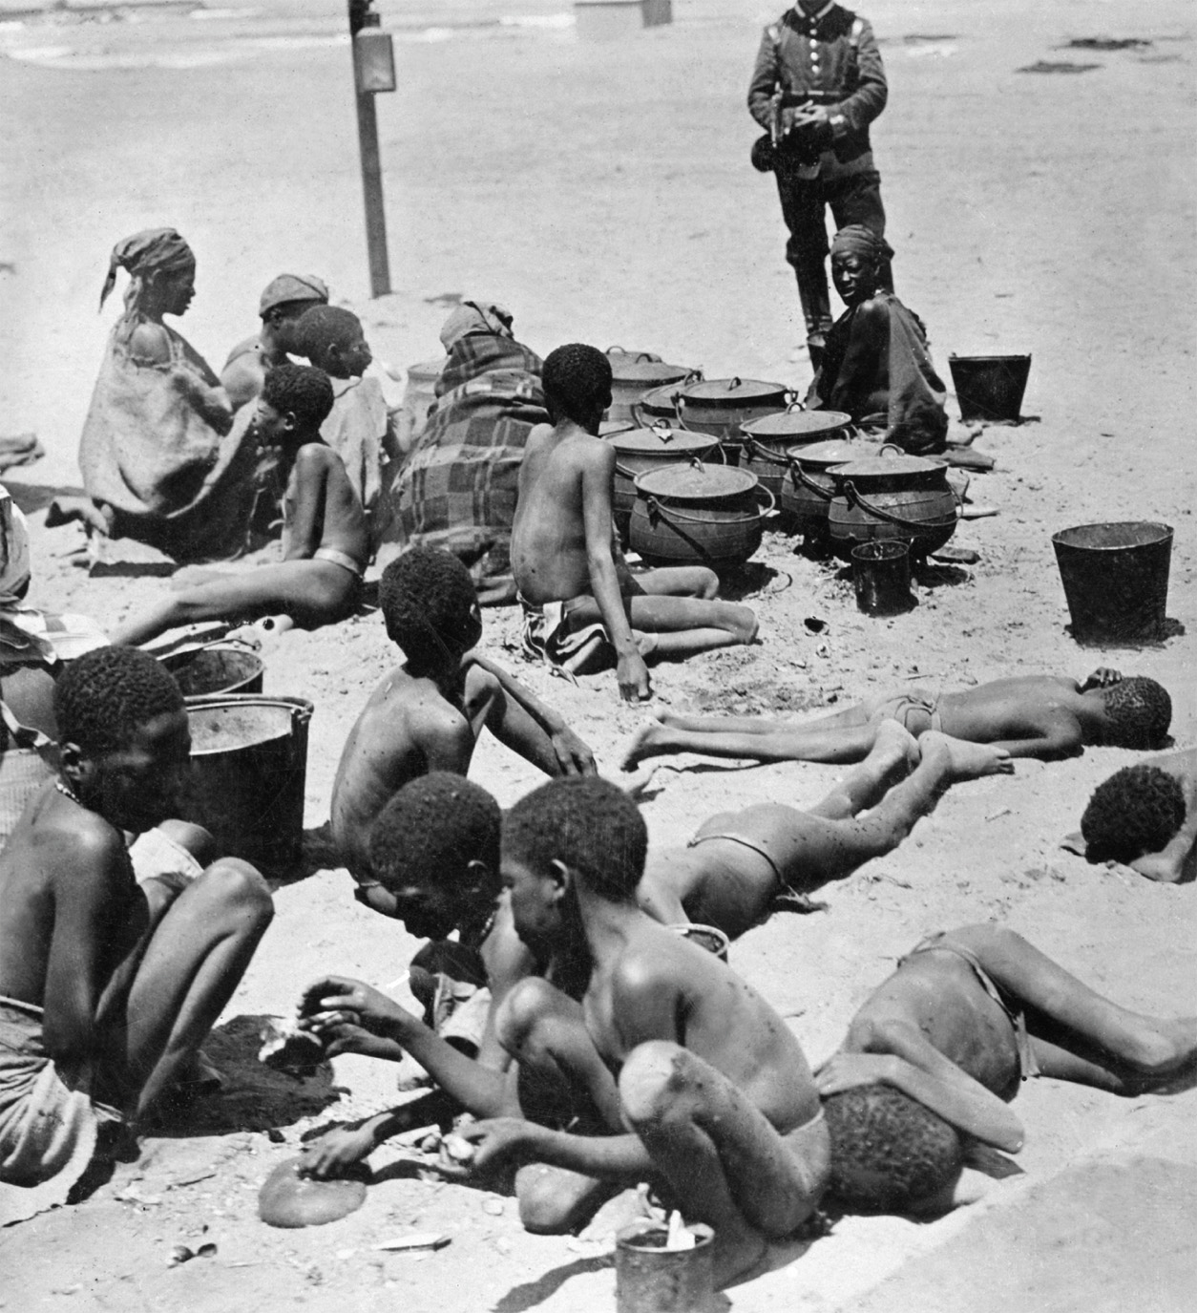
A German soldier guards Herero women and children in a prison camp in German South-West Africa in 1906. ullstein bild/The Granger Collection, NYC—All rights reserved
Notes:
A German soldier guards Herero women and children in a prison camp in German South-West Africa in 1906.
ullstein bild/The Granger Collection, NYC—All rights reserved

Slide 27
Southern Africa
Important resources include fertile pastures and farmland, deposits of coal, iron ore, gold, diamonds, and copper
Partially inhabited by the Afrikaners, or Boers, descendents of Dutch settlers
After a series of bloody wars, the British arranged with the Boers for a white-only ruling class
Apartheid
“Separateness” – the policy that segregated non-whites and granted virtually no civil rights in South Africa to Africans

Slide 28
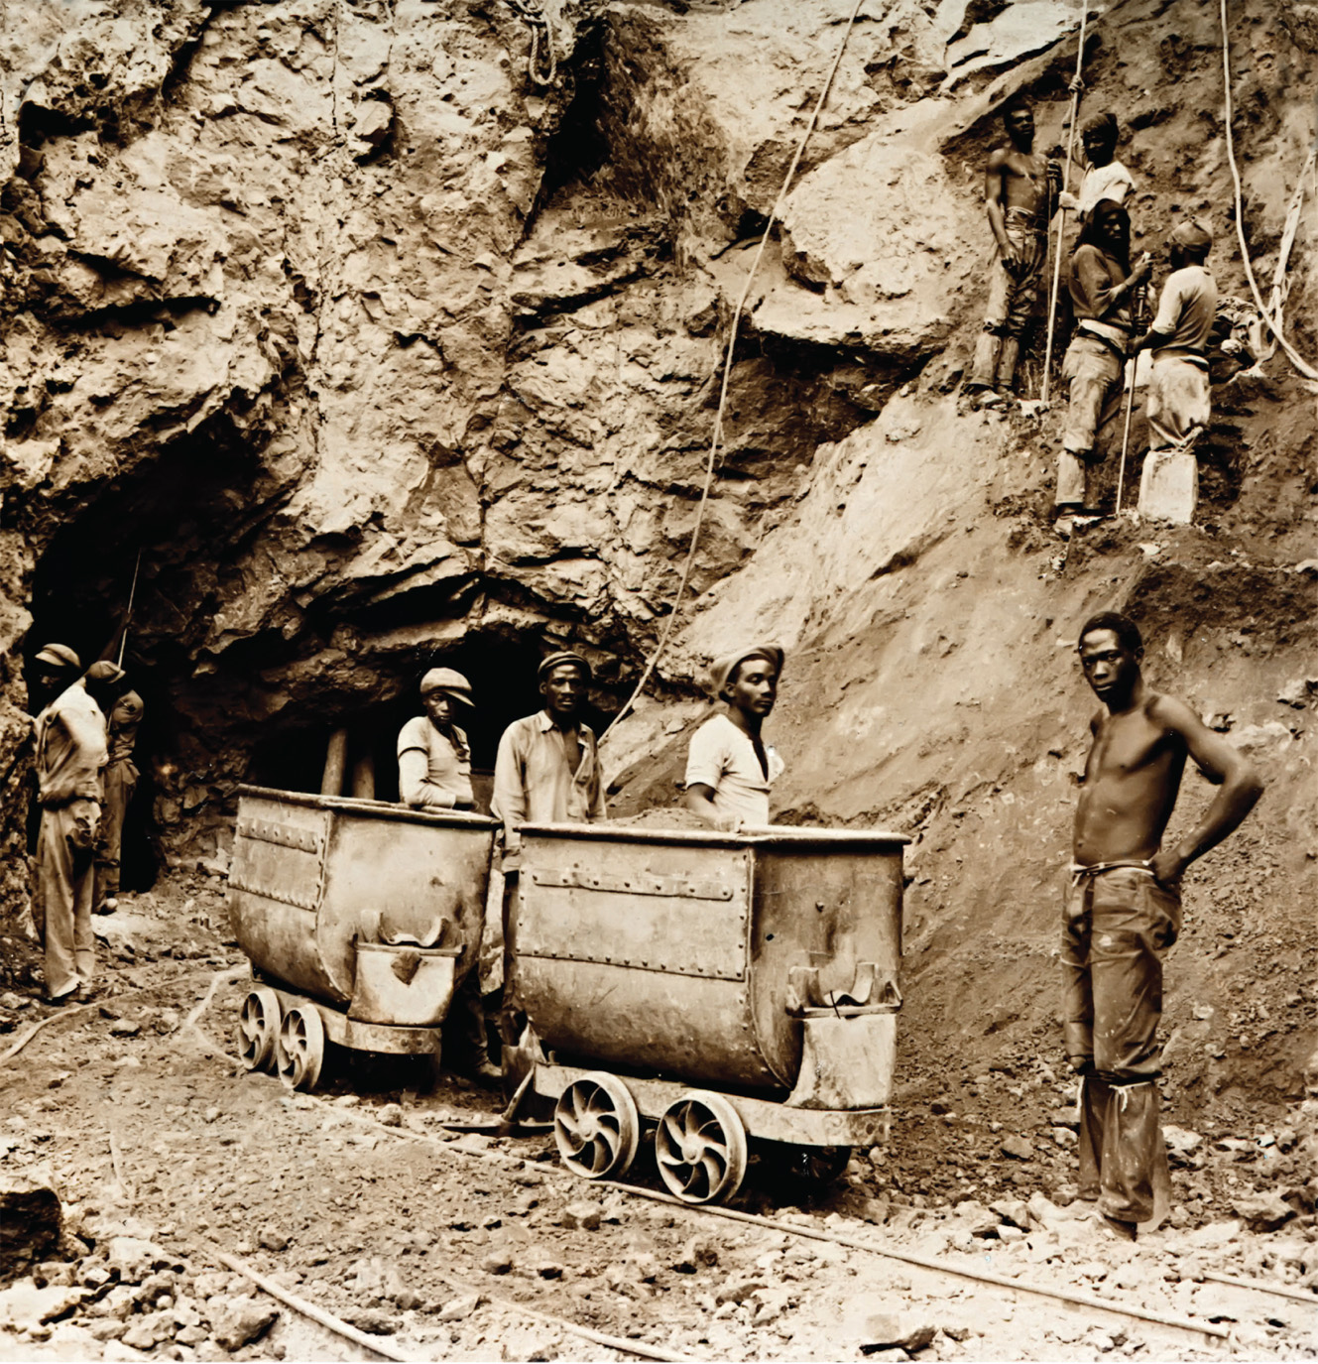
Diamond mining in South Africa took off in the late 1860s. By 1880 Kimberly, the biggest mine in the region, had 30,000 people, second only to Cape Town. Whites monopolized the well-paid, skilled jobs, while black Africans undertook dangerous work in the mines. This photograph was taken around 1900, when the De Beers diamond mines employed nearly 4,000 people. © Chris Howes/Wild Places Photography/ Alamy
Notes:
Diamond mining in South Africa took off in the late 1860s. By 1880 Kimberly, the biggest mine in the region, had 30,000 people, second only to Cape Town. Whites monopolized the well-paid, skilled jobs, while black Africans undertook dangerous work in the mines. This photograph was taken around 1900, when the De Beers diamond mines employed nearly 4,000 people.
© Chris Howes/Wild Places Photography/ Alamy

Slide 29
Russian Expansion in Mainland Asia
Consolidation of control around the Baltic Sea
Changing attitude toward nomadic societies
19th Century Russian Expansion
The Transcaucasus
Steppes of Central Asia
Southern Middle East

Slide 30
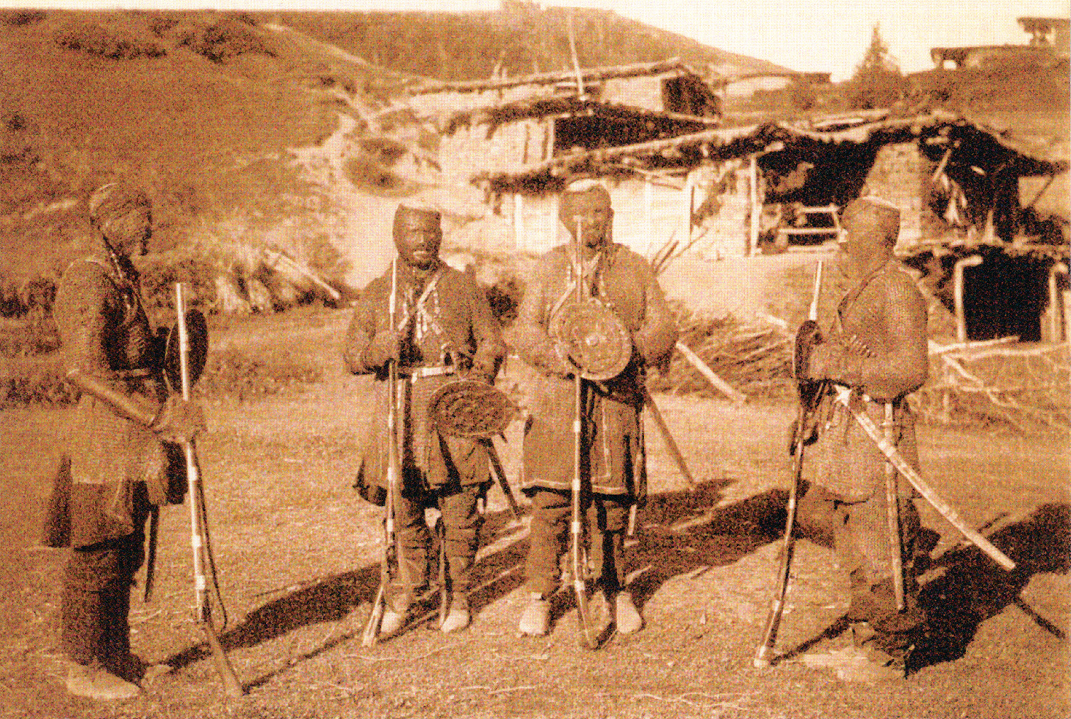
Though the Russians largely subdued the Caucasus region by the 1860s—with a Muslim separatist movement led by Imam Shamil put down only after decades of struggle—the many ethnic groups of this rugged mountain region remained largely autonomous until well into the twentieth century. This photograph, most likely taken around 1890, shows a group of chain-clad warriors from the Khevsureti region of Georgia (which had been incorporated into the Russian Empire early in the nineteenth century). With their primitive firearms, swords, and shields, these fighting men may appear to be no match for mechanized firepower, but the people of this region nevertheless remained largely free of governmental authority until well into the twentieth century. Courtesy of the Library of Congress
Notes:
Though the Russians largely subdued the Caucasus region by the 1860s—with a Muslim separatist movement led by Imam Shamil put down only after decades of struggle—the many ethnic groups of this rugged mountain region remained largely autonomous until well into the twentieth century. This photograph, most likely taken around 1890, shows a group of chain-clad warriors from the Khevsureti region of Georgia (which had been incorporated into the Russian Empire early in the nineteenth century). With their primitive firearms, swords, and shields, these fighting men may appear to be no match for mechanized firepower, but the people of this region nevertheless remained largely free of governmental authority until well into the twentieth century.
Courtesy of the Library of Congress

Slide 31
Western Powers in Asia
France in Asia
French interest in Indochina (Vietnam, Cambodia, Laos) began with missionaries
French expansion in Indonesia
The United States’ Actions in Asia and the Pacific
Matthew Perry and the opening of Japan (1853)
Purchase of Alaska (1867)
The Spanish-American War (1898)
The Boxer Rebellion
Qing decline
The Open Door Policy
1899–1901 Boxer Rebellion
Rebellion suppressed by Western powers

Slide 32
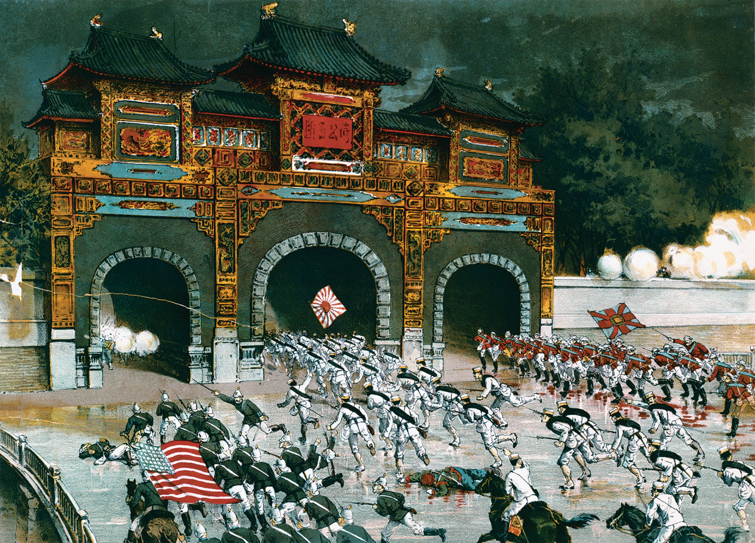
In 1900, an international force composed of troops drawn from Austria-Hungary, the French Third Republic, the German Empire, Italy, Japan, Russia, the United Kingdom, and the United States invaded China to put down the Boxer Rebellion, which had endangered Western missionaries and Western interests in China. In August 1900 these forces occupied Beijing. This contemporary print presents the image of a romanticized heroic assault by these foreign troops. Courtesy of the Library of Congress
Notes:
In 1900, an international force composed of troops drawn from Austria-Hungary, the French Third Republic, the German Empire, Italy, Japan, Russia, the United Kingdom, and the United States invaded China to put down the Boxer Rebellion, which had endangered Western missionaries and Western interests in China. In August 1900 these forces occupied Beijing. This contemporary print presents the image of a romanticized heroic assault by these foreign troops.
Courtesy of the Library of Congress

Slide 33
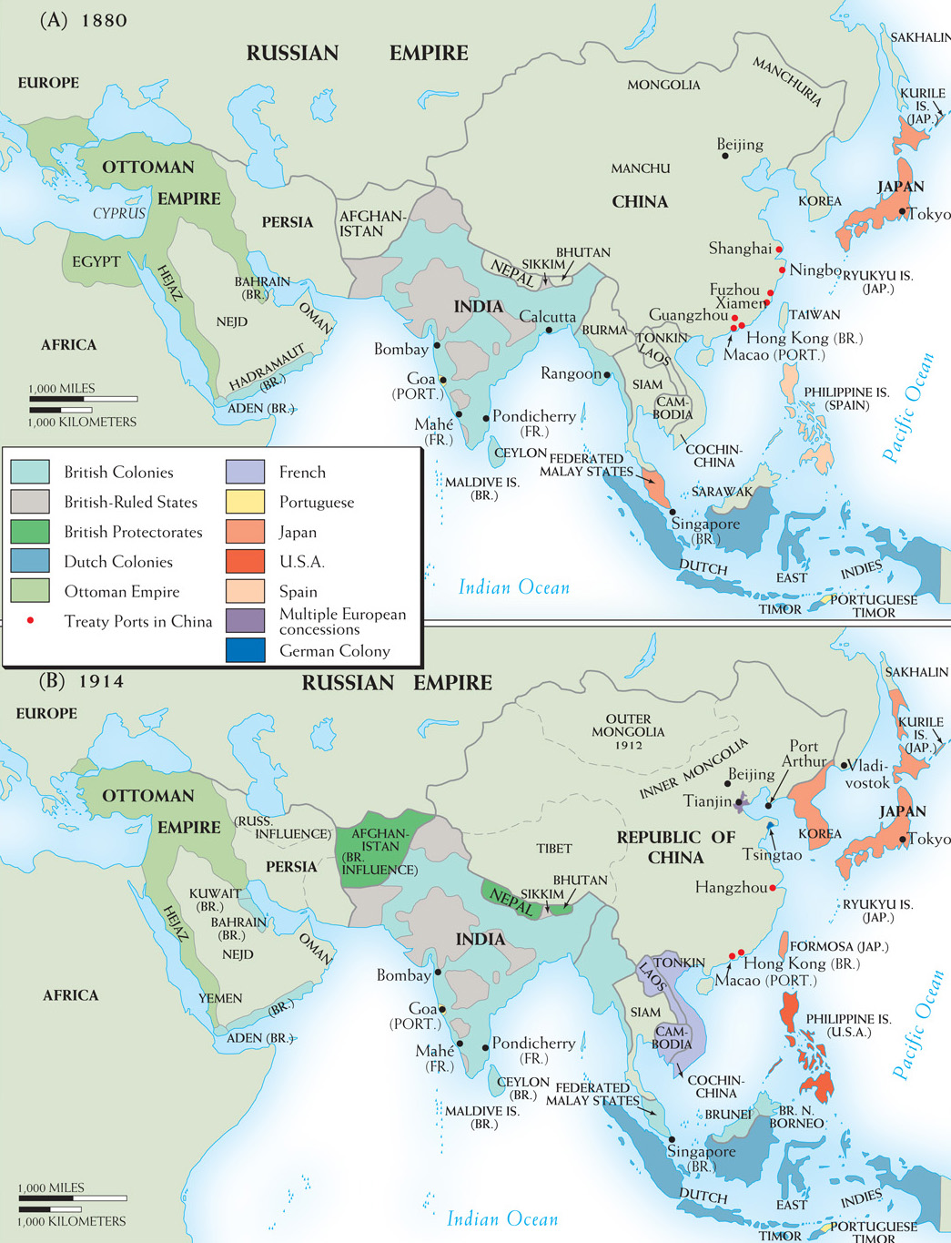
Map 25–4 ASIA, 1880–1914 As in Africa, the decades before World War I saw imperialism spread widely and rapidly in Asia. Two new powers, Japan and the United States, joined the British, French, and Dutch in extending control both to islands and to the mainland and in exploiting an enfeebled China.
Notes:
Map 25–4 ASIA, 1880–1914 As in Africa, the decades before World War I saw imperialism spread widely and rapidly in Asia. Two new powers, Japan and the United States, joined the British, French, and Dutch in extending control both to islands and to the mainland and in exploiting an enfeebled China.

Slide 34
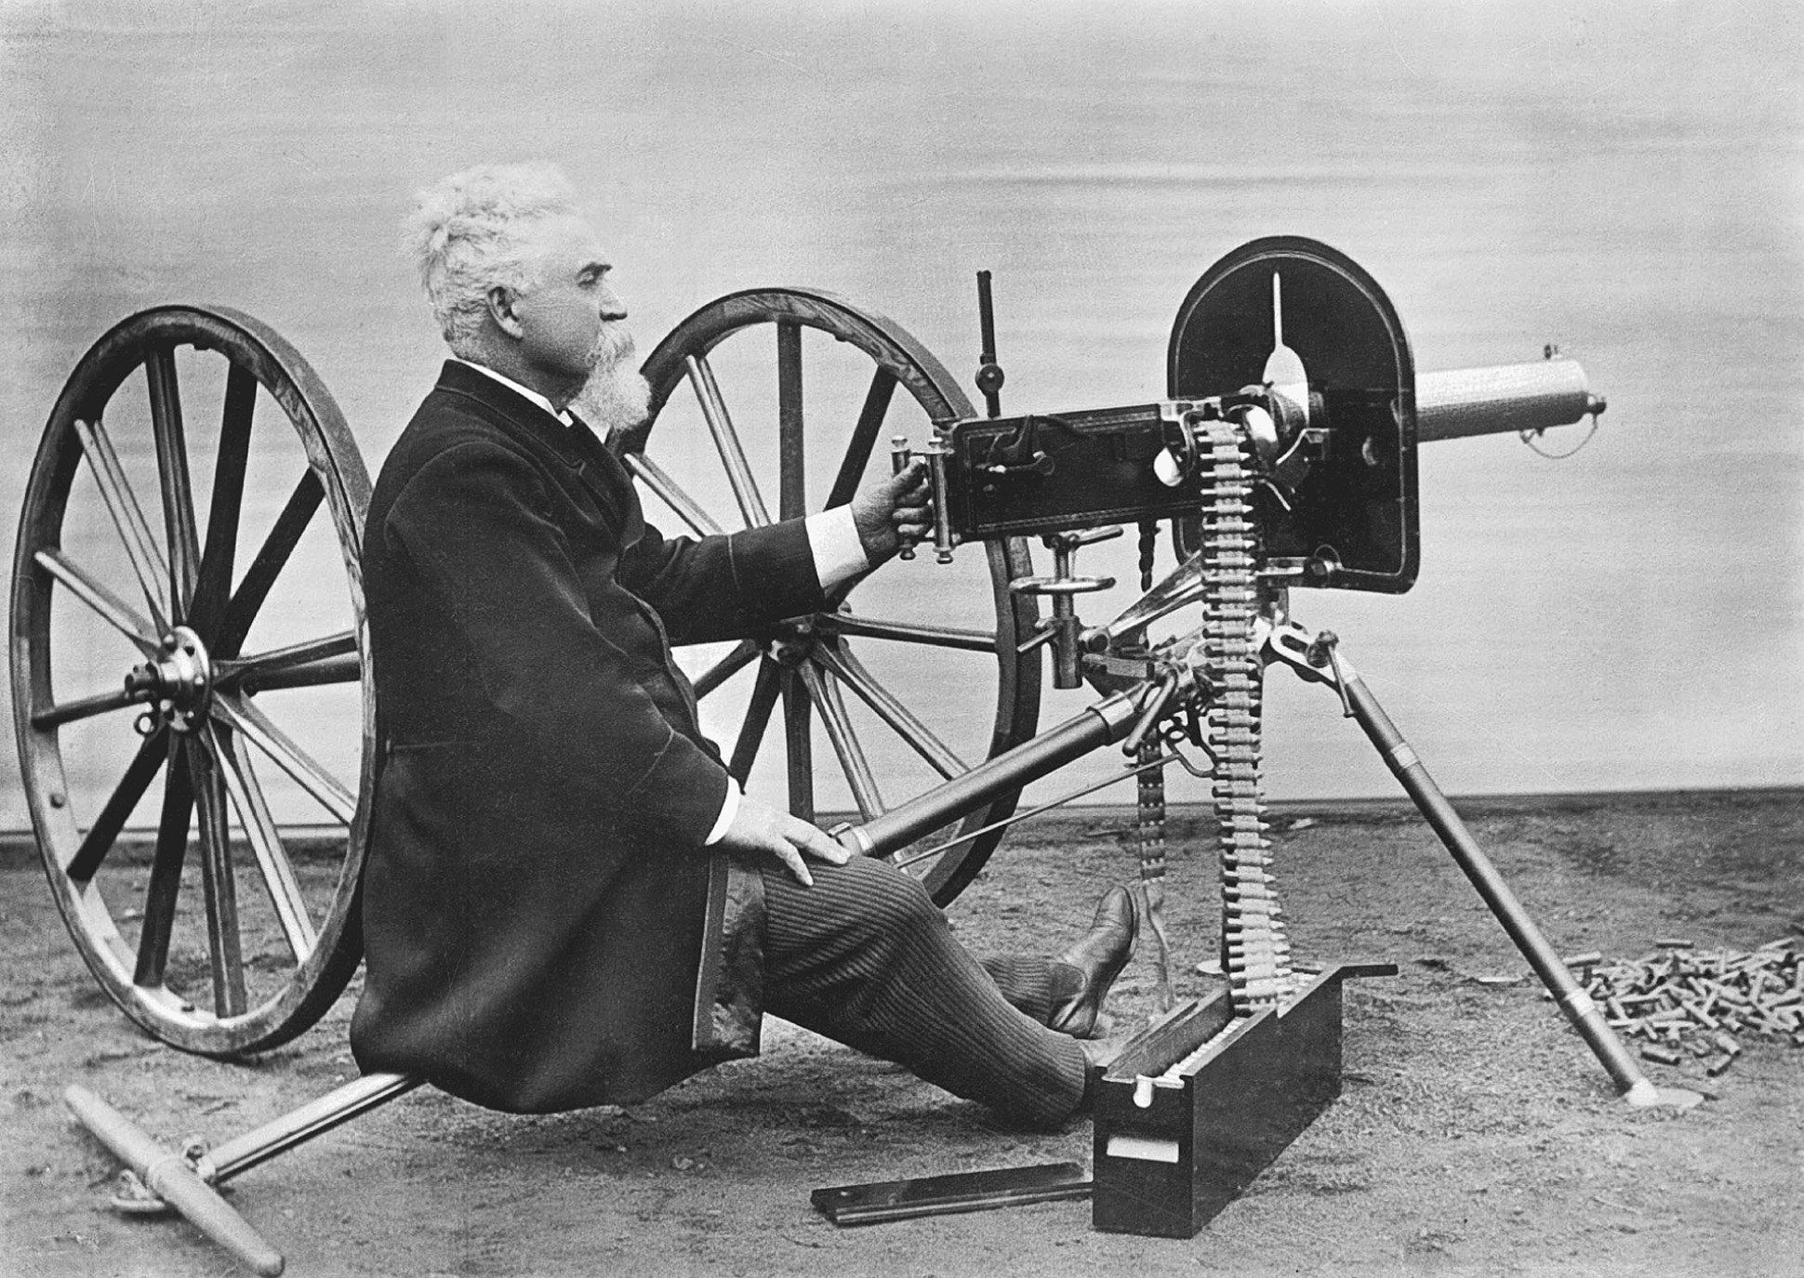
The Maxim was the first wholly portable machine gun, pictured here with its American-born inventor Hiram Stevens Maxim (1840–1916), who became a British citizen. Technological superiority in weaponry and naval ships accounted in large measure for the success of Western imperialism in the nineteenth century. © 2005 Roger Viollet/The Image Works
Notes:
The Maxim was the first wholly portable machine gun, pictured here with its American-born inventor Hiram Stevens Maxim (1840–1916), who became a British citizen. Technological superiority in weaponry and naval ships accounted in large measure for the success of Western imperialism in the nineteenth century.
© 2005 Roger Viollet/The Image Works

Slide 35
Tools of Imperialism
Steamboats
Conquest of tropical diseases
Quinine as a medical cure for malaria
Firearms
Machine guns
Telecommunications
Telegraphic cables

Slide 36
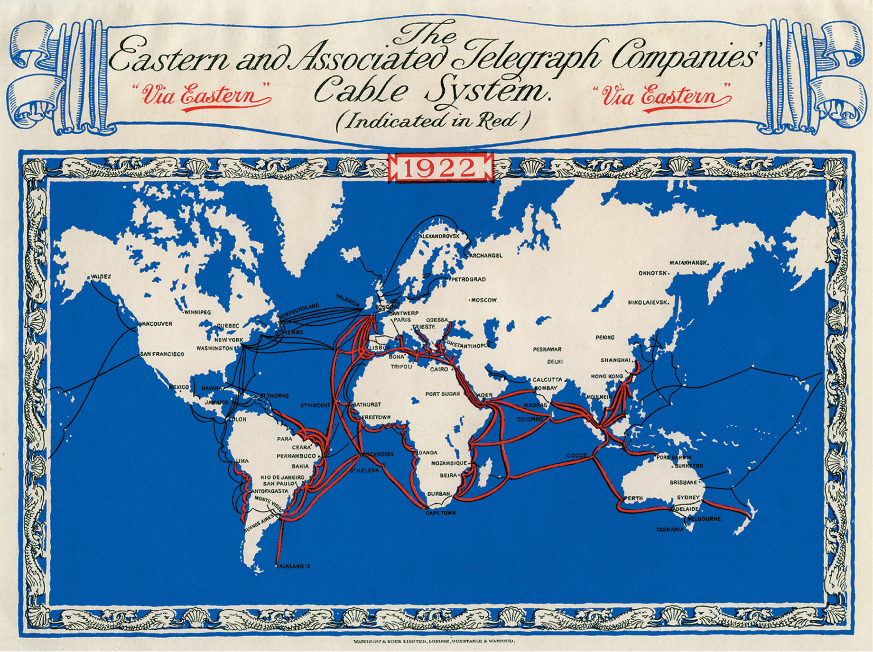
Underwater telegraphic cables were among the important inventions of the mid-nineteenth century utilizing then new electrical technology. Submarine cables amazed people of that era and the early twentieth century much as the Internet does today. These cables also allowed for unprecedented international communication. FTL Design
Notes:
Underwater telegraphic cables were among the important inventions of the mid-nineteenth century utilizing then new electrical technology. Submarine cables amazed people of that era and the early twentieth century much as the Internet does today. These cables also allowed for unprecedented international communication.
FTL Design

Slide 37
The Missionary Factor
Evangelical Protestant missionaries
Roman Catholic missionary advance
Women benefited from becoming missionaries or from missionaries in their region; schooling and traveling, ban of foot binding

Slide 38
The Missionary Factor (cont.)
Tensions between missionaries and imperial administrators
Became informal spokespeople for Western civilization; left impression
Assumption that native cultures were inferior
Had to learn native languages to translate Bible
Missionaries and indigenous religious movements clashed

Slide 39
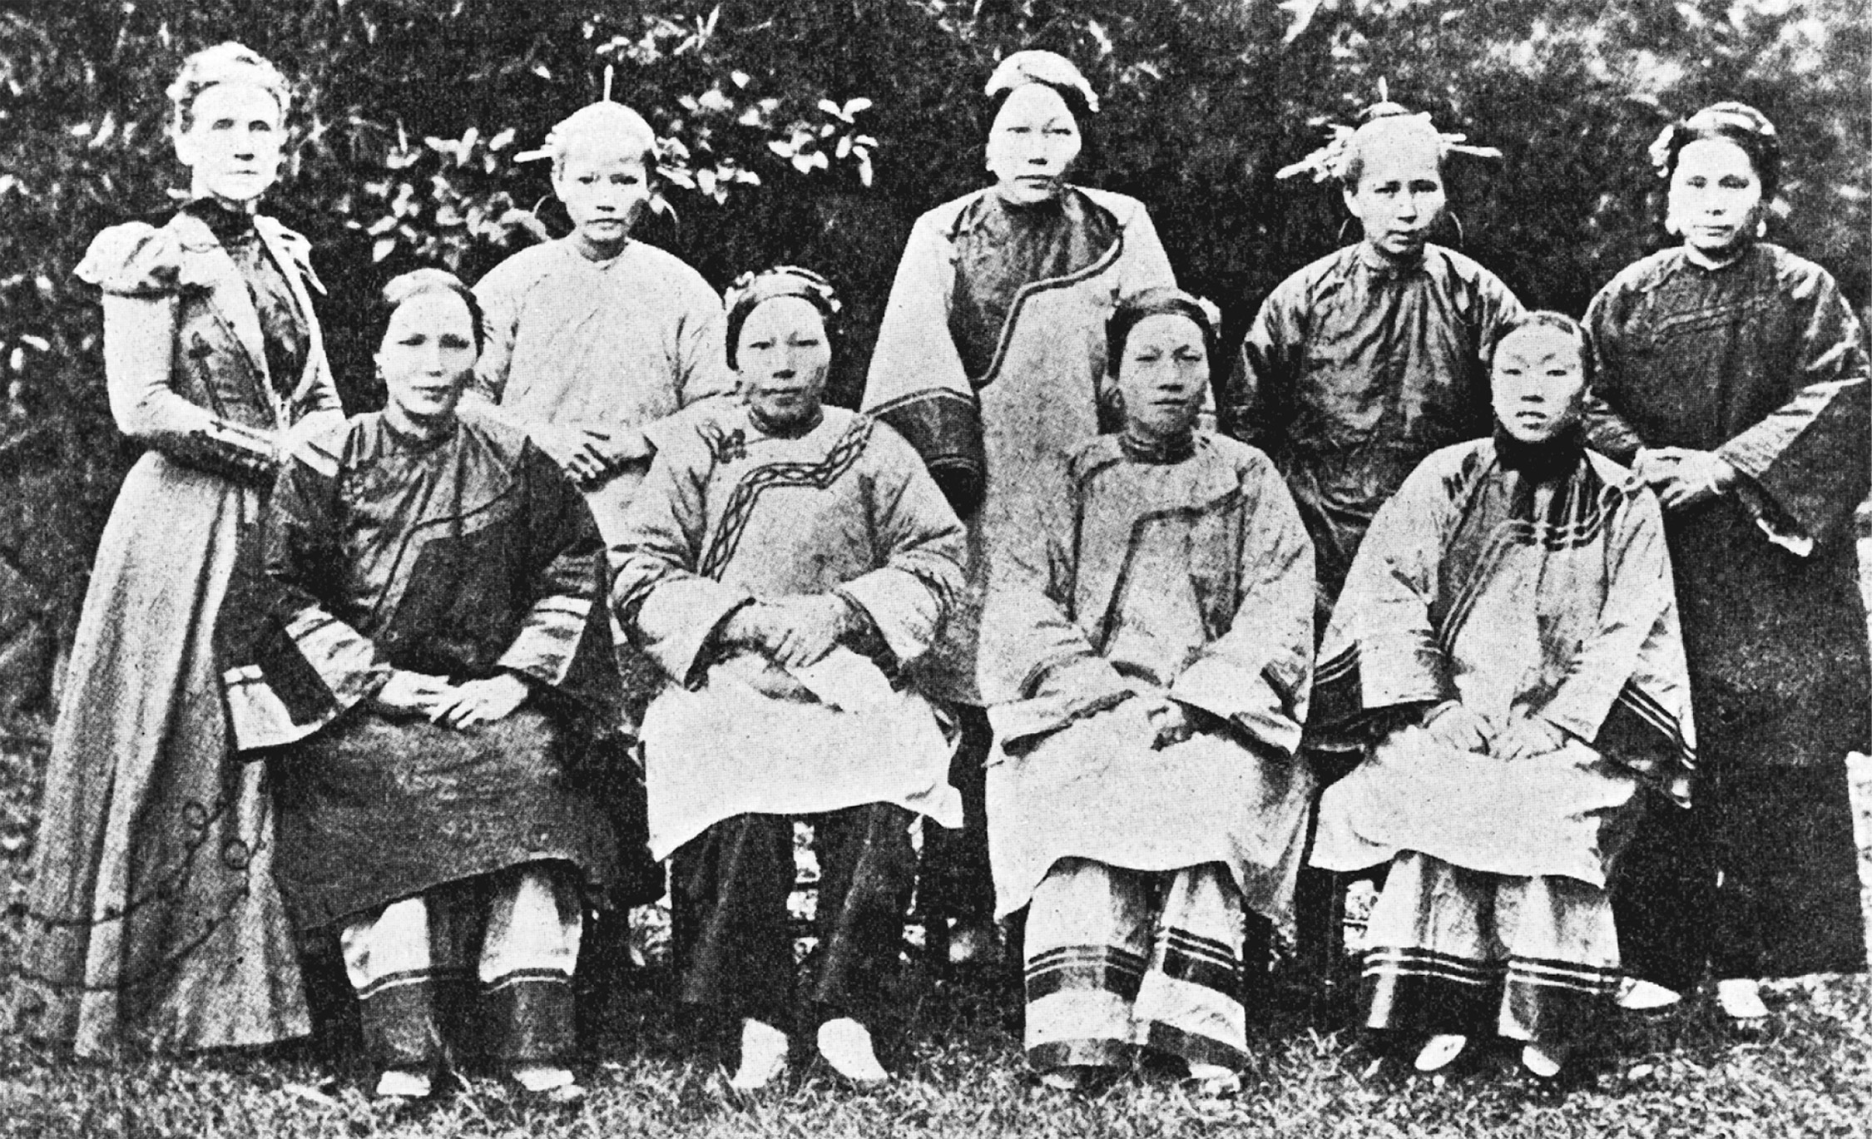
Women played a prominent role as teachers in the Western foreign missionary effort. Miss Emily Hartwell was a turn-ofthe- century, American-born Protestant missionary to the Foochow Mission in Fuzhou Shi, China. Here, in a photo from the missionary magazine Light and Life, she is pictured with one of her Bible classes composed of Chinese women. Her letters home spoke of the disadvantages of women in Chinese culture. Courtesy of the Library of Congress
Notes:
Women played a prominent role as teachers in the Western foreign missionary effort. Miss Emily Hartwell was a turn-ofthe- century, American-born Protestant missionary to the Foochow Mission in Fuzhou Shi, China. Here, in a photo from the missionary magazine Light and Life, she is pictured with one of her Bible classes composed of Chinese women. Her letters home spoke of the disadvantages of women in Chinese culture.
Courtesy of the Library of Congress

Slide 40
Science and Imperialism
Botany
Commercial applications
Botanical gardens
Zoology
Medicine
Medicine and the civilizing mission
Cures for tropical diseases
Anthropology
Racial thinking and imperial policy

Slide 41
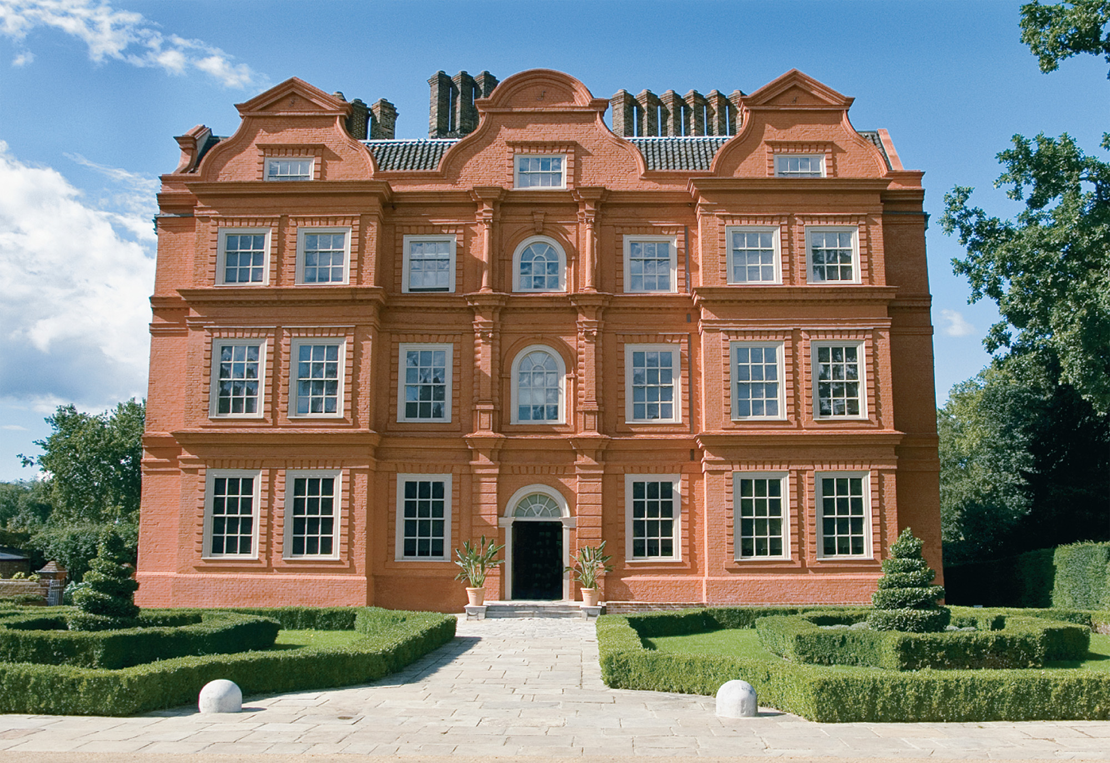
Kew Garden near London was the center of a vast network of botanical research. Joseph Dalton Hooker, its director, persuaded collectors from around the world to send specimens to Kew. Tropical plants were grown in its greenhouse, where British citizens could visit the grounds and see the plants that populated the far regions of the British empire. This photo shows Kew Palace, located in Kew Garden. Dorling Kindersley © Jamie Marshall
Notes:
Kew Garden near London was the center of a vast network of botanical research. Joseph Dalton Hooker, its director, persuaded collectors from around the world to send specimens to Kew. Tropical plants were grown in its greenhouse, where British citizens could visit the grounds and see the plants that populated the far regions of the British empire. This photo shows Kew Palace, located in Kew Garden.
Dorling Kindersley © Jamie Marshall

Slide 42
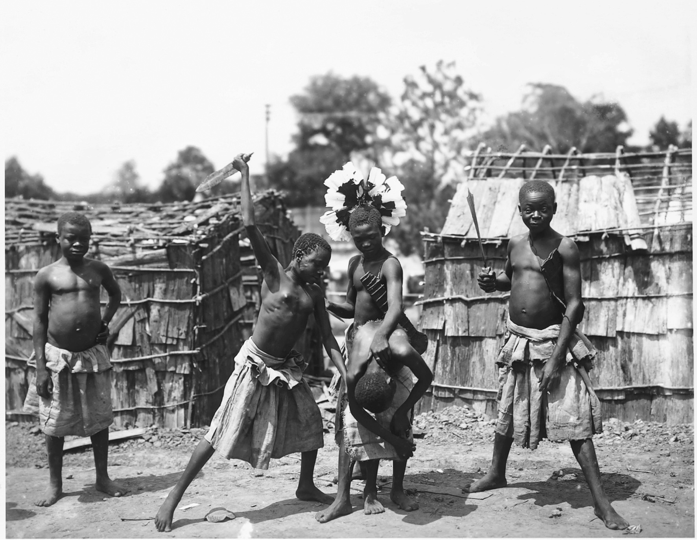
Peoples from colonized nations were transported to various world’s fairs and similar exhibitions during the late nineteenth and early twentieth centuries. They constituted living exhibitions, where they were expected to portray “native customs” or the like. Here at the St. Louis World’s Fair of 1904 African Pygmies demonstrated beheading. In this and other similar examples, native peoples were frequently presented in demeaning roles that filled the expectations of spectators to see “exotic” behavior. Such performances and exhibitions served to convince the Western spectators of the superiority of their civilization over that of the peoples living in the colonized world. Courtesy of the Library of Congress
Notes:
Peoples from colonized nations were transported to various world’s fairs and similar exhibitions during the late nineteenth and early twentieth centuries. They constituted living exhibitions, where they were expected to portray “native customs” or the like. Here at the St. Louis World’s Fair of 1904 African Pygmies demonstrated beheading. In this and other similar examples, native peoples were frequently presented in demeaning roles that filled the expectations of spectators to see “exotic” behavior. Such performances and exhibitions served to convince the Western spectators of the superiority of their civilization over that of the peoples living in the colonized world.
Courtesy of the Library of Congress

Slide 43
Imperialism: Ancient and Modern
The Greeks: from city-states to being united under Alexander the Great, who seizes Persia
The Romans and democracy
Muslims, Mongols, and Ottomans
Rise of Islam

Slide 44
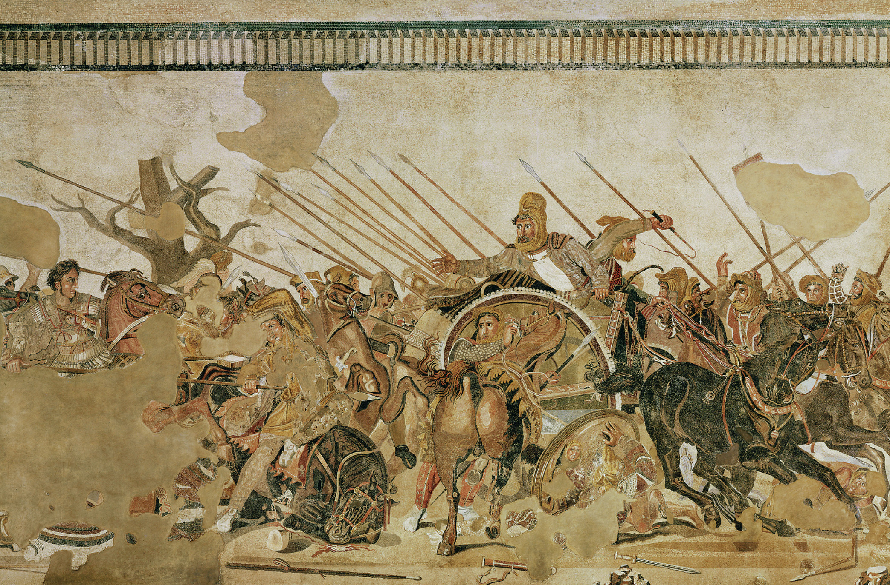
The ancient world was fascinated by the clash of empires that marked its history. The Romans created the grandest of the ancient empires, but they knew theirs had been preceded by others. On the walls of the House of the Faun in Pompeii, there resides an ancient mosaic depicting the Battle of Issus (333 B.C.E.), when the Macedonian Alexander the Great defeated the Persian Empire ruled by Darius III. Alexander appears on the left of the mosaic and Darius appears on his chariot. The mosaic, based on a still more ancient lost painting, probably dates from the second century B.C.E. and was rediscovered in 1831. Alinari/Art Resource, NY
Notes:
The ancient world was fascinated by the clash of empires that marked its history. The Romans created the grandest of the ancient empires, but they knew theirs had been preceded by others. On the walls of the House of the Faun in Pompeii, there resides an ancient mosaic depicting the Battle of Issus (333 B.C.E.), when the Macedonian Alexander the Great defeated the Persian Empire ruled by Darius III. Alexander appears on the left of the mosaic and Darius appears on his chariot. The mosaic, based on a still more ancient lost painting, probably dates from the second century B.C.E. and was rediscovered in 1831.
Alinari/Art Resource, NY

Slide 45
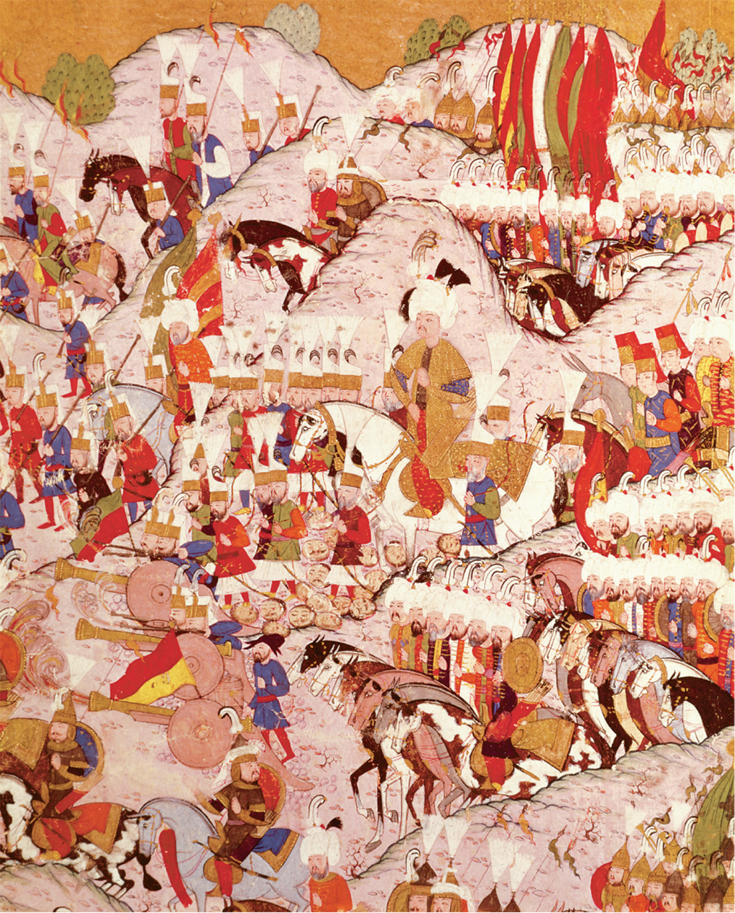
The Ottoman Turks began to overrun the Balkans in the mid-1300s. In 1526, Sultan Suleyman the Magnificent destroyed a Hungarian army at the Battle of Mohacs. The Ottoman Empire ruled most of the Balkans until the late nineteenth century. Suleyman I the Magnificent (1494–1566). Sultan Suleyman at the Battles of Mahocs (detail). Lokman, The Military Campaigns of Suleyman the Magnificent. Hunername manuscript. Ottoman dynasty, Istanbul. Topkapi Palace Museum, Istanbul, Turkey. Bridgeman-Giraudon/Art Resource, NY
Notes:
The Ottoman Turks began to overrun the Balkans in the mid-1300s. In 1526, Sultan Suleyman the Magnificent destroyed a Hungarian army at the Battle of Mohacs. The Ottoman Empire ruled most of the Balkans until the late nineteenth century.
Suleyman I the Magnificent (1494–1566). Sultan Suleyman at the Battles of Mahocs (detail). Lokman, The Military Campaigns of Suleyman the Magnificent. Hunername manuscript. Ottoman dynasty, Istanbul. Topkapi Palace Museum, Istanbul, Turkey. Bridgeman-Giraudon/Art Resource, NY

Slide 46
Imperialism: Ancient and Modern (cont.)
European Expansion
European willingness to use force
Toward Decolonization
Concept of empire came to be condemned in the mid to late 20th century and independence was championed

Slide 47
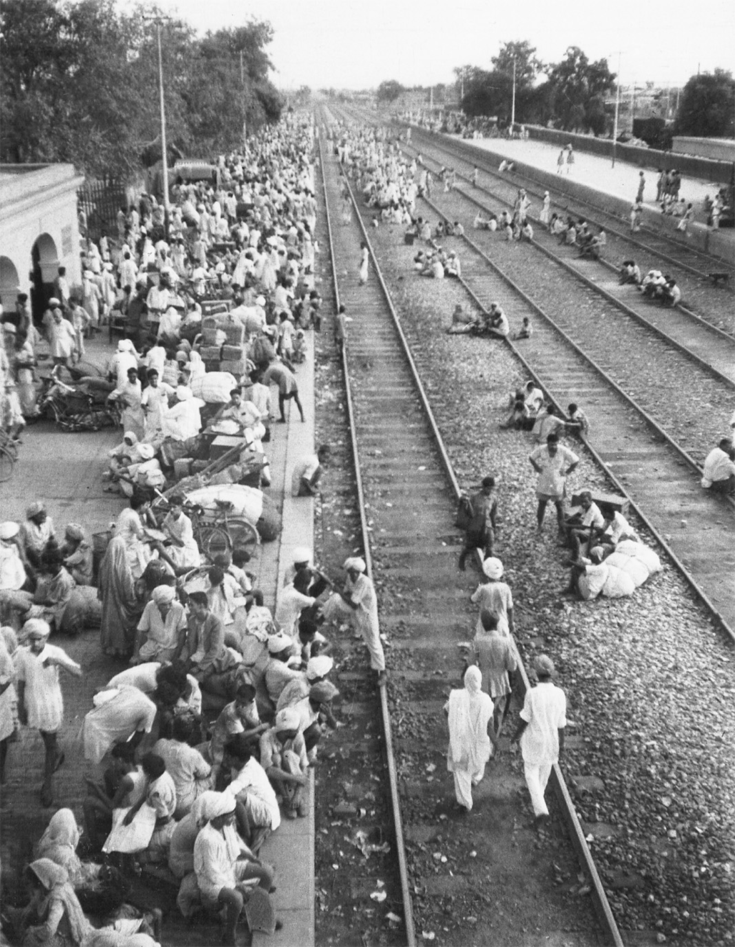
European imperialism ultimately rested on the willingness to use force. When anti- British agitation mounted in India after World War I, General Reginald Dyer’s troops fired on unarmed Indian demonstrators at Amritsar. More than three hundred Indians were killed. UPI/CORBIS/Bettmann
Notes:
European imperialism ultimately rested on the willingness to use force. When anti- British agitation mounted in India after World War I, General Reginald Dyer’s troops fired on unarmed Indian demonstrators at Amritsar. More than three hundred Indians were killed.
UPI/CORBIS/Bettmann

