Slide 1
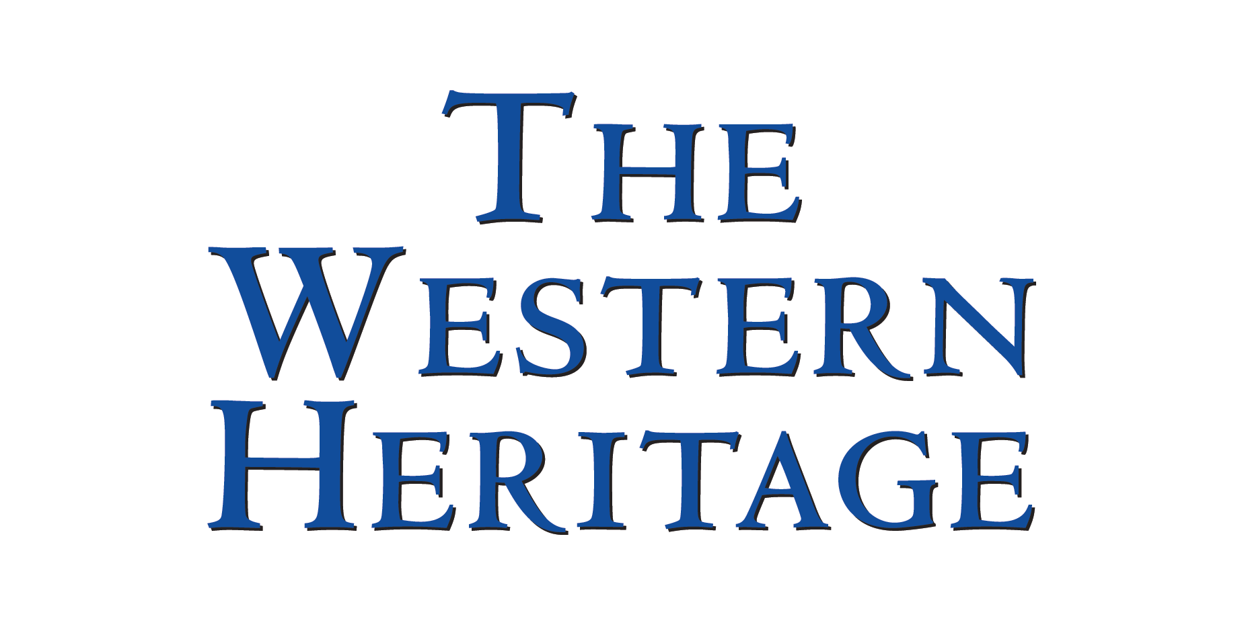
Chapter 27
The Interwar Years: the Challenge of Dictators and Depression
(our Chapter 26: Political Experiments)
Copyright © 2010 Pearson Education, Inc., Upper Saddle River, NJ 07458. All rights reserved.

Slide 2
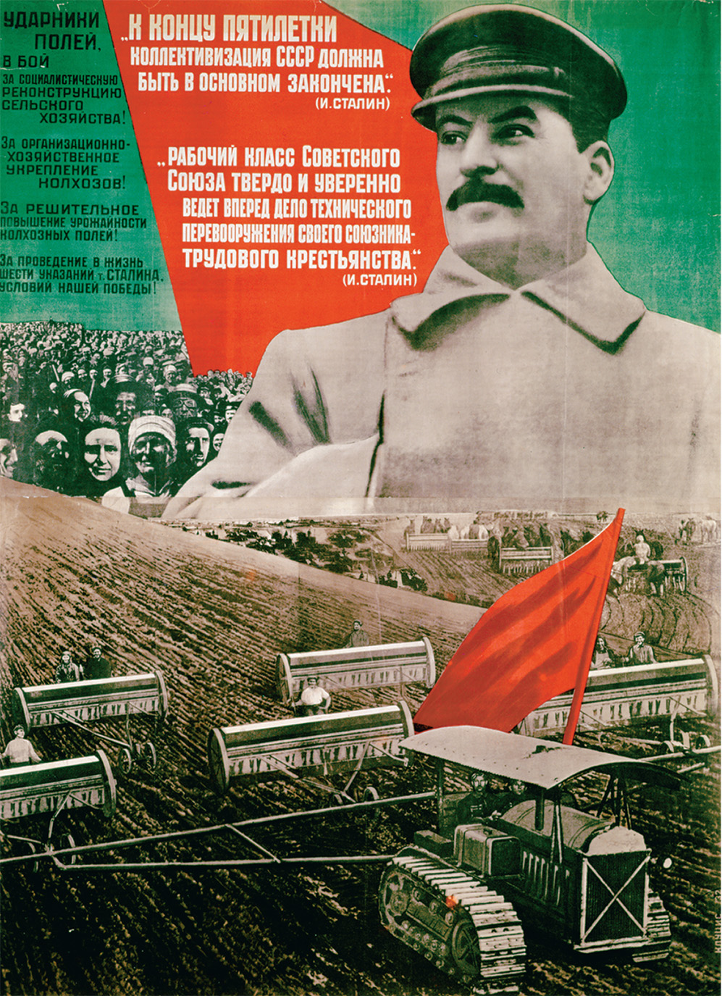
This poster shows an idealized Soviet collective farm on which tractors owned by the state have replaced peasant labor. In reality, collectivization provoked fierce resistance and caused famines in which millions of peasants died. Poster concerning the first Five Year Plan with a photograph of Joseph Stalin (1879–1953), “At the end of the Plan, the basis of collectivisation must be completed,” 1932 (colour litho.) by Klutchis (fl. 1932). Deutsches Plakat Museum, Essen, Germany/Archives Charmet/The Bridgeman Art Library
Copyright © 2010 Pearson Education, Inc., Upper Saddle River, NJ 07458. All rights reserved.
Notes:
This poster shows an idealized Soviet collective farm on which tractors owned by the state have replaced peasant labor. In reality, collectivization provoked fierce resistance and caused famines in which millions of peasants died.
Poster concerning the first Five Year Plan with a photograph of Joseph Stalin (1879–1953), “At the end of the Plan, the basis of collectivisation must be completed,” 1932 (colour litho.) by Klutchis (fl. 1932). Deutsches Plakat Museum, Essen, Germany/Archives Charmet/The Bridgeman Art Library

Slide 3
After Versailles: Demands for Revision and Enforcement
Political agitation in the successor states
German resentment of the treaty
French demands for enforcement of the treaty
Copyright © 2010 Pearson Education, Inc., Upper Saddle River, NJ 07458. All rights reserved.

Slide 4
Postwar Economic Woes
The war had damaged the economies of Europe’s old states
The loss of so many people was also a loss of producers and consumers
Every country had war debt, and no way to repay it
Losers also had to pay reparations
Industrial infrastructure had been destroyed
Copyright © 2010 Pearson Education, Inc., Upper Saddle River, NJ 07458. All rights reserved.

Slide 5
Postwar Economic Woes (cont.)
The new states had nothing to begin with
New borders separated factories from the resources they used
Railway systems were now split between multiple nations
The U.S. ceased to be dependent on European production
Copyright © 2010 Pearson Education, Inc., Upper Saddle River, NJ 07458. All rights reserved.

Slide 6
Stock Market Crash
Americans take money out of European investments and put them into booming stock market in 1928
Stock market crashes in 1929 as a result of virtually unregulated financial speculation
People cannot pay back loans to banks and many banks collapse
Little money invested in Europe
Copyright © 2010 Pearson Education, Inc., Upper Saddle River, NJ 07458. All rights reserved.

Slide 7
The End of Reparations
As German economy worsens, American president Herbert Hoover announces a one-year moratorium on all payments of international debts
The Lausanne Conference in 1932 effectively ends reparations
Copyright © 2010 Pearson Education, Inc., Upper Saddle River, NJ 07458. All rights reserved.

Slide 8
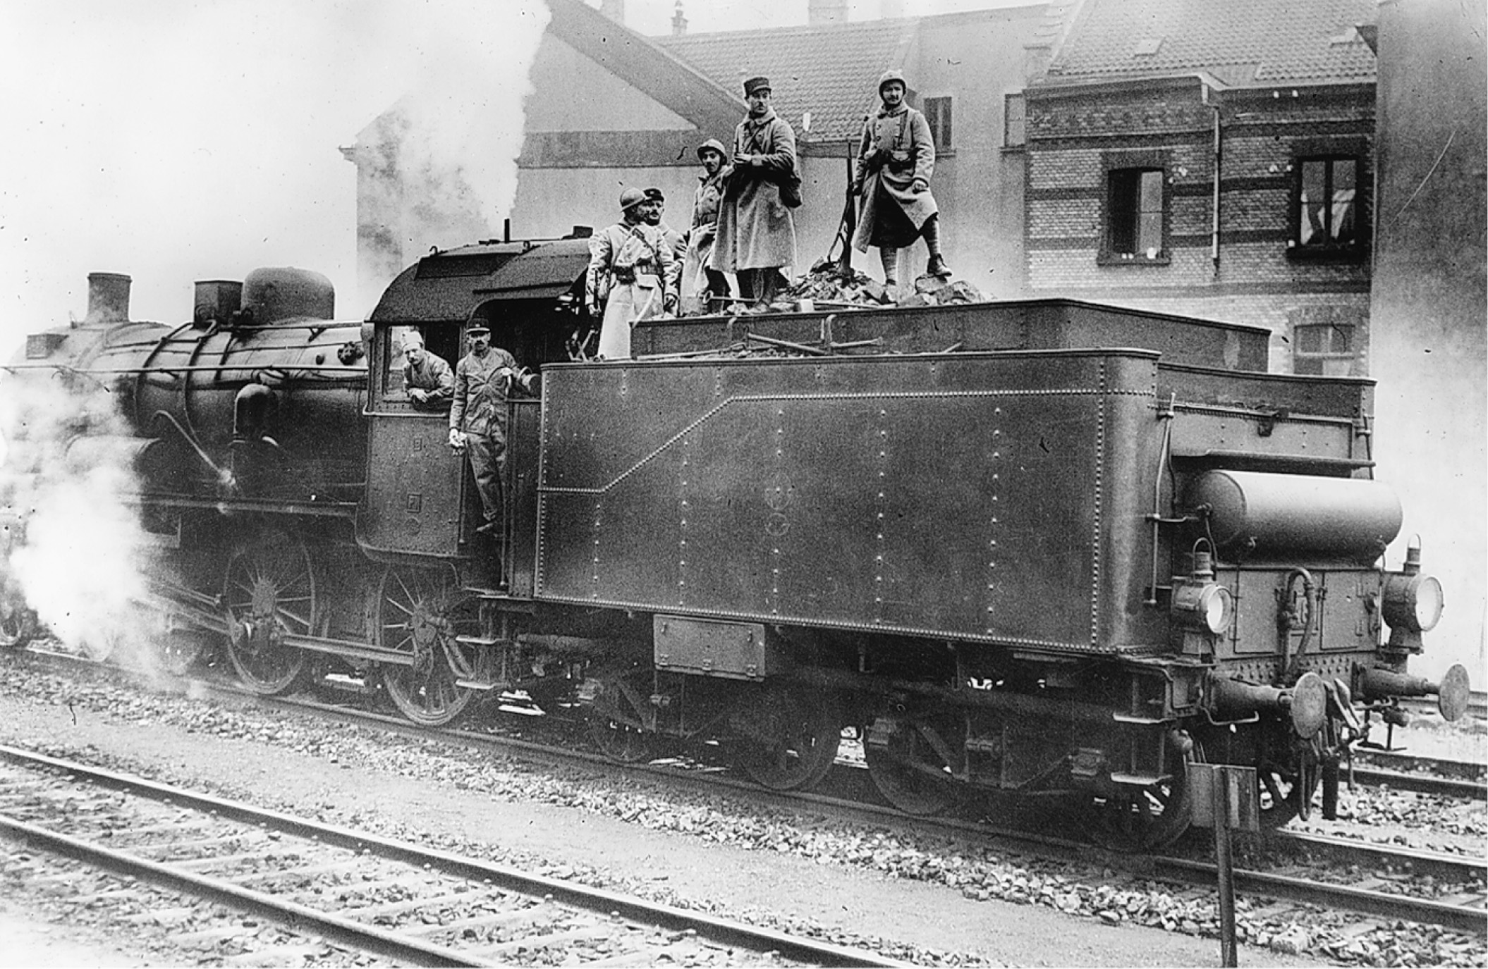
The French invasion of the German Ruhr (1923) began a crisis that brought strikes and rampant inflation in Germany. Here French troops have commandeered a German locomotive during one of the strikes. UPI/CORBIS/Bettmann
Copyright © 2010 Pearson Education, Inc., Upper Saddle River, NJ 07458. All rights reserved.
Notes:
The French invasion of the German Ruhr (1923) began a crisis that brought strikes and rampant inflation in Germany. Here French troops have commandeered a German locomotive during one of the strikes.
UPI/CORBIS/Bettmann

Slide 9
Problems in the Agriculture
Collapse of grain prices means lower incomes for European farmers
Large estates in Eastern Europe broken up into small inefficient farms
People in Asia, South America, and Africa could no longer afford to buy finished goods from industrial Europe
Commodity production outstripped world demand, leading to vast unemployment and an increased depression
Copyright © 2010 Pearson Education, Inc., Upper Saddle River, NJ 07458. All rights reserved.

Slide 10
Government Policies Toward the Depression
Orthodox economic theory felt cuts in government spending would prevent inflation
John Maynard Keynes – urged government spending to expand overall demand
Private economic enterprise becomes subject to new trade, labor, and currency regulations
Copyright © 2010 Pearson Education, Inc., Upper Saddle River, NJ 07458. All rights reserved.

Slide 11
Great Britain’s Response to the Great Depression: The National Government
Ramsay MacDonald – headed Labour government, wanted to slash the budget, reduce government salaries, and cut unemployment benefits
National Government – in 1931 takes three steps to end the depression
(1) raised taxes, cut benefits, and lowered government salaries
(2) took Britain off the gold standard
(3) Import Duties Bill – leveled a tariff on all imports, except those from the empire
Banking crisis that plagued most of Europe is avoided, but unemployment remains high and the economy remains stagnant
Copyright © 2010 Pearson Education, Inc., Upper Saddle River, NJ 07458. All rights reserved.

Slide 12
France’s Response to the Great Depression: The Popular Front
Depression in France started later and lasted longer due in part to the stoppage of the payment of reparations
Popular Front dissolves in 1938, leaving France divided; faith lost in the republic
Copyright © 2010 Pearson Education, Inc., Upper Saddle River, NJ 07458. All rights reserved.

Slide 13
France’s Response to the Great Depression: The Popular Front (cont.)
Right-wing violence
Large demonstration of right-wingers leads to the death of fourteen demonstrators in Paris in 1934
Socialist-communist cooperation – the Popular Front – a coalition of left-wing parties takes over the government
Copyright © 2010 Pearson Education, Inc., Upper Saddle River, NJ 07458. All rights reserved.

Slide 14
France’s Response to the Great Depression: The Popular Front (cont.)
Leon Blum - Popular Front’s elected leader
Calls for massive labor reforms involving wages, working hours, recognition of unions, and the establishment of a National Wheat Board that managed the sale of grain
French bankers and businessmen outraged
Copyright © 2010 Pearson Education, Inc., Upper Saddle River, NJ 07458. All rights reserved.

Slide 15
The Beginning of the Soviet Project
The Bolsheviks had consolidated power
Party membership did not exceed 1% of the population
Some opposition still remained
They viewed their revolution as internationally significant
Copyright © 2010 Pearson Education, Inc., Upper Saddle River, NJ 07458. All rights reserved.

Slide 16
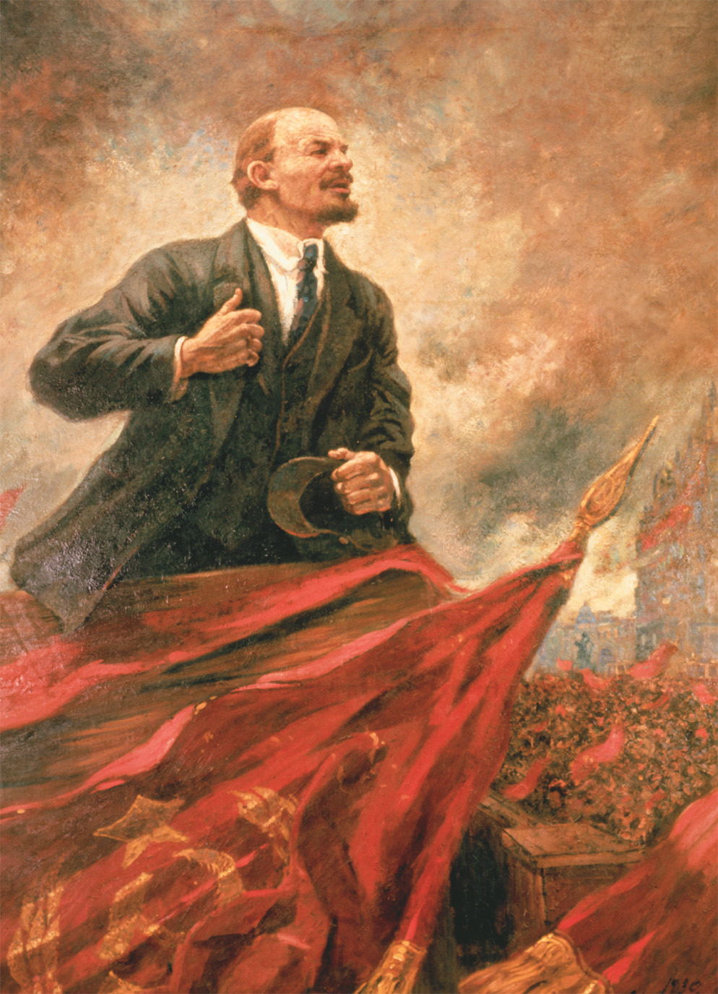
Anxiety over the spread of the Bolshevik Revolution was a fundamental factor of European politics during the 1920s and 1930s. Images like this Soviet portrait of Lenin as a heroic revolutionary conjured fears among people in the rest of Europe of a political force determined to overturn their social, political, and economic institutions. Bildarchiv Preussischer Kulturbesitz/Art Resource, NY
Copyright © 2010 Pearson Education, Inc., Upper Saddle River, NJ 07458. All rights reserved.
Notes:
Anxiety over the spread of the Bolshevik Revolution was a fundamental factor of European politics during the 1920s and 1930s. Images like this Soviet portrait of Lenin as a heroic revolutionary conjured fears among people in the rest of Europe of a political force determined to overturn their social, political, and economic institutions.
Bildarchiv Preussischer Kulturbesitz/Art Resource, NY

Slide 17
War Communism
Leon Trotsky (1879–1940) organized the Red Army to suppress both internal and foreign opposition
White Russian opposition could not get properly organized
The nation was run by Lenin from the top, undemocratically
The government ran the banks, the transport system, and heavy industry
All opposition was repressed
Copyright © 2010 Pearson Education, Inc., Upper Saddle River, NJ 07458. All rights reserved.

Slide 18
War Communism (cont.)
War Communism generated opposition
Peasants resisted the requisition of grain
Strikes in 1920 and 1921
Baltic fleet mutiny in March 1921
Copyright © 2010 Pearson Education, Inc., Upper Saddle River, NJ 07458. All rights reserved.

Slide 19
The New Economic Plan (NEP)
Outlined by Lenin in March 1921
Private industry would be tolerated except in:
Banking
Heavy Industry
Transportation
International Commerce
Peasant farming for profit was legalized
The countryside was stabilized
Copyright © 2010 Pearson Education, Inc., Upper Saddle River, NJ 07458. All rights reserved.

Slide 20
The Third International
Also called the Comintern, the Third International of the European Socialist Movement was designed by Lenin to promote the Bolshevik style of socialism in Europe
1920–21 conditions were imposed on any socialist party that wanted to join
Every major European party was split on whether to accept these policies
These splits helped lead to the rise of fascism
Copyright © 2010 Pearson Education, Inc., Upper Saddle River, NJ 07458. All rights reserved.

Slide 21
The Stalin/Trotsky Rivalry
After Lenin’s stroke in 1922 and his subsequent death in 1924, a power vacuum was left
Two factions emerged
Trotsky Faction
Faction of Joseph Stalin (1879-1953), general secretary of the party
Lenin had criticized both before his death, but especially Stalin
Copyright © 2010 Pearson Education, Inc., Upper Saddle River, NJ 07458. All rights reserved.

Slide 22
Trotsky’s Position
Urged rapid industrialization financed by expropriation of farm production
Collectivization of agriculture
The Soviet Union should encourage worldwide socialist revolution
Copyright © 2010 Pearson Education, Inc., Upper Saddle River, NJ 07458. All rights reserved.

Slide 23
Stalin’s Rise
His position of general secretary allowed him to amass bureaucratic and administrative power
Manipulated intraparty rivalries
Backed Nikolai Bukharin (1888–1938) in his battle with Trotsky over rapid industrialization
Also opposed Trotsky’s position on worldwide revolution
He was thus able to eventually have Trotsky humiliated and exiled by 1929
Copyright © 2010 Pearson Education, Inc., Upper Saddle River, NJ 07458. All rights reserved.

Slide 24
Russia: Rapid Industrialization
The slowing down of economic production leads Soviet Communist leader Joseph Stalin to abandon Lenin’s New Economic Policy (NEP) and reject free market operations
Series of Five-Year Plans would rapidly increase government-run heavy industries
Copyright © 2010 Pearson Education, Inc., Upper Saddle River, NJ 07458. All rights reserved.

Slide 25
Russia: Rapid Industrialization (cont.)
The State Planning Commission or Gosplan oversaw every aspect of the economy
Economy grows 400% between 1928 and 1940, but at the cost of deplorable human conditions for the workers
Copyright © 2010 Pearson Education, Inc., Upper Saddle River, NJ 07458. All rights reserved.

Slide 26
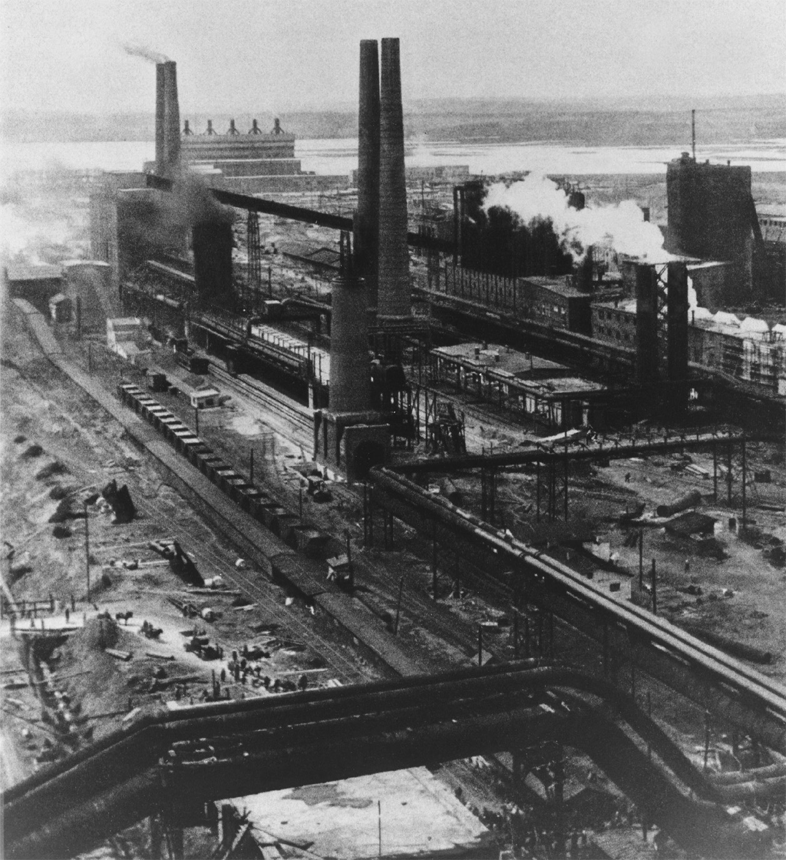
Magnitogorsk was a city that became a monument to Stalin’s drive toward rapid industrialization. Located in the Ural Mountains near a vast supply of iron ore, the city became the site of major iron and steel production. It was one of the new industrial cities founded under the Five Year Plan designed to challenge the capitalist production of the Western nations. National Archives and Records Administration
Copyright © 2010 Pearson Education, Inc., Upper Saddle River, NJ 07458. All rights reserved.
Notes:
Magnitogorsk was a city that became a monument to Stalin’s drive toward rapid industrialization. Located in the Ural Mountains near a vast supply of iron ore, the city became the site of major iron and steel production. It was one of the new industrial cities founded under the Five Year Plan designed to challenge the capitalist production of the Western nations.
National Archives and Records Administration

Slide 27
Collectivization
Stalin forces Russian peasants to give up their private farms and work collectively on farms owned by the state – collectives
Stalin felt this policy would end the hoarding of grain and produce enough food domestically and for foreign export
Copyright © 2010 Pearson Education, Inc., Upper Saddle River, NJ 07458. All rights reserved.

Slide 28
Collectivization (cont.)
“Dekulakization” – the removal of any peasants, especially those who were well off (kulaks), who resisted collectivization
Millions of peasants are killed, imprisoned, exiled to Siberia, or starve to death
Copyright © 2010 Pearson Education, Inc., Upper Saddle River, NJ 07458. All rights reserved.

Slide 29
Collectivization (cont.)
Religious leaders of many faiths are attacked and their places of worship closed
By 1937, 90% of the country’s grain is collectivized
Copyright © 2010 Pearson Education, Inc., Upper Saddle River, NJ 07458. All rights reserved.

Slide 30
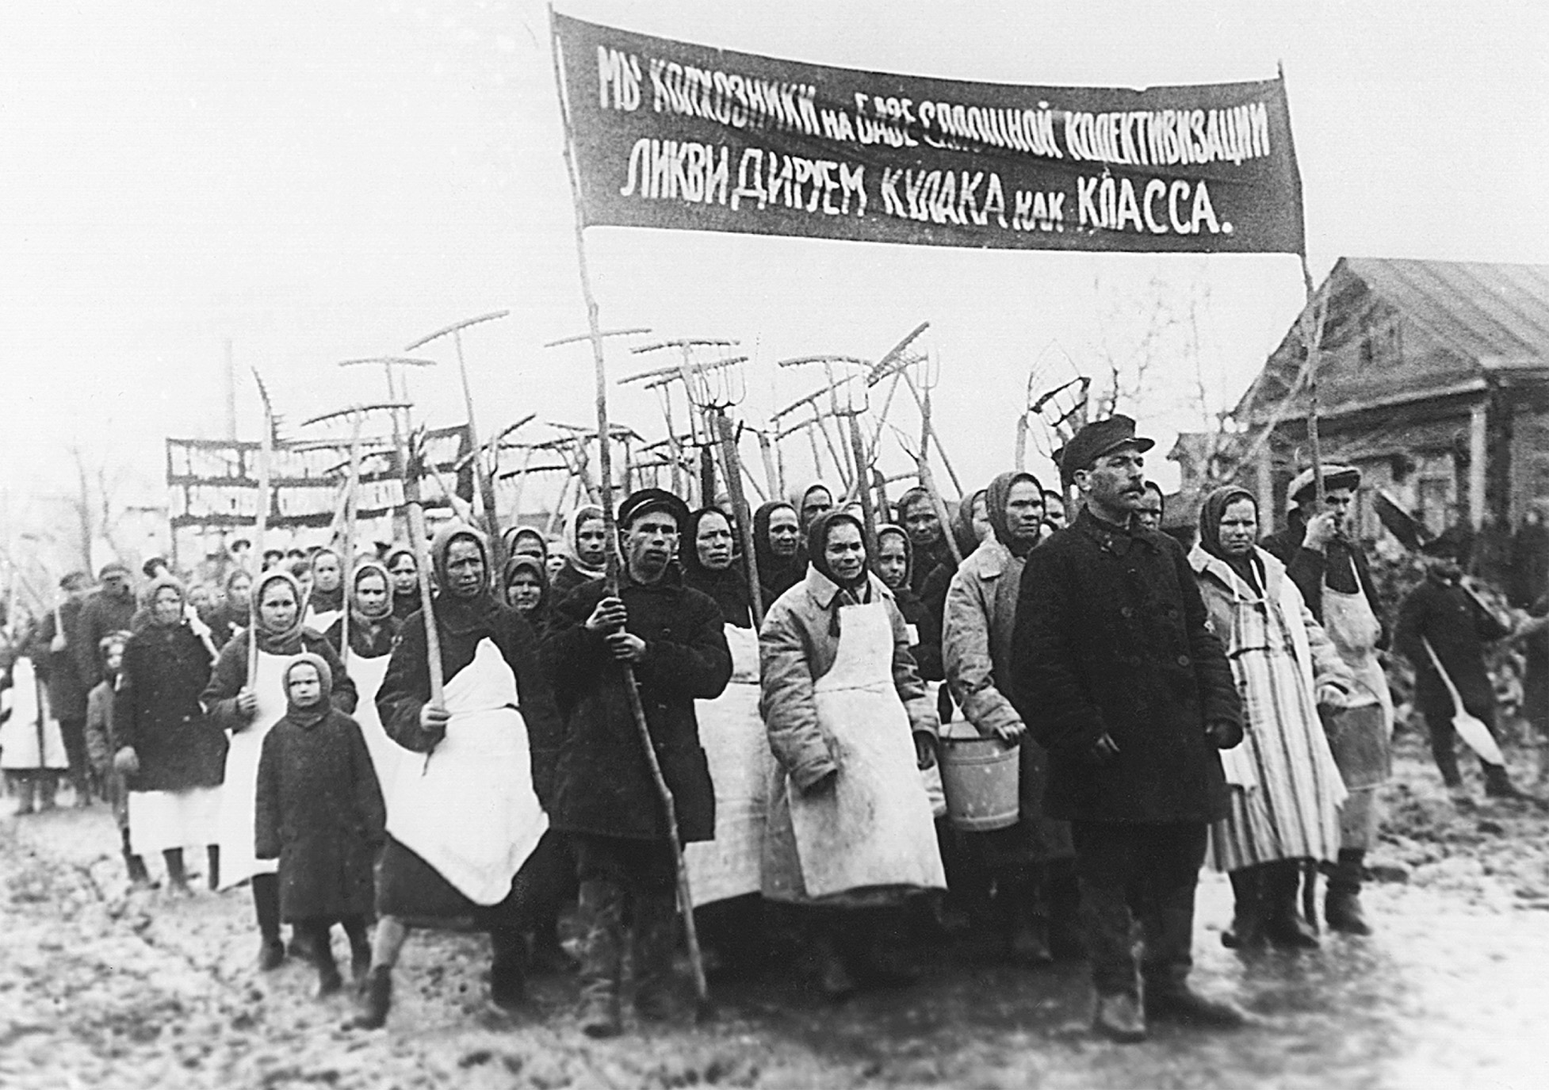
Stalin used intimidation and propaganda to support his drive to collectivize Soviet agriculture. Communist Party agitators led groups of peasants such as these to demand the seizure of the farms worked by the better-off and more successful farmers known as kulaks. AP/Wide World Photos
Copyright © 2010 Pearson Education, Inc., Upper Saddle River, NJ 07458. All rights reserved.
Notes:
Stalin used intimidation and propaganda to support his drive to collectivize Soviet agriculture. Communist Party agitators led groups of peasants such as these to demand the seizure of the farms worked by the better-off and more successful farmers known as kulaks.
AP/Wide World Photos

Slide 31
The Purges
Stalin, starting in 1933, gets rid of his enemies and opponents, both real and imagined, in the Great Purges
The assassination of party chief Sergei Kirov leads to the first purges
Kirov’s death still a mystery
Killed either by party opponents or perhaps by Stalin himself
Copyright © 2010 Pearson Education, Inc., Upper Saddle River, NJ 07458. All rights reserved.

Slide 32
The Purges (cont.)
Ex-high Soviet leader Bukharin along with other members of the Politburo are executed
Millions of people (family members of government leaders, ordinary Soviet citizens, members of the military) are either executed or sent to labor camps
Copyright © 2010 Pearson Education, Inc., Upper Saddle River, NJ 07458. All rights reserved.

Slide 33
The Purges (cont.)
Stalin’s thirst for power and his paranoia caused the purges
Communist Party moves away from the philosophies of Lenin and other early Communist leaders
Copyright © 2010 Pearson Education, Inc., Upper Saddle River, NJ 07458. All rights reserved.

Slide 34
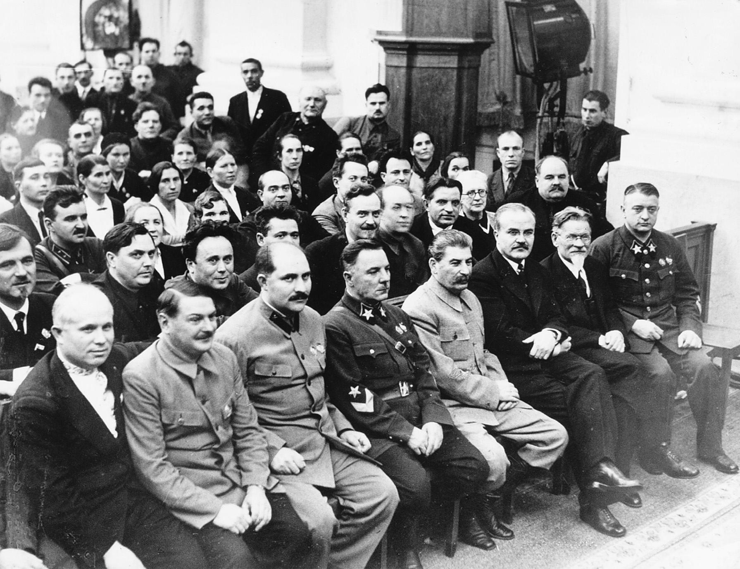
By the mid-1930s, Stalin’s purges had eliminated many leaders and other members from the Soviet Communist Party. This photograph of a meeting of a party congress in 1936 shows a number of the surviving leaders with Stalin, who sits fourth from the right in the front row. To his left is Vyacheslav Molotov, longtime foreign minister. The first person on the left in the front row is Nikita Khrushchev, who headed the Soviet Union in the late 1950s and early 1960s. Itar-Tass/Sovfoto/Eastfoto
Copyright © 2010 Pearson Education, Inc., Upper Saddle River, NJ 07458. All rights reserved.
Notes:
By the mid-1930s, Stalin’s purges had eliminated many leaders and other members from the Soviet Communist Party. This photograph of a meeting of a party congress in 1936 shows a number of the surviving leaders with Stalin, who sits fourth from the right in the front row. To his left is Vyacheslav Molotov, longtime foreign minister. The first person on the left in the front row is Nikita Khrushchev, who headed the Soviet Union in the late 1950s and early 1960s.
Itar-Tass/Sovfoto/Eastfoto

Slide 35
Fascism in Italy
Fascist governments were anti-Democratic, anti-Marxist, anti-Parliamentary, and frequently anti-Semitic
Rejected Liberalism
Dictatorial
Founded in Italy by Benito Mussolini (1883–1945)
Copyright © 2010 Pearson Education, Inc., Upper Saddle River, NJ 07458. All rights reserved.

Slide 36
The Rise of Mussolini
Italian Fasci Di Combattimento, “Bands of Combat,” founded in 1919 in Milan
Mostly Italian war veterans who rejected Versailles
Led by Mussolini
A former socialist
Broke with socialists in 1914, in order to support joining the war on the side of the Allies
Nationalism replaced socialism in his personal pantheon
Took advantage of postwar chaos
Copyright © 2010 Pearson Education, Inc., Upper Saddle River, NJ 07458. All rights reserved.

Slide 37
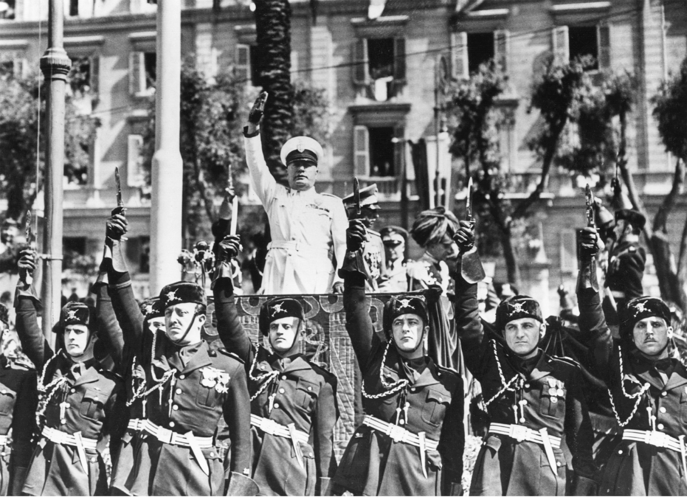
Benito Mussolini became famous for bombastic public speeches delivered in settings surrounded by his Fascist followers and military supporters. AP Wide World Photos
Copyright © 2010 Pearson Education, Inc., Upper Saddle River, NJ 07458. All rights reserved.
Notes:
Benito Mussolini became famous for bombastic public speeches delivered in settings surrounded by his Fascist followers and military supporters.
AP Wide World Photos

Slide 38
Early Fascist Organization
Mussolini initially supported factory occupation and land seizures
He later came to realize that Italians were more interested in order than abstract ideas of justice
Formed local squads of terrorists to go after socialists and other perceived malcontents
Law enforcement ignored them
Copyright © 2010 Pearson Education, Inc., Upper Saddle River, NJ 07458. All rights reserved.

Slide 39
Early Fascist Organization (cont.)
In 1921, Mussolini and 34 Fascists were elected to the government
The Black Shirt March
In October 1922, the Fascists marched on Rome
The Cabinet resigned in protest
On November 23, 1922 the king and Parliament granted Mussolini dictatorial power for one year
Copyright © 2010 Pearson Education, Inc., Upper Saddle River, NJ 07458. All rights reserved.

Slide 40
The Fascists in Power
Once in power, Mussolini moved cautiously
Changed election laws in 1924, so that the party which received the largest popular vote would have two-thirds of the seats in parliament
In the 1924 election, the Fascists won complete control of Parliament
By 1926, Mussolini was able to rule by decree
Copyright © 2010 Pearson Education, Inc., Upper Saddle River, NJ 07458. All rights reserved.

Slide 41
The Fascists in Power (cont.)
Violence and terror continued
Late 1924, Giacomo Matteotti, a socialist leader, was murdered
The Lateran Accord of 1929 made peace with the Vatican
Copyright © 2010 Pearson Education, Inc., Upper Saddle River, NJ 07458. All rights reserved.

Slide 42
The Weimar Republic
The Constitution, while refreshingly liberal, was also fundamentally flawed, as it allowed small parties to gain seats easily
The president was permitted to rule by decree in an emergency, permitting presidential dictatorship
The republic also lacked broad popular support
It was viewed as the government that had saddled Germany with the humiliation of the Versailles treaty
In the early 20s there were a number of violent uprisings, but they failed
There was massive inflation, due to the reparations imposed by the allies
The invasion of the Ruhr caused the German people to resent the Weimar government even more
Copyright © 2010 Pearson Education, Inc., Upper Saddle River, NJ 07458. All rights reserved.

Slide 43
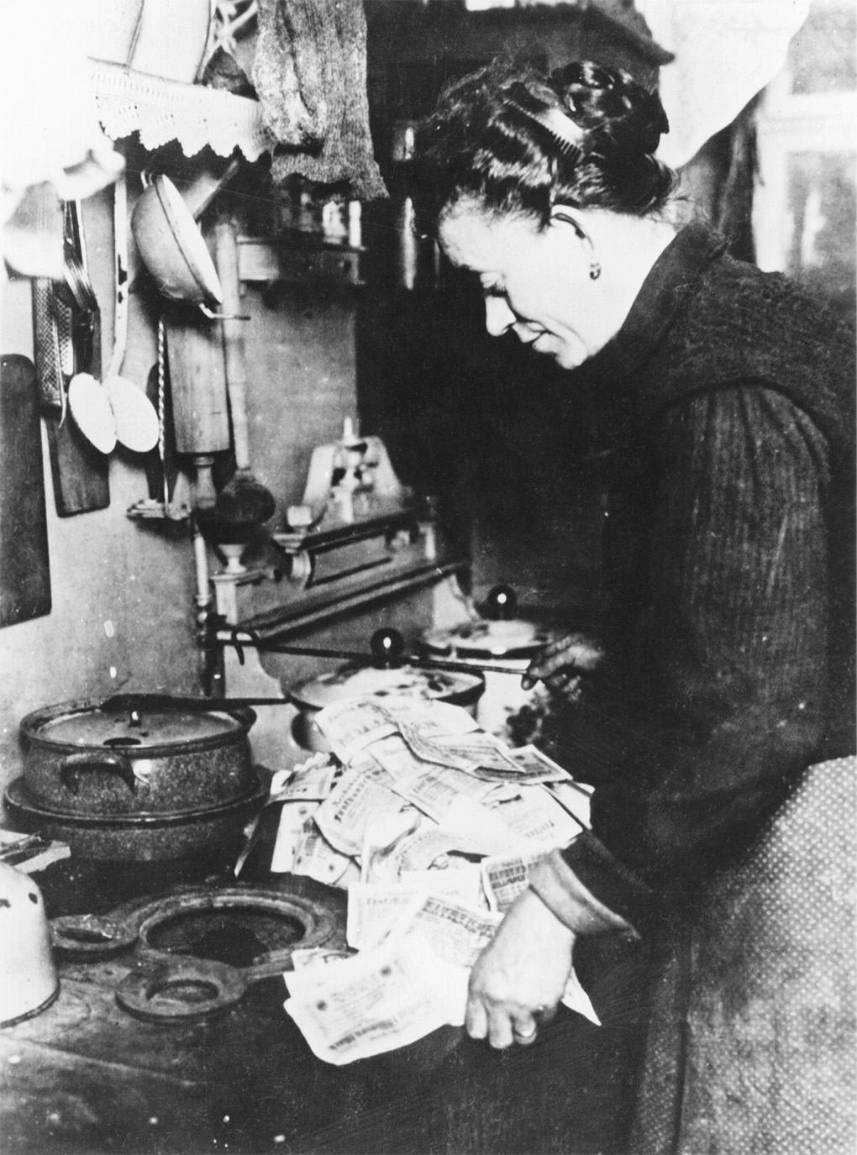
In 1923, Germany suffered from cataclysmic inflation. Paper money became worthless and people used it as fuel for kitchen stoves. Library of Congress
Copyright © 2010 Pearson Education, Inc., Upper Saddle River, NJ 07458. All rights reserved.
Notes:
In 1923, Germany suffered from cataclysmic inflation. Paper money became worthless and people used it as fuel for kitchen stoves.
Library of Congress

Slide 44
The Weimar Republic (cont.)
Hitler and the Early Years of Nazism
Adolf Hitler (1889–1945) made his first major appearance on the political scene in 1923. Along with a number of his followers, he attempted a putsch. Though it failed, and Hitler was imprisoned, it made him a hero to many Germans.
Nazism was characterized by extreme nationalism, anti-Communism, and anti-Semitism
The Stresemann Years
In order to repair inflation, Chancellor Gustav Stresemann introduced a new German currency
He also agreed to a new system of reparation payments in 1924, which helped to lower inflation
In 1925, right after the French left the Ruhr, Field Marshal Paul von Hindenburg became president
Locarno
The 1925 Locarno Agreements helped to integrate Germany back into the European system
However, its conciliatory outlook continued to alienate the German nationalist public
Copyright © 2010 Pearson Education, Inc., Upper Saddle River, NJ 07458. All rights reserved.

Slide 45
Germany: Depression and the Rise of the Nazis
Unemployment reaches six million in 1932
Parliamentary deadlock between Social Democrats and conservatives leads to the uprising of extreme political parties (Communists and Nazis)
Nazi politics meant power and intimidation of the Social Democrats and Communists
Copyright © 2010 Pearson Education, Inc., Upper Saddle River, NJ 07458. All rights reserved.

Slide 46
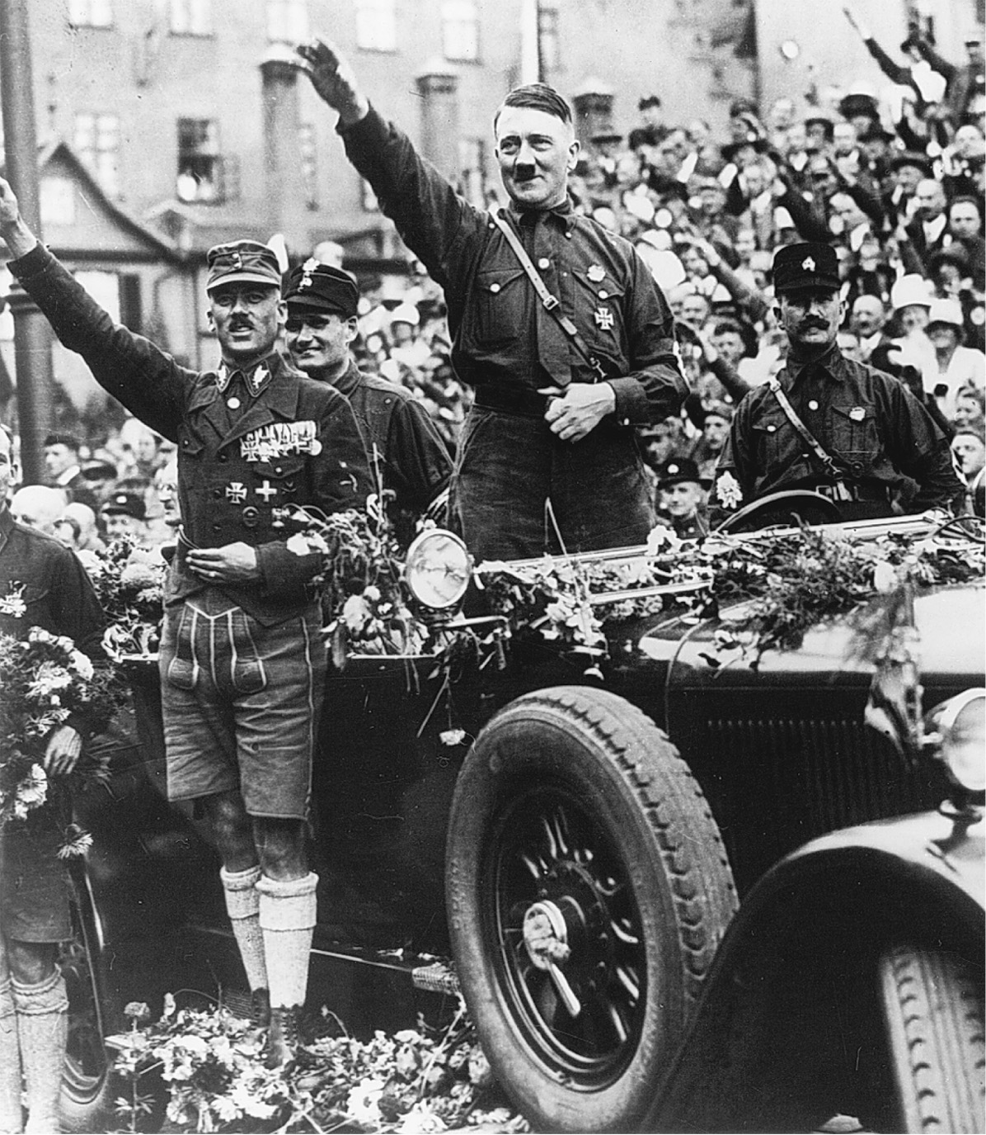
During a Nazi Party rally in Nuremberg in 1927, Adolf Hitler stops his motorcade to receive the applause of the surrounding crowd. In the late 1920s, the Nazi movement was only one of many bringing strife to the Weimar Republic. Heinrich Hoffman/ Bildarchiv Preussischer Kulturbesitz
Copyright © 2010 Pearson Education, Inc., Upper Saddle River, NJ 07458. All rights reserved.
Notes:
During a Nazi Party rally in Nuremberg in 1927, Adolf Hitler stops his motorcade to receive the applause of the surrounding crowd. In the late 1920s, the Nazi movement was only one of many bringing strife to the Weimar Republic.
Heinrich Hoffman/ Bildarchiv Preussischer Kulturbesitz

Slide 47
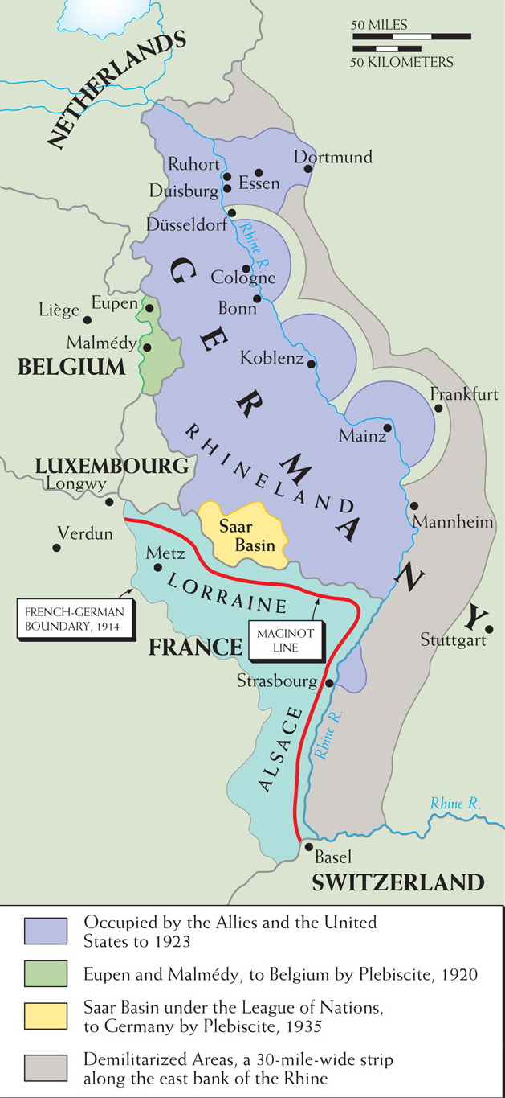
Map 26–1 GERMANY’S WESTERN FRONTIER The French-Belgian-German border area between the two world wars was sensitive. Despite efforts to restrain tensions, there were persistent difficulties related to the Ruhr, Rhineland, Saar, and Eupen-Malmédy regions that required strong defenses.
Copyright © 2010 Pearson Education, Inc., Upper Saddle River, NJ 07458. All rights reserved.
Notes:
Map 26–1 GERMANY’S WESTERN FRONTIER The French-Belgian-German border area between the two world wars was sensitive. Despite efforts to restrain tensions, there were persistent difficulties related to the Ruhr, Rhineland, Saar, and Eupen-Malmédy regions that required strong defenses.

Slide 48
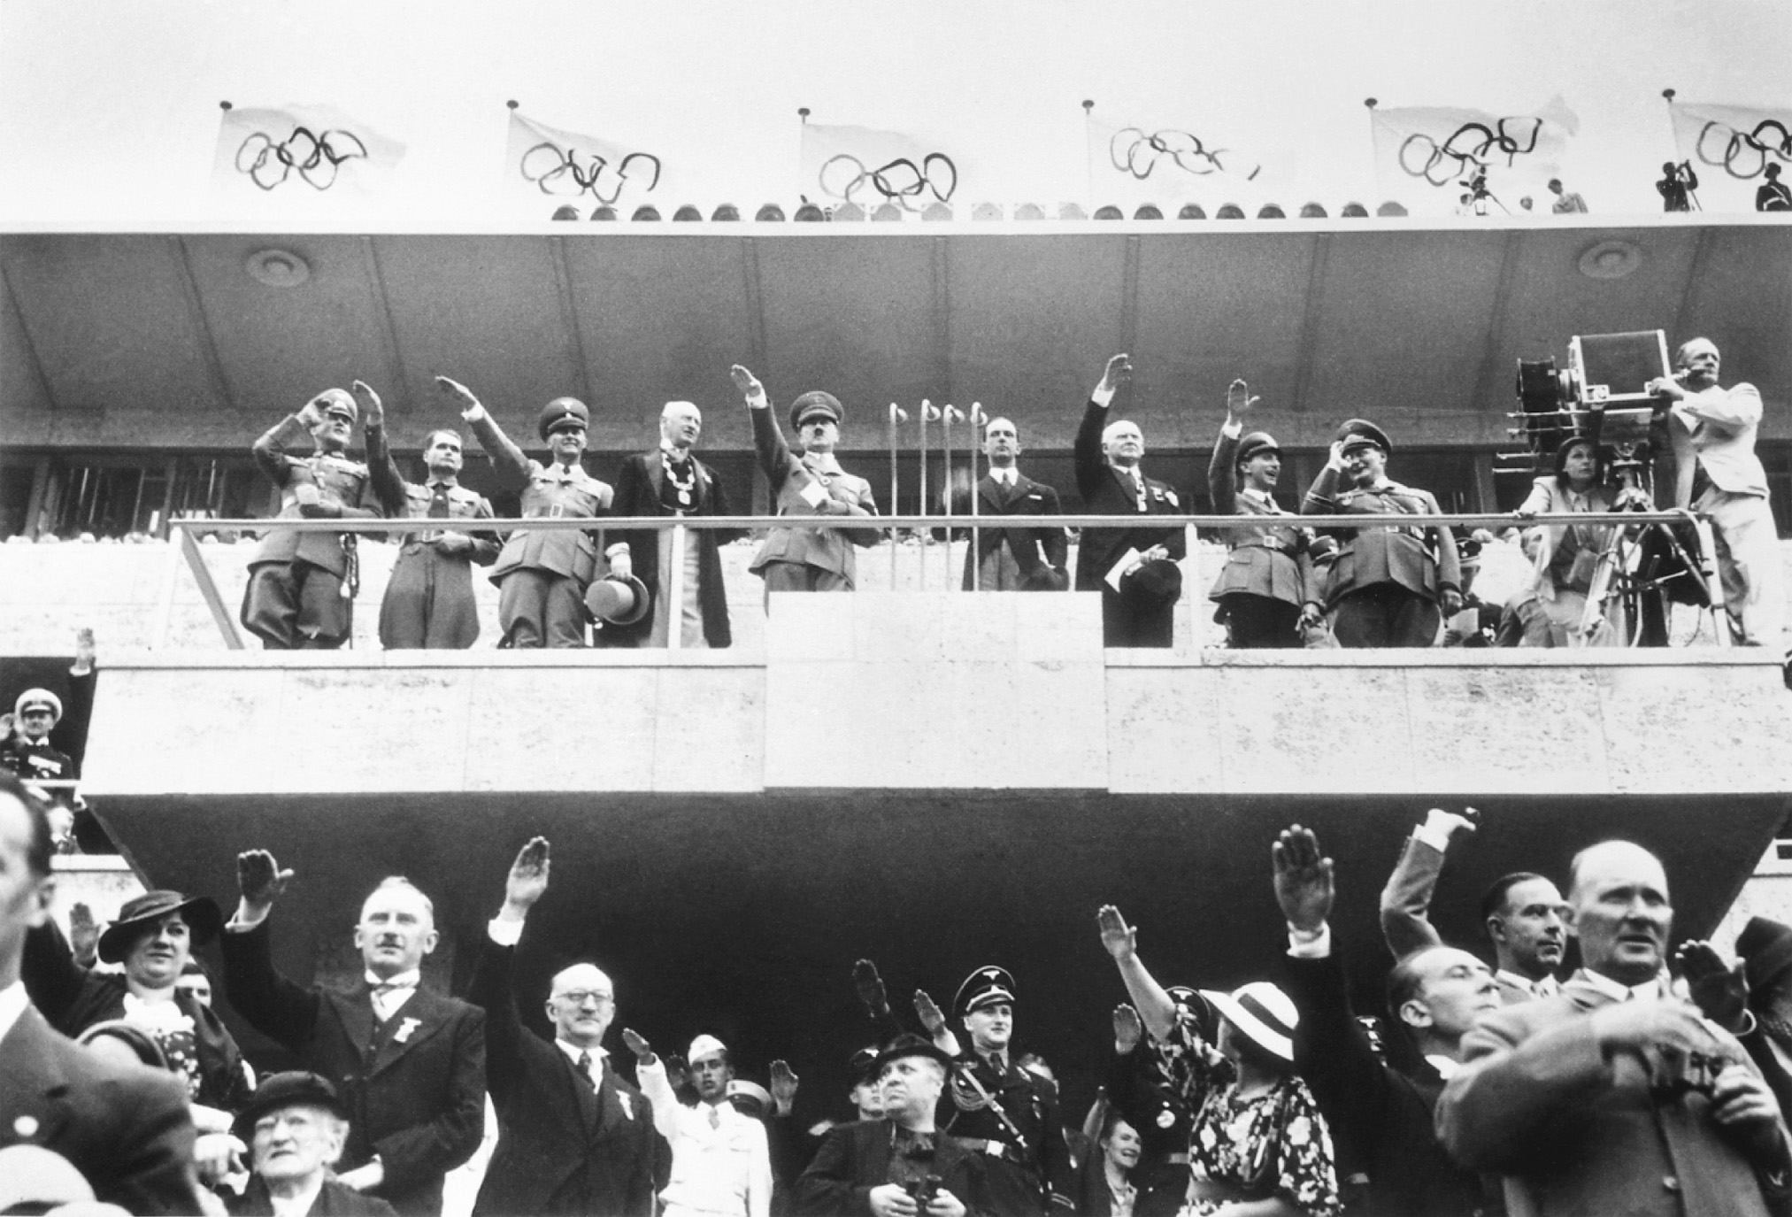
Leni Riefenstahl filming the 1936 Olympic Games in Berlin with Hitler on the reviewing stand. © Bettmann/CORBIS
Copyright © 2010 Pearson Education, Inc., Upper Saddle River, NJ 07458. All rights reserved.
Notes:
Leni Riefenstahl filming the 1936 Olympic Games in Berlin with Hitler on the reviewing stand.
© Bettmann/CORBIS

Slide 49
Hitler Comes to Power
President von Hindenburg – after eight months of trying to appease the Nazis without putting Adolf Hitler in power, in January 1933, he names Hitler chancellor
Von Hindenburg appointed several Conservatives to the cabinet, including Franz von Papen, as a way to attempt to control Hitler
Copyright © 2010 Pearson Education, Inc., Upper Saddle River, NJ 07458. All rights reserved.

Slide 50
How Hitler Came to Power
Blunders of conservative German politicians who hated the Weimer Republic put Hitler in charge
Hitler mastered techniques of mass politics and propaganda
Copyright © 2010 Pearson Education, Inc., Upper Saddle River, NJ 07458. All rights reserved.

Slide 51
How Hitler Came to Power (cont.)
Support came not just from lower classes, but war veterans, farmers and the young (particularly hurt by the depression)
Technically, Hitler came to power through legal means
Copyright © 2010 Pearson Education, Inc., Upper Saddle River, NJ 07458. All rights reserved.

Slide 52
Hitler’s Consolidation of Power
Reichstag Fire – mentally ill communist burns down Reichstag; as a result Hitler issues Article 48 – emergency decree suspending civil liberties and arresting suspected Communists
The Enabling Act – permitted Hitler to rule by decree, giving him unlimited power
Copyright © 2010 Pearson Education, Inc., Upper Saddle River, NJ 07458. All rights reserved.

Slide 53
Hitler’s Consolidation of Power (cont.)
1933 – National Socialists the only legal party in Germany
Internal Nazi Party Purges – Hitler orders German army to kill SA or storm troopers, including leader Ernst Roehm, because they were becoming too popular
Hindenburg dies – Hitler names himself chancellor and president, making him sole ruler of Germany and Nazi Party
Copyright © 2010 Pearson Education, Inc., Upper Saddle River, NJ 07458. All rights reserved.

Slide 54
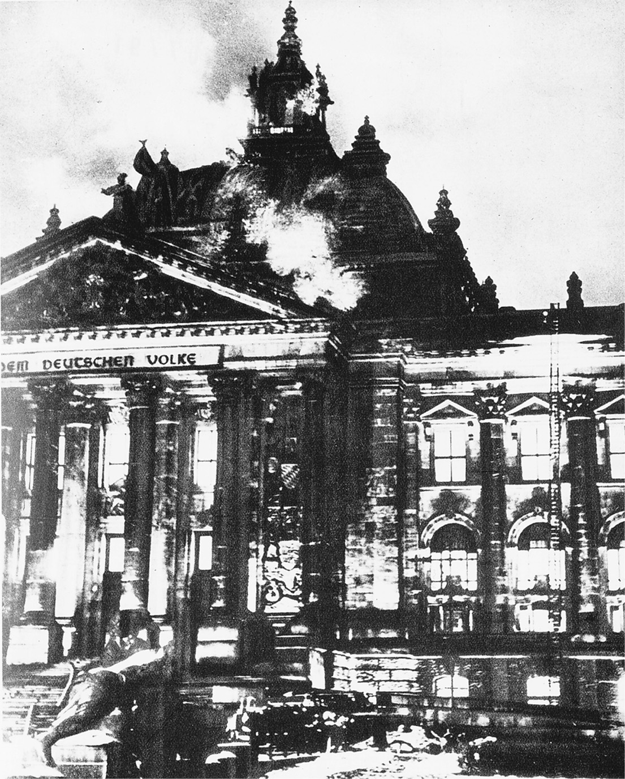
The Reichstag fire in 1933 provided Hitler with an excuse to consolidate his power. Bildarchiv Preussischer Kulturbesitz
Copyright © 2010 Pearson Education, Inc., Upper Saddle River, NJ 07458. All rights reserved.
Notes:
The Reichstag fire in 1933 provided Hitler with an excuse to consolidate his power.
Bildarchiv Preussischer Kulturbesitz

Slide 55
Anti-Semitism and the Police State
SS organization – commanded by Heinrich Himmler, it became chief vehicle of police surveillance and carried out the purges
Attack on Jewish economic life – anti-Semitism based on biological racial theories leads to Nazis excluding Jews from civil service and boycotts of Jewish businesses and shops
Copyright © 2010 Pearson Education, Inc., Upper Saddle River, NJ 07458. All rights reserved.

Slide 56
Anti-Semitism and the Police State (cont.)
Nuremberg Laws – German Jews robbed of citizenship, prohibited from marrying non-Jews, and publicly humiliated
Kristallnacht – Jews were forbidden to be in business and thousands of Jewish stores and synagogues were destroyed; Jews were forced to pay for the clean-up
Copyright © 2010 Pearson Education, Inc., Upper Saddle River, NJ 07458. All rights reserved.

Slide 57
Anti-Semitism and the Police State (cont.)
The Final Solution – Jews forced into small ghettos, then taken to prison camps, and in 1941 and 1942, the Final Solution leads to the extermination of six million eastern European Jews
Copyright © 2010 Pearson Education, Inc., Upper Saddle River, NJ 07458. All rights reserved.

Slide 58
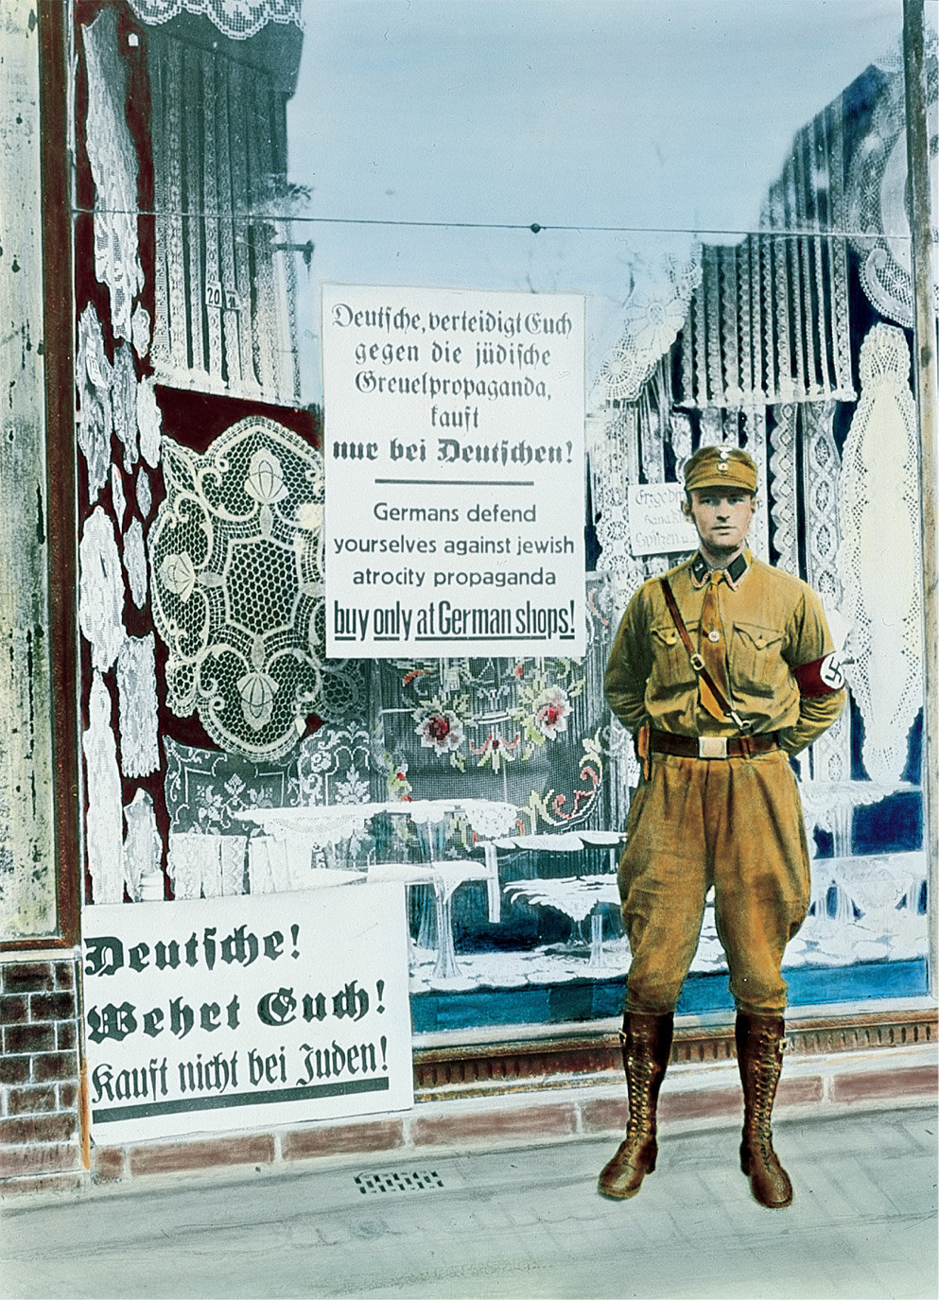
Soon after seizing power, the Nazi government began harassing German Jewish businesses. Non-Jewish German citizens were urged not to buy merchandise from shops owned by Jews. Art Resource/Bildarchiv Preussischer Kulturbesitz
Copyright © 2010 Pearson Education, Inc., Upper Saddle River, NJ 07458. All rights reserved.
Notes:
Soon after seizing power, the Nazi government began harassing German Jewish businesses. Non-Jewish German citizens were urged not to buy merchandise from shops owned by Jews.
Art Resource/Bildarchiv Preussischer Kulturbesitz

Slide 59
Women in Nazi Germany
Women were expected to breed strong sons and daughters to make a pure race of Germans
Jewish, Slavic, and Gypsy women were killed
Copyright © 2010 Pearson Education, Inc., Upper Saddle River, NJ 07458. All rights reserved.

Slide 60
Women in Nazi Germany (cont.)
Women who bore weak children were sterilized, killed, or forced to have abortions
Motherhood was emphasized, but women were encouraged to work, especially as educators teaching the young about Nazi philosophy
Copyright © 2010 Pearson Education, Inc., Upper Saddle River, NJ 07458. All rights reserved.

Slide 61
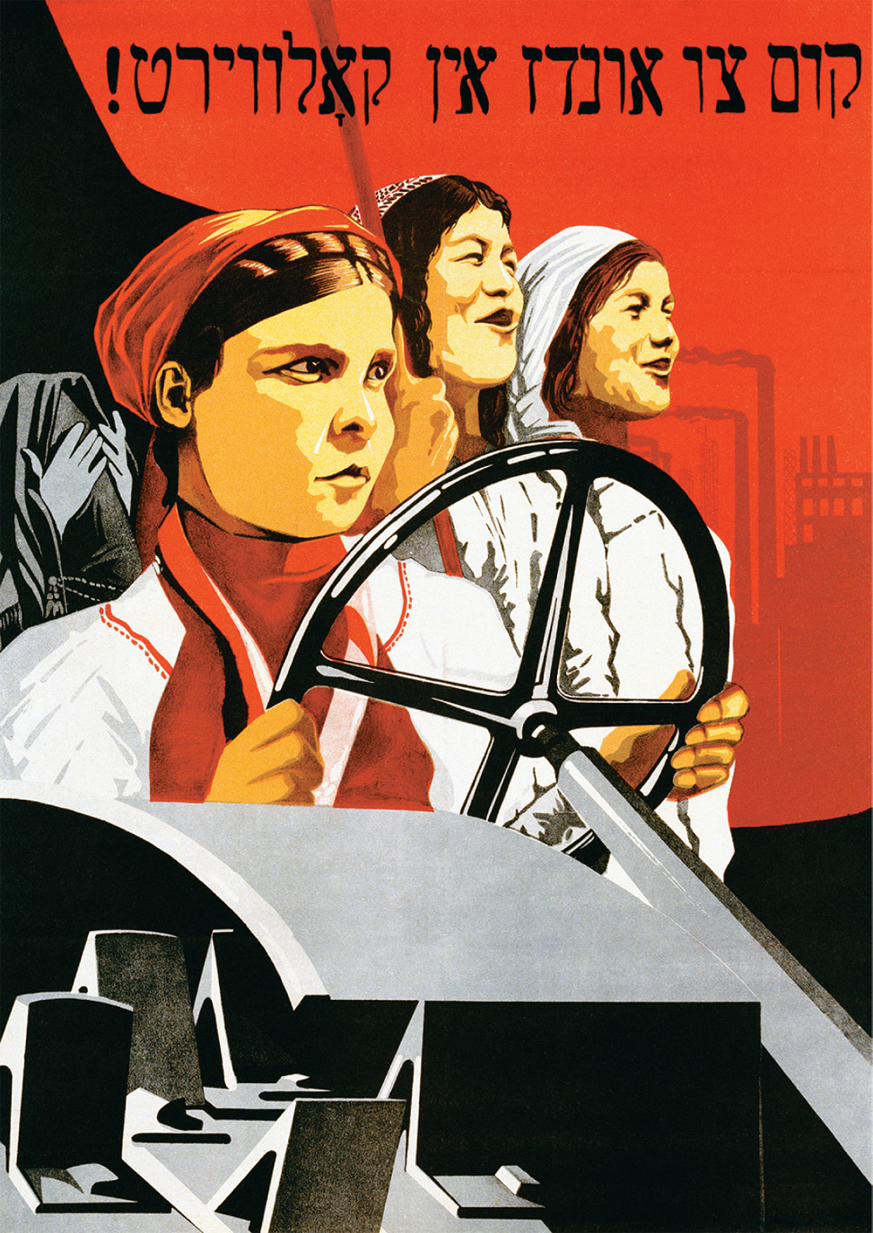
This Soviet poster illustrates the role of women in communist society as key players in industrial and agricultural development and progress. This differs greatly from the traditional role assigned to women in Nazi ideology. CORBIS/Bettmann © Swim Inc./CORBIS
Copyright © 2010 Pearson Education, Inc., Upper Saddle River, NJ 07458. All rights reserved.
Notes:
This Soviet poster illustrates the role of women in communist society as key players in industrial and agricultural development and progress. This differs greatly from the traditional role assigned to women in Nazi ideology.
CORBIS/Bettmann © Swim Inc./CORBIS

Slide 62
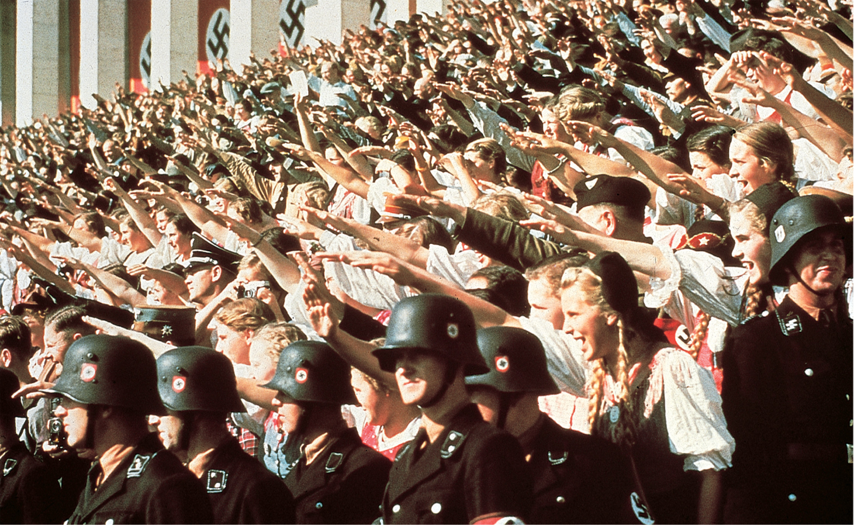
The Nazi Party Rally Young women were enthusiastic supporters among the crowd extending the Nazi salute in a 1938 rally. Bildarchiv Preussischer Kulturbesitz
Copyright © 2010 Pearson Education, Inc., Upper Saddle River, NJ 07458. All rights reserved.
Notes:
The Nazi Party Rally Young women were enthusiastic supporters among the crowd extending the Nazi salute in a 1938 rally. Bildarchiv Preussischer Kulturbesitz

Slide 63
Nazi Economic Policy
Hitler’s oppressive regime received support because he swiftly ended the depression in Germany
People would sacrifice all political and civil liberty and limit private exercise of capital in order to prepare for war and aggression
Copyright © 2010 Pearson Education, Inc., Upper Saddle River, NJ 07458. All rights reserved.

Slide 64
Nazi Economic Policy (cont.)
Massive public works programs
Renunciation of the Treaty of Versailles leads Hitler to appoint Hermann Goring to undertake a four-year plan to prepare the army and economy for war
Trade unions crushed and outlawed
Copyright © 2010 Pearson Education, Inc., Upper Saddle River, NJ 07458. All rights reserved.

Slide 65
Eastern Europe
The fall of the Eastern Empire created a number of new states
The question became, could those who had previously been powerless rule competently?
Economic and Ethnic Pressures
All of the new states except Czechoslovakia depended on foreign loans
All of the new states except Czechoslovakia fell under authoritarian ethnic rule
Copyright © 2010 Pearson Education, Inc., Upper Saddle River, NJ 07458. All rights reserved.

Slide 66
Poland
Restored after 130 years of being ruled by its neighbors; nationalism was not sufficient to overcome regional differences
In 1926, Marshal Josef Pilsudski (1867–1935) carried out a coup.
Copyright © 2010 Pearson Education, Inc., Upper Saddle River, NJ 07458. All rights reserved.

Slide 67
Czechoslovakia
Czechoslovakia was fortunate enough to have a gifted leader in Thomas Masaryk
The country worked well until the 1930s, when German nationalists looked to Hitler and he annexed the Sudetenland while the world watched
Copyright © 2010 Pearson Education, Inc., Upper Saddle River, NJ 07458. All rights reserved.

Slide 68
Hungary
After the war, there was a short-lived Communist Republic
Following the fall of the Communists, an aristocratic government ruled
Copyright © 2010 Pearson Education, Inc., Upper Saddle River, NJ 07458. All rights reserved.

Slide 69
Austria
Throughout the 20s there was dissention in Parliament between the Social Democrats and the Christian Socialists
By the 1930s, the Christian Socialists had control, until the Nazis annexed Austria in 1938
Copyright © 2010 Pearson Education, Inc., Upper Saddle River, NJ 07458. All rights reserved.

Slide 70
Southeastern Europe: Royal Dictatorships
Serbs and Croats clashed in Yugoslavia
Violence between ethnic nationalists led to royal dictatorship in 1929 under King Alexander I, a Serb
Royal dictatorships were also established in Romania, Bulgaria, and Greece
Copyright © 2010 Pearson Education, Inc., Upper Saddle River, NJ 07458. All rights reserved.

