Slide 1
Chapter 28
World War II

Slide 2
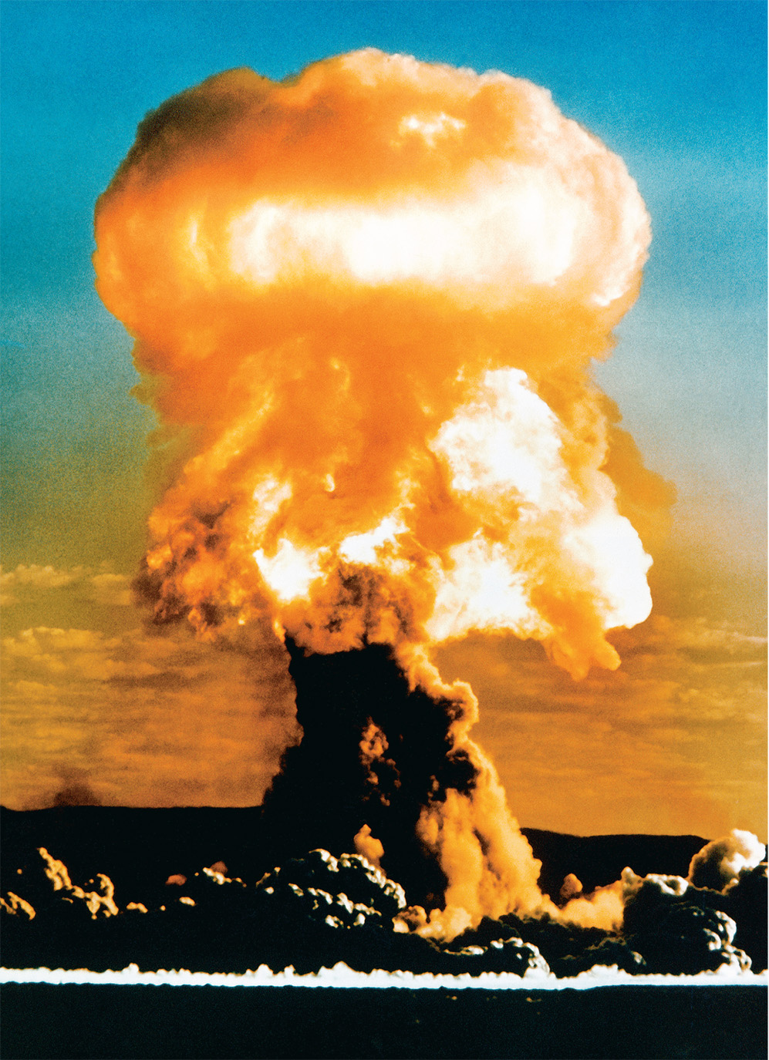
In August 1945, the United States exploded atomic bombs on the Japanese cities of Hiroshima and Nagasaki. A week later Japan surrendered. Without the bombs the United States would almost certainly have had to invade Japan, and tens of thousands of Americans would have been killed. Still, the decision to use the bomb remains controversial. © CORBIS
Notes:
In August 1945, the United States exploded atomic bombs on the Japanese cities of Hiroshima and Nagasaki. A week later Japan surrendered. Without the bombs the United States would almost certainly have had to invade Japan, and tens of thousands of Americans would have been killed. Still, the decision to use the bomb remains controversial.
© CORBIS

Slide 3
Once More, the Road to War
In Germany, the economic woes of the 1930s compounded the humiliations of defeat in World War I.
In response, the nationalism of the Nazi party became popular, catapulting Adolf Hitler into power.

Slide 4
Hitler’s Goals
Hitler expressed his main goals in his book Mein Kampf.
His primary goal was the unification of the German people, the Volk, under one flag.
This nation would include all of the Germanic parts of the Habsburg Empire, including Austria.

Slide 5
Hitler’s Goals (cont.)
Hitler expressed his main goals in his book Mein Kampf.
The nation would need extra room to live, Lebensraum, which would be taken from the Slavs, an inferior race; and it would be cleared of Jews, the lowest of the races.
Rearming
In 1933, Germany withdrew from the League of Nations.
In 1934, Germany signed a non-aggression pact with Poland.

Slide 6
Hitler’s Goals (cont.)
Rearming
In 1935, Hitler formally renounced the disarmament provisions of the Versailles treaty, and soon reinstated conscription.
Though the League of Nations denounced Germany’s decision to rearm, it was helpless to prevent it, rendering it uselessness.

Slide 7
Italy Attacks Ethiopia
In October 1935, Mussolini attacked Ethiopia.
France and Britain were both willing to appease him, in the hope that Italy would offset Germany’s growing power. They offered to allow him to control Ethiopia in fact, if it would remain legally independent.
Mussolini refused the offer, but France and Britain still did not substantially oppose him.

Slide 8
Remilitarization of the Rhineland
Mussolini’s success convinced Hitler that the Western powers would also not oppose him substantially.
On March 7, 1936 he sent a small armed force into the demilitarized Rhineland.
France and Britain both registered a complaint with the League of Nations, but did nothing else.

Slide 9
The Spanish Civil War
The new dividing line in Europe between Fascist and Western democracies was made clearer by the Spanish Civil War.
The war broke out in July 1936, between the elected Popular Front Government and the Falangist Fascists, lead by General Francisco Franco (1892–1975). It lasted three years.
Germany and Italy supported the Falangists.
The Soviets supported the Republicans.
The Western democracies remained neutral.
The Fascists won in 1939.

Slide 10
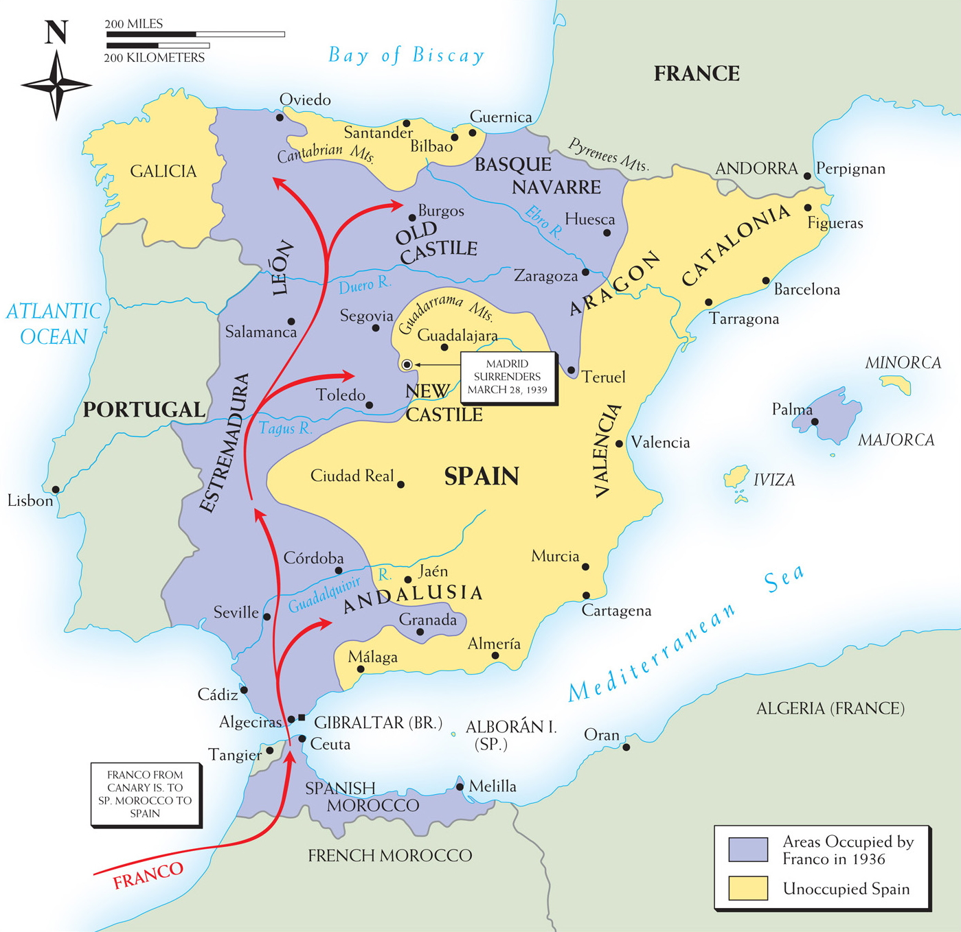
Map 28–1 THE SPANISH CIVIL WAR, 1936–1939 The purple area on the map shows the large portion of Spain quickly overrun by Franco’s insurgent armies during the first year of the war. In the next two years, progress came more slowly for the fascists as the war became a kind of international rehearsal for the coming World War II. Madrid’s fall to Franco in the spring of 1939 had been preceded by that of Barcelona a few weeks earlier.
Notes:
Map 28–1 THE SPANISH CIVIL WAR, 1936–1939 The purple area on the map shows the large portion of Spain quickly overrun by Franco’s insurgent armies during the first year of the war. In the next two years, progress came more slowly for the fascists as the war became a kind of international rehearsal for the coming World War II. Madrid’s fall to Franco in the spring of 1939 had been preceded by that of Barcelona a few weeks earlier.

Slide 11
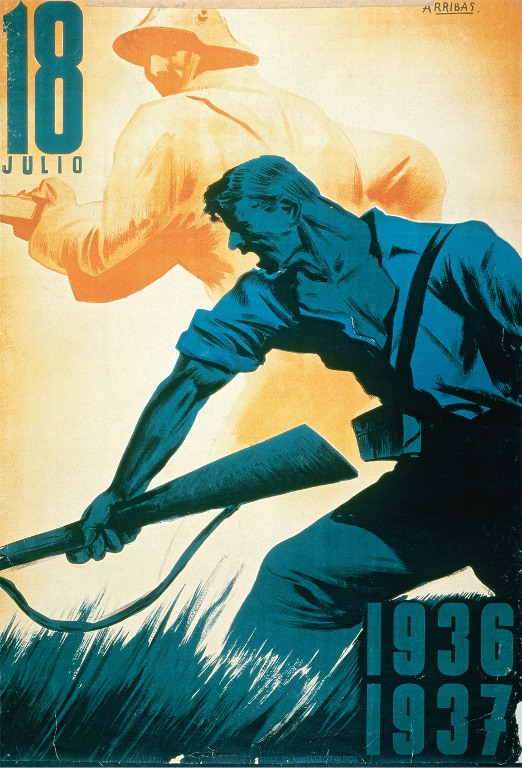
This poster supports General Francisco Franco’s Nationalists in the bloody Spanish Civil War, which lasted almost three years and claimed hundreds of thousands of lives. Courtesy of the Library of Congress
Notes:
This poster supports General Francisco Franco’s Nationalists in the bloody Spanish Civil War, which lasted almost three years and claimed hundreds of thousands of lives.
Courtesy of the Library of Congress

Slide 12
Austria and Czechoslovakia
In 1938, Hitler’s newfound closeness to Mussolini encouraged him to attempt to take Austria.
He marched into Austria on March 12th, in order to forestall a plebiscite on Anschluss, the union of Germany and Austria. Italy did not object.

Slide 13
Austria and Czechoslovakia (cont.)
The Anschluss was strategically significant, as Germany now surrounded Czechoslovakia, a country which was an affront to Hitler’s sensibilities.

Slide 14
Austria and Czechoslovakia (cont.)
Throughout 1938, Hitler increased the pressure on the Czechs:
Disseminated false rumors that the Germans would attack, forcing the Czechs to mobilize their army on the German border in May.
September 12: Hitler made a speech at a Nazi rally, which provoked ethnic German rioting in the Sudetenland; the Czechs declared martial law.

Slide 15
Austria and Czechoslovakia (cont.)
Neville Chamberlain, the British Prime Minister, made three flights to Germany between September 15th and 29th, attempting to appease Hitler and avoid war.
He ended up conceding the Sudetenland to Germany by withdrawing support from Czechoslovakia. However, Hitler insisted that the Czechs withdraw within three days. War appeared unavoidable.

Slide 16
The Munich Conference
On September 29th, 1938, Mussolini called a conference at Chamberlain’s request.
Results of the conference:
Hitler’s demands were met, and he gained control of the Sudetenland.
However, he promised that he had no further territorial demands in Europe.
Chamberlain claimed he had brought “peace with honour.”

Slide 17
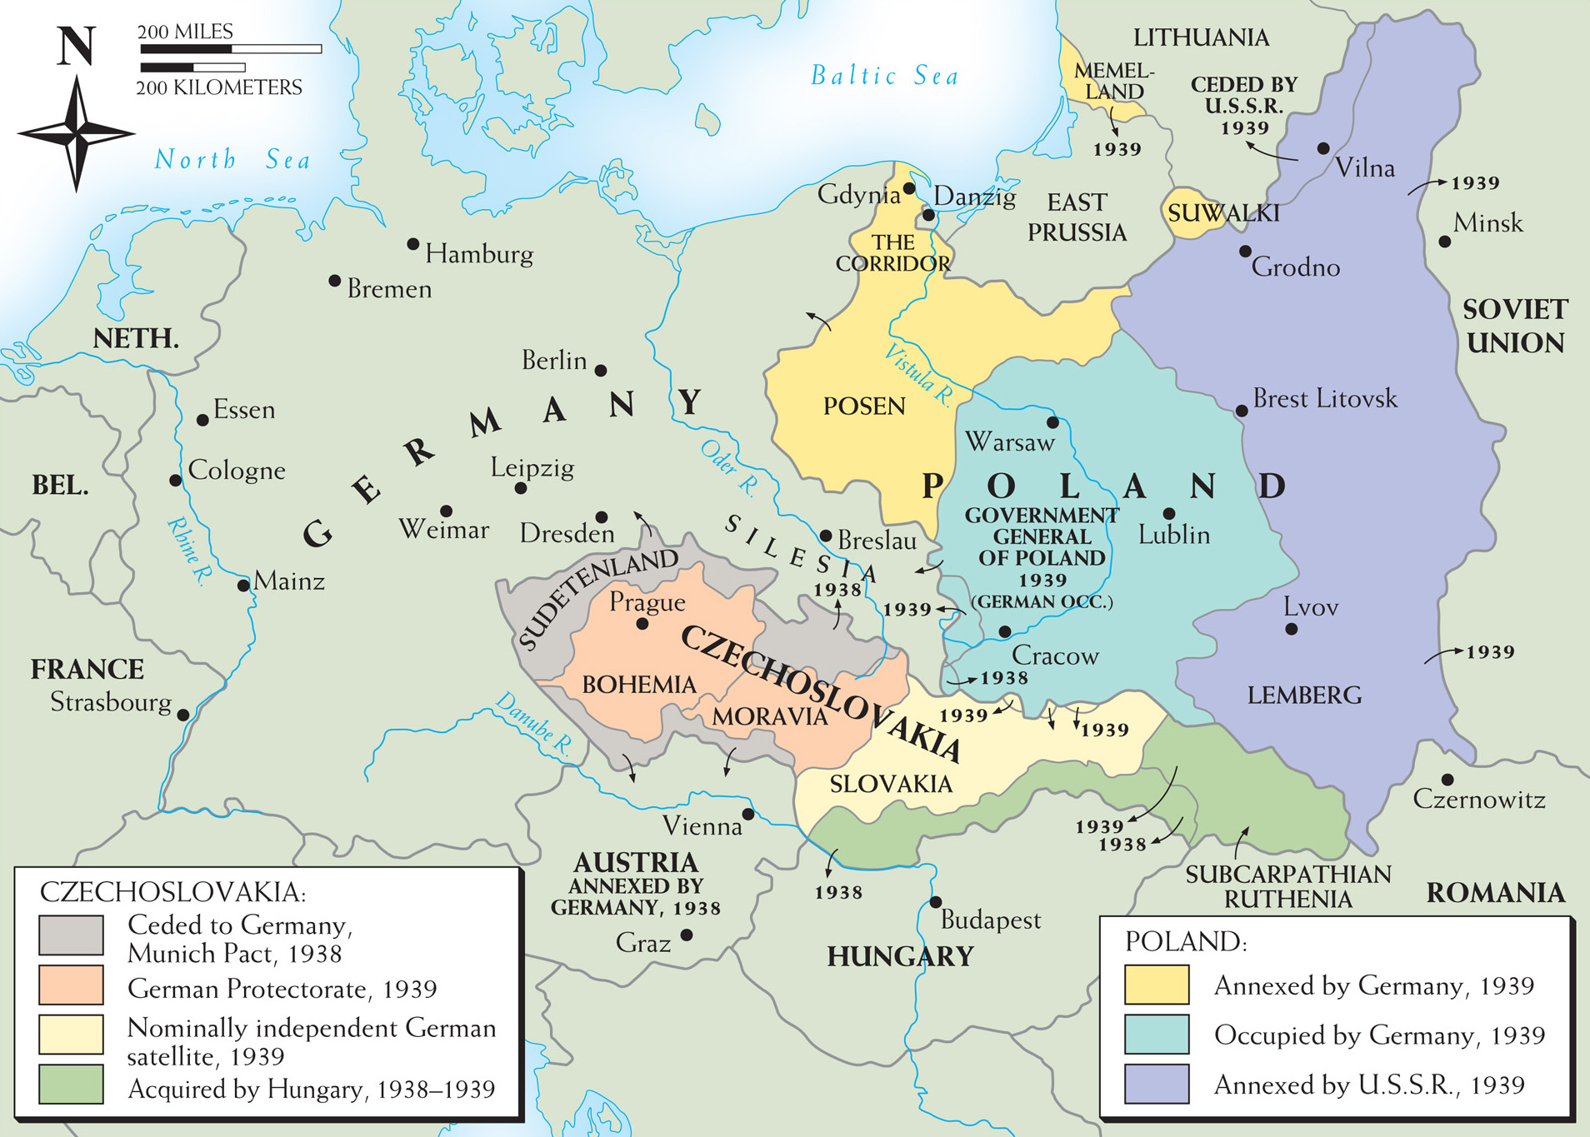
Map 28–2 PARTITIONS OF CZECHOSLOVAKIA AND POLAND, 1938–1939 The immediate background of World War II is found in the complex international drama unfolding on Germany’s eastern frontier in 1938 and 1939. Germany’s expansion inevitably meant the victimization of Austria, Czechoslovakia, and Poland. With the failure of the Western powers’ appeasement policy and the signing of a German-Soviet pact, the stage for the war was set.
Notes:
Map 28–2 PARTITIONS OF CZECHOSLOVAKIA AND POLAND, 1938–1939 The immediate background of World War II is found in the complex international drama unfolding on Germany’s eastern frontier in 1938 and 1939. Germany’s expansion inevitably meant the victimization of Austria, Czechoslovakia, and Poland. With the failure of the Western powers’ appeasement policy and the signing of a German-Soviet pact, the stage for the war was set.

Slide 18
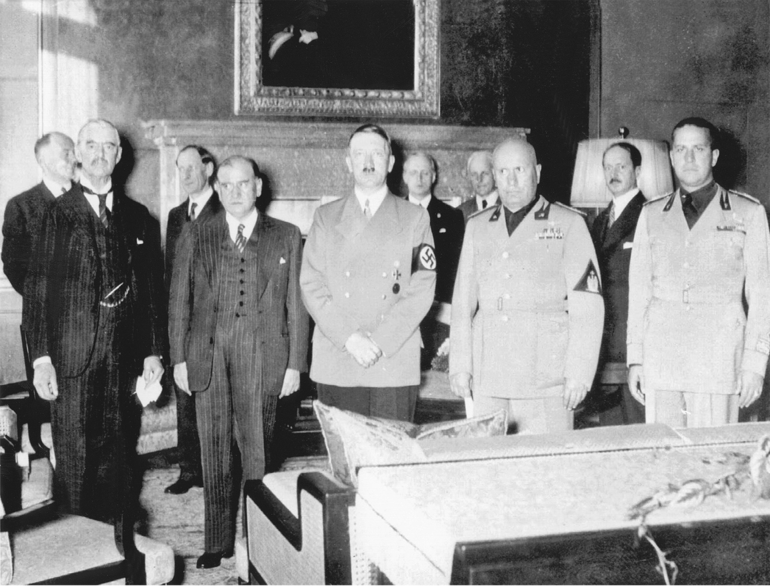
Agreement at Munich. On September 29–30, 1938, Hitler met with the leaders of Britain and France at Munich to decide the fate of Czechoslovakia. The Allied leaders abandoned the small democratic nation in a vain attempt to appease Hitler and avoid war. From left to right in the foreground: British Prime Minister Neville Chamberlain, French Prime Minister Edouard Daladier, Adolf Hitler, Benito Mussolini, and Italian Minister of Foreign Affairs (and Mussolini’s son-in-law), Count Ciano. National Archives and Records Administration
Notes:
Agreement at Munich. On September 29–30, 1938, Hitler met with the leaders of Britain and France at Munich to decide the fate of Czechoslovakia. The Allied leaders abandoned the small democratic nation in a vain attempt to appease Hitler and avoid war. From left to right in the foreground: British Prime Minister Neville Chamberlain, French Prime Minister Edouard Daladier, Adolf Hitler, Benito Mussolini, and Italian Minister of Foreign Affairs (and Mussolini’s son-in-law), Count Ciano.
National Archives and Records Administration

Slide 19
The Beginning of the War
March 15, 1939, Hitler occupied Prague, taking the rest of Czechoslovakia.
Spring, 1939, Germany put pressure on Poland to return the formerly German city of Danzig, and for the rights to build a connecting railroad through Poland to East Prussia.

Slide 20
The Beginning of the War (cont.)
March 31st, Chamberlain announced a joint Franco-British guarantee of Polish independence.
August 23rd, the Soviets signed a pact with Germany, agreeing to divide Poland between them.
September 1st, Hitler invaded Poland.
September 3rd, Britain and France declared war on Germany.

Slide 21
The German Conquest of Europe
Germany quickly overran Poland, using the new technique of Blitzkreig, “lightning warfare,” which employed fast moving armored columns supported by airpower.
September 17th, the Russians invaded from the east.

Slide 22
The German Conquest of Europe (cont.)
The French remained behind the Maginot Line, while the British rearmed and the British Navy blockaded Germany.
April 1940, Hitler invaded Denmark and Norway.

Slide 23
The German Conquest of Europe (cont.)
May 1940, Hitler began a Blitzkrieg through Belgium, the Netherlands and Luxembourg. The British and French Armies in Belgium were forced to flee.
Hitler continued into France, while Mussolini attacked from the south on June 10th. Less than a week later, the French, under Marshal Henri Philippe Petain, surrendered.

Slide 24
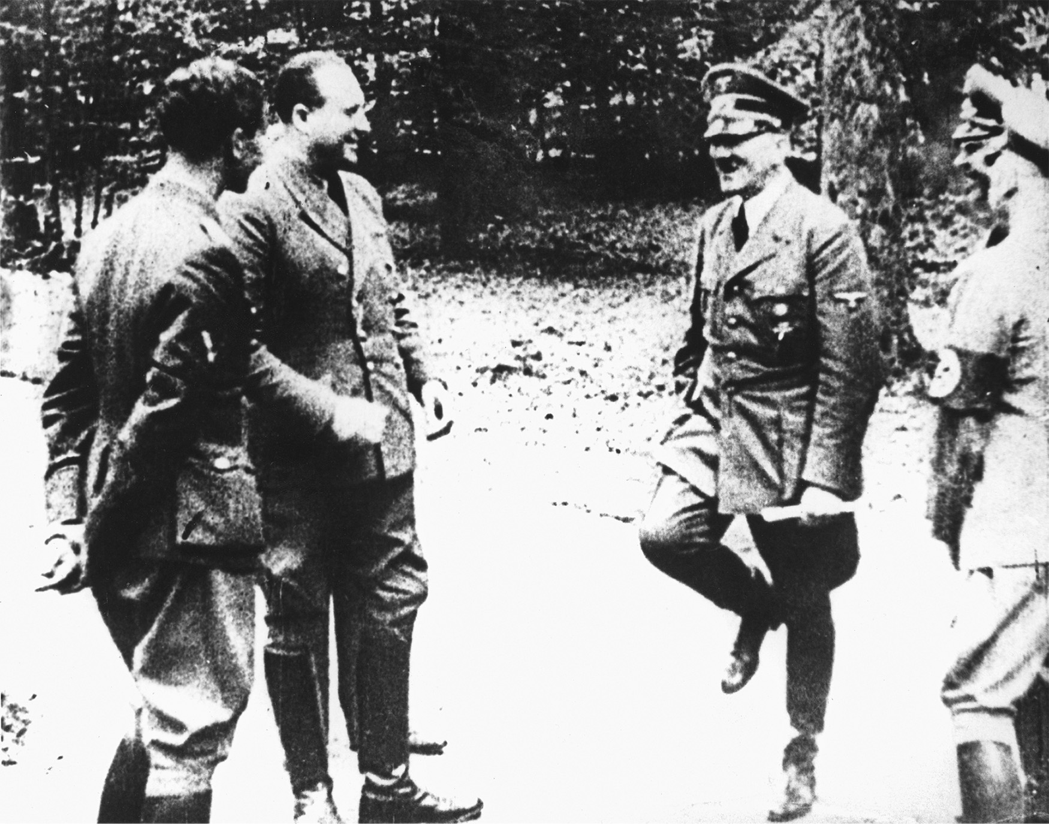
Adolf Hitler receives news of Marshal Pétain’s request for an armistice following the fall of Paris in June 1940. National Archives and Records Administration
Notes:
Adolf Hitler receives news of Marshal Pétain’s request for an armistice following the fall of Paris in June 1940.
National Archives and Records Administration

Slide 25
The Battle of Britain
May 1940, Chamberlain was replaced by Winston Churchill (1874-1965), an early and forceful critic of Hitler.
August 1940, Germany began bombardment of Britain, in the hopes of softening the country up for invasion.
He managed to destroy much of London and kill 15,000 people.
However, he lost twice as many planes as the British, and was forced to abandon the invasion plan.

Slide 26
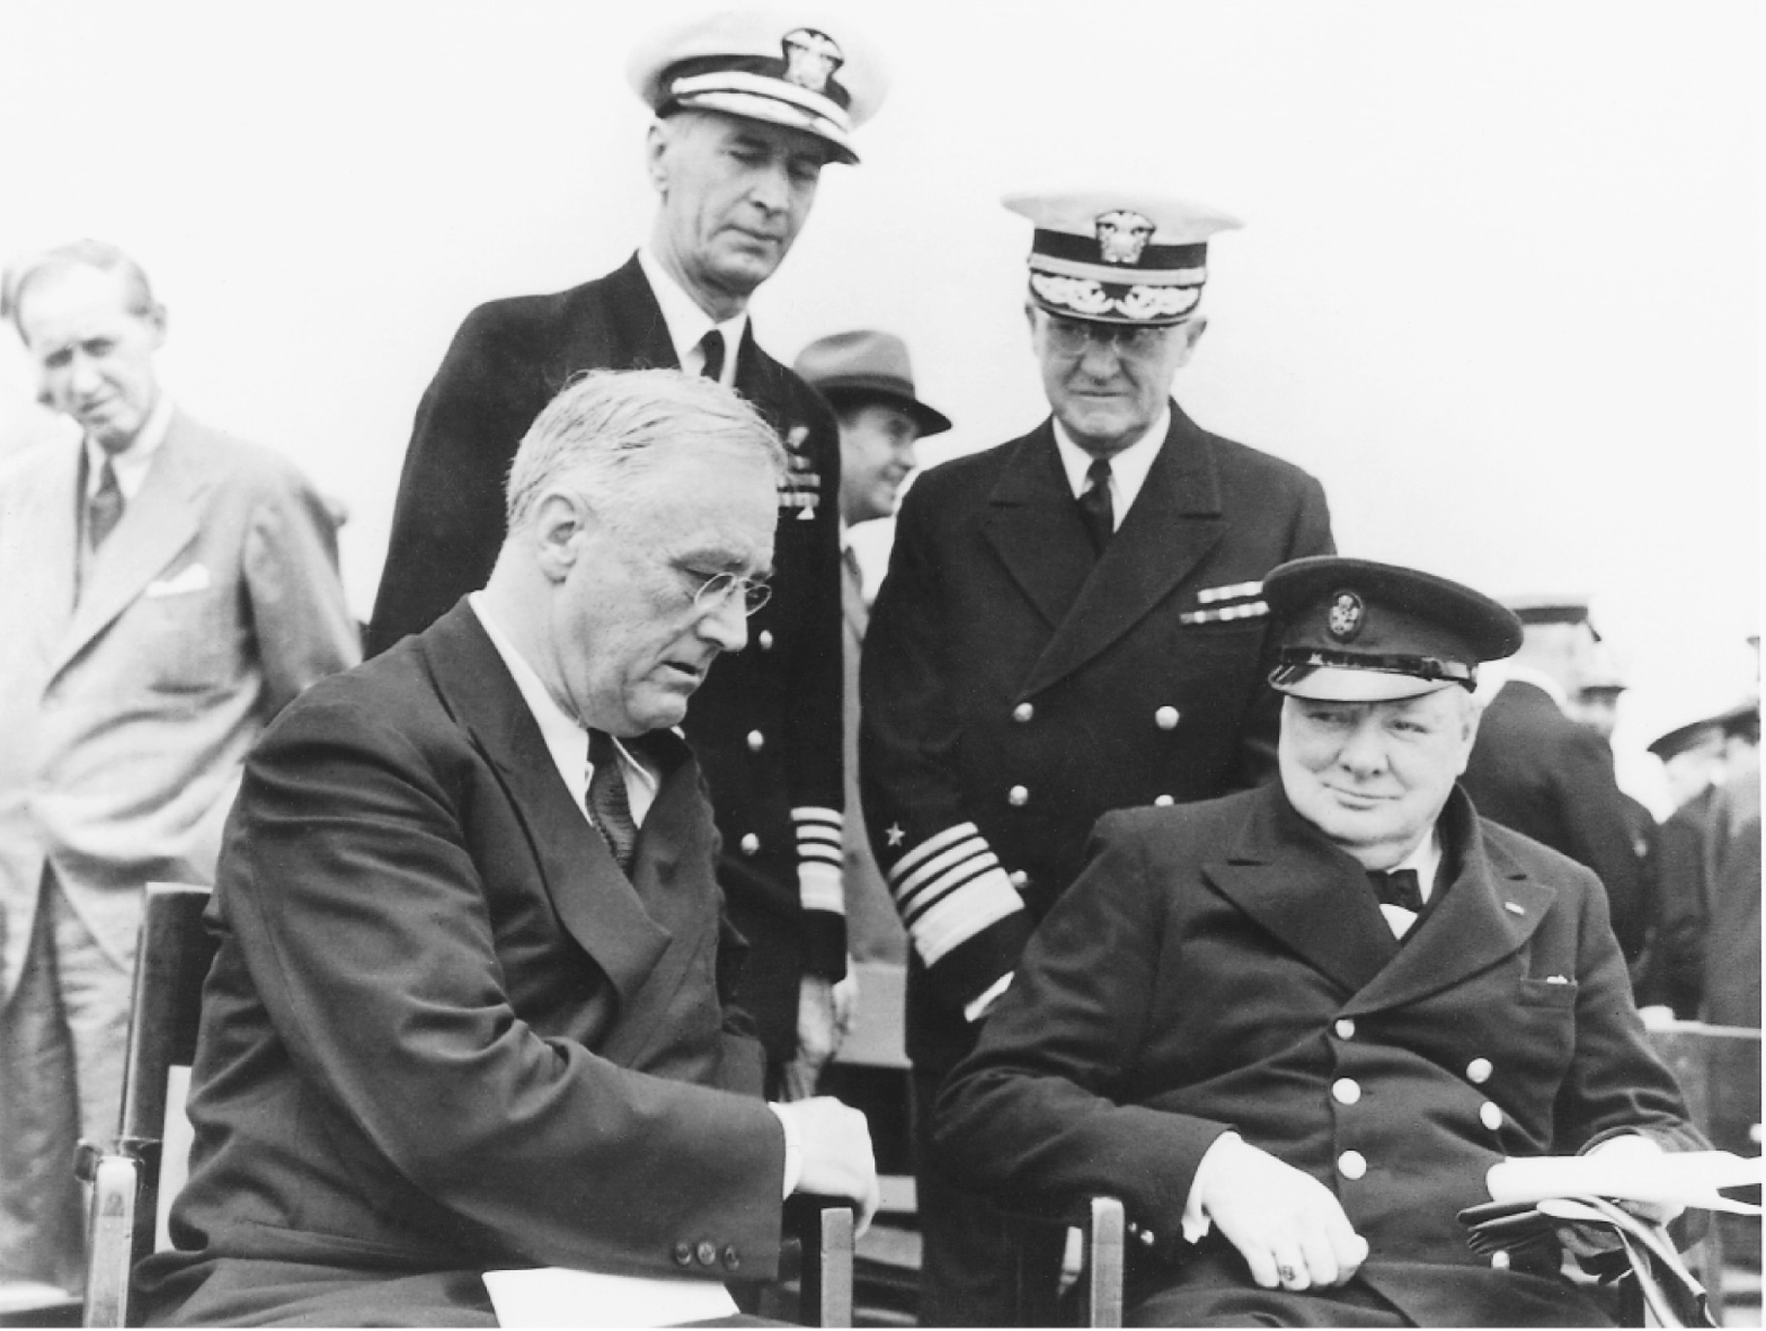
In August 1941, President Franklin Roosevelt and Prime Minister Winston Churchill met at sea and agreed on a broad program of liberal peace aims, called the Atlantic Charter, in the spirit of Woodrow Wilson’s Fourteen Points (see page 930). The Granger Collection
Notes:
In August 1941, President Franklin Roosevelt and Prime Minister Winston Churchill met at sea and agreed on a broad program of liberal peace aims, called the Atlantic Charter, in the spirit of Woodrow Wilson’s Fourteen Points (see page 930).
The Granger Collection

Slide 27
The German Attack on Russia
December 1940, Hitler tells his generals to prepare for an attack on Russia by May 15th, 1941, to be called Operation Barbarossa. It was designed to destroy Russia before winter set in.

Slide 28
The German Attack on Russia (cont.)
Operation Barbarossa does not actually begin until June 22, 1941.
The Russians were quite surprised; Stalin had not expected Hitler to violate their pact.
In the first two days, 2,000 Russian planes had been destroyed on the ground. By November, 2.5 million of Russia’s initial 4.5 million troops were dead.

Slide 29
The German Attack on Russia (cont.)
Hitler delayed the advance in August, to decide strategy. He diverted a troop south. By the time he got back to attacking Moscow, winter had ravaged his army and the city was better fortified. It had turned into a war of attrition.
November and December 1941, the Russians counterattacked.

Slide 30
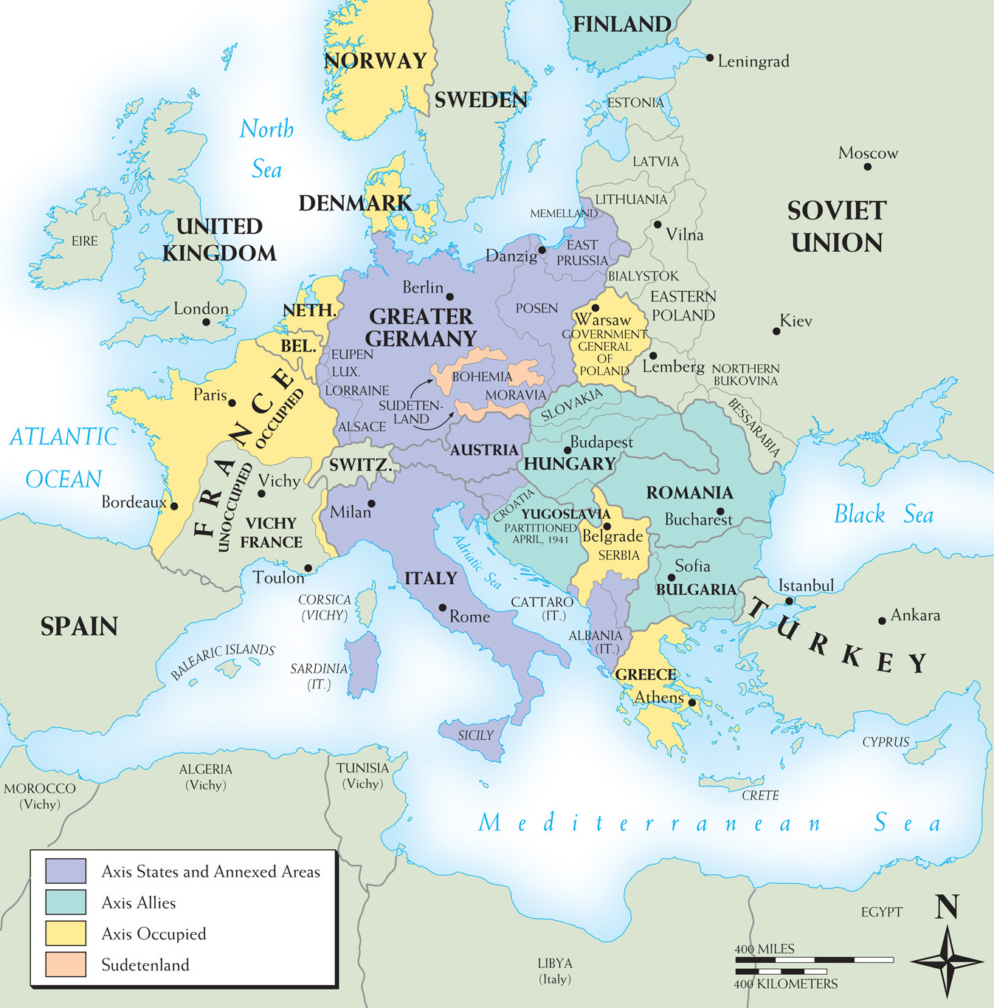
Map 28–3 AXIS EUROPE, 1941 On the eve of the German invasion of the Soviet Union, the Germany-Italy Axis bestrode most of western Europe by annexation, occupation, or alliance—from Norway and Finland in the north to Greece in the south and from Poland to France. Britain, the Soviets, a number of insurgent groups, and, finally, America, had before them the long struggle of conquering this Axis “fortress Europe.”
Notes:
Map 28–3 AXIS EUROPE, 1941 On the eve of the German invasion of the Soviet Union, the Germany-Italy Axis bestrode most of western Europe by annexation, occupation, or alliance—from Norway and Finland in the north to Greece in the south and from Poland to France. Britain, the Soviets, a number of insurgent groups, and, finally, America, had before them the long struggle of conquering this Axis “fortress Europe.”

Slide 31
Japan and the United States Enter the War
Throughout the 30s and 40s Japan’s Imperial interests had been thwarted by the United States.
October 1941, a war faction led by General Hideki Tojo took power in Japan.
December 7th, 1941, the Japanese bombed Pearl Harbor, Hawaii, catching the Americans completely off guard.

Slide 32
Japan and the United States Enter the War (cont.)
The U.S. and Britain immediately declared war on Japan. Three days later, Germany and Italy declared war on the U.S.

Slide 33
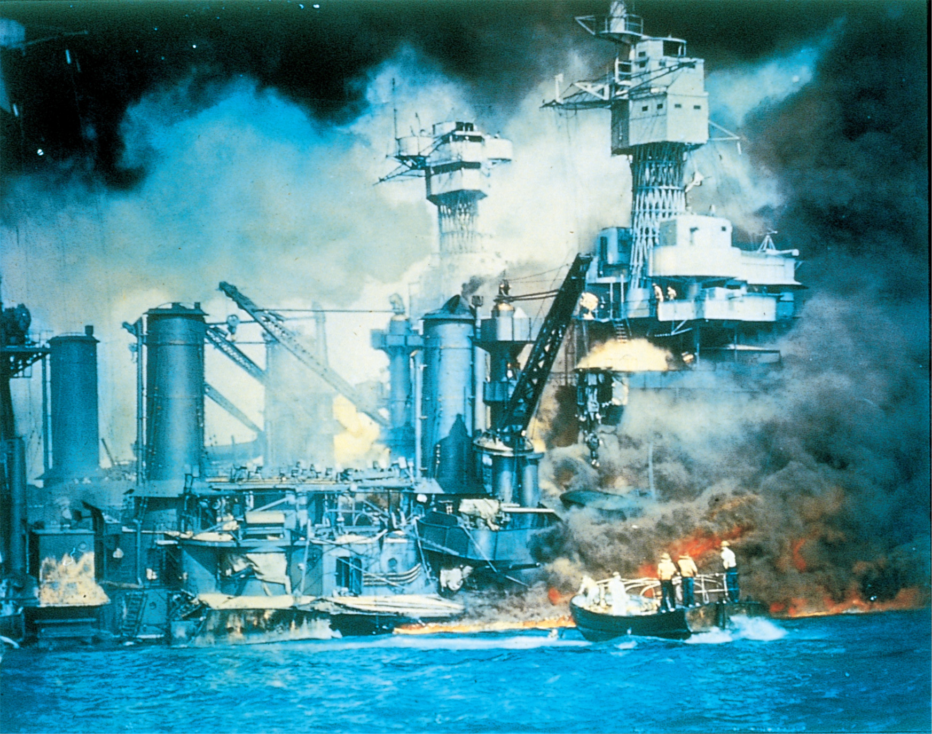
The successful Japanese attack on the American base at Pearl Harbor in Hawaii on December 7, 1941, together with simultaneous attacks on other Pacific bases, brought the United States into war against the Axis powers. This picture shows the battleships USS West Virginia and USS Tennessee in flames as a small boat rescues a man from the water. U.S. Army Photo
Notes:
The successful Japanese attack on the American base at Pearl Harbor in Hawaii on December 7, 1941, together with simultaneous attacks on other Pacific bases, brought the United States into war against the Axis powers. This picture shows the battleships USS West Virginia and USS Tennessee in flames as a small boat rescues a man from the water.
U.S. Army Photo

Slide 34
The Tide Turns
Spring 1942, the U.S. has a string of victories against Japan in the pacific.
Summer 1942, the Battle of Stalingrad raged for months, with the Russians eventually prevailing. The Germans lost an entire army.
November 1942, an Allied force landed in French North Africa, defeating German forces there.

Slide 35
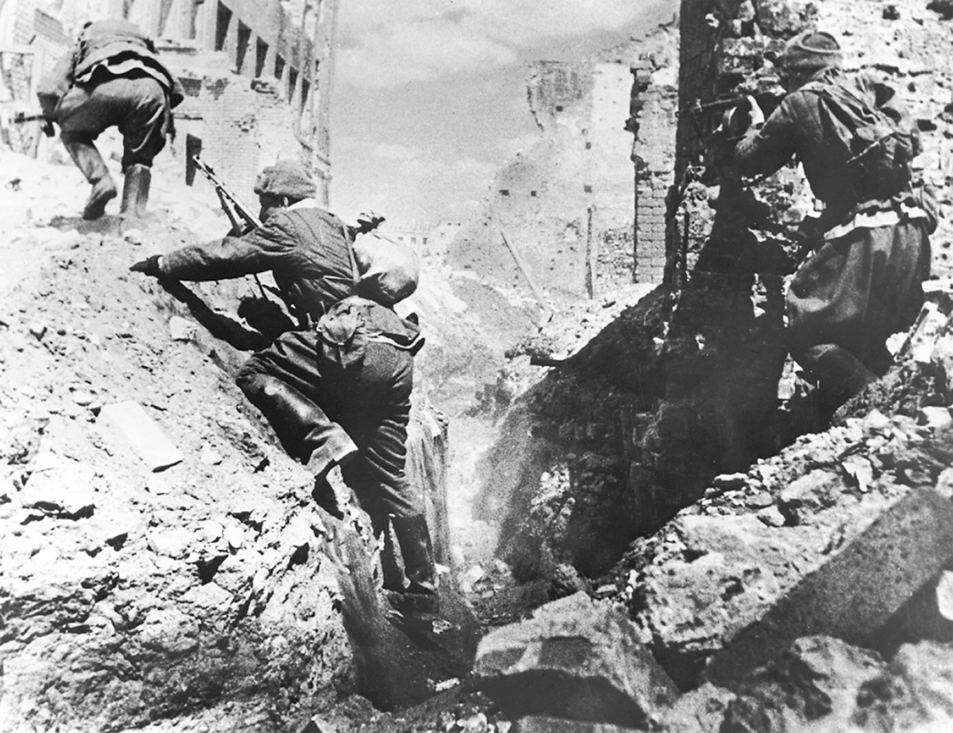
In the battle of Stalingrad, Russian troops contested every street and building. Although the city was all but destroyed in the fighting and Russian casualties were enormous, the German army in the east never recovered from the defeat it suffered there. Hulton Archives/Getty Images, Inc.
Notes:
In the battle of Stalingrad, Russian troops contested every street and building. Although the city was all but destroyed in the fighting and Russian casualties were enormous, the German army in the east never recovered from the defeat it suffered there.
Hulton Archives/Getty Images, Inc.

Slide 36
The Tide Turns (cont.)
July and August 1943, the Allies took Sicily.
In 1943, the Allies began a massive bombing campaign in Germany. By 1945, the Allies could bomb at will.

Slide 37
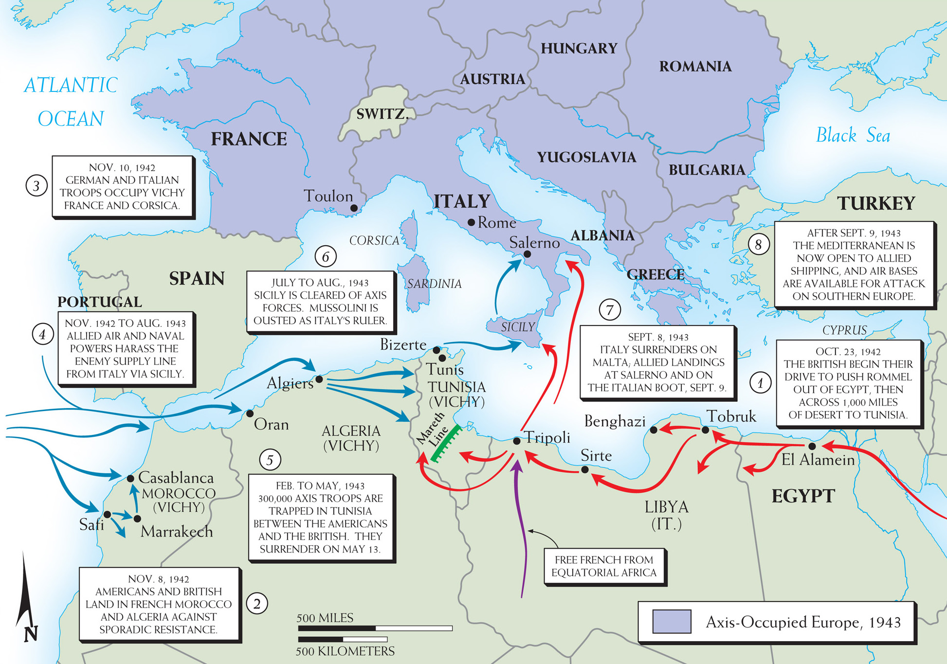
Map 28–4 NORTH AFRICAN CAMPAIGNS, 1942–1945 Control of North Africa would give the Allies access to Europe from the south. The map illustrates this theater of the war from Morocco to Egypt and the Suez Canal.
Notes:
Map 28–4 NORTH AFRICAN CAMPAIGNS, 1942–1945 Control of North Africa would give the Allies access to Europe from the south. The map illustrates this theater of the war from Morocco to Egypt and the Suez Canal.

Slide 38
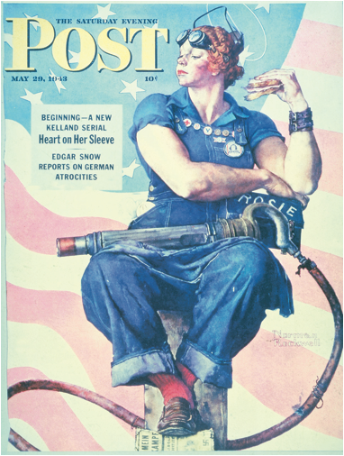
Notes:
Rosie the Riveter was one of the best known symbols of the U.S. war effort in World War II. Printed by permission of the Norman Rockwell Family Agency.
Copyright © 1943 the Norman Rockwell Family Entities

Slide 39
The Defeat of Nazi Germany
June 6th, 1944, D-day, a British-American invasion force landed at Normandy beach on the coast of France. By the beginning of September, France had been liberated.
December 1944, the Germans launched a counter attack in Belgium and Luxembourg. Known as “The Battle of the Bulge,” this was Germany’s last gasp in the West.

Slide 40
The Defeat of Nazi Germany (cont.)
By March 1945, the Allies were near Berlin. On April 30th, 1945 Hitler committed suicide. Germany surrendered within the week.

Slide 41
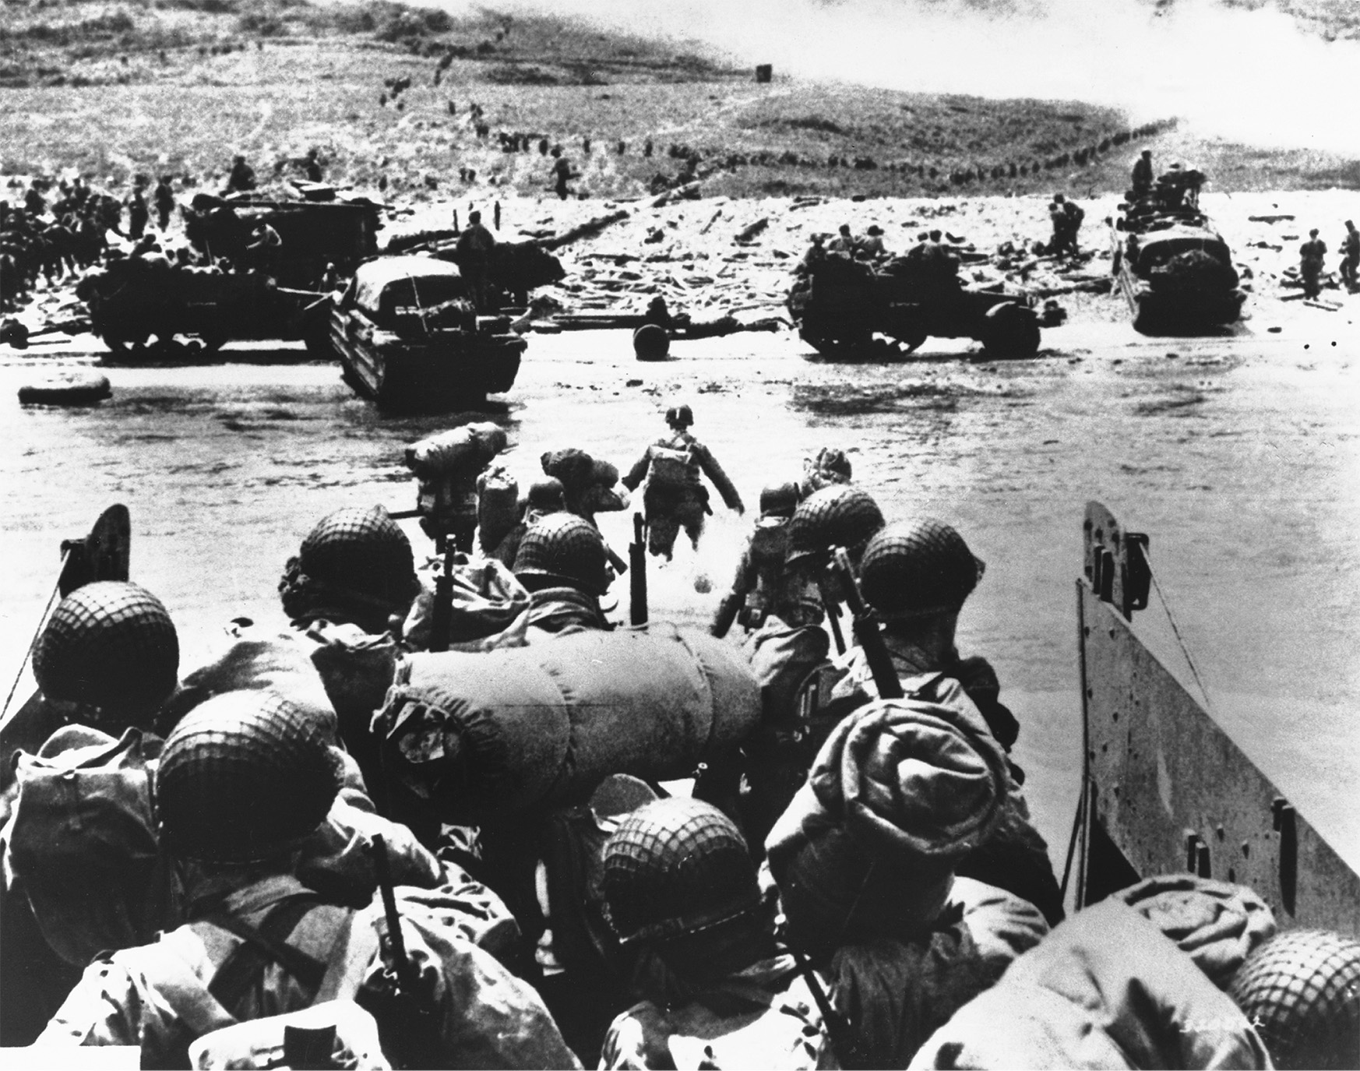
American soldiers land at Omaha Beach in Normandy on D-Day, June 6, 1944. Courtesy of the Library of Congress
Notes:
American soldiers land at Omaha Beach in Normandy on D-Day, June 6, 1944.
Courtesy of the Library of Congress

Slide 42
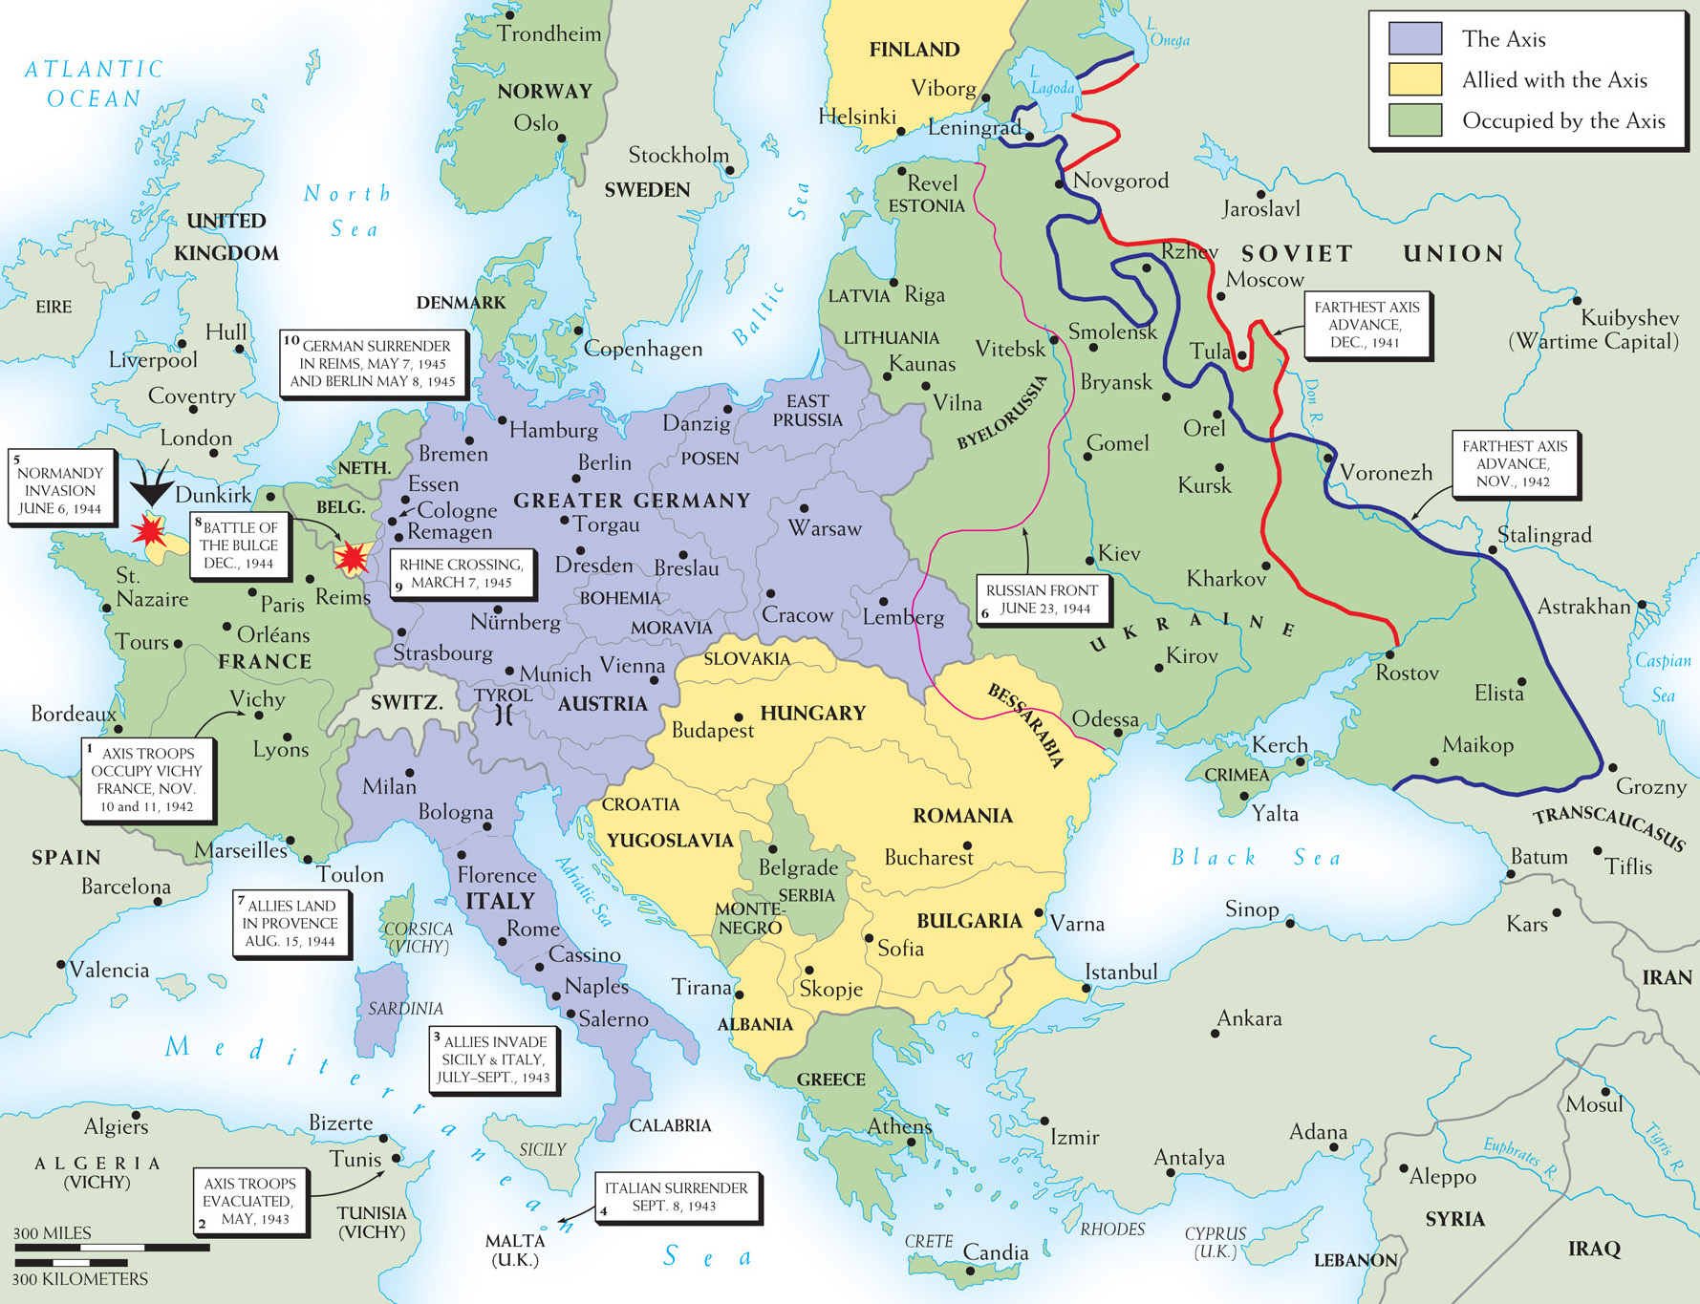
Map 28–5 DEFEAT OF THE AXIS IN EUROPE, 1942–1945 Here are some of the major steps in the progress toward Allied victory against Axis Europe. From the south through Italy, the west through France, and the east through Russia, the Allies gradually conquered the Continent to bring the war in Europe to a close.
Notes:
Map 28–5 DEFEAT OF THE AXIS IN EUROPE, 1942–1945 Here are some of the major steps in the progress toward Allied victory against Axis Europe. From the south through Italy, the west through France, and the east through Russia, the Allies gradually conquered the Continent to bring the war in Europe to a close.

Slide 43
The Fall of the Japanese Empire
1943, Americans “island hop” and recapture strategic Pacific Islands
August 6th, 1945, the U.S. dropped an atomic bomb on Hiroshima. Two days later, they dropped one on Nagasaki.
August 14th, 1945, Japan surrendered.

Slide 44
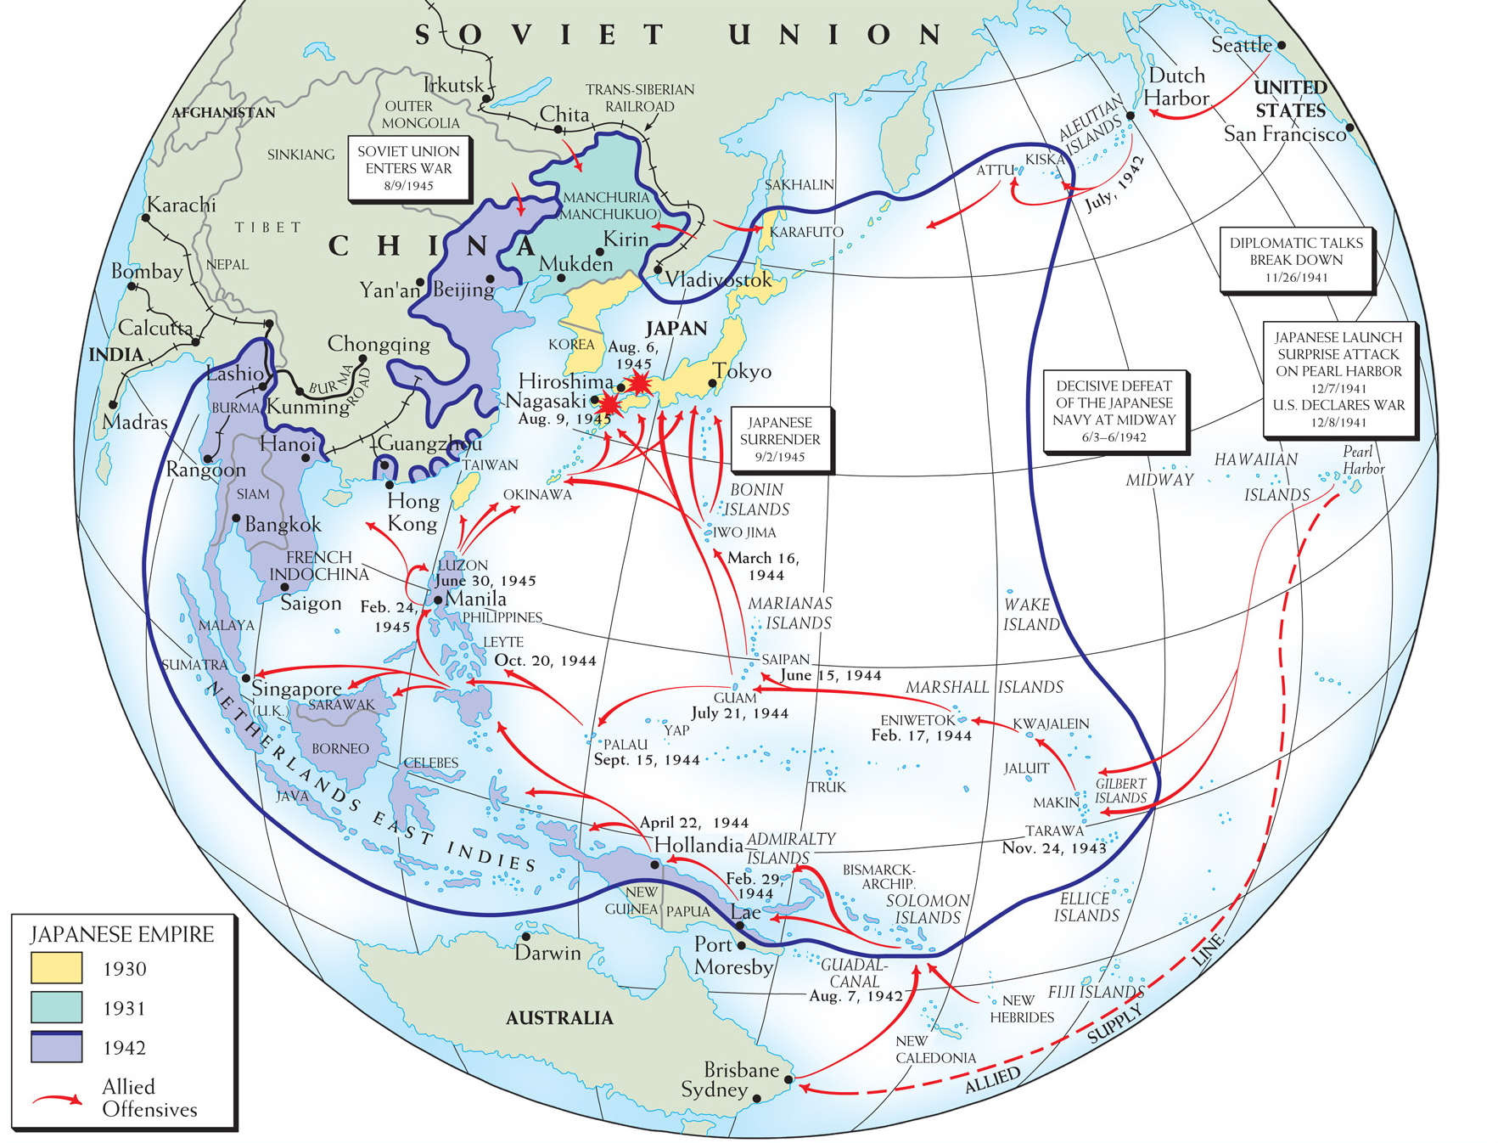
Map 28–6 WORLD WAR II IN THE PACIFIC As in Europe, the Pacific war involved Allied recapture of areas that had been quickly taken earlier by the enemy. The enormous area represented by the map shows the initial expansion of Japanese holdings to cover half the Pacific and its islands, as well as huge sections of eastern Asia, and the long struggle to push the Japanese back to their homeland and defeat them by the summer of 1945.
Notes:
Map 28–6 WORLD WAR II IN THE PACIFIC As in Europe, the Pacific war involved Allied recapture of areas that had been quickly taken earlier by the enemy. The enormous area represented by the map shows the initial expansion of Japanese holdings to cover half the Pacific and its islands, as well as huge sections of eastern Asia, and the long struggle to push the Japanese back to their homeland and defeat them by the summer of 1945.

Slide 45
Racism and the Holocaust
One of the pillars of Nazi ideology was racism.
All non-Aryan peoples, such as Slavs, Jews, and Gypsies, were considered lower orders of beings.
Hitler had envisioned a special fate for the Jews. He wanted to make all of Europe Judenrein, free of Jews. He planned to exterminate them.

Slide 46
Racism and the Holocaust (cont.)
The Fate of the Polish Jewish community as a case study for the Holocaust.
The joint German-Russian invasion of Poland brought millions of Jews under the control of the Nazi Government.
1940, the Jews were moved into ghettos, separate from the rest of the population. Many died of disease and malnourishment.

Slide 47
Racism and the Holocaust (cont.)
The Fate of the Polish Jewish community as a case study for the Holocaust.
1941–1944, a systematic campaign of extermination was carried out. Jews were transported by rail to death camps throughout Poland, where millions were gassed to death.
By 1945, 90% of the pre-1939 Polish Jewish population of Poland had been destroyed.

Slide 48
Racism and the Holocaust (cont.)
Approximately 6 million Jews were murdered in the Nazi Holocaust.

Slide 49
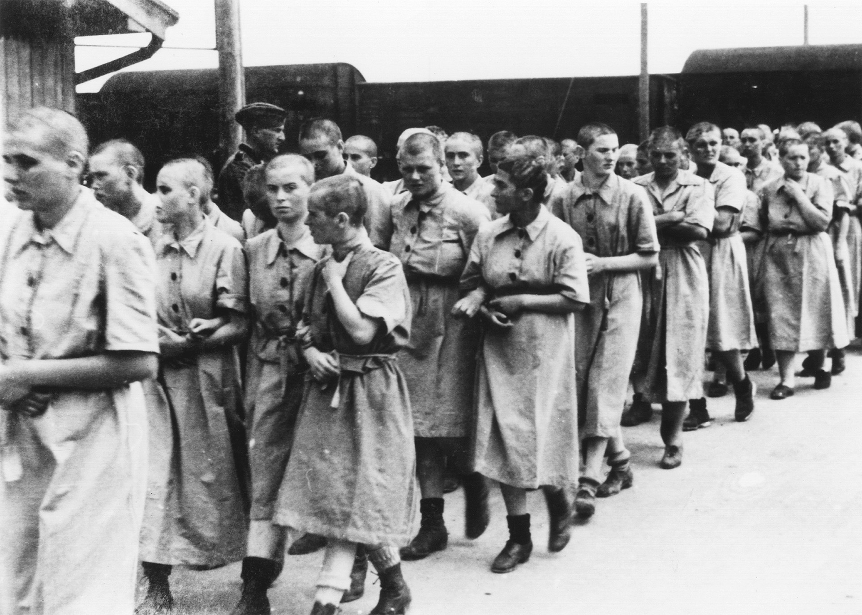
World War II resulted in the near-total destruction of the Jews of Europe, victims of the Holocaust spawned by Hitler’s racial theories of the superiority and inferiority of particular ethnic groups. Hitler placed special emphasis on the need to exterminate the Jews, to whom he attributed particular wickedness. This picture shows Hungarian Jewish women, after “disinfection” and head shaving, marching to the concentration or death camp at Auschwitz-Birkenau, Poland. Library of Congress/Photo by Bernhard Walter; Source: National Archives and Records Administration
Notes:
World War II resulted in the near-total destruction of the Jews of Europe, victims of the Holocaust spawned by Hitler’s racial theories of the superiority and inferiority of particular ethnic groups. Hitler placed special emphasis on the need to exterminate the Jews, to whom he attributed particular wickedness. This picture shows Hungarian Jewish women, after “disinfection” and head shaving, marching to the concentration or death camp at Auschwitz-Birkenau, Poland.
Library of Congress/Photo by Bernhard Walter; Source: National Archives and Records Administration

Slide 50
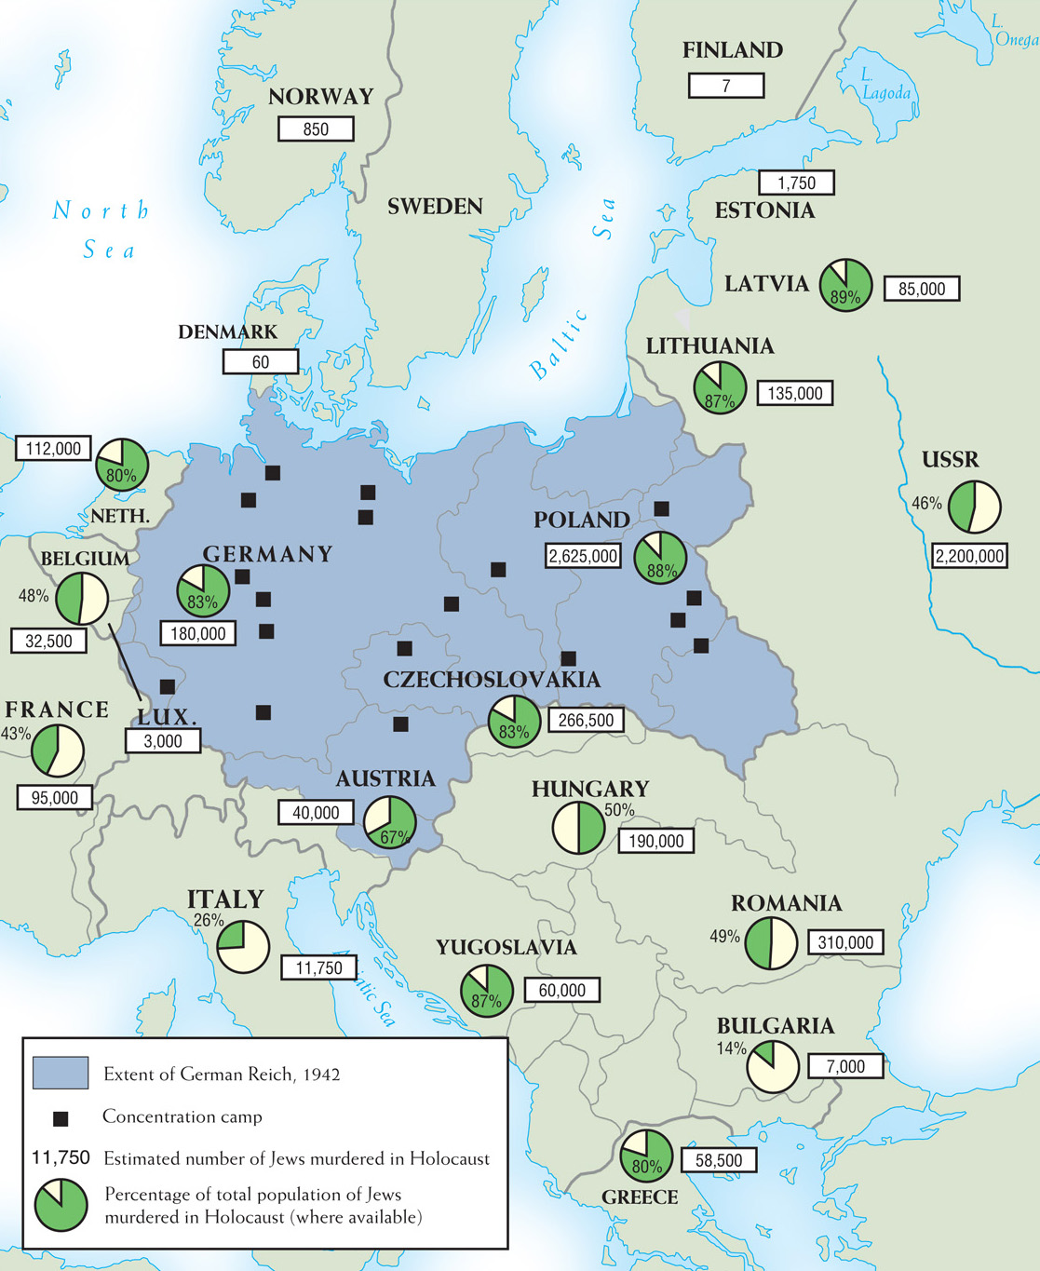
Map 28–7 THE HOLOCAUST The Nazi policy of ethnic cleansing—targeting Jews, Gypsies, political dissidents, and “social deviants”—began with imprisoning them in concentration camps, but by 1943 the Endlösung, or Final Solution, called for the systematic extermination of “undersirables.”
Notes:
Map 28–7 THE HOLOCAUST The Nazi policy of ethnic cleansing—targeting Jews, Gypsies, political dissidents, and “social deviants”—began with imprisoning them in concentration camps, but by 1943 the Endlösung, or Final Solution, called for the systematic extermination of “undersirables.”

Slide 51
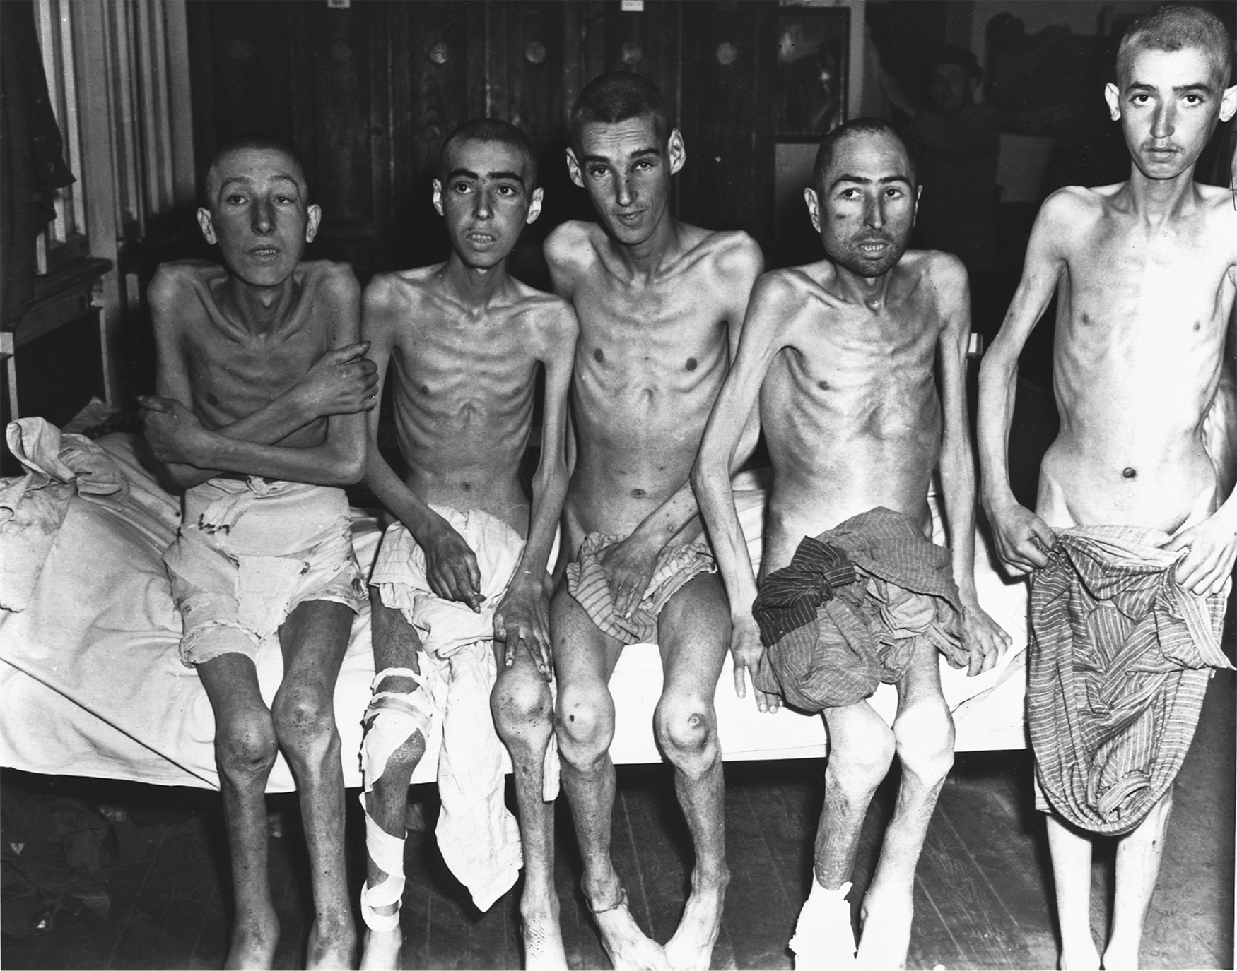
Male inmates, emaciated and freezing, at a German concentration camp in 1945. Library of Congress
Notes:
Male inmates, emaciated and freezing, at a German concentration camp in 1945.
Library of Congress

Slide 52
The German Home Front
Hitler demanded few sacrifices from the German people at first.
The economy improved during the war.
By 1943, labor shortages made it necessary for teenagers, retired men, and some women to work in the factories.
Radio and film propaganda were used to boost the Nazi cause.
After the Allied bombing campaign began, the Germans had much to fear.

Slide 53
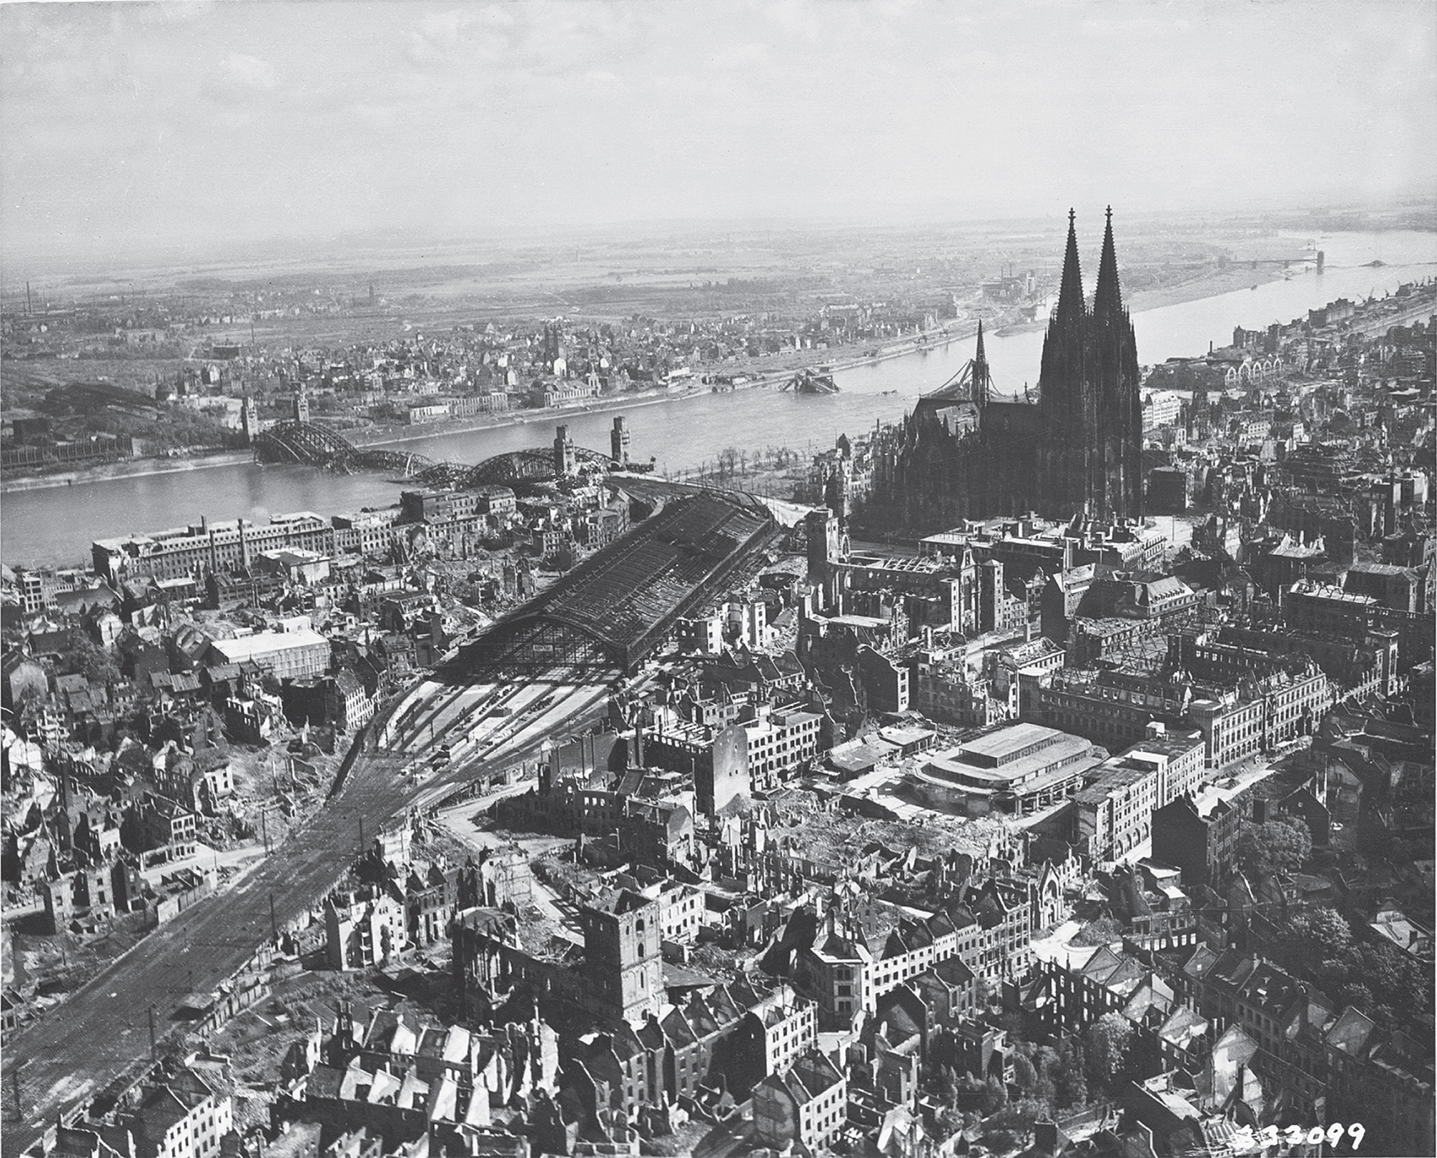
Bombing of Cologne. The Allied campaign of aerial bombardment did terrible damage to German cities. This photograph shows the devastation it delivered to the city of Cologne on the Rhine. United States Signal Corps
Notes:
Bombing of Cologne. The Allied campaign of aerial bombardment did terrible damage to German cities. This photograph shows the devastation it delivered to the city of Cologne on the Rhine.
United States Signal Corps

Slide 54
France at Home
The terms of the 1940 Armistice allowed the Germans to occupy more than half of France.
In Southern France, Petain set up a dictatorial regime based in Vichy. Many conservatives viewed this as a positive thing.

Slide 55
France at Home (cont.)
Some French men and women fled to Britain after the occupation, organizing the French National Committee of Liberation, or “Free French,” to resist the occupation and the collaborators. However, large scale resistance did not begin until 1944.

Slide 56
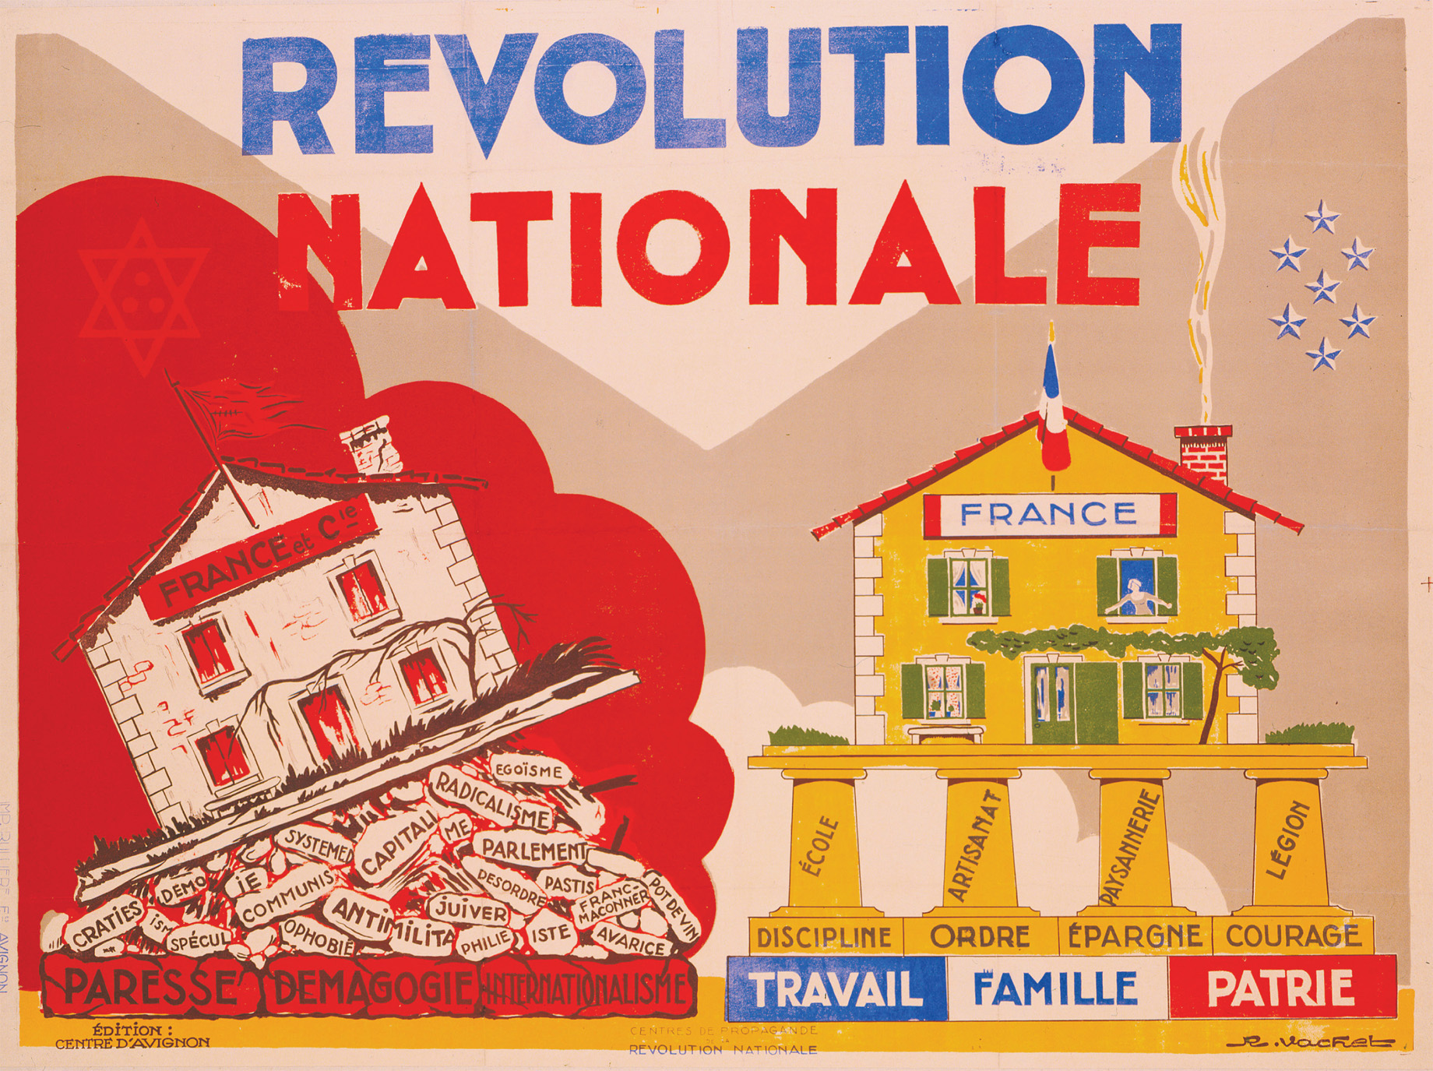
The Vichy Regime in France After their surprisingly swift conquest of France in 1940, the Germans ruled one part of it directly from Paris, leaving the rest unoccupied until 1942, but firmly under the control of a collaborationist French government under Marshal Henri Philippe Pétain (1856–1951; see Map 28–3). This regime, based in the city of Vichy, pursued a reactionary policy, turning away from the democratic ways of the defeated Third Republic. The “Propaganda Centers of the National Revolution” published the poster shown in the photo. “The National Revolution” was the name the Vichy regime gave to its program to remake France. Photo 12/Alamy
Notes:
The Vichy Regime in France After their surprisingly swift conquest of France in 1940, the Germans ruled one part of it directly from Paris, leaving the rest unoccupied until 1942, but firmly under the control of a collaborationist French government under Marshal Henri Philippe Pétain (1856–1951; see Map 28–3). This regime, based in the city of Vichy, pursued a reactionary policy, turning away from the democratic ways of the defeated Third Republic. The “Propaganda Centers of the National Revolution” published the poster shown in the photo. “The National Revolution” was the name the Vichy regime gave to its program to remake France.
Photo 12/Alamy

Slide 57
Great Britain
May 22, 1940, Parliament gave the government emergency powers, allowing them to institute a draft, rationing, and economic controls.
By 1941, Britain’s production had surpassed Germany’s.
The “blitz” bombings in 1940–41 were the most immediate experience of the war for most Britons. By the end of the war 30,000 were killed.

Slide 58
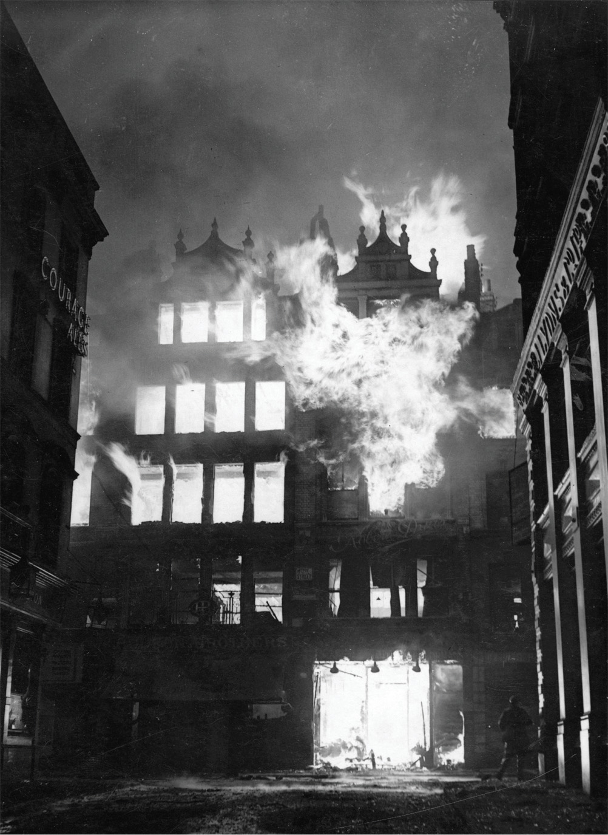
Fire engulfs a building in London, England, during the German air raids. Despite many casualties and widespread devastation, the German bombing of London did not break British morale or prevent the city from functioning. Getty Images
Notes:
Fire engulfs a building in London, England, during the German air raids. Despite many casualties and widespread devastation, the German bombing of London did not break British morale or prevent the city from functioning.
Getty Images

Slide 59
The Soviet Union
No nation suffered more than the Soviet Union during World War II.
16 million were killed
Within occupied portions of Western Russia there was an active resistance movement.

Slide 60
Preparations for Peace
August 1941, Roosevelt and Churchill met and agreed to the Atlantic Charter, which provided a theoretical basis for the peace they sought.
In 1943, Soviet, American, and British leaders met at Tehran. They agreed to make the western coast of Europe the main point of attack the following year.

Slide 61
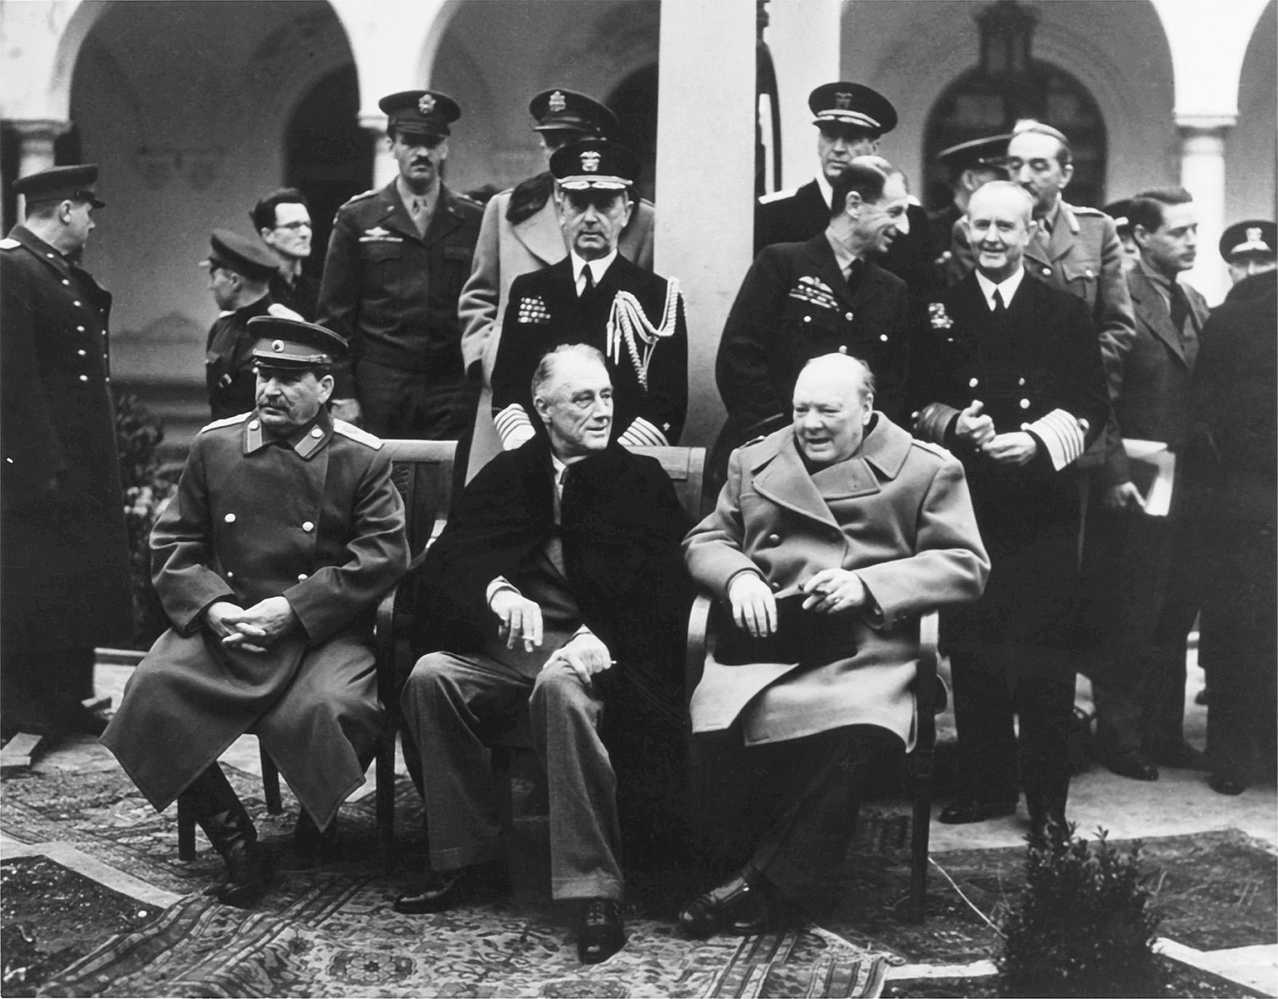
In February 1945, Churchill, Roosevelt, and Stalin met at Yalta in the Crimea to plan for the organization of Europe after the end of the war. The Big Three are seated. Standing behind President Roosevelt is Admiral William D. Leahy. Behind the prime minister are Admiral Sir Andrew Cunningham and Air Marshal Portal. U.S. Army Photograph
Notes:
In February 1945, Churchill, Roosevelt, and Stalin met at Yalta in the Crimea to plan for the organization of Europe after the end of the war. The Big Three are seated. Standing behind President Roosevelt is Admiral William D. Leahy. Behind the prime minister are Admiral Sir Andrew Cunningham and Air Marshal Portal.
U.S. Army Photograph

Slide 62
Yalta and Pottsdam
February 1945, the Big Three met in Yalta. The Americans encouraged the Russians to join the war against Japan. In the tradition of Wilson, Roosevelt encouraged a united-nations organization.
In July 1945, after the defeat of Germany, they met at Pottsdam. Germany was carved up into zones. The rest of Europe was split up.

Slide 63
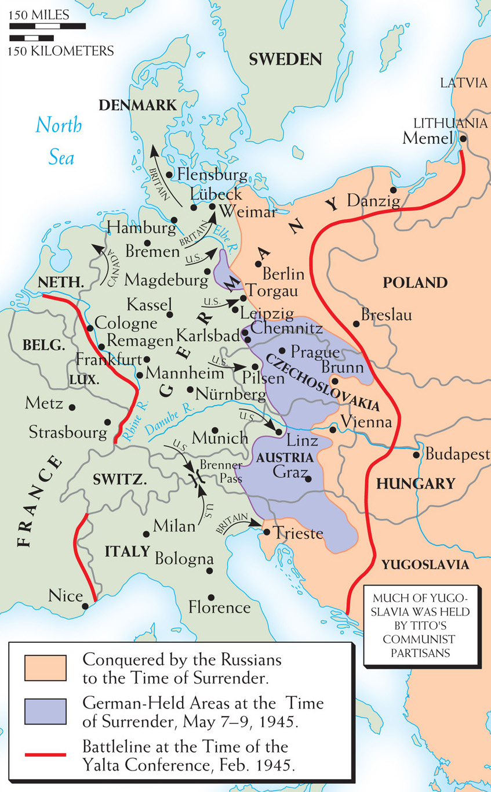
Map 28–8 YALTA TO THE SURRENDER “The Big Three”—Roosevelt, Churchill, and Stalin—met at Yalta in the Crimea in February 1945. At the meeting, concessions were made to Stalin concerning the settlement of eastern Europe because Roosevelt was eager to bring the Russians into the Pacific war as soon as possible. This map shows the positions held by the victors when Germany surrendered.
Notes:
Map 28–8 YALTA TO THE SURRENDER “The Big Three”—Roosevelt, Churchill, and Stalin—met at Yalta in the Crimea in February 1945. At the meeting, concessions were made to Stalin concerning the settlement of eastern Europe because Roosevelt was eager to bring the Russians into the Pacific war as soon as possible. This map shows the positions held by the victors when Germany surrendered.

