Slide 1
Chapter 29
The Cold War Era and the Emergence of a New Europe

Slide 2
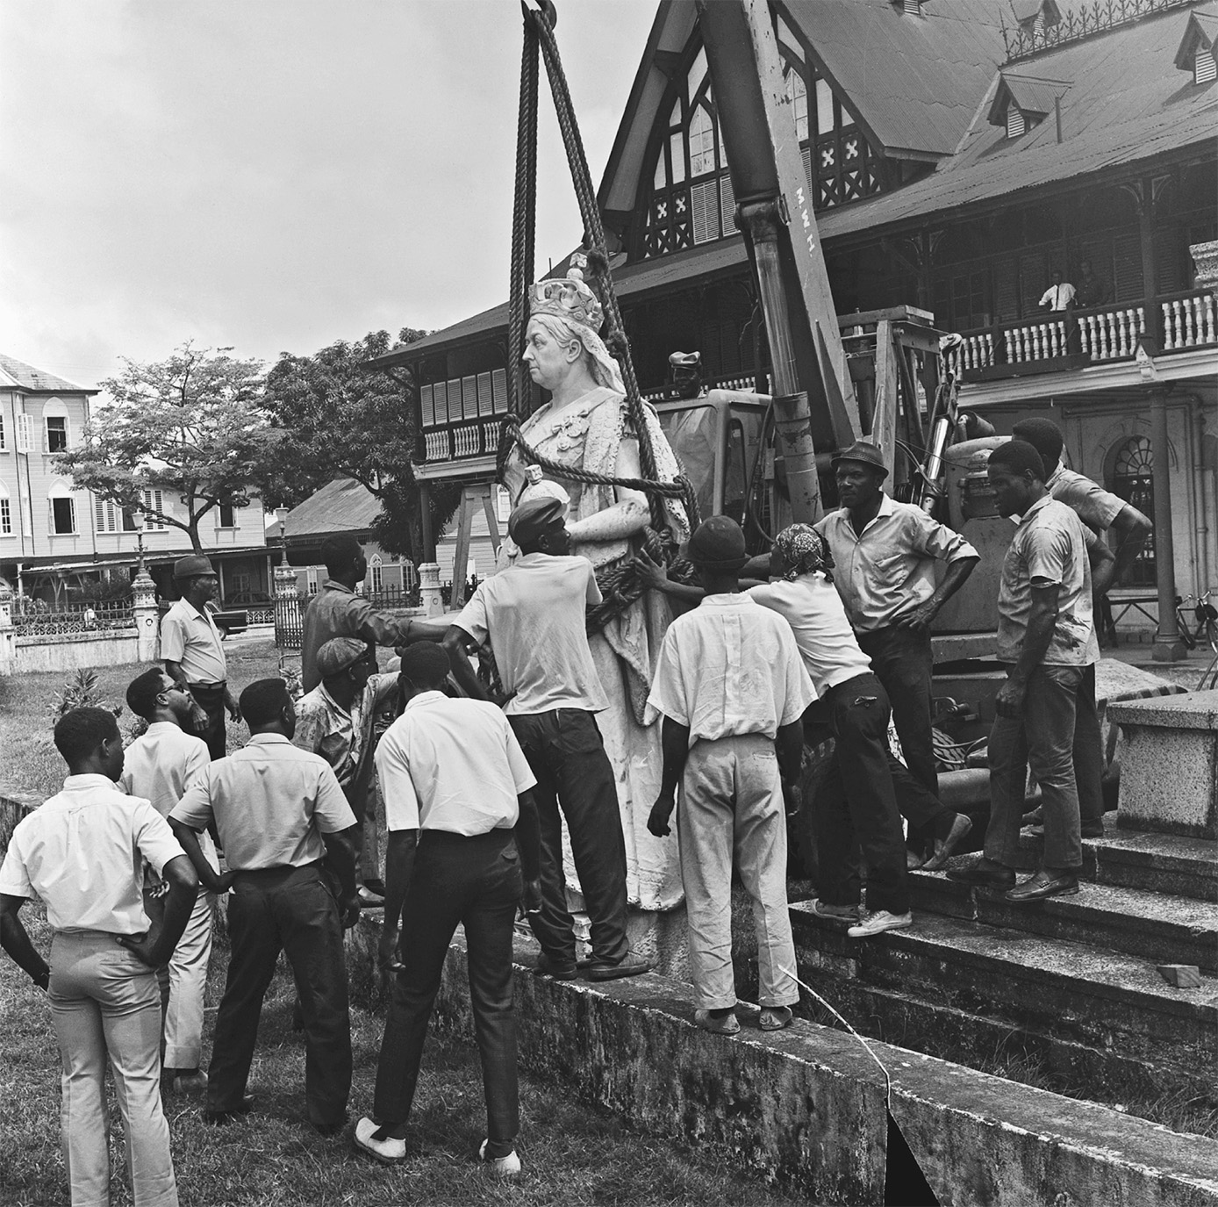
A statue of Queen Victoria is removed from the front of the Supreme Court building in Georgetown, former capital of the British colony of Guyana, in February 1970, in preparation for the transition to independence. Decolonization represented as dramatic a transition in world political relations as had the establishment of European empires in the nineteenth-century Victorian age. Bettmann/CORBIS—All rights reserved
Notes:
A statue of Queen Victoria is removed from the front of the Supreme Court building in Georgetown, former capital of the British colony of Guyana, in February 1970, in preparation for the transition to independence. Decolonization represented as dramatic a transition in world political relations as had the establishment of European empires in the nineteenth-century Victorian age.
Bettmann/CORBIS—All rights reserved

Slide 3
The Emergence of the Cold War
American President Truman worked hard to avoid Russian intervention against Japan in World War II (perhaps partially the reason for the atomic bombings of Hiroshima and Nagasaki)
The Americans had the strongest military forces in the world but made no attempt to roll back Soviet power in Europe

Slide 4
The Emergence of the Cold War (cont.)
America’s peacetime goals reflected American ideals and served American interests
The USSR wished to expand its borders and influence to ensure its security and pave the way for worldwide domination

Slide 5
Truman’s Containment Policies
Containment – resist Soviet expansion with the expectation that the USSR would eventually collapse from internal pressures and the burden of its foreign oppression
The Truman Doctrine – U.S. pledged to support free people resisting oppression

Slide 6
Truman’s Containment Policies (cont.)
The Marshall Plan – Provided broad U.S. economic aid to European states as long as they worked together for their mutual benefit. The Plan restored prosperity to Western Europe

Slide 7
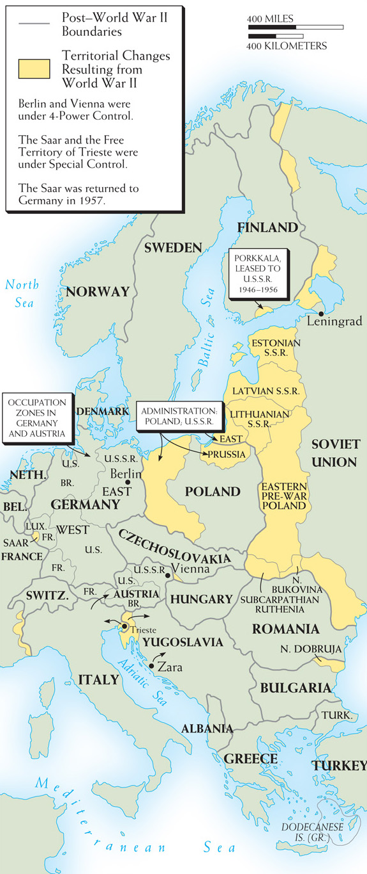
Map 29–1 TERRITORIAL CHANGES IN EUROPE AFTER WORLD WAR II The map shows the shifts in territory that followed the defeat of the Axis. No treaty of peace formally ended the war with Germany.
Notes:
Map 29–1 TERRITORIAL CHANGES IN EUROPE AFTER WORLD WAR II The map shows the shifts in territory that followed the defeat of the Axis. No treaty of peace formally ended the war with Germany.

Slide 8
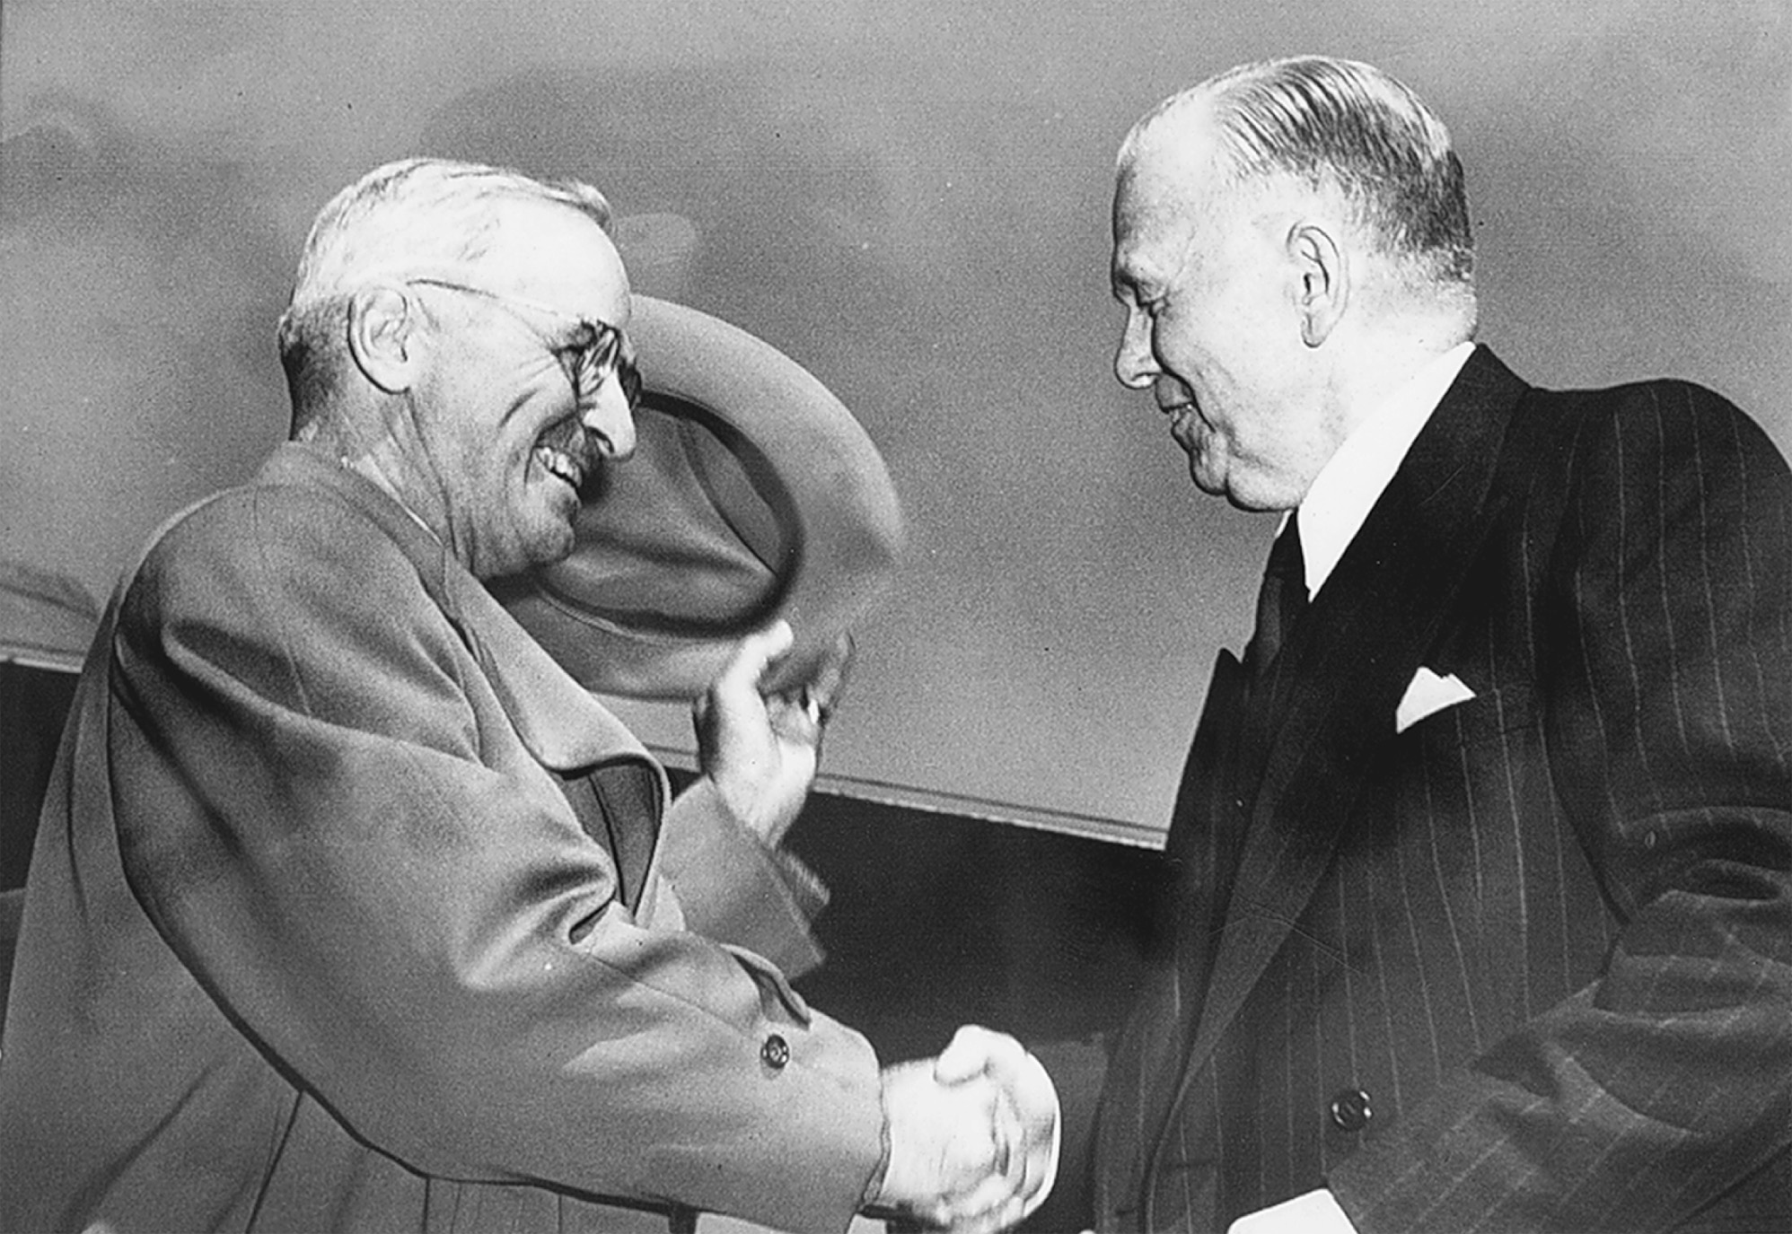
President Harry Truman greets Secretary of State George Marshall returning from Europe. Truman and Marshall were the architects of American foreign policy during the early years of the Cold War. Hulton Archive Photos/Getty Images, Inc.
Notes:
President Harry Truman greets Secretary of State George Marshall returning from Europe. Truman and Marshall were the architects of American foreign policy during the early years of the Cold War.
Hulton Archive Photos/Getty Images, Inc.

Slide 9
Communists in Eastern Europe
Stalin formed Cominform among international communist parties in the effort to spread communism around the globe
After the Soviets expelled the democratic government in Czechoslovakia, it was clear that there would not be multiparty political systems in Eastern Europe

Slide 10
The Postwar Division of Germany
The Russians dismantled the Germans in the east, while the other Allies favored rebuilding Germany in the west
Berlin Blockade – the Russians’ attempt to take over the capital city of Berlin by blockading it from the Allies fails when the Allies airlift supplies into the city

Slide 11
The Postwar Division of Germany (cont.)
Germany is split into two – the democratic West Germany or German Federal Republic and the communist East Germany or German Democratic Republic

Slide 12
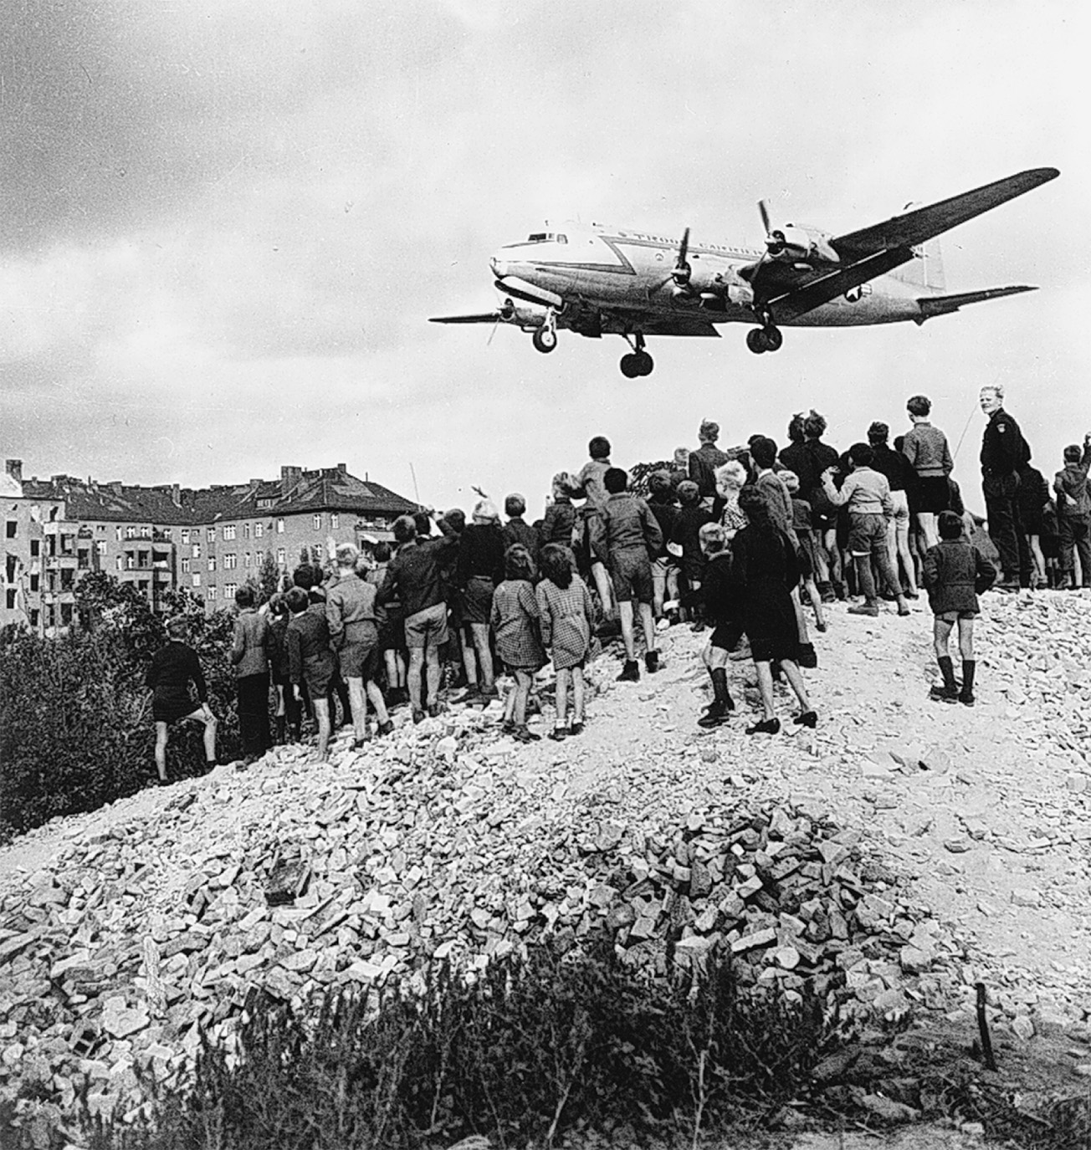
The Allied airlift in action during the Berlin Blockade. Every day for almost a year Western planes supplied the city until Stalin lifted the blockade in May 1949. Art Resource/Bildarchiv Preussischer Kulturbesitz
Notes:
The Allied airlift in action during the Berlin Blockade. Every day for almost a year Western planes supplied the city until Stalin lifted the blockade in May 1949.
Art Resource/Bildarchiv Preussischer Kulturbesitz

Slide 13
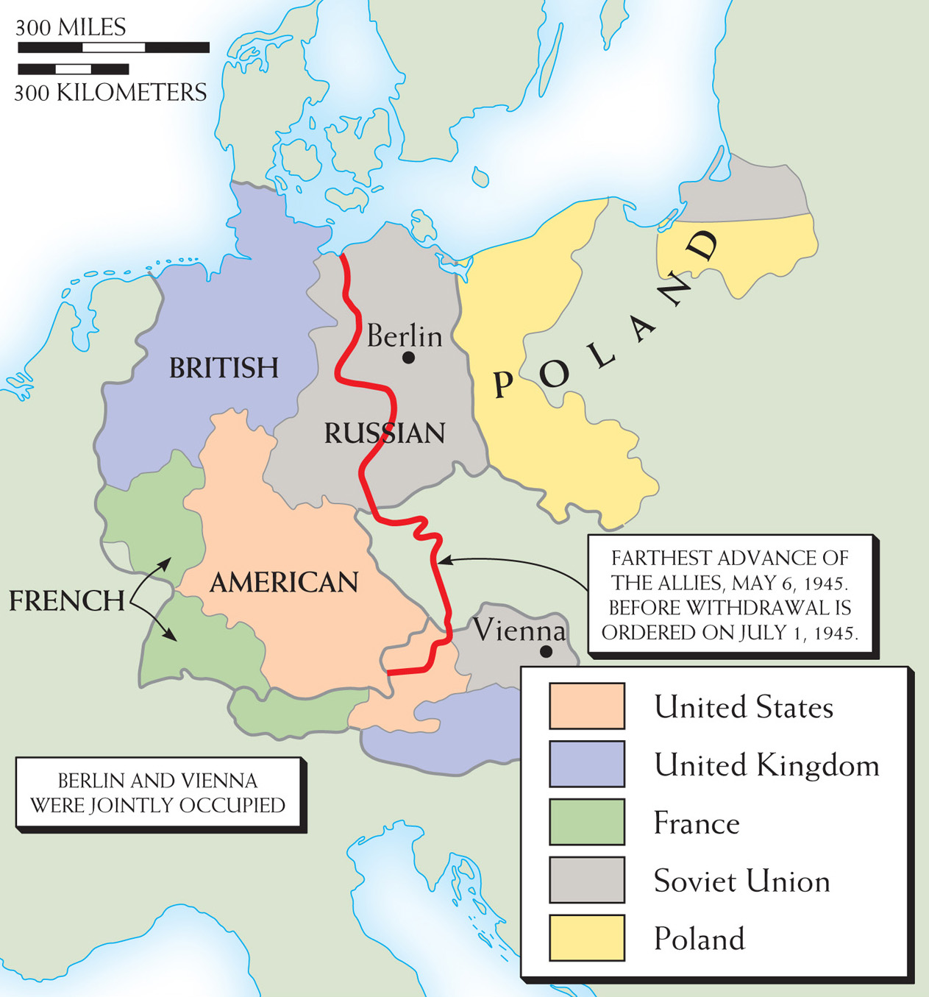
Map 29–2 OCCUPIED GERMANY AND AUSTRIA At the war’s end, defeated Germany, including Austria, was occupied by the victorious Allies in the several zones shown here. Austria, by prompt agreement, was reestablished as an independent, neutral state, no longer occupied. The German zones hardened into an “East” Germany (the former Soviet zone) and a “West” Germany (the former British, French, and American zones). Berlin, within the Soviet zone, was similarly divided.
Notes:
Map 29–2 OCCUPIED GERMANY AND AUSTRIA At the war’s end, defeated Germany, including Austria, was occupied by the victorious Allies in the several zones shown here. Austria, by prompt agreement, was reestablished as an independent, neutral state, no longer occupied. The German zones hardened into an “East” Germany (the former Soviet zone) and a “West” Germany (the former British, French, and American zones). Berlin, within the Soviet zone, was similarly divided.

Slide 14
Alliance Systems
The democratic nations of Western Europe, along with Canada and the United States, form an alliance of mutual assistance known as the North Atlantic Treaty Organization (NATO)

Slide 15
Alliance Systems (cont.)
The Council of Mutual Assistance (COMECON), completely controlled by the Soviets, is given formal recognition by the Warsaw Pact, which united the eastern European communist nations
Cold War takes shape and ends up in flash points in the Middle East, Asia, and North America

Slide 16
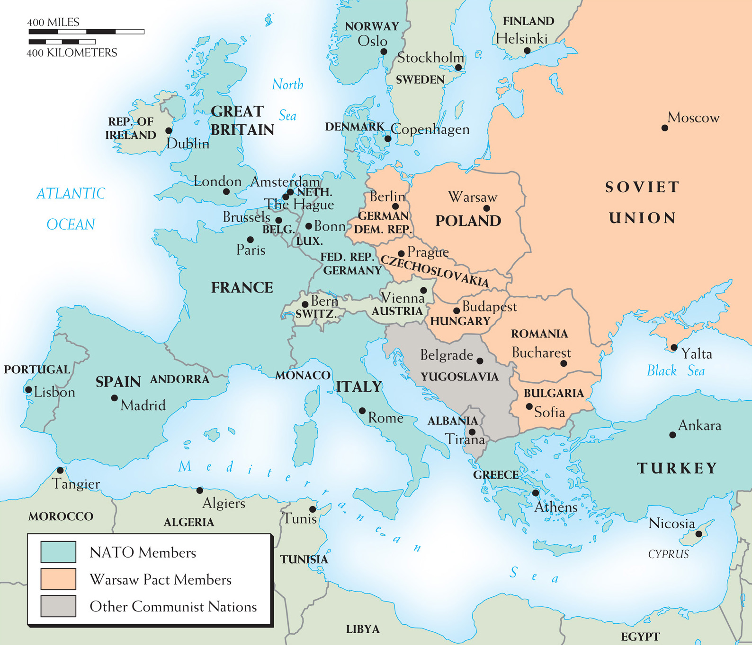
Map 29–3 MAJOR COLD WAR EUROPEAN ALLIANCE SYSTEMS The North Atlantic Treaty Organization, which includes both Canada and the United States, stretches as far east as Turkey. By contrast, the Warsaw Pact nations were the contiguous Communist states of Eastern Europe, with the Soviet Union, of course, as the dominant member.
Notes:
Map 29–3 MAJOR COLD WAR EUROPEAN ALLIANCE SYSTEMS The North Atlantic Treaty Organization, which includes both Canada and the United States, stretches as far east as Turkey. By contrast, the Warsaw Pact nations were the contiguous Communist states of Eastern Europe, with the Soviet Union, of course, as the dominant member.

Slide 17
A Jewish State is Created
British Balfour Declaration – Arthur Balfour, British Foreign Secretary, declares that he favors the establishment of a Jewish state in Palestine
Arabs consider the Jews invaders and violent conflict emerges

Slide 18
A Jewish State is Created (cont.)
In the 1947 United Nations Resolution, the British turn the area over to the United Nations, who partition the territory into two states: one Arab and one Jewish
Cold War implications – United States and Israel become firm allies, while the Soviet Union supports the Arabs

Slide 19
A Jewish State is Created (cont.)
May 14, 1948 – independence of a Jewish state, Israel, is declared with the support of U.S. President Harry Truman
First prime minister was David Ben-Gurion
Arab nations Lebanon, Syria, Jordan, Egypt, and Iraq immediately invade Israel but are defeated in 1949, as Israel expands its borders

Slide 20
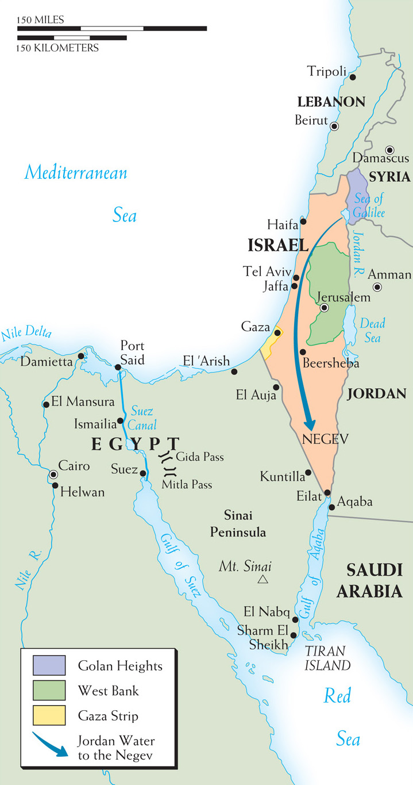
Map 29–4 ISRAEL AND ITS NEIGHBORS IN 1949 The territories gained by Israel in 1949 did not secure peace in the region. In fact, the disposition of those lands and the Arab refugees who live there has constituted the core of the region’s unresolved problems to the present day.
Notes:
Map 29–4 ISRAEL AND ITS NEIGHBORS IN 1949 The territories gained by Israel in 1949 did not secure peace in the region. In fact, the disposition of those lands and the Arab refugees who live there has constituted the core of the region’s unresolved problems to the present day.

Slide 21
The Korean War
After World War II, Korea is divided into two states: Democratic People’s Republic of Korea to the north, supported by the Soviet Union, and the Republic of Korea in the south, supported by the United States

Slide 22
The Korean War (cont.)
North Korea invades the South by crossing the 38th parallel separating the countries
A U.N. sponsored action has mainly the United States helping to defend South Korea
China helps support North Korea
President Eisenhower declares an armistice ending the war and keeping the borders the same to this very day

Slide 23
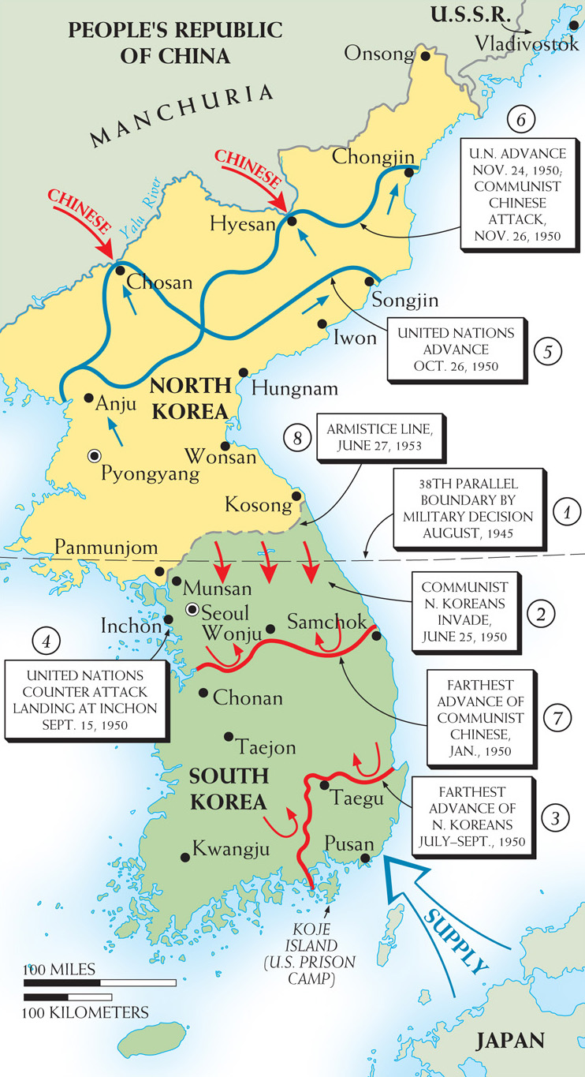
Map 29–5 KOREA, 1950–1953 This map indicates the major developments in the bitter three-year struggle that followed the North Korean invasion of South Korea in 1950.
Notes:
Map 29–5 KOREA, 1950–1953 This map indicates the major developments in the bitter three-year struggle that followed the North Korean invasion of South Korea in 1950.

Slide 24
Possible Easing of Cold War Tensions
Armistice in the Koreas, the death of Stalin, and a summit in Geneva over nuclear weapons and Germany seem to indicate an easing of the Cold War
Geneva meeting provides little agreement and the Cold War soon resumes

Slide 25
The Soviet Union Under Khrushchev
Soviet Communist leader Nikita Khrushchev wanted to keep the dominance of the Communist Party but does reform some of Stalin’s policies
Aleksandr Solzhenitsyn allowed to publish a grim account of Soviet labor under Stalin, One Day in the Life of Ivan Denisovich (1963)

Slide 26
The Soviet Union Under Khrushchev (cont.)
Soviet Communist leader Nikita Khrushchev wanted to keep the dominance of the Communist Party but does reform some of Stalin’s policies
Decentralized economic planning and removed restrictions on private cultivation of wheat
The Secret Speech of 1956 – Khrushchev denounces Stalin’s policies and purges and removes Stalin supporters from the government without executing them

Slide 27
The Three Crises of 1956
The Suez Crisis – Egyptian President Gamal Abdel Nasser goes to war with Israel and nationalizes the Suez Canal
The British and French intervene militarily, but the United States refuses to join
The Soviet Union protests the military intervention, but also does not intervene

Slide 28
The Three Crises of 1956 (cont.)
The Suez Crisis
Result was that Egypt maintains control of the canal, while the United States and Soviet Union show constraint in attempting to avoid war
Polish independent action – Poland refuses Soviet choice for prime minister and installs Wladyslaw Gomulka as Communist leader of Poland; he ends up being acceptable to the Soviets

Slide 29
The Three Crises of 1956 (cont.)
Hungarian uprising
New ministry in Hungary led by Imre Nagy, wants to make the country neutral and withdraw from the Warsaw Pact
Soviet troops invade Hungary, execute Nagy, and install Janos Kadar as premier

Slide 30
More Cold War Confrontations
The Soviets shoot down a U-2 aircraft that was spying in Russian airspace (1960) – Khrushchev demands apology from President Eisenhower, but does not get one, nixing a planned summit between the two world power leaders

Slide 31
More Cold War Confrontations (cont.)
The Berlin Wall (1961) – tired of refugees leaving East Germany for free West Berlin, the East Germans and Soviets build a wall separating the two parts of the city – the United States protests, but does little else

Slide 32
More Cold War Confrontations (cont.)
The Cuban Missile Crisis (1962)
Fidel Castro topples dictatorship in Cuba and becomes Communist leader
Soviet Union plants missiles in Cuba
In response President John Kennedy blockades Cuba and demands the removal of the missiles
Seemingly at the brink of nuclear war, Khrushchev backs down and the Soviets pull out

Slide 33
More Cold War Confrontations (cont.)
Soviet Union and United States sign nuclear test ban treaty in 1963

Slide 34
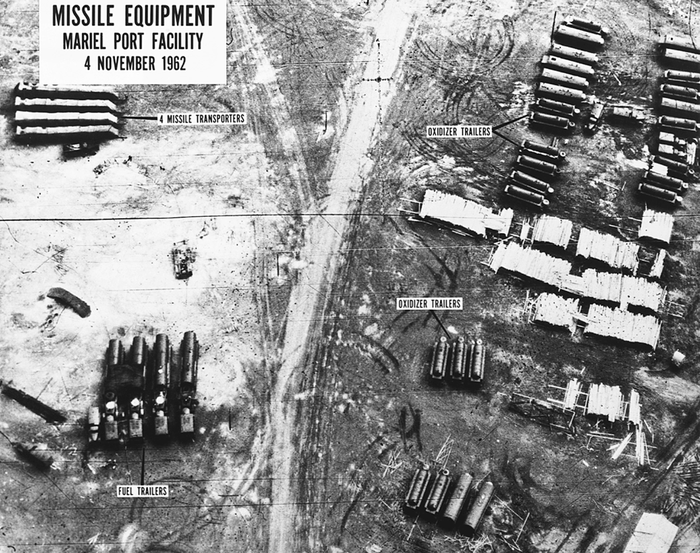
During the Cuban missile crisis of 1962, the American ambassador to the United Nations displayed photographs to persuade the world of the threat to the United States less than one hundred miles from its own shores. © CORBIS
Notes:
During the Cuban missile crisis of 1962, the American ambassador to the United Nations displayed photographs to persuade the world of the threat to the United States less than one hundred miles from its own shores.
© CORBIS

Slide 35
1968: The Invasion of Czechoslovakia
Russian forces, under the orders of Soviet premier Leonid Brezhnev, invade Czechoslovakia and remove liberal communist leader Alexander Dubcek from power
Brezhnev Doctrine – the Soviet Union has the right to interfere in the domestic policies of other communist nations when it feels it is necessary

Slide 36
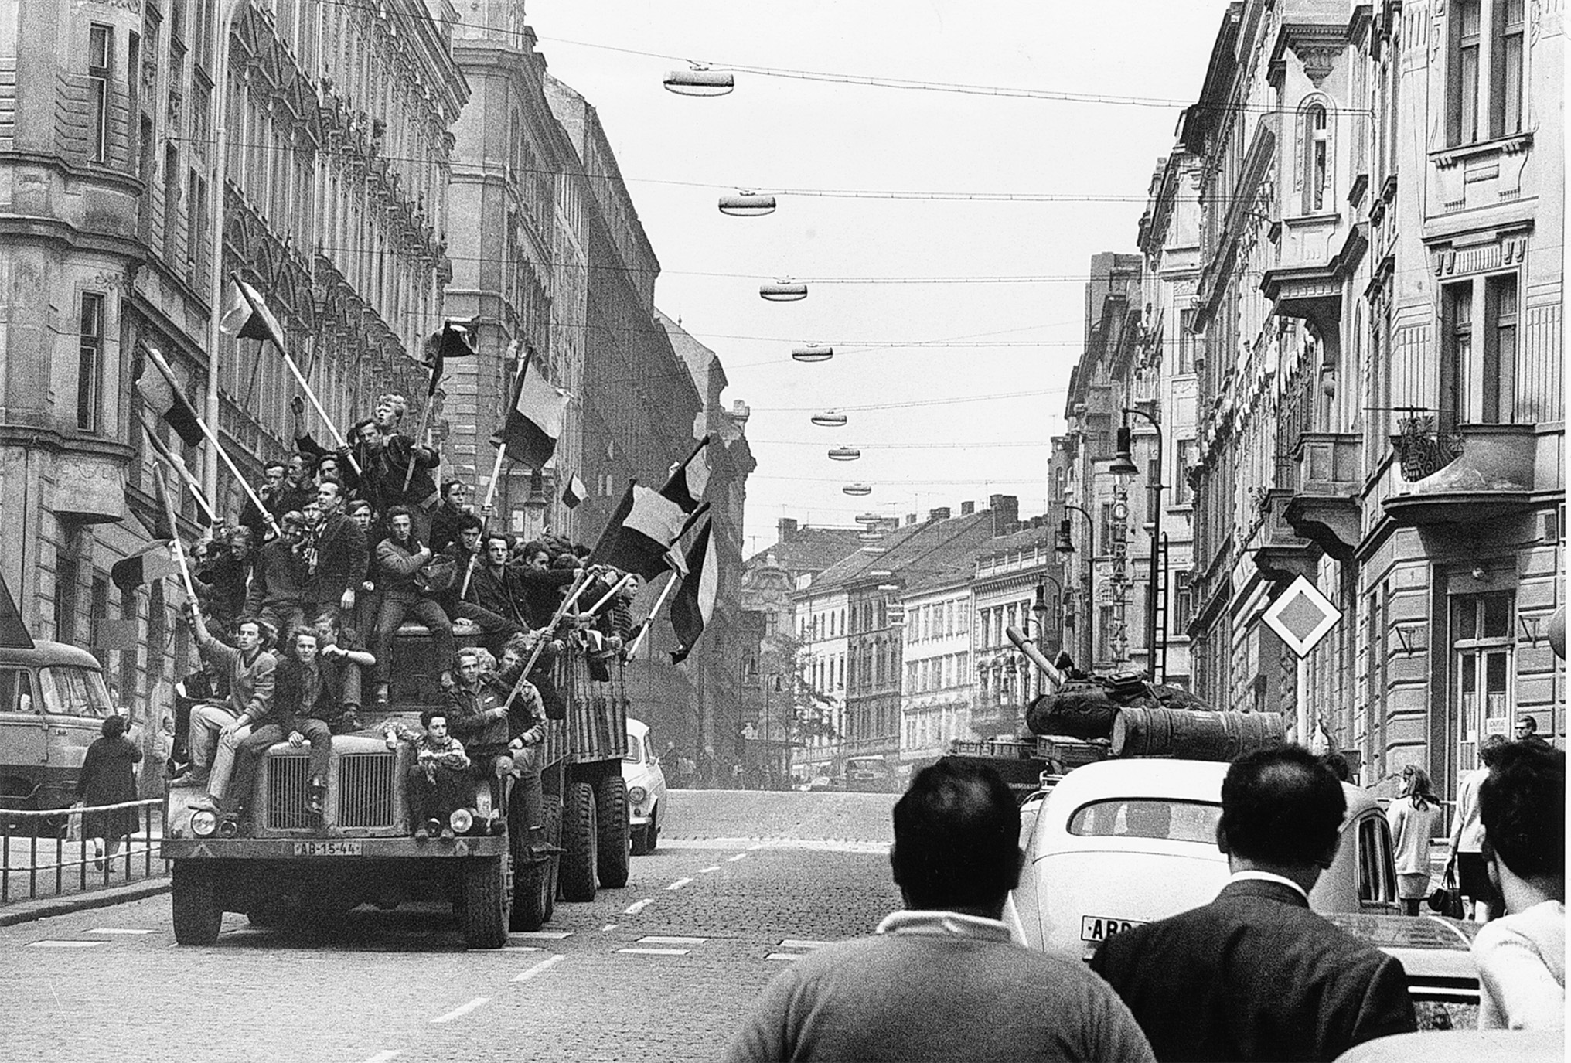
In the summer of 1968, Soviet tanks rolled into Czechoslovakia, ending that country’s experiment in liberalized communism. This picture shows defiant flag-waving Czechs on a truck rolling past a Soviet tank in the immediate aftermath of the invasion. Hulton Archive Photos/Getty Images, Inc.
Notes:
In the summer of 1968, Soviet tanks rolled into Czechoslovakia, ending that country’s experiment in liberalized communism. This picture shows defiant flag-waving Czechs on a truck rolling past a Soviet tank in the immediate aftermath of the invasion.
Hulton Archive Photos/Getty Images, Inc.

Slide 37
Détente with the United States
President Richard Nixon and Brezhnev conclude agreements on trade and reduction of nuclear arms
The United States under President Gerald Ford, along with the Soviet Union and other European nations, sign Helsinki Accord, recognizing the Soviet sphere of Eastern Europe as long as human rights are protected

Slide 38
Détente with the United States (cont.)
President Jimmy Carter demands the Soviets follow the Helsinki Accord, cooling relations between the countries
Soviets pursue activist foreign policy maneuvers in many African nations, Nicaragua, and Vietnam

Slide 39
The Invasion of Afghanistan
The Soviet Union, wanting more of a presence in the Middle East, invades Afghanistan
United States response: second Strategic Arms Agreement not signed, grain embargo of Soviet wheat, boycott of the 1980 Summer Olympics, aid sent to Afghan rebels – which included radical Muslims
Invasion fails, weakening and demoralizing Soviets

Slide 40
Communism in Poland
Pope John Paul II – Polish pope who was an outspoken critic of communism
Protest strikes led by Lech Walesa occur across the country in response to the rise in meat prices
September 1980 – Polish Communist Party replaced by independent union called Solidarity
1981 – General Wojciech Jaruzelski becomes head of the Communist Party, declares martial law, and arrests Solidarity leaders

Slide 41
President Ronald Reagan and Soviet Relations
Reagan, in his first term, intensifies Cold War rhetoric, increases military spending, slows arms limitations, and plans to deploy a Strategic Defense Initiative
Russians, in response, increase military spending even though they couldn’t afford to, eventually bringing the country to economic collapse

Slide 42
Britain’s Withdrawal from India
Indians basically paid for British rule, as Britain dominated the country through a divide and rule strategy
Mohandas Gandhi – leader of Indian nationalism and passive resistance movement
Led Salt March to the sea, breaking the British monopoly on salt
Imprisoned many times, where he became a martyr by going on hunger strikes
1947 – the British, weary of Gandhi’s policies, leave India

Slide 43
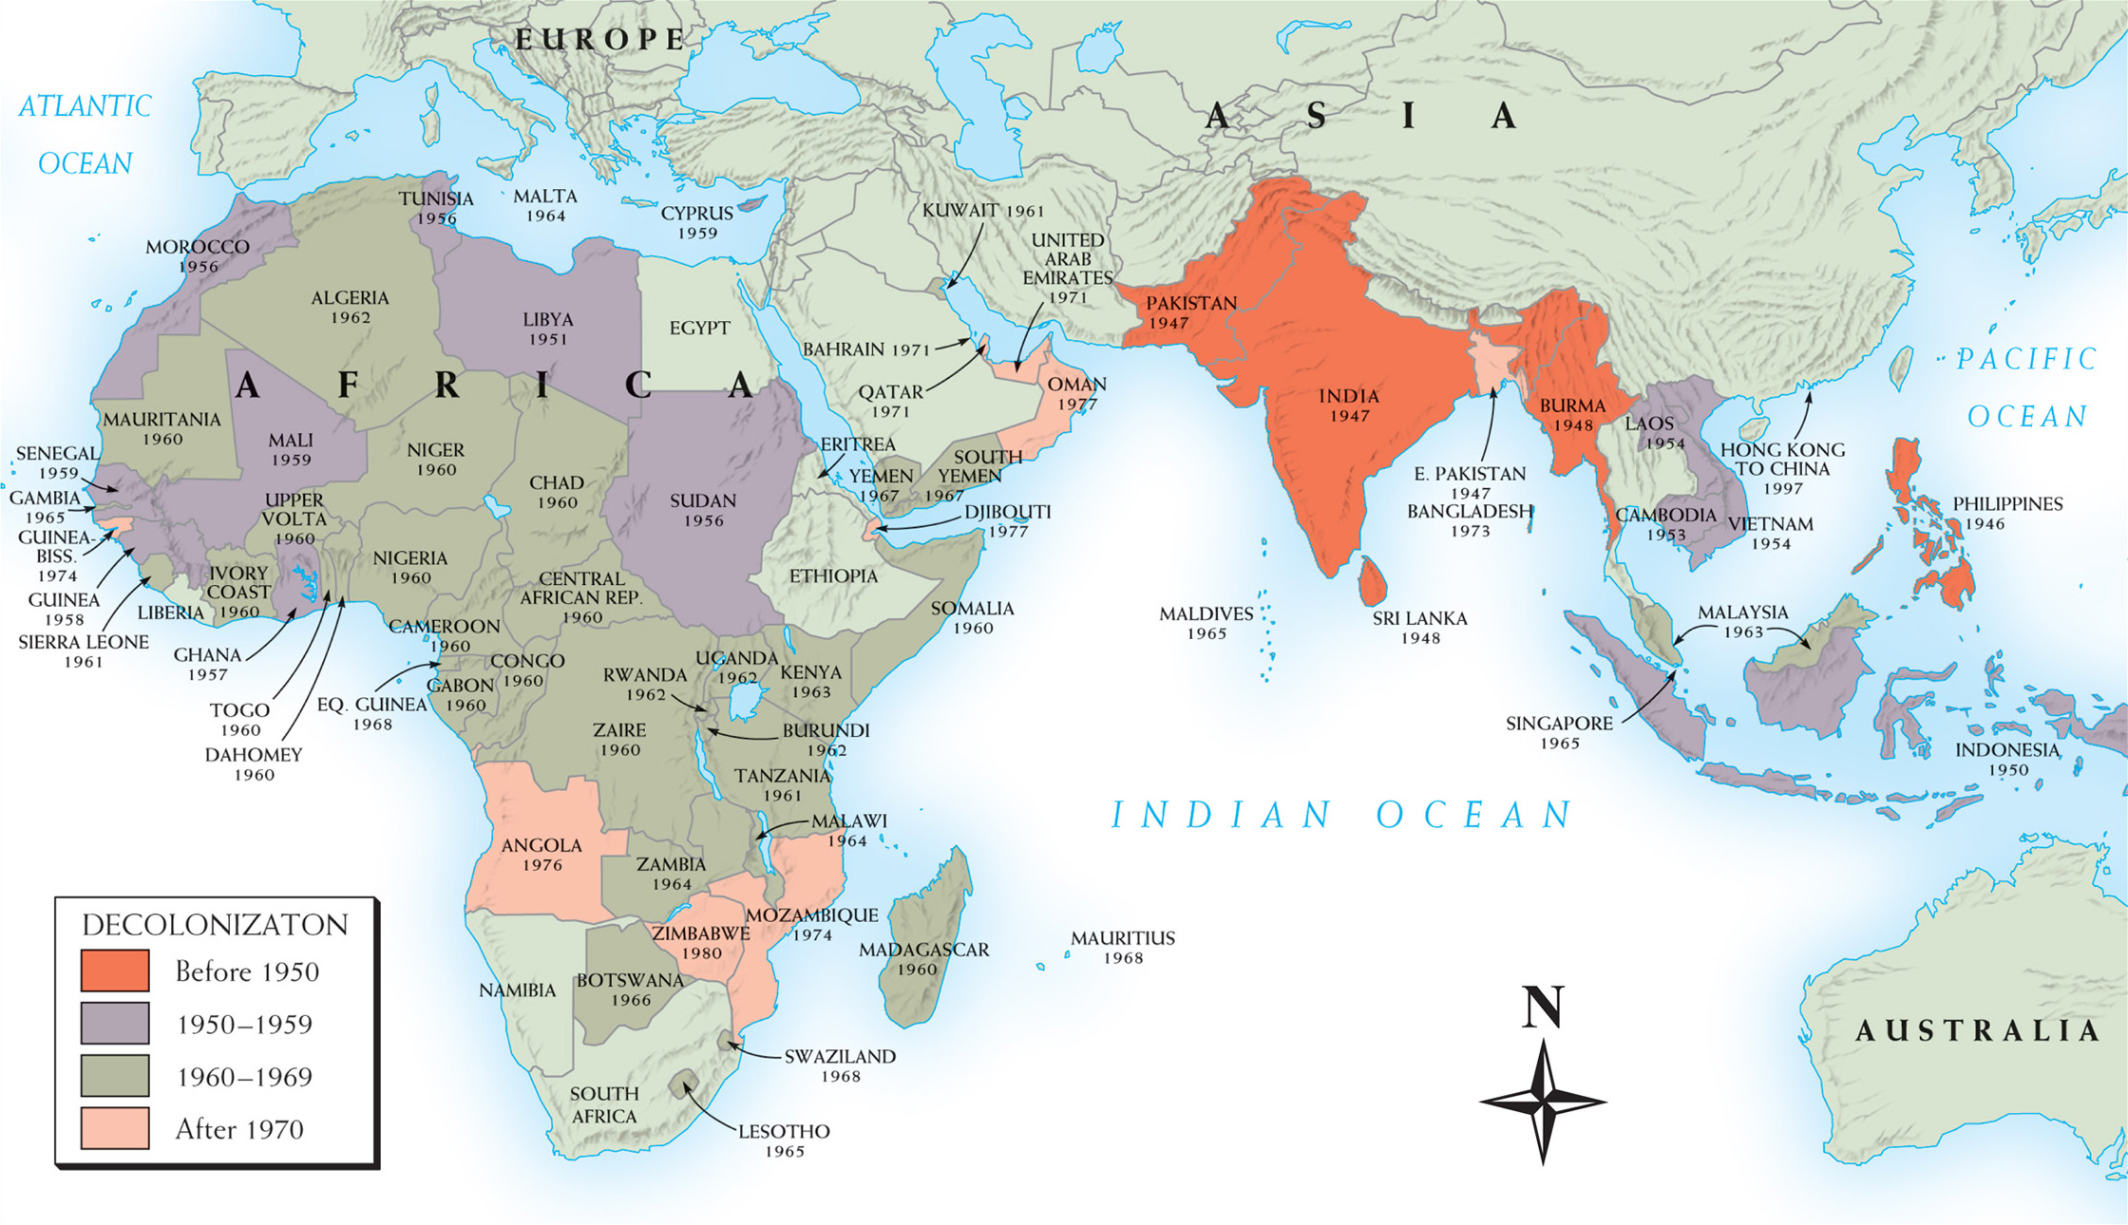
Map 29–6 DECOLONIZATION SINCE WORLD WAR II The Western powers’ rapid retreat from imperialism after World War II is graphically shown on this outline map covering half the globe—from West Africa to the southwest Pacific.
Notes:
Map 29–6 DECOLONIZATION SINCE WORLD WAR II The Western powers’ rapid retreat from imperialism after World War II is graphically shown on this outline map covering half the globe—from West Africa to the southwest Pacific.

Slide 44
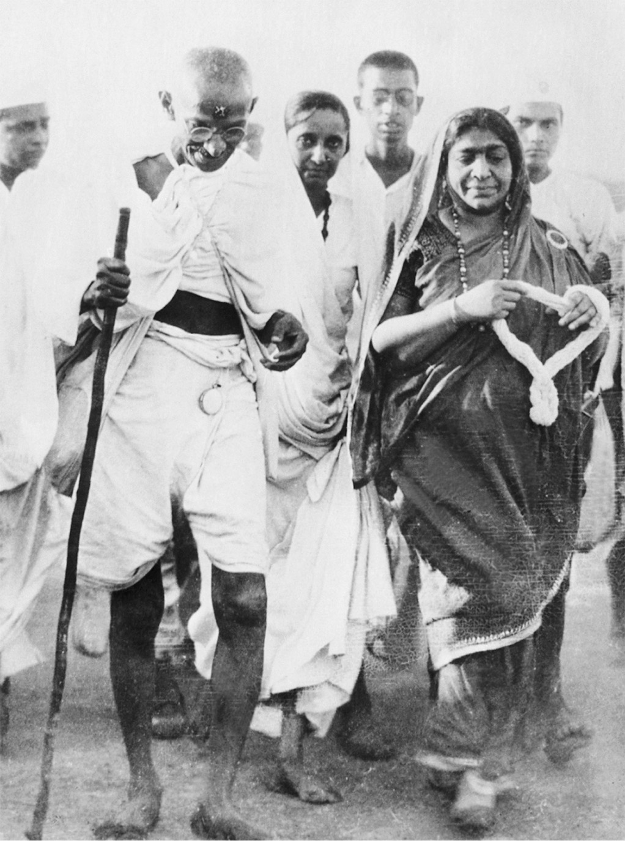
Ghandi led India from colonialism to independence. Part of his appeal was the simplicity of his life and dress. CORBIS/Bettmann
Notes:
Ghandi led India from colonialism to independence. Part of his appeal was the simplicity of his life and dress.
CORBIS/Bettmann

Slide 45
Conflict Between India and Pakistan
Gandhi’s vision of a country of many religions does not come true
India is partitioned into two states: India for the Hindus and Pakistan (under Ali Jinnah) for the Muslims
Gandhi assassinated by Hindu extremist
East Pakistan later breaks away to become Bangladesh
India and Pakistan have come to the brink of nuclear war over the ownership of the northern territory of Kashmir

Slide 46
More British Retreat from Colonial Empires
The British, realizing the costs of maintaining an empire and wanting to avoid conflict, start withdrawing from their colonies
1948 – Burma and Sri Lanka become independent; British withdraw from Palestine
1957 – Ghana becomes independent
1960 – Nigeria becomes independent

Slide 47
More British Retreat from Colonial Empires (cont.)
The British, realizing the costs of maintaining an empire and wanting to avoid conflict, start withdrawing from their colonies
British withdraw from Cyprus, Kenya, and Aden under pressure from militant movements
Withdrawal has led to poverty and instability in Africa, but stability and economic growth in Asia

Slide 48
France and Algeria
Voting structure had given the French more power than the native Muslim people of Algeria
Violent clashes between the Muslims and the French directly after World War II spur even more Algerian nationalism

Slide 49
France and Algeria (cont.)
Civil war breaks out in 1954 between Algerian nationalists led by the National Liberation Front and the French – the war divides French opinion and does not end until 1962
Under General Charles de Gaulle, France eventually grants Algeria independence in 1962
Many Muslims who supported France either flee Algeria for France or are massacred

Slide 50
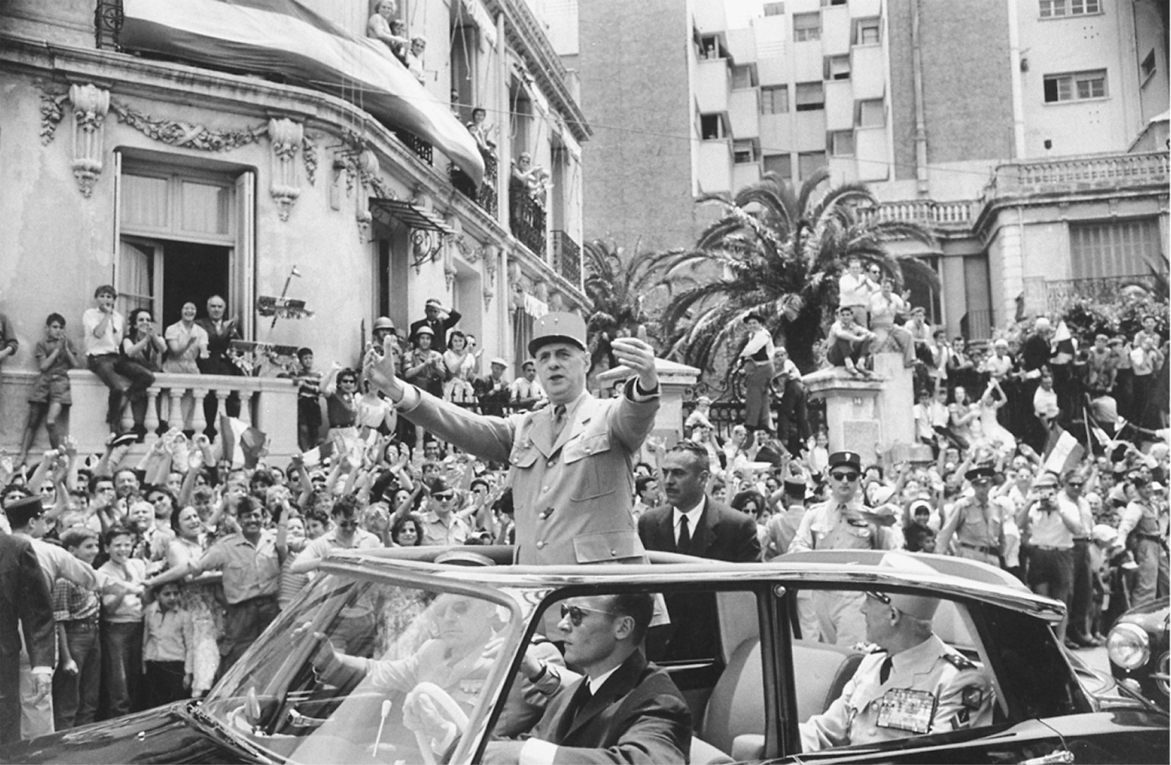
In 1959, Charles de Gaulle, as president of the French Republic, visited Algiers to great acclaim from its European inhabitants, known as colons. By 1962, however, he had sponsored a referendum that led to Algerian independence and the flight of most of those people. Loomis Dean/Getty Images, Inc.
Notes:
In 1959, Charles de Gaulle, as president of the French Republic, visited Algiers to great acclaim from its European inhabitants, known as colons. By 1962, however, he had sponsored a referendum that led to Algerian independence and the flight of most of those people.
Loomis Dean/Getty Images, Inc.

Slide 51
France and Vietnam
Communist, anti-colonial, and nationalistic Vietnam leader Ho Chi Minh declares Vietnam’s independence from France in 1945
Civil war breaks out in 1947
The French are crushed at Dien Bien Phu
Peace accord in 1954 splits Vietnam into two states
North Vietnam – Ho Chi Minh and the communists
South Vietnam – French-controlled

Slide 52
Vietnam and the Cold War
The United States, believing that North Vietnam was a puppet of the Soviet Union and the People’s Republic of China, form the Southeast Asia Treaty Organization to combat the communists
France withdraws from South Vietnam in 1955, leaving Vietnamese political groups to fight for its power

Slide 53
Vietnam and the Cold War (cont.)
United States supports Ngo Dinh Diem, a strong anti-communist nationalist (but certainly not in favor of democracy)
The National Liberation Front with its military wing, the Viet Cong, make it a goal to overthrow Diem

Slide 54
Vietnam and the Cold War (cont.)
United States supports Ngo Dinh Diem, a strong anti-communist nationalist (but certainly not in favor of democracy)
Diem becomes more repressive
In 1963, Diem is assassinated by an army coup supported by the United States

Slide 55
Vietnam and the Cold War (cont.)
The United States, hoping for popular support in South Vietnam, support Nguyen Van Thieu as leader
Kennedy is assassinated and his successor Lyndon Johnson steps up the commitment to South Vietnam, especially after an attack on an American ship in the Gulf of Tonkin

Slide 56
The Vietnam War
1965–1973 – major bombing attacks of Vietnam
At war’s peak – 500,000 American troops are stationed in Vietnam – 58,000 Americans killed
1969 – Vietnamization – President Nixon’s policy to gradually withdraw troops from Vietnam

Slide 57
The Vietnam War (cont.)
Peace negotiations start in 1968, but no treaty until 1973
1975 – South Vietnamese troops evacuate the country but are routed by the North Vietnamese, turning all of Vietnam over to the communists; South Vietnam capital renamed Ho Chi Minh City

Slide 58
The Vietnam War (cont.)
Consequences of war in Vietnam in the U.S.:
War hurt American prestige
Many European nations felt the United States neglected them to fight an aggressive colonial war
Produced enormous divisions and debates in the United States

Slide 59
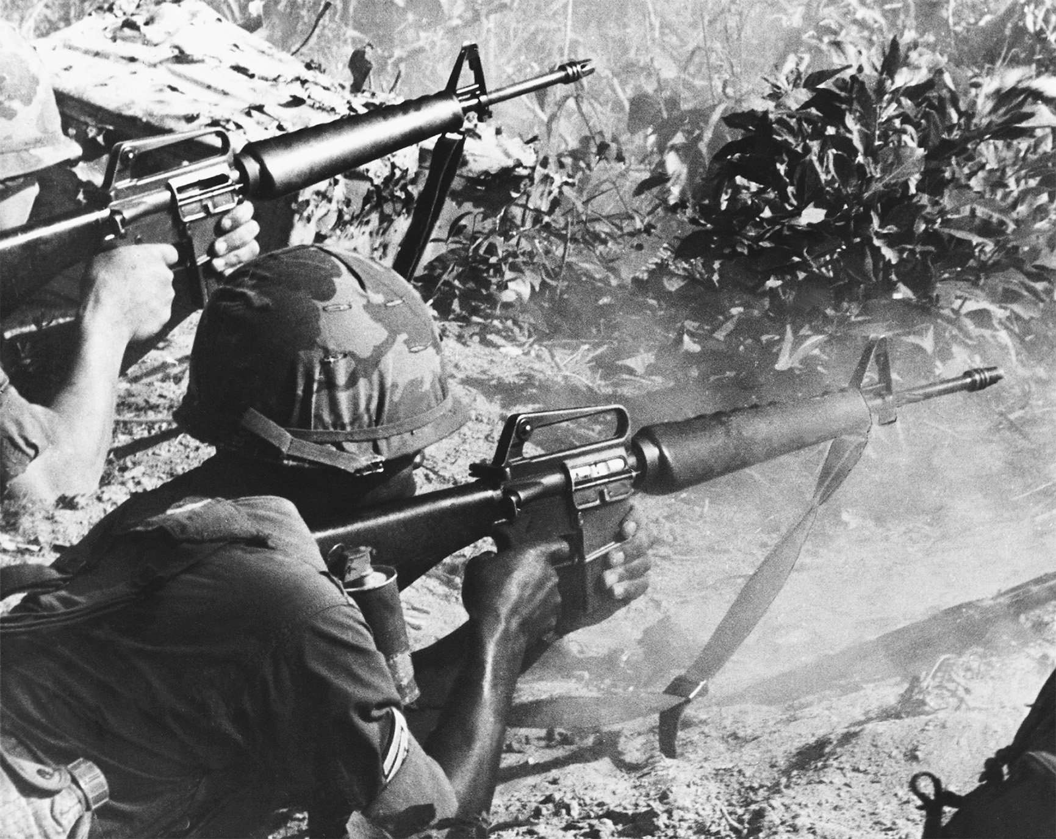
U.S. troops engaged in combat in Vietnam. At the war’s peak, more than 500,000 American troops were stationed in South Vietnam. The United States struggled in Vietnam for more than a decade, seriously threatening its commitment to Western Europe. U.S. Army Photo
Notes:
U.S. troops engaged in combat in Vietnam. At the war’s peak, more than 500,000 American troops were stationed in South Vietnam. The United States struggled in Vietnam for more than a decade, seriously threatening its commitment to Western Europe.
U.S. Army Photo

Slide 60
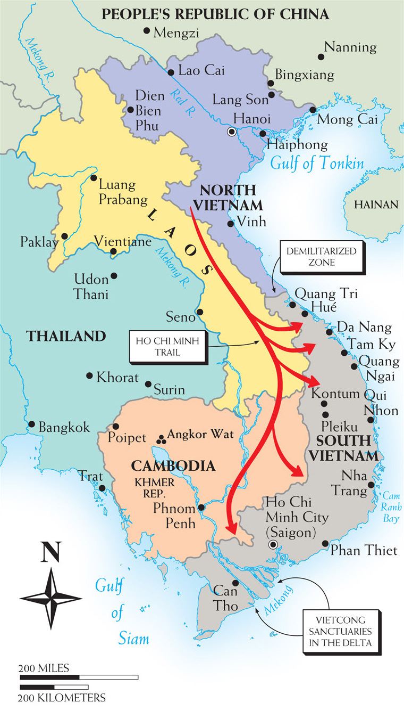
Map 29–7 VIETNAM AND ITS SOUTHEAST ASIAN NEIGHBORS The map identifies important locations associated with the war in Vietnam.
Notes:
Map 29–7 VIETNAM AND ITS SOUTHEAST ASIAN NEIGHBORS The map identifies important locations associated with the war in Vietnam.

Slide 61
Continued Soviet Oppression Under Brezhnev
Aleksandr Solzhenitsyn expelled from country
Harassment of Jewish citizens
Dissidents such as Andrei Sakharov placed in psychiatric hospitals or under house arrest

Slide 62
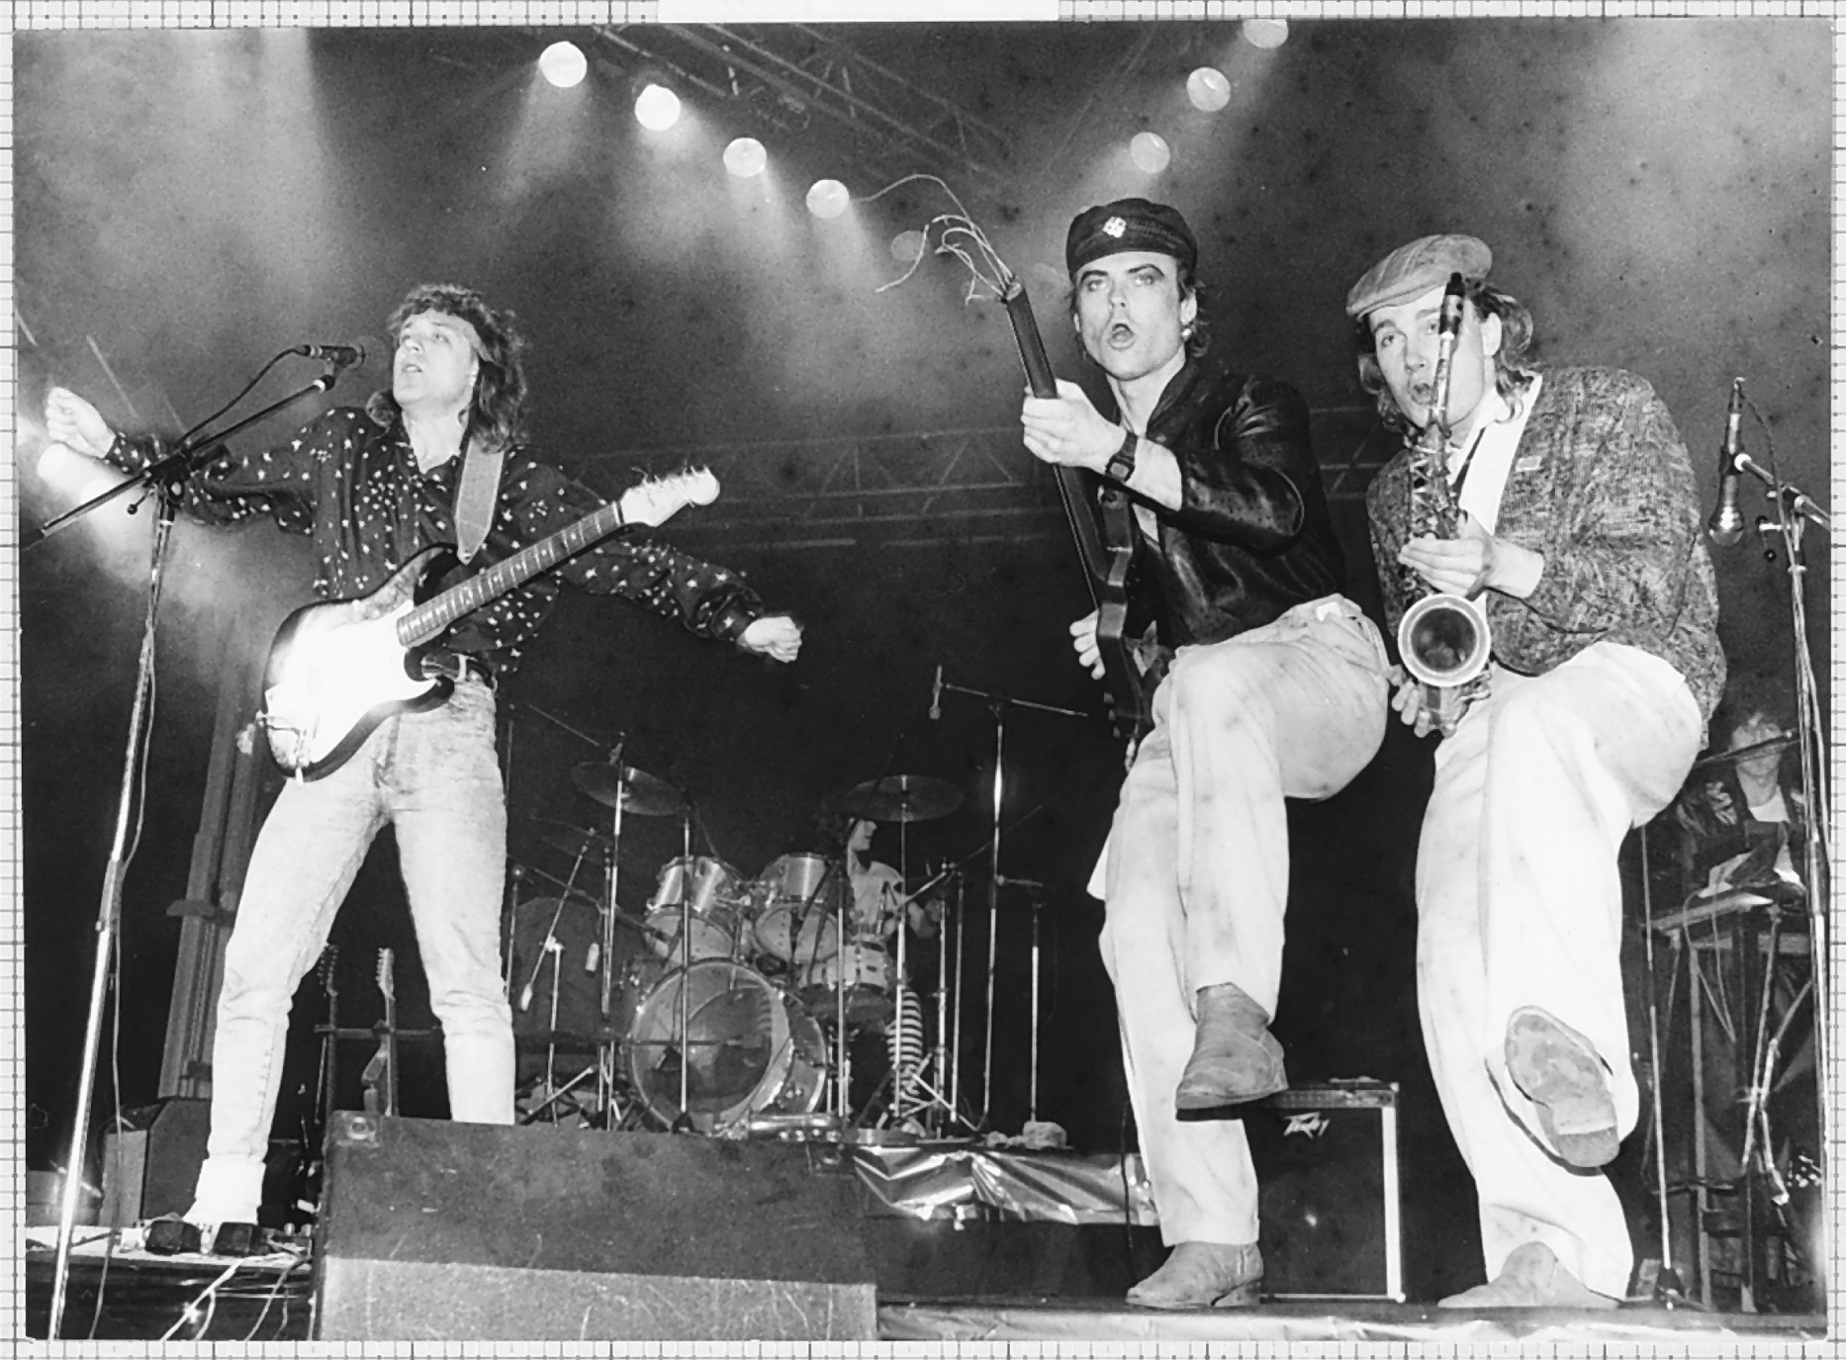
The Russian rock group Dynamic performs in Moscow in 1987. R. Podemi/TASS/Sovfoto/Eastfoto
Notes:
The Russian rock group Dynamic performs in Moscow in 1987.
R. Podemi/TASS/Sovfoto/Eastfoto

Slide 63
The Reforms of Mikhail Gorbachev
Economic perestroika – or “restructuring” – reduced size and importance of the centralized economic ministries
Advocated private ownership of property and the steering of the economy toward a free market system
Economic policies fail as economy remains stagnant

Slide 64
The Reforms of Mikhail Gorbachev (cont.)
Glasnost or openness – Gorbachev allows criticism of the government, less censorship, free expression encouraged, and dissidents released from prison
Applied perestroika to government with free elections that elect Gorbachev president in 1989
Despite the reforms, Gorbachev is unable to address the complaints of ethnic minorities which split the country

Slide 65
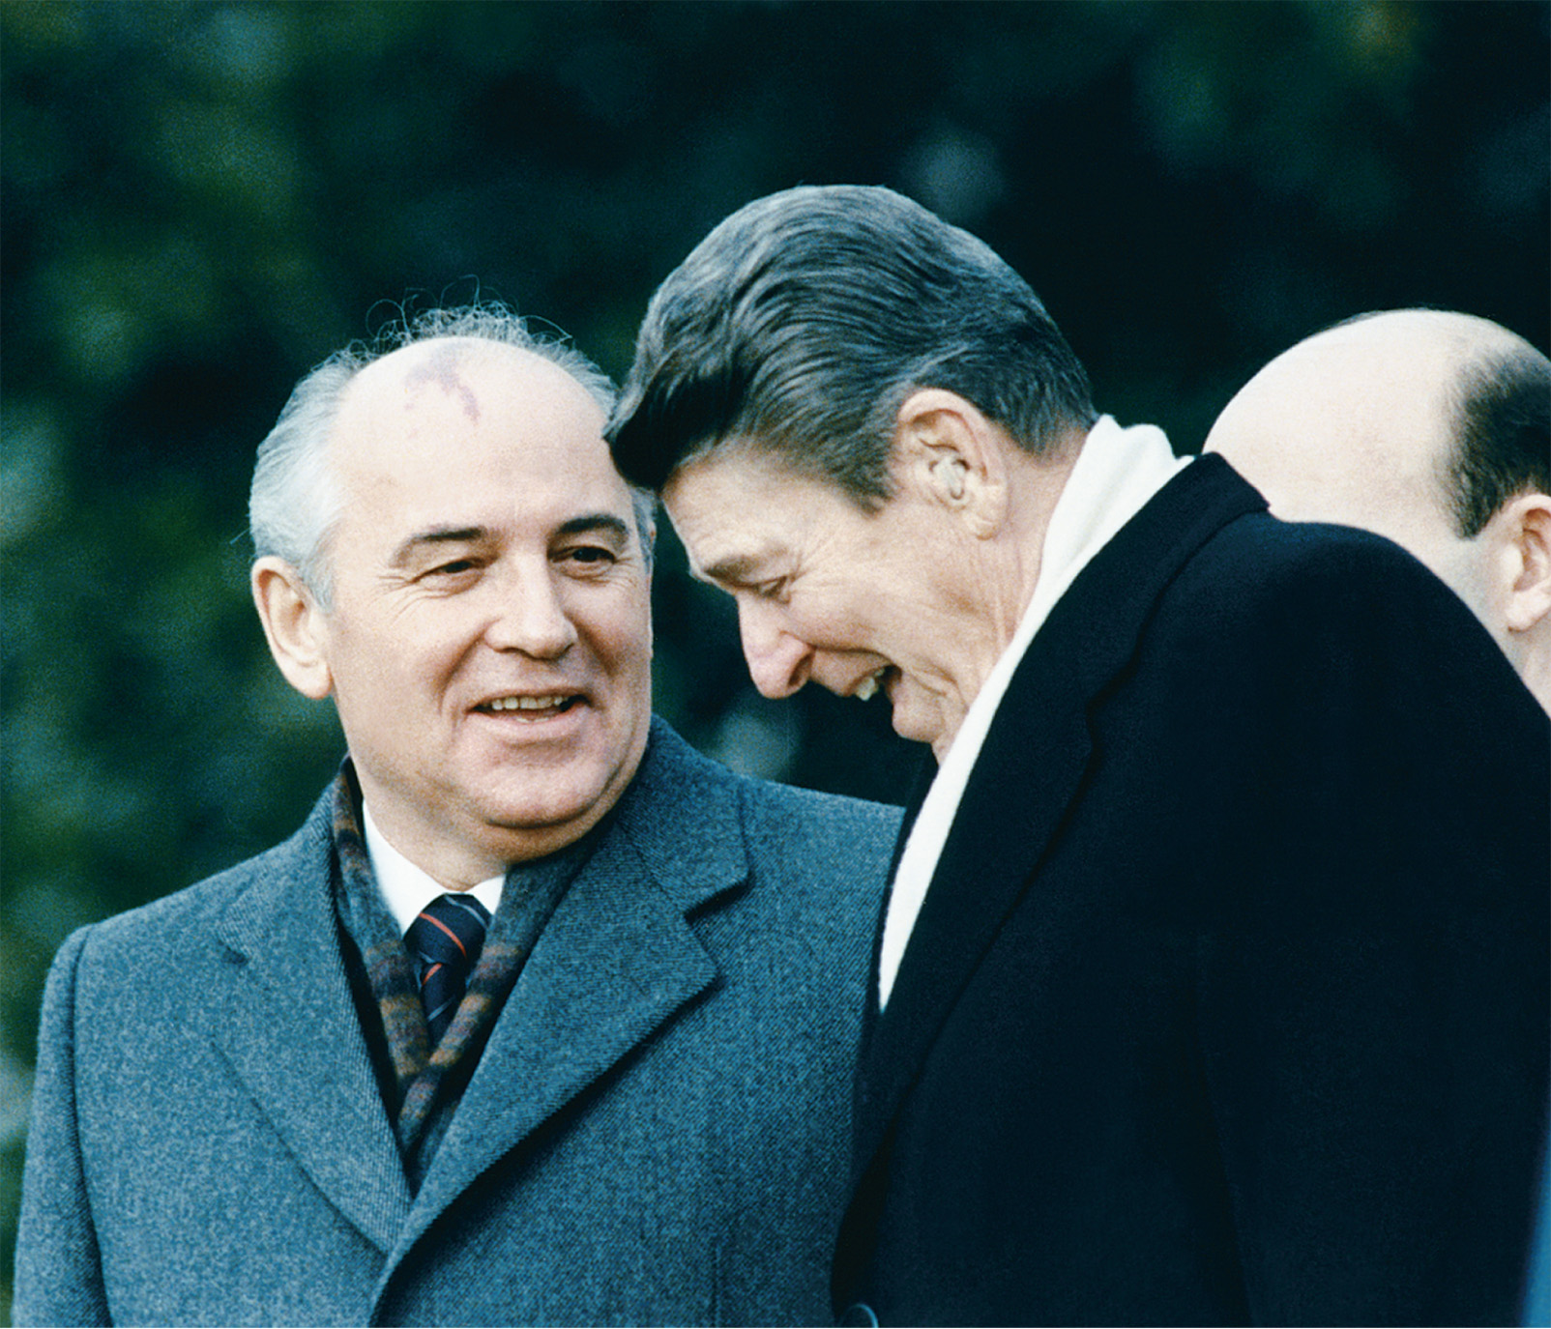
President Ronald Reagan and Premier Mikhail Gorbachev confer at a summit meeting in December 1987. AP Wide World Photos
Notes:
President Ronald Reagan and Premier Mikhail Gorbachev confer at a summit meeting in December 1987.
AP Wide World Photos

Slide 66
1989: Communism Collapses in Eastern Europe
Poland – Communist government, unable to control Solidarity this time, calls for free elections in which communist leader Jaruzelski is roundly defeated and a non-communist prime minister is appointed
Hungary – Kadar stripped of his power as communist leader and Hungarian Communist Party is replaced by Socialist Party, which promises free elections

Slide 67
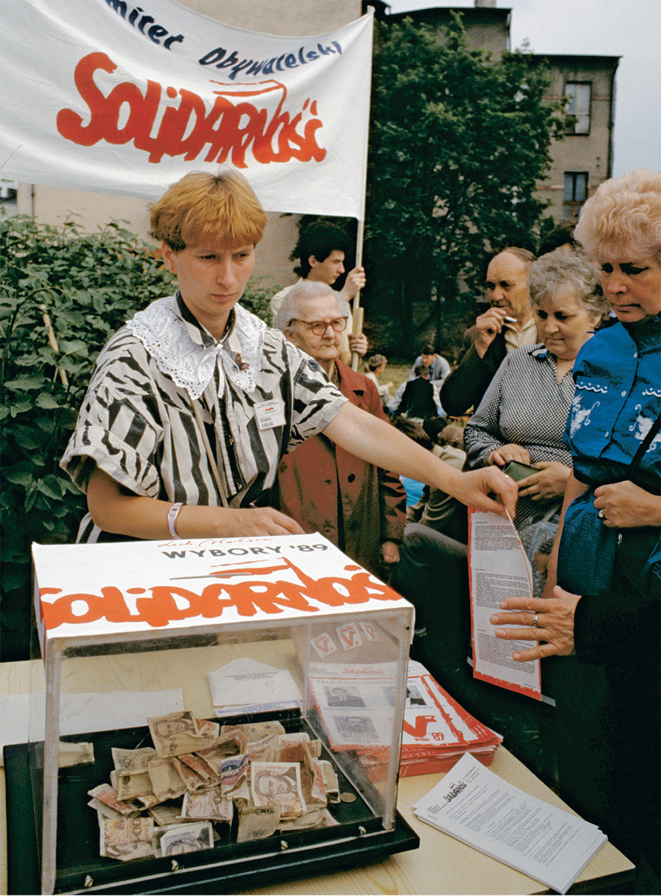
The Polish trade union “Solidarity” in 1989 successfully forced the Polish communist government to hold free elections. In June of that year Solidarity, whose members here are collecting funds for their campaign, won overwhelmingly. Bernard Bisson/CORBIS/ Bettmann
Notes:
The Polish trade union “Solidarity” in 1989 successfully forced the Polish communist government to hold free elections. In June of that year Solidarity, whose members here are collecting funds for their campaign, won overwhelmingly.
Bernard Bisson/CORBIS/ Bettmann

Slide 68
1989: Communism Collapses in Eastern Europe (cont.)
Germany – old communists in power resign, East German government orders opening of Berlin Wall, and within days Germany is reunited under one leader, Helmut Kohl (unification recognized by world in early 1990)

Slide 69
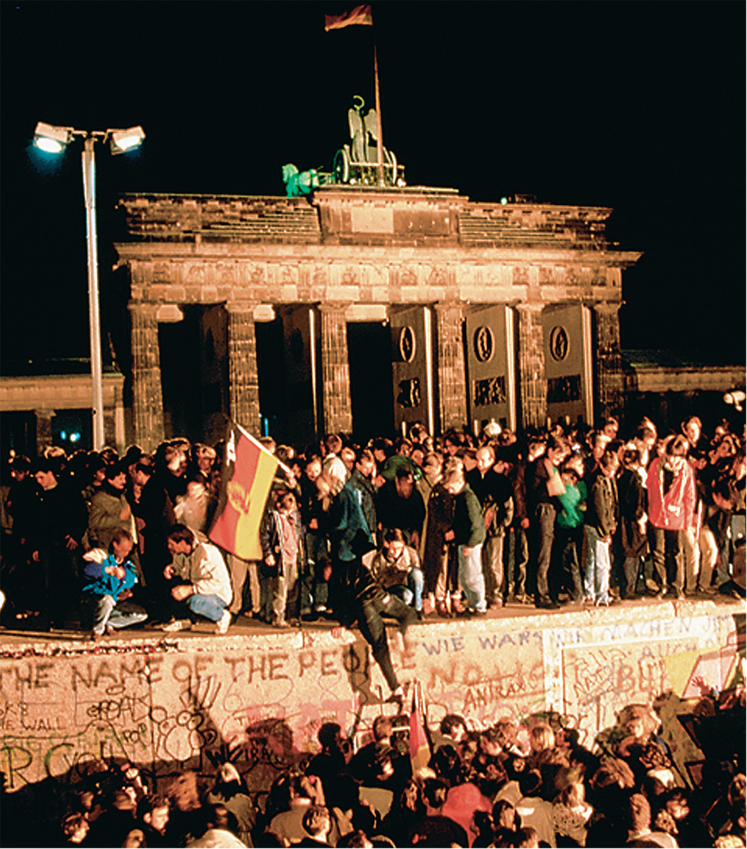
Collapse of the Berlin Wall No single structure so illustrated the divisions of the Cold War as the Berlin Wall, which was erected in 1961. The most symbolic moment in the collapse of communism across Eastern Europe came in November 1989 when that wall was breached. R. Bossu/Sygma/CORBIS
Notes:
Collapse of the Berlin Wall No single structure so illustrated the divisions of the Cold War as the Berlin Wall, which was erected in 1961. The most symbolic moment in the collapse of communism across Eastern Europe came in November 1989 when that wall was breached. R. Bossu/Sygma/CORBIS

Slide 70
1989: Communism Collapses in Eastern Europe (cont.)
Czechoslovakia – Vaclav Havel’s supporters, known as the Civic Forum, force communist leader Gustav Husak out of power and elect Havel as president
Romania – the only violent revolution, where communist leader Nicolae Ceausescu fires on opposition crowds, but later is overthrown and, along with his wife, executed

Slide 71
1989: Communism Collapses in Eastern Europe (cont.)
The mainly peaceful conclusions to these revolutions may have been a reaction to the Tiananmen Square Massacre in the People’s Republic of China, where the communists responded violently to protests

Slide 72
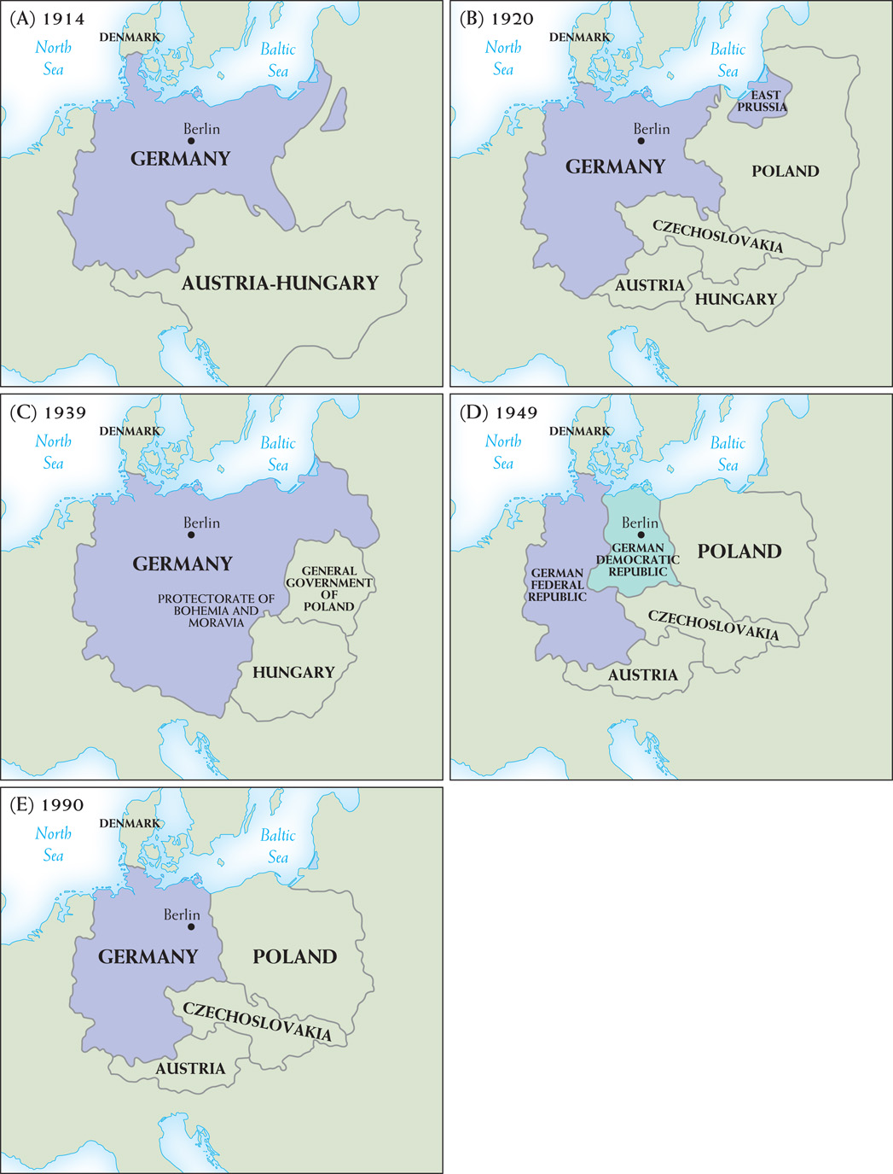
Map 29–8 THE BORDERS OF GERMANY IN THE TWENTIETH CENTURY Map A shows the borders of imperial Germany at the outbreak of World War I. Map B shows the borders of Germany after the Versailles peace settlement. Map C shows the borders of Germany after Hitler’s invasion of the Rhineland, the Anschluss with Austria, the Munich Pact, the invasion of Czechoslovakia, and the invasion of Poland. Map D illustrates the division of Germany into the German Federal Republic (West Germany) and the German Democratic Republic (East Germany) in the aftermath of World War II. Map E illustrates the borders of Germany after reunification in 1990..
Notes:
Map 29–8 THE BORDERS OF GERMANY IN THE TWENTIETH CENTURY Map A shows the borders of imperial Germany at the outbreak of World War I. Map B shows the borders of Germany after the Versailles peace settlement. Map C shows the borders of Germany after Hitler’s invasion of the Rhineland, the Anschluss with Austria, the Munich Pact, the invasion of Czechoslovakia, and the invasion of Poland. Map D illustrates the division of Germany into the German Federal Republic (West Germany) and the German Democratic Republic (East Germany) in the aftermath of World War II. Map E illustrates the borders of Germany after reunification in 1990.

Slide 73
Soviet Response to Revolution
Gorbachev renounces Brezhnev Doctrine and refuses to interfere on behalf of the communists in Eastern Europe
Troops withdraw from Eastern Europe haphazardly

Slide 74
The Soviet Union Collapses
1989 – Gorbachev announces the Soviet Communist Party has abandoned its monopoly on power
1990 – three major political groups vie for power:
Conservatives – wanted to keep Communist Party and Soviet army

Slide 75
The Soviet Union Collapses (cont.)
1990 – three major political groups vie for power:
Reformers – led by Gorbachev critic Boris Yeltsin (later elected president of Russian Republic) – wanted to move quickly to a market economy and democracy

Slide 76
The Soviet Union Collapses (cont.)
1990 – three major political groups vie for power:
Nationalists – some republics in the Soviet Union wanted independence; Gorbachev fails to make new constitutional arrangements with these republics, leading directly to the rapid collapse of the Soviet Union

Slide 77
The Soviet Union Collapses (cont.)
1991 – the August 1991 Coup – communists attempt to seize power and place Gorbachev under house arrest
Coup fails within two days because of Boris Yeltsin’s followers
Gorbachev returns to Moscow humiliated by his own followers
Yeltsin steadily takes control of government

Slide 78
The Soviet Union Collapses (cont.)
Soviet Union collapses in December, 1991 as Gorbachev leaves office and the Commonwealth of Independent States appears
Soviet Union broken up into fifteen constituent republics, of which eleven are part of the Commonwealth of Independent States

Slide 79
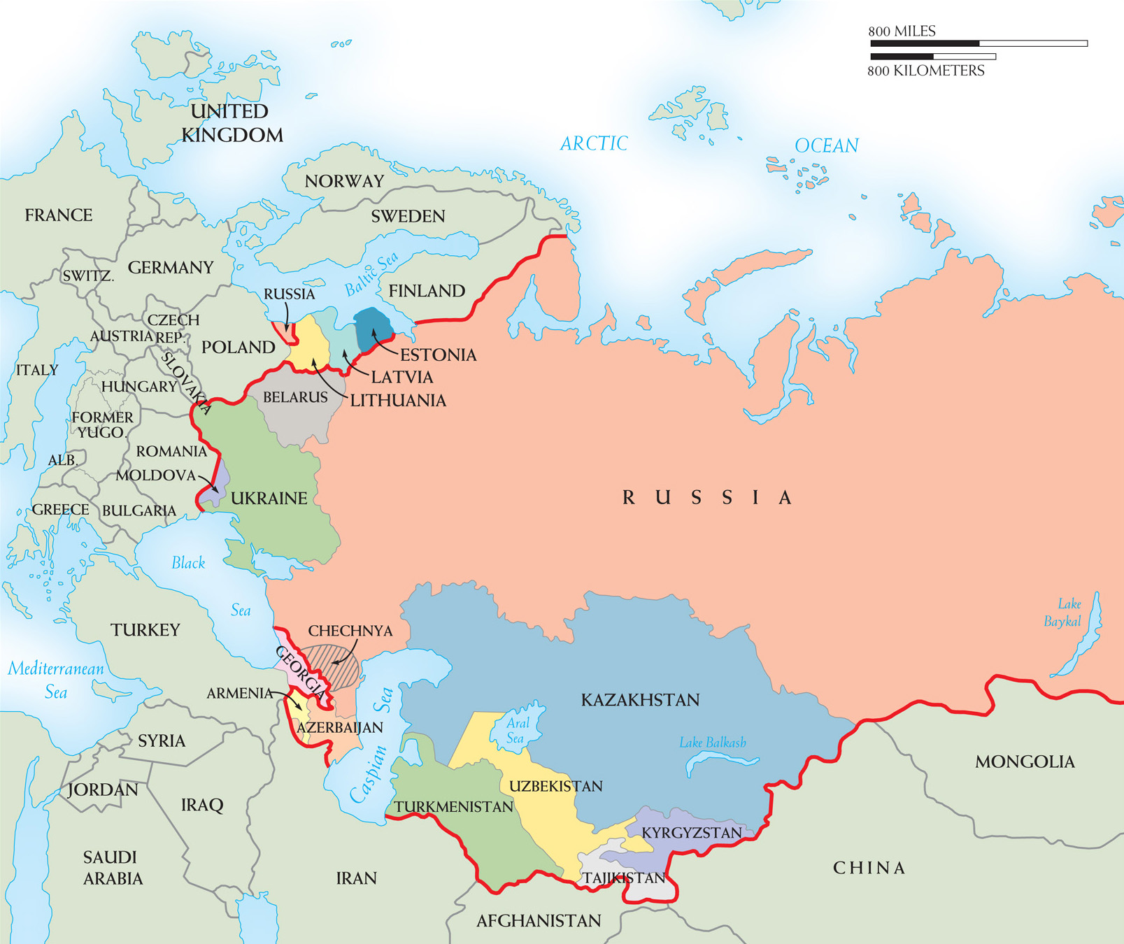
Map 29–9 THE COMMONWEALTH OF INDEPENDENT STATES In December 1991, the Soviet Union broke up into its fifteen constituent republics. Eleven of these were loosely joined in the Commonwealth of Independent States. Also shown is the autonomous region of Chechnya, which has waged two bloody wars with Russia in the last decade. Because the borders of Soviet republics were drawn not so much as to promote stability but instability among the many ethnic groups of the Soviet Union, long-simmering disputes flared up once the empire collapsed. The many conflicts Georgia has faced since it regained its independence in 1991 are representative: It fought unsuccessful wars in the early 1990s to keep the break-away regions of Abkhazia and South Ossetia, both of whose populations were heavily non-Georgian, under its control. In August 2008, when Georgia attempted to reassert its sovereignty over South Ossetia after Russian provocation, it was quickly repulsed by a massive invasion from Russia that resulted in hundreds of fatalities and billions of dollars of damage.
Notes:
Map 29–9 THE COMMONWEALTH OF INDEPENDENT STATES In December 1991, the Soviet Union broke up into its fifteen constituent republics. Eleven of these were loosely joined in the Commonwealth of Independent States. Also shown is the autonomous region of Chechnya, which has waged two bloody wars with Russia in the last decade. Because the borders of Soviet republics were drawn not so much as to promote stability but instability among the many ethnic groups of the Soviet Union, long-simmering disputes flared up once the empire collapsed. The many conflicts Georgia has faced since it regained its independence in 1991 are representative: It fought unsuccessful wars in the early 1990s to keep the break-away regions of Abkhazia and South Ossetia, both of whose populations were heavily non-Georgian, under its control. In August 2008, when Georgia attempted to reassert its sovereignty over South Ossetia after Russian provocation, it was quickly repulsed by a massive invasion from Russia that resulted in hundreds of fatalities and billions of dollars of damage.

Slide 80
The Yeltsin Decade
Yeltsin’s troubled reign
Yeltsin, supported by the West, puts down Parliament protest that attempts to overthrow him
New Parliament and constitution voted on in 1993
Russia at war with Islamic province of Chechnya to this day
Economic downturn due to corruption by the “oligarchs,” defaults on international debts, and political assassinations
Yeltsin resigns in 1998 and is replaced by Vladimir Putin

Slide 81
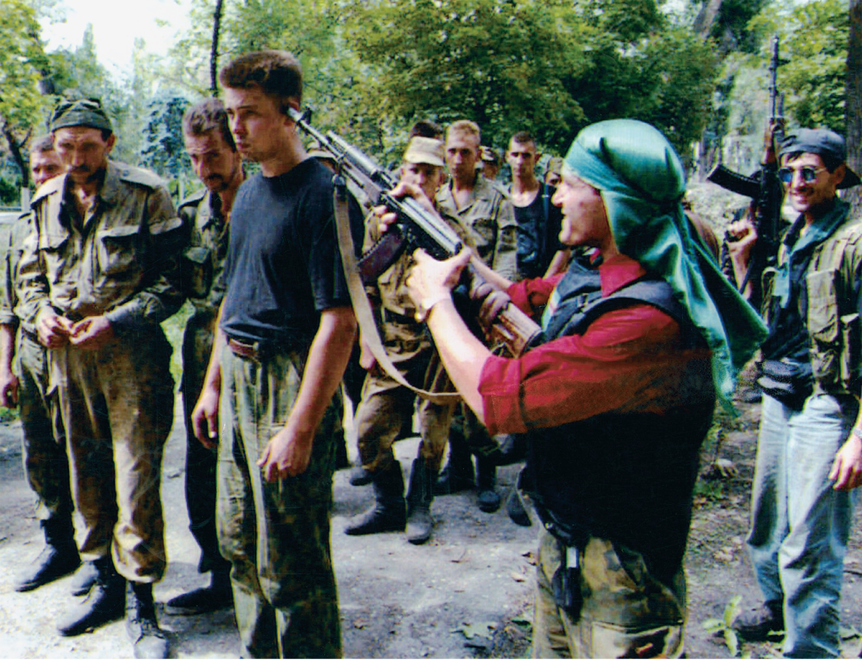
A Chechen fighter points his rifle at the head of a Russian prisoner of war outside the Chechen capital Grozny in August 1996. Mindaugas Kulbis/AP Wide World Photos
Notes:
A Chechen fighter points his rifle at the head of a Russian prisoner of war outside the Chechen capital Grozny in August 1996.
Mindaugas Kulbis/AP Wide World Photos

Slide 82
Civil War and the Collapse of Yugoslavia
Yugoslav leader Tito keeps the many different ethnic and national groups under control – his death eventually leads the country into chaos and civil war
Nationalist leaders Slobodan Milosevic in Serbia and Franjo Tudjman in Croatia gain authority
1991 – Slovenia and Croatia declare independence from Yugoslavia

Slide 83
Civil War and the Collapse of Yugoslavia (cont.)
Civil war erupts in 1992 between Serbs and Croatians
Serbia accuses Croatia of fascism, while Croatia accuses Serbia of being a Stalinist regime
Both forces attempt to divide Bosnia-Herzegovina
Muslims in Bosnia are caught in the middle and are subject to “ethnic cleansing” by the Serbs

Slide 84
Civil War and the Collapse of Yugoslavia (cont.)
NATO, led by the United States, engages in strategic bombing of Serbia to remove the Serbs from Sarajevo
1995 – peace agreement signed in 1995 in Dayton, Ohio

Slide 85
Civil War and the Collapse of Yugoslavia (cont.)
Serbs again force NATO into action by attacking Albanians in Kosovo in 1999
An air campaign – the largest since World War II – is sent to protect the ethnic Albanians
2000 – revolution overthrows Milosevic

Slide 86
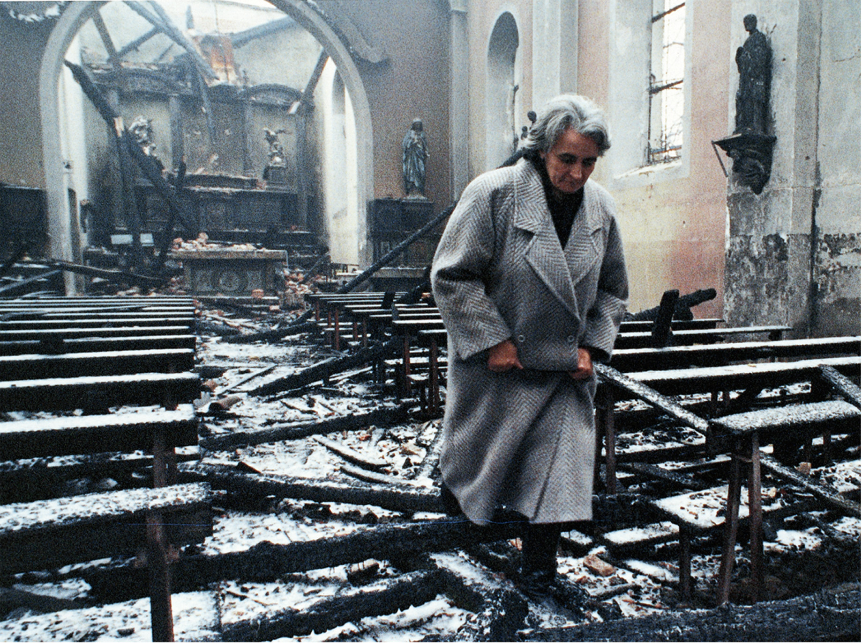
Destruction of Sarajevo. An elderly parishioner walks through the ruins of St. Mary’s Roman Catholic Church in Sarajevo. The church was destroyed by Serb shelling in May 1992. Reuters/CORBIS/Bettmann
Notes:
Destruction of Sarajevo. An elderly parishioner walks through the ruins of St. Mary’s Roman Catholic Church in Sarajevo. The church was destroyed by Serb shelling in May 1992.
Reuters/CORBIS/Bettmann

Slide 87
Putin and the Resurgence of Russia
Putin becomes president of the Russian Federation in 2000
Revives war in Chechnya
Central government dominates economic and political life
Putin uses economic recovery to reassert Russia’s position as a major power
August 2008 invasion of Georgia epitomizes new Russian aggressiveness
The worldwide financial crisis threatens Russian economic stability and the plans of its leaders

Slide 88
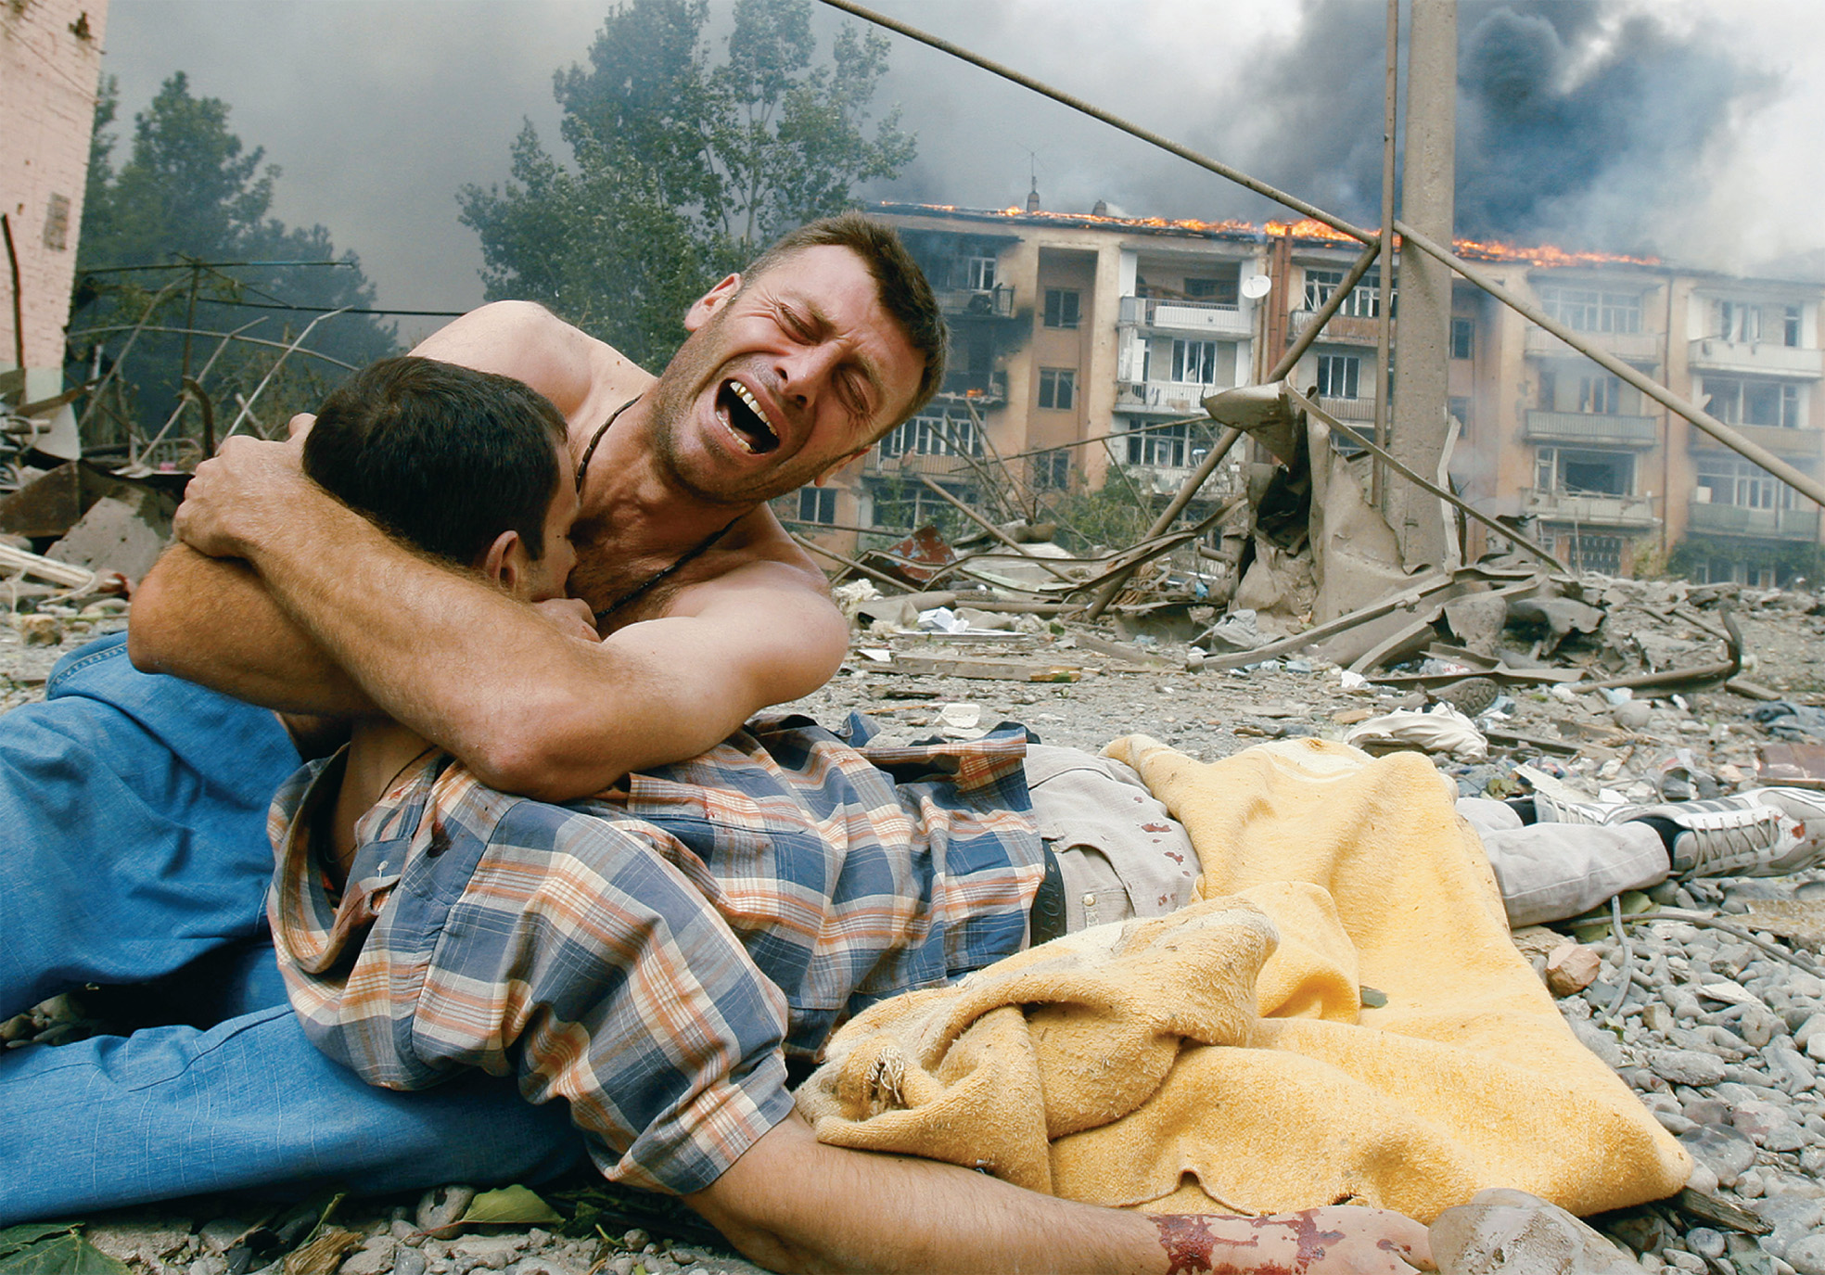
The aftermath of an attack by a Russian warplane on an apartment block in Gori, Georgia, during the conflict in South Ossetia in August 2008. Here a Georgian man cradles the body of a relative killed during the bombing, which killed at least five people. © Gleb Garanich/Reuters/America LLC
Notes:
The aftermath of an attack by a Russian warplane on an apartment block in Gori, Georgia, during the conflict in South Ossetia in August 2008. Here a Georgian man cradles the body of a relative killed during the bombing, which killed at least five people.
© Gleb Garanich/Reuters/America LLC

Slide 89
Arab Nationalism
Radical Islamism rose in reaction to secular Arab nationalism of the 1920s and 1930s
Radical Islamists reject Western ideals and culture
Middle Eastern Arab countries become rich because of oil

Slide 90
Arab Nationalism (cont.)
The Saudi royal family turns education over to a rigorist form of Islam known as Wahhabism, while modernizing its infrastructure
Egypt pitted Islamic groups against one another
Poor Arabs remain poor while religious leaders remained hostile to the Soviet Union

Slide 91
The Iranian Revolution of 1979
Led by Ayatollah Ruhollah Khomeini, revolutionary leaders overthrow a modern, but repressive, government supported by the United States and turn Iran into a theocracy, a government controlled by religion
Revolution embodied Islamic fundamentalism or Muslim reformism
Iran considered the United States to be “The Great Satan” and opposed the state of Israel on religious and nationalist grounds

Slide 92
Afghanistan and Radical Islamism
The Taliban – rigorist Muslims who impose Muslim law through the strict regimentation of women, public executions, floggings, and mutilations for a variety of criminal, religious, or moral offenses
Al Qaeda – groups of Muslim terrorists supported by the Taliban

Slide 93
Afghanistan and Radical Islamism (cont.)
Ideology came from Pakistan, which taught madrasas – the rejection of liberal and secular views, intolerance towards non-Muslims, repudiation of Western culture, and hostility and hatred toward the United States and Israel

Slide 94
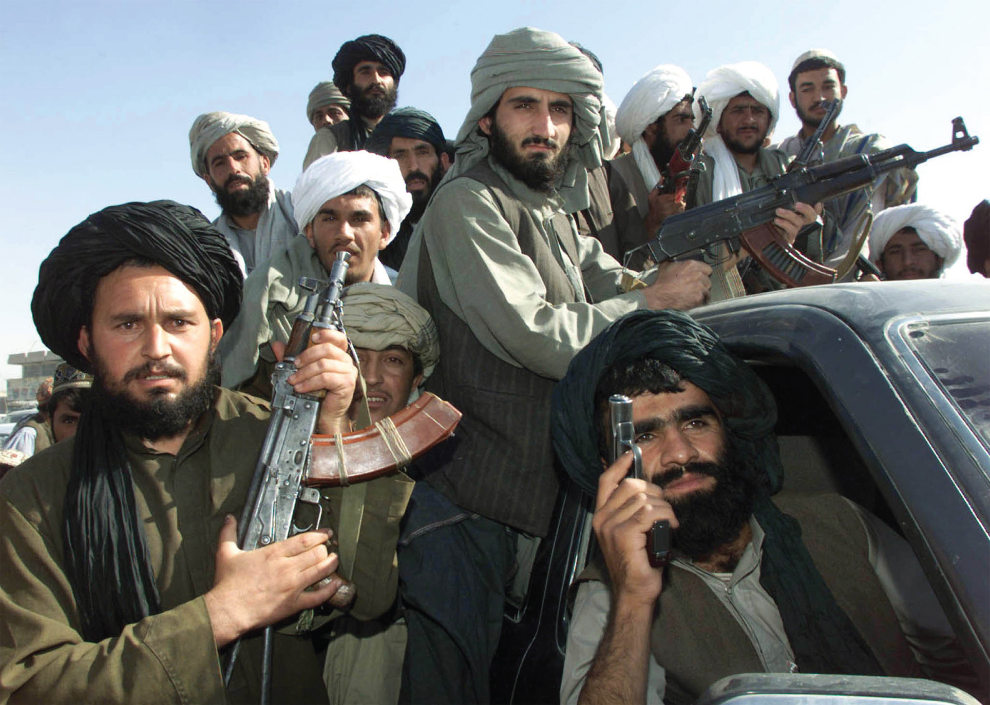
Taliban fighters brandish their weapons in the main bazaar of Kandahar, Afghanistan, in late 2001. Reuters/Mian Kursheed
Notes:
Taliban fighters brandish their weapons in the main bazaar of Kandahar, Afghanistan, in late 2001.
Reuters/Mian Kursheed

Slide 95
Jihad Against the United States
Arabs redirect their jihad (religious war) from the Soviet Union to the United States, especially after the Persian Gulf War of 1991
The United States drives Iraq under Saddam Hussein out of Kuwait with the support of conservative Arab governments such as Saudi Arabia

Slide 96
Jihad Against the United States (cont.)
Arabs redirect their jihad (religious war) from the Soviet Union to the United States, especially after the Persian Gulf War of 1991
Islamic extremist leader Osama Bin Laden is horrified that the United States is allowed to have their military in Saudi Arabia, home of Islam’s two holiest cities, Mecca and Medina

Slide 97
Jihad Against the United States (cont.)
Terrorist attacks on United States
World Trade Center Bombing – 1993
U.S. army barracks bombed in Saudi Arabia – 1996
U.S. embassies in East Africa bombed – 1998
Attack on the ship USS Cole in Yemen – 2000
9/11/2001 – attacks in New York City, Washington D.C., and Pennsylvania leave more than 3,000 dead

Slide 98
The 9/11 Response and War in Iraq
U.S. President George W. Bush responds to 9/11 by attacking the Taliban in Afghanistan; Taliban defeated but Al Qaeda and Bin Laden in hiding and intact

Slide 99
The 9/11 Response and War in Iraq (cont.)
Bush preemptively attacks Iraq, citing dangers to the United States; sparks controversy at home and abroad
United States and Great Britain, with token support of fifty other nations, invade Iraq in March 2003
Iraqi government collapses and Saddam Hussein is eventually captured

Slide 100
The 9/11 Response and War in Iraq (cont.)
Bush preemptively attacks Iraq, citing dangers to the United States; sparks controversy at home and abroad
Invasion sparks opposition from France, Germany, Russia, and many other nations, splitting the European Union and directing hostility from European citizens to the United States
Many in the United States opposed the war due to the fact that weapons of mass destruction (WMDs) were never found in Iraq

Slide 101
Recent Events in Europe and United States
Terrorist attacks in Spain (2004) and London (2005)
Bush re-elected in 2004; in 2005 Iraq had first free elections since the 1950s
Britain re-elects Tony Blair as prime minister, but with a much reduced parliamentary majority

Slide 102
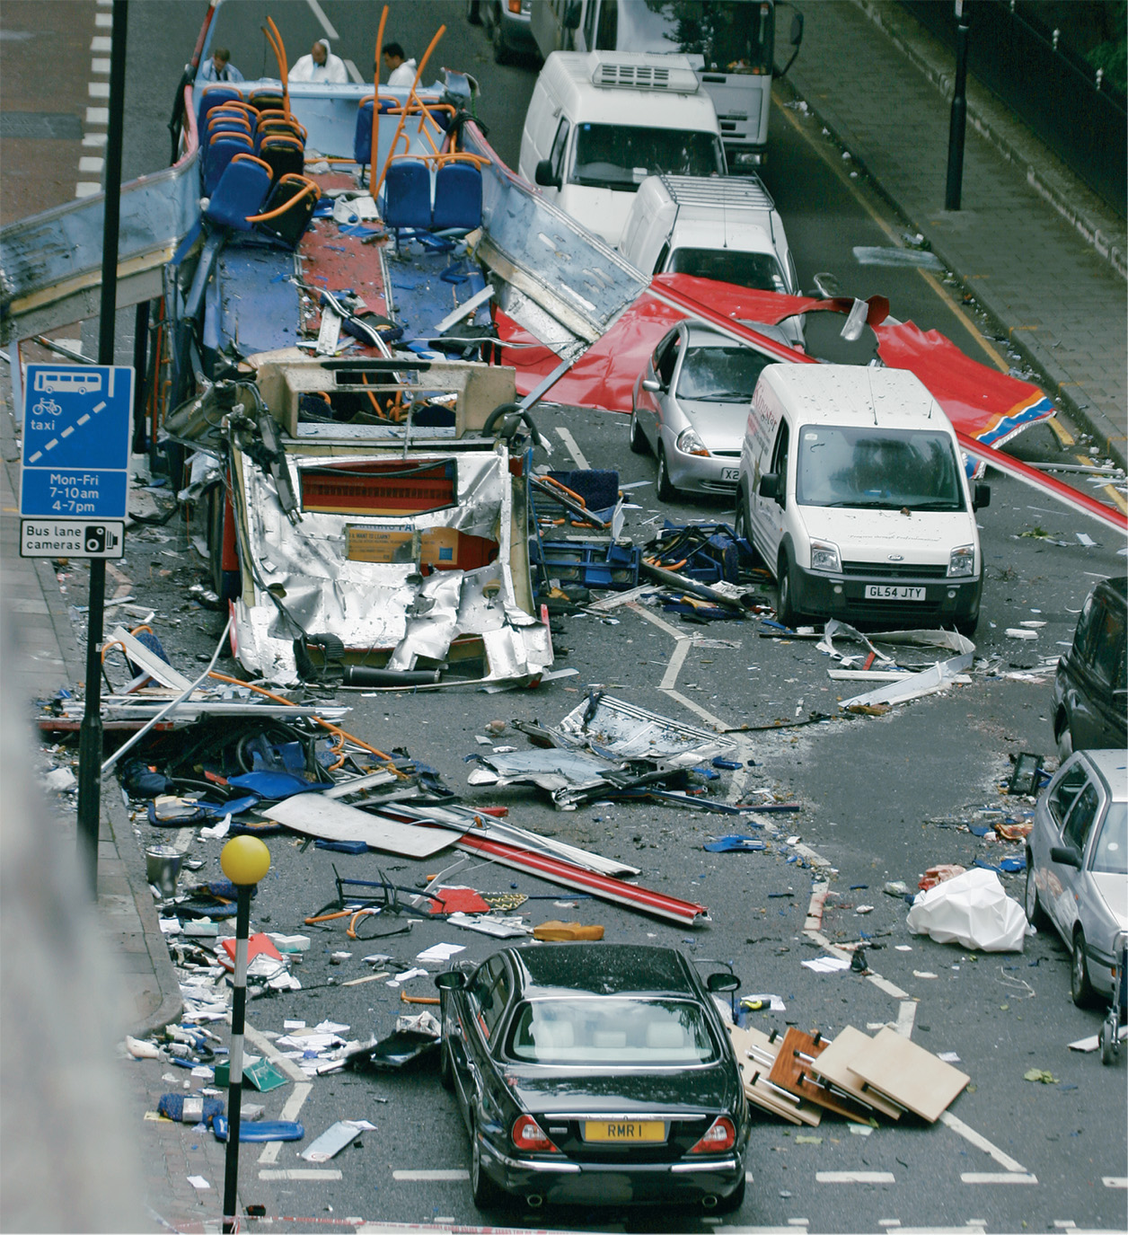
On July 7, 2005, a series of bombs rocked the London transport system, with the loss of over fifty lives. This photo shows the remains of a London bus on which a suicide bomber took more than a dozen lives near Russell Square, London. Sion Touhig/CORBIS/Bettmann
Notes:
On July 7, 2005, a series of bombs rocked the London transport system, with the loss of over fifty lives. This photo shows the remains of a London bus on which a suicide bomber took more than a dozen lives near Russell Square, London.
Sion Touhig/CORBIS/Bettmann

