Slide 1
Chapter 10
Renaissance and Discovery

Slide 2
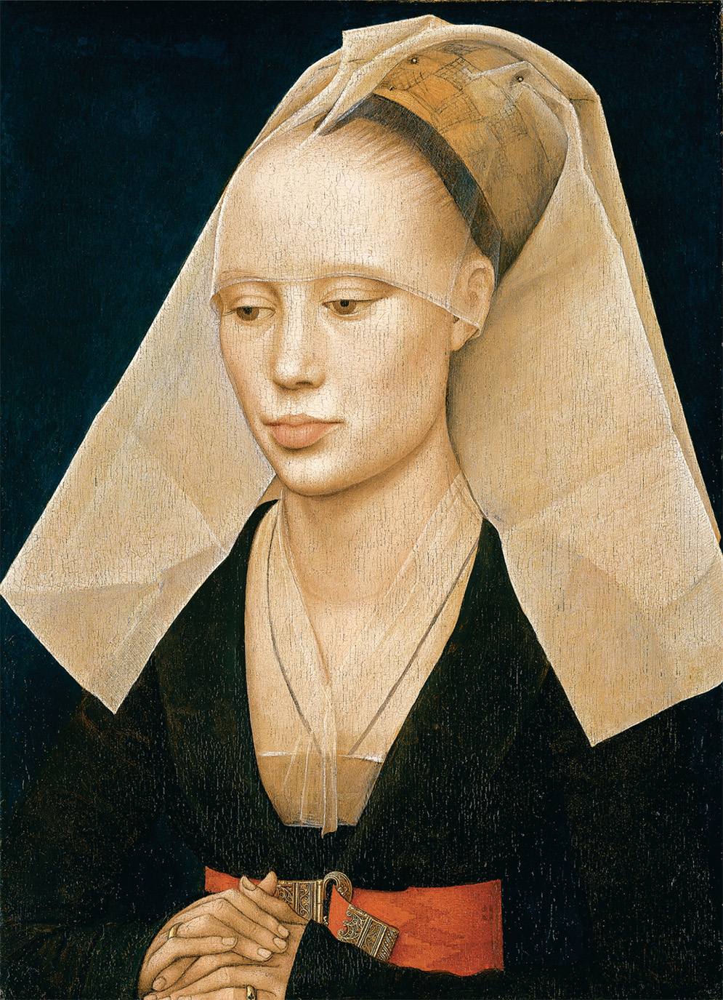
The Renaissance celebrated human beauty and dignity. Here the Flemish painter Rogier van der Weyden (1400–1464) portrays an ordinary woman more perfectly on canvas than she could ever have appeared in life. Rogier van der Weyden (Netherlandish, 1399.1400–1464), “Portrait of a Lady.” 1460. .370 × .270 (14 × 10 ); framed: .609 × .533 × .114 (24 × 21 × 4 ). Photo: Bob Grove. Andrew W. Mellon Collection. Photograph © Board of Trustees, National Gallery of Art, Washington, D.C.
Notes:
The Renaissance celebrated human beauty and dignity. Here the Flemish painter Rogier van der Weyden (1400–1464) portrays an ordinary woman more perfectly on canvas than she could ever have appeared in life.
Rogier van der Weyden (Netherlandish, 1399.1400–1464), “Portrait of a Lady.” 1460. .370 × .270 (14 × 10 ); framed: .609 × .533 × .114 (24 × 21 × 4 ). Photo: Bob Grove. Andrew W. Mellon Collection. Photograph © Board of Trustees, National Gallery of Art, Washington, D.C.

Slide 3
The Renaissance in Italy
“Rebirth”; transition from medieval to modern times
Medieval Europe (pre-12th c.)
Fragmented, feudal society
Agricultural economy
Church-dominated thought, culture

Slide 4
The Renaissance in Italy (cont.)
“Rebirth”; transition from medieval to modern times
Renaissance Europe (post-14th c.)
Political centralization, national feelings
Urban, commercial-capitalist economy
Growing lay/secular control of thought & culture

Slide 5
The Italian Renaissance (1375–1527)
Beginning: deaths of Petrarch (“father of humanism”) in 1374 & Boccaccio, author of the Decameron in 1375
End: sack of Rome by Spanish imperial soldiers, 1527
Francis I (France) & Charles V (HRE) had made Italy a battleground for mutual dynastic claims to Burgundy & parts of Italy
Pope Clement sided w/ France

Slide 6
The Italian Renaissance (cont.)
Spread of “civic humanism” (the term coined by scholars to mean humanism + civic reform) through northern Europe
Italian city-states: duchy of Milan, republics of Florence & Venice, Papal States, kingdom of Naples—prosperous urban centers of trade & commerce
trade-rich cities became powerful city-states

Slide 7
The Italian City-State
Left to develop by endemic warfare between popes & Holy Roman emperors which positioned the Guelf (propapal) & Ghibelline (proimperial) factions against one another
Characterized by intense social strife & competition for political power
Florentine Social classes: old rich (grandi), new rich (popolo grosso), middle burgher ranks (guild masters & small business owners), popolo minute (poor)

Slide 8
The Ciompi Revolt
uprising of the poor in 1378 that resulted from
1) feuding btwn old rich & new rich
2) social anarchy created by Black Death
3) collapse of great banking houses
Resulted in great instability under reign of lower Florentine classes

Slide 9
The Italian City-State (cont.)
Florence illustrated well social division & anarchy
Cosimo de’ Medici—Florentine banker & statesman - manipulated constitution & influenced elections
Despots hired by many city states to keep order
Art & culture flourished nonetheless, because of the profusion of wealth

Slide 10
Despotism
Known as podesta, a despot’s sole purpose was to maintain law & order
Essentially a hired strongman to prevent internal
social conflict
had executive, military, & judicial authority
mandate was to continue the normal flow of
business activity
accomplished this through mercenary armies
obtained through military brokers known as
condottieri

Slide 11
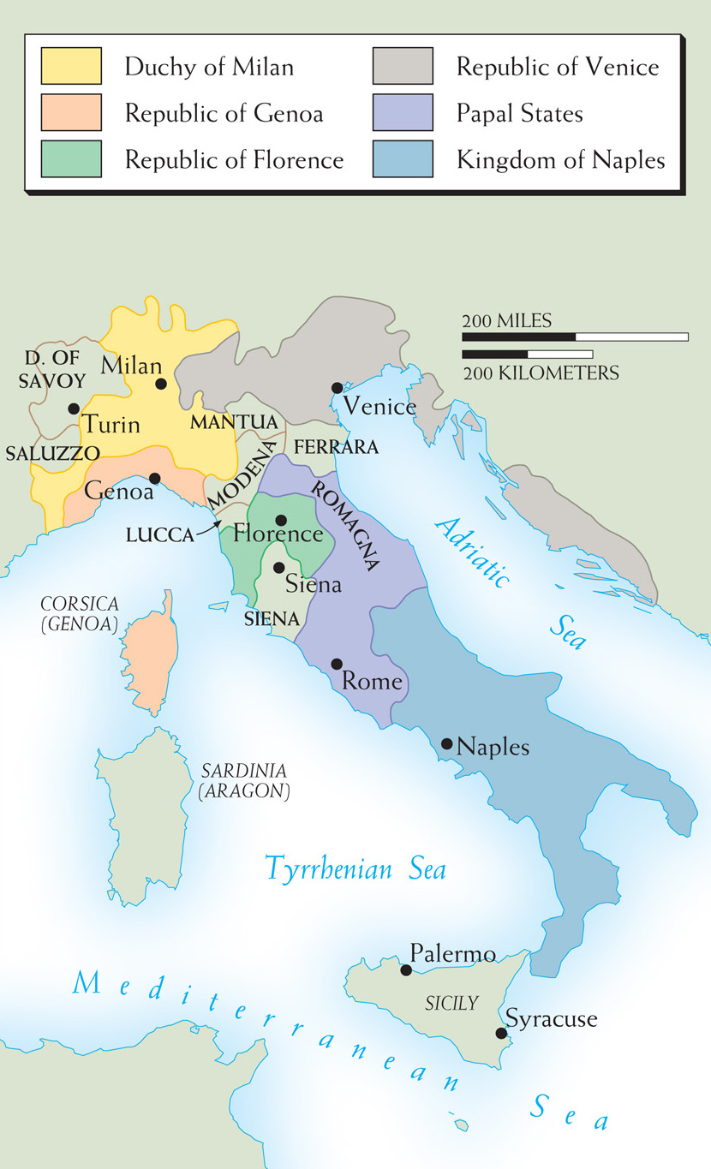
Map 10–1 RENAISSANCE ITALY The city-states of Renaissance Italy were self-contained principalities whose internal strife was monitored by their despots and whose external aggression was long successfully controlled by treaty.
Notes:
Map 10–1 RENAISSANCE ITALY The city-states of Renaissance Italy were self-contained principalities whose internal strife was monitored by their despots and whose external aggression was long successfully controlled by treaty.

Slide 12
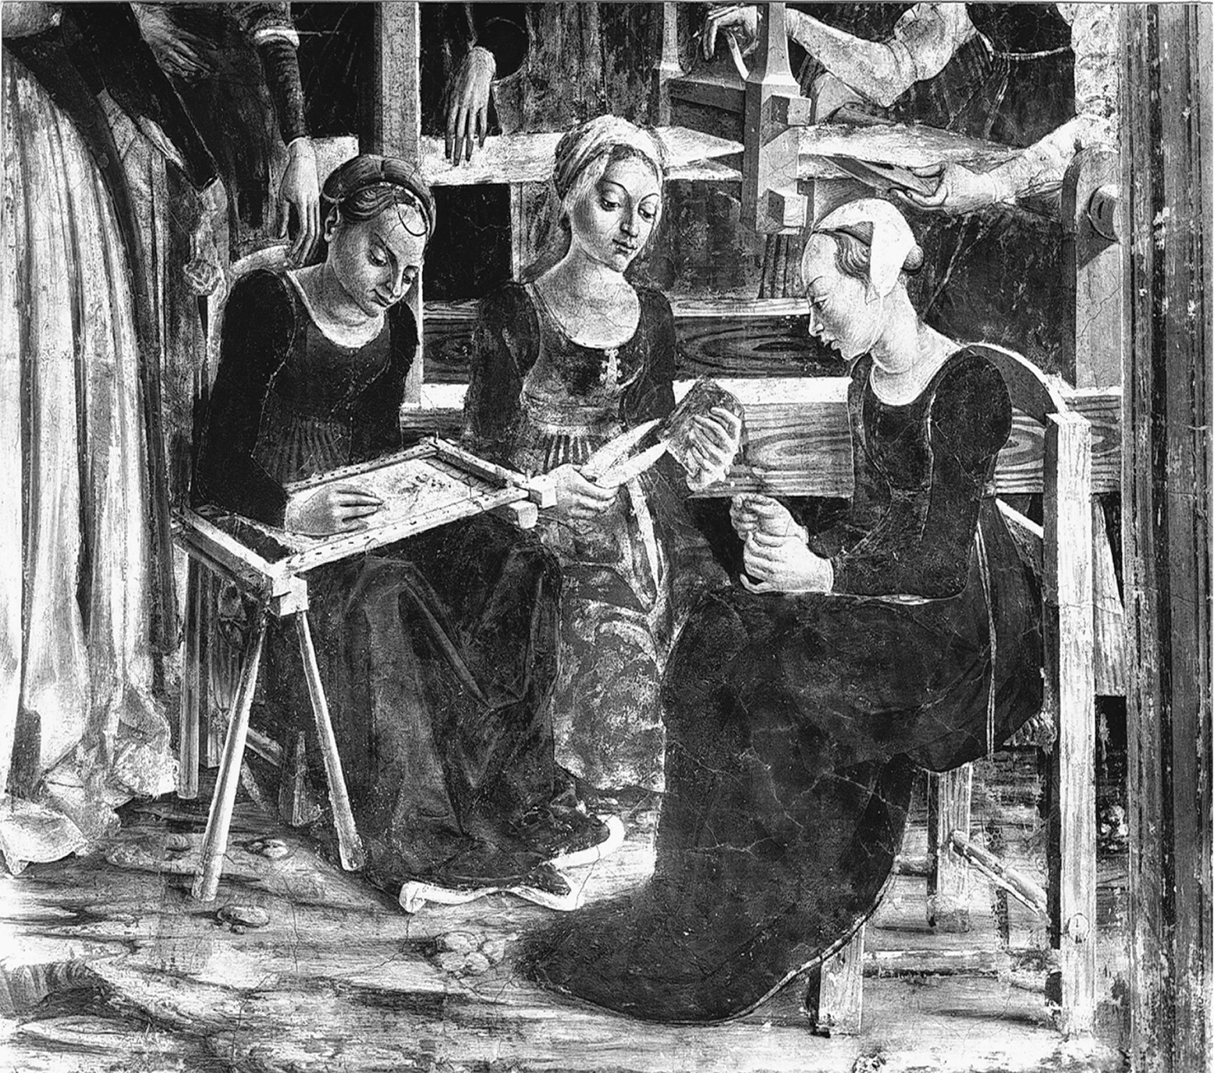
Florentine women doing needlework, spinning, and weaving. These activities took up much of a woman’s time and contributed to the elegance of dress for which Florentine men and women were famed. Palazzo Schifanoia, Ferrara. Alinari/Art Resource, NY
Notes:
Florentine women doing needlework, spinning, and weaving. These activities took up much of a woman’s time and contributed to the elegance of dress for which Florentine men and women were famed.
Palazzo Schifanoia, Ferrara. Alinari/Art Resource, NY

Slide 13
Humanism
Still debated in terms of meaning
Burckhardt - birth of modernity/un-Christian philosophy/dignity of humankind, individualism, secular
Others argue it champions Catholic Christianity, countering the pagan teaching of Aristotle & the Scholasticism that resulted
some regard it as neutral & promoting historical scholarship

Slide 14
Humanism
The scholarly study of Greek & Latin classics and the ancient Church Fathers, in hopes of reviving worthy ancient values
Advocated studia humanitatis: liberal arts study (grammar, rhetoric, poetry, history, politics, philosophy)—to celebrate the dignity of humankind & prepare for life of virtuous action

Slide 15
Humanism (cont.)
Italian humanists searched out manuscript collections, making volumes of Greek & Latin learning available to scholars
Leonardo Bruni (Florentine) was a student of Chrysoloras, a Byzantine scholar, who taught Greek scholarship to Italian humanists
He 1st gave the term humanities to learning in such a way (liberal arts)

Slide 16
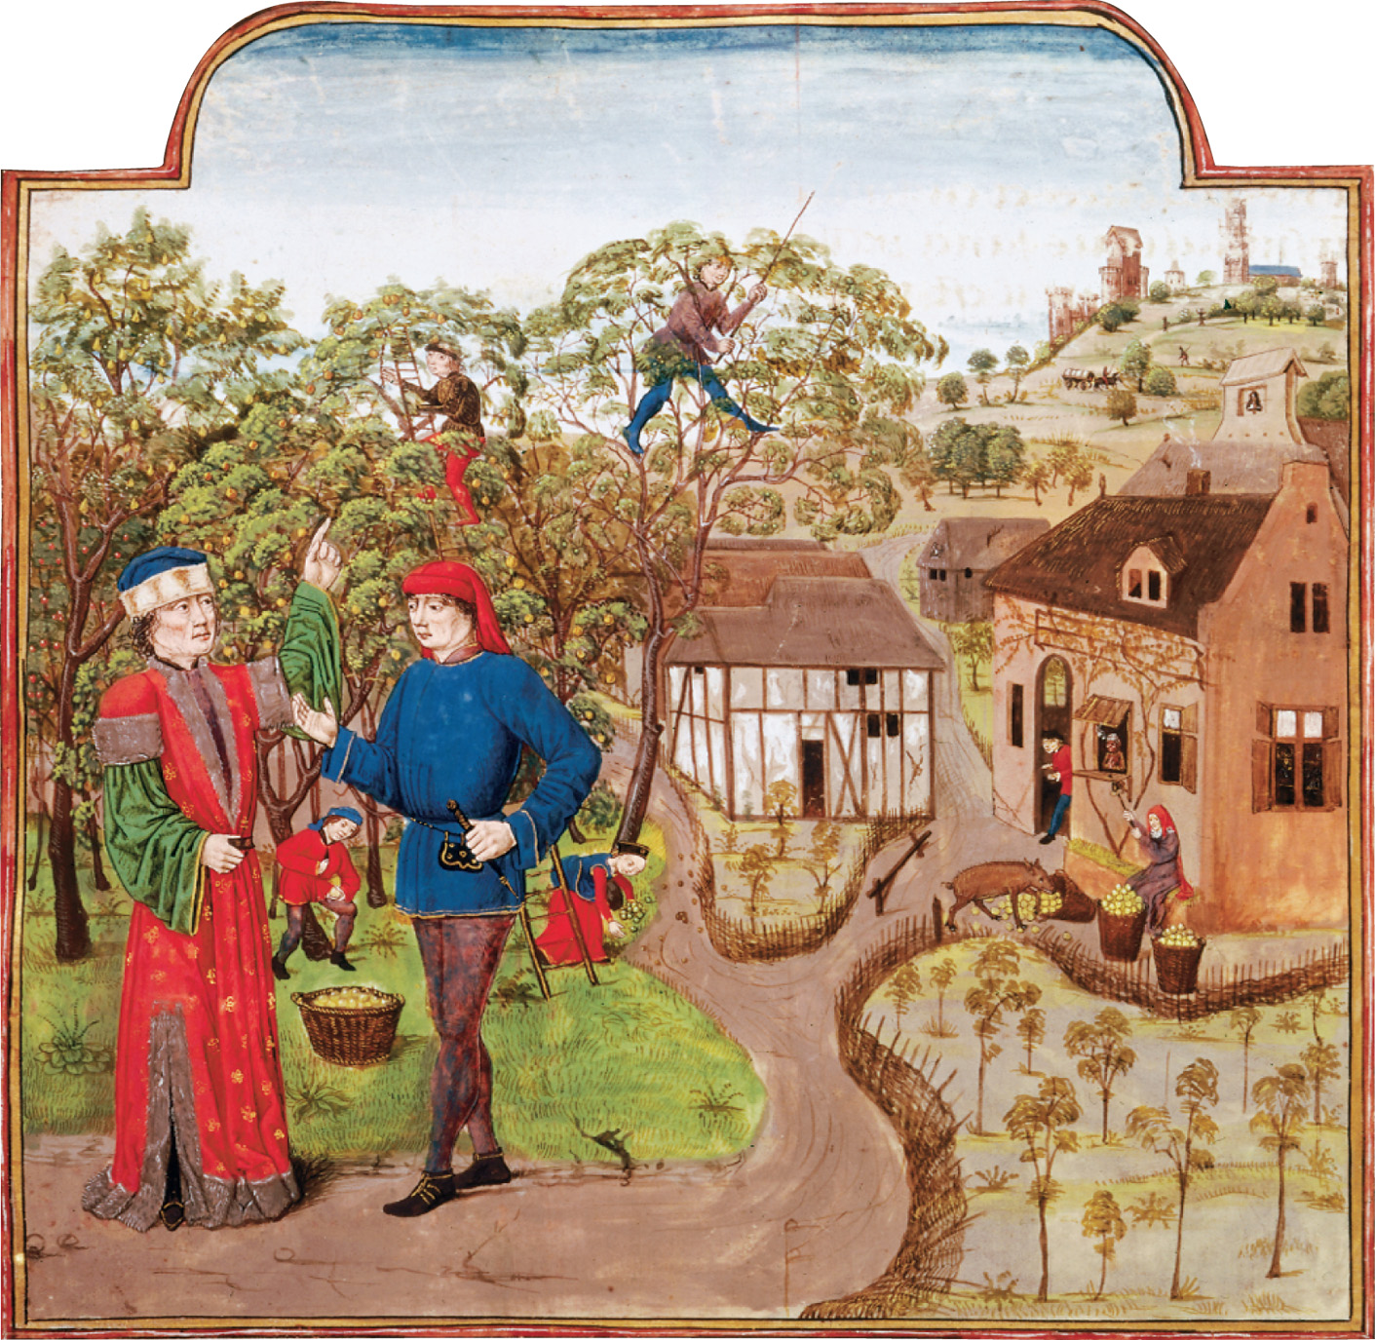
A wealthy man oversees apple picking at harvest time in a fifteenth-century French orchard. In the town below, individual house gardens can be seen. Protective fences, made of woven sticks, keep out predatory animals. In the right foreground, a boar can be seen overturning an apple barrel. The British Library
Notes:
A wealthy man oversees apple picking at harvest time in a fifteenth-century French orchard. In the town below, individual house gardens can be seen. Protective fences, made of woven sticks, keep out predatory animals. In the right foreground, a boar can be seen overturning an apple barrel.
The British Library

Slide 17
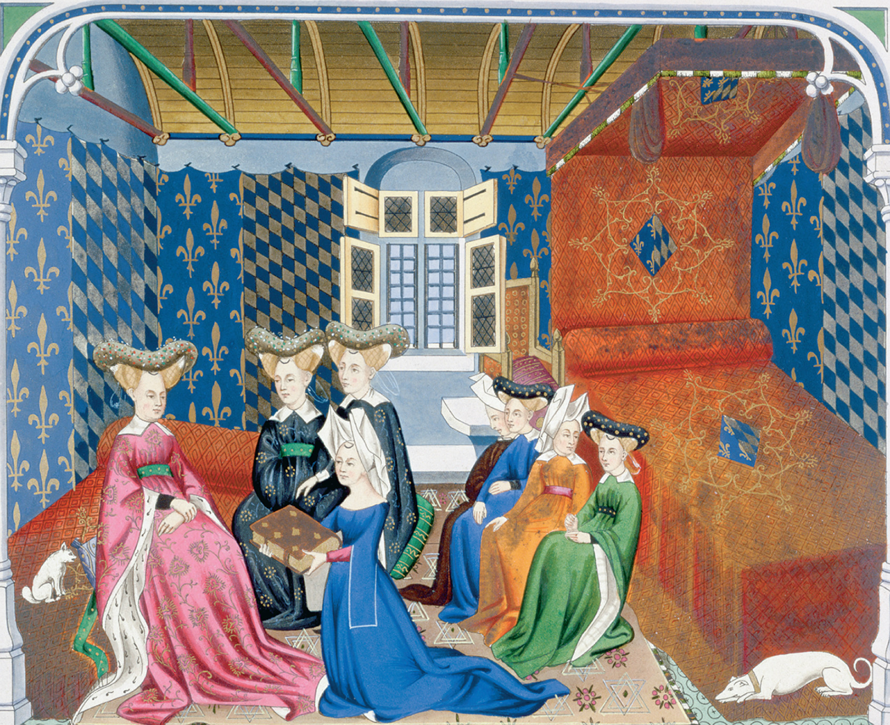
Christine de Pisan, who has the modern reputation of being the first European feminist, presents her internationally famous book The Treasure of the City of Ladies, also known as The Book of Three Virtues, to Isabella of Bavaria amid her ladies in waiting. Philip de Bay/Historical Picture Archive/Corbis
Notes:
Christine de Pisan, who has the modern reputation of being the first European feminist, presents her internationally famous book The Treasure of the City of Ladies, also known as The Book of Three Virtues, to Isabella of Bavaria amid her ladies in waiting.
Philip de Bay/Historical Picture Archive/Corbis

Slide 18
Revival of Greek Studies
1st humanists - orators & poets
original lit in both vernacular & classical languages
taught rhetoric
served as teachers but also secretaries, speechwriters, & diplomats in both princely & papal courts

Slide 19
Revival of Greek Studies
Educational reforms guided by ideals of useful education & becoming a well-rounded person
Florentine “Academy”—15th century Florence
not a formal school, but gathering of influential Florentine humanists devoted to reviving Plato & Neoplatonists: Plotinus, Proclus, Porphyry, & Dionysius the Areopagite

Slide 20
Florentine Platonic Academy
evolved under patronage of Cosimo de’ Medici & supervision of Marsilio Ficino & Pico della Mirandola
Renaissance thinkers very attracted to Platonic tradition & to the Church Fathers who tried to synthesize Platonic philosophy w/ Christianity

Slide 21
Florentine Platonic Academy(cont.)
Platonism: flattering view of human nature
distinction between the eternal sphere of being (in which reason belonged) and the real (perishable) world

Slide 22
Oration on the Dignity of Man
Pico della Mirandola
statement on nature of humankind
intended to serve as basis for public debate on all of life’s impt. issues
Humans are the only creatures possessing freedom to be whatever they choose to be (because of reason)

Slide 23
Lorenzo Valla
critic of tradition even if this was not his original tradition
authored standard text on Latin philology
good Catholic but admired by Protestants
exposed the Donation of Constantine as forgery by demonstrating the impossibility of certain words & info as existing in the 4th century
defended predestination against advocates of free will
indeed, young humanists were 1st identifiable group among Luther’s supporters

Slide 24
Revival of Greek Studies (cont.)
Study of classical & Christian antiquity had preceded Renaissance
Carolingian renaissance - 9th c.
Cathedral school of Chartres -12th c.
Aristotelian revival in Paris - 13th c.
Augustinians - early 14th c.
But the Italian Renaissance was more secular & therefore, more broad & less bound to tradition

Slide 25
Great Humanists
Francesco Petrarch - father of humanism
celebrated ancient Rome in Letters to the Ancient Dead
love sonnets, fanciful letters to Cicero, Vergil, Horace
critical textual studies, elitism, & contempt for Scholasticism shared by later humanists

Slide 26
Petrarch, Alighieri & Boccaccio
Classical & Christian values coexist uneasily in his work
more secular in his orientation than others, like Dante Alighieri who wrote Vita Nuova & Divine Comedy
Boccaccio, student of Petrarch, wrote Decameron, which is critical social commentary on sexual & economic misconduct

Slide 27
Educational Goals
celebrated taking mastery of ancient languages directly to past
made them innovative
continually looked for new sources of info & so amassed magnificent manuscript collections
goal - wisdom eloquently spoken, knowledge of the good, but also inciting desire in others to desire it

Slide 28
Educational Reforms
Roman orator, Quintilian’s Education of the Orator became classical guide for humanist revision of the traditional curriculum
Vittorino da Feltre taught his students difficult works of Pliny, Ptolemy, Plautus, & Plutarch but also made them do vigorous physical exercise
Guarino da Verona & Manuel Chrysoloras streamlined study of classical languages

Slide 29
Baldassare Castiglione
Book of the Courtier
practical guide for the nobility at the court of Urbino (small duchy in central Italy)
illustrated highest ideals of Italian humanism: integrate knowledge of ancient languages & history w/ athletic, military, & musical skills and practice good manners, & exhibit high moral character

Slide 30
Civic Humanism
basic criticism of Scholasticism was that much of its content was useless
education should promote individual virtue but also public service - civic humanism
best examples were 3 Florentian chancellors of the city: Coluccio Salutati, Leonardo Bruni, Poggio Bracciolini

Slide 31
Civic Humanism
rhetorical skills to rally Florentines against aggression of Naples & Milan
some dispute that their active civic service was due to humanism but rather their own ambitions
Toward end of Renaissance, see a divide in humanist thinkers between elite academics with no interest in social or civic life and those interested in contemporary history (ex. Machiavelli)

Slide 32
High Renaissance Art
Embraced natural world & human emotion
Works characterized by rational order, symmetry, proportionality; addition of linear perspective (3-D look)
reflected the belief in the harmony of the universe

Slide 33
High Renaissance Art (cont.)
development of new technical skills
availability of oil paints
use of shading to enhance naturalness - chiaroscuro
adjustment of size of figures i.e. linear perspective
ex. Giotto - painted a more natural world

Slide 34
High Renaissance Art (cont.)
Leonardo da Vinci (1452–1519): lived Renaissance ideal of the universal person: painter, advisor to Italian princes & the French king Francis I, engineer, physiologist, botanist, etc.; Mona Lisa

Slide 35
High Renaissance Art (cont.)
Raphael
a man of great kindness, loved and respected by his contemporaries
famous for tender madonnas, great fresco in the Vatican, & for The School of Athens

Slide 36
High Renaissance Art (cont.)
Michelangelo
melancholy genius
sculptor, David
four different popes commissioned works
frescoes in the Vatican’s Sistine Chapel are the most famous

Slide 37
High Renaissance Art (cont.)
Michelangelo’s later works reflect deep personal changes
more complex & mark passing of High Renaissance painting & advent of new style called mannerism
made room for the strange and abnormal
ex.s Tintoretto & El Greco

Slide 38
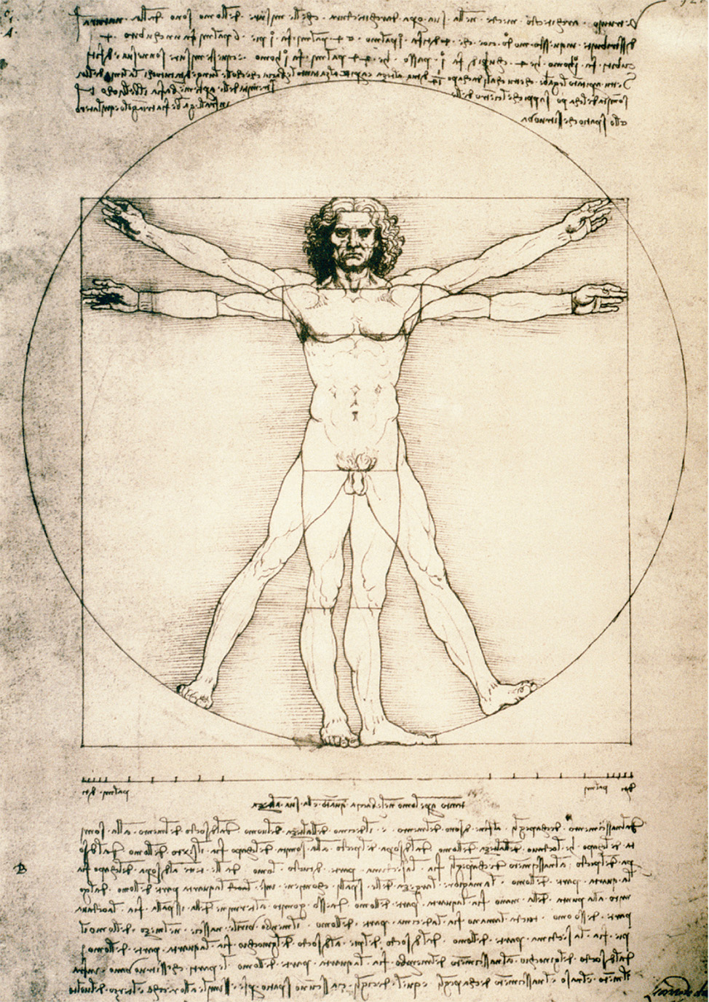
Leonardo Plots the Perfect Man Vitruvian Man by Leonardo da Vinci, c. 1490. The name “Vitruvian” is taken from that of a first-century c.e. Roman architect and engineer, Marcus Pollio Vitruvius, who used squares and circles to demonstrate the human body’s symmetry and proportionality. Vitruvius’ commentary reads counter-clockwise in three paragraphs that highlight Leonardo’s scientific portrayal. CORBIS/Bettmann
Vitruvian Man
Notes:
Leonardo Plots the Perfect Man Vitruvian Man by Leonardo da Vinci, c. 1490. The name “Vitruvian” is taken from that of a first-century c.e. Roman architect and engineer, Marcus Pollio Vitruvius, who used squares and circles to demonstrate the human body’s symmetry and proportionality. Vitruvius’ commentary reads counter-clockwise in three paragraphs that highlight Leonardo’s scientific portrayal.
CORBIS/Bettmann

Slide 39
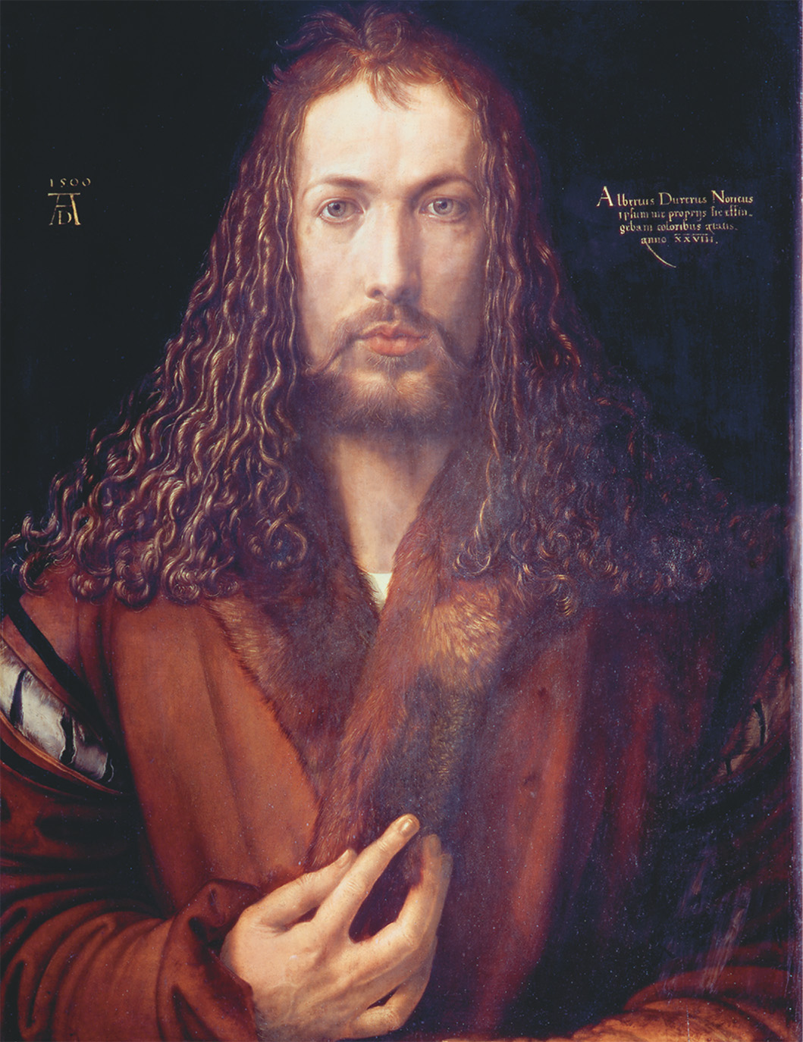
Albrecht Dürer (1471–1528). Self-portrait at Age 28 with Fur Coat. 1500 Oil on wood, 67 × 49 cm. Alte Pinakothek, Munich, Germany. Photograph © Scala/Art Resource, NY
Albrecht Durer - Self Portrait
Notes:
Albrecht Dürer (1471–1528). Self-portrait at Age 28 with Fur Coat. 1500
Oil on wood, 67 × 49 cm. Alte Pinakothek, Munich, Germany. Photograph © Scala/Art Resource, NY

Slide 40
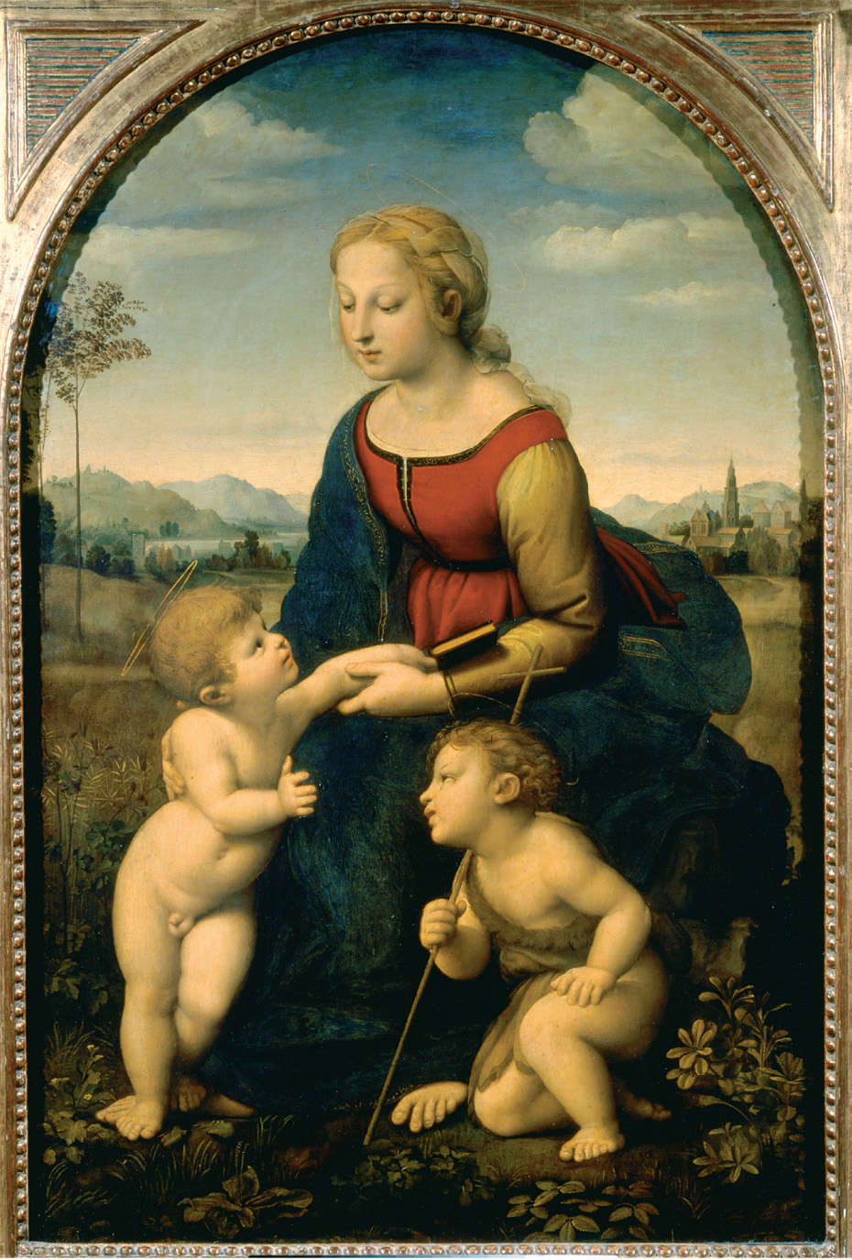
Combining the painterly qualities of all the Renaissance masters, Raphael created scenes of tender beauty and subjects sublime in both flesh and spirit. Musee du Louvre, Paris/Giraudon, Paris/SuperStock
Raphael
Notes:
Combining the painterly qualities of all the Renaissance masters, Raphael created scenes of tender beauty and subjects sublime in both flesh and spirit.
Musee du Louvre, Paris/Giraudon, Paris/SuperStock

Slide 41
Slavery in the Renaissance
Slavery flourished as extravagantly as art and culture.
Contemporaries looked on slavery as merciful as opposed to killing the captives.
After the Black Death, slavery demand soared and slaves were imported from the lands surrounding the Black Sea.

Slide 42
Slavery (cont.)
collective plantation slavery, based on East Asian models, developed in eastern Med during High Middle Ages
In Sudan & Venetian estates on islands of Cyprus & Crete, gangs of slaves cut sugarcane
Slaves imported from many places & consisted of many races

Slide 43
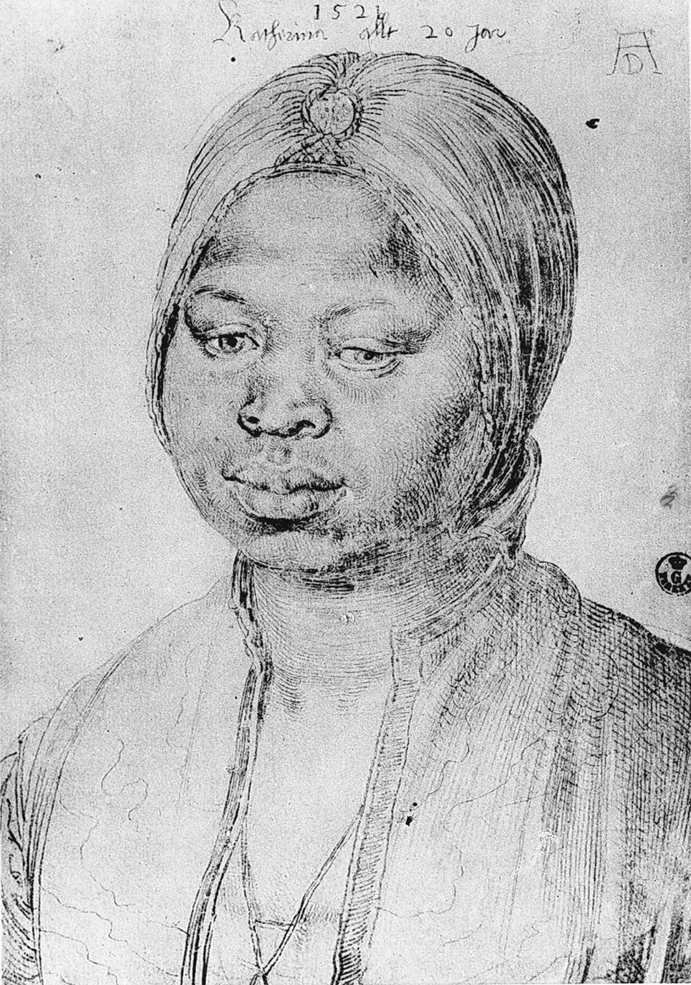
This portrait of Katharina, by Albrecht Dürer, provides evidence of African slavery in Europe during the sixteenth century. Katharina was in the service of one João Bradao, a Portuguese economic minister living in Antwerp, then the financial center of Europe. Dürer became friends with Bradao during his stay in the Low Countries in the winter of 1520–1521. Albrecht Dürer (1471–1528), Portrait of the Moorish Woman Katharina. Drawing. Uffizi Florence, Italy. Photograph © Foto Marburg/Art Resource, NY
“Katharina”
painted by
Albrecht Durer
Notes:
This portrait of Katharina, by Albrecht Dürer, provides evidence of African slavery in Europe during the sixteenth century. Katharina was in the service of one João Bradao, a Portuguese economic minister living in Antwerp, then the financial center of Europe. Dürer became friends with Bradao during his stay in the Low Countries in the winter of 1520–1521.
Albrecht Dürer (1471–1528), Portrait of the Moorish Woman Katharina. Drawing. Uffizi Florence, Italy. Photograph © Foto Marburg/Art Resource, NY

Slide 44
The French Invasions (1494–1527)
Italy’s political decline
Italy had relied on internal cooperation for its peace & safety from foreign invasion b/c a land of autonomous city states
maintained this in 2nd half of 15th century thru Treaty of Lodi
brought traditional enemies, Milan & Naples, together in alliance w/ Florence against Venice & Papal states

Slide 45
The French Invasions (1494–1527)
hostilities btwn Milan & Naples resumed after despot Ludovico il Moro rose to power in Milan
Treaty of Lodi ended when Naples, supported by Florence & Borgia pope Pope Alexander VI, threatened Milan
il Moro appealed to France for aid - fatal mistake
failed to anticipate French desire to revive dynastic claims to Milan as well as Naples

Slide 46
The French Invasions (1494–1527)
French king Charles VIII (r. 1483–1498) stormed through Italy
raced through Florence, & Papal States into Naples
as French approached Florence, the Florentine ruler Piero de Medici tried to placate Charles VIII by giving him Pisa & other Florentine possessions

Slide 47
The French Invasions (1494–1527)
As a result, Piero is exiled by the Florentines who were being revolutionized by a radical Dominican preacher, Girolamo Savonarola
Eventually, after Charles was ousted & the Italian cities were reunited, Savonarola was imprisoned & executed

Slide 48
The French Invasions (1494–1527)
In response to the French march on Italy, Ferdinand of Aragon created a new counter alliance - League of Venice
Consisted of Spain, Venice, Papal States, & Emperor Maximilian I
united against the French
set the stage for the conflict btwn Spain & France
il Moro recognized his fatal error, joined the League to end the French menace

Slide 49
Pope Alexander VI &
the Borgia Family
French returned to Italy under Louis XII (r. 1498–1515)
Louis XII allies with the corrupt Borgia pope, Alexander VI and takes Milan
Widely considered to be the most corrupt pope in history w/ passions for both gold and women

Slide 50
Pope Alexander VI &
the Borgia Family (cont.)
openly acknowledged his children
devoted to them & promoted the political careers of both Cesare & Lucrezia
used his papal policy to further his efforts in securing a political base in Romagna in north central Italy

Slide 51
Romagna
several principalities had fallen away from the church during the Avignon papacy (1309-1377)
Venice (supposed ally of the papacy in the League) continued to contest the loyalty of the Papal States
Alexander hoped to secure alliance / France to reestablish control

Slide 52
Pope Alexander VI
annulled marriage of Louis XII to the sister of Charles VIII so he could marry his widow instead, Anne of Brittany
political move to keep Brittany French
Made Louis’s favorite cleric, Archbishop of Rouen, a cardinal

Slide 53
Pope Alexander VI (cont.)
most important move was to abandon League of Venice
French reconquest of Milan
In return, Cesare Borgia married the sister of the king of Navarre, enhancing Borgia military strength
Cesare received land grants from Louis XII & promise of French support in Romagna

Slide 54
Consequences
Louis invaded Milan in August 1499
Ludovico il Moro imprisoned
Louis & Ferdinand of Aragon divided Naples btwn them
Pope & Cesare Borgia conquered cities of Romagna

Slide 55
The French Invasions (cont.)
Pope Julius II:
strong opponent of Borgia family
succeeded Alexander VI
placed Romagna under papal jurisdiction
as “warrior pope”, raised Renaissance papacy to its peak in military prowess & diplomatic intrigue

Slide 56
Pope Julius II
thoroughly secular papacy shocked many contemporaries, including Erasmus
Julius Excluded from Heaven
satire portraying the pope appealing to St. Peter for admission to heaven
http://www.history.ucsb.edu/faculty/lansing/classes/hist4b/materials/Week7.pdf

Slide 57
Pope Julius II
successfully drove the Venetians out of Romagna
fully secured the Papal states
2nd goal was to drive the French out of Italy
Julius, Ferdinand, & Venice formed a 2nd Holy League in 1511
joined by Emperor Maximilian I & the Swiss

Slide 58
The French Invasions (cont.)
invaded Italy a third time under Francis I (r. 1515–1547)
massacred Swiss soldiers of the Holy League at Marignano
Concordat of Bologna - agreement from the pope
giving French king control over French clergy
France recognized pope’s superiority over church councils & right to collect annates in France

Slide 59
Results of Concordat of Bologna
kept France Catholic after outbreak Protestant Reformation
set the stage for the first of 4 major wars w/ Spain: the Habsburg-Valois Wars - none of which France won

Slide 60
Niccolò Machiavelli (1469–1527)
Convinced by chaos of foreign invasions that Italian political unity & independence were ends justifying any means
Concluded only a strongman could impose order on a divided & selfish people (Italians)
Note that this same period was a cultural peak

Slide 61
Niccolò Machiavelli (cont.)
Humanist & student of ancient Rome
lamented the absence of patriotism & self-sacrifice of the Romans in his fellow Italian citizens
Virtù: ability to act heroically & decisively for the good of one’s country
The Prince (1513): recommends temporary use of fraud & brutality to achieve Italian unity; hoped for strong ruler from the Medici family
dedicated to Lorenzo, duke of Urbio

Slide 62
Niccolò Machiavelli (cont.)
criticized for exaggerating both Roman virtue & contemporary failings
held Republican ideals but…
desired a reunited Italy by any means necessary

Slide 63
Niccolò Machiavelli (cont.)
Some argue that The Prince is actually a cynical satire on the way rulers do behave & not a serious recommendation of unprincipled despotic rule
contradicts earlier works & his family tradition of republican service

Slide 64
Niccolò Machiavelli (cont.)
the other argument is that it seems an earnest advisement to rulers that brutality as a temporary means to a higher end of reuniting Italy is justified
desired to see a strong ruler emerge from the Medici family which had captured the papacy in 1513 - Pope Leo X
admired Cesare Borgia & Pope Alexander VI

Slide 65
Niccolò Machiavelli (cont.)
Medici family retained control over powerful territorial state of Florence
The Prince pointedly dedicated to Lorenzo de’ Medici, duke of Urbino & grandson of Lorenzo the Magnificent
Medicis not destined to be the deliverer of Italy during the papacy of the Medici pope Clement VII
Machiavelli died same year Emperor Charles V sacked Rome

Slide 66
Revival of Monarchy -
Northern Europe
After 1450, shift from divided feudal monarchies ➔ unified national monarchies
Dynastic ideals persisted & territorial princes remained
Evolving representative bodies
Rise of towns, alliance of growing business classes with kings—broke bonds of feudal society & led to sovereign states

Slide 67
Revival of Monarchy (cont.)
The sovereign state: powers of taxation, war making, law enforcement no longer resided with semiautonomous vassals, but with monarch & royal agents; taxes, wars, laws became national rather than regional matters

Slide 68
Revival of Monarchy (cont.)
Overcoming the decentralization that impeded nation-building depended on the strength of the monarch
Ferdinand & Isabella rarely called Cortes into session
Estates General met irregularly; usually in crisis
Henry VII managed to raise revenues w/out Parliament

Slide 69
Revival of Monarchy (cont.)
Political theorists of the time reflected the emphatic defense of sovereign rights of the monarchy
Marsilius of Padua- 14th century
Machiavelli - 15th century
Jean Bodin - 16th century

Slide 70
Revival of Monarchy (cont.)
Monarchs in last half of the 15th c demonstrated increasingly that law was of their making; civil servant appointment
Castile - corregidores
England - justices of the peace
France - bailiffs thru lieutenants
Royal ministers closely attached to their region but outlook was now to the state

Slide 71
Revival of Monarchy (cont.)
Monarchs began to create standing armies in 15th century
infantry & artillery replaced noble cavalry
Mercenaries recruited from Switzerland & Germany to form major part of king’s army
More efficient but risk of mutiny & banditry if payroll not met

Slide 72
Revival of Monarchy (cont.)
Increasing cost of warfare in 15th & 16th century
Greatest obstacle to raising needed revenue came from highest social classes; immune from taxation
Considered to be insulting

Slide 73
Revival of Monarchy (cont.)
Monarchs had options for revenue:
collect rents from royal domains
levy nat’l taxes on food & clothing
French gabelle (salt tax) & Spain’s alcabala (10% sales tax) on commercial transactions
levy direct taxes on peasantry; ex. taille
fundraising thru sale of public offices, issuance of high-interest gov’t bonds; borrow

Slide 74
Revival of Monarchy (France)
France: two cornerstones in 15th-c. nation-building:
Collapse of English Empire in France after Hundred Years’ War, 1453
Charles VII created a permanent professional army
Defeat of Charles the Bold of Burgundy, 1477—perhaps strongest political power in Europe at the time
Louis XI & Maximilian I divided the conquered lands; Louis almost doubled the size of France

Slide 75
Revival of Monarchy (France)
Louis XI:
harnessed the nobility
expanded trade & industry set. by merchant banker Jacques Coeur; developed strong economy, diplomatic corps, & nat’s admin.
created national postal system
established lucrative silk industry

Slide 76
Revival of Monarchy (France)
Furture monarchs inherited a strong nation & pursued bad foreign policy
Conquests in Italy in 1490s & losing wars w/ Hapsburgs in 1st half of 16th century
left France a defeated nation by mid 16th century

Slide 77
Revival of Monarchy (Spain)
Spain: 1469 marriage of Isabella of Castile & Ferdinand of Aragon
Together secured borders, ventured abroad militarily, Christianized Spain
Brought Spanish church under state control, ended toleration of Jews & Muslims
Castile - more populous, lucrative sheep-farming industry run by the Mesta; centralized econ. planning
Sponsored Christopher Columbus, leading to Spanish Empire in Mexico & Peru, helping make Spain the dominant European power in 16th c.

Slide 78
Revival of Monarchy (Spain)
Between 1482 & 1492, conquered Moors in Granada
Naples became Spanish possession - 1504
Conquered Navarre, securing northern borders in 1512
Limited power of nobility
won allegiance of Hermandad, a league of cities & towns

Slide 79
Revival of Monarchy (Spain)
Long been a nation of 3 religions, Judaism, Islam, Christianity
Isabella & Ferdinand exercised total control over the church & made Spain prime ex. of state-controlled religion
appointed higher clergy & officers of the Inquisition; run by Tomas de Torquemada
monitored activity of converted Jews (conversos) & Muslims (Moriscos)

Slide 80
Revival of Monarchy (Spain)
1492 - exiled Jews & confiscated properties
1502 - exiled nonconverting Muslims in Granada (Cardinal Francisco Jimenez de Cisneros
Spain remained loyal Catholic country thru 16th century & remained secure base of operation during European Counter-Reformation

Slide 81
Revival of Monarchy (Spain)
contracted anti-French marriage alliances that determined European history to come
marriage btwn daugher Joanna & Archduke Philip produced Charles I (1st to rule over united Spain)
marriage btwn daughter Catherine of Aragon and Henry VIII - key event in emergence of Anglican church & English Reformation

Slide 82
Revival of Monarchy (Spain)
Ferdinand & Isabella promoted overseas expansion
sponsored Genoese adventurer Christopher Columbus
patronage led to creation of Spanish empire in Mexico & Peru & gold & silver mining that led to Spanish dominance in 16th century

Slide 83
Revival of Monarchy (England)
England went through difficulty in latter half of 15th century
Civil warfare - Turmoil of Wars of the Roses, 1455–1485 (Lancaster vs. York)
Duke of York & supporters in prosperous southern towns challenged Lancastrian monarchy of Henry VI (1422-1461)
1461-1483, Edward IV son of duke of York, seized power & established rule for more than 20 years
brief interruption by Henry VI’s restoration (1470-1)
Edward increased power & finances of monarchy
Edward’s brother Richard III usurped power from Edward’s son

Slide 84
Revival of Monarchy (England)
Shakespeare’s Richard III portrays Richard III as the unprincipled villain that murders Edward’s sons in Tower of London
exiled Lancastrian Henry Tudor returned to England to unseat Richard III
1485 Battle of Bosworth Field seats Henry VII, first Tudor monarch
Henry VII, 1st of new Tudor dynasty that dominated thru 16th century
married Edward IV’s daughter Elizabeth of York

Slide 85
Revival of Monarchy (England)
brought English nobility in line by creating the Court of Star Chamber
king’s councilors sat as judges; not swayed by intimidation or bribery of powerful nobles
more equitable court system
court more amenable to royal will
Henry VII shrewdly confiscated lands & fortunes of nobles; not dependent on Parliament for royal funds - cornerstone of strong monarchy

Slide 86
Revival of Monarchy
(Holy Roman Empire)
Holy Roman Empire: Germany & Italy exceptions to 15th-c. politically centralizing trend
The many (princes) fought off the one (emperor)
Germany - territorial rulers & cities resisted every effort at consolidation & unity
kingdoms partitioned among sons; Divided into some 300 autonomous entities

Slide 87
Revival of Monarchy (HRE)
1356 Golden Bull agreement btwn Emperor Charles IV & major territorial rulers:
established seven-member electoral college
functioned as administrative body
elected emperor & provided some transregional unity; imperial Reichstag created

Slide 88
Revival of Monarchy (HRE)
Reichstag was created to control incessant feuding
nat’l assembly of the 7 electors, the non electoral princes, & reps from 65 imperial free cities
cities were the weakest
Worms-1495; members won an imperial ban on private warfare, creation of Supreme Court of Justice to enforce internal peace, & imperial Council of Regency to coordinate an imperial & internal German policy

Slide 89
Revival of Monarchy (HRE)
reforms remained poor substitute for true national unity
16th & 17th centuries - territorial princes became virtually sovereign
disunity aided religious dissent & conflict
ripe for Protestant Reformation

Slide 90
The Northern Renaissance
Northern humanists: more interested than Italians in religious reform & educating laity
Printing press with movable type: Johann Gutenberg, Mainz, mid-15th c.
Precursors: rise of schools & literacy (demand for books); invention of cheap paper

Slide 91
The Northern Renaissance (cont.)
Printing press with movable type: Johann Gutenberg, Mainz, mid-15th c.
By 1500, printing presses running in more than 200 cities in Europe
Rulers in church & state now had to deal with more educated, critical public; also powerful tool of religious/political propaganda

Slide 92
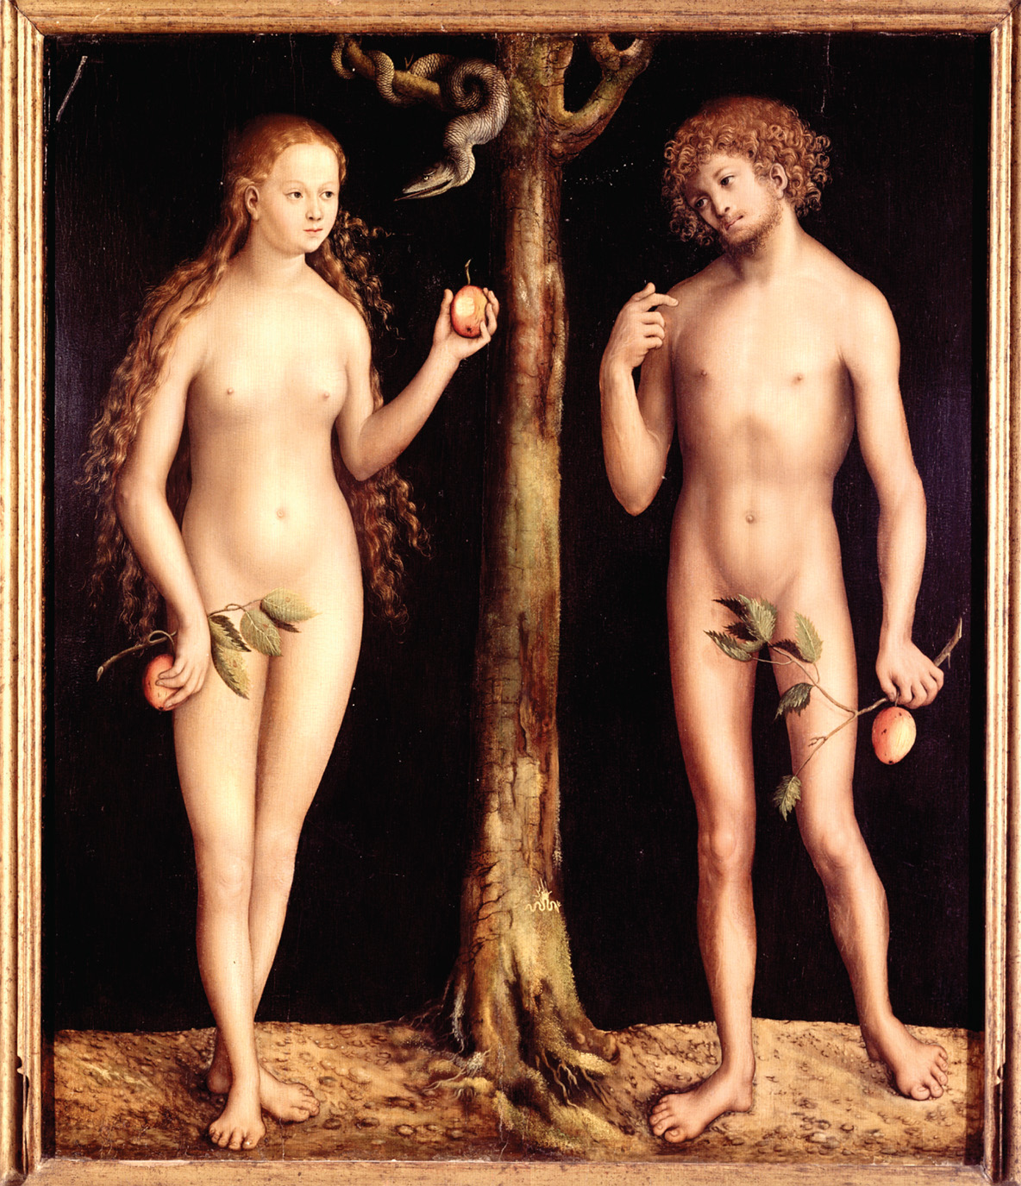
Lucas Cranach the Elder, Adam and Eve, 1513–1515. Compare Lucas Cranach, the Elder’s rendering of Adam and Eve with the nude body depicted in Leonardo’s Vitruvian Man (see page 297). Which of these images is truer to real life? © INTERFOTO/Alamy
Notes:
Lucas Cranach the Elder, Adam and Eve, 1513–1515. Compare Lucas Cranach, the Elder’s rendering of Adam and Eve with the nude body depicted in Leonardo’s Vitruvian Man (see page 297). Which of these images is truer to real life?
© INTERFOTO/Alamy

Slide 93
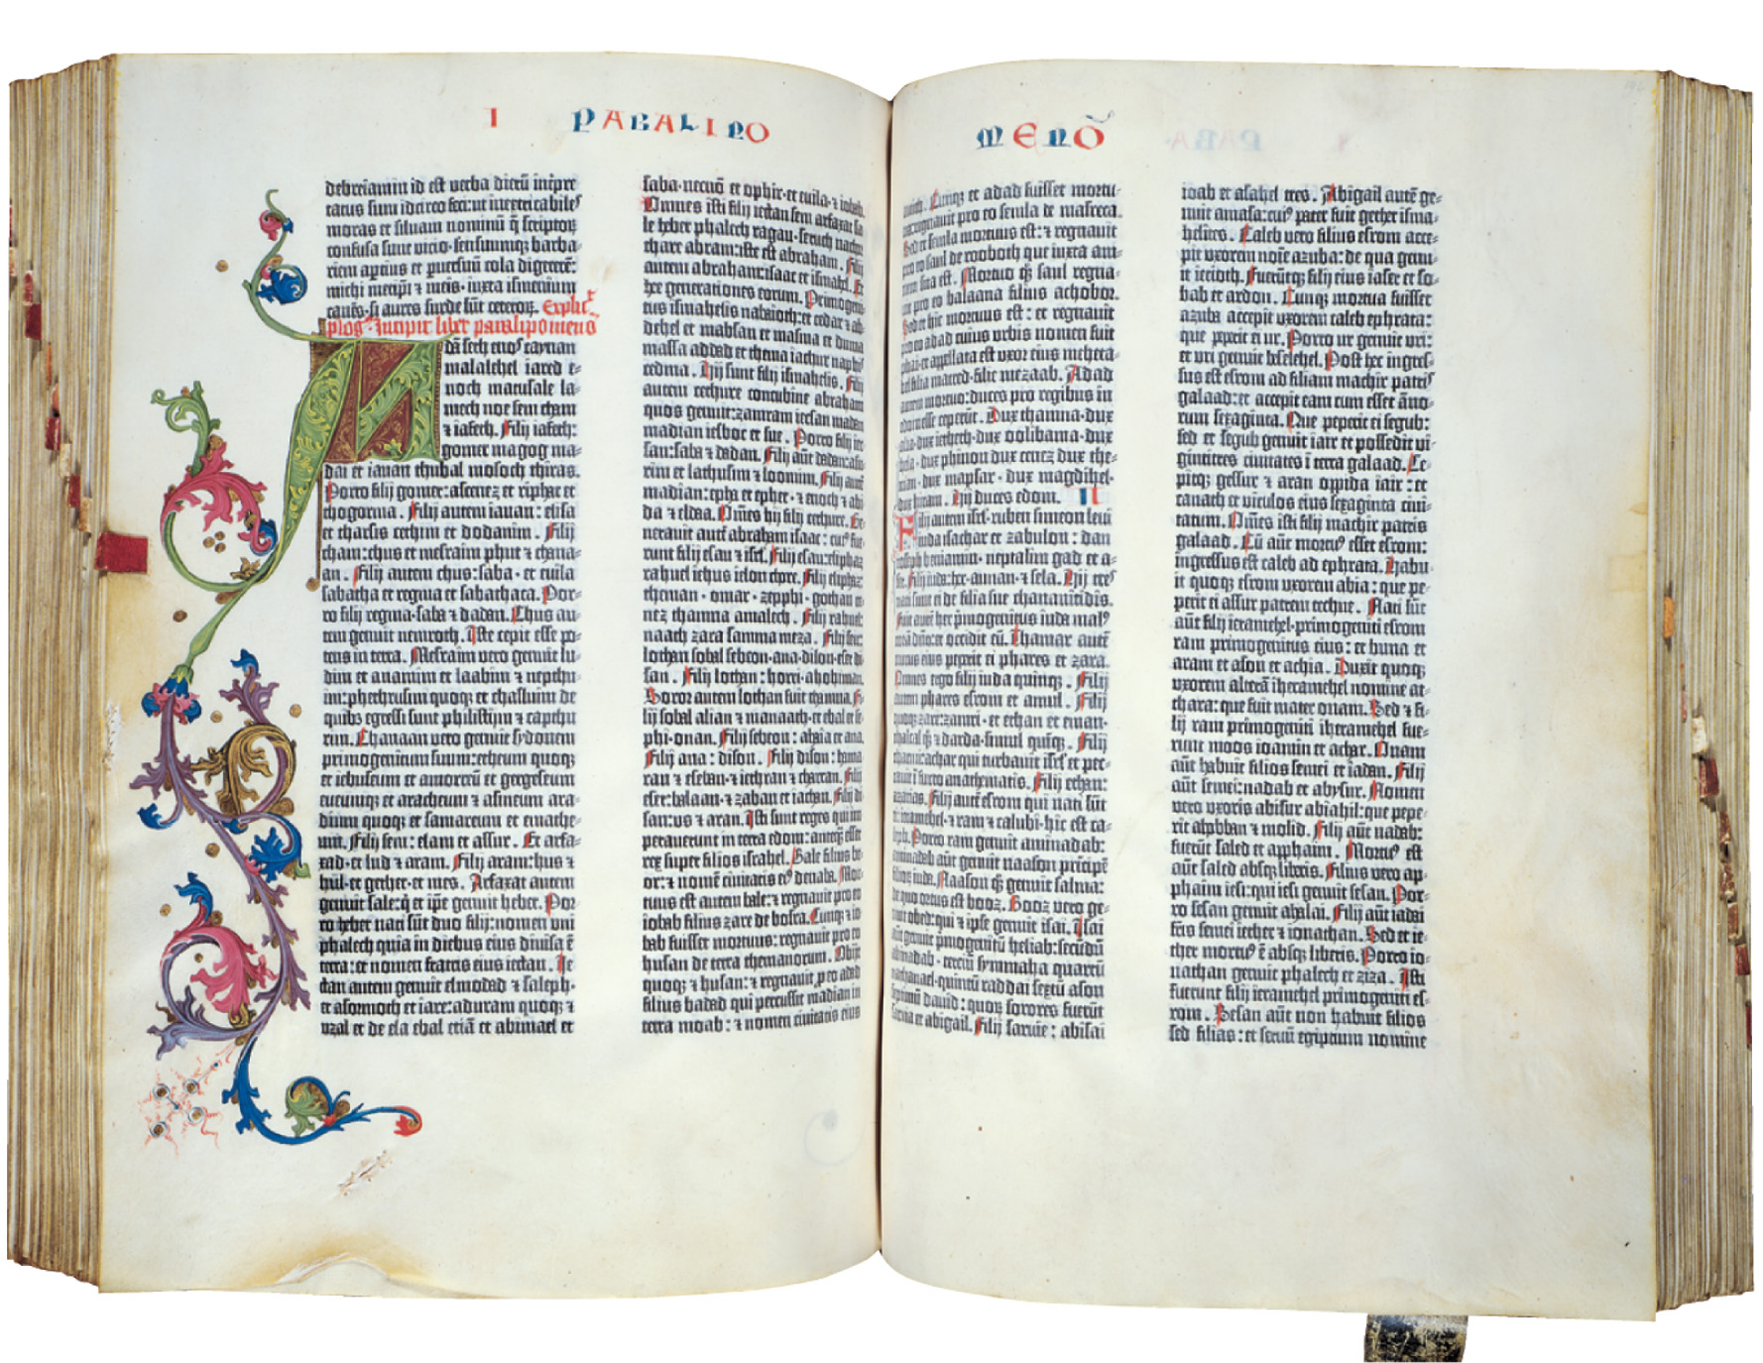
The printing press made possible the diffusion of Renaissance learning, but no book stimulated thought more at this time than did the Bible. With Gutenberg’s publication of a printed Bible in 1454, scholars gained access to a dependable, standardized text, so Scripture could be discussed and debated as never before. Reproduced by permission of The Huntington Library, San Marino, California
Notes:
The printing press made possible the diffusion of Renaissance learning, but no book stimulated thought more at this time than did the Bible. With Gutenberg’s publication of a printed Bible in 1454, scholars gained access to a dependable, standardized text, so Scripture could be discussed and debated as never before.
Reproduced by permission of The Huntington Library, San Marino, California

Slide 94
Humanism & Reform
Catholic humanist reformers pave the way for Protestantism
Desiderius Erasmus (1466–1536): most famous northern humanist; Catholic educational & religious reformer
Germany: Reuchlin controversy—humanists defend Christian scholar of Judaism on grounds of academic freedom

Slide 95
Humanism & Reform
England: Thomas More (1478–1535), best-known English humanist; Utopia (1516)
France: Guillaume Budé, Jacques Lefèvre
Spain: humanism in service of Catholic Church; Francisco Jiménez de Cisneros: Grand Inquisitor, founder of University of Alcalá, biblical scholar

Slide 96
Exploration & Empire, East & West
Portuguese: exploration of African coast, leading to sea-route around Africa to Asian spice markets; African slave trade
Bartholomew Dias: rounded Cape of Good Hope
Vasco de Gama: reached India
Columbus, 1492: thought Cuba was Japan & South America China

Slide 97
Exploration & Empire, East & West (cont.)
Amerigo Vespucci, 1497: explored South American coastline
Ferdinand Magellan (d. 1521), 1519–1522: first circumnavigation

Slide 98
Exploration & Empire, East & West (cont.)
Consequences: 300+ years of overseas Spanish empire; Europe’s largest and longest-lived trading bloc; biological impact of exchanging plant & animal species, diseases; Native American devastation

Slide 99
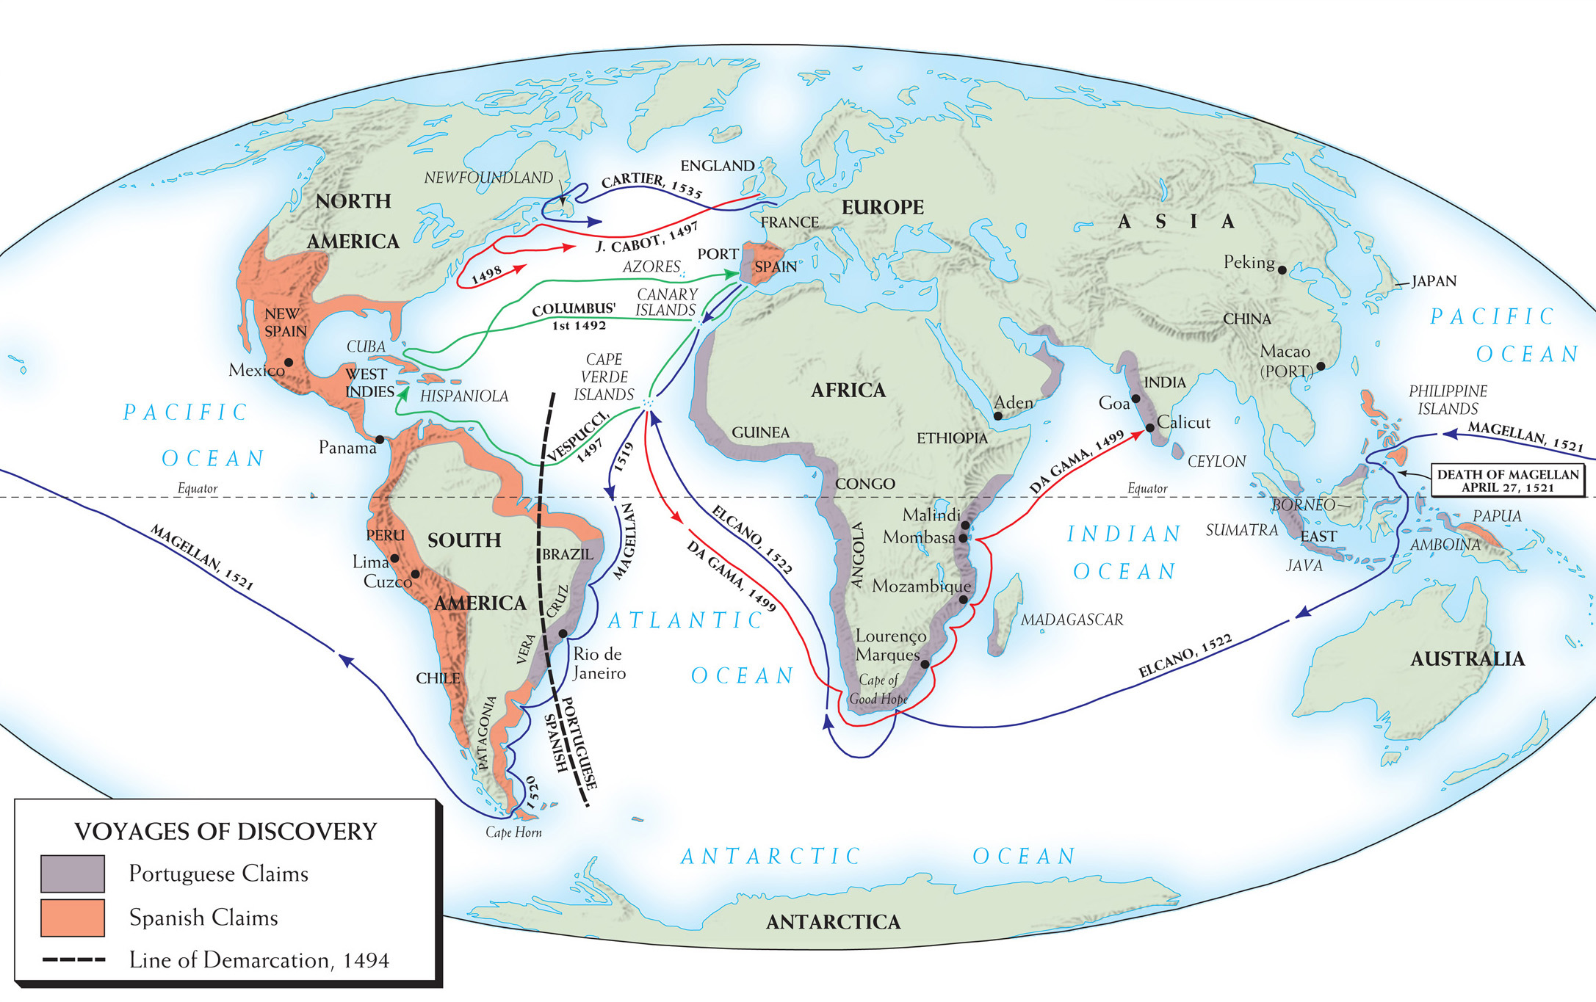
Map 10–2 EUROPEAN VOYAGES OF DISCOVERY AND THE COLONIAL CLAIMS OF SPAIN AND PORTUGAL IN THE FIFTEENTH AND SIXTEENTH CENTURIES The map dramatizes Europe’s global expansion in the fifteenth and sixteenth centuries.
Notes:
Map 10–2 EUROPEAN VOYAGES OF DISCOVERY AND THE COLONIAL CLAIMS OF SPAIN AND PORTUGAL IN THE FIFTEENTH AND SIXTEENTH CENTURIES The map dramatizes Europe’s global expansion in the fifteenth and sixteenth centuries.

Slide 100
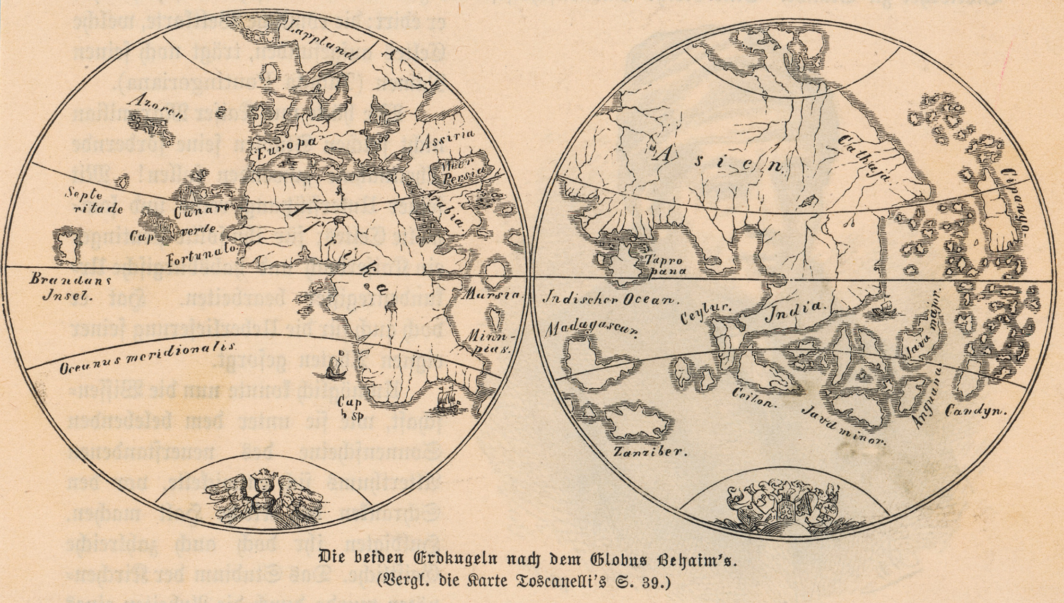
What Columbus knew of the world in 1492 was contained in a map by Nuremberg geographer Martin Behaim, creator of the first spherical globe of the earth. Departing the Canary Islands, Columbus expected his first major landfall to be Japan. When he landed at San Salvador, he thought he was on the outer island of Japan. Thus, when he arrived in Cuba, he thought he was in Japan. © Mary Evans Picture Library/Alamy
Notes:
What Columbus knew of the world in 1492 was contained in a map by Nuremberg geographer Martin Behaim, creator of the first spherical globe of the earth. Departing the Canary Islands, Columbus expected his first major landfall to be Japan. When he landed at San Salvador, he thought he was on the outer island of Japan. Thus, when he arrived in Cuba, he thought he was in Japan.
© Mary Evans Picture Library/Alamy

Slide 101
Spanish Empire in the New World
The Aztecs of Mexico – group of Native Americans who ruled all of central Mexico
Believed in human sacrifice
Hernan Cortes – Spanish conqueror of the Aztecs – at first attempted to make peace with the Aztecs, then was defeated by the Aztecs, and then eventually turned around and conquered them
Aztec leader Moctezuma was killed

Slide 102
Spanish Empire in the New World (cont.)
The Incas of Peru – large Native American empire in Western South America conquered by Francisco Pizarro who executed their leader Atahualpa – later the Europeans spread horrible diseases to the Native Americans

Slide 103
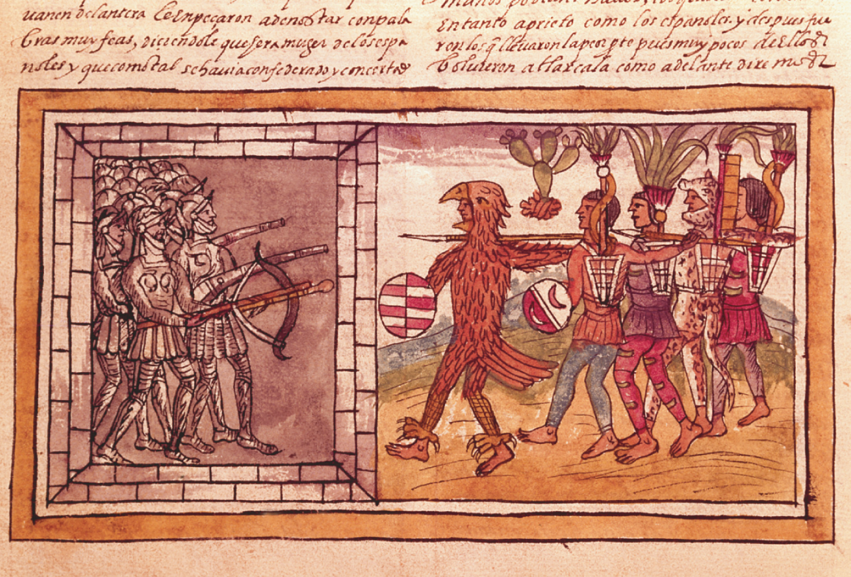
Armored Spanish soldiers, under the command of Pedro de Alvarado (d. 1541) and bearing crossbows, engage unprotected and crudely armed Aztecs, who are nonetheless portrayed as larger than life by Spanish artist Diego Duran (sixteenth century). Codex Duran: Pedro de Alvarado (c. 1485–1541), companion-at-arms of Hernando Cortés (1845–1547) besieged by Aztec warriors (vellum) by Diego Duran (16th century), Codex Duran, Historia De Las Indias (16th century). Biblioteca Nacional, Madrid, Spain. The Bridgeman Art Library International Ltd.
Notes:
Armored Spanish soldiers, under the command of Pedro de Alvarado (d. 1541) and bearing crossbows, engage unprotected and crudely armed Aztecs, who are nonetheless portrayed as larger than life by Spanish artist Diego Duran (sixteenth century).
Codex Duran: Pedro de Alvarado (c. 1485–1541), companion-at-arms of Hernando Cortés (1845–1547) besieged by Aztec warriors (vellum) by Diego Duran (16th century), Codex Duran, Historia De Las Indias (16th century). Biblioteca Nacional, Madrid, Spain. The Bridgeman Art Library International Ltd.

Slide 104
The Church in Spanish America
The conquerors wanted to convert the captured native people to Christianity and to accept European culture
Some religious leaders felt the natives were being treated poorly, such as Bartolome de Las Casas

Slide 105
The Church in Spanish America (cont.)
Despite the opposition, the Roman Catholic Church becomes one of the most powerful conservative forces in Latin America

Slide 106
Latin America Exploitation
Mining – the Spanish conquistadores or conquerors mined gold and silver with forced labor

Slide 107
Latin America Exploitation (cont.)
Agriculture – on haciendas, large land estates owned by the peninsulares (people born in Spain) and creoles (people of Spanish descent born in America) used forced labor for mining, farming and ranching
Plantations in the West Indies used slaves to process sugar

Slide 108
Latin America Exploitation (cont.)
Economic activity in government offices, the legal profession, and shipping
Labor servitude in order of appearance:
Encomienda – a formal grant of the right to the labor of a specific number of Indians

Slide 109
Latin America Exploitation (cont.)
Labor servitude in order of appearance:
Repartimiento – required adult male Indians to devote a certain number of days of labor annually to Spanish economic enterprises
Debt peonage – Indian laborers required to purchase goods from the landowner to whom they were forever indebted
Black slavery

Slide 110
Impact in Europe
At first condemned for the treatment of the native populations, Columbus and other explorers are hailed 300 years later for opening up the world to new civilizations
Influx of spices and precious metals increases inflation in Europe

Slide 111
Impact in Europe (cont.)
New wealth, however, increased the expansion of printing, shipping, mining, textile, and weapons industries

