Slide 1
Chapter 11
The Age of Reformation

Slide 2
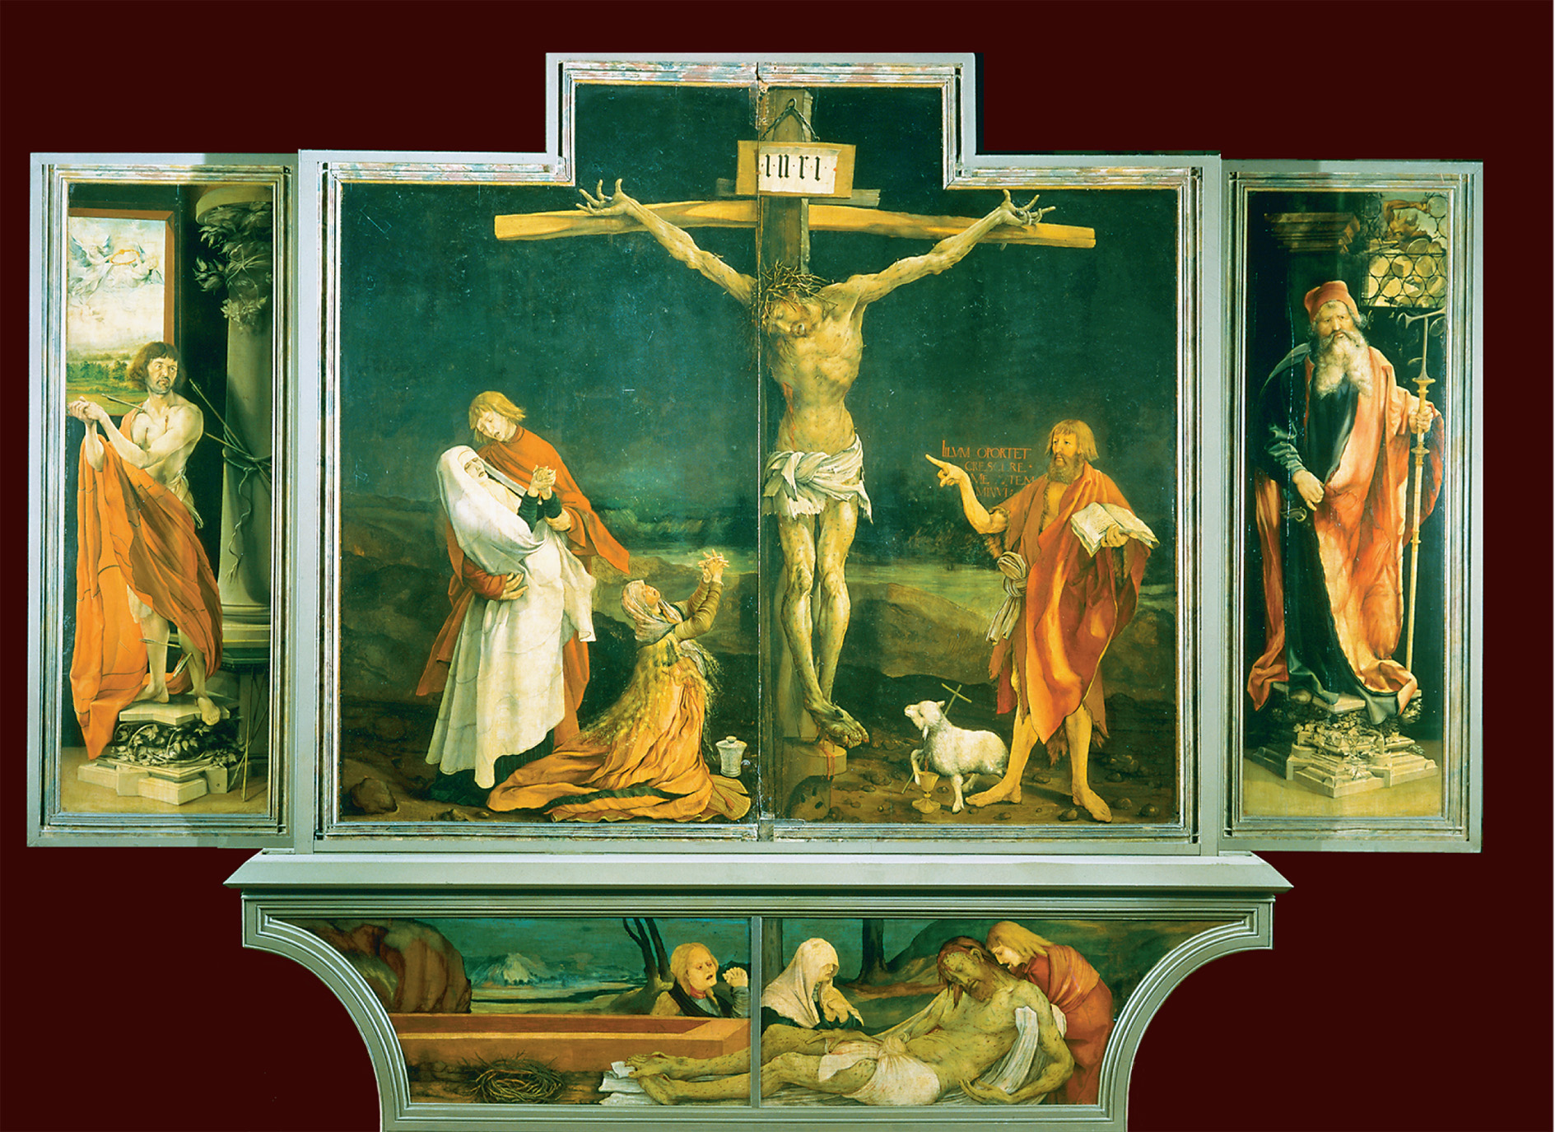
Painted on the eve of the Reformation, Matthias Grunewald’s (ca. 1480–1528) Crucifixion shows a Christ who takes all the sins of the world into his own body, as his mother, Mary Magdalene, and John the Baptist share the pain of his afflictions. Musée Unterlinden, Colmar, France/The Art Archive/SuperStock
Matthias Grunewald
Notes:
Painted on the eve of the Reformation, Matthias Grunewald’s (ca. 1480–1528) Crucifixion shows a Christ who takes all the sins of the world into his own body, as his mother, Mary Magdalene, and John the Baptist share the pain of his afflictions.
Musée Unterlinden, Colmar, France/The Art Archive/SuperStock

Slide 3
Society and Religion
Social and political conflict
Reformation occurred at a time of sharp conflict btwn emerging nation-states & self-governing towns & villages
The Reformation first broke out in the free imperial cities in Germany and Switzerland.
Lutheran & Zwinglian Protestantism was visible in future movements

Slide 4
Society and Religion
Deep social & political divisions:
groups favoring Reformation:
guilds whose members were economically prospering & socially rising
printer’s guild is an example
members literate & sophisticated
rapidly growing industry

Slide 5
Society and Religion
Economic stake as well as sincere belief
guilds had history of opposition to reigning gov’tal authority
dissatisfaction w/ local or distant authority, guild by an aristocratic local gov’t,or city or region by powerful prince/king

Slide 6
Society and Religion
Influenced religious & political change in town & countryside
townspeople facing incorporation into territory of powerful local prince chafed at being looked at as subjects not free citizens
Luther encouraged scorn of authority of ecclesiastical landlords
ridiculed papal laws as arbitrary

Slide 7
Popular Religious Movements and Criticism of the Church
Reformation could not have happened without the earlier challenges to the medieval Church’s authority:
Avignon papacy - the period of Church history from 1308 to 1378 when the popes lived and ruled in Avignon, France instead of in Rome
The Great Schism - a period of division in the Roman Catholic Church, 1378-1417, over papal succession, during which there were two, or sometimes three, claimants to the papal office
The Conciliar Period - The belief that the Catholic Church should be led by councils of cardinals rather than popes.
The Renaissance papacy

Slide 8
Criticism of the Church
Lay criticism of the church was growing
Many sought a more egalitarian church
many intellectuls & lay people felt sense of spiritual crisis
Diet of Worms (1521) German nobility presented emperor w/ list of 102 church burdens & abuses

Slide 9
Criticism (cont)
Factors contributing to growing lay criticism:
urban laypeople increasingly aware of world around them & how rulers controlled lives
widely traveled (soldiers, pilgrims, explorers, traders)
new postal systems & printing press
new age of books & libraries
increase in literacy

Slide 10
Criticism (cont)
Shared common goal of religious simplicity & imitiation of Jesus
Albigensians, Waldensians, Beguines, Beghards - 13th century
Lollards & Hussites - 15th century
inspired by ideals of apostolic poverty in religion
sought more egalitarian church

Slide 11
Modern Devotion
Modern Devotion refers to Brothers of the Common Life
kind of boarding school for reform-minded laity
lay religious life of prayer & study
Centered at Zwolle & Deventer (Netherlands)
brother & less numerous sister houses spread through N. Europe & influenced parts of S. Europe

Slide 12
Modern Devotion
Brothers were also educators
worked as copyists
sponsored religious publications
ran hospices & conducted schools (esp those preparing for priesthood or monastic vocation)
exs. Nicholas of Cusa, Hebraist Johannes Reuchlin, Erasmus (formed his own philosophy of Christ)

Slide 13
Modern Devotion
Thomas A Kempis summarized philosophy of brothers in most popular religious book of the period Imitation of Christ - primarily intended for monks & nuns but widely read by laity
Modern Devotion seen as the source of humanist, Protestant & Catholic reform movements in 16th century
criticized by others as having individualized approach to religion - indifferent & hostile to sacramental piety & papal loyalty

Slide 14
Modern Devotion
conservative movement that retained clerical doctrines & values but placed them within new framework of active & common life
increased demand for good preaching in the vernacular

Slide 15
Lay Control Over Religious Life (cont.)
Rome’s int’l network of church offices in disarray
Other factors contributing to collapse:
growing regional identity
increasingly competent secular local administration
newly emerging nationalism

Slide 16
Lay Control Over Religious Life (cont.)
Failure of the entrenched Benefice system
Important ecclesiastical posts sold to highest bidders
requirement of bishops & priests living in parishes/dioceses not enforced
ministering to their communities not existent
Many complaints about concubinage, maladministration, & financial greed

Slide 17
Lay Control Over Religious Life (cont.)
Communities loudly protested financial & spiritual abuses long before Luther published Address to the Christian Nobility of the German Nation
Sale of indulgences especially
rulers & magistrates had little objection provided generous portion of income the sales generated remained in local coffers

Slide 18
Lay Control Over Religious Life (cont.)
Sale of indulgences
When indulgences were sold for distant interests (Saint Peter’s Basilica), resistance stemmed b/c drained local revenues
City gov’ts endowed preacherships as a means to improve local religious life
Magistrates began to restrict growth of ecclesiastical properties & clerical privileges

Slide 19
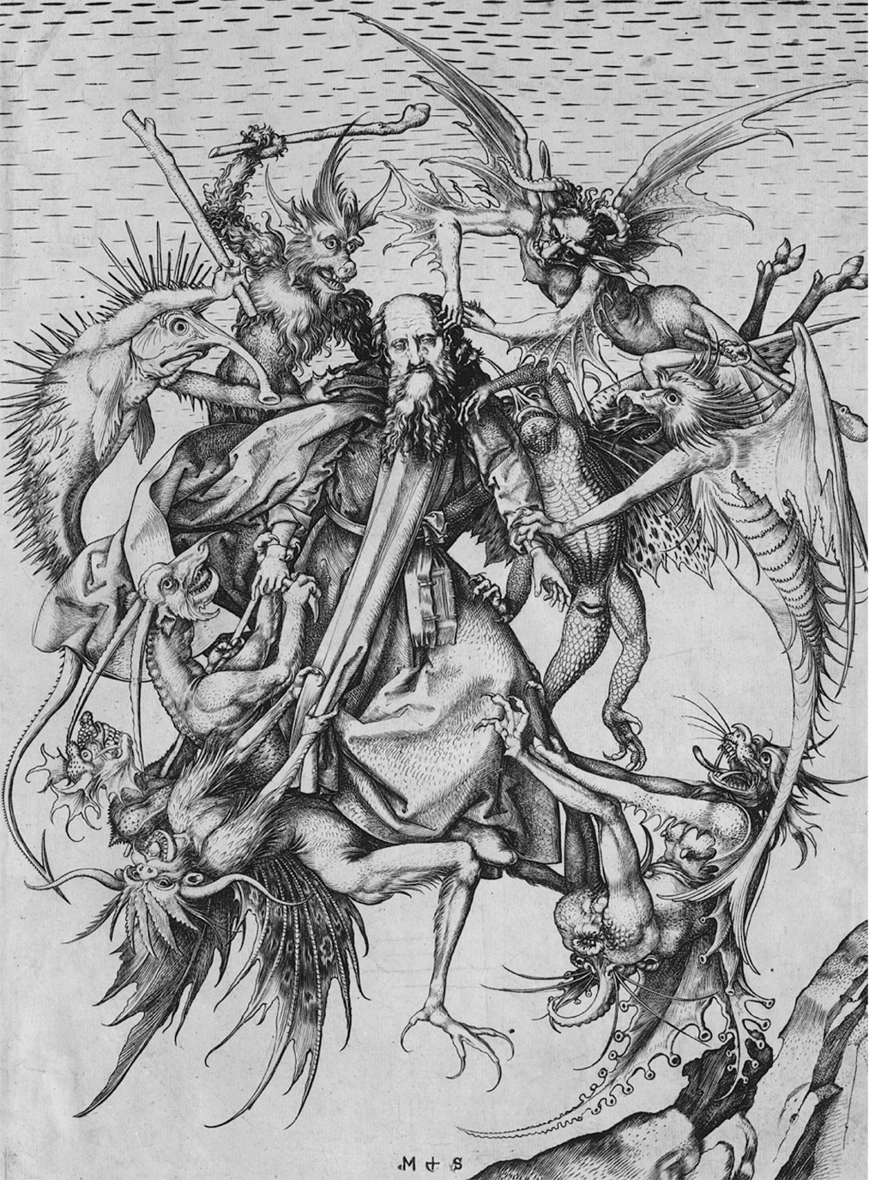
Martin Schongauer (c. 1430–1491), the best engraver in the Upper Rhine, portrays the devil’s temptation of St. Anthony in the wilderness as a robust physical attack by demons rather than the traditional melancholic introspection. Martin Schongauer/National Gallery of Art, Washington, DC
Notes:
Martin Schongauer (c. 1430–1491), the best engraver in the Upper Rhine, portrays the devil’s temptation of St. Anthony in the wilderness as a robust physical attack by demons rather than the traditional melancholic introspection.
Martin Schongauer/National Gallery of Art, Washington, DC

Slide 20
Martin Luther & the German Reformation
Late Medieval Germany lacked the political unity to enforce large-scale religious reforms
No lasting Statutes of Provisors & Praemunire (England) or Pragmatic Sanction of Bourges (France)
These limited papal jurisdiction & taxation on a national scale

Slide 21
Martin Luther & the German Reformation
Piecemeal reform & resentment of clerical immunities & ecclesiastical abuses spread among German cities & towns
Unorganized national opposition in German humanists

Slide 22
Martin Luther & the German Reformation (cont.)
Educated by the Brothers of the Common Life
Initially prepared for career in law
instead entered Order of the Hermits of Saint Augustine

Slide 23
Martin Luther & the German Reformation (cont.)
By 1517, discontent with the church was ripe enough for Martin Luther’s critiques to take hold.
1507, Luther was ordained
1510, on his visit to Rome, he found the German complaints about the Church to be accurate
1512, he earned his doctorate in Theology at the Augustinian Monastery in Wittenberg

Slide 24
Justification by Faith Alone
Luther especially plagued by disproportion between sense of sinfulness & perfect righteousness God required for salvation
Felt this could never be attained
Studied sola fide to conclude that righteousness achieved not thru charitable acts & religious ceremonies but by belief & faith alone

Slide 25
Justification by Faith Alone
Medieval church always taught that salvation was joint venture
Luther discounted the issue of whether or not good works should be done but how it should be regarded
conditioning of salvation on good works led to counting merits & demerits

Slide 26
Justification by Faith Alone
Good works to be expected over a lifetime
Posited that faith sets narcissistic souls free to serve others selflessly

Slide 27
Indulgences
Indulgence - remission of the temporal penalty imposed on penitents by priests as a “work of satisfaction” for confessed mortal sins
Though a priest could absolve a penitent of guilt, the sinner still had an eternal penalty to pay.
Absolution could turn the eternal penalty into a temporal penalty - manageable work of satisfaction
The remission of that temporal penalty was an indulgence.

Slide 28
Indulgences
Indulgences began for Crusaders who could not complete penance for having fallen in battle
late Middle Ages - granted to laypeole who were anxious about a possible future of suffering
Starting in 1343, Pope Clement VI started selling “letters of indulgence.”
Pope Sixtus IV expanded to unrepented sins of all Christians in purgatory

Slide 29
Indulgences (cont.)
By Luther’s time, they were often sold for small cash payments which were regarded as almsgiving
Pope Leo X revived a plennary Jubilee Indulgence, proceeds to rebuild St. Peter’s Basilica

Slide 30
Indulgences (cont.)
Martin Luther objected to the impression created by Tetzel that indulgences remitted sins & released unrepentant sinners from punishment in purgatory
Disliked idea that salvation could be bought & sold
Luther’s ninety-five theses against indulgences expressed discontent w/ idea that it could be bought & sold

Slide 31
Indulgences (cont.)
Archbishop Albrecht of Mainz also preached the indulgence as he had incurred debt for a papal dispensation
Selling of indulgence became joint venture btwn Albrecht of Mainz, Pope Leo X, & the Augsburg Banking House of Fugger (Jacob Fugger)
John Tetzel was enlisted to preach indulgence in Albrecht territories

Slide 32
Indulgences (cont.)
Archbishop Albrecht of Mainz also preached the indulgence as he had incurred debt for a papal dispensation
Selling of indulgence became joint venture btwn Albrecht of Mainz, Pope Leo X, & the Augsburg Banking House of Fugger (Jacob Fugger)
John Tetzel was enlisted to preach indulgence in Albrecht territories

Slide 33
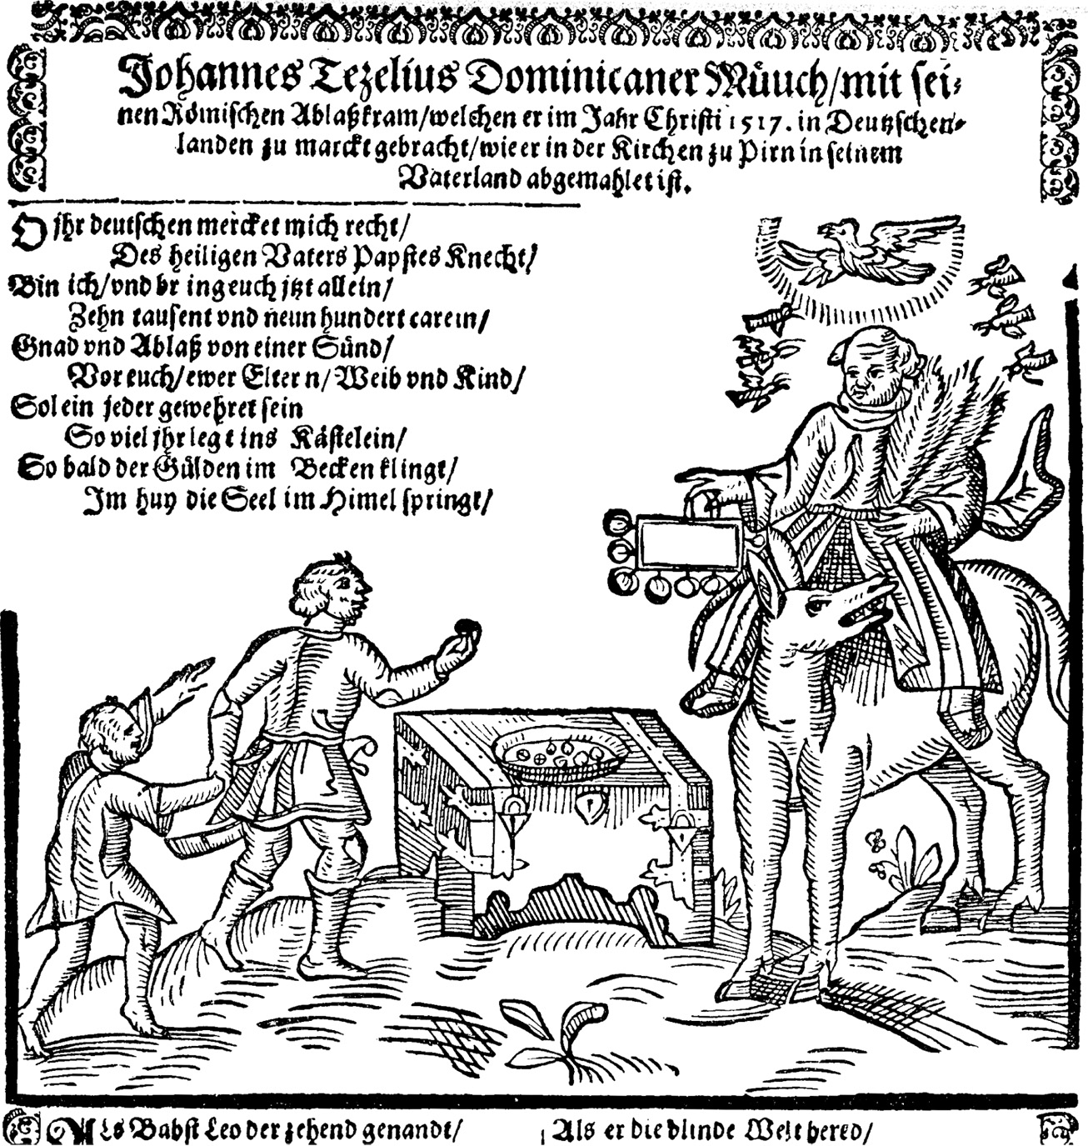
A contemporary caricature depicts John Tetzel, the famous indulgence preacher. The last lines of the jingle read, “As soon as gold in the basin rings, right then the soul to Heaven springs.” It was Tetzel’s preaching that spurred Luther to publish his ninety-five theses. akg-images
Contemporary
Caricature
Depicts John
Tetzel
Notes:
A contemporary caricature depicts John Tetzel, the famous indulgence preacher. The last lines of the jingle read, “As soon as gold in the basin rings, right then the soul to Heaven springs.” It was Tetzel’s preaching that spurred Luther to publish his ninety-five theses.
akg-images

Slide 34
Charles V
The Ninety-five Theses were embraced by Nuremberg humanists, which made Luther a central figure in an already organized national German cultural movement against foreign influence & competition - esp. Italians
He was called before the general of the Dominican order in Ausburg to answer for his criticisms.
As sanctions were being prepared against him, Emperor Maximillian I died (1519), which turned attention away from Luther & & heresy in Saxony

Slide 35
Charles V (cont.)
In contest for new emperor, Charles I of Spain succeeded his Grandfather and became Emperor Charles V.
Pope had backed the French king, Francis I
Charles backed by long tradition of Hapsburg imperial rule & massive Fugger campaign chest that secured votes of 7 imperial electors
The most prominent was Frederick the Wise, Luther’s lord & protector

Slide 36
Charles V (cont.)
Electors secured # of concessions from Spanish favorable to Germans:
revived German-based Imperial Supreme Court & Council of Regency
Promise to consult w/ a diet of the empire on all major domestic & foreign affairs
helped Reformation b/c prevented unilateral imperial action against Germans

Slide 37
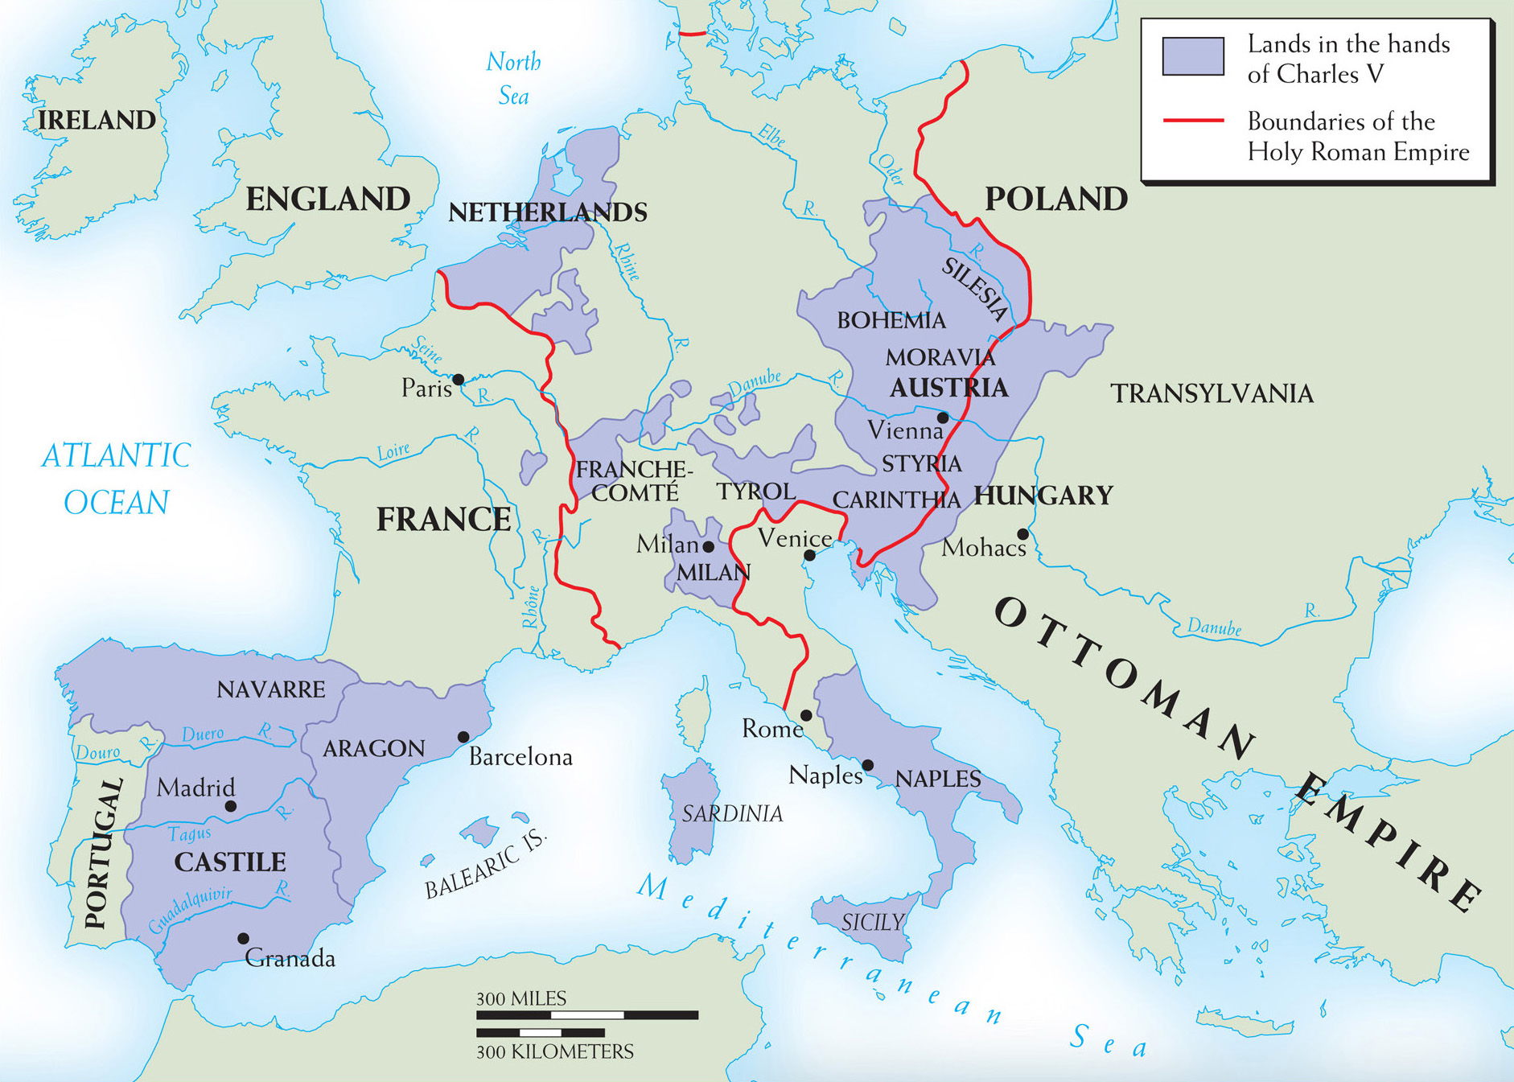
Map 11–1 THE EMPIRE OF CHARLES I Dynastic marriages and simple chance concentrated into Charles’s hands rule over the lands shown here, plus Spain’s overseas possessions. Crowns and titles rained down on him; his election in 1519 as emperor gave him new distractions and responsibilities.
Empire of
Charles I
Notes:
Map 11–1 THE EMPIRE OF CHARLES I Dynastic marriages and simple chance concentrated into Charles’s hands rule over the lands shown here, plus Spain’s overseas possessions. Crowns and titles rained down on him; his election in 1519 as emperor gave him new distractions and responsibilities.

Slide 38
Luther’s Excommunication and the Diet of Worms
June 27, 1519, Luther debated the Ingolstadt professor John Eck in Leipzig.
Questioned the infallibility of the pope and the inerrancy of church councils.
Appealed to the authority of scripture alone for the 1st time
defended certain teachings of John Huss - burned all bridges since Huss condemned to death for heresy at Council of Constance
These views were published in 1520.

Slide 39
Luther’s Excommunication and the Diet of Worms
3 famous pamphlets:
Address to the Christian Nobility of the German Nation - urging princes to force reform thru curtailing of pol. & econ. power
The Babylonian Captivity of the Church a) attacked traditional 7 sacraments arguing that only two, baptism & Eucharist, were unquestionably Biblical; b) exalted authority of Scripture, church councils, & secular princes over the pope

Slide 40
Luther’s Excommunication and the Diet of Worms
3 famous pamphlets (cont.):
Freedom of a Christian summarized new teaching of salvation by faith alone - sola fide
June 1520 - Leo’s papal bull Exsurge Domine (“Arise, O Lord”) condemned Luther for heresy & gave 60 days to retract
April 1521 - Luther presented views to the Diet of Worms
1) refused to recant on basis that it would violate Scripture, reason & his conscience
2) Imperial ban issued - made him an outlaw to secular as well as religious authority

Slide 41
Luther’s Excommunication and the Diet of Worms (cont.)
Luther was forced into hiding, protected by the Elector Frederick
Hid for a year
Translated New Testament into German using Erasmus’s new Greek text & Latin translation
oversaw by correspondance the 1st steps of the Reformation

Slide 42
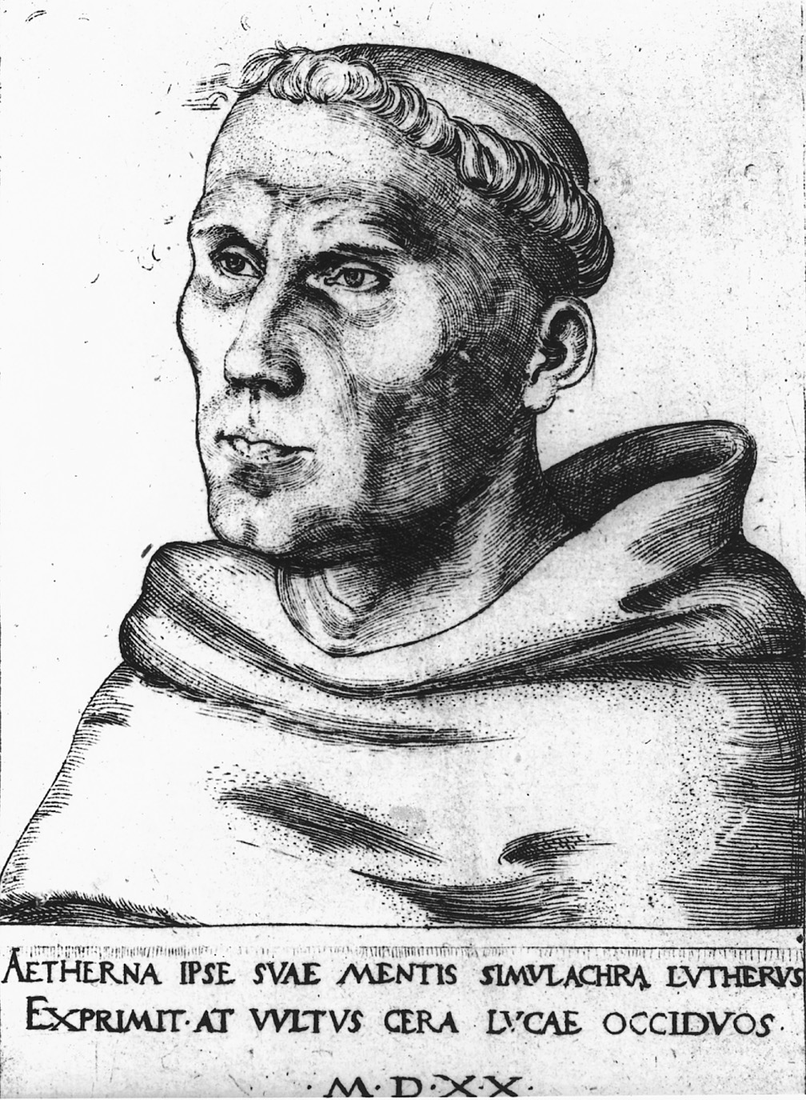
In 1520, Luther’s first portrait, shown here, depicted him as a tough, steely-eyed monk. Afraid that this portrayal might convey defiance rather than reform to Emperor Charles V, Elector Frederick the Wise of Saxony, Luther’s protector, ordered court painter Lucas Cranach to soften the image. The result was a Luther placed within a traditional monk’s niche reading an open Bible, a reformer, unlike the one depicted here, who was prepared to listen as well as to instruct. © Foto Marburg/Art Resource, NY
Notes:
In 1520, Luther’s first portrait, shown here, depicted him as a tough, steely-eyed monk. Afraid that this portrayal might convey defiance rather than reform to Emperor Charles V, Elector Frederick the Wise of Saxony, Luther’s protector, ordered court painter Lucas Cranach to soften the image. The result was a Luther placed within a traditional monk’s niche reading an open Bible, a reformer, unlike the one depicted here, who was prepared to listen as well as to instruct.
© Foto Marburg/Art Resource, NY

Slide 43
Catholic Response to Reformation
What was the Reformation's main principle? Not, as many Catholics and even some Protestants think, "private judgment" in religion.
Sola Gratia:
According to Bouyer, "the true fundamental principle of Protestantism is the gratuitousness of salvation" — sola gratia.
Sola Fide:
the claim that justification by grace comes through faith alone (sola fide) ?
Affirms that justification was wholly the work of God and denies any positive human contribution apart from grace.
God's gift to man, with man contributing nothing of his own to receive salvation.
Sola Scriptura:
The Word of God, rather than a human word, must govern the life of the Christian and of the Church. And the Word of God is found in a unique and supreme form in the Bible, the inspired Word of God. The inspiration of the Bible means that God is the primary author of Scripture.
Notes:
In 1520, Luther’s first portrait, shown here, depicted him as a tough, steely-eyed monk. Afraid that this portrayal might convey defiance rather than reform to Emperor Charles V, Elector Frederick the Wise of Saxony, Luther’s protector, ordered court painter Lucas Cranach to soften the image. The result was a Luther placed within a traditional monk’s niche reading an open Bible, a reformer, unlike the one depicted here, who was prepared to listen as well as to instruct.
© Foto Marburg/Art Resource, NY

Slide 44
Catholic Response to Reformation
So if Catholic doctrine supports all of the three Solas, what is the dilemna?
The linkage to certain negative elements, which the Catholic Church had to reject.
Two of those elements: 1) the doctrine of extrinsic justification and the nature of justifying faith and 2) the authority of the Bible.
Notes:
In 1520, Luther’s first portrait, shown here, depicted him as a tough, steely-eyed monk. Afraid that this portrayal might convey defiance rather than reform to Emperor Charles V, Elector Frederick the Wise of Saxony, Luther’s protector, ordered court painter Lucas Cranach to soften the image. The result was a Luther placed within a traditional monk’s niche reading an open Bible, a reformer, unlike the one depicted here, who was prepared to listen as well as to instruct.
© Foto Marburg/Art Resource, NY

Slide 45
Spread of the Reformation
The emperor was distracted by war with the French and the Turks.
Permitted each local prince to enforce the ban as he saw fit, essentially giving them each religious authority in their own domain.

Slide 46
Spread of the Reformation (cont.)
In many cities, princes began to enact religious reforms, and they welcomed Lutheran preachers.
The Elector of Saxony and the prince of Hesse both instated Protestantism in their lands.
By the 1530s German Protestant lands formed the Schmaldkaldic League and prepared for war with the emperor.

Slide 47
Peasants’ Revolt
The peasants initially saw Luther as an ally, asking him for support in their demands to end serfdom and for other economic reforms.

Slide 48
Peasants’ Revolt (cont.)
Luther initially had sympathy for them, but when they invoked his name in their revolt he called them “unChristian.”
For Luther, the freedom of Christianity lay in inner spiritual release, not revolutionary politics.
The revolt was crushed, killing tens of thousands of peasants.

Slide 49
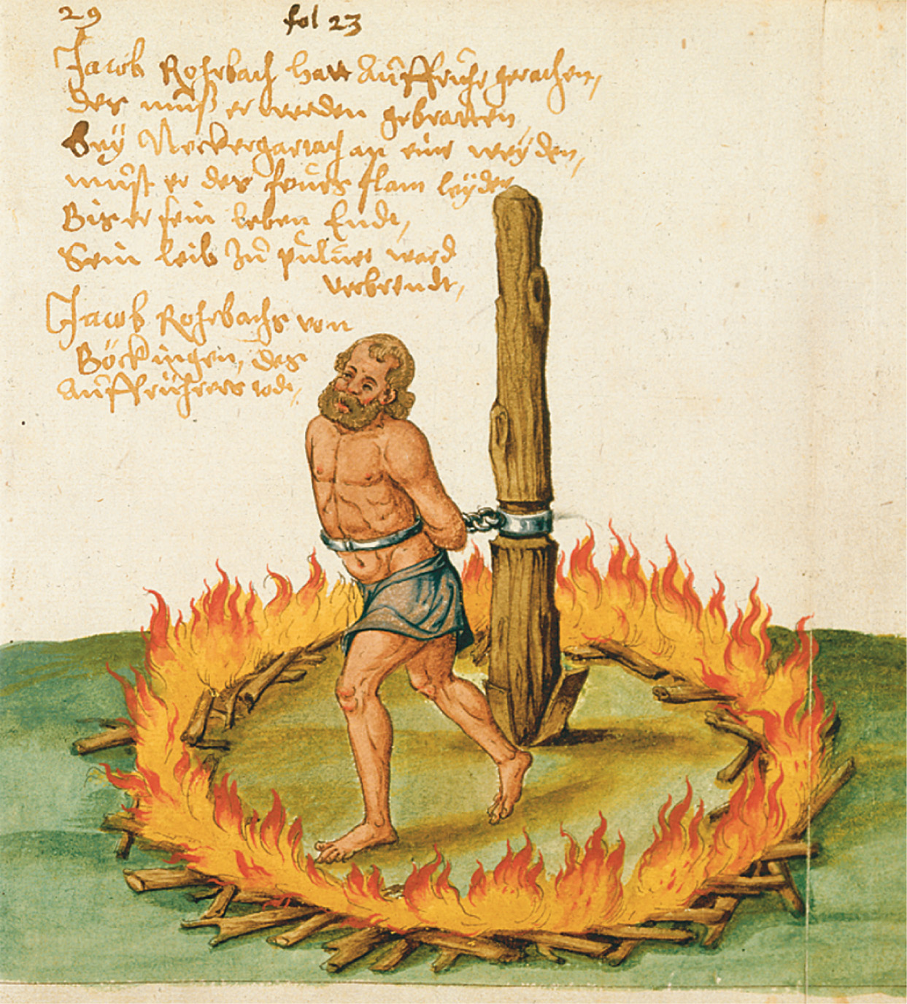
The punishment of a peasant leader in a village near Heilbronn. After the defeat of rebellious peasants in and around the city of Heilbronn, Jacob Rorbach, a well-to-do peasant leader from a nearby village, was tied to a stake and slowly roasted to death. Courtesy of the Library of Congress
Notes:
The punishment of a peasant leader in a village near Heilbronn. After the defeat of rebellious peasants in and around the city of Heilbronn, Jacob Rorbach, a well-to-do peasant leader from a nearby village, was tied to a stake and slowly roasted to death.
Courtesy of the Library of Congress

Slide 50
The Swiss Reformation
Switzerland
loose confederacy of 13 autonomous cantons (states) & allied areas
Some Catholic & some Protestant
few managed a compromise
Two conditions for Reformation:
growth of national sentiment & popular opposition to foreign mercenary service
desire for church reform dating to the councils of Constance & Basel

Slide 51
The Swiss Reformation
Ulrich Zwingli
Humanistically educated, he credited Erasmus as setting him on the path to reform.
By 1518, he was known for his opposition to the sale of indulgences and religious superstition.

Slide 52
The Swiss Reformation (cont.)
In 1519, Zwingli became the people’s priest in main church of Zurich.
Ended priestly celibacy
had a child out of wedlock but denied paternity & claimed she seduced him
March 1522, broke the Lenten fast
Preached the authority of Scripture alone & used this as justification

Slide 53
The Swiss Reformation (cont.)
Led to questioning fasting, transubstantiation, saints, pilgrimages, some sacraments, & purgatory
Though a Protestant, he had significant theological differences with Luther, which prevented an alliance with the German Protestants.
The Swiss Civil war forced the Swiss Catholics to recognize the Protestants.

Slide 54
The Swiss Reformation (cont.)
Led to questioning fasting, transubstantiation, saints, pilgrimages, some sacraments, & purgatory
City gov’t sanctioned Zwingli’s scripture test
http://www.thecaveonline.com/APEH/reformdocument.html#anchorzwingli

Slide 55
The Swiss Reformation (cont.)
Zwingli favored an abstract,spiritualized Christ while Luther insisted that Christ could be both spiritually & bodily present
Philip of Hesse brought the two together in Marburg
Luther felt Zwingli a dangerous fanatic
Theological & spiritual split in the Protestant movement
non-Lutheran Tetrapolitan Confession embodies semi Zwinglian ideas
prepared by Strasbourg reformers Martin Bucer & Caspar Hedio

Slide 56
Swiss Civil Wars
Cantons divided themselves between Protestants & Catholics - erupted in civil wars
2 Major battles:
Kappel - June 1529; ended in Protestant victory & forced Catholic cantons to break foreign alliances & recognize rights of Swiss Protestants
Kappel - October 1531; Zwingli wounded & executed
Subsequent treaty confirmed right of each canton to determine own religion
Heinrich Bullinger — new leader of Swiss Reformation guided development & eventual merging with Calvinism

Slide 57
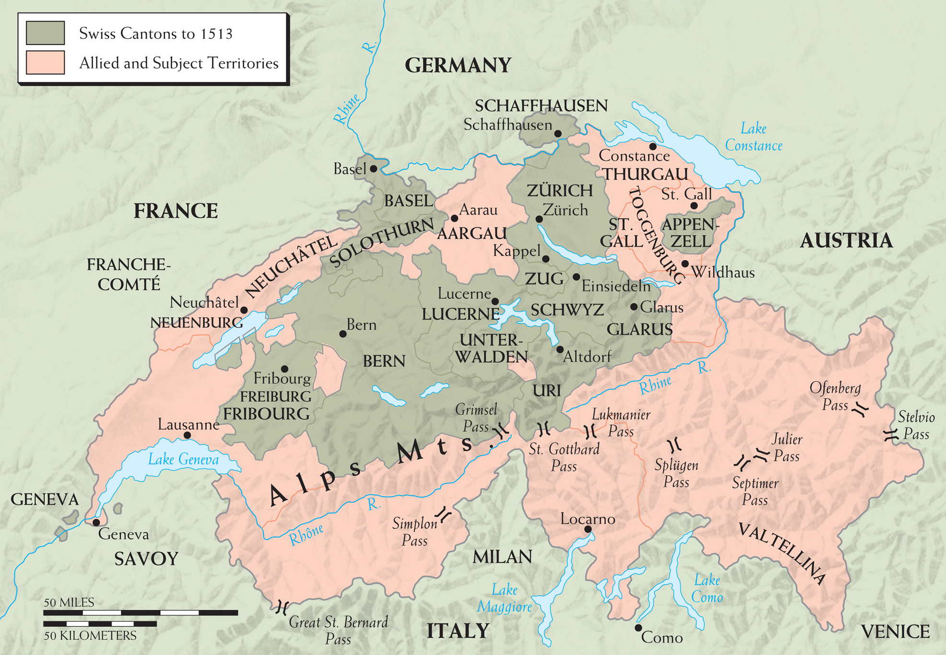
Map 11–2 THE SWISS CONFEDERATION Although nominally still a part of the Holy Roman Empire, Switzerland grew from a loose defensive union of the central “forest cantons” in the thirteenth century into a fiercely independent association of regions with different languages, histories, and, finally, religions.
Notes:
Map 11–2 THE SWISS CONFEDERATION Although nominally still a part of the Holy Roman Empire, Switzerland grew from a loose defensive union of the central “forest cantons” in the thirteenth century into a fiercely independent association of regions with different languages, histories, and, finally, religions.

Slide 58
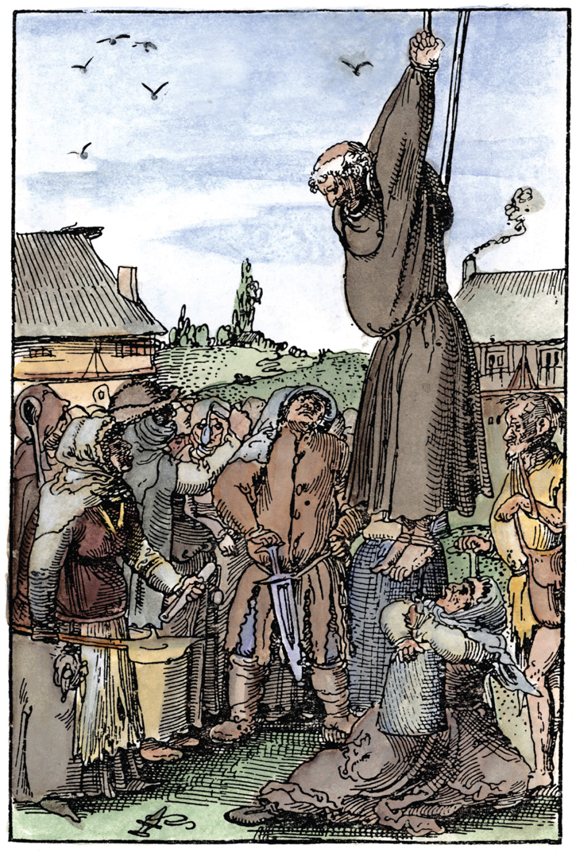
This 1525 woodcut shows Swiss peasants hanging a seller of indulgences during the Reformation. The Granger Collection, NYC—All rights reserved
Notes:
This 1525 woodcut shows Swiss peasants hanging a seller of indulgences during the Reformation.
The Granger Collection, NYC—All rights reserved

Slide 59
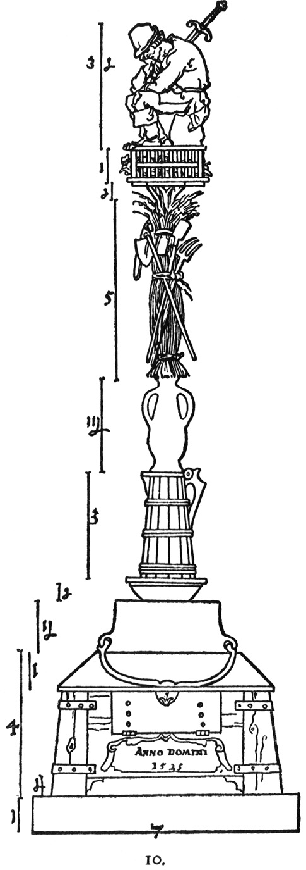
The caption reads: “He who wants to commemorate his victory over the rebellious peasants might use to that end a structure such as I portray here.” Foto Marburg/Art Resource, NY
Notes:
The caption reads: “He who wants to commemorate his victory over the rebellious peasants might use to that end a structure such as I portray here.”
Foto Marburg/Art Resource, NY

Slide 60
Anabaptists & Radical Protestants
Moderate pace & seemingly low ethical results of Luther & Zwingli movements bred discontent
devout fundamentalists that believed Apostolic Christianity must be implemented thoroughly & rapidly
Most impt of the radical groups were the Anabaptists (16th c. ancestors of modern Mennonites & Amish)

Slide 61
Anabaptists & Radical Protestants
Rejected infant baptism
belief that only a consenting adult can accept Christ
Anabaptism derives from Greek - means to rebaptize
both Luther & Zwingli agreed that believers must believe for themselves but retained tradition of infant baptism
even though no clear biblical mandate
argued congregation “believed” for infant
emphasis on communal nature & responsibility of the church

Slide 62
Anabaptists & Radical Protestants
Conrad Grebel and the Swiss Brethren
Performed 1st adult rebaptism in Zurich
Originally a co-worker of Zwingli’s, openly broke with Zwingli
Biblical literalist
Disagreed w/ Zwingli’s support of gov’ts plea for peaceful gradual removal of resented traditional religious practices

Slide 63
Anabaptists & Radical Protestants
Alternative of the Swiss Brethren embodied in the Schleitheim Confession
distinguished Anabaptists
practice of adult baptism
pacifism
refusal to swear oaths
non-participation in offices of secular gov’t
physically separated from established society

Slide 64
Anabaptists & Radical Protestants (cont.)
A more rural agrarian class came to characterize Anabaptists as Lutherans & Zwinglians joined Catholics in opposition
Rebaptism became capital offense w/in the HRE
Executions between 1525 & 1618 for rebaptism

Slide 65
Anabaptists & Radical Protestants (cont.)
The Anabaptist Reign in Munster
Dutch emigrants, Jan Beukelsz & Jan Matthys, led an Anabaptist takeover in 1534-1535.
forced Lutherans & Catholics to convert or emigrate
City blockaded
Munster transformed into Old Testament theocracy
The features of the regime included charismatic leaders and polygamy.
It was crushed by united Protestant and Catholic armies.

Slide 66
Anabaptists & Radical Protestants (cont.)
Following this tragedy, moderate & pacifist Anabaptists became the norm among most nonconformists
Menno Simons, founder of the Mennonites, set ex. for non-provocative separatist Anabaptism

Slide 67
Anabaptists & Radical Protestants (cont.)
Other Radical Groups
Spiritualists rejected institutional religion
mostly isolated individuals distinguished by disdain for external, institutional religion
only religious authority - Spirit of God
Renegade Lutherans:
Thomas Muntzer - died as a leader of a peasant’s revolt in Frankenhausen
Sebastian Franck - critic of all dogmatic religion, proclaimed religious autonomy, & freedom of every individual soul
Caspar Schwenckfeld - prolific writer & wanderer

Slide 68
Anabaptists & Radical Protestants (cont.)
Other Radical Groups
Antitrinitarians
exponents of commonsense, rational, & ethical religion
rejected the Trinity
Spaniard Michael Servetus - executed in Geneva at the encouragement of Calvin for blasphemies of the Holy Trinity
Lelio & Faustus Sozzini (Italians) - founders of Socinianism
strongest opponents of Calvinism, esp. original sin & predestination

Slide 69
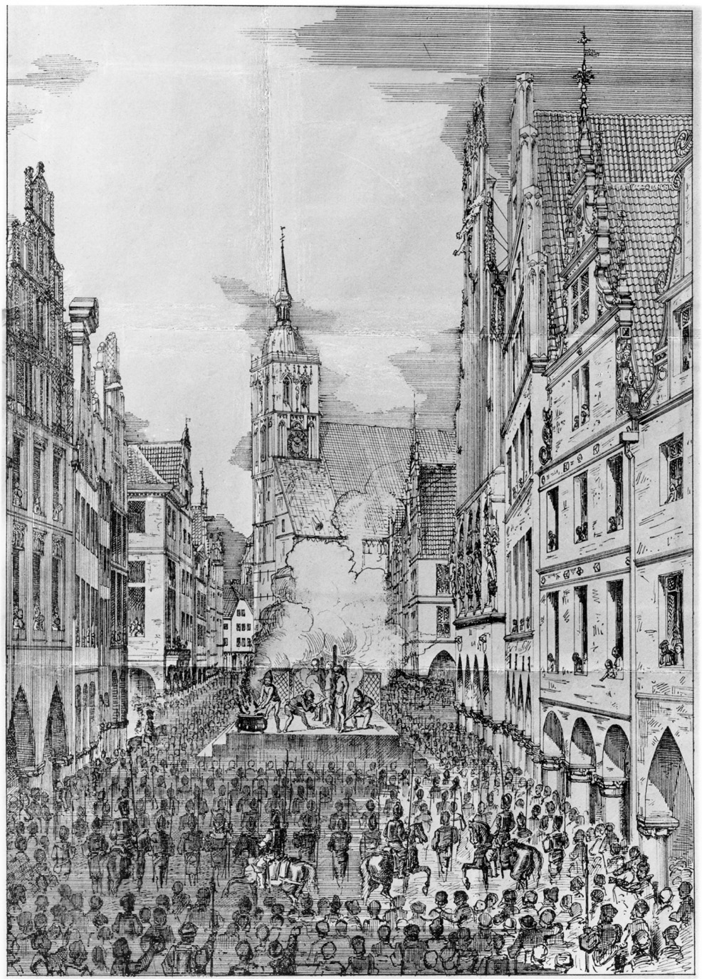
Anabaptists are burned at the stake in Muenster. Foto Marburg/Art Resource, NY
Notes:
Anabaptists are burned at the stake in Muenster. Foto Marburg/Art Resource, NY

Slide 70
John Calvin
Calvinism replaced Lutheranism a dominant Protestant force in 2nd half of 16th century
The religious ideology that inspired massive political resistance in France, the Netherlands, & Scotland
Established itself during the reign of Elector Frederick III (the Wise), within the geographical region of the Palatinate
the German state in the Rhineland in which the Thirty Years War would break out in 1618

Slide 71
John Calvin
Calvinists believed:
divine predestination
individual’s responsibility to reorder society according to God’s plan
marriage between internal belief & external demonstration

Slide 72
John Calvin
Born in France in well-to-do family and educated by the Church
May 1534 - he joined the Reformation
Received benefices that financed best possible education at Parisian colleges & a law degree
In 1520 - identified w/ French reform party even though he rejected them as being too compromising

Slide 73
John Calvin
1534 - experienced a conversion to Protestantism
mature theology stressed sovereignty of God’s will over all creation & the necessity of humankind’s conformity to it
1534 - surrendered the benefices that had educated him & joined the Reformation in Geneva

Slide 74
John Calvin & Political Revolt
In contrast to Saxony religious reform, which paved the way for political revolution, political revolution in Geneva against the prince-bishop paved the way for religious reform
City council assumed legal & political powers of prince-bishop after Genevans revolted
Protestant city of Bern sent 2 reformers to Geneva 6 years after the revolt
Guillaume Farel & Antoine Froment
1535 - after much internal turmoil, Protestants triumphed
traditional Mass & other religious practices removed

Slide 75
John Calvin & Political Revolt
1536 - official adoption of Protestantism in Geneva
Calvin arrived in Geneva after these events in 1536
Farel intercepted Calvin escaping persecution in France & caught in conflict btwn France & Spain
threatened & demanded assistance in Reformation

Slide 76
John Calvin & Political Revolt
Calvin drew up
articles for governance of new church
catechism to guide & discipline
Reforms met w/ suspicion due to the strong measures
Bern had adopted more moderate Protestant reform & still retained traditional religious ceremonies & holidays abolished by Calvin & Farel

Slide 77
John Calvin & Political Revolt
Calvin left for Strasbourg:
became pastor to French exiles
wrote biblical commentaries
produced 2nd edition of Institutes of the Christian Religion
Considered by many to be the definitive theological statement of the Protestant faith

Slide 78
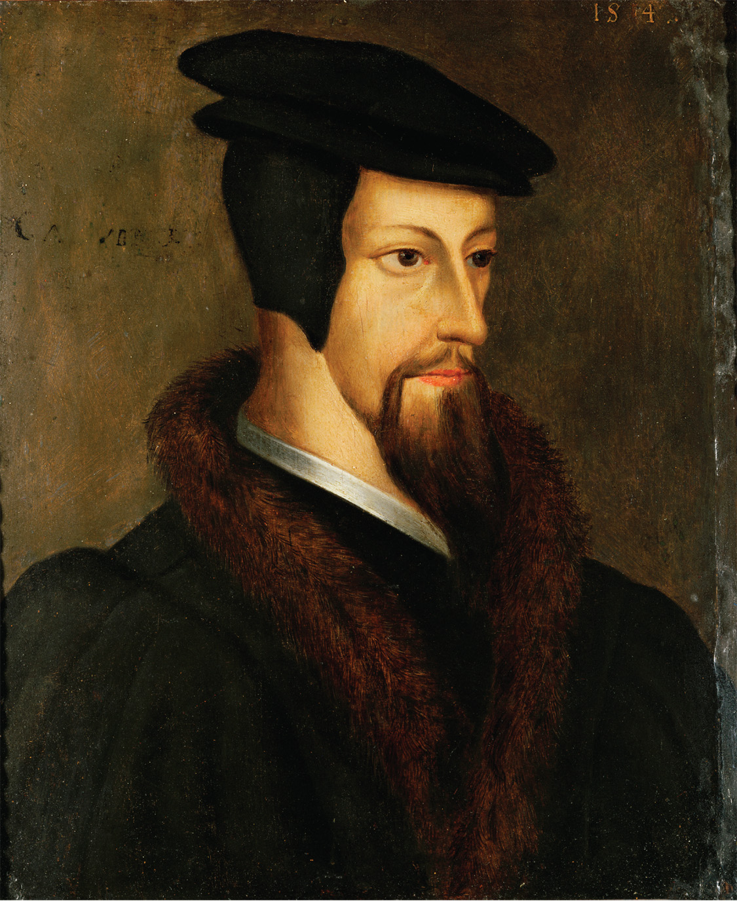
A portrait of the young John Calvin. Erich Lessing/Art Resource, NY
Notes:
A portrait of the young John Calvin.
Erich Lessing/Art Resource, NY

Slide 79
Calvin’s Geneva
1540 - Geneva elected officials favorable to Calvin
determined to establish political & religious independence from Bern
Invited Calvin to return
Implemented new ecclesiastical ordinances providing cooperation btwn magistrates & clergy in matters of internal discipline

Slide 80
Calvin’s Geneva
The Genevan Church was organized into four offices
Pastors (5)
Teachers to instruct the populace in true doctrine
Elders, (12) laypeople chosen by & from the Genevan councils
Deacons to dispense church goods and services to the poor

Slide 81
Calvin’s Geneva (cont.)
Controversial doctrine of Predestination at center of Calvin’s theology (like Luther’s doctrine of justification by faith)
the doctrine that only a chosen few are saved by God’s grace alone, without regard to acts or faith, was central to Calvin’s theology
criticism is that this seems to deny existence of human free will

Slide 82
Calvin’s Geneva (cont.)
Calvin does not discuss predestination until the end of Institutes of the Christian Religion
states that its discussion only for mature Christians
Idea that true believers understand that predestination recognized the world and all in it are in God’s hands for eternity

Slide 83
Calvin’s Geneva (cont.)
In this sense, a truly “elect” would exercise faith by conforming every action to God’s law & would live in a pleasing way to God
Calvin had personal reputation for being strict moralist
His role in capturing & execution of Spanish physician Michael Servetus (condemned by Inquisition for heresy) damaged his reputation

Slide 84
Calvin’s Geneva (cont.)
After 1555 - Geneva became home to 1000s of exiled Protestants from France, Scotland & England
Refugees made up more than 1/3
Magistrates all devout Calvinists
Also became a beacon for women who regarded it as a paradise - laws that severely punished men for beating their wives

Slide 85
Diet of Augsburg
In 1st decade of his reign, Emperor Charles V focused on politics & military campaigns outside empire, to include Spain & Italy
In 1530, returned to preside over Diet of Augsburg - assembly of Protestants and Catholics to address growing religious divisions
The emperor unrealistically ordered all Lutherans to return to Catholicism.
In response, the Schmalkaldic League formed in 1531 to defend Lutheran interests

Slide 86
Diet of Augsburg
Schmalkaldic League took as its banner the Augsburg Confession
moderate statement of Protestant beliefs spurned by the emperor at Diet of Augsburg
Luther drafted stronger Protestant confession, Schmalkaldic Articles
Stalemate achieved due to:
leadership of Frederick of Saxony & Landgrave Philip of Hesse
renewed war w/ France & Turks

Slide 87
Expansion
Throughout the 1530s, German Lutherans formed regional consistories - judicial bodies which oversaw the new Protestant Churches.
Educational reforms included:
compulsory primary education
schools for girls
humanist revision of traditional curricula
instruction of laity in new religion

Slide 88
Expansion
The Reformation spread to Denmark (introduced by King Christian II & thrived under Frederick I, who joined the Schmalkaldic League)
Lutheranism became official state religion under Christian III
In Sweden, King Gustavus Vasa embraced Lutheranism
supported by nobility - greedy for church lands
subjected clergy to royal authorities at Diet of Vesteras

Slide 89
Expansion
Poland, politically splintered, receptive to Lutherans, Calvinists, Anabaptists & even Antitrinitarians & became model for religious pluralism
resulted from an absence of central political authority

Slide 90
Expansion (cont.)
In the 1540s, Charles V made abortive efforts to enforce compromise btwn Protestants & Catholics
Turned to military solution when this failed
1547 - Imperial armies crushed Protestant Schmalkaldic League & captured both Philip of Hesse & John Frederick of Saxony
Placed puppet rulers in Hesse and Saxony and forced Protestants to return to Catholicism.
Many Protestants fled to Magdeburg - refuge for persecuted Protestants

Slide 91
Peace of Augsburg
The Reformation was too entrenched by 1547 to be ended.
The puppet ruler of Saxony, Maurice of Saxony, shifted allegiance to Lutherans
The emperor was forced to relent due to relentless resistance & war weariness
Peace of Passau - Charles reinstated Protestant leaders & guaranteed religious freedoms
thus, surrendered lifelong quest for European religious unity

Slide 92
Peace of Augsburg (cont.)
In September 1555, the Peace of Augsburg made the division of Christendom permanent
Cuius regio, eius religio, the ruler of a land determines its religion.
Lutherans were permitted to retain church lands confiscated before 1552 but,
Ecclesiastical reservation - prevented high Catholic prelates who converted to Protestantism from taking land, titles, & privileges with them

Slide 93
Peace of Augsburg (cont.)
It did not extend recognition to Anabaptists and Calvinists as legal forms of Christian belief & practice
Anabaptists were accustomed to such exclusion but Calvinists were not separatists
Calvinists determined to secure right to worship publicly
Calvinists organized to lead nat’l revolutions thru northern Europe in 2nd half of 16th century

Slide 94
The English Reformation
England was a likely breeding ground for Protestantism, but its advance was slow.
England had a reputation for maintaining the authority of the crown against the pope
There were already many secret Protestants.
Lollardy (refers to English followers of Wycliffe) and Humanism also were influences.

Slide 95
The English Reformation
Preconditions for reform:
early 1520s, future reformers met in Cambridge to discuss Lutheran writings
William Tyndale - translated New Testament into English
Cardinal Thomas Wolsey - chief minister to Henry VIII &
Sir Thomas More - Wolsey’s successor, guided royal opposition to English Protestantism
Henry VIII defended the 7 sacraments against Luther - Pope Leo X titled him Defender of the Faith

Slide 96
Henry VIII
King’s Affair:
Henry’s first wife, Catherine of Aragon (aunt to Emperor Charles V), did not provide him a son
Daughter - Mary
He wanted an annulment in order to marry Anne Boleyn, which was not granted.

Slide 97
Henry VIII (cont.)
Henry claimed God had cursed him
marriage had required special dispensation
enamored with Catherine’s lady in waiting, Anne Boleyn
1527 was also the same year that imperial soldiers mutinied & sacked Rome
Pope Clement VII was prisoner of Emperor Charles V (nephew of Catherine)

Slide 98
Henry VIII (cont.)
Cardinal Wolsey aspired to become Pope & was in charge of securing an annulment
Long been in influence but dismissed in disgrace when he failed the Pope
Thomas Cranmer & Thomas Cromwell became closest advisers
It was suggested that he declare himself supreme in English spiritual affairs, which would solve his problem

Slide 99
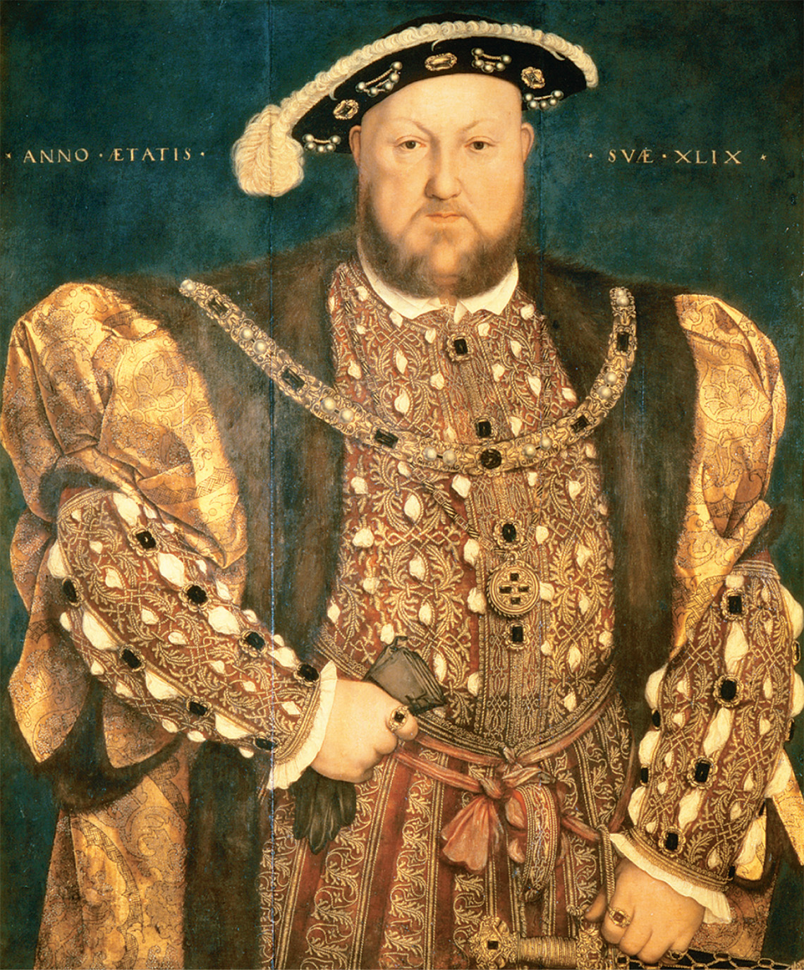
Hans Holbein the Younger (1497–1543) was the most famous portrait painter of the Reformation. Here he portrays a seemingly almighty Henry VIII. © Scala / Art Resource
Notes:
Hans Holbein the Younger (1497–1543) was the most famous portrait painter of the Reformation. Here he portrays a seemingly almighty Henry VIII.
© Scala / Art Resource

Slide 100
“Reformation Parliament”
In 1529, Parliament convened for what would be a seven year session
Flood of Legislation that eventually put the clergy under the authority of the king.
Established precedent that monarchy must work through Parliament for fundamental changes made in religion
In January 1531, Convocation (leg. assembly representing English clergy) recognized the king as head of the church in England.
1532, Parliament published official grievances against the church
Also passed Submission of the Clergy - canon law under royal control

Slide 101
“Reformation Parliament” (cont.)
Henry VIII wed pregnant Anne Boleyn (Cranmer officiated)
1533 - King - highest court of appeals
1533 - Cranmer made archbishop of Canterbury & annulled marriage to Catherine
1534 - Parliament ended all payments to Rome and gave Henry sole jurisdiction over ecclesiastical appointments
1534 - Act of Succession - legitimized Boelyn’s children
1534 - Act of Supremacy declared Henry “the only supreme head of the Church of England.”

Slide 102
“Reformation Parliament” (cont.)
Thomas More & John Fisher refused to recognize either Supremacy or Succession
Both executed & in 1536 & 1538, all monasteries & nunneries dissolved
Despite these changes, Henry did not make many concessions to Protestant sensibilities, retaining most of the ritual and doctrinal trappings of Catholicism.

Slide 103
Wives of Henry VIII
Henry’s domestic life lacked the consistency of his political life.
In 1536, Ann Boleyn was executed for alleged treason and adultery.
Elizabeth (like half-sister Mary) declared illegitimate
Henry married four more times

Slide 104
Wives of Henry VIII
Jane Seymour died in childbirth
Anne of Cleves - Cromwell had advised as an alliance w/ Protestant princes of Germany; failed, marriage annulled & Cromwell executed
His last wife, Catherine Parr, patron of humanists & reformers
survived Henry to marry a fourth time.

Slide 105
The King’s Religious Conservatism
Henry’s boldness in politics and domestic affairs did not extend to religion.
He made mild concessions to Protestant tenets in Ten Articles of 1536, but otherwise Catholic doctrine was maintained.

Slide 106
The King’s Religious Conservatism
Six Articles of 1539 - angry response to growing popularity of Protestantism
referred to as whip with six stings - reaffirmed transubstantiation, continued oral confession, etc.
England had to await Henry’s death before it could become a genuinely Protestant country

Slide 107
Edward VI
When Henry died, his 10-year-old son, Edward VI, took over the throne.
Ruled under several regencies - Edward Seymour, earl of Warwick,
Enacted a series of reforms, bringing the Church of England more in line with Protestant England.
Act of Uniformity - imposed Cranmer’s Book of Common Prayer
2nd Act of Uniformity established moderate Protestant doctrine

Slide 108
Edward VI
Established justification by faith, supremacy of Holy Scripture & established recognition of only 2 sacraments
In 1553, Edward died, leaving his Catholic half-sister, Mary, as queen. She quickly reversed the reforms.

Slide 109
The Counter-Reformation
Even before the Reformation, Catholics had begun to make efforts at reforms, but they were squashed by popes who remembered Councils of Constance & Basel
Once the Reformation set in, new religious orders had begun to form.

Slide 110
The Counter-Reformation
New religious orders
1524, Theatines, to groom church leaders & hierarchy
Bishop Gian Pietro Carafa - would become Pope Paul IV
1528, the monastic Capuchins - mission to return to ideals of Saint Francis; popular among ordinary people
Somaschi - active mid 1520s
Barnabites - 1530 - to repair war-torn Italy
Oratorians
elite group of clerics devoted to promotion of religious literature & church music - da Palestrina

Slide 111
The Counter-Reformation
New religious orders for women
Ursulines
1535 - established convents in Italy & France for religious ed for girls from all social classes
Mystical piety of medieval monasticism revived
Saint Teresa of Avila
Saint John of the Cross

Slide 112
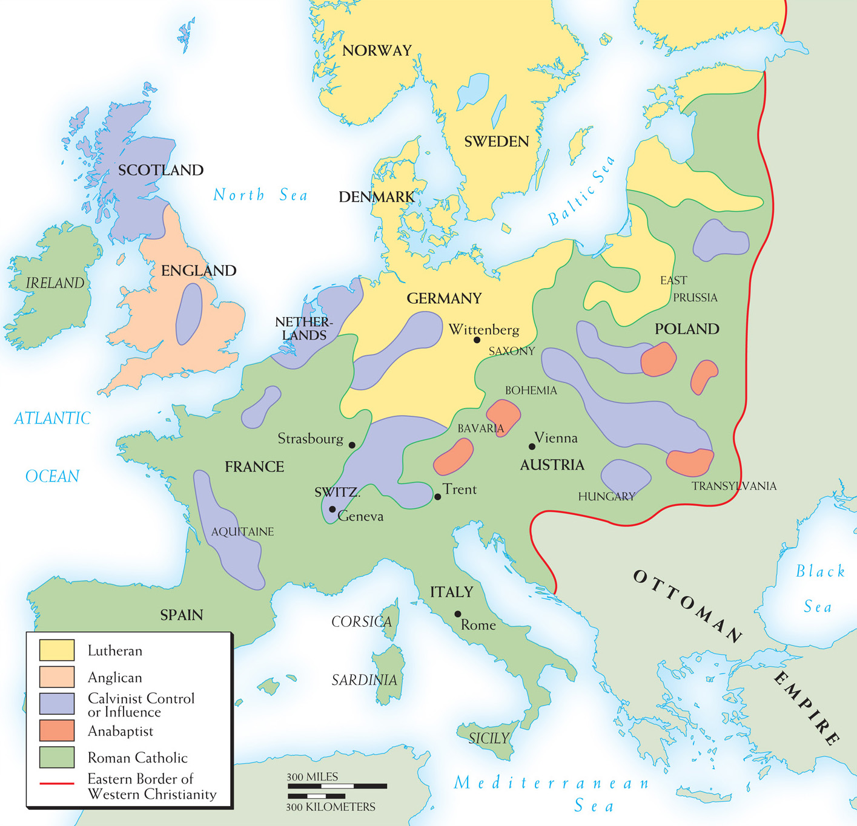
Map 11–3 THE RELIGIOUS SITUATION ABOUT 1560 By 1560, Luther, Zwingli, and Loyola were dead, Calvin was near the end of his life, the English break from Rome was complete, and the last session of the Council of Trent was about to assemble. This map shows “religious geography” of western Europe at the time.
Religious situation - 1560
Notes:
Map 11–3 THE RELIGIOUS SITUATION ABOUT 1560 By 1560, Luther, Zwingli, and Loyola were dead, Calvin was near the end of his life, the English break from Rome was complete, and the last session of the Council of Trent was about to assemble. This map shows “religious geography” of western Europe at the time.

Slide 113
The Counter-Reformation (cont.)
The Jesuits were the most successful of the reform movements.
Founded by Ignatius Loyola (courtier & soldiero in his youth) in the 1530s, it was recognized in 1540.
Based on a military model, he wanted people to be “soldiers of Christ.”
Preached self-mastery through discipline, self-sacrifice, and obedience.
Spiritual Exercises - devotional guide to shape behavior thru disciplined study & regular practice

Slide 114
The Counter-Reformation (cont.)
Ignatius taught that good Catholics deny themselves & submit to higher spiritual direction, which also requires a recognition of church authority
Self-control essential
Enthusiasm for traditional spirituality, mysticism, & loyalty to Christ’s church

Slide 115
Council of Trent (1545–1563)
Pope Paul III called general council, in order to:
reassert doctrine
address current heresies
prevent schisms
Councils are held for the unity and benefit of the Church

Slide 116
Council of Trent (1545–1563)
Pope appointed liberal theologian Caspar Contarini to head a reform commission.
Report was critical of fiscal practices & simony (the buying or selling of ecclesiastical privileges)
Keep in mind, protest itself was largely against the sale of indulgences, a matter which the church does and did consider an abuse.
Met in Trent in northern Italy

Slide 117
Council of Trent (cont.)
3 sessions spread over 18 years, spanning four diff. popes
The council was strictly under the pope’s control.
Its most important reforms concerned internal discipline.
Bishops needed to preach regularly and spend time in their dioceses.
curtailed selling of church offices & religious goods
Priests were required to be neatly dressed, educated, and strictly celibate.

Slide 118
Council of Trent (cont.)
No doctrinal concessions were made to the Protestants.
They reaffirmed many key doctrines such as:
The role of good works but also of faith as there is more than one aspect of salvation
The authority of tradition
7 sacraments
clerical celibacy & purgatory
Veneration of Saints
Doctrinal foundation of Indulgences
Rulers initially resisted the reforms, but eventually the new legislation took hold.

Slide 119
Council of Trent (cont.)
Resolved # of medieval Scholastic quarrels:
In favor of theology of Saint Thomas Aquinas
enhanced his authority
resisted the Jansenists who endorsed medieval Augustinian tradition as well as other alternative Catholic & Protestant doctrines
Initial resistance waned when rulers realized that intent was sincere in religious reform

Slide 120
Religious Life in Fifteenth-Century Cities
The clergy were considered ubiquitous & exercised considerable influence - political & spiritual
Daily life was regulated by the calendar, with frequent fasts and festivals.
Monasteries and nunneries were influential institutions.

Slide 121
Religious Life in Sixteenth-Century Cities
There were far fewer clergy even though the political & social structure remained the same
The number of holidays shrunk by a third
Cloisters had nearly disappeared & churches were reduced in number by at least 1/3
Greater regard for lay authority in religion
Ironically, laity was ambivalent about some aspects of Reformation & over half of original converts returned to Catholicism

Slide 122
Education
The Reformation had a profound effect on education, as it implemented humanistic educational reforms.
Even when particular views on human nature & church doctrine separated them from humanist movement, Protestant reformers shared the opposition to Scholasticism

Slide 123
Education (cont.)
Catholic counter-reformers recognised the connection between humanism & Reform
Cautious about limitations of a strict observance of humanism
Ignatius of Loyola in particular insisted that scholastic theolgians still be recognized a authority on both the teachings of the Bible & the Church Fathers
Argued that Thomas Aquinas especially had clearest understanding of both Scripture and the Church Fathers

Slide 124
Education (cont.)
Philip Melanchthon “praeceptor of Germany” - University of Wittenburg
humanist & professor of Greek
reformed curricula on humanist model
defender of good letters & classical studies
With Luther, developed curricula that dropped canon law as well as Scholastic commentary

Slide 125
Education (cont.)
Calvin and his successor, Theodore Beza founded Genevan Academy
Similar to Luther in its curricula ideals
Some criticized its narrow focus as excluding liberal arts & fundamentals of quality learning
ex. Erasmus
Sebastian Franck exposed parallels between Luther & Zwingli’s debates over Christ’s presence in Eucharist to Scholastic disputes about Immaculate Conception

Slide 126
Women
The Protestant rejection of clerical celibacy accompanied their rejection of the Medieval tendency to degrade women as temptresses or exalt them as virgins
Many Catholic reformers celebrated the abilities of women and the need for equitable regard - Thomas More
Praised women in biblical vocation as mothers and housewives
new laws gave women greater security & protection but still remained subject to husbands

Slide 127
Women
Both Luther & Calvin wrote favorably of wives in tribute
Seen as a point to counter argument that marriage would serve as a distraction from the ministry
Stressed sacredness of home & family
Stressed ideal of companionate marriage - co-workers in God-ordained community of family

Slide 128
Women (cont.)
This concept also had another consequence:
Women had the right to divorce and remarry, just as men did.
Catholics feared liberal divorce laws could lead to social upheaval but Protestants insisted that divorce on grounds of adultery or abandonment was legitimate

Slide 129
Women (cont.)
Consequences of Reformation:
Emboldened women to challenge conventional entities:
Some nuns criticized nunneries but cloistered noblewomen increasingly defended nunneries b/c cloistered life provided more interest & independence than secular world
women in higher classes found that the Reformation complemented new social & political freedoms found in Renaissance

Slide 130
Family Life in Early Modern Europe
Between 1500 and 1800, men and women married later than they had before.
Men: mid to late 20s
Women: early to mid 20s
Marriage still required parental consent & public vows in church
Pronounced move away from coerced marriage (illegal & also regarded by Church doctrine as invalid)

Slide 131
Family Life in Early Modern Europe (cont.)
If marriages tended to be “arranged” thru heavy familial influence
West European family was conjugal, consisting of two parents and two to four children who lived to adulthood
Larger family household to include in-laws, servants, laborers & boarders

Slide 132
Family Life in Early Modern Europe
Marriages also reflected economic reality
Difficult to prepare themselves materially
16th century - 1 in 5 never married
15% unmarried widows
Men often remarried due to death in childbirth
Evidence that delayed marriage also increased premarital sex
reflected in rapid growth of orphanages & foundling homes

Slide 133
Family Life in Early Modern Europe (cont.)
Artificial birth control has existed since antiquity.
Early birth control measures were not very effective and the church & often physicians, opposed them
St. Thomas Aquinas - a moral act must aid & abet, never frustrate nature’s goal

Slide 134
Family Life in Early Modern Europe (cont.)
The church and physicians condemned those who hired wet nurses (popular among upper-class women)
Increased risk of infant mortality
Evidence that among upper-calss, nursing was not popular
women - vanity & convenience
men- nursing women were forbidden from church to have marital relations

Slide 135
Loving Families?
traditional Western families had features that seem cold & distant today
Children 8-13 sent to apprenticeships, school or employment
marriages sometimes seemed limited in affection; men often remarried if wife died w/in months
Is there a defense for this?

Slide 136
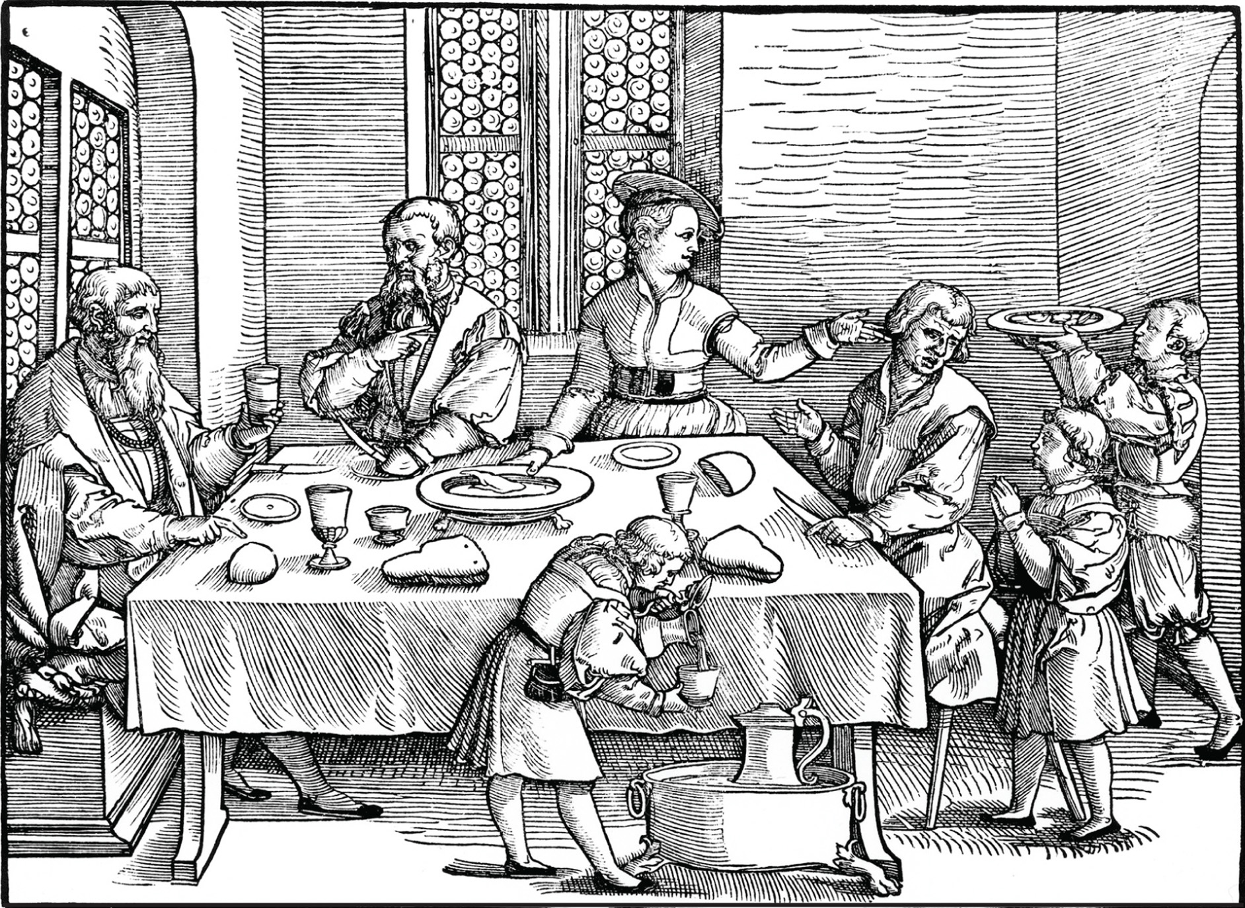
A family meal. bpk, Berlin/Kupferstichkabinett, Staatliche Museen, Berlin, Germany/Joerg P. Anders/Art Resource, NY
Notes:
A family meal.
bpk, Berlin/Kupferstichkabinett, Staatliche Museen, Berlin, Germany/Joerg P. Anders/Art Resource, NY

Slide 137
Literature
The Reformation did not only bring about cultural and political changes. There were also major innovations in literature.
Miguel De Cervantes Saavedra was a Spanish writer.
His major work was Don Quixote, which was a satire of the chivalric romances popular in Spain.
Juxtaposition of idealism and realism in the novel was very innovative.

Slide 138
Literature
Miguel De Cervantes Saavedra
Not formally educated
worked for a cardinal
had been a soldier & decorated for gallantry in Battle of Lepanto
also spent 5 years as a slave
Began Don Quixote in prison

Slide 139
Literature
Influences on Spanish literature:
1) traditional Catholic teaching remained prevalent in Spain
2) Aggressive piety of Spanish rulers
3) Emphasis on medieval chivalric virtues
Cervantes depicts both affection & ridicule for the idealism of Don Quixote

Slide 140
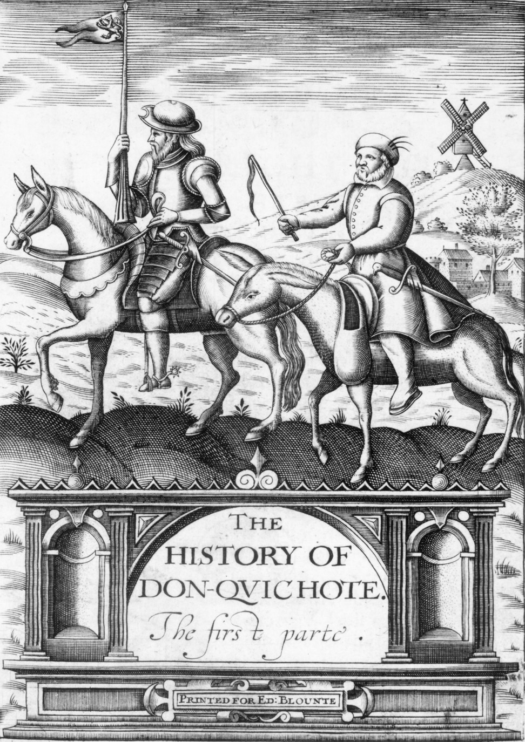
Cover of the 1620 English translation of The History of Don-Quichote, The Firste Parte. HIP/Art Resource, NY
Notes:
Cover of the 1620 English translation of The History of Don-Quichote, The Firste Parte.
HIP/Art Resource, NY

Slide 141
Literature (cont.)
William Shakespeare was an English playwright.
He wrote histories, tragedies, and comedies.
His work struck universal human themes, many of which were rooted in contemporary religious traditions
By Modern standards, political conservative
accepted social ranking & power structure

